Slide 1
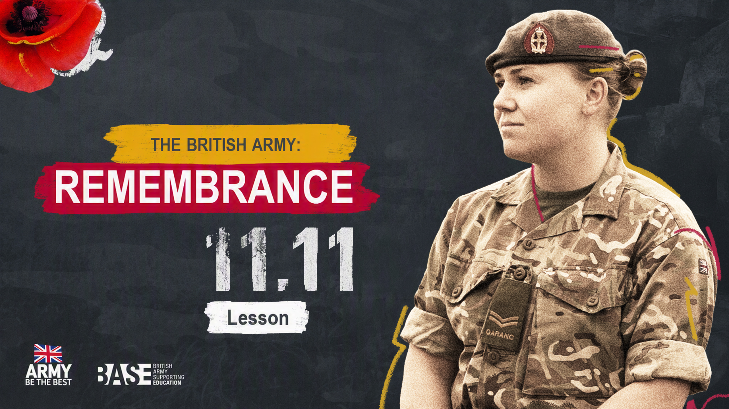
THE BRITISH ARMY:
REMEMBRANCE
Assembly

Slide 2

OUTLINE
ABOUT THIS PRESENTATION
This 15–20 minute presentation for ages 11–16 (KS3-KS4) explores Remembrance in the UK. It has been designed to be delivered as an assembly, or in tutor time. It is flexible, for you to adapt and deliver in different ways. The timings in the notes are suggestions — you can add and remove activities as you wish.
This assembly will introduce students to the ways that different groups, both inside and outside of the military, commemorate Remembrance, highlighting diverse voices and experiences.
OBJECTIVES
Students can:
describe what Remembrance is
explain why we commemorate Remembrance
give examples of the diverse ways that we commemorate Remembrance in the UK.
USING THIS PRESENTATION
Simple delivery notes are included in the ‘Notes’ section underneath each slide, including support and challenge suggestions for effective differentiation.

Slide 3


CURRICULUM LINKS – ENGLAND AND NORTHERN IRELAND
PSHE – ENGLAND
Students will learn about:
how to identify and articulate a range of emotions accurately and sensitively, using appropriate vocabulary
change and its impact on mental health and wellbeing and to recognise the need for emotional support during life changes and/ or difficult experiences.
HISTORY – ENGLAND
Students will learn about:
the history of these islands as a coherent, chronological narrative, from the earliest times to the present day: how people’s lives have shaped this nation and how Britain has influenced and been influenced by the wider world
historical perspective by placing their growing knowledge into different contexts, understanding the connections between local, regional, national and international history; between cultural, economic, military, political, religious and social history; and between short- and long-term timescales
specified key events, periods and societies in local, British, and wider world history; and of the wide diversity of human experience.
PDMU – NORTHERN IRELAND
Students will learn to:
respect themselves, understand their rights and responsibilities
recognise the richness and diversity of cultural influences in contemporary society.
HISTORY – NORTHERN IRELAND
Students will learn about:
chronological awareness and the ability to make connections between historical periods, events and turning points
the impact of significant events/ideas of the 20th century on the world
the need to preserve history in the local and global environment.

Slide 4


CURRICULUM LINKS – SCOTLAND AND WALES
HEALTH AND WELLBEING – SCOTLAND
Students will learn that:
representing my class, school and/or wider community encourages my self-worth and confidence and allows me to contribute to and participate in society
through contributing my views, time and talents, I play a part in bringing about positive change in my school and wider community.
SOCIAL STUDIES: PEOPLE, PAST EVENTS AND SOCIETIES
– SCOTLAND
Student will learn that:
by studying groups in past societies who experienced inequality, I can explain the reasons for the inequality and evaluate how groups or individuals addressed it
through researching, I can identify possible causes of a past conflict and report on the impact it has had on the lives of people at that time.
PERSONAL AND SOCIAL EDUCATION – WALES
Students will learn to:
value and celebrate diversity and equality of opportunity locally, nationally and globally
participate in school and the wider community
empathise with others’ experiences, feelings and actions.
HISTORY – WALES
Students will learn about:
how some 20th century individuals and events have shaped our world today
how to select and summarise information accurately from sources.

Slide 5


REMEMBRANCE: ASSEMBLY PLAN
A plan with suggested timings and support to help you choose the activities right for your school.
ACTIVITY | SLIDE(S) | TIMING | RESOURCES AND SET UP
Starter | 4 | 2 min | Slides only
Learning objectives (optional) | 5 | 1 min | Slides only
What is Remembrance? | 6–7 | 3 min | Slides only
The Commonwealth | 11 | 1 min
Who do we remember? | 12 | 2 min | Slides only
Video | 14 | 5 min | Slides only
How do we commemorate Remembrance? | 15–20 | 5–10 min | Slides only
Final reflection | 21 | 1 min | Slides only
Signposting | 22 | 1 min | Slides only

Slide 6

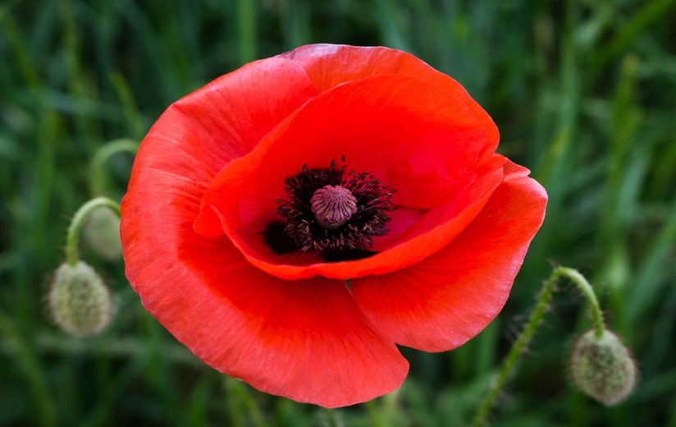
STARTER
What does this image make you think of?
Key words:
Remembrance
World War 1
Conflict
11th November
Notes:
Starter: The Red Poppy | 2 minutes / as students arrive
Ask students to share their thoughts about the image and question on screen, or silently reflect.
Questions to stimulate pair or whole group discussion:
What does this image make you think of?
Where have you seen this before?
What does this mean to you?
Support: Show the key word bank.
Challenge: Ask students to explain the link between the red poppy and Remembrance.

Slide 7


LEARNING OBJECTIVES
At the end of this assembly, you will be able to:
describe what Remembrance is
explain why we commemorate Remembrance
give examples of the diverse ways that we commemorate Remembrance in the UK.
Notes:
Learning objectives | 1 minute | This is an optional slide to share the learning objectives with students if you wish to.
Read through the slide to share learning objectives with students.

Slide 8





WHAT IS REMEMBRANCE?
Definition of Remembrance:
The act of someone remembering and showing respect for someone who has died, or a past event.
We commemorate Remembrance every year at 11:00 on the 11th day of the 11th month, November.
Notes:
What is Remembrance? Slide 1 of 3 | 3 minutes | Introduction to theme, key historical information and definitions
Explain and confirm that the red poppy is our national symbol for Remembrance because poppies grew out of the battlefields of World War 1.
Explain that we have been commemorating Remembrance since 1919, one year after World War 1 ended.
We commemorate Remembrance every year, and over 10,000 service people have participated in the past.
Reinforce by reading the definition of Remembrance: ‘The act of remembering and showing respect for someone who has died, or a past event’.
Source: https://dictionary.cambridge.org/dictionary/english/remembrance
Remind students that remembrance services are held on 11th November at 11:00am in recognition of the Armistice - an agreement to stop fighting.

Slide 9



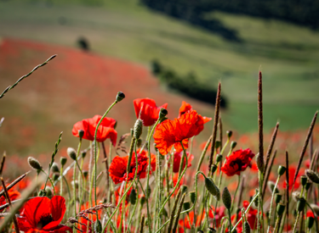
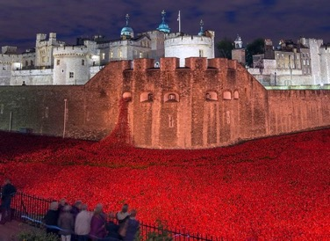
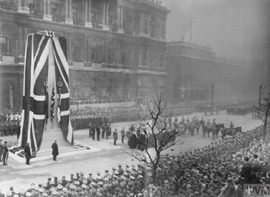



WHAT IS REMEMBRANCE?
The poppy display at Tower of London in 2018 to mark 100 years since Armistice.
Poppy growing from WW1 battlefields.
Remembrance day service at the Cenotaph in London, 1920.
Notes:
What is Remembrance? Slide 2 of 3 | 3 minutes | Introduction to theme, key historical information and definitions
Explain that the red poppy is our national symbol for Remembrance because poppies grew out of the battlefields of World War 1.
Explain that we have been commemorating Remembrance since 1919, one year after World War 1 ended.
We commemorate Remembrance every year, and over 10,000 service people have participated in the past.
Reinforce by reading the definition of Remembrance: ‘The act of remembering and showing respect for someone who has died, or a past event’.
Source: https://dictionary.cambridge.org/dictionary/english/remembrance
Remind students that remembrance services are held on 11th November at 11:00am in recognition of the Armistice - an agreement to stop fighting.
Image of cenotaph from 1920 is a photograph collected by the National Army Museum (NAM), found at https://collection.nam.ac.uk/detail.php?acc=1999-07-23-22

Slide 10


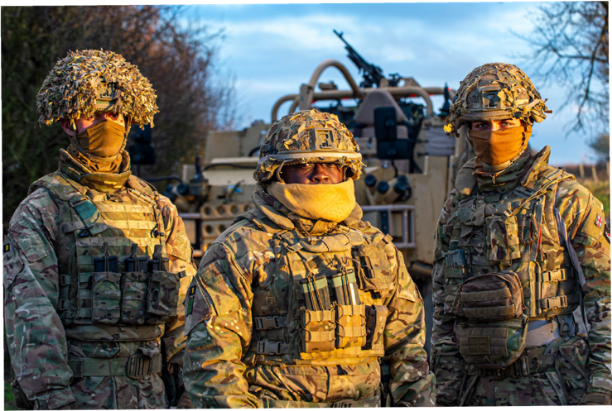

WHAT IS REMEMBRANCE?
Remembrance aims to honour those who serve to defend our democratic freedoms and way of life.
This includes:
remembering the sacrifice of the Armed Forces community from Britain and the Commonwealth
paying tribute to the special contribution of families and of the emergency services
acknowledging innocent civilians who have lost their lives in conflict and acts of terrorism.
Notes:
What is Remembrance? Slide 3 of 3 | 3 minutes | Defining Remembrance
Explain that Remembrance aims to honour those who serve to defend our democratic freedoms and way of life.
This includes:
remembering the sacrifice of the Armed Forces community from Britain and the Commonwealth
paying tribute to the special contribution of families and of the emergency services
acknowledging innocent civilians who have lost their lives in conflict and acts of terrorism.
Source: https://www.britishlegion.org.uk/get-involved/remembrance/about-remembrance

Slide 11


THE COMMONWEALTH
In many wars that Britain has been involved in, communities around the Commonwealth have supported them. To begin with, the Commonwealth was made up of nations and territories controlled by the British Empire.
The Commonwealth works towards shared goals of prosperity, democracy and peace. It supports small states as well as developing societies and young people.
Some nations and territories in the Commonwealth are Barbados, Nigeria, Kenya, India, Sri Lanka, Canada, Malta, Cyprus, Australia and Samoa. There are currently 56 countries in the Commonwealth.
Notes:
What is the historical context of Remembrance? | 1 minute | History of the Commonwealth and how it relates to Remembrance and who we remember
1. Read through the slide as a class to reflect on how the Commonwealth impacts who we remember, before taking a look at some examples of people we remember on the next slide.

Slide 12


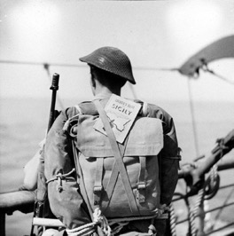

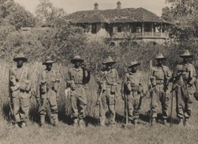

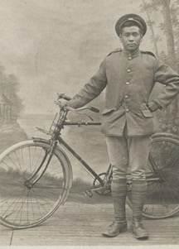

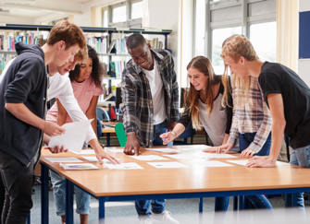
WHO DO WE REMEMBER?
Chinese labourers were recruited by the British government to support with non-military roles in WWI.
A civilian, a person not in the armed forces or the police force – someone just like you and me.
Soldiers of the King’s African Rifles photographed in 1944.
A British Soldier in WW2.
Notes:
Who do we celebrate when remembering? Slide 1 of 2 | 2 minutes | Examples of people we commemorate
Look through the images and read the descriptions on the screen of various personnel and civilians that we honour on Remembrance Day.
Emphasise that Remembrance has a broad definition, and includes many different kinds of people and types of job.
The first image is sourced from the National Army Museum, featuring a member of the 55th Company, Chinese Labour Corps in 1918. The second image is also sourced from the National Army Museum, featuring a British soldier in World War Two during the invasion of Sicily. The last image on the slide is also sourced from the National Army Museum, featuring a group of soldiers of the King’s African Rifles joined by a member of the British Army in 1944.

Slide 13


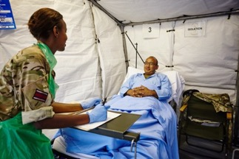
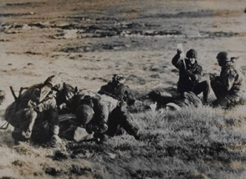

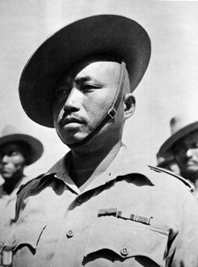
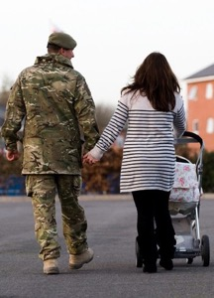
WHO DO WE REMEMBER?
A member of the Gurkha Rifles during WW2, taken in 1943.
Every service person has some family or friends waiting for them at home.
Paramedics tending to the wounded in the Falklands War in 1982.
The Army nurses supported the Covid-19 outbreak in 2020.
Notes:
Who do we celebrate when remembering? Slide 2 of 2 | 2 minutes | Examples of people we commemorate
Look through the images and read the descriptions on the screen of various personnel and civilians that we honour on Remembrance Day.
Emphasise that Remembrance has a broad definition, and includes many different kinds of people and types of job.
The third and fourth images are sourced from the National Army Museum. The third image is a photograph of a member of the Gurkha Rifles in 1943. The fourth image is a photograph of a group of paramedics tending to the wounded during the Falklands War, taken in 1982.

Slide 14



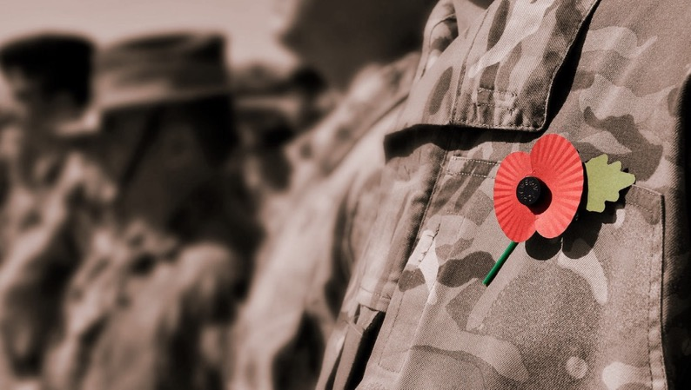

REMEMBRANCE FILM
Think about:
What does Remembrance mean to you?
Why do you think it’s important?
How do you think the way in which we commemorate might change/stay the same in the future?
Notes:
Video | 5 minutes | Students watch the video and then discuss some simple questions as a class.
Read questions for students to think about as they watch.
Watch the video: https://vimeo.com/764147228/ac36b217d4
If time, gather some feedback from students using the questions below.
Support questions:
Who was speaking on the video?
What job to they do?
What were they talking about on the video?
Challenge:
What does Remembrance mean to you?
Why do you think it’s important?
How do you think the way in which we commemorate might change/stay the same in future?

Slide 15
HOW DO WE COMMEMORATE REMEMBRANCE?
Remembrance isn’t just about why we remember, and who we remember; it’s also about how we remember. Remembrance is a verb – not just a noun!
Remembrance is an act – we choose to do something, alone, with friends and family or the wider community that helps us understand, reflect on, share or put into practice what we have learned.
Let’s take a look at some examples…
Notes:
How do we commemorate Remembrance? Slide 1 of 6 | 5–10 minutes – max. 2 minutes per slide | Examples of the different ways in which we commemorate Remembrance
Read through the text on screen, or ask a student to read it aloud.

Slide 16


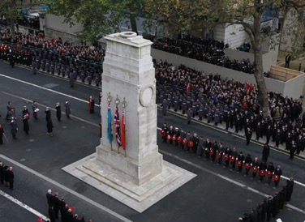
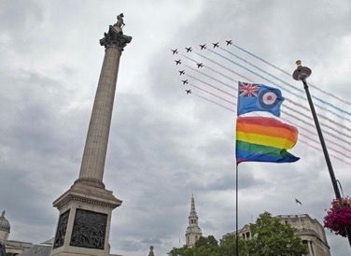
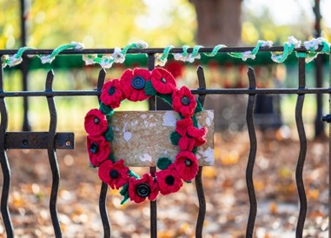
PARADES
We All Remember – The first LGBTQ+ marches were held in 2021 in the Remembrance Sunday parade.
We Remember – The traditional Remembrance Sunday Service at the Cenotaph, London.
Children Remember – Children and young people take part in Remembrance activities in school and in with clubs or with their family.
Sound clip: "Last Post 2.wav" by Benboncan is licensed under CC BY 4.0.
Notes:
How do we commemorate Remembrance? Slide 2 of 6 | 5–10 minutes – max. 2 minutes per slide | Examples of the different ways in which we commemorate Remembrance
Play the last post to represent the end of the traditional two minutes of silence held at Remembrance Day services: https://freesound.org/people/Benboncan/sounds/62050/#
Show images and read descriptions on the slide.
Additional information:
Remembrance Day:
- Traditionally, our Remembrance services takes place on Remembrance Sunday with an event at the Cenotaph in London. The Cenotaph is our most significant war memorial, built at the end of World War 1 to honour those who had died. Since then, it has become the site where we honour casualties and losses in all wars.
- Remembrance Sunday services take place all over the country, in churches, town halls, villages, social groups, and in public spaces. The main Remembrance Sunday service in London includes three main parts: a parade of current military personnel and veterans, laying poppy wreaths and holding two minutes silence. Members of Government and members of the Royal Family attend this event, and it is broadcast live on TV.
In 2021, LGBTQ+ veterans and marched for the first time in the Remembrance Sunday parade. In 2000, a ban was lifted on LGBTQ+ people serving in the military. In 2020, this was lifted to create a more inclusive, open and diverse military that is truly reflective of the society it serves.
Children and young people are involved in many different groups including the Army Cadets, Sea Cadets, Scouts and Girl Guides. They all commemorate Remembrance each year.

Slide 17
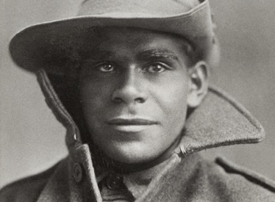
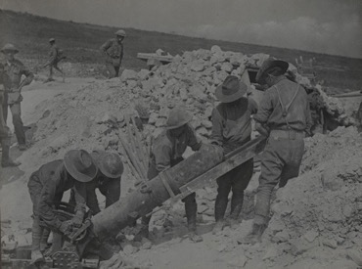
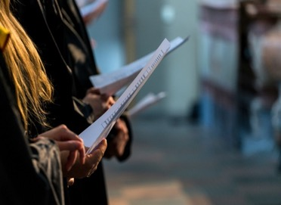
THE ARTS
Performance Remembers – ‘We’re Here Because We’re Here’ – a live theatre event to commemorate the Battle of the Somme.
Theatre Remembers – ‘Black Diggers’ – a theatre production in Australia celebrating the sacrifice made by Aborigini soldiers in WW1.
Music Remember – The Military Wives Choir has 2,000 members in 72 choirs.
Sound clip: "DIDGERIDOO 05.wav" by sandyrb is licensed under CC BY 4.0
Notes:
How do we commemorate Remembrance? Slide 3 of 6 | 5–10 minutes – max. 2 minutes per slide | Examples of the different ways in which we commemorate Remembrance
Play one of the music choices related to Remembrance Day such as didgeridoo music, more recently featured in Australian Anzac Day services: https://freesound.org/people/sandyrb/sounds/85780/, ‘We’re here because we’re here’ from the centenary commemorations: https://www.youtube.com/watch?v=rYHJkRMhnIc or music from the military wives choir: https://www.militarywiveschoirs.org/
Show images and read descriptions on the slide.
Additional information:
Black Diggers is an Australian theatre production based around the lives of Aboriginal Australian men who fought during the First World War. The basis of this story was true for many members of the Indigenous community. These people fought to return to discrimination rather than celebration. Although Australia became independent from Great Britain in 1901, Australia was still heavily influenced by Great Britain – and this included British control of Australian foreign policy until 1931. The photograph is from the Australian War Memorial collection and is of Miller Mack a Private in the Australian Imperial Force who supported Britain in WW1.
War Horse is a British war novel by Michael Morpurgo originally published in 1982. Since then, it has been made as a film (2011) and a National Theatre production. It is a very powerful story that tells the tale of Joey, a horse bought by the Army for service in World War 1, and the ways in which his previous owner, 15-year-old Albert, tries to bring him safely home.
‘We’re here because we’re here’ was a live theatre event performed in 2018 to commemorate the centenary of the Battle of the Somme, the deadliest battle, and join in the 1918–2018 Centenary events.
Young men dressed up as WW1 soldiers, each one representing a real soldier. In the performance, they walked through town centres, stood in train stations, and occupied modern public spaces in tribute. If approached by the public, they didn’t speak, but gave a card about the soldier they were representing. The image used on this slide is from the National Army Museum of soldiers loading a mortar nicknamed the ‘Flying Pig’ in 1916 on the Somme.
The Military Wives Choir has 2,000 members and 72 choirs in British military bases across the UK and internationally. The choir is built on a love of singing, a shared understanding of the Armed Forces, and the benefits that being in a choir can bring to military wives when their spouses are deployed. https://www.militarywiveschoirs.org/

Slide 18


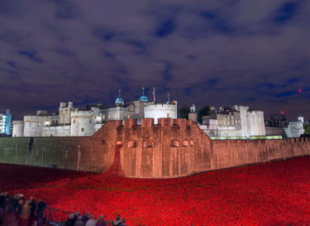
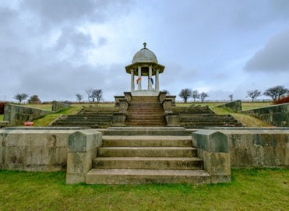
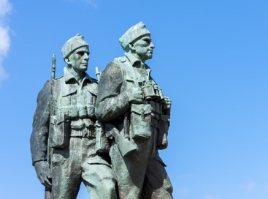

MEMORIALS
Brighton Remembers – In 1921, the Chattri memorial was built to commemorate the lives of Indian soldiers lost in WW1.
The Tower of London Remembers – 888,246 ceramic poppies filled the Tower of London in 2018 to commemorate each British and Commonwealth soldier who died during WW1.
The Scottish Highlands Remembers – The Commando Memorial was unveiled in 1952 to commemorate the lives of the 1,700 commandos who lost their lives during WW2.
Notes:
How do we commemorate Remembrance? Slide 4 of 5 | 5–10 minutes – max. 2 minutes per slide | Examples of the different ways in which we commemorate Remembrance
Play sounds of bagpipes: https://freesound.org/people/Urkki69/sounds/588640/
Show images and read descriptions on the slide.
Additional information:
The 2018 Centenary
Explain that 2018 was commemorated with a year of events, through cities and countries in Europe, remembering the end of WW1.
Example: The Tower of London and 2018 exhibition of Poppies, commemorating 100 years since Armistice.
Emphasise: 5 million people from countries around the world travelled to see this exhibition.
That Chattri Memorial
In 1921 the Chattri Memorial was constructed to commemorate the lives of Indian soldiers who fought in WW1. Hindu and Sikh injured soldiers were treated in various locations in Brighton including the pavilion. The Hindu and Sikh soldiers who passed away were cremated and the site of their cremation marks the spot of the memorial.
The Commando Memorial
The Commando Memorial was unveiled in 1952 to honour those in the commandos who lost their lives in WW2. The statue has now become a popular sight in the highlands of Scotland. A plaque underneath the statue reads, ‘United We Conquer’.
Highlight how memorials can be found in all cities and towns, and most villages. They are permanent, 24/7 places of commemoration. People lay wreaths, hold vigils and gather and pay their respects all year round (e.g. Christmas, or a special anniversary).
Challenge question: Where is the war memorial in your town? Do you know where your nearest war memorial is? Who does it commemorate?

Slide 19

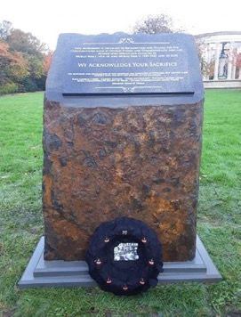

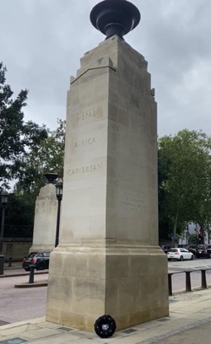

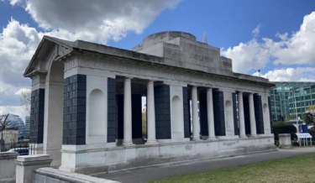



MEMORIALS
Hyde Park Remembers – The Memorial Gates commemorate the lives of those who fought for the British Empire from Africa, the Caribbean, Bangladesh, India, Nepal, Pakistan and Sri Lanka.
Tower Hill Remembers – The original memorial was unveiled in 1928 to commemorate the lives lost at sea in WW1. An extension was added for those whose lives were lost in WW2.
Cardiff Remembers – As part of the wider Welsh National War Memorial, this monument recognises the Diverse Ethnic and Commonwealth men and women who served in WW1 and WW2.
Notes:
How do we commemorate Remembrance? Slide 5 of 6 | 5–10 minutes – max. 2 minutes per slide | Examples of the different ways in which we commemorate Remembrance
Play sounds of applause or band/other music, common at the unveiling of a memorial.
Show images and read descriptions on the slide.
Additional information:
The Tower Hill Memorial
In 1928 the original memorial was created to commemorate the lives lost at sea during World War 1. In 1955 an extension was added to the memorial to commemorate the lives lost at sea during World War 2, this was unveiled by Queen Elizabeth II.
The Memorial Gates
The Memorial Gates were first revealed in 2002. They commemorate the lives sacrificed by forces around the Commonwealth to aid the British Army. Men and women from Africa, the Caribbean, Bangladesh, India, Nepal, Pakistan and Sri Lanka gave their lives during both World Wars as part of the British Empire.
The Ethnic Minority and Commonwealth servicemen and women memorial
In 2019 the memorial was built and placed in Cardiff among the wider Welsh National War Memorial. This monument recognises the contribution given by the servicemen and women around the Commonwealth who served in both World Wars.
Highlight how memorials can be found in all cities and towns, and most villages. They are permanent, 24/7 places of commemoration. People lay wreaths, hold vigils and gather and pay their respects all year round (e.g. Christmas, or a special anniversary).
Challenge question: Where is the war memorial in your town? Do you know where your nearest war memorial is? Who does it commemorate?

Slide 20


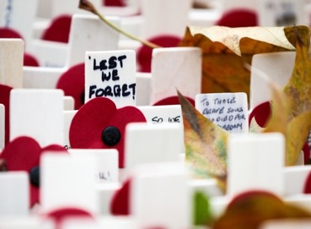
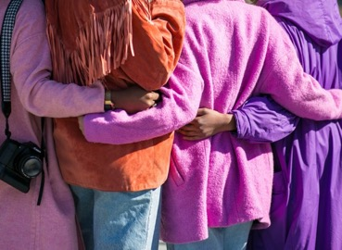
TIME TO REFLECT
Students Remember – Schools remember in unity, commemorating Remembrance Day each year with their school community.
Nature Remembers – The Remembrance Glade in Staffordshire was created as a peaceful environment for reflection.
Communities Remember – Towns, villages and cities commemorate Remembrance and a range of cultures and communities together.
Notes:
How do we commemorate Remembrance? Slide 6 of 6 | 5–10 minutes – max. 2 minutes per slide | Examples of the different ways in which we commemorate Remembrance
Play the sound of birdsong.
Show images and read descriptions on the slide.
Additional information:
Remembrance Glade: In the National Memorial Arboretum in Staffordshire, the Remembrance Glade has been designed to offer a tranquil space for individuals, families, schools and communities to gather and remember. The Glade has been specially designed with symbolic trees, shrubs and features to provoke reflection.
School reflection: At 11am, on the 11th November each year, all schools join in the moment of national Remembrance with a moment of 2 minutes silence. Lessons are stopped, break times are paused, and some schools hold special assemblies to gather for the occasion.
Communities reflecting: The African and Caribbean memorial in Windrush Square, Brixton was unveiled in 2017. The memorial was created to commemorate those who lost their lives fighting in both World Wars to support the British Army.

Slide 21


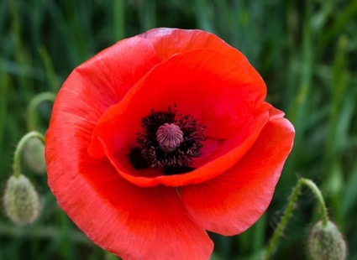

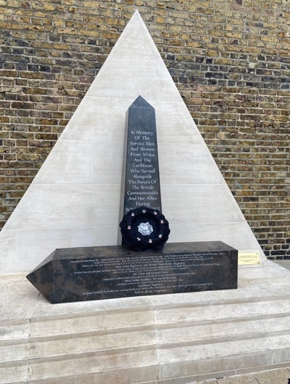
FINAL REFLECTION
How else can people honour Remembrance Day?
How will you / we mark Remembrance Day this year?
Notes:
Final reflection | 1 minute | Students reflect on the presentation
Give students a moment to consider the presentation, and ask for feedback or ideas to answer the questions:
How else can people honour Remembrance Day?
Why do you think Remembrance is important?
How will you / we mark Remembrance Day this year?

Slide 22

SIGNPOSTING
Want to know more? There are many organisations working on Remembrance who can give you further information and resources:
army.mod.uk/news-and-events/events/2022/ remembrance-sunday/
britishlegion.org.uk/get-involved/ remembrance/remembrance-events/remembrance-sunday
royal.uk/remembrance-day
britishlegion.org.uk
iwm.org.uk
blackpoppyrose.org/
sikhmuseum.com
helpforheroes.org.uk/
fightingwithpride.org.uk/
ppu.org.uk/
Notes:
Signposting | 1 minute | Signpost students to additional sources for more information and further exploration

