Slide 1

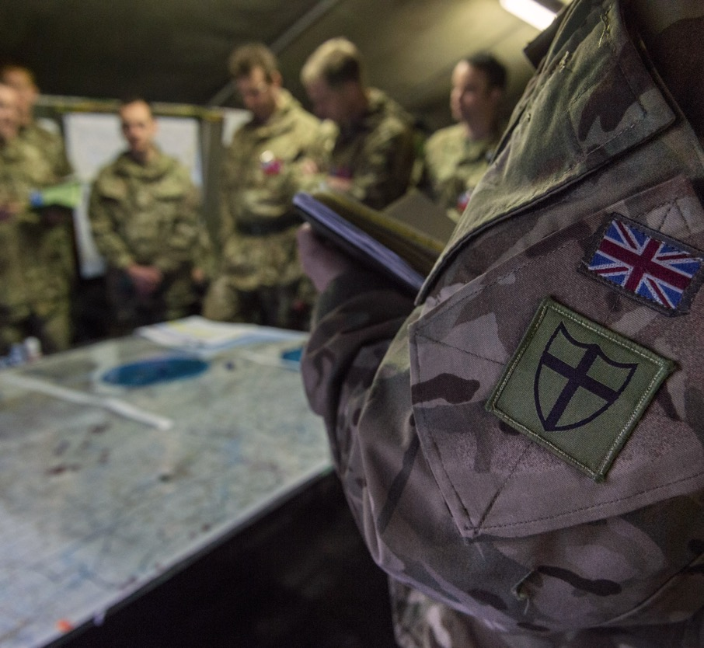
UPS L3 diploma, Unit 2: F and Unit 5: B/C1
UNIFORMED
PROTECTIVE
SERVICES
TEAMS, TENSION AND
COMMUNICATION
WORKSHOP:
TEAMS, TENSION AND COMMUNICATION IN DISASTER RELIEF

Slide 2
ABOUT THE BASE UPS RESOURCES
​Overview​
British Army Supporting Education (BASE) is an education programme from the British Army. It includes a website hub providing free-to-use engaging teaching resources, work experience and inspiring workshops.
This workshop complements the sessions designed to support teaching of Uniformed Protective Services L3 BTEC.
Key information​
Age: 16–18​
Time: 120 minutes​ + extra time for optional communication challenges
Subject: UPS, Personal development
Resources:​
Internet access for audio and video content
Preparation:​
Print copies of slides as shown in the session overviews
UPS curriculum links
This session applies learning from unit 2 F managing the behaviours of others and self in high-tension situations, unit 5 B exploring and applying theories of teamwork and optionally, unit C1, types and methods of communication.
Developed by experts​
This programme has been developed in partnership with Hark and a panel of subject matter experts and practising teachers.​
Using this presentation​
Teachers’ notes slides will not display in presentation mode.​
Student slides may have animation – view in presentation mode to see all content. ​
Slide notes contain further teacher guidance, including sample answers and suggestions for using your preferred digital classroom tools.
Links to external websites​
Please follow your school’s own internet safety guidelines.

Slide 3
SESSION OVERVIEW, 1X 120 MINUTES
​Learning objective: To understand and apply techniques for forming and leading teams in high-tension situations. Optionally, to use formal and informal communication verbally, over radio and in writing.
Activity | Slides | Overview | Timings | Preparation and resources required​
Opening​ | 6-9 | Students review what they will do in the workshop. (Only show slide 7 if students will complete any optional communications challenges. | 10 mins
​​Scene setter film | 10 | Students watch an intro film that sets the scene. | 5 mins​​
Briefing | 11-14 | Students prioritise tasks for the day. | 15 mins​​ | Print copies of slide 12-14
Comms challenge | 15 | OPTIONAL: Students plan and give a formal radio briefing. | (10-15 mins)
Create your team | 16-19 | Students apply their understanding of Belbin's team roles to form an effective team. | 15 mins​​ | Print copies of slides 17-19
Build your team | 20-23 | Students apply their understanding to overcome barriers to cohesion. | 15 mins​​ | Print copies of slides 22-23
Lead your team | 24-26 | Students apply Adair's leadership to lead their team in a difficult task. | 20 mins | Print copies of slide 25-26
Comms challenge | 27 | OPTIONAL: Students write a brief, formal email on how they responded to one challenge. | (10-15 mins)

Slide 4
SESSION OVERVIEW, 1X 120 MINUTES
​Learning objective: To understand and apply techniques for forming and leading teams in high-tension situations. Optionally, to use formal and informal communication verbally, over radio and in writing.
Activity | Slides | Overview | Timings | Preparation and resources required​
Defuse the situation | 28-30 | Students apply their knowledge and understanding to role-play how to defuse a high-tension situation. | 15 mins | Print copies of slide 30
Comms challenge | 31 | OPTIONAL: Students plan and read a brief radio call to explain how they defused a high-tension situation. | (10-15 mins)
Reflect and move forward | 32-34 | Students help soldiers in their team to reflect on their performance. | 10 mins​​ | Print copies of slide 34
Comms challenge | 35 | OPTIONAL: Students write a one-page document outlining one soldier’s areas for development. | (10-15 minutes)
Self-reflection | 36-39 | Students reflect on their own performance during the workshop and identify goals for improvement. | 10 mins​​ | Print copies of slide 39
Comms extension | 40 | OPTIONAL: Students write a formal report to a superior officer on what they have identified as their own areas to develop, after reflecting on their workshop performance. | (15-20 mins)
Comms extension | 41 | OPTIONAL: Students draft a short press release and a social media post about the Army’s response to the flooding. | (15-20 minutes)

Slide 5
TEACHER QUICK GUIDE
Divide students into groups of four (or pairs if preferred)
Each task is independent of the others (so selected tasks can be removed to alter timings/challenge)
Role-plays can be within the group, to another group, to the class
Differentiate through:
Easier/harder information
Number of tasks
Assigning a leader in each group
Group composition
Different delivery approaches in the notes
Including the OPTIONAL communications challenges on slides 7, 15, 27, 31, 35 and communications extension activities on slides 40 and 41.

Slide 6

LEARNING OUTCOMES
You will be able to:
Apply Belbin’s nine team roles to justify team selections.
Identify solutions to barriers to effective teamwork.
Explain how a leader would apply Adair’s theory of leadership to support a team through a task.
Demonstrate how to defuse high-tension situations within and external to a team.
Suggest ways to motivate, train, coach and mentor team members.
Notes:
Deliver​
Review the learning outcomes with students. These are repeated at the end of the workshop to support reflection and self-evaluation.​
​
If you amend the content of the workshop, please remember to amend the learning outcomes to match.

Slide 7
COMMS CHALLENGE
LEARNING OUTCOMES
You will be able to:
Communicate over radio using the phonetic alphabet and digits.​​
Communicate over radio using standard voice procedures and prowords.
Communicate formally and informally in writing.​
Evaluate your communication skills.
Notes:
Deliver​
Optional for if you choose to include any communications challenges.
Review the learning outcomes with students. These are repeated at the end of the workshop to support reflection and self-evaluation.​
​
If you amend the content of the workshop, please remember to amend the learning outcomes to match.

Slide 8
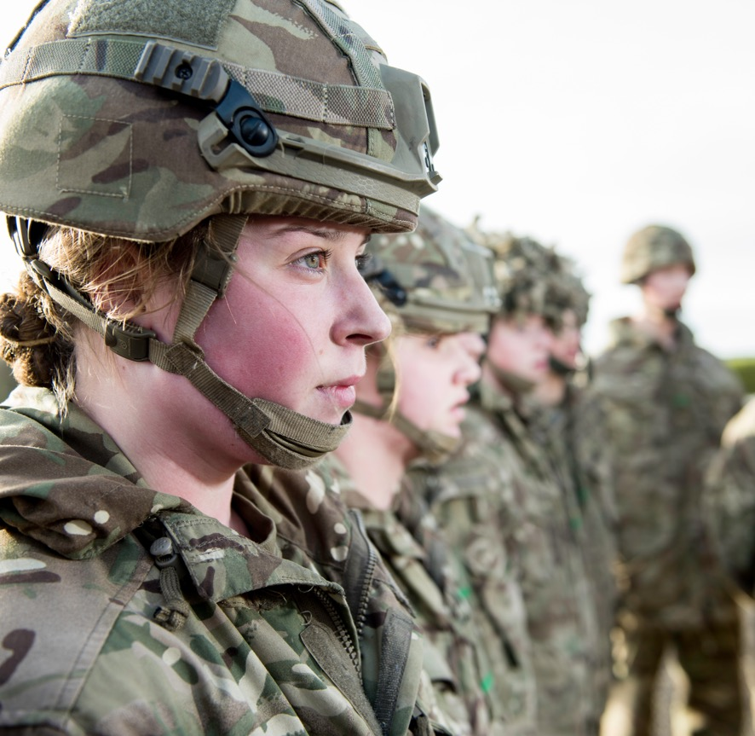

INTRODUCTION
Welcome to your Teams and tension in disaster relief workshop.
You have been learning about:
Why teams are important within the uniformed protective services
Belbin’s nine team roles
Tuckman’s stages in team development
Adair’s action-centred leadership
Motivation, training, coaching and mentoring
How to defuse high-tension situations
It is time to step up and apply your learning.
Notes:
Deliver​
Introduce the workshop and review the topics that students have covered and will apply in this activity.​
​
Amend the slide to remove any topics if you are shortening or amending the workshop content.

Slide 9
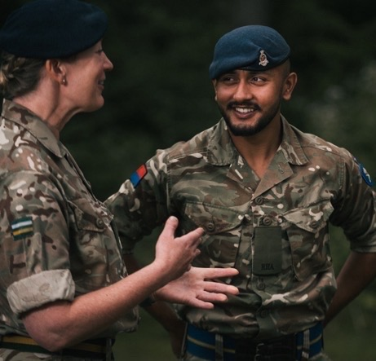

PREPARE TO REFLECT
As you take part, think about:
What you are proud of doing well
What learning you found easiest to apply
What learning you would like to reinforce
Any other ways you would like to improve, and how you could achieve this
Be ready to reflect and self-evaluate at the end of the workshop.
Notes:
Deliver​
Briefly review the four areas of reflection and self-evaluation students will complete at the end of the workshop.

Slide 10
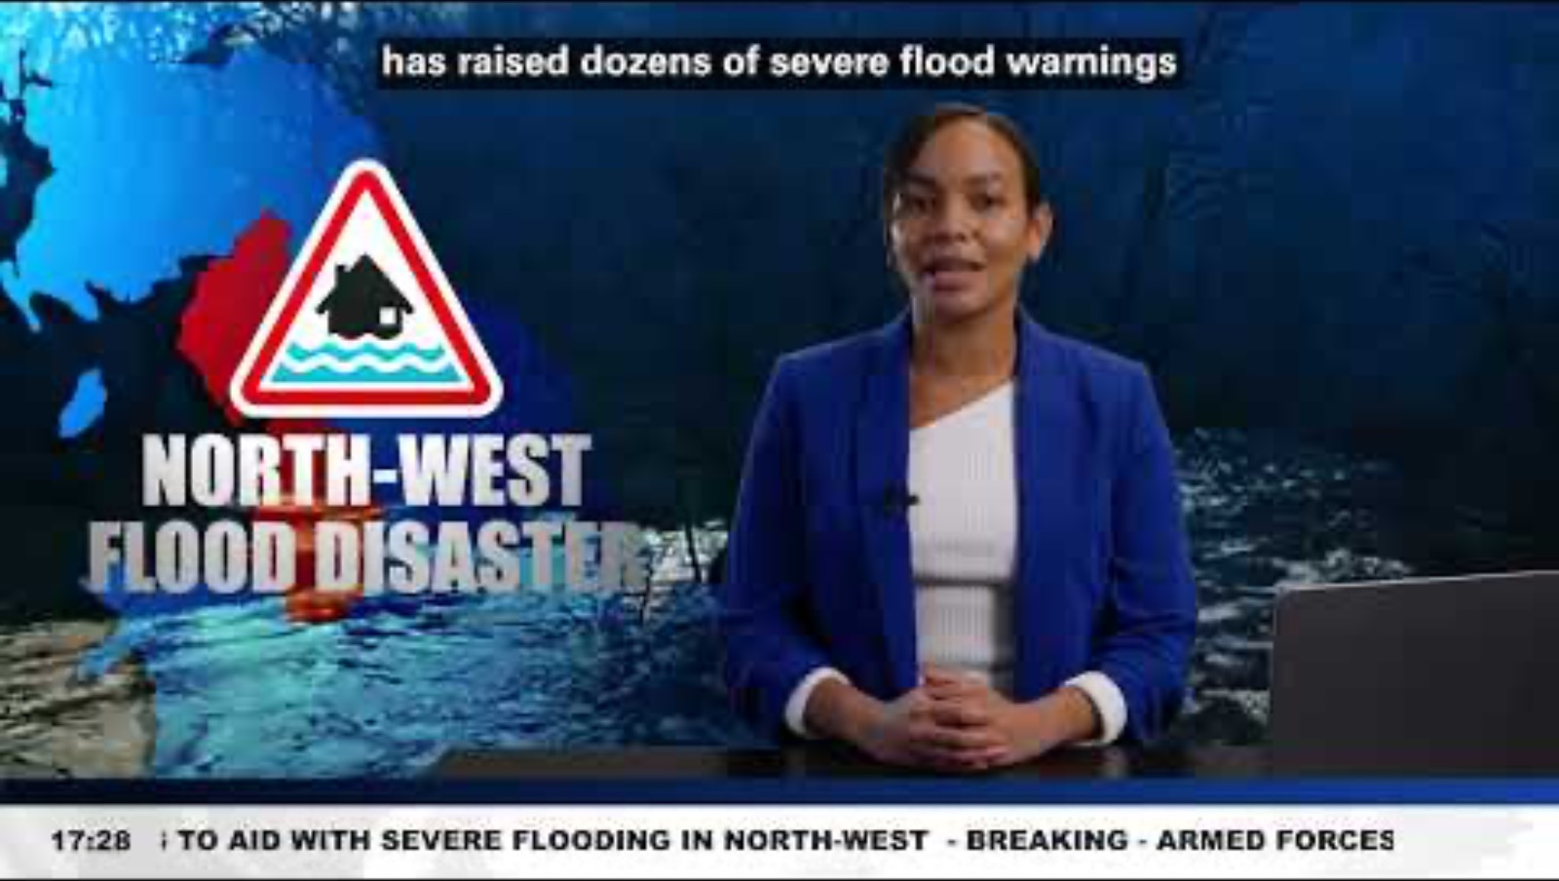
Notes:
Deliver​
Introduce the scenario: The Army has been tasked with supporting civilian agencies and emergency services in a coordinated response to severe flooding.​
​
This will require students to apply their learning to scenarios that will be relevant in any uniformed protective service – not just for those students considering a career in the Army.​
​
Discuss what civilian uniformed protective services would be helping with the relief effort and what roles they might play.​
​
This can lead to brief consideration of command and control structures during multi-agency responses.
Video link: https://www.youtube.com/watch?v=qviCr7a-TS4

Slide 11




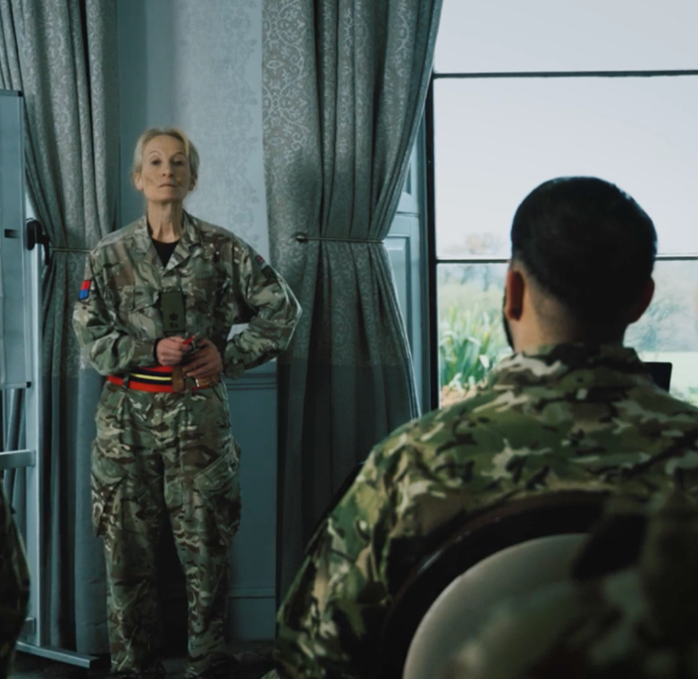
BRIEFING – 0800 HOURS
Carefully read your briefing document.
Identify your key tasks.
Prioritise these tasks.
Be ready to justify your decisions.
Notes:
Deliver​
Introduce the first task: students are to receive their first briefing on the situation and must prioritise their tasks to ensure an effective response.​
​
There are two versions of the command briefing to support students of different abilities (see next two slides). Note that students don’t need to complete each task (for example there is no weather report to read). The purpose of the activity is to explore how they prioritise each task and can then justify their decisions.​
​
This can be a group or individual task. Group members can first make individual decisions and then compare and agree.​
​
Digital classroom
Student teams could be emailed a version of the command briefing to open and read, instead of presenting one of the following slides. They could complete a digital version of the printable worksheet slide.​
​
Add support​
Use the simple list. Students complete the diamond nine.​
​
Add challenge​
Use the more complex briefing, from which students should extract nine tasks. Students add written justifications of their priorities and link to a sequence of activities.

Slide 12
COMMAND BRIEFING – 0800 HOURS
Identify the nine tasks this commend briefing suggests. Prioritise the tasks in a diamond nine grid.
Prepared: 0800 Valid until: 12:00
Heavy rain continued to fall overnight, and rivers are still swollen above their banks. Flooding in low-lying areas is increasing and the area under floodwaters is predicted to grow by 25%–40%.
A weather report for the next 24 and 72 hours is attached at annex A.
Civilian emergency forces are working together to evacuate communities and provide emergency accommodation, food and support.
A detailed briefing on the civilian response is planned for 0830.
As expected, there is considerable press interest.
There is a request for a press conference as soon as possible.
Commander’s accommodation has not yet been organized.
An early deployment of Engineers has conducted ground and aerial surveys of rivers, roads, bridges and other civilian infrastructure. A number of significant risks to life have been identified. These are attached at annex B. Surveys will continue throughout the day.
As of writing, there is no authoritative map of safe road routes for Army and civilian forces to use, although the information to create this now exists.
Rescue equipment and PPE for Army personnel will arrive by 0900 by helicopter. Larger equipment for flood relief and barrier construction will arrive by road by 1000.
The location of the Army command and civilian liaison centre is yet to be agreed.
Soldiers are arriving as of 0700. They need to be organized into rescue teams according to priorities and briefed on their tasks.
End.
Notes:
Print copies for students.

Slide 13
COMMAND BRIEFING – 0800 HOURS
Prioritise these nine tasks in a diamond nine grid.
Prepared: 0800 Valid until: 12:00
Read the weather report.
Get briefed on the civilian response so far.
Hold a press conference as soon as possible.
Organise your accommodation.
Review the significant risks to life.
Organise a map of safe road routes.
Choose the location for your command centre.
Provide rescue equipment and PPE to Army teams.
Organise soldiers into rescue teams.
- End -
Notes:
Print or display slide for students (support sheet).

Slide 14
PRIORITISE YOUR TASKS
Your briefing includes nine key tasks you may have to carry out.
Prioritise each task by organizing them into a diamond nine:
Most urgent and important
Justify your 3 most important and three least important tasks:
.…………………………………………………
.…………………………………………………
.…………………………………………………
.…………………………………………………
.…………………………………………………
.…………………………………………………
Least urgent and important
Notes:
Print copies for students.

Slide 15
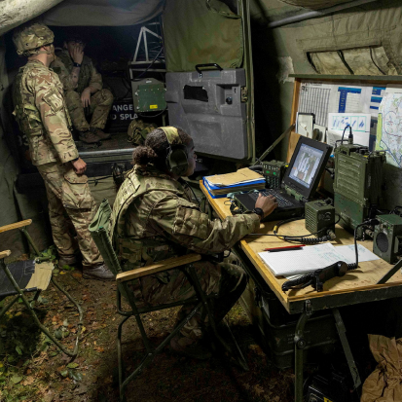
COMMS CHALLENGE:
PLAN AND GIVE A FORMAL
RADIO BRIEFING
Turn the 08:00 hours command briefing into a radio briefing for all stations.
Include the initial weather report in the first paragraph.
Summarise the second half of the briefing information that begins at “An early deployment of Engineers…”
Ask stations to confirm their understanding.
Remember ABCD. Use prowords and phonetics as required.
Notes:
Deliver
This slide supports an additional communication task within the workshop. Students will require prior learning about standard voice procedure and prowords when communicating by radio. If you have not covered this content, skip this slide and task.
This task refers to the written briefing on slide 12.
Choose how much of the briefing you would like students to include, to suit their ability and the additional time you can allow for this task. The full information for the radio briefing task is as follows:
Heavy rain continued to fall overnight, and rivers are still swollen above their banks. Flooding in low-lying areas is increasing and the area under floodwaters is predicted to grow by 25%–40%. An early deployment of Engineers has conducted ground and aerial surveys of rivers, roads, bridges and other civilian infrastructure. A number of significant risks to life have been identified. These are attached at annex B. Surveys will continue throughout the day. As of writing, there is no authoritative map of safe road routes for Army and civilian forces to use, although the information to create this now exists. Rescue equipment and PPE for Army personnel will arrive by 0900 by helicopter. Larger equipment for flood relief and barrier construction will arrive by road by 1000. The location of the Army command and civilian liaison centre is yet to be agreed. Soldiers are arriving as of 0700. They need to be organized into rescue teams according to priorities and briefed on their tasks.
Digital classroom​
Students can use radio equipment, walkie-talkies or mobile phones to relay their transmission.
Add support​
Highlight which sections of the briefing you would like students to include in their radio transmission. Identify one or two paragraphs to transmit. Review which prowords students should use to open the transmission, share information and end the transmission.
​
Add challenge​
Students work independently, drawing on their recall or notes of which prowords to use and how to structure their transmission.

Slide 16



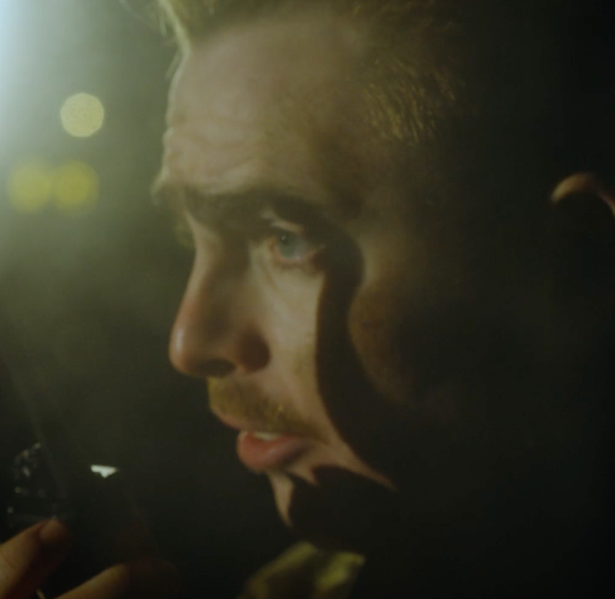
CREATE YOUR TEAMS
TASK
Now you’ve identified your priorities you need to allocate your section into teams.
Read the team cards.
Divide the characters into four balanced teams of four.
Every small team needs to perform at its best at a range of tasks.
Hint: Ensure each team includes at least one person well suited to a thinking, action and social role.
Notes:
Deliver​
Introduce the task: students have received their briefing and have prioritized the tasks for the morning. Working in their group/pair, they must now allocate personnel to four teams.​
​
Every team must be balanced so students need to interpret the information on the character cards to allocate each person. (Teams and characters are not optimised to then take on specific tasks later in the workshop, but should be ’all-rounders’.)​
​
Each group could have cut-out team members on a table or display board to arrange into possible teams, before recording their final decision.​
​
Digital classroom
Share the team cards as a screen of online notes that students can select and move to create their teams.​
​
Add support​
Ensure students have their Belbin team role information to hand from the prior lessons. Use the cards that include the nine Belbin role names. Hint that four people have leadership qualities and should be placed in separate teams (Jordan, Rick, Alex and Jaden).​
​
Help students identify which people provide each of these roles. Remind students that people with a certain quality are usually able to play other roles from the same Belbin group.​
​
Add challenge​
Use the cards that do not have the role names. The character card descriptions match those used in the Belbin content in the prior lessons.​
​
Ask students to explain the meaning and importance of ‘balanced teams’, especially where, like this, teams may rapidly move from one challenging task to another.​
​
Students can choose to 'lead' their specific team through the subsequent team-based activities (except where students defuse a high-tension scenario) and consider which of their chosen team members might behave in a certain way or be best for a task.

Slide 17
CREATE YOUR TEAMS
LIZ Creative and imaginative, generates ideas and solves problems. | SCOTT Cooperates, solves disagreements. | JORDAN Organises and gets on with the work. | CALUM Explores opportunities, finds help and guidance
NISHA Spots mistakes, aims for perfection. | RICK Sets goals, leads and links people with tasks. | HENRY Creative and imaginative, generates ideas and solves problems. | ALEX Organises and gets on with the work.
JUDE Judges good ideas from bad ones, checks on quality. | SASHA Pushes ahead and challenges. | FELIX Contributes specialist knowledge and skills. | JADEN Sets goals, leads and links people with tasks.
STYLLIOS Cooperates, solves disagreements. | LEANNE Spots mistakes, aims for perfection. | MATT Pushes ahead and challenges. | MILLIE Creative and imaginative, generates ideas and solves problems.
Notes:
Print for students.

Slide 18
CREATE YOUR TEAMS
LIZ Plant: Creative and imaginative, generates ideas and solves problems. | SCOTT Team worker: Cooperates, solves disagreements. | JORDAN Implementer: Organises and gets on with the work. | CALUM Resource investigator: Explores opportunities, finds help and guidance.
NISHA Completer: Spots mistakes, aims for perfection. | RICK Coordinator: Sets goals, leads and links people with tasks. | HENRY Plant: Creative and imaginative, generates ideas and solves problems. | ALEX Implementer: Organises and gets on with the work.
JUDE Monitor evaluator: Judges good ideas from bad ones, checks on quality. | SASHA Shaper: Pushes ahead and challenges. | FELIX Specialist: Contributes specialist knowledge and skills. | JADEN Coordinator: Sets goals, leads and links people with tasks.
STYLLIOS Team worker: Cooperates, solves disagreements. | LEANNE Completer: Spots mistakes, aims for perfection. | MATT Shaper: Pushes ahead and challenges. | MILLIE Plant: Creative and imaginative, generates ideas and solves problems.
Notes:
Print slide for students.

Slide 19
CREATE YOUR TEAMS
Divide the characters into four four-person teams.​ Make sure every team includes at least one person in each type of Belbin’s roles.
TEAM A | TEAM B | TEAM C | TEAM D
Thinking roles: | Thinking roles: | Thinking roles: | Thinking roles:
Action roles: | Action roles: | Action roles: | Action roles:
Social roles: | Social roles: | Social roles: | Social roles:
Notes:
Print slide for students.

Slide 20
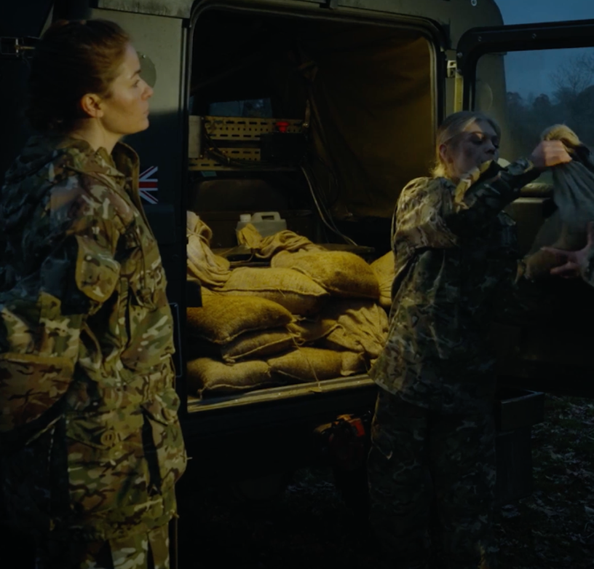


BUILD YOUR TEAM
TASK
Your teams are balanced but are not yet cohesive and effective.
Listen to the update from another section leader who’s observed your teams so far. Identify the internal or external issue affecting each team.
Divide your group in to two and choose two issues each. Suggest what you would say and do to guide the team towards greater cohesion.
Be ready to role-play your response as overall Section leader.
Hint: You do not need to match the issue to a specific team – just provide a general response.
Notes:
Deliver​
Introduce the task: students have created three balanced teams that will each make an effective contribution to the flood relief and safety efforts. However, each team is displaying ‘teething troubles’ as the members get used to working together.​
​
Discuss what stages a team will go through, referring to Tuckman’s stages in team development. Help students identify that the teams are at the ‘storming stage’.​
​
Digital classroom​
Students could record video of their response or create a written response as an email.​
​
Add support​
Ensure students have their Tuckman team development stages information to hand from the prior lessons. Reduce the number of scenarios so groups work together to solve one or two issues (randomly allocate/ask teams to randomly select a number for their issue). ​
​
Add challenge​
Groups/pairs can choose to 'lead' one specific team through each of the tasks and consider which of their chosen team members might be involved, and how best to deal with their personality.

Slide 21





BUILD YOUR TEAM
Dramatisation: Actors used for audio files
Listen carefully to each update to identify the issue impacting the team.
CLIP 1
CLIP 3
CLIP 2
CLIP 4
Notes:
Deliver​
Play the audio and/or provide transcripts for groups to read.​
​
Add support​
Listen to the audio and provide transcripts for students. Students address one challenge each.​
​
Add challenge​
Listen to the audio but do not provide transcripts so students must remember. Students address as many challenges as they can in the time available or from memory.​
​
Groups/pairs can choose to 'lead' one specific team through each of the tasks and consider which of their chosen team members might be involved, and how best to deal with their personality.

Slide 22
BUILD YOUR TEAM
Listen carefully to each update to identify the issue impacting the team.
CLIP 1
Team members seem intent on proving themselves in front of one another. They each have their own ideas about how to complete their tasks and rarely support one another. They are achieving little as a result and waste energy arguing and criticising one another’s ideas.
CLIP 2
The team is moving food supplies to isolated homes, often through fast-flowing water. The work is slow and exhausting. The team is very tired and, as a result, are starting to argue and be impatient with one another. They still have four homes to reach, which will take at least another two hours.
CLIP 3
Every team has been given a clear briefing to follow their training to work safely together. However, two members of one team appear not to be following their orders and training. It is not clear whether this is to reach people faster, or for another reason. The remaining team members feel unsafe.
CLIP 4
The team is working hard but rarely talk to one another. The members do not seem interested in the task or in each other. As a result, they are making mistakes, which slows down their progress. The team is following its orders but is clearly not effective.
Notes:
Print copies for students.

Slide 23
BUILD YOUR TEAM
Choose two scenarios. Explain what you will say and do to help each team overcome their barrier to cohesion:
Scenario: | Scenario:
What I would say: | What I would say:
What I would do: | What I would do:
Notes:
Optional sheet to support role play responses (or replace role play responses). Print copies for students.

Slide 24


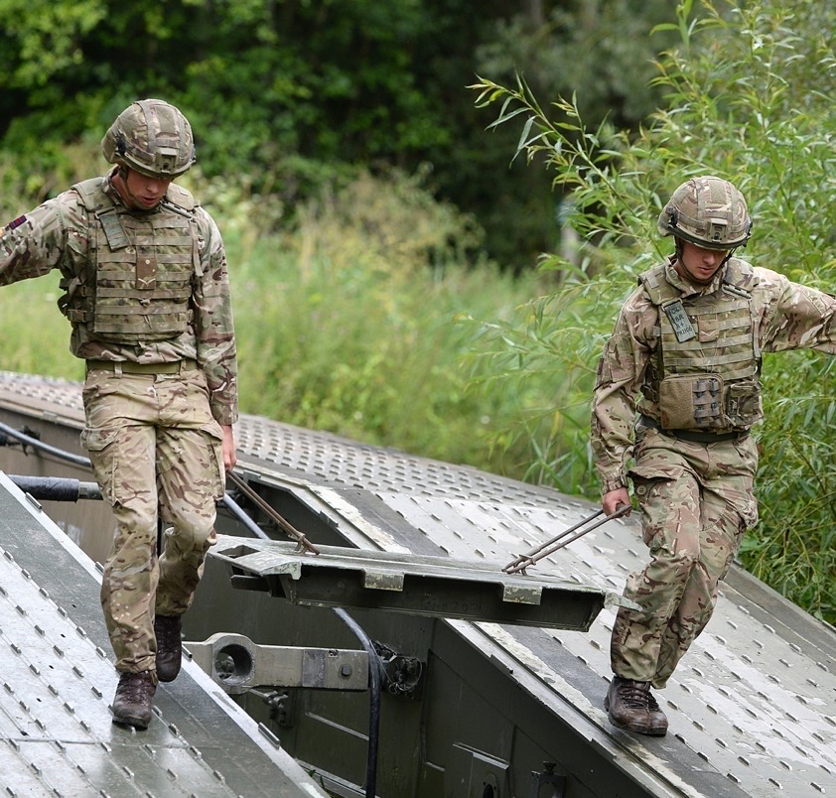
LEAD YOUR TEAM
OPTIONAL TASK
Each team is developing well, but must now take on a difficult task.
As their overall leader, you are responsible for their performance.
Select your task card and read the briefing.
Consider how you would best support the task and the team.
List what actions you would take as leader to help them overcome each challenge.
Notes:
Deliver​
Introduce the task: students have provided the guidance needed to help each team progress out of the storming stage of team development.​
​
However, each team must take on a difficult and uncertain task: new information or priorities are constantly changing, vital equipment and supplies are only just arriving and so the teams must do the best they can under difficult circumstances.​
​
To help each team, students must act as leaders and identify helpful actions that would help to support the team and complete the task as best as possible.​
​
Review what actions a leader can take (in simple terms) to support the team and to address and achieve the task.​
​
Students can make assumptions or presuppose, for example that more equipment or supplies will be arriving frequently during the day.​
​
Digital classroom
Email each student one task to read. Students can complete a digital version of the printable worksheet slide or could organise their ideas using a concept mapping tool.​
​
Add support​
Ensure students have their Adair leadership role information to hand from the prior lessons. Students address one challenge. Listen to the audio and provide transcripts for students. ​
​
Add challenge​
In their teams students consider all the challenges and formulate responses. Students listen to the audio only and respond from memory.​
​
Students can choose to 'lead' their specific team through the activity and consider which of their chosen team members might be involved, and how best to use their strengths.

Slide 25
LEAD YOUR TEAM
Prepared: 12:00 Valid until: 16:00 Task: House to house search and rescue Prioritise which streets to check first then go systematically from house to house, while also prioritising and responding to urgent cases. There is no best order as the situation is constantly changing. | Prepared: 12:00 Valid until: 16:00 Task: Food and blanket rationing and delivery Fairly ration food and blankets to families in a local sports hall, taking into account where there are possible dietary needs. There are enough blankets, but the first supply of food is limited and basic.
Prepared: 12:00 Valid until: 16:00 Task: Bridge safety inspection Prioritise which bridges to inspect first based on their importance and possible damage. Stay safe at all times while making the best judgements possible. Every decision is the best possible as there is no certainty. | Prepared: 12:00 Valid until: 16:00 Task: Flood barrier construction Construct barriers to prevent flooding of important infrastructure like electricity substations and internet towers. Respond to an ever-changing list of priority locations as the water level continues to rise.
Notes:
Print cards for students, ask each group to select one task at random.

Slide 26
LEAD YOUR TEAM
Consider how you would best support the task and the team.
List what actions you would take as leader.
Actions to help the team achieve the task:
Actions to manage the team:
Achieve the task
Build and maintain the team
Develop the individual
Notes:
Print copies for students.

Slide 27
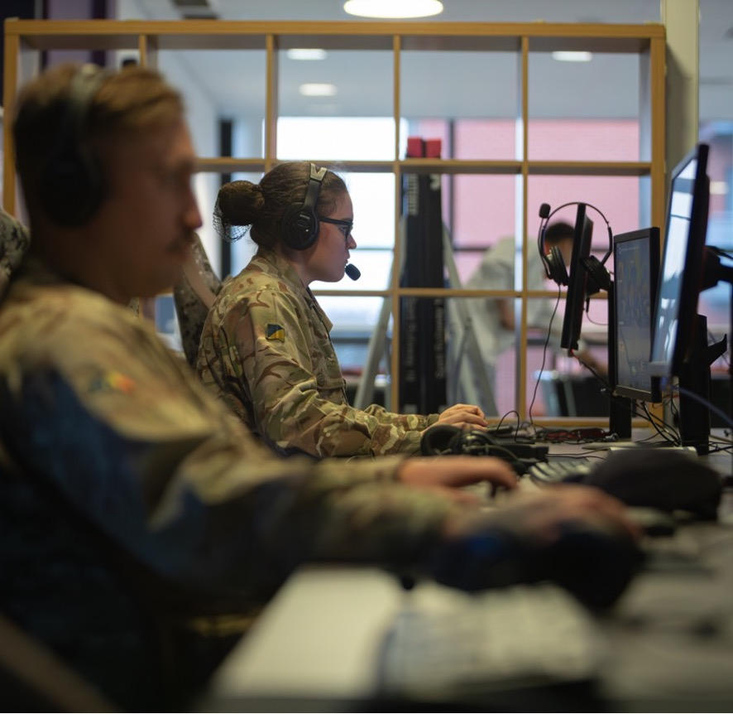
COMMS CHALLENGE:
WRITE A BRIEF
EMAIL REPORT
Compose a brief, formal email report on how you responded to one task.
Your report is to your commanding officer.
Summarise the task.
Summarise the actions you planned to manage the team and help them achieve the task. Use your completed ‘Lead your team’ activity sheet to inform what you say.
Notes:
Deliver
This slide supports an additional communication task within the workshop. If you have not covered this content, skip this slide and task.
Use after delivering the team leadership activity.
Digital classroom​
Students can email their reports to you.
​
Add support​
Lead students through the task and their completed ‘Lead the team’ activity sheet to model how to structure the email. Discuss how to open and end the email, thinking about its recipient and formality. Some students could use a writing frame to structure their email.
​
Add challenge​
Students work independently.

Slide 28
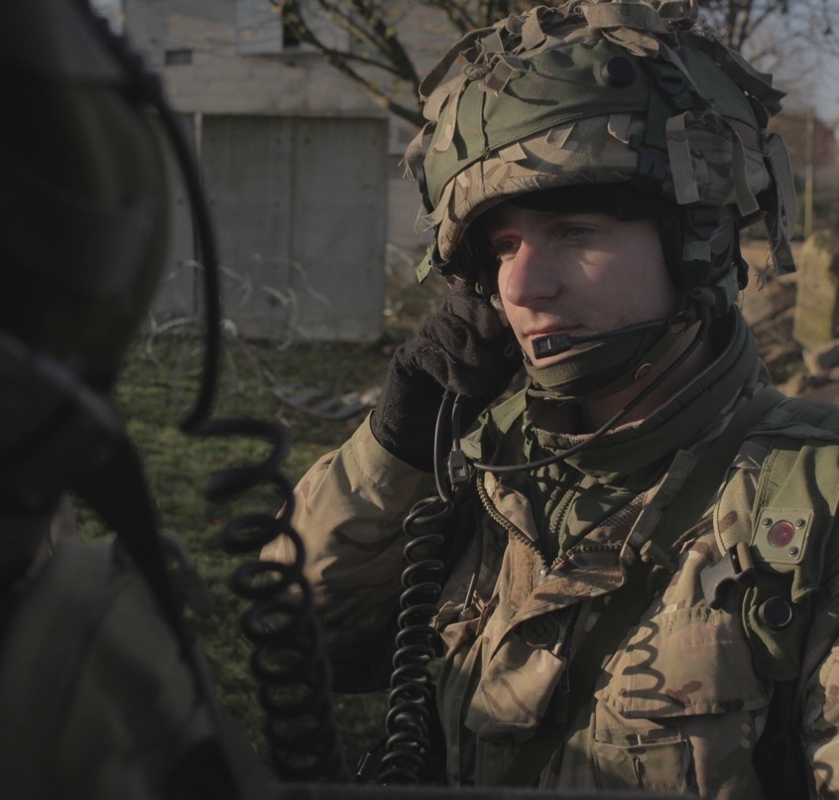

BRIEFING – 1600 HOURS
TASK
As the day goes on the floods are causing strong emotions that are making some people behave in dangerous and unpredictable ways.
Watch the briefings. Use your knowledge and understanding to defuse each situation.
Plan what you would say and do.
Be ready to role-play your response.
Notes:
Deliver​
Introduce the task: Students have successfully helped their teams to tackle each difficult task and their work is starting to make a real positive difference for families and the community.​
​
Discuss what emotions people who are affected by the flooding might feel.​
​
Help students identify that some people who have existing conditions may also respond in unexpected ways.​
​
In addition, some people may choose to take advantage of the flooding for their own gain. What feelings and emotions might they have?​
​ Choose which elements of the two worksheets you would like students to focus on and complete.​
​
Students use the sheets to plan a role-played response. You may wish to play the part of one of the civilians featured in each scenario, to add realism. Role-plays should not involve contact.​
​
Digital classroom
Students can complete a digital version of the printable worksheet slide. They can record video of their response, to review and provide constructive feedback.​
​
Add support​
Ensure students have their materials on defusing high-tension situations, from prior lessons. Use the sheets to frame discussion of responses. Groups consider and respond to one scenario.​
​
Add challenge​
Ask students to list what intentions and strategies will help: for example, to empathise, aim to provide an off-ramp to de-escalate, dynamically risk-assess and maintain a safe reactionary gap, actively listen, be assertive and use helpful verbal and non-verbal communication.​
​
Groups add more detail to their written responses and can consider more than one scenario.​

Slide 29
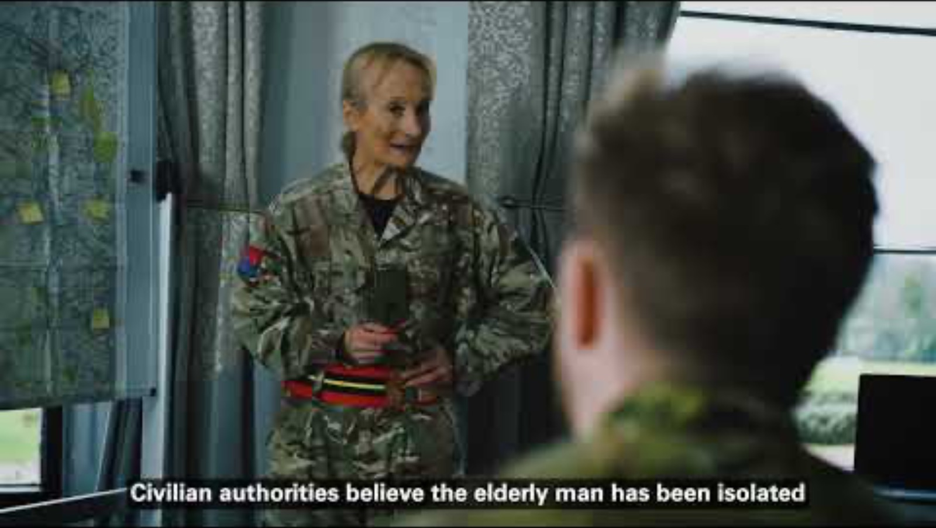
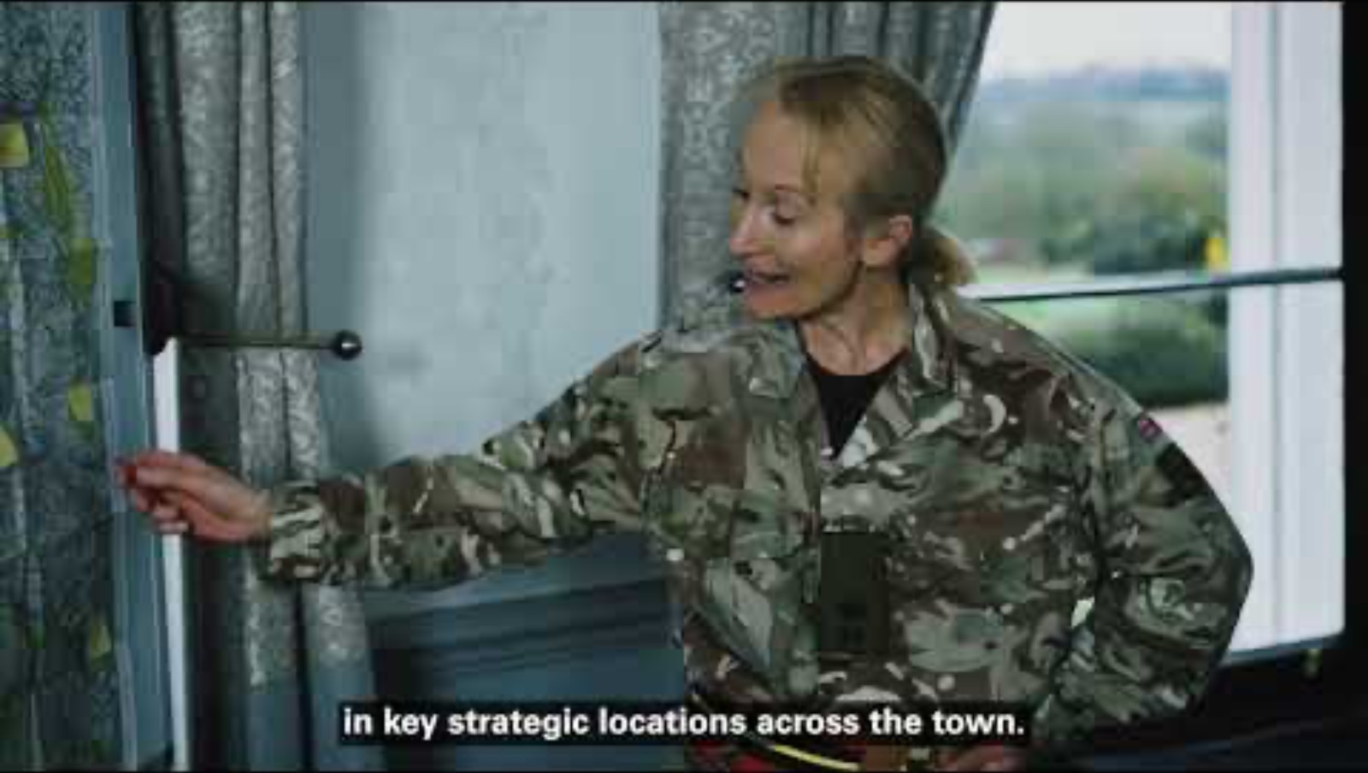
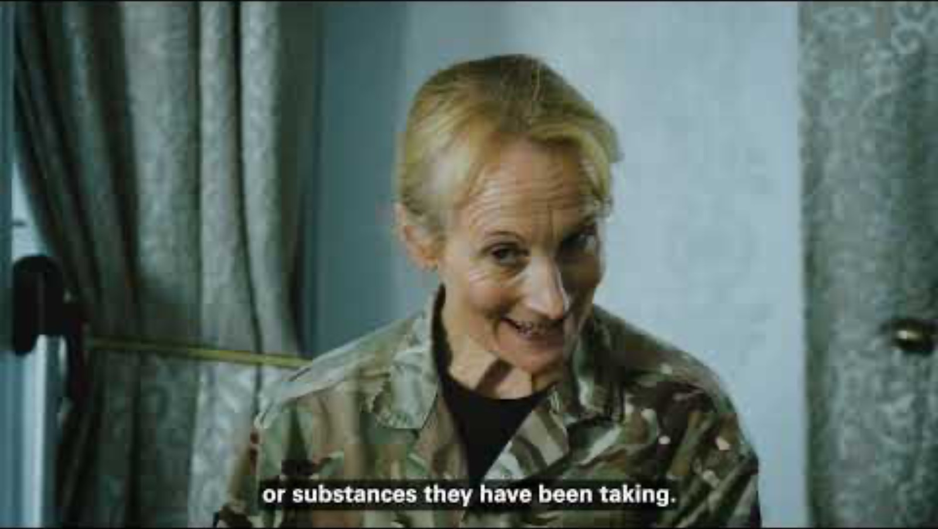
1: CIVILIAN TRANSPORT
2. UNDER THE INFLUENCE
3. COMMS BREAKDOWN
Notes:
Deliver​
Students listen carefully to each briefing, which includes important observational details about involved parties' behaviour and their immediate environment, including potential risks of communication breakdown, escalation of negative behaviour and any objects might be used as weapons.​
​
Students complete the worksheets to first record the salient details from one or more briefings, and then to plan their response, which they may role-play in groups or to the class.​
​​
Add support​
Use one scenario to discuss and model a response, before students listen to and develop their own response to another scenario.​
​
Add challenge​
Treat as a memory task and see how many details students can remember from each briefing.
Video links
Civilian transport: https://www.youtube.com/watch?v=bLrG1XQtRfM
Under the influence: https://www.youtube.com/watch?v=WPuGFTqL6H8
Comms breakdown: https://www.youtube.com/watch?v=K-lJoVijoQ4

Slide 30
DEFUSE THE TENSION
Plan what you would say and do to defuse the tension in one scenario.
Record your observations. Use these to identify possible causes and plan what you will say and do.
Scenario:
Observations:
Possible environmental causes:
Possible behavioural causes:
Reasons to empathise:
Scenario:
Positive attitude – what I will think and feel:
Positive communication – what I will say:
Positive communication – what I will do:
Notes:
Print copies for students.

Slide 31

COMMS CHALLENGE:
HOLD A DEBRIEF
RADIO CALL
Plan and read a radio call to explain what you did to defuse one high-tension situation.
Use your completed ‘Defuse the tension’ activity sheet to inform what you say.
Your radio transmission is for your headquarters.
Use prowords and phonetics as required. Remember ABCD.
Notes:
Deliver
This slide supports an additional communication task within the workshop. Students will require prior learning about standard voice procedure and prowords when communicating by radio. If you have not covered this content, skip this slide and task.
Use the slide after delivering the high-tension activity. The radio call should summarise the written notes students make using the 'Defuse the tension' activity sheet on slide 30.
​
Digital classroom​
Students can use radio equipment, walkie-talkies or mobile phones to relay their transmission.
​
Add support​
Discuss together how to use the completed activity sheet to structure their radio transmission. Review which prowords students should use to open the transmission, share information and end the transmission.
​
Add challenge​
Students work independently.

Slide 32
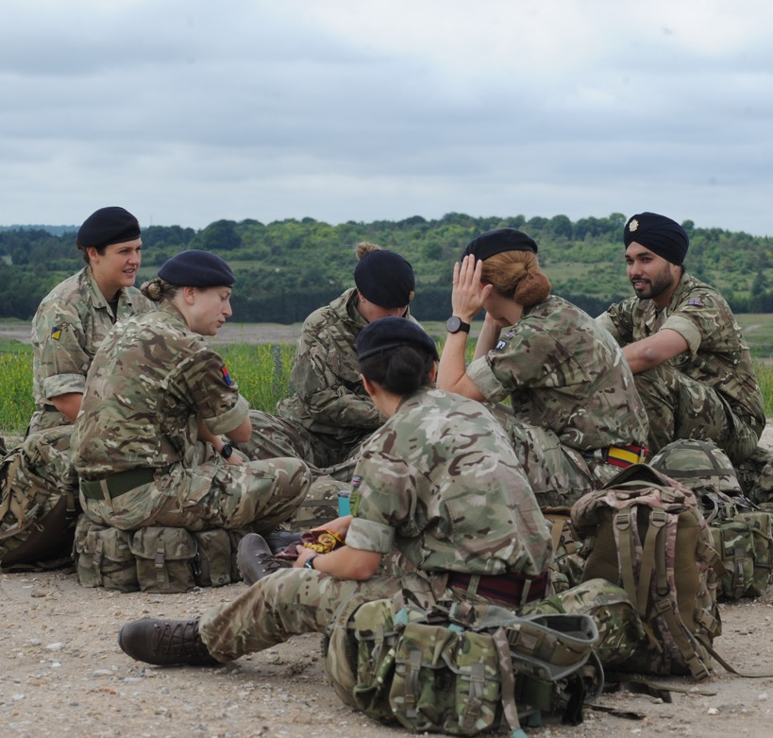

REFLECT AND MOVE FORWARD
Your Section is having a well-earned rest.
While their memories are fresh, you want to help them to learn from their experiences and develop as a team.
Select and read a team member report card.
Suggest how you will use motivation, training, coaching and mentoring to help them develop their teamworking skills and qualities.
Notes:
Deliver​
Congratulate students. It has not been easy. It took time for teams to gel and perform well together. Their tasks were difficult and in unsafe, uncertain circumstances. Many high-tension situations emerged and needed to be defused.​
​
However, students were able to apply their understanding of team selection, development, and leadership, and of defusing high-tension situations.​
​
The soldiers are resting. Every one of them has shown many positive qualities. However, each has also demonstrated several areas for development.​
​
Briefly review the role of each form of development.​
​
Add support​
Ensure learners have their materials on motivating, training, coaching and mentoring. Students choose one soldier to consider.​
​
Add challenge​
Groups collectively address all four soldiers’ areas for development.

Slide 33
AREAS FOR DEVELOPMENT
RICK
Easily shows frustration
Poor personal admin skills
Can be unreliable
Unprofessional use of humour at times
Select a team member to develop.
LIZ
Is easily stressed or overwhelmed
Can be distracted from task
Must communicate with greater clarity
Needs better attention to detail
SASHA
Needs to accept and act on feedback
Does not appreciate own skills and strengths
Lack of physical fitness
Must take better personal responsibility
NISHA
Does not carry out own share of the work
Lack of engagement with the task
Needs to improve listening skills
Must show more consideration for others

Slide 34
REFLECT AND MOVE FORWARD
Team member:
Motivation:
Training:
Coaching:
Mentoring:
Notes:
Print copies for students.

Slide 35

COMMS CHALLENGE:
WRITE A FORMAL DEBRIEF
ON PERSONAL DEVELOPMENT
Write a formal, one-page document outlining one soldier’s areas for development.
Your opening paragraph should summarise the soldier’s areas for development that were identified.
Then, turn each box on your completed 'Reflect and move forward' activity sheet into a short paragraph focused on motivation, training, coaching or mentoring.
End by wishing the soldier well in their future development.
Notes:
Deliver
This slide supports an additional communication task within the workshop. If you have not covered this content, skip this slide and task.
Use the slide after delivering the soldier development task. The document should be based on the notes students make on the 'Reflect and move forward' activity sheet on slide 34.
​
Digital classroom​
Students can organise and share their ideas using an online document.
​
Add support​
Discuss together how to use the completed activity sheet to structure their report. Review which prowords students should use to open the transmission, share information and end the transmission. Some students could use a writing frame to structure their report.
​
Add challenge​
Students work independently.

Slide 36
LEARNING OUTCOMES
You will be able to:
Apply Belbin’s nine team roles to justify team selections.
Identify solutions to barriers to effective teamwork.
Explain how a leader would apply Adair’s theory of leadership to support a team through a task.
Demonstrate how to defuse high-tension situations within and external to a team.
Suggest ways to motivate, train, coach and mentor team members.
Notes:
Deliver​
Review the learning outcomes once more.​
​
Students can reflect using red/amber/green, a 1–5 rating or emojis, to help them complete the final self-evaluation task that follows.

Slide 37
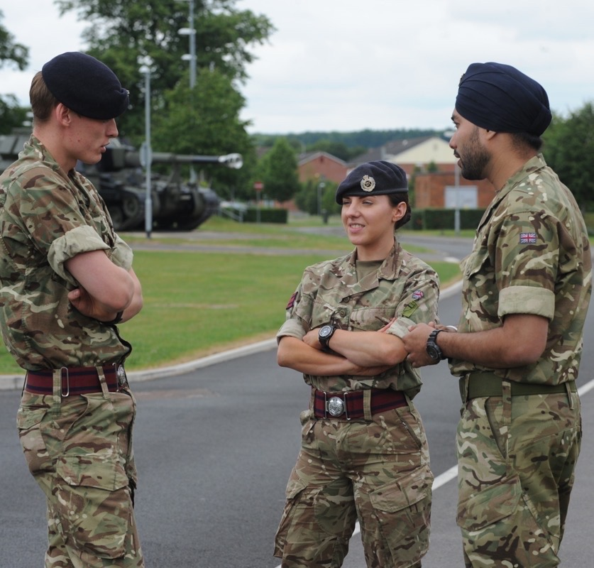

TIME TO REFLECT
This workshop has helped you to apply your knowledge and skills in teamworking, team development and defusing tension.
You will need this knowledge and skill in your career within the Uniformed Protective Services.
Reflect on what you have done and learned today.
Notes:
Deliver​
Remind students that they were primed to think about for areas for reflection and self-evaluation.​
​
If time permits, invite students to share how their activities today might help them in their career in any Uniformed Protective Service.​
​

Slide 38
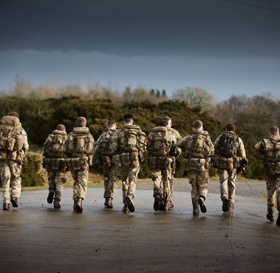

TIME TO REFLECT
Reflect on the questions below. If you like, invite a peer to share their observations.
Identify:
What you are proud of
What learning you found easiest to apply
What learning you would like to reinforce
Any other ways you would like to improve, and how you could achieve this
Notes:
Deliver​
Invite students to make notes in their own books, or print the reflection sheet on the next slide. ​
​
Digital classroom
Students can complete a digital version of the printable worksheet slide. They could share feedback as a class using an online whiteboard or notes tool.​
​
Add support​
Discuss each question sequentially as a class.​
​
Add challenge​
Students complete independently and can work in pairs or their groups to include constructive peer feedback.

Slide 39
TIME TO REFLECT
I am proud I did these things well:
Learning I found easy to apply:
Learning I would like to reinforce:
Other actions I will take to improve:
Notes:
Optionally print copies for students.​

Slide 40
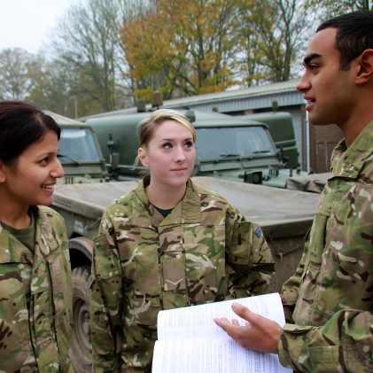
COMMS CHALLENGE:
EXTENSION:
AREAS TO DEVELOP
Write a formal report to a superior officer on what you have identified as your own areas to develop, after reflecting on your workshop performance.
Think about how you will begin your report.
Use your completed ‘Time to reflect’ activity sheet. Turn each box into a short paragraph.
Think about how you would end this formal report.
Notes:
Deliver
This slide supports an additional communication task after the workshop. If you have not covered this content, skip this slide and task.
Digital classroom​
Students can organise and share their ideas using an online document.
​
Add support​
Discuss together how to use the completed activity sheet to structure their report. Some students could use a writing frame to structure their report.
​
Add challenge​
Students work independently. Students could write their report about a peer and then present their report back to that person.

Slide 41

COMMS CHALLENGE:
EXTENSION:
PRESS AND SOCIALS
Draft a short press release and a social media post about the Army’s response to the flooding.
Visit army.mod.uk/news-and-events to see how the Army structures its press releases.
Visit instagram.com/britisharmy to see how the Army writes and tags social media posts.
Notes:
Deliver
This slide supports an additional communication task after the workshop. If you have not covered this content, skip this slide and task.
​
Digital classroom​
Students can organise and share their ideas using an online whiteboard or notes.​
​
Add support​
Open the links and review an example press release and social media post. Identify the structure, length and tone of each. List together some topics or outcomes from the workshop that students could include in a report about the Army’s response.
​
Add challenge​
Students work independently. Some could turn their press release into a video news report segment.

