Slide 1

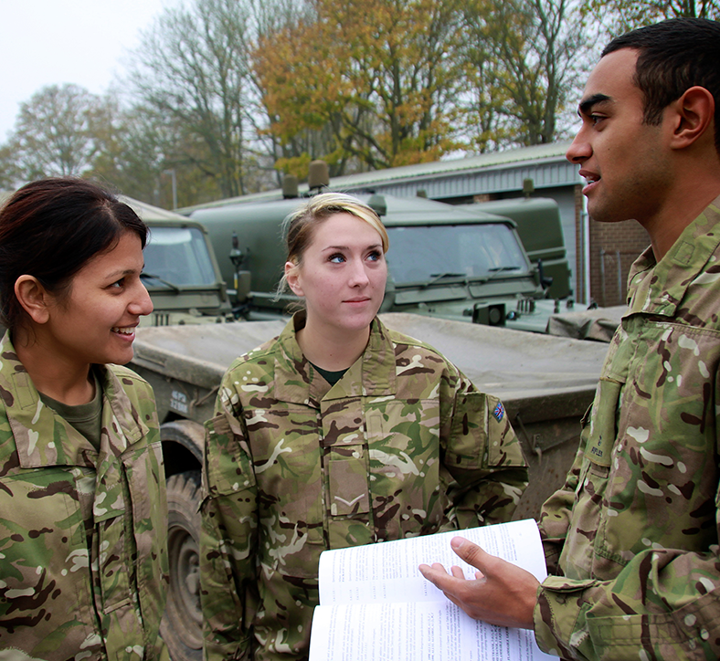
UPS L3 diploma,
Unit 5: C1
UNIFORMED
PROTECTIVE
SERVICES
COMMUNICATION
SESSION 1: INTRODUCTION TO COMMUNICATION
(PART 1)

Slide 2
ABOUT THE BASE UPS RESOURCES
​Overview​
British Army Supporting Education (BASE) is an education programme from the British Army. It includes a website hub providing free-to-use engaging teaching resources, work experience and inspiring workshops.
This lesson is designed to support teaching of Uniformed Protective Services L3 BTEC. You can deliver just one of the sessions, or multiple as best suits.​​
Key information​
Age: 16–18​
Time: 120 minutes or 2 x 60 minutes​
Subject: UPS, Personal Development​
Preparation:​
Print copies of slides as shown in the session overviews
Plain or scrap A4 paper, or sticky notes
Key vocabulary:​
See slide 5
UPS curriculum links
This session covers Unit 5 C1 Types and Methods of Communication.
Developed by experts​
This programme has been developed in partnership with Hark and a panel of subject matter experts and practising teachers.​
Using this presentation​
Teachers’ notes slides will not display in presentation mode.​
Student slides may have animation – view in presentation mode to see all content. ​
Slide notes contain further teacher guidance, including sample answers and suggestions for using your preferred digital
classroom tools.
Links to external websites​
Please follow your school’s own internet safety guidelines.

Slide 3
SESSION OVERVIEW, 1 X 120 MINUTES
​Learning objective: to explore what it means to communicate well in a range of Uniformed Protective Services contexts as students develop their verbal communication skills in face-to-face and radio scenarios.
Activity | Slides | Overview | Timings | Preparation and resources required​
Starter and introduction | 6–8 | Learning outcomes/Introducing communication/Five steps in communication.​ | 10 mins | Paper or sticky notes
​Forms of communication | 9–11 | Students suggest and explore forms of communication, including internal/external, formal/informal, verbal/non-verbal. | 25 mins | Sticky notes (optional)
What communication is taking place? | 12–16 | Students identify what forms of communication take place in a range of scenarios. | 25 mins | Print copies of slide 12
F2F communication | 17–19 | Students explore verbal and non-verbal features of face-to-face communication. | 15 mins | Audio recordings on slide 18–19
F2F communication skills | 20–27 | Students model effective face-to-face communication in a range of scenarios. | 30 mins | Print copies of slides 25–26
Plenary and extension tasks | 28–30 | Summary/Learning outcomes/Extension tasks. | 15 mins
Notes:
Session overview when delivered as 1 x 120 minute session.

Slide 4
SESSION OVERVIEW, 2 X 60 MINUTES
​Learning objective: to explore what it means to communicate well in a range of Uniformed Protective Services contexts as students develop their verbal communication skills in face-to-face and radio scenarios.
Activity | Slides | Overview | Timings | Preparation and resources required​
Starter and introduction | 6–8 | Learning outcomes/Introducing communication/Five steps in communication.​ | 10 mins | Paper or sticky notes
​Forms of communication | 9–11 | Students suggest and explore forms of communication, including internal/external, formal/informal, verbal/non-verbal. | 25 mins | Sticky notes (optional)
What communication is taking place? | 12–16 | Students identify what forms of communication take place in a range of scenarios. | 25 mins | Print copies of slide 12
Activity | Slides | Overview | Timings | Preparation and resources required​
F2F communication | 17–19 | Students explore verbal and non-verbal features of face-to-face communication. | 15 mins | Audio recordings on slide 18–19
F2F communication skills | 20–27 | Students model effective face-to-face communication in a range of scenarios. | 30 mins | Print copies of slides 25-36
Plenary and extension tasks | 28–30 | Summary/Learning outcomes/Extension tasks. | 15 mins
Notes:
Session overview when delivered as 2 x 60 minute sessions.

Slide 5
VOCABULARY
Communication | The exchange (swapping) of information.
Convey | To transfer e.g. to share information when communicating.
External | Outside of e.g. communicating with another uniformed service or with the general public.
Formal | Something that is official or done in a professional way.
Gesture | A movement of part of the body to communicate information or an emotion.
Informal | Something that is relaxed or unofficial.
Internal | Within e.g. communicating within the same uniformed service.
Non-verbal | Communication that does not include words e.g. images, posture or gestures, tone of voice.
Posture | How you hold your body, and part of non-verbal communication.
Receive | In communication, to listen or read carefully.
Respond | Say or write something in reply.
Understanding | To know correctly what the other person means.
Verbal | Communication using words.
Notes:
Display or print the key vocabulary and definitions (optional). You can adapt the definitions if necessary.

Slide 6

LEARNING OUTCOMES
You will be able to:
Explain a simple model of effective communication.
Identify forms of communications as formal/informal, internal/external, verbal/non-verbal.​
Demonstrate face-to-face verbal communication skills including body language, tone and word choice.
Evaluate your communication skills.
Notes:
Deliver
​Review the learning outcomes with students. These are repeated at the end of the lesson to support reflection and self-evaluation.

Slide 7




WHAT IS COMMUNICATION?
Communication is the exchange (swapping) of information.
When and how do you communicate?
What does communication include?
What do you do to communicate well?
Organise these steps into a simple model of communication:
Receive
Respond
Convey
Plan
Check Understanding
Notes:
Deliver
Use the questions on the slide to introduce the idea of communication.
Students can complete as a think-pair-share task or add their ideas to sticky notes to organise on your board.
​
Digital classroom​
Students can organise and share their ideas using an online whiteboard or notes.​
​
Add support​
Use these additional questions:
In what situations should you consider how you communicate?
How do you communicate at these times? (E.g. verbally, email, message, a document.)
How do you make sure you say what you mean?
How do you know the receiver understands what you mean?
Students write the five steps on sheets of paper or sticky notes to organise them.
​
Add challenge​
Ask students to role-play organising to meet up after college. Freeze their conversation at points that help you illustrate the steps on the board to help students organise them.

Slide 8
WHAT IS COMMUNICATION?
Effective communication depends on every step.
Discuss how communication is affected when each step is missing.
What can you do to check understanding?
Name as many forms of communication in the UPS as you can.
Check Understanding
Plan
Convey
Receive
Respond
Notes:
Deliver
Work through the five steps in the correct order. Discuss how ‘planning’ might apply to different forms, e.g. a message, a conversation, an email or document.
Who needs to be involved at each step?
Plan: Sender
Convey: Sender
Receive: Receiver
Respond: Receiver
Check understanding: BOTH – this is important.
Assign one step to groups or pairs and ask them to identify possible problems if this step is omitted.
Discuss ways to check understanding e.g. repeat message back.
Give groups one minute to list as many forms of communication as they can. This can include technologies (e.g. messages, emails, radio) and purposes (a report, a form, a verbal message etc).
Share ideas.
Compare and contrast ideas from different services.
​
Digital classroom​
Students can organise and share their ideas using an online whiteboard or notes.​

Slide 9
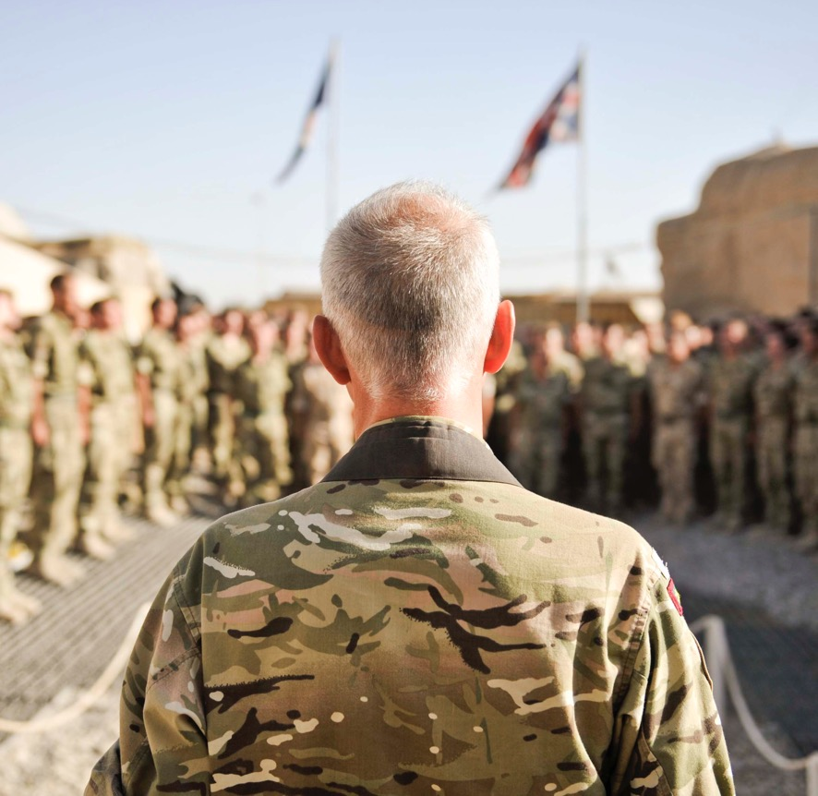
COMMUNICATION IN THE UNIFORMED
PROTECTIVE SERVICES
Internal or external?
Internal communication takes place within the same service.
External communication is with people or groups outside of the service, for example cross-service, with the press or with the public.
Notes:
Deliver
This and the next two slides review different forms of communication.
Invite students to generate examples of each of the two forms of communication on each slide, on sticky notes or verbally, to form lists.
Image source: https://www.defenceimagery.mod.uk/ 45152440.jpg

Slide 10
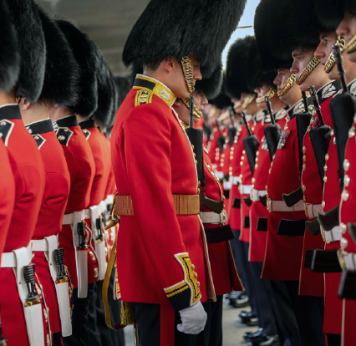
COMMUNICATION IN THE UNIFORMED
PROTECTIVE SERVICES
Formal or informal?
Formal communication is used for official purposes. It follows a specific format and is professional in tone and language.
Informal communication is for casual interactions. It is less structured and uses everyday language.
Notes:
Deliver
Invite students to generate examples of each of the two forms of communication on each slide, on sticky notes or verbally, to form lists.
Image source: https://www.defenceimagery.mod.uk/ AHQCPL11-OFFICIAL-20230617-031-015.jpg

Slide 11
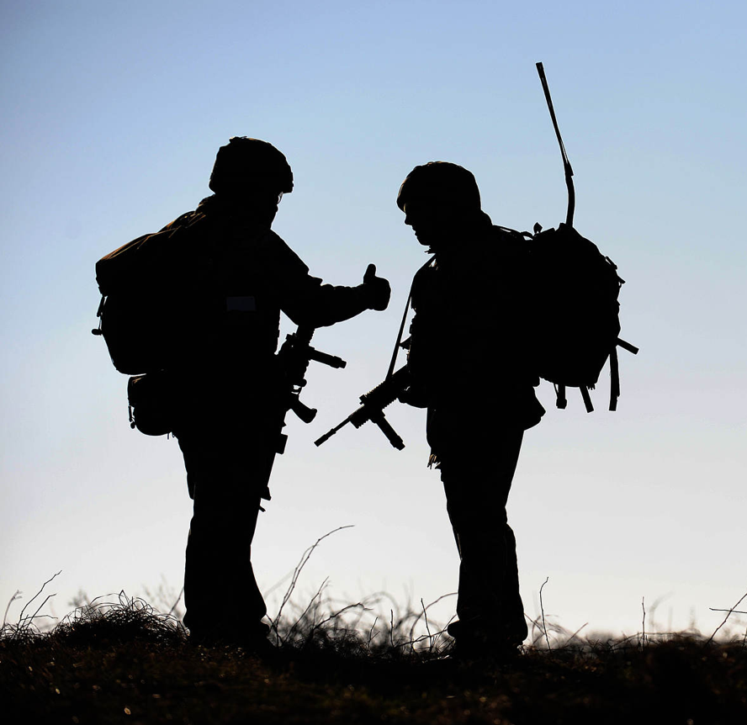
COMMUNICATION IN THE UNIFORMED
PROTECTIVE SERVICES
Verbal or non-verbal?
Verbal communication uses words.
Non-verbal communication uses posture and gestures. It might also use images or sounds. It takes place alongside verbal communication or may happen without the use of words e.g. signs or alarms.
Notes:
Deliver
Invite students to generate examples of each of the two forms of communication on each slide, on sticky notes or verbally, to form lists.
Review how any form of communication fits into this matrix of formal/informal, internal/external and verbal/non-verbal.
Support
Ask students to reflect on how an example they have shared for one pair (e.g. formal/informal) is also reflected in the other pairs (e.g. it may be also be internal or external).
Challenge
Use copies of the printable slide for the next activity to ask students to organise their own ideas in the same way.
Image source: https://www.defenceimagery.mod.uk/ 45153574.jpg

Slide 12
WHAT FORMS OF COMMUNICATION
ARE TAKING PLACE?
Tick the boxes to show which types of communication are taking place in each scenario.
 | Formal | Informal | Internal | External | Verbal | Non-verbal
A face-to-face briefing from a Unit commander.
Battlefield communications within an infantry squad.
Battlefield communications between Divisions.
A press release to print, online and TV news outlets.
Cooperation and joint planning with civilian UPS when providing disaster assistance after a flood.
Advising or ordering members of the public when providing disaster assistance after a flood.
Notes:
Print copies of this worksheet for students, ready to use in the next activity.

Slide 13


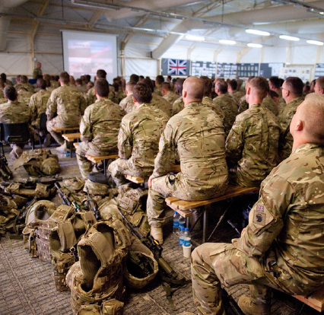
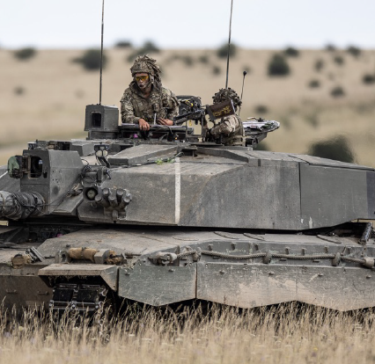
WHAT COMMUNICATION IS TAKING PLACE?
Identify whether each form of communication is formal/informal, internal/external, and verbal and/or non-verbal.
Battlefield communications within an infantry squad.
A face-to-face briefing from a Unit commander.
Notes:
Deliver
Students use the printable activity sheet to identify how each form of communication is formal/informal etc.
Work through this and the next two slides and then share suggestions.​ Students should begin to understand that all six categories exist at once.
​
Digital classroom​
Students can organise and share their ideas using an online whiteboard or notes.​
​
Add support​
Discuss as a class as you go or ask students to first think in pairs before feeding back to the class.
​
Add challenge​
Students complete the activity sheet independently as you go though the examples on the slides. Students could think of their own examples.
Image source: https://www.defenceimagery.mod.uk/ 45154541.jpg and AHQSSGT-OFFICIAL-20230725-005-388.jpg

Slide 14

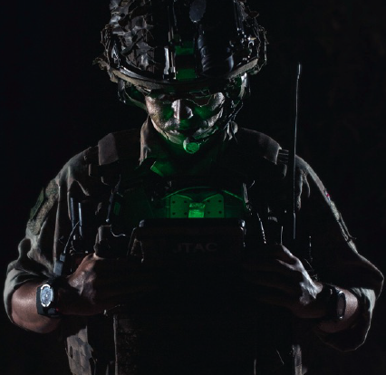
WHAT COMMUNICATION IS TAKING PLACE?
Identify whether each form of communication is formal/informal, internal/external, and verbal and/or non-verbal.
Battlefield communications between Divisions.
A press release to print, online and TV news outlets.
Notes:
Deliver
Students use the printable activity sheet to identify how each form of communication is formal/informal etc.
Image source: https://www.defenceimagery.mod.uk/ 45168180.jpg and https://www.shutterstock.com

Slide 15
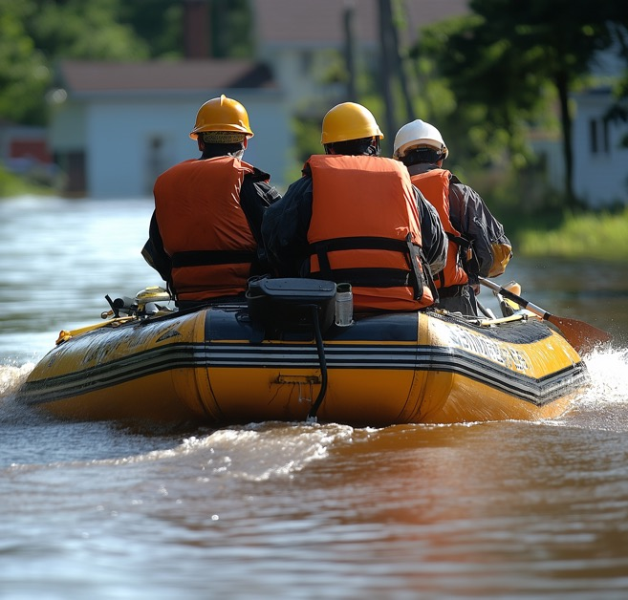
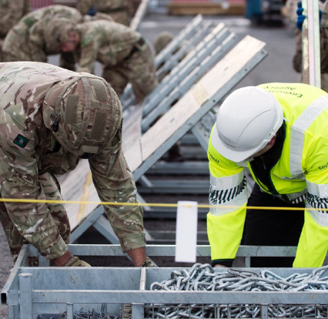
WHAT COMMUNICATION IS TAKING PLACE?
Identify whether each form of communication is formal/informal, internal/external, and verbal and/or non-verbal.
Cooperation and joint planning with civilian UPS when providing disaster assistance after a flood.
Advising or ordering members of the public when providing disaster assistance after a flood.
Notes:
Deliver
Students use the printable activity sheet to identify how each form of communication is formal/informal etc.
If splitting this session across two lessons, take time to briefly revisit the learning outcomes slide and assess progress against the first two outcomes.
Students could complete the Army Jobs website research task on the final slide of this presentation or research websites from other Uniformed Protective Services.
Image 2 source: https://www.shutterstock.com

Slide 16
WHAT FORMS OF COMMUNICATION
ARE TAKING PLACE?
Tick the boxes to show which types of communication are taking place in each scenario.
 | Formal | Informal | Internal | External | Verbal | Non-verbal
A face-to-face briefing from a Unit commander. | ✓ |  | ✓ |  | ✓ | ✓
Battlefield communications within an infantry squad. |  | ✓ | ✓ |  | ✓ | ✓
Battlefield communications between Divisions. | ✓ |  | ✓ |  | ✓ | ✓
A press release to print, online and TV news outlets. | ✓ |  |  | ✓ | ✓
Cooperation and joint planning with civilian UPS when providing disaster assistance after a flood. | ✓ |  |  | ✓ | ✓ | ✓
Advising or ordering members of the public when providing disaster assistance after a flood. |  | ✓ |  | ✓ | ✓ | ✓
Notes:
Deliver
Review suggested answers. These are suggested only.
If students have different answers, discuss why this is.
Note how many forms include both verbal and non-verbal components, which might include tone, body language, etc.

Slide 17
UPS L3 diploma,
Unit 5: C1
UNIFORMED
PROTECTIVE
SERVICES
COMMUNICATION
SESSION 1: INTRODUCTION TO COMMUNICATION
(PART 2)

Slide 18
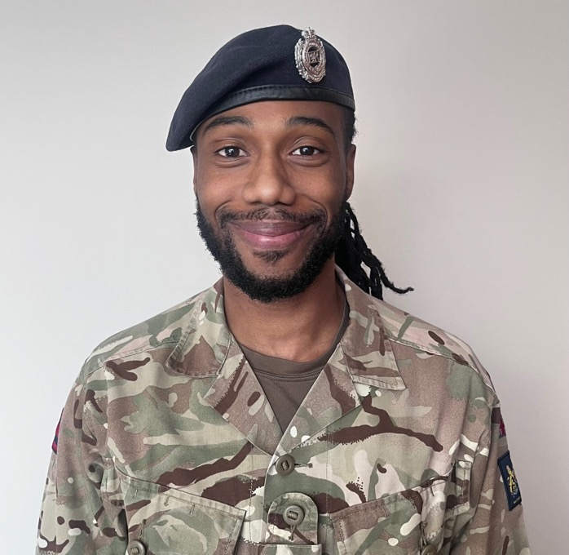

VERBAL COMMUNICATION
FACE-TO-FACE SKILLS
How do we use language when we communicate?
Think about how a person’s tone of voice and choice of words can change depending on the situation.
How can the choice of words change the communication?
How can tone of voice affect the communication?
Model different language and tone and reflect
on what it communicates.
Hear from Cpl Carlington Reid on communication
Notes:
Deliver
Before you begin, ask students to recall an example of formal/informal, internal/external and verbal/non-verbal communication. Students discuss in groups or pairs and then report back.
Review the questions on the slide.
Invite students to first model different choices of language (warn against using anything inappropriate for the classroom). This can be a challenge for some students to accept that their colloquial use of language with their peers is not appropriate in many internal communication scenarios, nor when dealing with the public. For example, how would they ask someone to move out of the way?
Then ask them to model using different tones of voice. For example, take ‘Please can you move out of the way’ and then say it using different tones, including as a question and as a command.
Note the difference between being assertive (which shows confidence and is appropriate) and aggressive (which is confrontational and is never appropriate). Note how aggressive language can have negative consequences both internally between colleagues and externally with a member of the public.
Listen to the audio case study on communication in the Army.
​
Digital classroom​
Students can organise and share their ideas using an online whiteboard or notes.​ They can record video of different uses of language and tone of voice.
​
Add support​
Suggest ways to use language, for example in conversation with a friend, talking to a tutor, or talking with a member of the services when on work experience or a visit. Suggest tones to use, for example: nervous, questioning, confident or assertive, and aggressive.
​
Add challenge​
Ask students to generate and share more ideas of their own.

Slide 19
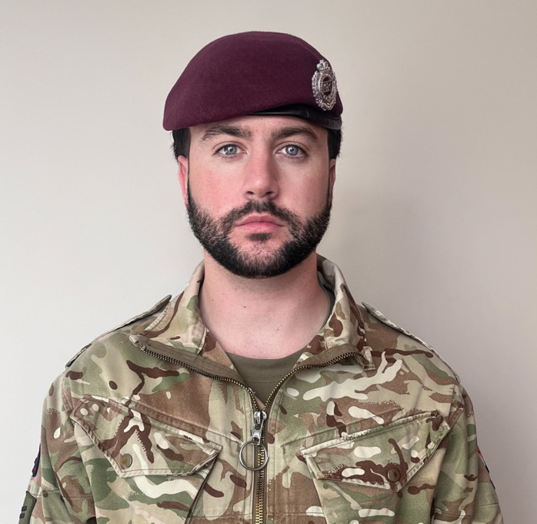
NON-VERBAL COMMUNICATION
FACE-TO-FACE SKILLS
How do we use body language and gestures when we communicate?
Think about how a person’s posture and movements change depending on the situation.
What can a person’s posture say?
What can their eye contact say?
What can gestures say?
Model different postures and gestures and reflect
on what they communicate.
Hear from Cpl George Stag on communication
Notes:
Deliver
Now introduce the importance of body language, eye contact and posture.
Invite a ‘line up’ of students to model different postures and gestures for students to interpret. Faces might represent happy, sad, angry, fearful, for example. Postures and gestures could represent fearful, confident, aggressive, relaxed, alert.
Discuss how variations in eye contact can say a lot:
Constant contact may be linked to fear or aggression.
The ‘right’ amount can indicate a normal or assertive conversation.
Looking down – nervous or unsure.
Avoiding contact – possible lying.
Listen to the audio case study on communication in the Army.
Digital classroom​
Students can organise and share their ideas using an online whiteboard or notes.​
​
Add support​
Write emotional states on separate pieces of paper for students to hand to the correct ‘models’.​
Add challenge​
Ask students to demonstrate gestures they might need when interacting with the public: to stop, warn, reassure, give choices, direct to do something, etc.

Slide 20
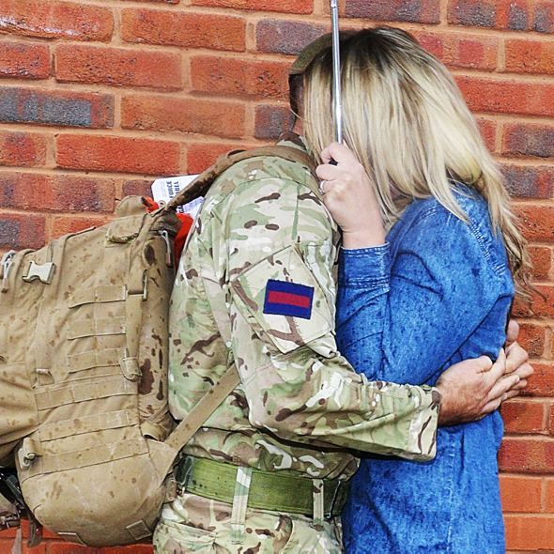
FACE-TO-FACE COMMUNICATION
MISSING PERSON
SCENARIO
You are seeking a missing person. Use A-H to describe a celebrity to a colleague, as if briefing for a search:
A – age
B – build
C – colour, clothing
D – distinguishing marks
E – elevation (height)
F – face
G – gait (how they walk), gender
H – hair
Notes:
Deliver
Students should use the printable worksheet on slide 25 to plan their communication in one or more scenarios and then deliver to the class or a smaller group.
Assign one scenario to each student (there are five). Print the summary slide that follows.
Give students time to plan and present their communication.
Invite students to:
Provide constructive feedback to one another.
Identify what they would do better next time to improve their communication skills.
​
Digital classroom​
Students can organise and share their ideas using an online whiteboard or notes.​
​
Add support​
Work through the examples. Use yourself as a model or ask for a volunteer. Students explain how to talk and what posture and gestures are appropriate. Do what they say and ask for more information or feedback to improve your demonstration until students are happy.
​
Add challenge​
In preparation for the second part of this resource where students explore radio communications, discuss what non-verbal information is missing and review the body language students demonstrated.

Slide 21
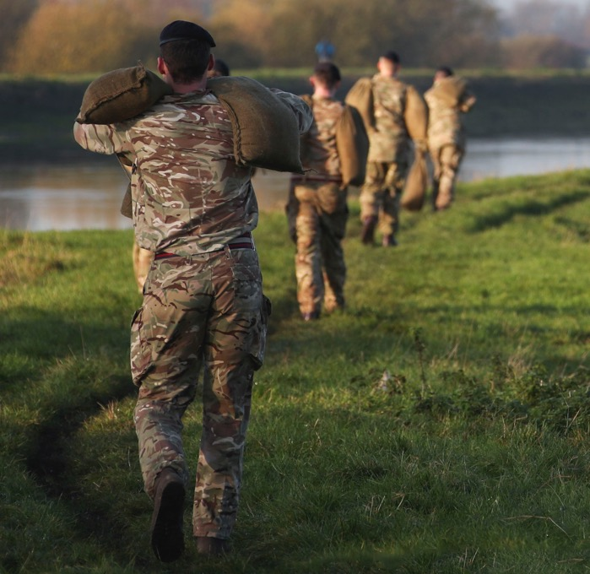
FACE-TO-FACE COMMUNICATION
FLOOD RELIEF 1
SCENARIO
You are providing flood relief. A cooperative civilian has asked where they can shelter.
Food, beds and blankets are being delivered to a nearby sports hall.
People are being evacuated from the end of this road and will be taken by bus in 15 minutes. If their home is not flooded, it is OK to gather essentials like medicines and a phone. If the home is at immediate risk, then they must not return.
Ask them which end of the road they live in and if any family members are still at home.
Notes:
Deliver
Please see previous slide.

Slide 22
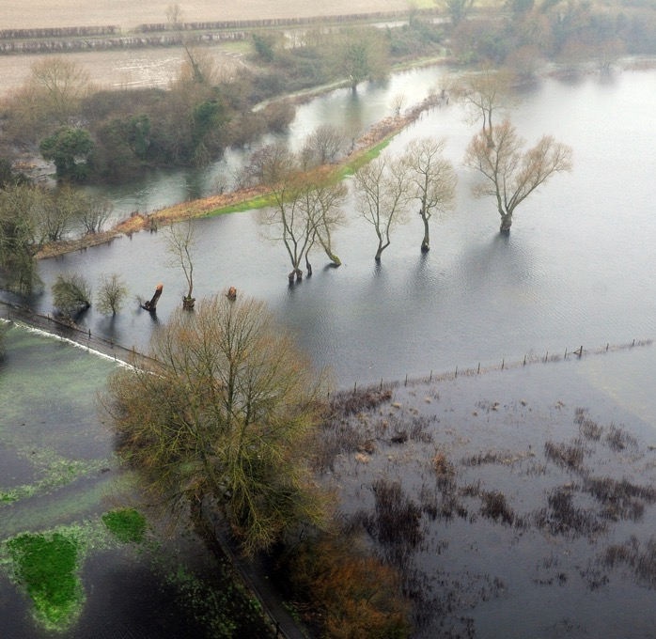
FACE-TO-FACE COMMUNICATION
FLOOD RELIEF 2
SCENARIO
You are providing flood relief. A civilian is refusing to leave their home, which is at immediate risk of flooding.
You must order them to gather any essentials like a phone or medicines but to leave all other personal belongings.
They have two minutes to find these, after which you will escort them to safety.
They insist that they have the right to stay, to protect their belongings.
Notes:
Deliver
Please see previous slide.

Slide 23
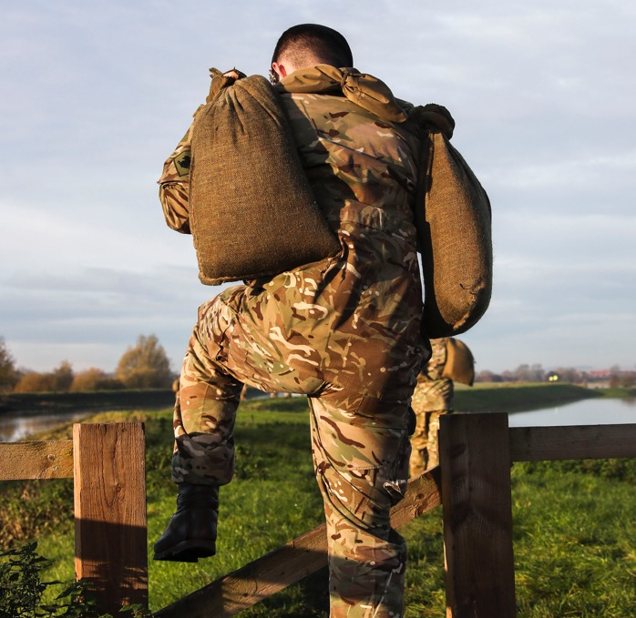
FACE-TO-FACE COMMUNICATION
FLOOD RELIEF 3
SCENARIO
You are providing flood relief. A civilian is refusing to leave their home, which is at immediate risk of flooding.
You must order them to gather any essentials like a phone or medicines but to leave all other personal belongings.
They have two minutes to find these, after which you will escort them to safety.
The civilian, who is elderly, has limited understanding of English. They are confused and afraid.
Notes:
Deliver
Please see previous slide.

Slide 24
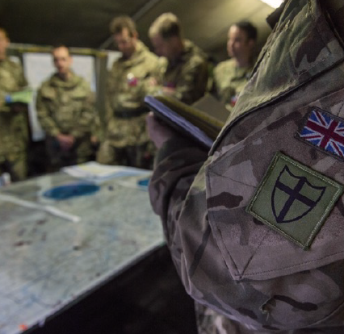
FACE-TO-FACE COMMUNICATION
FLOOD RELIEF 4
SCENARIO
The flood relief operation is complete. You are providing a debrief to your commanding officer.
You must explain that all the residents of your assigned area have been evacuated to a place of safety.
All are accounted for apart from the residents of one house. Neighbours are unsure whether they are visiting relatives or just out locally.
You are cooperating with the police to trace where they are and get in contact. The police hope to have an answer by 8pm.
Notes:
Deliver
Please see previous slide.

Slide 25
PLAN YOUR FACE-TO-FACE COMMUNICATION
Plan how you would communicate well in your assigned scenario.
Be ready to demonstrate and receive feedback on your communication skills.
Posture
Eye contact
Gestures
Formal/informal language and tone of voice
Notes:
Print copies of this worksheet for students.

Slide 26
FACE-TO-FACE COMMUNICATION
Missing Person | Flood Relief 1 | Flood Relief 2 | Flood Relief 3 | Flood Relief 4
You are seeking a missing person. Use A-H to describe a celebrity to a colleague, as if briefing for a search: A – age B – build C – colour, clothing D – distinguishing marks E – elevation (height) F – face G – gait (how they walk), gender H – hair | You are providing flood relief. A cooperative civilian has asked where they can shelter. Food, beds and blankets are being delivered to a nearby sports hall. People are being evacuated from the end of this road and will be taken by bus in 15 minutes. If their home is not flooded, it is OK to gather essentials like medicines and a phone. If the home is at immediate risk, then they must not return. Ask them which end of the road they live in and if any family members are still at home. | You are providing flood relief. A civilian is refusing to leave their home, which is at immediate risk of flooding. You must order them to gather any essentials like a phone or medicines but to leave all other personal belongings. They have two minutes to find these, after which you will escort them to safety. They insist that they have the right to stay, to protect their belongings. | You are providing flood relief. A civilian is refusing to leave their home, which is at immediate risk of flooding. You must order them to gather any essentials like a phone or medicines but to leave all other personal belongings. They have two minutes to find these, after which you will escort them to safety. The civilian, who is elderly, has limited understanding of English. They are confused and afraid. | The flood relief operation is complete. You are providing a debrief to your commanding officer. You must explain that all the residents of your assigned area have been evacuated to a place of safety. All are accounted for apart from the residents of one house. Neighbours are unsure whether they are visiting relatives or just out locally. You are cooperating with the police to trace where they are and get in contact. The police hope to have an answer by 8pm.
Notes:
Print copies of this worksheet for students.
Alternatively, show this slide as students fill in their ‘Plan Your Face-to-Face Communications’ worksheet as an overview of each scenario.
Before moving to the plenary activity, ask students to remind you of the five steps in the model of communication you introduced at the start. [Plan. Convey. Receive. Respond. Check Understanding.]

Slide 27



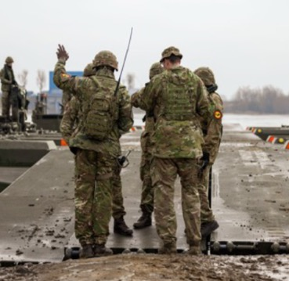
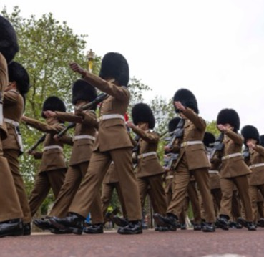
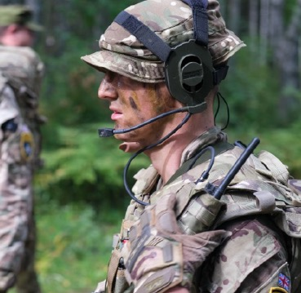
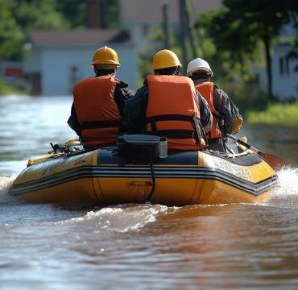
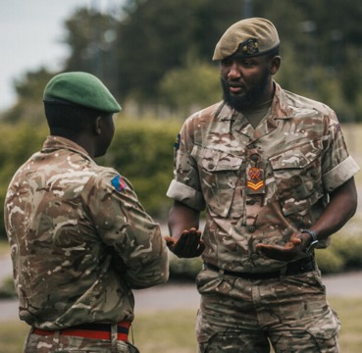
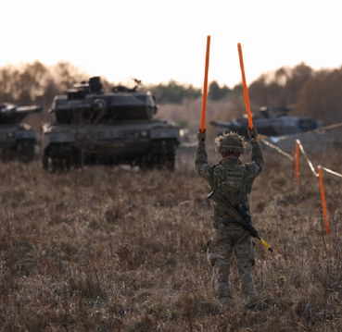

COMMUNICATION IN THE UNIFORMED
PROTECTIVE SERVICES
Formal
Verbal
Internal
Non-verbal
External
Informal
Notes:
Deliver
Briefly review that communication in the Uniformed Protective Services will be a combination of internal/external, formal/informal, and verbal and/or non-verbal.
Ask students to suggest an example of each, including written and spoken examples.
Image source: https://www.defenceimagery.mod.uk/
AHQCPL2-OFFICIAL-20240302-009-060.jpg
APOLOND-OFFICIAL-20230601-056-009.jpg
45167217.jpg
AHQCPL4-OFFICIAL-20240223-012-110.jpg

Slide 28
HOW DO WE KNOW WE HAVE COMMUNICATED?
How well did you apply each step of the communication model?
If you missed a step, what was the effect on your communication?
How could you check your understanding?
What might you do better next time?
How will you apply your understanding in your own day-to-day communication?
Check Understanding
Plan
Convey
Receive
Respond
Non-verbal
Posture, Gestures, Eye contact
Verbal
Language and tone
Notes:
Deliver
Use the slide questions to help students reflect on how well they applied this model as they demonstrated examples of communication.
Review again who needs to be involved at each step:
Plan: Sender
Convey: Sender
Receive: Receiver
Respond: Receiver
Check understanding: BOTH – this is important.
Discuss appropriate phrases that could check understanding in each scenario. These could include:
Asking if the person understands
Asking the person to repeat back what was said, or a summary of it.
Ask students to identify a key insight they will apply to improve their own face-to-face communication. Emphasise the importance of receiving – which highlights the importance of listening to understand – and that checking understanding can often be the responsibility of both the speaker and the listener, for example when giving and receiving instructions or orders.

Slide 29
LEARNING OUTCOMES
You should now be able to:
Explain a simple model of effective communication.
Identify forms of communications as formal/informal, internal/external, verbal/non-verbal.​
Demonstrate face-to-face verbal communication skills including body language, tone and word choice.
Evaluate your communication skills.
Notes:
Deliver
​Review the learning outcomes with students. These are repeated at the end of the lesson to support reflection and self-evaluation. Students can reflect using red/amber/green, a 1–5 rating or emojis.

Slide 30
RESEARCH TASK SUGGESTIONS
Practice using A-H to describe people and SCRIM to describe vehicles during
a face-to-face patrol report:
  S – shape, size
  C – colour
  R – registration
  I – identifying features
  M – make and model
Research the Army jobs website and the Army’s social media feeds or adverts. Identify examples of where formal and informal language are used. Explain why each form has been chosen.
Create a presentation to teach new recruits how to use appropriate body language and posture.
Active listening includes paying attention and questioning for clarification. Go back to the face-to-face communication scenarios. Write three questions you could ask to check understanding in each scenario.
Notes:
Deliver
Students can complete the extension tasks individually or as a paired/group task.
Adapt the requirement to suit your class or each individual.

