Slide 1
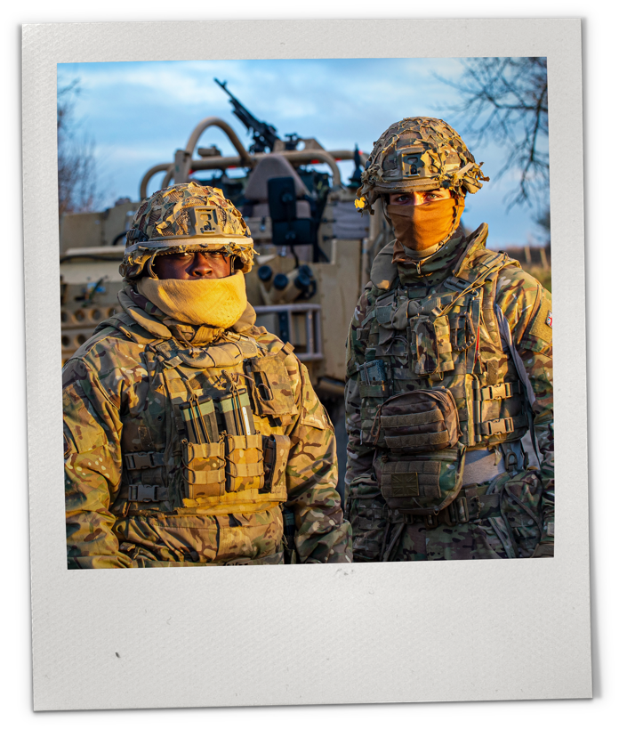




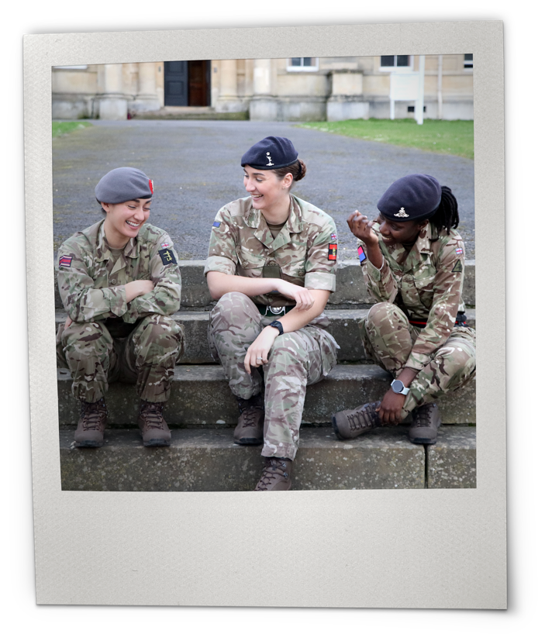




Sessions:
1–2
Subject:
PSHE
Ages:
11–14
DIVERSITY,
BELONGING
AND INCLUSION
IN THE ARMY​

Slide 2


ABOUT THIS RESOURCE
British Army Supporting Education (BASE) is an education programme from the British Army, providing free-to-use engaging teaching resources, work experience and inspiring workshops.
This adaptable resource has been created to support schools in exploring how diversity and inclusion are essential to building a strong community.
Students will gain insight into the initiatives supported by the Army to promote diversity and inclusion. They will also develop essential skills to foster inclusion and diversity as active citizens, leaders, and collaborators in their communities, whether at school, in the workplace, or in the broader world, both now and in the future.​
This presentation covers sessions 1–2.
Make sure to view in presentation mode to see the animation.

Slide 3
KEY INFORMATION
Age: 11–14​
Time:​ 15–20 minutes per session,
with opportunities to extend​
Subject: PSHE ​
Resources: ​
Warm-up activity​ (optional)
Five sessions​
Preparation: ​
Use the warm-up activity to cover core themes and assess the prior knowledge of students.​
Review this presentation, pick and choose content for your setting, and adapt for your students.​
Use the signposting content on final slide for further support.​
Key vocabulary: ​
Inclusion, diversity, belonging, heritage, community, leadership, stereotypes.​
Delivery​
This resource can be delivered:​
as standalone form time activities​
as part of a five-session series​
delivered together in a longer session as part of a theme day.​
​Developed by experts ​
This programme has been developed in partnership with Hark, a panel of subject matter experts and practising teachers. ​
​Using this presentation ​
Slide notes contain further teacher guidance, ideas for support and challenge, sample answers and extension activities are indicated.​
Slide notes will not display in presentation mode. ​
Student slides have animation – view in presentation mode to see
all content. ​
​Links to external websites
Please follow your school’s own internet safety guidelines.​
​Additional PSHE guidance in
slide notes.​
Notes:
For PSHE sessions and sensitive topics, it is important to consider how to handle complex issues in each context, focussing on how to create a safe learning environment:
Identify students for whom the topic may be challenging.
Use distancing in discussion questions, e.g. asking students to think about a young person their age, rather than asking for specific examples from their own lives.
Draw on established ground rules for PSHE sessions to help students focus and respect others’ opinions.
Highlight the signposting at the end of each session, offering students a place to go with any questions or worries.
Provide signposting for teachers in your setting where applicable.

Slide 4


LEARNING OBJECTIVES
By the end of the sessions, students will be able to: ​
demonstrate skills to strengthen diversity and inclusion through a range of approaches
explain why it is important to strengthen diversity and inclusion in any group or organisation
reflect on how everyone can take an active role in supporting diverse and inclusive communities in driving change and challenging barriers.

Slide 5
CONTENT OVERVIEW​​
This presentation covers sessions 1–2.
Content | Timing​ | Resources needed​
Warm-up activity​ | 5–10 minutes | n/a​
Session 1: Community Networks​ | 15 minutes​ | n/a​
Session 2: History​ and Heritage | 15 minutes + project task​ | Internet access for research​ Mini-whiteboards/paper and pens, optional​
Session 3: Challenging Stereotypes​ | 15 minutes + optional extension​ | Printed scenarios, optional​ Mini-whiteboards/paper and pens, optional​
Session 4: Community Voice | 15 minutes + optional extension​
Session 5: Leadership in Action​ | 15 minutes + optional extension​ | Mini-whiteboards/paper and pens, optional​
Signposting​
Notes:
Delivery
This resource can be delivered:
as standalone form time activities
as part of a five-session series
delivered together in a longer session as part of a theme day.

Slide 6

CURRICULUM LINKS
British Values
In addition to the PSHE curriculum links, these sessions touch on several themes from British Values, including democracy/inclusion, tolerance and respect.
England – PSHE – KS3
​Health and Wellbeing
H1. how we are all unique; that recognising
and demonstrating personal strengths build
self-confidence, self-esteem and good health
and wellbeing​.
Relationships
R14. the qualities and behaviours they should expect and exhibit in a wide variety of positive relationships (including in school and wider society, family and friendships, including online).​
​R15. to further develop and rehearse the skills of team working. ​
​R16. to further develop the skills of active listening, clear communication, negotiation and compromise. ​
Living in the Wider World
​L9. the benefits of setting ambitious goals and being open to opportunities in all aspects of life​.
​L10. to recognise and challenge stereotypes
and family or cultural expectations that may
limit aspirations​.
Curriculum links from the PSHE Association Programme of Study for PSHE Education
KS1-KS5.​
Wales – Health and Well-being – Progression Step 4
​Our decision-making impacts on the quality of our lives and the lives of others.
I can consider relevant factors and implications when making decisions individually and collectively.
How we engage with social influences shapes who are and affects our health and well-being.
I have a developing awareness of how rules, norms and behaviours become established within groups and at times go unchallenged.
Healthy relationships are fundamental to our well-being.
​I can respect other people’s points of view and use this to help resolve conflict.
Curriculum links from The Curriculum
for Wales.​
Teachers are encouraged to make these links and discuss with students as relevant within your setting.​

Slide 7

CURRICULUM LINKS
Northern Ireland – Personal Development and Mutual Understanding – KS3
Diversity and Inclusion
Investigate factors including religious and political that influence individual and group identity, for example age, gender, youth culture, ethnicity, community background, multiple identity, changing identities, etc.
Investigate ways in which individuals and groups express their identity, for example dress code, language, musical and sporting traditions, religious and political opinion, beliefs, etc.
Investigate how and why conflict, including prejudice, stereotyping, sectarianism and racism may arise in the community. Investigate ways of managing conflict and promoting community relations, reconciliation.
Democracy and Active Participation
Investigate various ways to participate in school and society, for example school councils, peer mediation, mock elections, volunteering, community action/involvement, lobbying and campaigning through NGOs, local councillors, MLA or MEP, etc.
Self-awareness
Explore personal morals, values and beliefs, for
example the origin of personal values, developing
a moral framework, personal integrity, etc.
Curriculum links from The Northern
Ireland Curriculum.
Scotland – Health and wellbeing – third
and fourth level:
Social wellbeing
I recognise that each individual has a unique
blend of abilities and needs. I contribute to
making my school community one which values individuals equally and is a welcoming place for all.
Representing my class, school and/or wider community encourages my self-worth and
confidence and allows me to contribute to and participate in society.
Through contributing my views, time and talents, I play a part in bringing about positive change in my school and wider community.
Curriculum links from The Curriculum for Excellence.
Cross-Curricular Links
In addition to the curriculum links provided, these resources have cross-curricular links to Oracy, History and the Gatsby Benchmarks.

Slide 8






WARM-UP
The word ‘heritage’ means ‘features belonging to a particular culture such as traditions, legacies, languages or buildings, which have been passed down generations.’ ​
​Why is it important to protect and preserve heritage today?
To help us understand the histories of different cultures.
​To connect with different communities.​
To ensure precious artifacts and stories aren't lost to history.​
To boost a sense of pride and belonging for a given community.​
Notes:
Warm-up
Read question and click to reveal multiple-choice answers to students. Give them up to 30 seconds to consider the answer.
Explain that preserving heritage has a range of benefits.
For example: by preserving and restoring key castles in England, millions of visitors each year are able to learn about the past, connect to English history and reflect on how things have changed today.

Slide 9












WARM-UP
Which of the following are methods for avoiding stereotypes?
Repeat what you see online.
Check your assumptions
with evidence.
Avoid generalising from statistics.
Believe everything that you hear.
Notes:
Warm-up
Read question and multiple-choice answers to students. Give them up to 30 seconds to consider the answer.
Explain that stereotypes are oversimplified beliefs about people or places. Stereotypes can be based on race, age, weight, gender, geographic location or other characteristics. Stereotypes can make it difficult for people to be their true selves.
Share the key vocabulary below with students.
It is important not to make generalisations - they are often inaccurate and can be harmful.
Key vocabulary
Stereotype: A set idea that people have about what someone or something is like https://dictionary.cambridge.org/dictionary/english/stereotype?q=stereotypes#google_vignette
Global Majority: The group of people in the world who do not consider themselves or are not considered to be white https://dictionary.cambridge.org/dictionary/english/global-majority

Slide 10









WARM-UP
The leaders and the deputy leaders. They know the most about the issues.
When decisions are being made that will affect a whole group of people (a school, a community, a country), who needs to be involved in making that decision to ensure that everyone’s voices are represented?
The leaders, deputy leaders and a panel of representatives from the people affected.
The leader.
They are in charge.
The leadership team. They are the experts.
Notes:
Warm-up
Read question and multiple-choice answers to students. Give them up to 30 seconds to consider the answer.
Explain that decision making is a powerful process and can have long-lasting impacts. Explain that by taking into account as many viewpoints as possible, decisions can be made that are inclusive and welcomed by all.
For example: a local school was granted a large pot of funding, and the Headteacher wanted to build a new swimming pool, but asked for a survey to be conducted across all teachers, students and parents. The result of the survey was that students wanted an Astro Turf pitch, teachers wanted a new coffee machine in the staff room, and parents suggested improvements to the school library. In the end, each of these suggestions were able to be implemented, and everyone’s perspectives were taken into account.

Slide 11








WARM-UP
Which of the following is a characteristic of an effective leader?
Listening, being empathetic and guiding members of the team.
Controlling others and what they are doing.
Shouting at the group to issue orders and commands.
Focusing solely on their own personal success.
Notes:
Warm-up
Read question and multiple-choice answers to students. Give them up to 30 seconds to consider the answer.
Explain that there are many different styles of leadership, and it is widely understood that building trust, focusing on inclusion, encouraging diversity and boosting collaboration are key ways to make members of a team feel listened to, understood and able to perform at their best.
For example: after a survey of employees was conducted, the key characteristics that the team admired about their leader was that she was supportive, encouraging and empathetic as well as decisive, punctual and reliable.

Slide 12

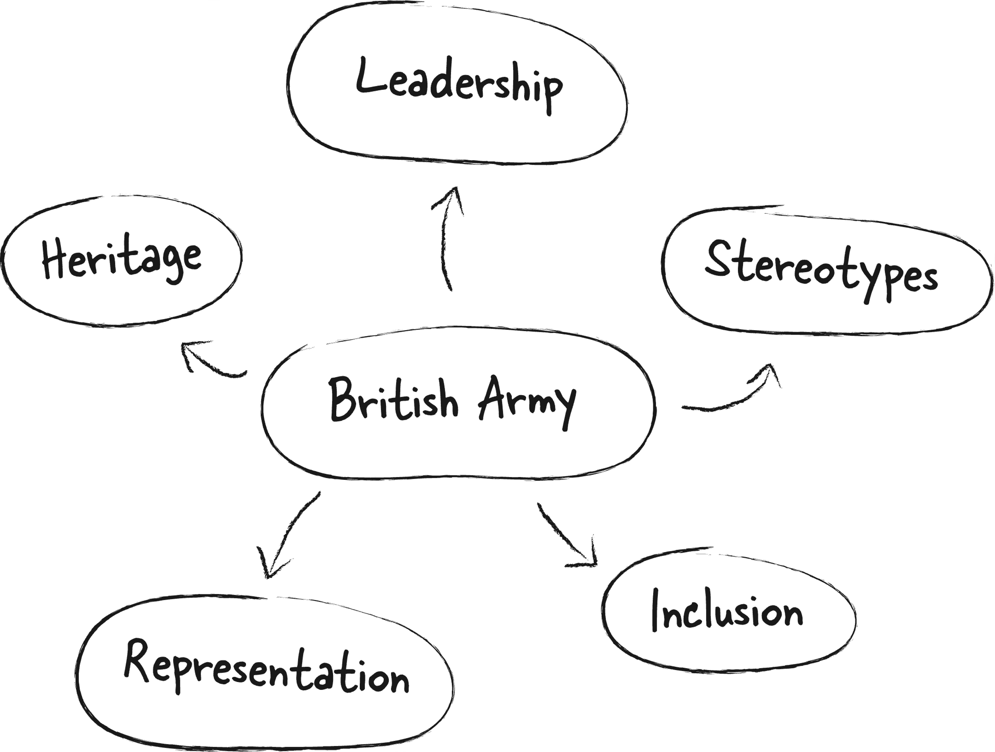
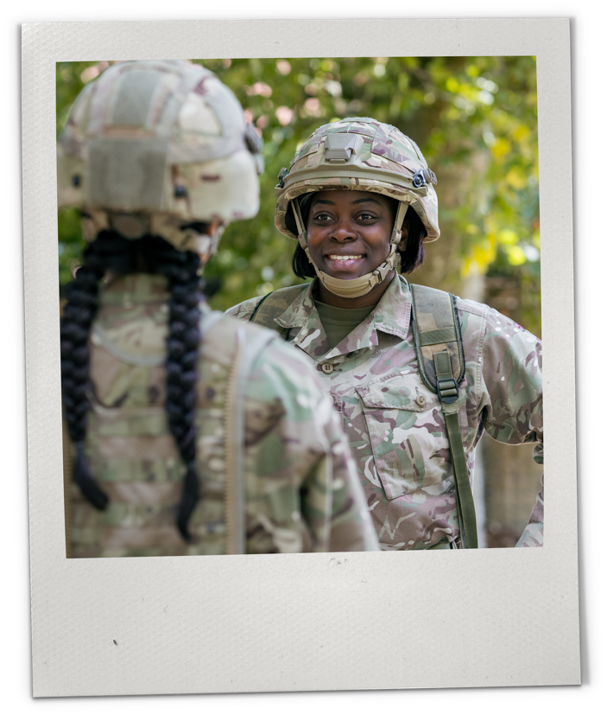

WARM-UP: REFLECTION
The warm-up quiz has introduced some key themes and ideas:
Leadership
Stereotypes
Inclusion
Representation
Heritage
How do you think these themes link to the Army?
Notes:
Warm-up: Reflection (optional activity)
Review quiz themes with students, and create a mind map, or have a verbal discussion to suggest how they think themes might link to the Army. This will be a further indicator of prior knowledge.
Look at some of the key vocabulary below to introduce to students ahead of the sessions.
Key vocabulary
Stereotype: A set idea that people have about what someone or something is like https://dictionary.cambridge.org/dictionary/english/stereotype?q=stereotypes#google_vignette
Inclusion: Providing access to opportunities, support and resources for people who might otherwise be excluded.
Heritage: Features belonging to the culture of a particular society, such as traditions, languages, or buildings, that were created in the past and still have historical importance.
Global Majority: The group of people in the world who do not consider themselves or a not considered to be white https://dictionary.cambridge.org/dictionary/english/global-majority

Slide 13
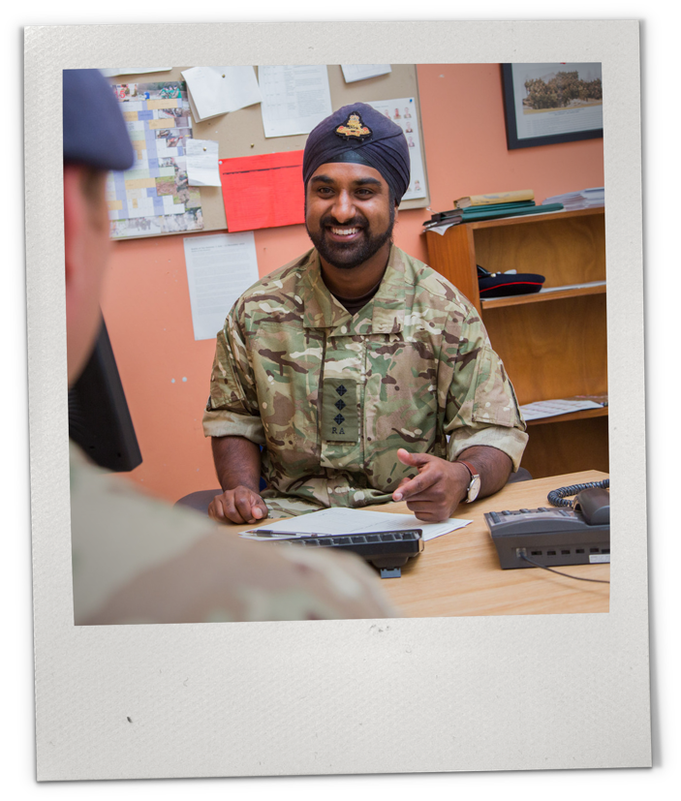

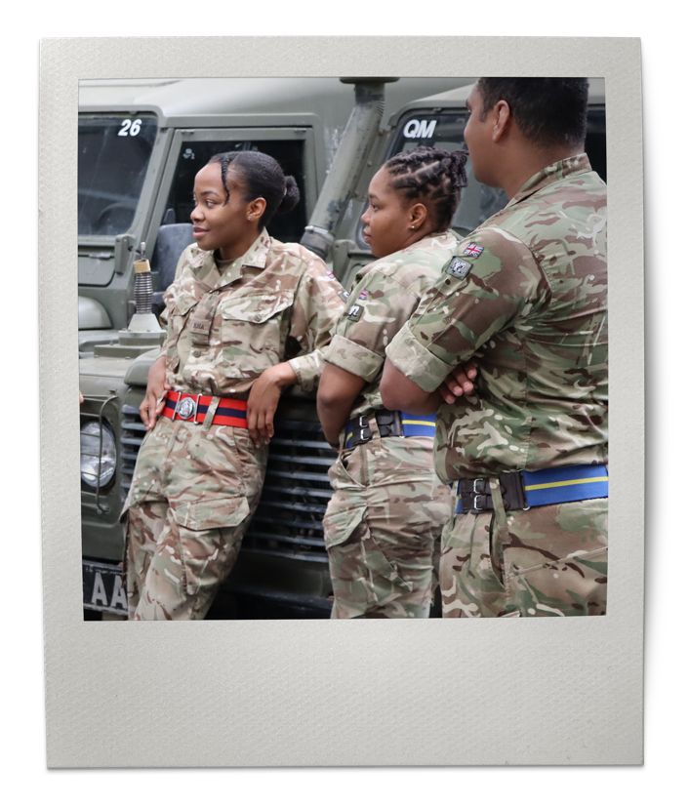
Session
One
Time:
15–20 minutes
COMMUNITY
NETWORKS​
DISCOVER COMMUNITY NETWORKS AND
LEARN ABOUT THE IMPACT THEY HAVE ON
INCLUSION AND DIVERSITY IN THE ARMY.​

Slide 14


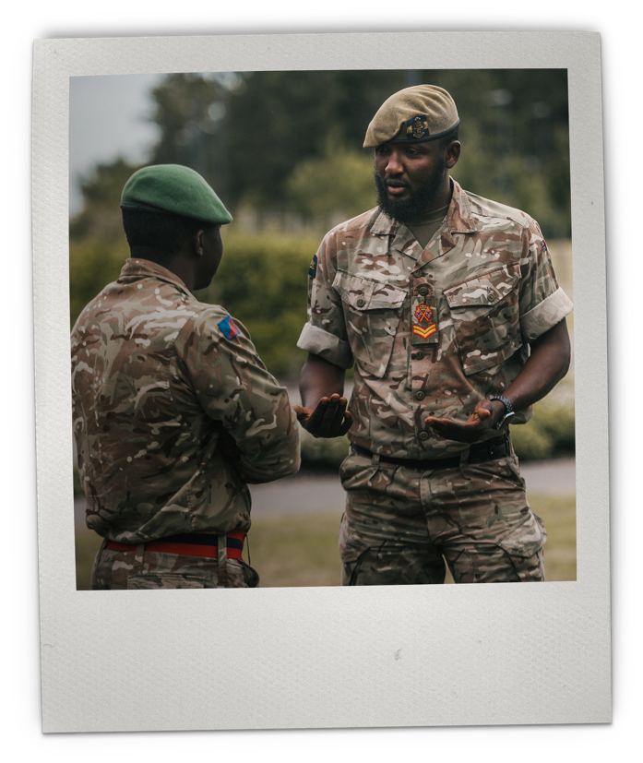
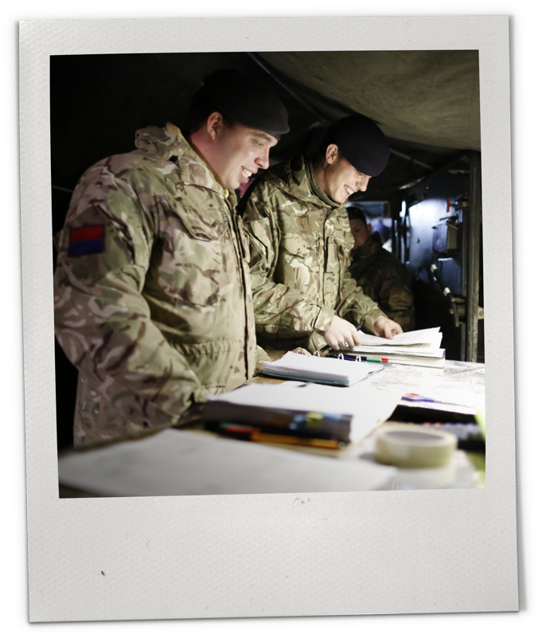
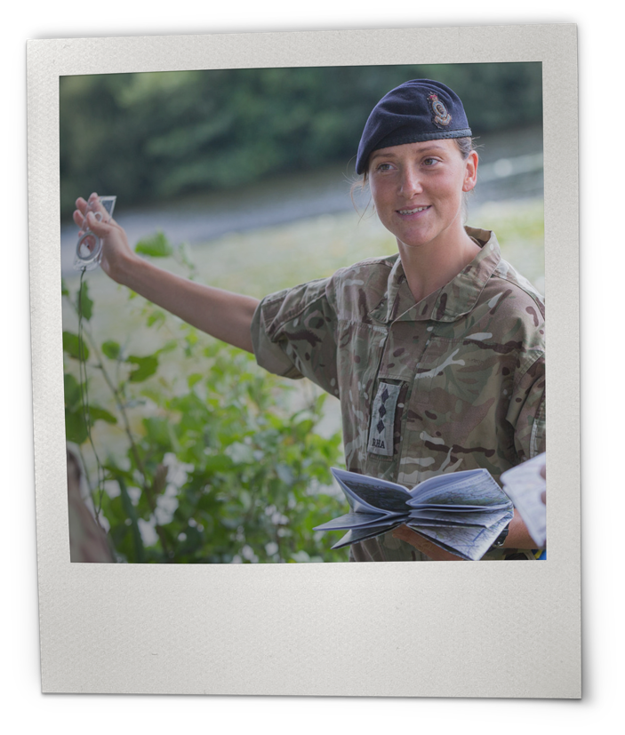

COMMUNITY NETWORKS​
What are they?​
Think of three examples
of community groups or community networks.​
​What is their role in
the community?
Notes:
Community networks – baseline discussion
Use this slide to discuss with your students what a community network is. Use the questions on the slide to start this discussion.
Elicit various types and purposes (from exercise clubs to religious / cultural networks) but focus on always bringing people together to share what they have in common and support each other in different ways.

Slide 15

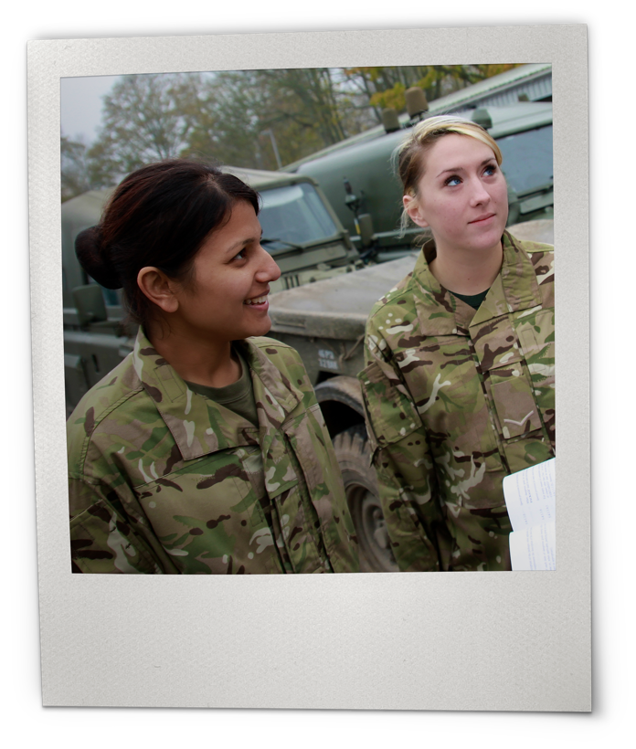
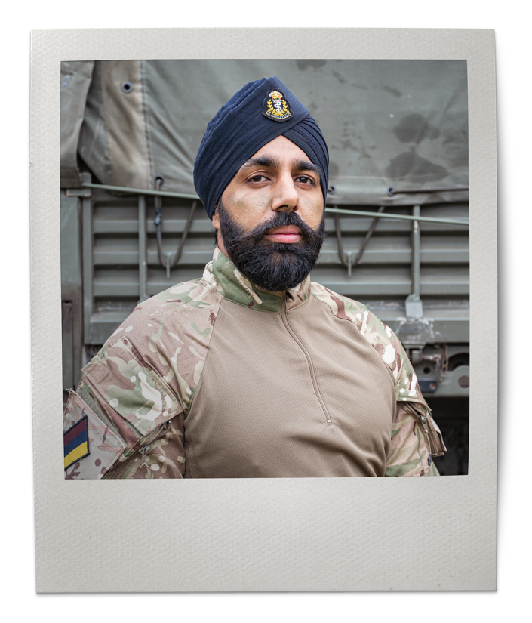
UNDERREPRESENTED GROUPS IN THE ARMY
What percentage of service personnel would you guess are:​
female?
from a global majority?
from a non-Christian religion such as Islam, Hinduism and Judaism?
Underrepresented groups exist in every community. Women, people of global majority backgrounds and people with faith backgrounds in Islam, Hinduism and Judaism are underrepresented groups in the Army.
Notes:
Underrepresented groups in the Army
Show images to students and read out questions – students write answers on whiteboards. Students to work independently or in pairs, at teachers’ discretion.
Receive answers from students and reveal the answers, discussing if students guesses are close to the statistics:
Women make up 11.7% of the UK Armed Forces.
Ethnic minorities make up 11.2% of the UK Armed Forces.
5.2% of service personnel are from a non-Christian religion.
Click to reveal and read the definition.
3. Share how these stats compare to the UK population:
Approx 51% women https://www.beta.ons.gov.uk/aboutus/transparencyandgovernance/freedomofinformationfoi/populationoftheukbysex
18% from global majority backgrounds https://www.ethnicity-facts-figures.service.gov.uk/#:~:text=Government%20data%20about%20the%20UK's,a%20variety%20of%20ethnic%20backgrounds.
10.7% non-Christian religions https://www.ethnicity-facts-figures.service.gov.uk/#:~:text=Government%20data%20about%20the%20UK's,a%20variety%20of%20ethnic%20backgrounds.
Support: Help students to identify other examples of underrepresented groups in their school community or wider community, e.g. EAL students, specific religions, specific ethnicities.
Challenge: Ask students to think of any other groups who might be in an underrepresented group in the Army or wider society (e.g. people with disabilities, people who are neurodiverse, people who are LGBTQ+).
Did you know?
‘Global majority' can be preferred by some to refer to people who are black, Asian, brown, dual-heritage, indigenous to the global south and / or have been racialised as ethnic minorities. This reflects that these groups represent approximately 80% of the world's population and seeking to disrupt past ways of thinking.
Terms like 'minoritised' ethnic groups are often used as well as a way to reflect the fact that ethnically diverse individuals aren't always a minority in terms of actual numbers but have been minoritised through social processes.
Sources:
Statistics: https://www.gov.uk/government/statistics/uk-armed-forces-biannual-diversity-statistics-april-2024/uk-armed-forces-biannual-diversity-statistics-april-2024#:~:text=At%201%20April%202024%2C%20ethnic%20minorities%20(excluding,Other%20Ranks%20in%20the%20Future%20Reserves%202020 and https://commonslibrary.parliament.uk/research-briefings/cbp-7930/#:~:text=The%20Army%20had%20the%20highest,30%25%20of%20intake%20by%202030.

Slide 16


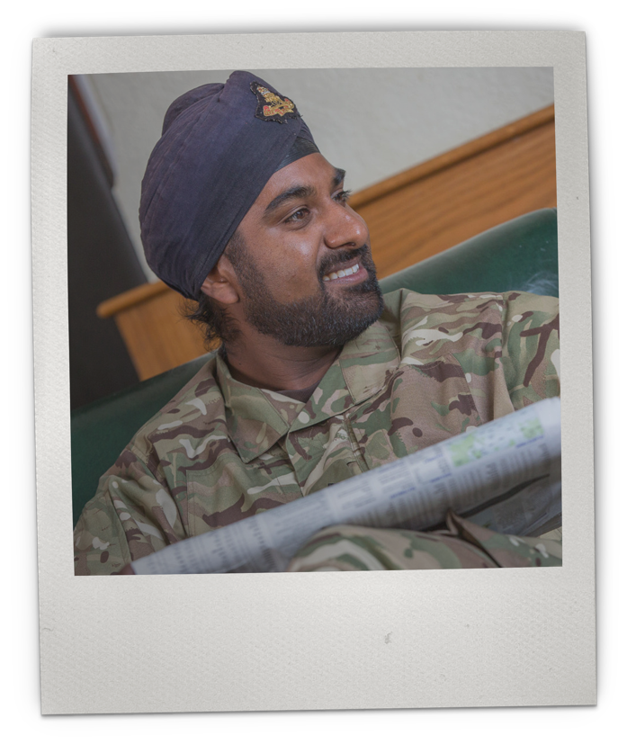
SUPPORTING UNDERREPRESENTED GROUPS
The Army is committed to supporting underrepresented groups within its organisation and is actively working to become more diverse and inclusive.
Can you think of ways underrepresented groups are supported at school or in
your community?
“...our people are our greatest asset, and if we are to maximise the talent of all our people we need to create a culture that is centred on respect and integrity…
a department where everyone, regardless of background, feels safe to give their best self, have their effort and skills properly recognised, and their individuality and experiences respected”
– Ministry of Defence, 2023
Notes:
Supporting underrepresented groups
Read the quote through with students.
Ask them to identify the reasons why this is important. Click to reveal answers in bold:
people are our greatest asset
maximise talent
feels safe to give their best self
individuality and experiences respected
Click to reveal and read the focus point.
Highlight the link to British Values ‘tolerance’ and ‘respect’. Emphasise that living in a diverse, inclusive society helps to enrich communities, promote understanding, reduce tensions and improve economic growth through different businesses.
Support: Help students to identify ways that underrepresented groups are supported in their school community or wider community, e.g. extra-curricular clubs for special interests, small group support in lesson time, celebrating special days or weeks to highlight certain issues: Mental Health Awareness Week, LGBTQ+ History Month, Black History Month. Explain that these activities help to ensure that people feel included and more able to express themselves.
Challenge: Ask students to suggest ways that the Army might support underrepresented groups.
Extension: Ask students to critically reflect on what happens when underrepresented groups are not supported in wider society, e.g. people with disabilities, people who are neurodiverse, people who are LGBTQ+ and discuss if this would have a positive or negative impact on society. Return to link to British Values and emphasising the benefits of living in a diverse, tolerant society.
Key vocabulary
Community: The people living in one particular area or people who are considered as a unit because of their common interests, social group, or nationality.
Example: "The Army strives to provide a sense of community for all service personnel."
Diversity: Actively involving people from a range of different backgrounds and of different genders, sexual orientations, or other characteristics.
Example: "Equality and diversity should be supported for their own sake."
Quote source:
https://www.gov.uk/guidance/mod-diversity-networks

Slide 17



COMMUNITY NETWORKS
Army Defence Fertility Network
A group for UK Military individuals and couples to engage with others that have been on a fertility journey or are currently doing so.
Army LGBTQ+ Network
The Army LGBTQ+ Network offers a space
for LGBTQ+ soldiers to discuss issues affecting them, access support
and advice and networking events.
The Army supports underrepresented groups through community networks – private groups where similar people can meet, connect and discuss issues affecting them. This helps to build support and a feeling of belonging.
Examples of community networks include:
Army Multicultural Network
A community for officers, soldiers and civil servants who identify as from global majority backgrounds and allies to discuss race, ethnicity and cultural heritage.
Army Servicewoman’s Network
A professional network that supports women of all ranks across the Army, both Regular and Reserve to develop and expand professional and personal interests, reaching their full potential.
Notes:
Community networks
Read the slide with students.
Highlight that each community network has a private online space for members to communicate, and many have annual conferences and social events throughout the year.
Ask students:
Do any of the community networks surprise you?
Would you add any community networks to the list?
Emphasise that the Army supports these community networks to support underrepresented groups, tackle discrimination and build a more inclusive organisation.
Key vocabulary
Allyship: Active support for the rights of an underrepresented group without being a member of it.
Example: "These sessions should emphasise tangible ways that students can practice allyship, such as supporting underrepresented groups, challenging stereotypes, utilising community voice, honouring heritage and reflecting on leadership styles."
Belonging: An affinity for a place or situation.
Example: "As a result of the inclusion practices in this organisation, I feel a real sense of belonging – I feel understood, and as if I can be myself."
Sources:
Community Networks: https://www.gov.uk/guidance/mod-diversity-networks

Slide 18








COMMUNITY NETWORKS: TIME TO REFLECT
Three, two, one…over to you!
1.
Choose one word below to write a sentence explaining why you think supporting underrepresented groups is important:
3.
List three reasons why
you think community networks are an important part of the Army being an inclusive and diverse organisation.
2.
Think of two similar groups that support underrepresented groups
at school, in your wider community, or in the wider world.
Extension: Reflect on what leadership qualities help these groups thrive. Could you apply these qualities in your own environment to make it more inclusive? Share your thoughts with a partner!
Now that you’ve explored how leadership, community networks, and inclusion work together, think about your own role.
What actions can you take to make your school a more inclusive place?
Inclusion
Belonging
Self-expression
Safety
Diversity
Notes:
Community networks: Time to reflect
Read the slide and set the tasks. Students to share and work in pairs, practising listening and providing positive, constructive feedback on others’ explanations.
Receive feedback from students, and support discussion with the following answers:
Question 3:
Allow everyone to have a safe space to discuss issue important to / affecting them.
Allow everyone to have a voice.
Are places where individuality and different experiences are accepted and respected.
Support underrepresented groups.
Can help break down barriers and promote inclusion.
When people feel heard, valued, included and respected, they are able to give their best-self to the job.
Question 2:
Highlight School Council as a student body for highlighting concerns.
Royal National Institute of Blind People (RNIB) – A charity that serves people living with visual impairments.
Stonewall – A charity supporting LGBTQ+ people in the UK.
The King’s Trust (formerly the Prince’s Trust) – A charity supporting vulnerable young people aged 18–30 with training, business and career support.
Question 1:
Example: ‘Safety’ - ‘Supporting underrepresented groups is important so that everyone experiences safety, and can perform at their best.’
Explain to students: Now that you’ve explored how leadership, community networks, and inclusion work together, think about your own role. What actions can you take to make your school a more inclusive place? Whether it’s standing up for others, starting a support group, or simply being a good listener, every action matters.
Support: As an alternative activity, students could focus on creating a new ‘community network’ for the Army, giving it a name, a group to support and a logo.
Challenge: Students to use all five words in question one to write two to three sentences about the importance of supporting underrepresented groups.

Slide 19

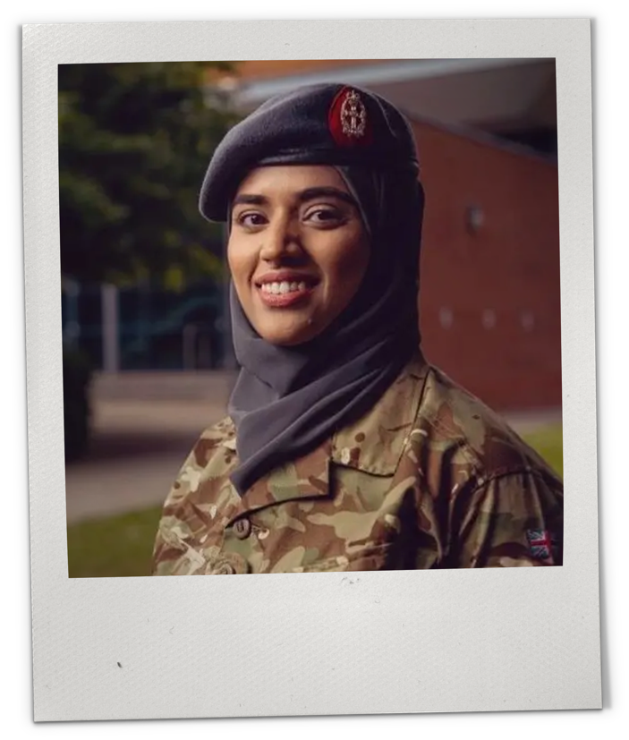
Session
Two
Time:
15–20 minutes
HISTORY AND
HERITAGE​
LEARN ABOUT THE SIGNIFICANT CONTRIBUTIONS
OF THREE MUSLIM ​SOLDIERS THROUGHOUT
BRITISH MILITARY HISTORY AND EXPLORE THE
DIVERSE BACKGROUNDS OF ARMY PERSONNEL.

Slide 20





























DIVERSITY IN THE ARMY
Look at the symbols and icons below. How many can you name to a religion / country / culture?​
Did you know?
Members of the British Army come from a variety of cultural, religious and ethnic backgrounds.
Notes:
Diversity in the Army
Show image to students and read question.
Set task - students can work in pairs or independently, at teacher’s discretion. Students may need to use whiteboards, if necessary.
Receive answers/suggestions from students.
Click to reveal answers on the slide, and briefly discuss any appropriate affiliations with the class, school or local community. Examples: ‘There is a Sikh Gurdwara close to our school’ or ‘Students at our school come from a range of religious backgrounds, including Christianity, Judaism, Islam and Hinduism’.
Click to reveal and read focus point.

Slide 21

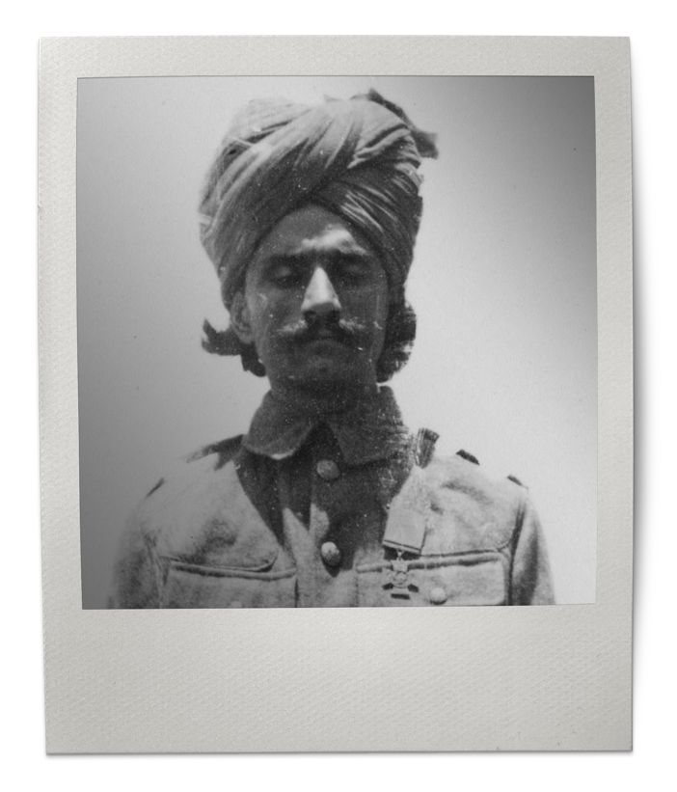
MUSLIM SOLDIERS: THEN AND NOW​
Representing their different ethnicities or backgrounds, Muslim soldiers have made a significant contribution to the British Army with their bravery, dedication and loyalty.
Sepoy Khudadad Khan VC
A machine-gun operator in World War I, he fought in the Battle of Ypres in 1914. His team was heavily attacked, and all but Khan were killed. He kept fighting throughout the day, despite being wounded and outnumbered five to one, which bought time for the Allies to stock reinforcements. He was the first British Indian to be a recipient of the Victoria Cross, the highest military decoration in the United Kingdom, awarded for dedication and bravery.
Notes:
Muslim soldiers: Then and now
Read the next three slides, inviting students to read aloud as appropriate.
Discuss the stories with students, using the questions and answers below as a guide:
Support:
Has anything inspired you?
Suggestion: Corporal Iqra Shahzadi’s story is a story of standing up for what she believes in and being herself. Her quest to stand up for herself has paved the way for others.
Has anything surprised you?
Suggestion: These stories tell us that Muslim service personnel have served in the British Army for over 100 years with bravery, loyalty and dedication – which we may not have known before.
What can these stories tell us about the role of Muslim service personnel in the Army?
Suggestion: Muslim service personnel have made a significant contribution to the British Army throughout history and present day, playing a pivotal role in shaping our country.
Challenge:
Why is it important to learn about these stories today?
Learning the stories of underrepresented groups ensures that these stories are not lost, and can help to change perspectives and foster respect and tolerance to build a more inclusive society.
Why is it important to recognise, honour and memorialise the contributions of underrepresented groups and communities?
It is important to recognise, honour and memorialise the contributions of all groups, communities and underrepresented groups because these stories improve representation - meaning that people from those same underrepresented groups can see themselves represented, helping them to feel recognised, included and celebrated.
Click to reveal and read the focus point.
Sources:
Sepoy Khudadad Khan VC:
https://www.thegazette.co.uk/all-notices/content/332#:~:text=Sepoy%20Khudadad%20Khan%20from%20the,Cross%20in%20WW1%20for%20bravery.
https://www.bcu.ac.uk/research/english/stories-of-sacrifice/virtual-tour/vc-winners#:~:text=Khudadad%20Khan%2C%20born%20in%20October,Duke%20of%20Counaught's%20Own%20Baluchis.
https://memorialgates.org/history/ww1/participants/indian-subcontinent/khudadad-khan.html
https://www.muslimwarmemorial.org/veterans-project/khudadad-khan-vc/
Noor Inayat Khan GC:
https://www.theguardian.com/world/2012/nov/08/statue-indian-secret-agent-killed
https://www.nationalarchives.gov.uk/education/resources/who-was-noor-khan/
https://war-experience.org/lives/noor-inayat-khan-soe/
Corporal Iqra Shahzadi:
https://www.bbc.co.uk/news/uk-england-surrey-68434986
https://www.fhft.nhs.uk/news/a-trust-trailblazer/
Image sources:
https://www.iwm.org.uk/collections/item/object/205131012 Image: IWM (VC 694)
https://www.iwm.org.uk/collections/item/object/205020940 Image: IWM (HU 74868)

Slide 22
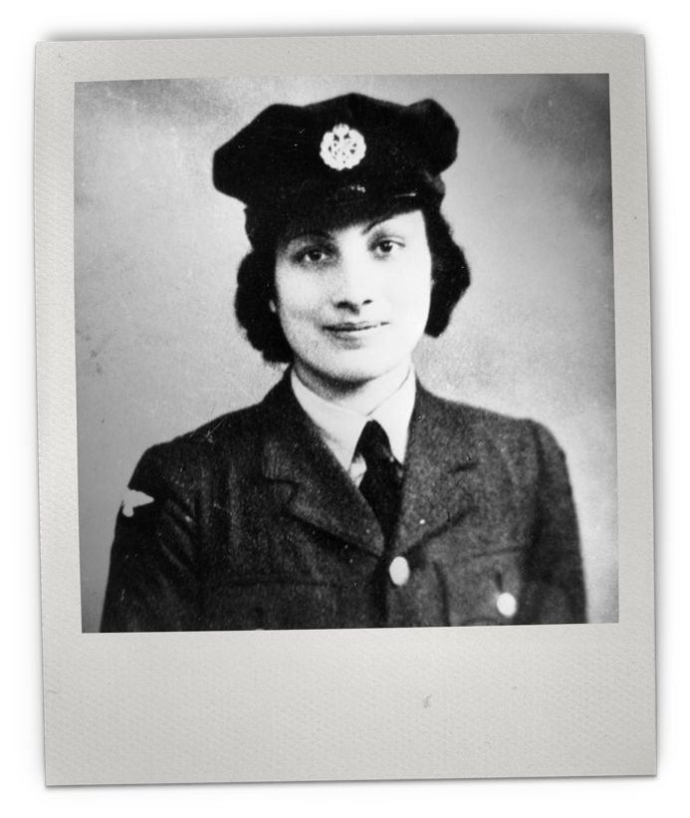

MUSLIM SOLDIERS: THEN AND NOW​
Representing their different ethnicities or backgrounds, Muslim soldiers have made a significant contribution to the British Army with their bravery, dedication and loyalty.
Noor Inayat Khan GC
A British-Indian secret agent, she was the first female radio operator to be sent into Nazi-occupied France in World War II. Captured by the Nazis, she was murdered at Dachau concentration camp. She was posthumously awarded the George Cross – the highest civilian award for gallantry in the United Kingdom – and was honoured with a statue in 2012, the only stand-alone statue of an Asian woman in Britain at the time.
Notes:
See previous slide notes

Slide 23

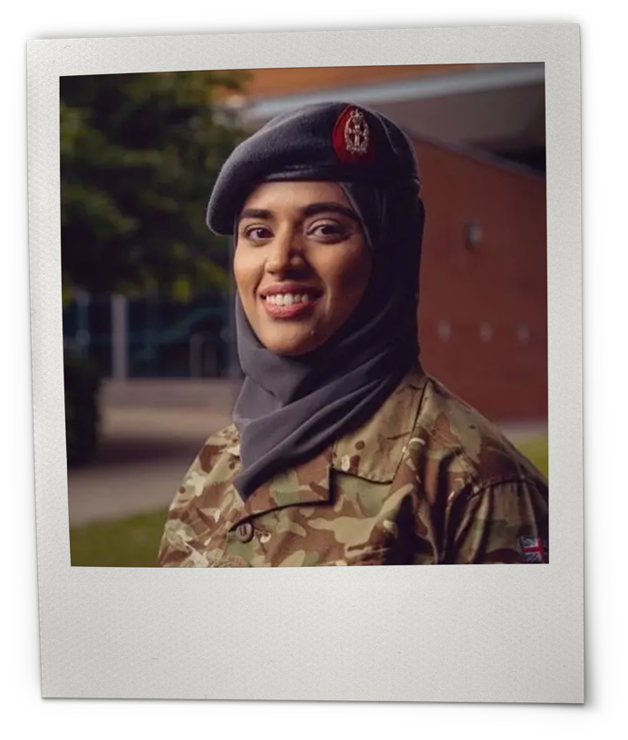
MUSLIM SOLDIERS: THEN AND NOW​
Representing their different ethnicities or backgrounds, Muslim soldiers have made a significant contribution to the British Army with their bravery, dedication and loyalty.
Corporal Iqra Shahzadi
A present-day military nurse, she is the first ever hijab-wearing Army recruit. When she joined the Army, she didn’t see any other women wearing hijabs, but the Armed Forces Network Association supported her in her campaign to wear it. Her self-advocacy has spearheaded diversity and inclusion for young Muslim women seeking to join the Army.
Notes:
See previous slide notes

Slide 24

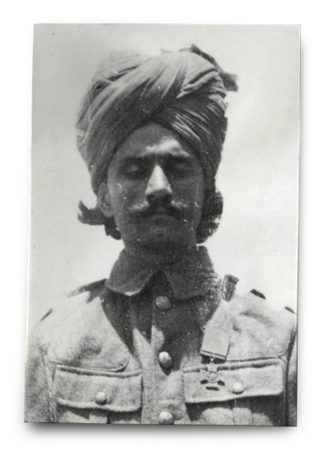
COMMUNITY HERITAGE WALL
Example
Name: Sepoy Khudadad Khan VC
Date and place of birth:
20 October 1888 in Dab, Chakwal, former Pakistan
Date and place of death:
8 March 1971 in Mandi Bahauddin
We are going to create a community heritage wall to celebrate the range of contributions to the Army – both historically, and in the present day.
Your task is to research the story of a service person from an underrepresented group who has contributed to the Army and present your findings.
Key facts about education, personal life, family:
………………………………………………………………….........
Unique contribution to the British Army:
………………………………………………………………….........
How their service has been celebrated, commemorated
or memorialised:
………………………………………………………………….........
Why is this person inspiring to you?:
………………………………………………………………….........
Add 2–3 key points from research
Add 2–3 key points from research
Add 2–3 key points from research
Add your personal viewpoint here
Notes:
Community heritage wall
Before delivery, decide if you will create a community heritage wall virtually, or in the classroom, and set the guidelines as appropriate.
Read the slide, example and set the task.
Scaffolding:
KS3 students - create a profile / poster.
Support:
Students to create a profile based on one of the stories told in the session.
Students to present work in bullet points.
Challenge:
Students to research stories from other underrepresented groups in the Army.
Students to present work in long-hand, perhaps as a biography.
Image source:
https://www.iwm.org.uk/collections/item/object/205131012 Image: IWM (VC 694)

Slide 25

SIGNPOSTING
If you enjoyed the topics raised, and want to explore further, visit the British Army Supporting Education (BASE) Hub to explore more lessons and resources:
Women in the Army
LGBTQ+ Voices
Support Networks
Sikh Service
Black History Month
https://jobs.army.mod.uk/base/
If any of the topics raised have concerned you, please reach out for support in the following places:
Speak to a trusted adult, e.g. teacher, form tutor, family member, member of the community.
Call ChildLine to discuss your concerns with
a trained counsellor. It is a free, private and confidential service where you can talk about anything. Call 0800 1111 or visit childline.org.uk to chat to a counsellor online.
Notes:
Signposting

