Slide 1
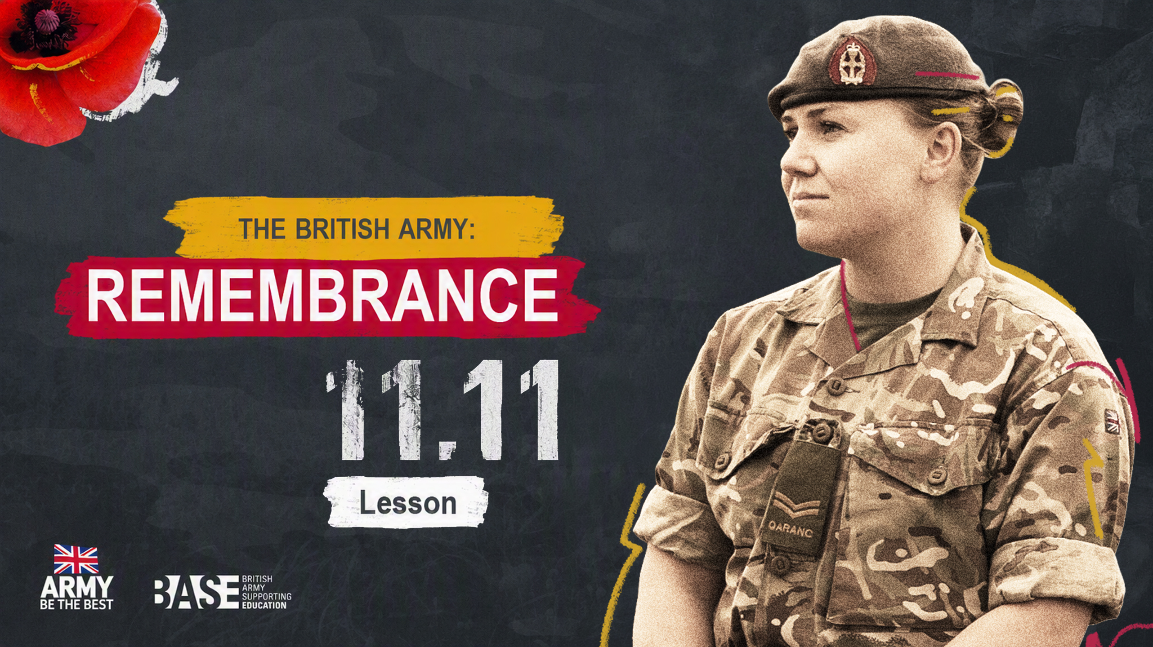
THE BRITISH ARMY:
REMEMBRANCE
Lesson

Slide 2

OUTLINE
ABOUT THIS PRESENTATION
This 45–60 minute presentation for ages 11–16 (KS3-KS4) explores Remembrance in the UK. It has been designed to be delivered as a full PSHE or History lesson to support Remembrance Day activities. It is flexible, and has been designed for you to adapt and deliver in different ways. The timings given in the notes section are suggestions.
This lesson has been designed to be delivered alongside the assembly, or on its own. It will focus on how we commemorate Remembrance, and will introduce students to the ways that different groups both inside and outside of the military commemorate Remembrance, highlighting diverse voices and experiences.
OBJECTIVES
Students can:
describe what Remembrance is
explain why we commemorate Remembrance
give examples of the diverse ways that we commemorate Remembrance in the UK.
USING THIS PRESENTATION
Simple delivery notes are included in the ‘Notes’ section underneath each slide, including support and challenge suggestions for effective differentiation.

Slide 3



CURRICULUM LINKS – ENGLAND AND NORTHERN IRELAND
PSHE – ENGLAND
Students will learn about:
how to identify and articulate a range of emotions accurately and sensitively, using appropriate vocabulary
change and its impact on mental health and wellbeing and to recognise the need for emotional support during life changes and/or difficult experiences.
HISTORY – ENGLAND
Students will learn about:
historical concepts such as continuity and change
changes within living memory including aspects of change in national life.
understanding of British, local and world history.
identify significant events, make connections, draw contrasts, and analyse trends within periods and over long arcs of time.
PDMU – NORTHERN IRELAND
Students will learn to:
respect themselves, understand their rights and responsibilities;
recognise the richness and diversity of cultural influences in contemporary society.
HISTORY – NORTHERN IRELAND
Students will learn about:
chronological awareness and the ability to make connections between historical periods, events and turning points.

Slide 4


CURRICULUM LINKS – SCOTLAND AND WALES
HEALTH AND WELLBEING – SCOTLAND
Students will learn that:
representing my class, school and/or wider community encourages my self-worth and confidence and allows me to contribute to and participate in society
through contributing my views, time and talents, I play a part in bringing about positive change in my school and wider community.
SOCIAL STUDIES: PEOPLE, PAST EVENTS AND SOCIETIES
– SCOTLAND
By studying groups in past societies who experienced inequality, I can explain the reasons for the inequality and evaluate how groups or individuals addressed it.
Through researching, I can identify possible causes of a past conflict and report on the impact it has had on the lives of people at that time.
PERSONAL AND SOCIAL EDUCATION – WALES
Students will learn to:
value and celebrate diversity and equality of opportunity locally, nationally and globally
participate in school and the wider community
empathise with others’ experiences, feelings and actions.
HISTORY – WALES
Students will learn about:
how some twentieth century individuals and events have shaped our world today
how to select and summarise information accurately from sources.

Slide 5


REMEMBRANCE: LESSON PLAN
A lesson plan with suggested timings and support to help you choose the activities right for your class. (Slide 1/2.)
ACTIVITY | OVERVIEW OF ACTIVITY | SLIDE(S) | TIMING | RESOURCES AND SET UP
Starter | Identifying what different poppies symbolise in reference to Remembrance. | 4 | 5 min | Slides only
Learning objectives | Objectives for the lesson displayed for students to read through. | 5 | 1 min | Slides only
What is Remembrance? | A definition of Remembrance is accompanied by a historical timeline. | 6 | 5 min | Slides only
Why do we remember? | Students explore why many around the world commemorate Remembrance. | 7–8 | 6 min | Slides only
Video | The Remembrance film shows different voices on what Remembrance means to them. | 9 | 5 min | Slides only
How do we commemorate Remembrance? | A carousel activity that involves students looking at different sources to learn about different Remembrance traditions or commemorations. | 10 | 15–20 min | Print information sheets Print student worksheets Set up carousel stations around classroom

Slide 6
REMEMBRANCE: LESSON PLAN
A lesson plan with suggested timings and support to help you choose the activities right for your class. (Slide 2/2.)
ACTIVITY | OVERVIEW OF ACTIVITY | SLIDE(S) | TIMING | RESOURCES AND SET UP
We Will Remember | Students plan their own memorial for Remembrance by using the knowledge they gathered from the sources in the carousel activity. | 11 | 15–20 min | Paper or exercise books
Plenary | A recap of knowledge gained throughout the lesson. | 12 | 5 min | Slides only
Signposting | Links to websites with more information on Remembrance. | 13 | 1 min | Slides only
Extension / additional activities | Activities to challenge students with leftover time or to set as homework along with extra worksheets. | 14–16 | 10–30 min | Printable worksheets

Slide 7


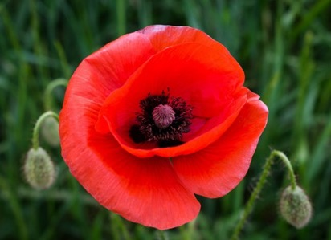


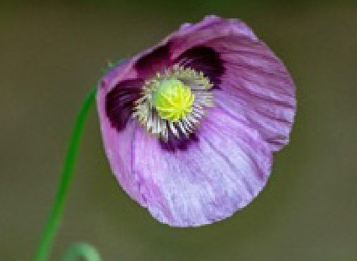

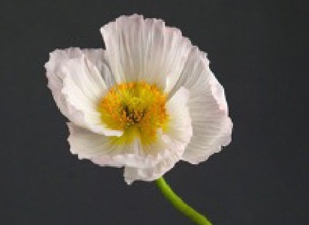
Task: What does each poppy represent? You have 1 minute to discuss with your partner. Get ready to feedback!
STARTER
Black, African, Caribbean, Pacific Islanders and Indigenous community service people.
Peace from conflict.
Service people who sacrificed their lives in World War 1 and conflicts that followed.
Indian soldiers in the British Army.
Animals who have been victims of war.
Notes:
Starter: Which Flower? | 3 minutes | Hook into lesson and Remembrance topic, emphasis on diversity
Read the question: ‘What does each flower represent?’.
Give students 30–60 seconds to discuss with a partner.
Ask students for their ideas and feedback.
Reveal answers on the board.
Explain that the poppy campaign was born in 1921, making and selling artificial poppies to raise money to support ex-servicemen.
Emphasise that although the flowers are different, each of these flowers commemorates those who served and have died in war. These symbols invite us to pause and remember their lives, and the sacrifice they made.
Support question: Which flower is the ‘original’ Remembrance flower? (A: the red poppy). Can you explain why the red poppy is a symbol for Remembrance? (A: because red poppies grew out of the battlefields in Flanders, Belgium and France after fighting stopped in World War One).
Challenge questions: Why do you think there are different colours of flowers to represent different groups? (A: to highlight the sacrifice and contribution of groups that are under-represented). Why might this be important? (A: to honour the lives of those from under-represented communities and bring awareness to their sacrifice).

Slide 8


LEARNING OBJECTIVES
At the end of this lesson, you will be able to:
describe Remembrance
explain why we commemorate Remembrance
give examples of the diverse ways that we commemorate Remembrance in the UK.
Notes:
Learning objectives | 1 minute | Share learning objectives with students
Read through the slide to share learning objectives with students.

Slide 9



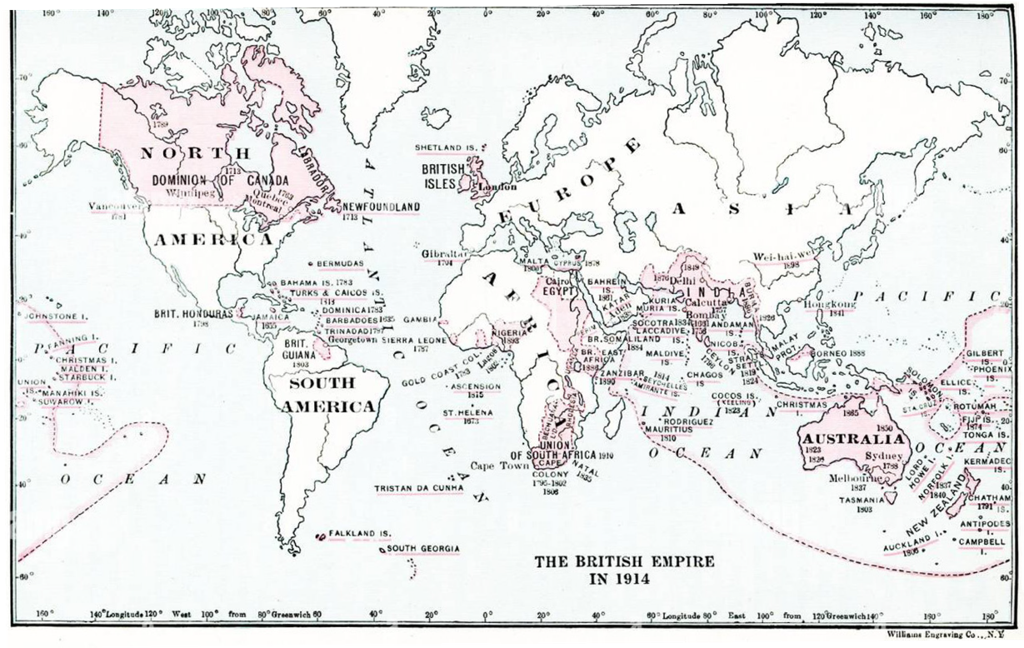

A WORLD AT WAR
In 1914, the beginning of the Great War – or World War 1 as it is now commonly known – required allied forces from around the British Empire to come together and fight enemy forces.
This included recruiting the help of long established armies such as the West India Regiments, British Indian Army, West African Frontier Force, King’s African Rifles and Maori Pioneers Battalion. In some cases, help came for manual labour and supporting work like the Chinese Labour Corps.
As the war raged around the world, more and more forces were needed.
Notes:
A world at war
Read the information on the slide to students to give them some context on why Remembrance commemorations started and why lots of communities honour those whose lives were lost in war.

Slide 10







WHAT IS REMEMBRANCE?
Definition of Remembrance:
The act of someone remembering and showing respect for someone who has died, or a past event.
At the eleventh hour on the eleventh day of the eleventh month – we will remember them.
– Royal British Legion
Notes:
What is Remembrance?
Read definition of Remembrance: The act of someone remembering and showing respect for someone who has died, or a past event.

Slide 11


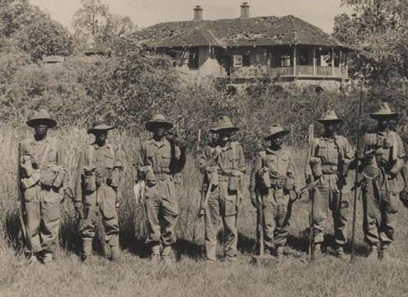

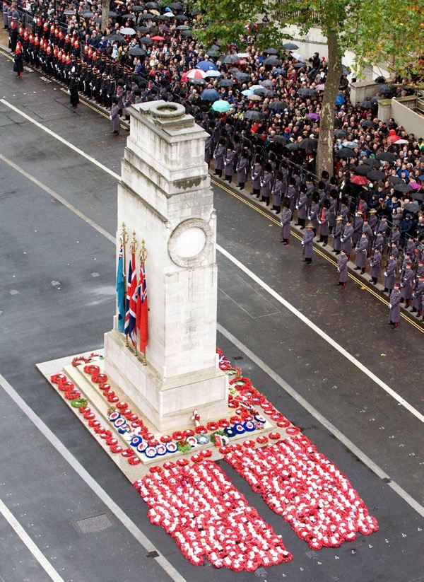

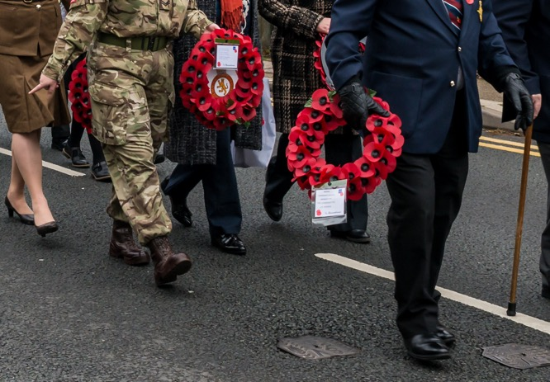

WHAT IS REMEMBRANCE?
Notes:
What is Remembrance? | 5 minutes | Introduction to theme, key historical information and definitions
Explain the key historical timeline:
1. On 11th November 1918, the Allies (United Kingdom, France, Russia, Italy, Japan, and the United States) signed the Armistice, an agreement to stop fighting at 11:00am that same day.
2. Word travelled across the continent within hours, and all fighting stopped and there were huge celebrations in the streets of every country.
3. On the 11th of November in 1919, King George V held the first of what we now know as Remembrance Day celebrations. This was called Armistice Day which involved the first two-minute silence as a sign of respect and mourning to those who had fallen in the war. 15,000 troops took part; however, many veterans refused to participate in what they saw as a 'militaristic celebration'. (Source: https://www.forces-war-records.co.uk/blog/2015/11/02/remembrance-day--in-the-beginning)
4. In 1920 the permanent structure of the Cenotaph made of portland stone now in Whitehall in London was built and where the traditional Remembrance parade and silence is held, as it was in 1919.
5. In 1921 the first artificial poppies were created and sold to give money to ex-service people and their families for their contribution to the war. (Source: https://www.iwm.org.uk/history/why-we-wear-poppies-on-remembrance-day#:~:text=She%20campaigned%20to%20make%20the,had%20died%20in%20the%20conflict. )
Explain that now, over 100 years later, we still commemorate Remembrance Day on the 11th of November - the 11th day of the 11th month at 11am. Services are held across the country – in town squares, city halls, in schools, privately in people’s homes, and most famously in London where the Remembrance Sunday parade includes three important aspects. These are: the parade of service people and veterans, the laying of poppy wreaths at the Cenotaph, and a two-minute silence to remember those lost and sacrificed.
Discussion questions:
What does Remembrance mean to you?
Have you taken part in any Remembrance Day activities?
Challenge questions:
Why do you think Remembrance is important?
The first image on the slide is also sourced from the National Army Museum, featuring a group of soldiers of the King’s African Rifles joined by a member of the British Army in 1944.

Slide 12




WHY DO WE REMEMBER?
CONFLICT | DATES | BRITISH ARMED FORCES DEATHS | TOTAL CIVILIAN DEATHS | ESTIMATED TOTAL DEATHS
World War 1 | 1914 - 1918 | 908,371* | 6,821,248** | 20,000,000
World War 2 | 1939 - 1945 | 373,372* | 45,000,000*** | 45,000,000
The Troubles | 1969 - 1998 | 1,441 | 1,930 | 3,500
Falklands War | 1982 - 1982 | 258 | 3 | 910
Gulf War | 1990 - 1991 | 47 | 150,000** | 42,031
Afghanistan War | 2001 - 2014 | 453 | 46,319 | 176,000
Iraq War | 2003 - 2009 | 179 | 196,500 | 592,000
As you look at these numbers, remember that one casualty represents an individual story – and a whole family, community, school or town that has lost someone.
65,814,441
LIVES LOST
Notes:
Why do we remember? | Slide 1 of 2 | 3 minutes | Discussion to emphasise the reasons behind Remembrance Day traditions
Explain that our Remembrance traditions began in WW1 – a global event in which more military personnel died than in any conflict before or since. Now, our Remembrance services commemorate all conflicts that have happened since WW1, too.
Show students the table on the slide and ask them to read through it. Explain that this table shows the military and civilian casualties of seven selected conflicts out of the 26 conflicts that the United Kingdom has been involved in since 1914. (1 minute)
Support: Read through the columns to explain what each represents.
Ask students to discuss this question with a partner: ‘Why do we commemorate Remembrance?’. (1 minute)
Gather feedback from the group - write ideas on the board.
Support: Facilitate discussion by repeating student contributions for all to hear and write ideas on the board.
Challenge: emphasise that ‘As you look at these numbers, remember that one casualty represents an individual story – a whole family, community, school or town that has lost someone.’ Ask students: ‘What does this mean for the impact of war?’ and ‘What impact does this have on Remembrance?’.
*Number of lives lost of the British Empire’s Army
**Number of lives lost could not be accurately recorded at this time, so this number is an estimate.
(Source: http://www.centre-robert-schuman.org/userfiles/files/REPERES%20%E2%80%93%20module%201-1-1%20-%20explanatory%20notes%20%E2%80%93%20World%20War%20I%20casualties%20%E2%80%93%20EN.pdf )
***Number of lives lost varies widely between sources

Slide 13
WHY DO WE REMEMBER?
Remembrance aims to honour those who serve to defend our democratic freedoms and way of life.
This includes:
remembering the sacrifice of the Armed Forces community from Britain and the Commonwealth
paying tribute to the special contribution of families and of the emergency services
acknowledging innocent civilians who have lost their lives in conflict and acts of terrorism
to think about those who have suffered physical or mental illnesses because of their sacrifices in war.
Why is Remembrance important? What is its purpose?
Challenge question:
Why would Remembrance be important for:
a Veteran?
a widow/er?
a serviceperson?
a young person today?
Notes:
Why do we remember? | Slide 2 of 2 | 3 minutes | Discussion to emphasise the reasons behind Remembrance Day traditions
The Royal British Legion explains that Remembrance aims to honour those who serve to defend our democratic freedoms and way of life.
This includes:
remembering the sacrifice of the Armed Forces community from Britain and the Commonwealth
paying tribute to the special contribution of families and of the emergency services
acknowledging innocent civilians who have lost their lives in conflict and acts of terrorism.
Source: https://www.britishlegion.org.uk/get-involved/remembrance/about-remembrance
Why is Remembrance important? What is its purpose? Highlight that when we remember those that have died, we remember how precious and fragile our lives are. We commemorate Remembrance because we value life, and being alive. Remembrance can remind us of how precious life is, and how lucky we are to be alive.
Challenge question:
Why would Remembrance be important for a Veteran? A widow/er? A serviceperson? A young person today?
Optional extension: Ask students what else we remember during the year? Examples: September 11th, the COVID Pandemic Memorial Wall, ongoing military service. Emphasise that Remembrance exists on many scales – from the personal to the international. Remembrance exists on many scales – from one person remembering a loved one who died, to the whole country stopping for the two-minute silence. In addition to our national events, it’s important to remember that most people have a special day in the year when they are remembering the loss of a loved one.

Slide 14



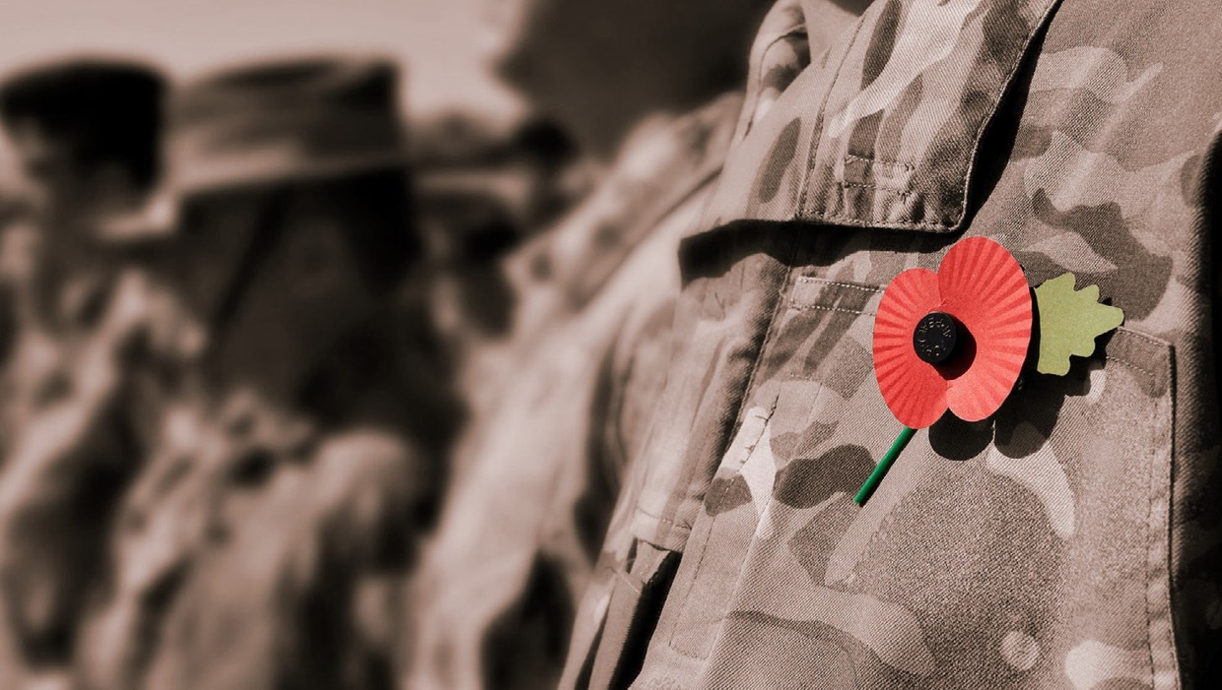

REMEMBRANCE FILM
Think about:
What is Remembrance?
How do the different speakers feel about Remembrance? What does it mean to them?
How do different people mark Remembrance?
Notes:
Video | 5 minutes | Students watch the film and then discuss some of the questions below as a class
Read questions for students to think about as they watch.
Watch the video: https://www.youtube.com/watch?v=u7VLSkBjJ6o&t=2s
If time, gather some feedback from students using the questions below.
Support questions:
Who was speaking on the video?
Who do they remember?
How do they remember?
Challenge questions:
What does Remembrance mean to you?
Why do you think it’s important?
How do you think the way in which we commemorate might change/stay the same in future?

Slide 15

HOW DO WE COMMEMORATE REMEMBRANCE IN THE UK?
As you saw, Remembrance isn’t just about why we remember, and who we remember; it’s also about how we remember.
Remembrance is a verb, not just a noun! Remembrance is an act – doing something that helps us understand, reflect on, share or put into practice what we learned.
Let’s take a look at some examples…
Your task:
This is a carousel activity, with seven stations giving you information about different ways that we commemorate Remembrance.
In groups of three or four, you are going to visit each station in the carousel. You will have 5 minutes to read the information from three or four of these source stations and make notes on your worksheet. Some source stations will give you questions to think about and discuss in your groups.
After the activity, we will feedback as a class.
Notes:
How do we commemorate Remembrance? | 15–20 minutes | Carousel activity in which students explore different forms of commemoration
Each source card should be printed out and placed in their station ahead of the lesson or printed to be given out to students in their groups.
Read the slide with students and outline the task.
Read through the worksheet with the students.
Group children into sets of three or four and keep a five minute timer on the board so they know when to move onto the next station. Timings or how many stations that are looked at can be changed according to the class/time needs.
When students have finished the activity, facilitate whole class feedback with a mindmap on the board ‘How do we commemorate Remembrance?’. Write down the names of the seven stations, and add the ideas that students gathered from them.
Support: Help students to write the first row or two on the worksheet, so they understand what to do.
Challenge: Challenge questions to support discussion:
What do you think of any of these ways of remembering?
Why do you think there are so many different ways to remember? How might having lots of different ways help us to remember?
Which ways of commemoration do you think are most powerful?
Can you think of any other ways to commemorate?
Why do you think some groups make a special effort to commemorate within their communities?
Why do people celebrate so differently?
Alternative task | For teachers with larger groups of less time for the lesson
After reading out the information at the top of the slide, split the class into seven groups and give them a source card each to discuss as a group and make notes on.
After five to ten minutes bring the groups back together as a class and discuss what each group learned from their source card to share with the group. This could be in the form of a presentation or simply picking a spokesperson for each group.

Slide 16

CAROUSEL ACTIVITY
Look at the three or four different source sheets and fill in the table below with your notes.
WHAT IS THE NAME OF THE SOURCE? | WHAT CAN YOU SEE? DESCRIBE THE TYPES OF COMMEMORATION IN THIS SOURCE. | WHAT IS UNIQUE ABOUT THIS FORM OF REMEMBRANCE? | HOW DOES IT MAKE YOU FEEL? | WHAT MORE DO YOU THINK COULD BE ADDED TO THIS FORM OF REMEMBRANCE?
THE BRITISH ARMY: REMEMBRANCE
Notes:
This slide is a worksheet to be printed and hand out to students. Alternatively, display the slide for students to copy the table into their books.

Slide 17



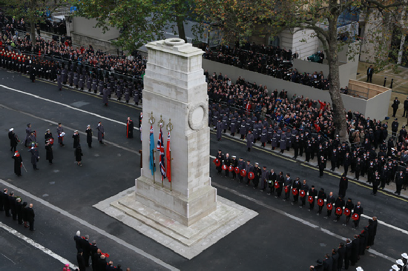
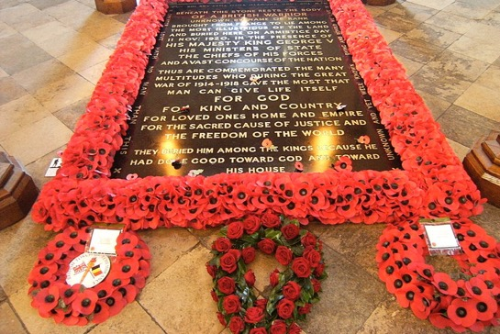
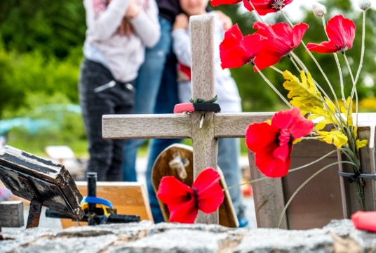
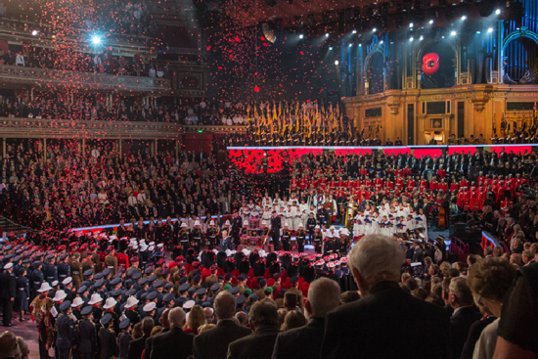
REMEMBRANCE TRADITIONS
Here are some examples of the ways in which we traditionally commemorate Remembrance in the UK.
Festival of Remembrance at the Royal Albert Hall is an event that remembers service people in Britain and the Commonwealth who sacrificed their lives during war in poetry, storytelling and song.
Two-minute silence – time to remember.
Remembrance Sunday parade at the Cenotaph. The Cenotaph is a popular monument to commemorate Remembrance at on each Remembrance Sunday in London.
Tomb of the Unknown Warrior, whose body was recovered from France
and buried at Westminster Abbey in 1920. It is used as a way of honouring those who fell during WW1.
Tomb of the Unknown Warrior by Mike, licenced by CC BY-SA 2.0
Think about:
Which events do you recognise?
Why is it important to commemorate Remembrance publicly, in significant places like Westminster Abbey and at the Cenotaph?
THE BRITISH ARMY: REMEMBRANCE
Notes:
Carousel activity station 1
This slide is a source sheet to be printed and put around the classroom.

Slide 18

POETRY
Remembered still those souls who tried To save the world, but many died.
A moment stolen for a tear,
As we recall those unlived years.
The camaraderie that flew those souls back home to those they knew, And loved them dear and held them close
But for our sakes released to foes The silence that they leave behind
Is space to calm the troubled minds of those they loved – And can’t rewind.
Again this day we give our thanks
For those returned from serving ranks And them as gave it all away
Forever in our minds will stay.
In Flanders fields the poppies blow Between the crosses, row on row,
That mark our place; and in the sky The larks, still bravely singing, fly
Scarce heard amid the guns below.
We are the Dead. Short days ago
We lived, felt dawn, saw sunset glow, Loved and were loved, and now we lie,
In Flanders fields.
Take up our quarrel with the foe: To you from failing hands we throw
The torch; be yours to hold it high. If ye break faith with us who die
We shall not sleep, though poppies grow In Flanders fields.
Remembered Still (2019) by Ms Ernie Rowe,
a broadcaster for the British Forces Broadcasting Service.
Think about:
What are the poems trying to say?
Why might poetry be a useful way of commemorating Remembrance?
What are the similarities and differences between the poems?
In Flanders Fields (1915) by Lt Col John McCrae, a Canadian poet and soldier during WW1.
THE BRITISH ARMY: REMEMBRANCE
Notes:
Carousel activity station 2
This slide is a source sheet to be printed and put around the classroom.

Slide 19

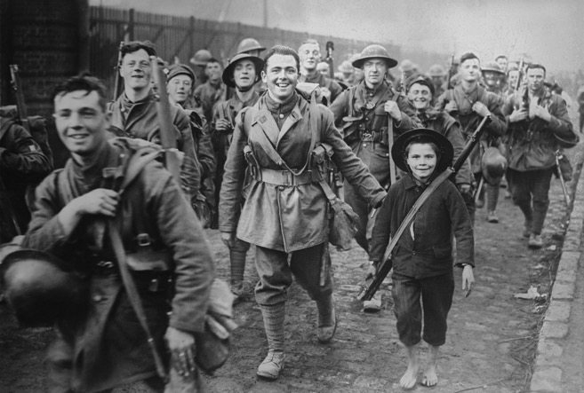
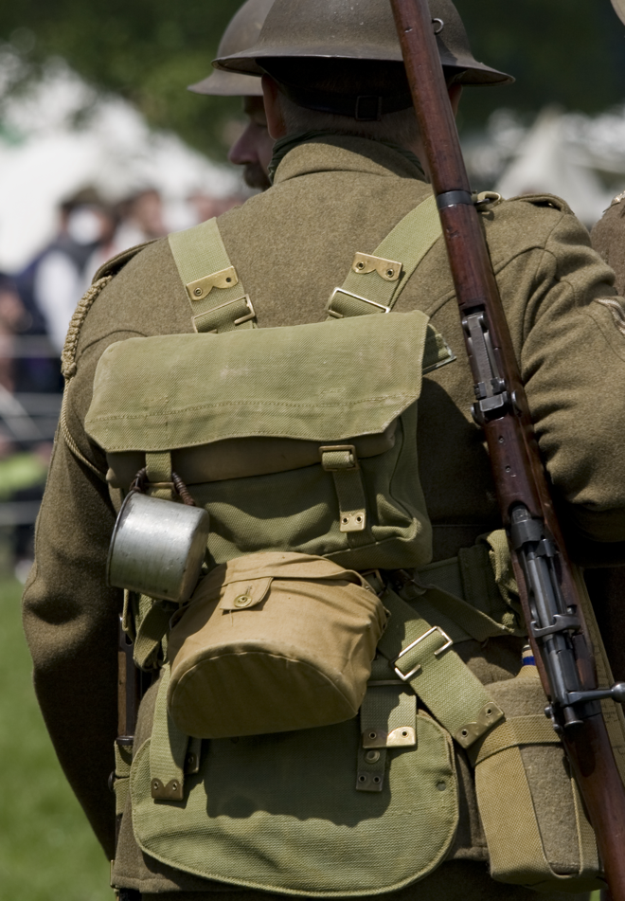
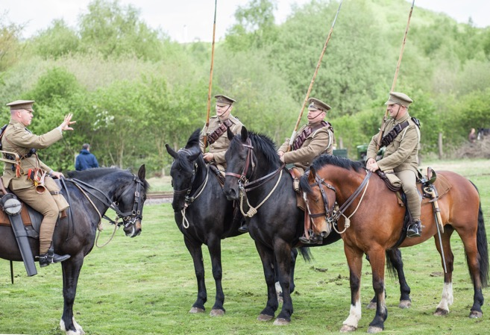
THEATRE
‘We’re Here Because We’re Here’ was a piece of live theatre produced in 2018 to commemorate
the Battle of the Somme – the bloodiest battle
of the WW1.
Young men dressed as WW1 soldiers each represented a soldier, and walked through town centres, stood in train stations, and occupied modern public spaces in tribute. If approached by the public, they didn’t speak, but gave a card about the soldier they were representing.
Think about:
Why did they dress like this?
What might people have thought as they met them in the street?
Why do you think the performance was silent?
What do you think the name of the performance means?
THE BRITISH ARMY: REMEMBRANCE
Notes:
Carousel activity station 3
This slide is a source sheet to be printed and put around the classroom.

Slide 20

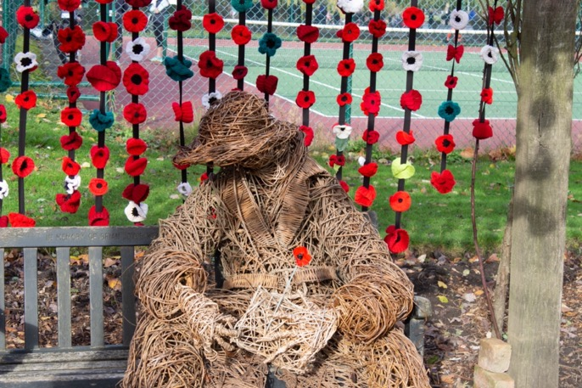
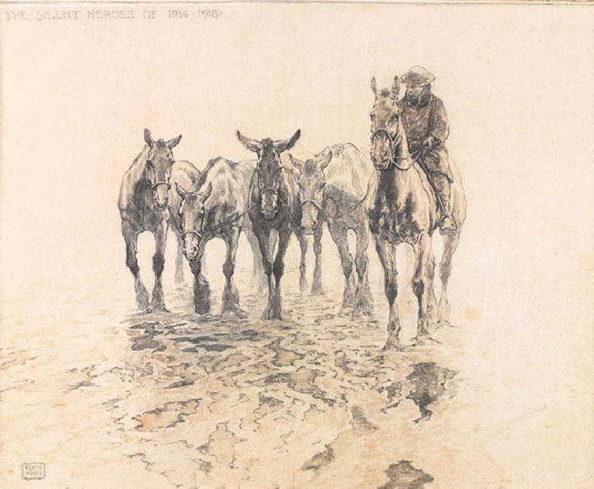
ARTWORK
Many artists explore the impact of war in their work, here are some examples. Such artwork explores how artists processed the physical and emotional effects of the devastation of war.
The shared experience of loss and destruction inspired very different works of art, which include depictions of landscapes after battle, war memorials and reflections on post-war society.
Some artists who create this work have experienced war themselves, and others have not experienced battle first hand.
Think about:
What can you see in the artwork and sculpture?
What do you think about these works of art?
Why do you think ex-soldiers make art work about war?
Why do you think making art is useful for Remembrance?
THE BRITISH ARMY: REMEMBRANCE
Notes:
Carousel activity station 4
This slide is a source sheet to be printed and put around the classroom.

Slide 21

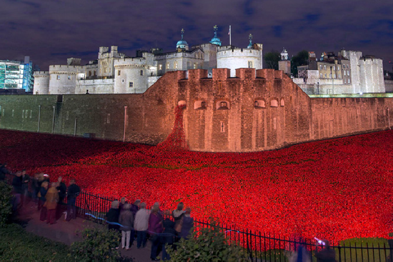
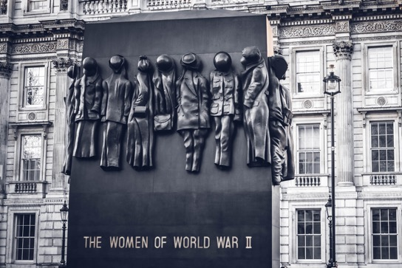
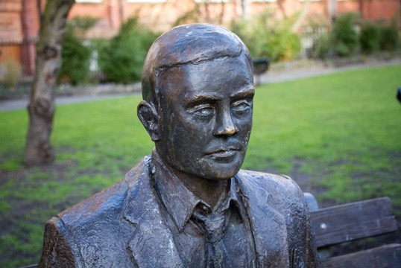
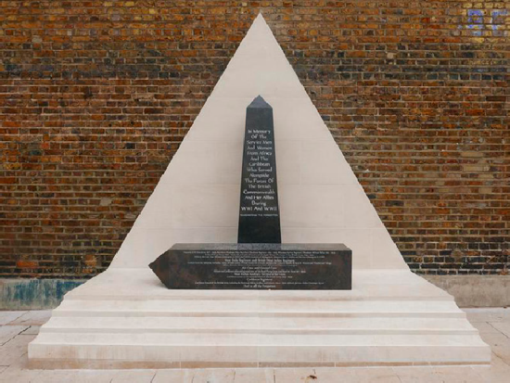
MEMORIALS
Here are some examples of memorials to specific people, groups and events.
The Alan Turing Memorial, Manchester.
The memorial remembers the mathematician who broke the German Enigma code during WW2.
Memorial to Black, Asian and Minority Ethnic (BAME) communities who lost their lives to conflicts in the name of Britain’s Empire and Commonwealth. This image is from the Imperial War Museum collection.
The Tower of London and 2018 exhibition of Poppies, commemorating 100 years since Armistice. Five million people from countries around the world travelled to see this exhibition.
The Women of World War II Memorial, London.
The memorial remembers the seven million women who served, either in the armed forces or on the Home Front, some of whom are still alive today.
Think about:
What can you see in the images? What are the memorials trying to remember?
Do you think it is important to have memorials for specific people, groups and events? Why / why not?
THE BRITISH ARMY: REMEMBRANCE
Notes:
Carousel activity station 5
This slide is a source sheet to be printed and put around the classroom.
Guidance on questions:
The significance of the first Cenotaph being built in 1919 marked the year anniversary since Armistice Day was on the 11th November 1918 and marked the end of the fighting.
The Cenotaph is built out of White Portland Stone, a stone that is from the Isle of Portland in the English Channel. The stone is used for many historic British buildings and is known for its strength. The location of the Cenotaph is surrounded by important locations of power in England, such as the houses of Parliament and Buckingham Palace.

Slide 22


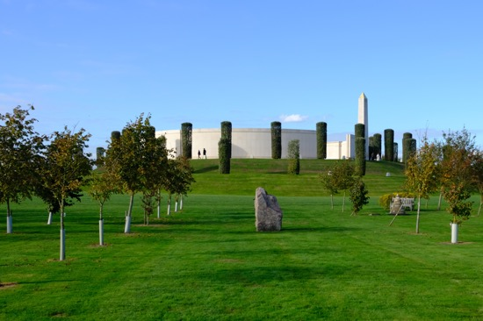
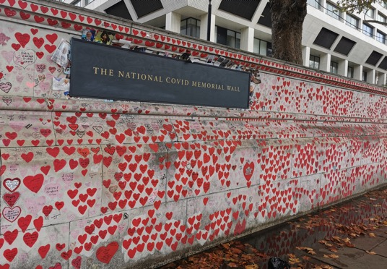
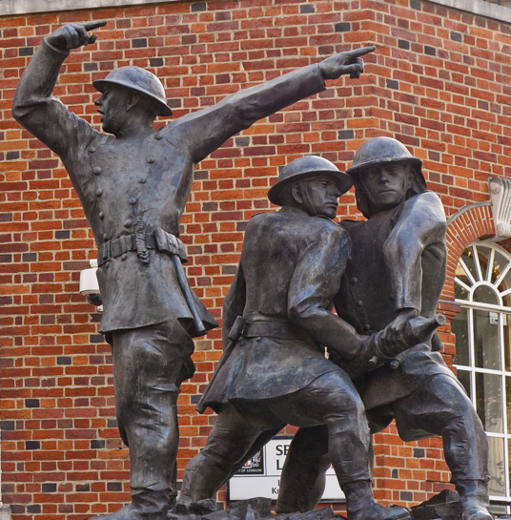
NON-MILITARY MEMORIALS
Here are some examples of memorials to specific people, groups and events.
The National Firefighters Memorial
Firefighter’s Memorial Day is commemorated on the 4th May.
This memorial is located in London, near St Paul’s Cathedral and was unveiled in 1991.
National Memorial Arboretum, Staffordshire
The Arboretum (a garden of trees grown usually for educational or cultural purposes) was as a place for Remembrance for those who have fallen in war. There is also a police memorial here dedicated to those in the force who have lost their lives in service.
The National Covid Memorial Wall outside St Thomas’ Hospital, Westminster
The National Covid Memorial Wall was decorated in 2021 after the devastating effects of the pandemic were felt around the world. The memorial represents lives lost during the pandemic.
Think about:
What can you see in the images? What are the memorials trying to remember?
Do you think it is important to have memorials for specific people, groups and events? Why / why not?
THE BRITISH ARMY: REMEMBRANCE
Notes:
Carousel activity station 6
This slide is a source sheet to be printed and put around the classroom.

Slide 23

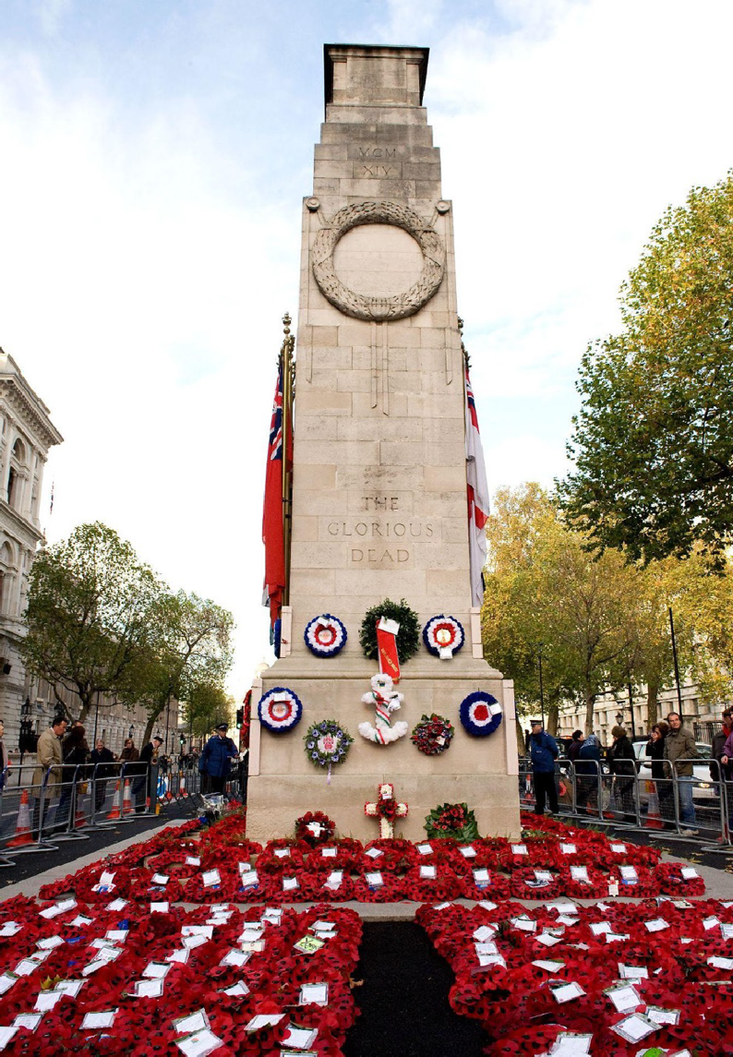
THE CENOTAPH
The Cenotaph is the UK’s national war memorial. Memorials are built to remind people of a person, or an event.
Name: ‘Cenotaph’ comes from Greek kenos taphos, or ‘empty tomb’.
Date: Unveiled by King George V in a special Remembrance ceremony – 11th of November 1920 (The original structure built for the first 1919 Remembrance Day was constructed out of wood!)
Location: Whitehall, London – the seat of power in the United Kingdom, home to the Prime Minister, chief offices of Government, and close to Buckingham Palace.
Shape: Tall, rectangular pylon with a coffin on the top.
Material: White Portland Stone – renowned for its durability, quality and distinctive tones.
Design: Based on ancient Greek architects of the Parthenon, the largest temple in ancient Greece – a symbol of power, wealth and significance.
Size: 11m tall, based on the measurements of the Parthenon columns.
Think about:
What is significant about when the Cenotaph was built?
What does the design and location of the Cenotaph tell you about the way we approach Remembrance in the UK?
THE BRITISH ARMY: REMEMBRANCE
Notes:
Carousel activity station 7
This slide is a source sheet to be printed and put around the classroom.

Slide 24





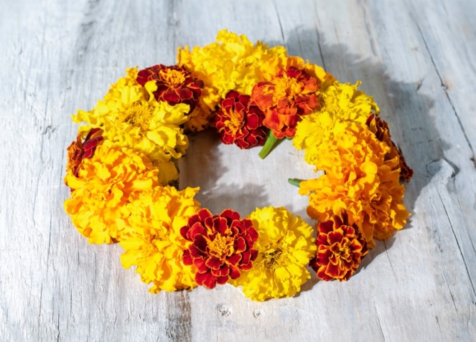
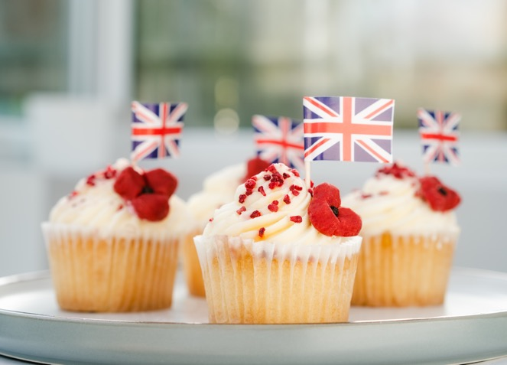
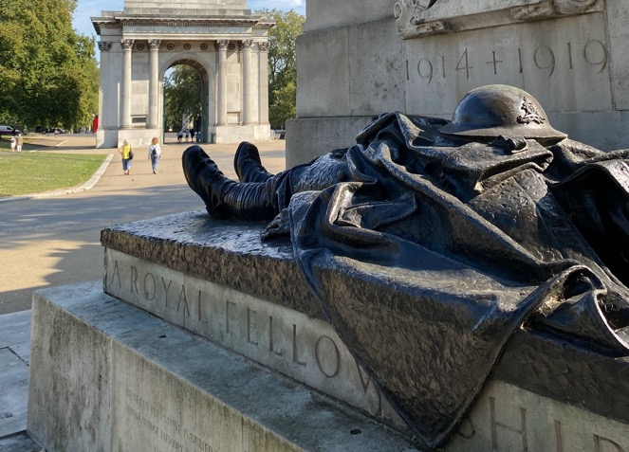


WE WILL REMEMBER
Your task: To plan an act of Remembrance for your school community to take part in this year, around the 11th of November. This might be a memorial, an event, or a piece of artwork – anything that you think will help people take the time to stop and remember.
Notes:
We Will Remember | 15-20 minutes | Activity designed to give students the opportunity to apply their knowledge and learning gained during the lesson.
Read through the slide with students and introduce them to the task.
Give students 15 minutes to do the task independently or in pairs.
Leave 5 minutes at the end for students to share what they have created.
Support: Direct students to the notes on the board and on their worksheets to support them with ideas.
Challenge: How will they promote their event/memorial? How will they make sure people come and visit?
Alternatively this task can be set as a homework task for students to present at a later stage. Instead of using paper this activity could be completed using Google classroom and audio feedback could be given instead of written. If this task is being set for homework instead, skip to slide 26 for the plenary.

Slide 25

WE WILL REMEMBER
Think about:
Who will you Remember?
Who will your event/memorial attract?
How do you want participants/visitors to think and feel?
  What will your act of Remembrance be?
  What will it look like?
  Will there be sound?
  How long will it last?
  What will people do?
Where will the act of Remembrance happen/where will the memorial be placed? Why?
Success criteria:
A name/title.
A description of what the memorial/event will be.
A timeframe for how long it will last. One hour? One week?
A labelled diagram / drawing.
A description of how you want participants to think and feel.
A description of any activities you want participants to join in with.
A suggested location for the design, explaining why it is placed there.
Notes:
We Will Remember | 15–20 minutes | Activity designed to give students the opportunity to apply their knowledge and learning gained during the lesson.
Read through the slide with students and introduce them to the task.
Give students 15 minutes to do the task independently or in pairs.
Leave 5 minutes at the end for students to share what they have created.
Support: Direct students to the notes on the board and on their worksheets to support them with ideas.
Challenge: How will they promote their event/memorial? How will they make sure people come and visit?

Slide 26



HOW DO WE COMMEMORATE
REMEMBRANCE
PLENARY
High-five reflection:
Think – think of five ways that we commemorate Remembrance. Pair – pair up with a partner to discuss.
Share – feedback and share with the class – what are the similarities and differences between the different ways of observing Remembrance?
Notes:
Plenary | 5 minutes | Designed to consolidate knowledge of commemoration and Remembrance, and to focus on how we remember.
Read through the slide with students, and give them the think-pair-share task:
1 minute to think
1 minute to share with a partner
3 minutes to share with the class
When you share as a class, use these questions to facilitate discussion and reflection:
What did you learn that you didn’t know before?
What would you like to try in real life?
Has this lesson inspired you to do Remembrance differently this year?
What was your favourite example of Remembrance in the lesson?

Slide 27

SIGNPOSTING
Want to know more? There are many organisations working on Remembrance who can give you further information and resources:
army.mod.uk/news-and-events/events/2022/ remembrance-sunday/
britishlegion.org.uk/get-involved/ remembrance/remembrance-events/remembrance-sunday
royal.uk/remembrance-day
britishlegion.org.uk
iwm.org.uk
blackpoppyrose.org/
sikhmuseum.com
helpforheroes.org.uk/
fightingwithpride.org.uk/
ppu.org.uk/
Notes:
Signposting | 1 minute | Signpost students to additional sources for more information and further exploration

Slide 28


EXTENSION ACTIVITIES
WE WILL REMEMBER
Ask students to further develop their Remembrance plans. Then peer assess their plans in pairs. Then give students more time to develop and refine their act, allowing them to research and add detail – and then put their plan into action.
ARTWORK
Research examples of traditional or contemporary artwork inspired by war and conflict. Can you create a work of art inspired by these styles to commemorate the stories of war and conflict?
TIME
20–30 minutes
HOW DO OTHER COUNTRIES REMEMBER?
Research how an ally or enemy country from WW1 commemorates Remembrance Day on 11th November, and find five key facts.
Students could use these questions to guide them:
Does ‘Remembrance Day’ have another name in the country you have chosen?
What events take place?
What actions are taken to remember?
Write a short paragraph describing the similarities and differences between their research and how we commemorate Remembrance Day in the UK.
TIME
30–45 minutes

Slide 29


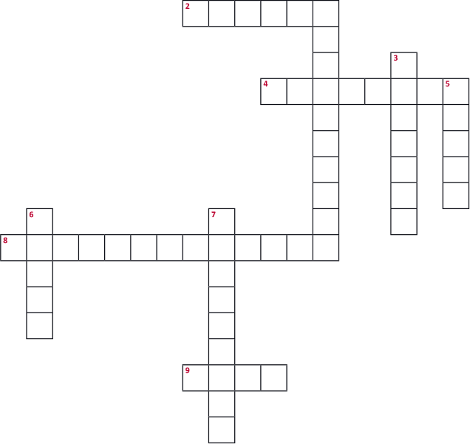

EXTENSION ACTIVITIES
CROSSWORD
Complete the crossword puzzle below to learn more about the topics we will cover today.
Across
2. An assembly for a formal occasion, commonly held on Remembrance Day.
4. A structural reminder of a person, people or event
8. The first event Remembrance Day commemorated.
9. A person belonging to a faith which originated in India.
Down
1. The action of remembering something or someone.
3. No noise or sound.
An abbreviation of a group of people representing their sexuality and gender identity.
A flower which commonly symbolises Remembrance Day.
Another word for a truce, as well as an alternative name for Remembrance before the word Day.
THE BRITISH ARMY: REMEMBRANCE

