Slide 1

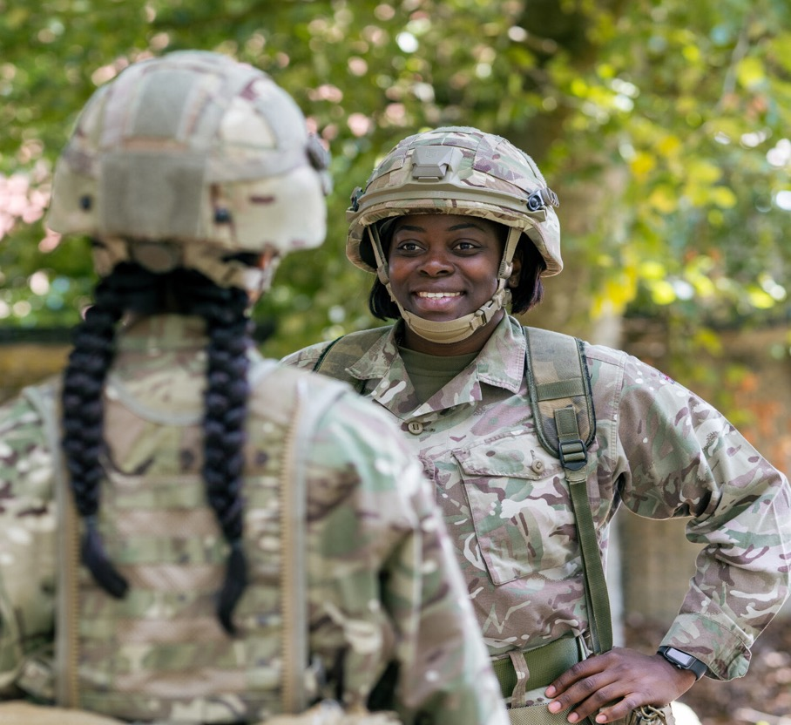
UPS L3 diploma, Unit 5: C1
UNIFORMED
PROTECTIVE
SERVICES
COMMUNICATION
SESSION 2:
RADIO
COMMUNICATION (PART 1)

Slide 2
ABOUT THE BASE UPS RESOURCES
​Overview​
British Army Supporting Education (BASE) is an education programme from the British Army. It includes a website hub providing free-to-use engaging teaching resources, work experience and inspiring workshops.
This lesson is designed to support teaching of Uniformed Protective Services L3 BTEC. You can deliver just one of the sessions, or multiple as best suits.​​
Key information​
Age: 16–18​
Time: 120 or 2 x 60 minutes​
Subject: UPS, Personal development
Preparation:​
Print copies of slides as shown in the session overviews
Plain or scrap A4 paper, or sticky notes
Key vocabulary:​
See slide 5
UPS curriculum links
This session covers Unit 5 C1 Types and Methods of Communication.
Developed by experts​
This programme has been developed in partnership with Hark and a panel of subject matter experts and practising teachers.​
Using this presentation​
Teachers’ notes slides will not display in presentation mode.​
Student slides may have animation – view in presentation mode to see all content. ​
Slide notes contain further teacher guidance, including sample answers and suggestions for using your preferred digital classroom tools.
Links to external websites​
Please follow your school’s own internet safety guidelines.

Slide 3
SESSION OVERVIEW, 1 X 120 MINUTES
​Learning objective: to explore what it means to communicate well in a range of Uniformed Protective Services contexts as students develop their verbal communication skills in face-to-face and radio scenarios.
Activity | Slides | Overview | Timings | Preparation and resources required​
Starter and introduction | 6–8 | Learning outcomes/Introducing radio communications. | 10 mins | Paper or sticky notes
​PRRs v Bowman | 9–11 | Students compare personal role radios (PRRs) with the Bowman system. | 10 mins
SVP | 12–14 | Students explore the components of standard voice procedure (SVP). | 10 mins
Phonetics | 15–19 | Students apply the phonetic alphabet in a range of scenarios. | 30 mins | Print copies of slide 17
Prowords and code words | 20–24 | Students explore the use of procedure words (prowords) and code words. | 20mins | Print copies of slide 22
Using prowords | 25–29 | Students plan and use prowords in a range of communications scenarios. | 25 mins | Print copies of slide 29
Plenary and research task | 30–32 | Summary/Learning outcomes/Extension tasks. | 15 mins
Notes:
Session overview when delivered as 1 x 120 minute session.

Slide 4
SESSION OVERVIEW, 2 X 60 MINUTES
​Learning objective: to explore what it means to communicate well in a range of Uniformed Protective Services contexts as students develop their verbal communication skills in face-to-face and radio scenarios.
Activity | Slides | Overview | Timings | Preparation and resources required​
Starter and introduction | 6–8 | Learning outcomes/Introducing radio communications. | 10 mins | Paper or sticky notes
​PRRs v Bowman | 9–11 | Students compare personal role radios (PRRs) with the Bowman system. | 10 mins
SVP | 12–14 | Students explore the components of standard voice procedure (SVP). | 10 mins
Phonetics | 15–19 | Students apply the phonetic alphabet in a range of scenarios. | 30 mins | Print copies of slide 17
Activity | Slides | Overview | Timings | Preparation and resources required​
Prowords and code words | 20–24 | Students explore the use of procedure words (prowords) and code words. | 20 mins | Print copies of slide 22
Using prowords | 25–29 | Students plan and use prowords in a range of communications scenarios. | 25 mins | Print copies of slide 29
Plenary and research task | 30–32 | Summary/Learning outcomes/Extension tasks. | 15 mins
Notes:
Session overview when delivered as 2 x 60 minute sessions.

Slide 5
VOCABULARY
Accuracy | In communication, being precise and correct in what you say or write.
Bowman | Integrated tactical communications system for voice and data.
Brevity | Saying only what you need to say. Using as few words as possible.
Clarity | Being easy to understand. In communication, speaking clearly and choosing the right words.
Discipline | In communication, making sure there is no talking over other speakers or unnecessary radio use.
Phonetic | Using words to represent letters and digits.
Proword | Procedure word that replaces longer sentence. Used to improve clarity and brevity in radio communication.
PRR | Personal Role Radio. Used for voice communications over short distances.
SVP | Standard Voice Procedure. Correct radio use to ensure accuracy, brevity, clarity and discipline (ABCD), and security.
Walkie-talkie | Two-way radios for short distances.
Notes:
Display or print the key vocabulary and definitions.

Slide 6

LEARNING OUTCOMES
You will be able to:
List the forms of radio communication used in the Uniformed Protective Services.
Communicate over radio using the phonetic alphabet and digits.​
Communicate over radio using standard voice procedures and prowords.
Evaluate your communication skills.
Notes:
Deliver
​Review the learning outcomes with students. These are repeated at the end of the lesson to support reflection and self-evaluation.

Slide 7
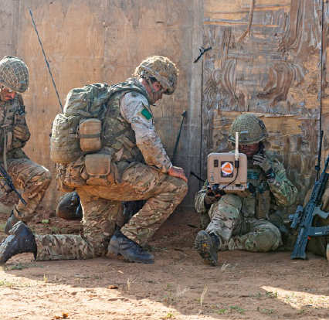
WHEN MIGHT WE USE
RADIO TO COMMUNICATE?
When might you use radio to communicate within a Uniformed Protective Service, or for cross-service communication?
Where might you be?
What type of radio will you use?
What information will you share?
Notes:
Deliver
Use the slide questions to explore students’ current ideas about radio communication.
Students can complete as a think-pair-share task, add their ideas to sticky notes to organise on your board, or write each question on a large sheet of paper to place on a table or wall for students to circulate between.
Digital classroom​
Students can organise and share their ideas using an online whiteboard or notes.​
​
Add support​
Suggest examples: communicating between people; between yourself and a base or command center; when on patrol or when on a call or ‘shout’.
​
Add challenge​
Ask students to compare ideas between armed and civilian protective services.
Image source: https://www.defenceimagery.mod.uk/ 45166112.jpg

Slide 8


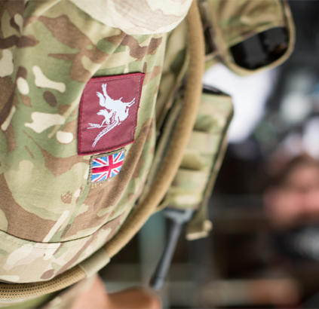
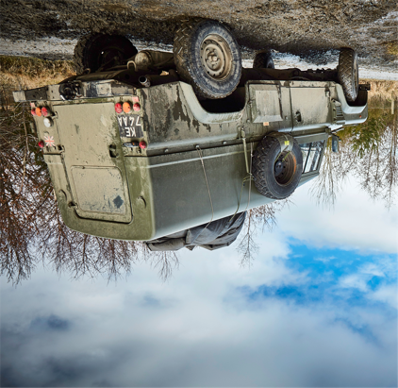
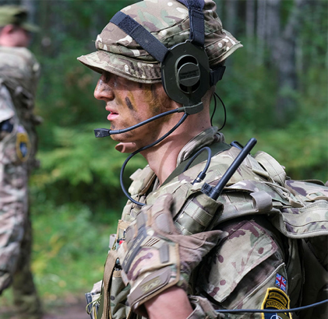
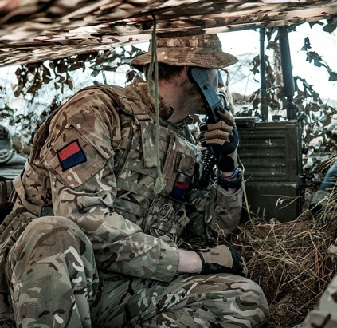

WHEN MIGHT WE USE
RADIO TO COMMUNICATE?
Walkie-talkies
Vehicle radios
Personal radios
Bowman
Notes:
Deliver
Briefly discuss each form of radio communication.
Walkie-talkies tend to be shorter range, cheaper and of lower build quality than personal two-way radio sets, which are also likely to have many more user features (as students will explore in the following slides), including encryption.
A vehicle radio will have similar functionality to a personal two-way radio but may also have a longer range and digital connectivity for sharing data or connecting to, for example, a police database.
Digital classroom​
Provide sample equipment for students to handle and explore. Contrast key features.
Image source: https://www.defenceimagery.mod.uk/
Image 1: 45162492.jpg
Image 2: 45167217.jpg
Image 4: 45167235.jpg

Slide 9
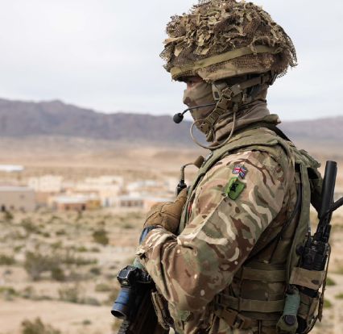
PERSONAL ROLE RADIO
(PRR)
PRR allows soldiers to communicate by voice over short distances.
Weight: 1.5kg
Range: 500m, including through walls and thick vegetation
Channels: 16 available
Length: 380mm
Battery: Up to 24 hours from 2 x AA
Notes:
Deliver
Outline the features of the PRR.
Digital classroom
Students can research further facts and images online.
Add support:
Discuss the concept of channels: distinct pairs of frequencies used for transmission in each direction. Selecting a different channel enables separate conversations to take place - important when many personnel are using PRRs at once.
Add challenge:
Discuss how radio contact can enhance:
Briefing time/sharing
Situational awareness
Image source: https://www.defenceimagery.mod.uk/ AHQCPL1-OFFICIAL-20240310-002-030.jpg

Slide 10
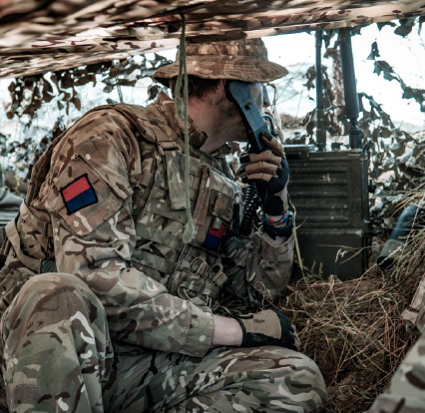
BOWMAN
Bowman is an integrated tactical communications system for voice and data.
Used across the Armed Forces
Battlefield Information System Applications (BISAS)
Secure data transfer
Enhanced communications security
Resilient to electronic attack
Notes:
Deliver
Outline the features of Bowman.
​
Digital classroom
Students can research further facts and images online.
​
Add support​
Discuss the importance of being resistant to electronic attack.
​
Add challenge​
Ask students to suggest what forms of battlefield data Bowman might be used to share.
Image source: https://www.defenceimagery.mod.uk/ 45167235.jpg

Slide 11

PERSONAL ROLE RADIO v BOWMAN
Bowman
Used at all levels including soldiers, vehicles, command HQs, up to Division level.
Includes User Data terminals (UDTs) that run software applications (BISAs).
Situational awareness and operational control for commanders.
Tactical voice and data communications.
PRR
Used for Section level and below.
Rapid voice communication for situational awareness, tactical planning and coordination.
No direct integration with Bowman.
Notes:
Deliver
Briefly contrast PRR with Bowman.
Note how PRR supports close tactic and coordination, while Bowman can support wide-scale awareness and control of operations.
​

Slide 12
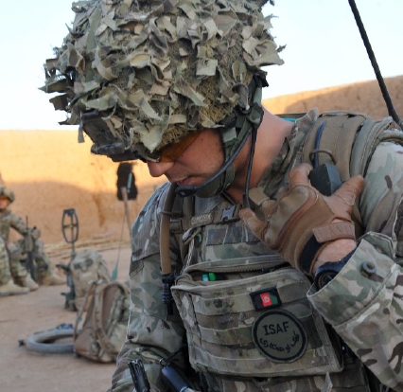
VERBAL COMMUNICATION
RADIO SKILLS
How will verbal radio communication differ from face-to-face communication?
What parts of communication will you lose?
What parts become more important?
What problems or challenges might radio communication introduce?
Notes:
Deliver
Ask students to imagine they are making a radio call (a telephone call is a suitable approximation to consider, if students find this easier).
Discuss how talking over radio differs from talking face-to-face (students can draw on their learning from Parts 1 and 2 of these Communications resources) and any challenges or potential problems this can introduce.​
​​
Add support​
Ask two students to stand up and share some simple information face-to-face, and then contrast with doing this over the phone. Help students note that all non-verbal aspects of the communication, like posture, eye contact and gestures, is now absent. This makes aspects like language, tone and clarity even more important.
​
Add challenge​
Students can consider what issues a weak or noisy signal may introduce, for example if radios are at the edge of their operational range.
Image source: https://www.defenceimagery.mod.uk/ 45155449.jpg

Slide 13
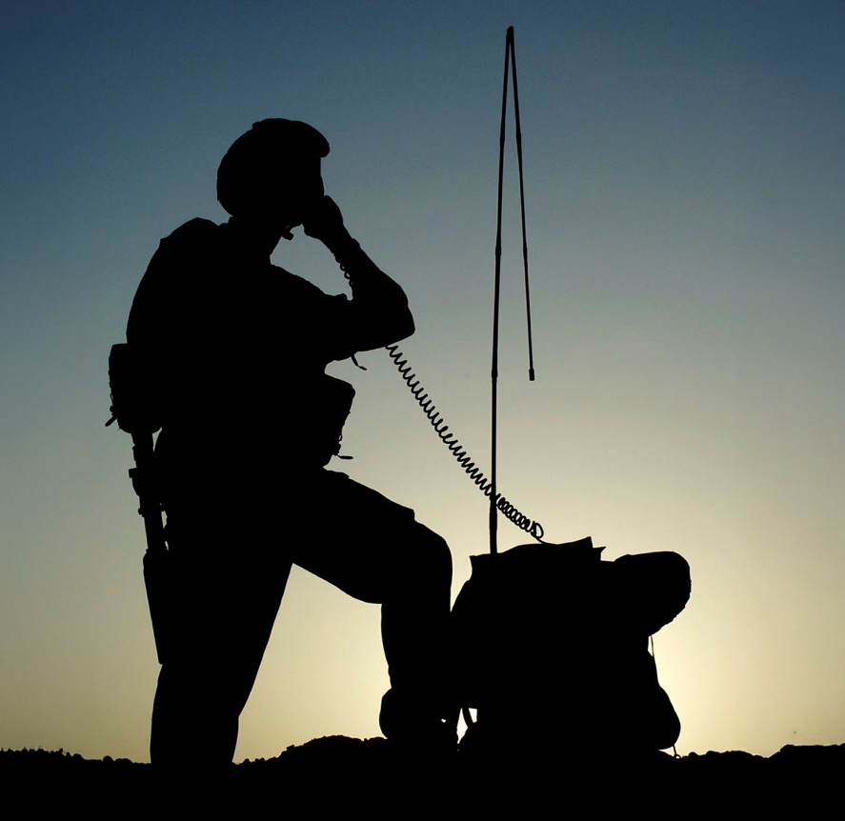
VERBAL COMMUNICATION
RADIO SKILLS
We lose most non-verbal communication when we communicate by radio.
We need to ensure we are clear and understood.
We must avoid talking over one another, especially in urgent or high-tension situations.
Security is essential.
What rules might we follow to make radio communications effective and secure?
Notes:
Deliver
Briefly summarise that we lose many non-verbal aspects of communication.
What’s more, radio communication needs to be effective and secure.
Session 1 includes audio case studies if useful.
​
Ask students to suggest some solutions to this: what rules might we follow to make radio communications effective and secure?
Image source: https://www.defenceimagery.mod.uk/Home/Search?Query=45146633.jpg&Type=Filename 45146633.jpg

Slide 14

RESEARCH TASK SUGGESTIONS
STANDARD VOICE PROCEDURES (SVP)
5cm from microphone, speak at normal volume
Higher pitch than normal
Steady, medium speed
Allow time for messages to be written down
Pronounce every word clearly
Think: ABCD
A: ACCURACY
Think before you speak
Plan what you will say
B: BREVITY
Be brief, keep to the point
C: CLARITY
Use correct words and phrases
Speak clearly
D: DISCIPLINE
Listen carefully and wait before speaking
No over-talking
Allow priority use
Notes:
Deliver
Review standard voice procedures, which can help to make radio communications effective.

Slide 15


PHONETIC ALPHABET
The NATO phonetic alphabet assigns a code word to each letter and digit.
Pronounced clearly, each letter is easily understood.
Contributes to clear communication, regardless of first language.
A Alpha | H Hotel | O Oscar | V Victor
B Bravo (Brar-vo) | I India | P Papa | W Whisky
C Charlie | J Juliet | Q Quebec (Ke-bek) | X X-Ray
D Delta | K Kilo | R Romeo | Y Yankee
E Echo | L Lima | S Sierra | Z Zulu
F Foxtrot | M Mike | T Tango
G Golf | N November | U Uniform
Notes:
Deliver
One way to ensure clear communication over radio is to use a phonetic alphabet to spell out words or letters.
Review the alphabet. Note that syllables in bold are stressed, e.g. ALpha, BRAvo.
​
Discuss some occasions when the phonetic alphabet would be essential. These include:
Names
Car registrations
Letters in grid references
Hand out copies of the printable reference sheet on slide 17.
​
Add support​
Give students one minute to review the alphabet then hide the slide and hold a quick-fire quiz on how to say each letter.
​
Add challenge​
Give students one minute to review the alphabet then, starting with ‘A’, see which student can say the most letters before forgetting the answer.

Slide 16
PHONETIC ALPHABET AND DIGITS
A Alpha | H Hotel | O Oscar | V Victor
B Bravo (Brar-vo) | I India | P Papa | W Whisky
C Charlie | J Juliet | Q Quebec (Ke-bek) | X X-Ray
D Delta | K Kilo | R Romeo | Y Yankee
E Echo | L Lima | S Sierra | Z Zulu
F Foxtrot | M Mike | T Tango
G Golf | N November | U Uniform
O Zero | 1 Wun | 2 Too | 3 Tree | 4 Fower
5 Fife | 6 Six | 7 Seven | 8 Ate | 9 Niner
Hundreds = hun-dred e.g. 300 = tree hun-dred
Thousands = tou-sand e.g. 5000 = fife tou-sand
. = day-see-mal e.g. 3.14 = tree day-see-mal wun fow-er
The TOU in ‘tousand’ and FOW in ‘fower’ are pronounced like ‘towel’.
Notes:
Print copies of this worksheet for students.

Slide 17
USING PHONETICS
Names
Use phonetics to communicate the name of another student in your group.
Now communicate one of these words:
Bowman
Phonetic
Communication
Registrations
Write a fictitious car registration (or observe one from your window), then communicate it to someone else.
(Bonus: if you observed the car, can someone identify the car and describe it using SCRIM?)
Notes:
Deliver
Students use the printed reference to complete the four tasks on this and the following slide.
SCRIM is covered in Parts 1 and 2 of these Communications resources:
S – shape, size
C – colour
R – registration
I – identifying features
M – make and model
Invite students to:
Provide constructive feedback to one another.
Identify what they would do better next time to improve their communication skills.
Digital classroom​
Students can write and share their answers using an online whiteboard or notes.​
They could share answers with a partner via walkie-talkie or mobile phone, for the partner to write down.
Support
Model an answer for each task before students complete it. For example, share your own name phonetically.
Challenge
Students create their own challenges to give to another pair to complete. What information could they share using the phonetic alphabet and digits?

Slide 18
USING PHONETICS
Grid references
Communicate the follow MGRS grid reference to a partner:
30UVC 69952 48272
Or use your own mapping and an OS grid reference to communicate a location of your own.
Time
Military time starts at midnight (00:00), called ‘zero hundred hours’.
For example, 4:34 pm would be ‘sixteen thirty-four’, before converting to phonetics.
Give the exact time to a partner using this format.
Notes:
Deliver
Please refer to the previous slide.
The grid reference is for Pen Y Fan summit, Wales. If you wish to use ODS grid references, this is SO 01230 21490.
Digital classroom​
Students can use https://www.map.army/ to search for the reference using MGRS. (Click the options slider icon in the top left of the screen. Scroll down to coordinate settings and select MGRS in the coordinate grid drop-down box.)
Vocabulary: Military Grid Reference System (MGRS).
If splitting this session across two lessons, take time to briefly revisit the learning outcomes slide and assess progress against the first two outcomes.

Slide 19
UPS L3 diploma, Unit 5: C1
UNIFORMED
PROTECTIVE
SERVICES
COMMUNICATION
SESSION 2:
RADIO
COMMUNICATION (PART 2)

Slide 20
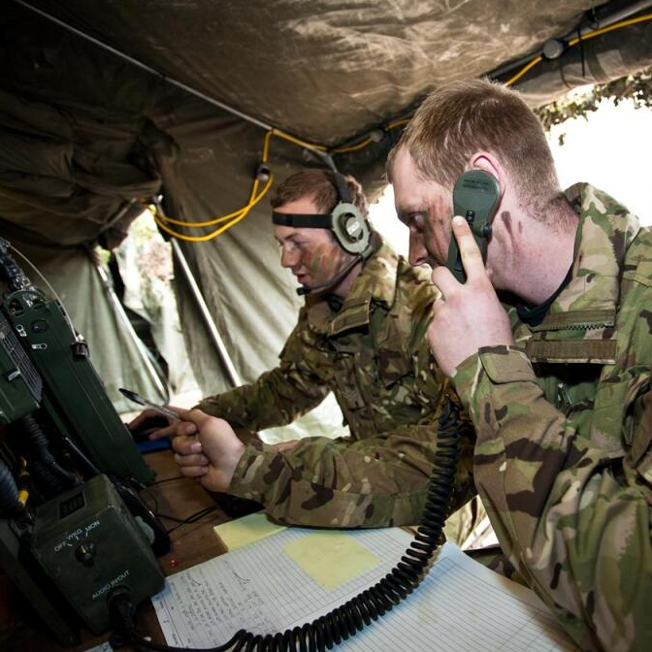
PROCEDURE WORDS
(PROWORDS)
Procedure words or prowords are easily pronounced words or phrases that shorten message time while increasing clarity.
It is important to understand the full meaning of each proword.
Notes:
Deliver
Before you begin, hold a quick-fire phonetic alphabet and digits quiz to recall learning from the previous session.​
​
Introduce the concept of procedure words.
Can students share any prowords they think they already know?
Hand out copies of the printable reference slide that follows.
Challenge:
Can students suggest any prowords they already know which help to ensure people do not talk over one another?
Prowords shorten message time and increase clarity. Can students relate these to ABCD? (SVP)

Slide 21
COMMON PROCEDURE WORDS
ACKNOWLEDGE | Let me know that you have understood (Y/N).
AFFIRMATIVE | Yes.
ALL STATIONS | This message is for all stations.
BE ADVISED | This information is from a third party.
COPY | I have received and understand the information.
CORRECTION | I made a mistake.
DISREGARD THIS | Ignore what I have just said.
FROM | The message originator.
GRID | Say before giving a grid reference.
HELLO | Say to start the communication.
MESSAGE | A warning that the content may need to be written down.
MINIMISE | Only send essential messages.
NEGATIVE | No.
OUT | End of transmission – no reply needed.
OVER | I have finished my transmission. You can now reply.
ROGER | Message received and understood.
SAY AGAIN | Repeat your last transmission.
STAND BY | Wait for another transmission shortly.
THIS IS | Say before saying your station call sign.
WAIT | Wait a moment. (You can add the number of minutes, e.g. ‘Wait wun’.)
Notes:
Print copies of this worksheet for students.

Slide 22
USING PROCEDURE WORDS
Alpha Bravo, this is Control, over
Control, this is Alpha Bravo, over
Control, this is Alpha Bravo, over
Alpha Bravo, this is Control, over
This is Alpha Bravo, our location is GRID XZ12345 67890, over
This is Control wait for Charlie Delta at GRID XZ12345 67890, acknowledge, over
This is Control, verify GRID XZ12345 67890, over
This is Alpha Bravo, roger, out
This is Alpha Bravo, affirmative, out
Notes:
Deliver
Run through the example conversations.
​
Digital classroom​
Students could simulate the conversation using walkie-talkies for other students to observe.
​
Add support​
Ask students to highlight each proword and use of phonetics. Highlight the use of ‘over’ and ‘out’ to ensure no cross-talking.
​
Add challenge​
Ask students to write or role-play a similar short conversation, this time to confirm that:
They have located a vehicle registration XY12 ABC, or
They are at location West St (share phonetically)

Slide 23

CODE WORDS
Like prowords, code words help make communications brief and clear.
However, code words are either:
Names for locations or activities that ensure security.
Abbreviations of common military terms.
Security code word examples:
The name of a military exercise or operation, e.g. ‘Tempest’.
A sensitive location, e.g. ‘Capital’ for a known enemy position.
Abbreviation code word examples:
ETA – estimated time of arrival
OIC – officer in charge
PRR – personal role radio
ECM – electronic counter measure
NYK – not yet known
UAV – unmanned aerial vehicle
Notes:
Deliver
Introduce code words. You may wish to share your own longer list of code words.
​
Digital classroom​
Students can research code words in the UPS and present their findings as a slide presentation or document.
​
Add support​
Highlight that code words that are abbreviations are not secret – anyone can interpret them, so they are not used for sensitive information.
​
Add challenge​
Ask students to list any other abbreviation code words they can think of.

Slide 24
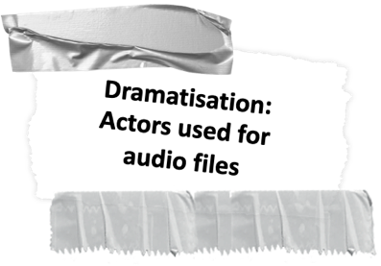

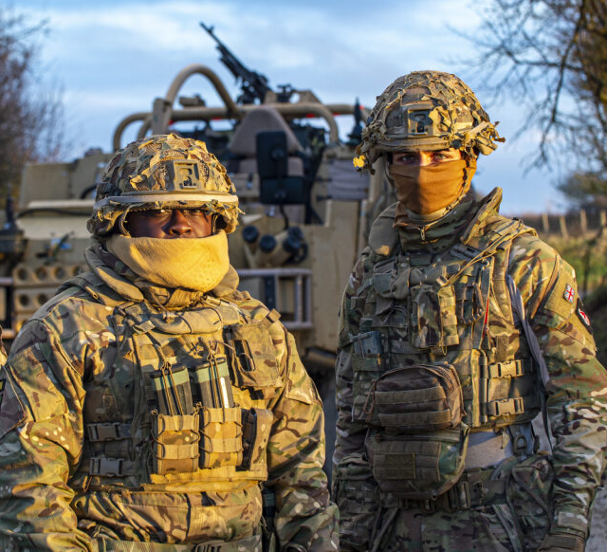
USING PROWORDS 1
SCENARIO
Infantry inter-squad coordination
You are ensuring that four buildings are empty of civilians.
There are four buildings on each side of the road.
One squad is checking buildings on one side of the road and is coordinating with the squad checking the other side.
Your squad has checked two buildings and both are clear. You are unsure of the other squad’s progress.
Establish contact to share your progress and agree to meet at the end of the road when complete.
Notes:
Deliver
The next four slides provide briefings for students to convert into radio transmissions using the correct prowords.
We have provided audio examples for scenarios 1-2 only for additional support. These are optional examples. Dramatisation: Actors used for audio files.
Students use the printable template to plan their transmission.
Review the five steps in communication: Plan, Convey, Receive, Respond, Check Understanding.
Assign one scenario to each pair.
After students have presented their solutions, invite students to:
Provide constructive feedback to one another
Identify what they would do better next time to improve their communication skills
​
Digital classroom​
Students can role-play their conversations and record them for peer evaluation.
We have provided audio examples for scenarios 1-2 to support pupils where necessary.
​
Add support​
Use one scenario to model a proword conversation as a class then assign the remaining three to students.​
Put the information into the correct order for the transmission
Use prowords to establish contact
Share the information
Ask for confirmation that it is understood
End the transmission
Add challenge​
Students work independently as pairs or individuals.

Slide 25
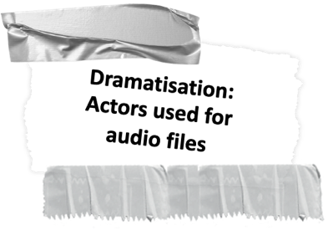
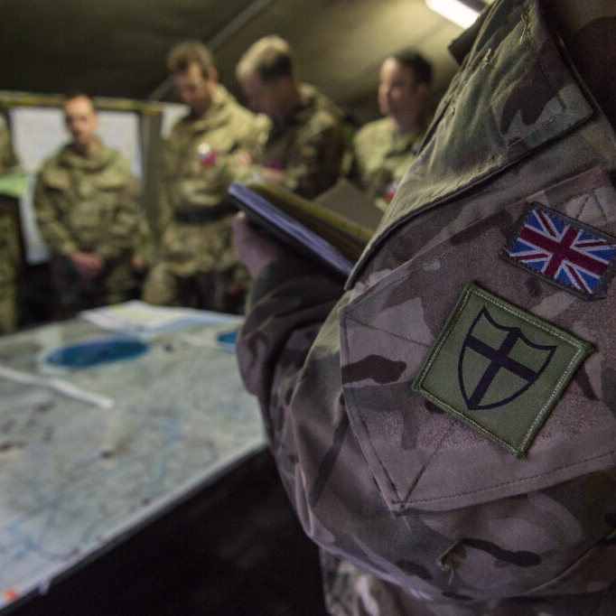
USING PROWORDS 2
SCENARIO
Intelligence
While on exercise you have intercepted enemy communications and movements.
You have two grid references and the details of a convoy of four armoured vehicles moving between the two.
Communicate this information to your OIC and ask for further instructions.
Notes:
Deliver
Please refer to the previous slide.
We have provided audio examples for scenarios 1-2 only for additional support. These are optional examples. Dramatisation: Actors used for audio files.
Note:
OIC is explained as meaning Officer in Charge on slide 24.
Example also uses phonetic alphabet and digits. See part 1 to cover this.

Slide 26
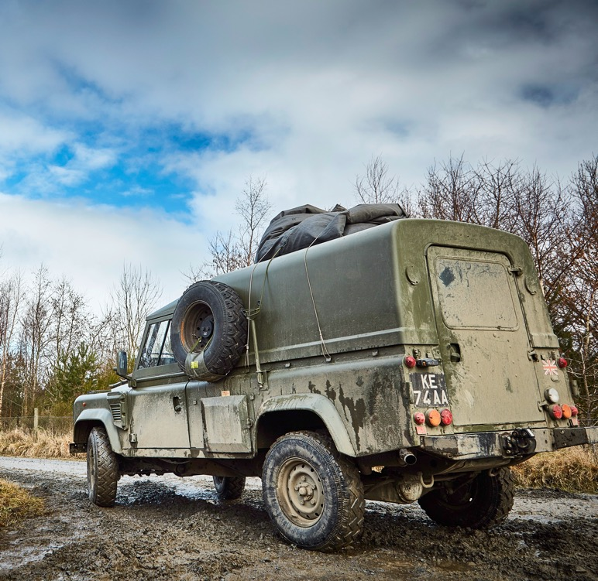
USING PROWORDS 3
SCENARIO
Logistics
You are managing a supply chain.
You have four trucks of equipment in convoy that will visit three forward positions – Alpha, Beta and Gamma – in turn.
The convoy will arrive at 05:30hrs, 09:50hrs and 15:45hrs respectively.
Positions have 30 minutes to unload after which they will affect future ETAs.
Notes:
Deliver
Please refer to the previous slide.
Note: ETA is defined as meaning Estimated Time of Arrival on slide 24.

Slide 27
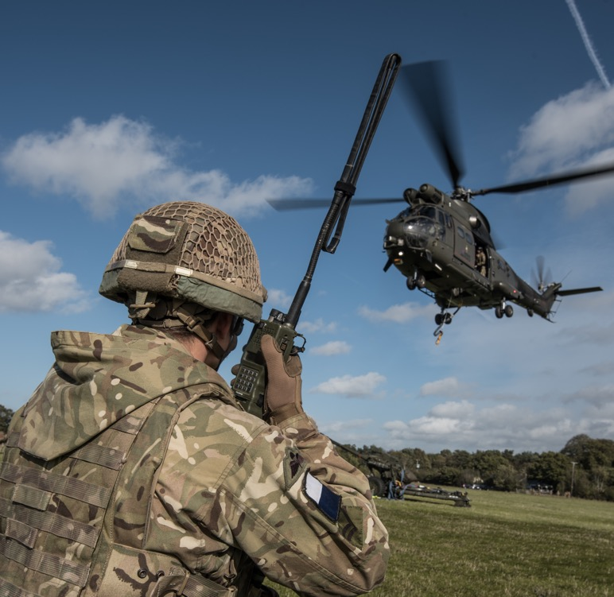
USING PROWORDS 4
SCENARIO
Electronic Warfare & Signals Intelligence
You are deploying active counter-measures to disrupt enemy activity.
Inform your OIC that you have successfully blocked the control signals to local UAVs and await further instructions.
All UAVs appear to have crash-landed. You are determining their landing site positions.
Notes:
Deliver
Please refer to the previous slide.
Note: OIC is defined as meaning Officer in Charge and UAV is defined as meaning Unmanned Aerial Vehicle on slide 24.

Slide 28
STANDARD VOICE PROCEDURES
Plan a short radio transmission to share the information you are given.
Use prowords and if necessary, phonetics.
Open the transmission
Share the information and check understanding
End the transmission
Notes:
Print copies of this worksheet for students.

Slide 29




HOW DO WE KNOW WE HAVE COMMUNICATED?
How well did you apply each step of the communication model?
If you missed a step, what was the effect on your communication?
How could you check your understanding?
How might you check your understanding when using other forms of communication?
What might you do better next time?
Check Understanding
Plan
Convey
Receive
Respond
Security
ABCD
Voice procedure
Prowords
Notes:
Deliver
Use the slide questions to help students reflect on how well they applied this model as they demonstrated examples of radio communication.
Ask students to identify a key insight they will apply as they develop their radio communication skills.
As for face-to-face communication, emphasise the importance of receiving (which highlights the importance of listening to understand) and that checking understanding can often be the responsibility of both the speaker and the listener, for example when giving and receiving instructions or orders.
Review the prowords that aid understanding, e.g. acknowledge, copy, negative, roger, say again.

Slide 30
LEARNING OUTCOMES
You should now be able to:
List the forms of radio communication used in the Uniformed Protective Services.
Communicate over radio using the phonetic alphabet and digits.​
Communicate over radio using standard voice procedures and prowords.
Evaluate your communication skills.
Notes:
Deliver
Review the learning outcomes with students. These are repeated at the end of the lesson to support reflection and self-evaluation. Students can reflect using red/amber/green, a 1–5 rating or emojis.

Slide 31
EXTENSION TASK SUGGESTIONS
During radio practice, pretend your signal has weakened. Use phonetics to share vital information.
Research more military or civilian UPS prowords. Present your findings in a table.
Research tables that show the morse or semaphore alphabets and print copies. Imagine your radio system has broken but you are in visual contact. Plan and convey a short message.
When visiting a military or civilian UPS, research other forms of communications technology they use and how these have changed over time. Identify what advantages new technologies provide and any issues they may cause.
Patrol your school perimeter. Use prowords to convey information about what you observe and your location. Practice using A-H to describe people and SCRIM to describe vehicles during a face-to-face patrol report:
People:
A – age
B – build
C – colour, clothing
D – distinguishing marks
E – elevation (height)
F – face
G – gait (how they walk), gender
H – hair
Vehicles:
S – shape, size
C – colour
R – registration
I – identifying features
M – make and model
Notes:
Deliver
Students can complete the extension tasks individually or as a paired/group task.
Adapt the requirement to suit your class or each individual.

