Slide 1
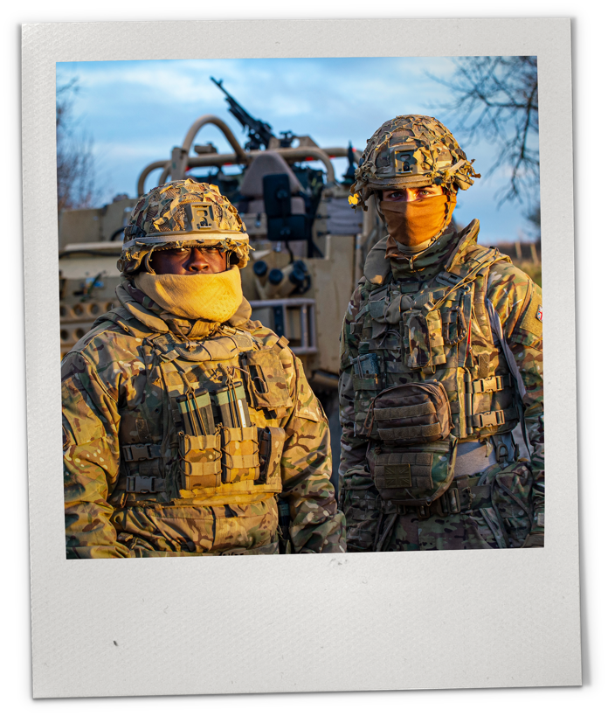




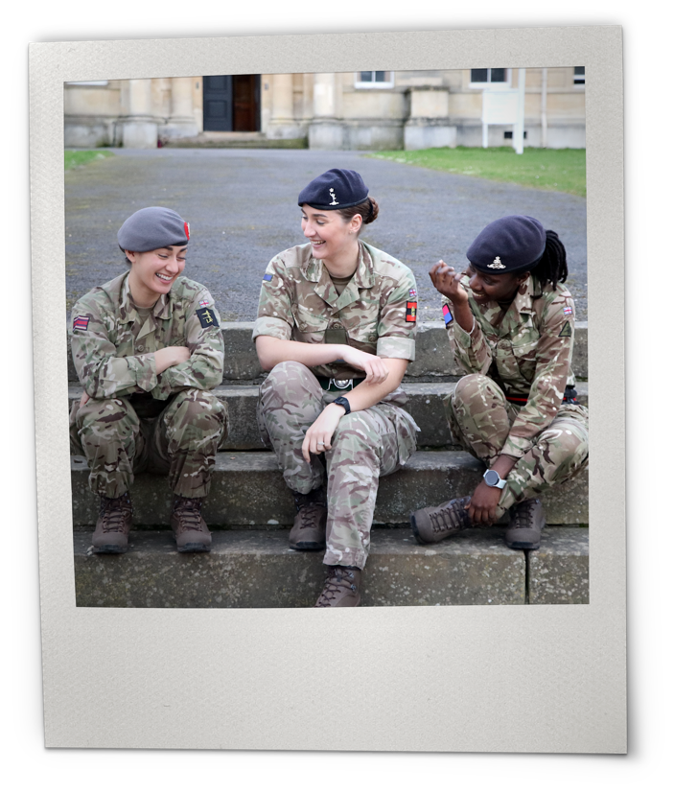




Sessions:
3–5
Subject:
PSHE
Ages:
11–14
DIVERSITY,
BELONGING
AND INCLUSION
IN THE ARMY​

Slide 2


ABOUT THIS RESOURCE
British Army Supporting Education (BASE) is an education programme from the British Army, providing free-to-use engaging teaching resources, work experience and inspiring workshops.
This adaptable resource has been created to support schools in exploring how diversity and inclusion are essential to building a strong community.
Students will gain insight into the initiatives supported by the Army to promote diversity and inclusion. They will also develop essential skills to foster inclusion and diversity as active citizens, leaders, and collaborators in their communities, whether at school, in the workplace, or in the broader world, both now and in the future.​
This presentation covers sessions 3–5.
Make sure to view in presentation mode to see the animation.

Slide 3
KEY INFORMATION
Age: 11–14​
Time:​ 15–20 minutes per session, with opportunities to extend​
Subject: PSHE ​
Resources: ​
Warm-up activity​ (optional)
Five sessions​
Preparation: ​
Use the warm-up activity to cover core themes and assess the prior knowledge of students.​
Review this presentation, pick and choose content for your setting, and adapt for your students.​
Use the signposting content on final slide for further support.​
Key vocabulary: ​
Inclusion, diversity, belonging, heritage, community, leadership, stereotypes.​
Delivery​
This resource can be delivered:​
as standalone form time activities​
as part of a five-session series​
delivered together in a longer session as part of a theme day.​
​Developed by experts ​
This programme has been developed in partnership with Hark, a panel of subject matter experts and practising teachers. ​
​Using this presentation ​
Slide notes contain further teacher guidance, ideas for support and challenge, sample answers and extension activities are indicated.​
Slide notes will not display in presentation mode. ​
Student slides have animation – view in presentation mode to see all content. ​
​Links to external websites
Please follow your school’s own internet safety guidelines.​
​Additional PSHE guidance in slide notes.​
Notes:
For PSHE sessions and sensitive topics, it is important to consider how to handle complex issues in each context, focussing on how to create a safe learning environment:
Identify students for whom the topic may be challenging.
Use distancing in discussion questions, e.g. asking students to think about a young person their age, rather than asking for specific examples from their own lives.
Draw on established ground rules for PSHE sessions to help students focus and respect others’ opinions.
Highlight the signposting at the end of each session, offering students a place to go with any questions or worries.
Provide signposting for teachers in your setting where applicable.

Slide 4


LEARNING OBJECTIVES
By the end of the sessions, students will be able to: ​
demonstrate skills to strengthen diversity and inclusion through a range of approaches
explain why it is important to strengthen diversity and inclusion in any group or organisation
reflect on how everyone can take an active role in supporting diverse and inclusive communities in driving change and challenging barriers.

Slide 5
CONTENT OVERVIEW​​
This presentation covers sessions 3-5.
Content | Timing​ | Resources needed​
Warm-up activity​ | 5–10 minutes​ | n/a​
Session 1: Community Networks​ | 15 minutes​ | n/a​
Session 2: History​ and Heritage | 15 minutes + project task​ | Internet access for research​ Mini-whiteboards/paper and pens, optional​
Session 3: Challenging Stereotypes​ | 15 minutes + optional extension​ | Printed scenarios, optional​ Mini-whiteboards/paper and pens, optional​
Session 4: Community Voice | 15 minutes + optional extension​
Session 5: Leadership in Action​ | 15 minutes + optional extension​ | Mini-whiteboards/paper and pens, optional​
Signposting​
Notes:
Delivery
This resource can be delivered:
as standalone form time activities
as part of a five-session series
delivered together in a longer session as part of a theme day.

Slide 6

CURRICULUM LINKS
British Values
In addition to the PSHE curriculum links, these sessions touch on several themes from British Values, including democracy/inclusion, tolerance and respect.
England – PSHE – KS3
​Health and Wellbeing
H1. how we are all unique; that recognising and demonstrating personal strengths build self-confidence, self-esteem and good health and wellbeing​.
Relationships
R14. the qualities and behaviours they should expect and exhibit in a wide variety of positive relationships (including in school and wider society, family and friendships, including online).​
​R15. to further develop and rehearse the skills of team working. ​
​R16. to further develop the skills of active listening, clear communication, negotiation and compromise. ​
Living in the Wider World
​L9. the benefits of setting ambitious goals and being open to opportunities in all aspects of life​.
​L10. to recognise and challenge stereotypes and family or cultural expectations that may limit aspirations​.
Curriculum links from the PSHE Association Programme of Study for PSHE Education KS1-KS5.​
Wales – Health and Well-being – Progression Step 4
​Our decision-making impacts on the quality of our lives and the lives of others.
I can consider relevant factors and implications when making decisions individually and collectively.
How we engage with social influences shapes who are and affects our health and well-being.
I have a developing awareness of how rules, norms and behaviours become established within groups and at times go unchallenged.
Healthy relationships are fundamental to our well-being.
​I can respect other people’s points of view and use this to help resolve conflict.
Curriculum links from The Curriculum for Wales.​
Teachers are encouraged to make these links and discuss with students as relevant within your setting.​

Slide 7

CURRICULUM LINKS
Northern Ireland – Personal Development and Mutual Understanding – KS3
Diversity and Inclusion
Investigate factors including religious and political that influence individual and group identity, for example age, gender, youth culture, ethnicity, community background, multiple identity, changing identities, etc.
Investigate ways in which individuals and groups express their identity, for example dress code, language, musical and sporting traditions, religious and political opinion, beliefs, etc.
Investigate how and why conflict, including prejudice, stereotyping, sectarianism and racism may arise in the community. Investigate ways of managing conflict and promoting community relations, reconciliation.
Democracy and Active Participation
Investigate various ways to participate in school and society, for example school councils, peer mediation, mock elections, volunteering, community action/involvement, lobbying and campaigning through NGOs, local councillors, MLA or MEP, etc.
Self-awareness
Explore personal morals, values and beliefs, for example the origin of personal values, developing a moral framework, personal integrity, etc.
Curriculum links from The Northern Ireland Curriculum.
Scotland – Health and wellbeing – third and fourth level:
Social wellbeing
I recognise that each individual has a unique blend of abilities and needs. I contribute to making my school community one which values individuals equally and is a welcoming place for all.
Representing my class, school and/or wider community encourages my self-worth and confidence and allows me to contribute to and participate in society.
Through contributing my views, time and talents, I play a part in bringing about positive change in my school and wider community.
Curriculum links from The Curriculum for Excellence.
Cross-Curricular Links
In addition to the curriculum links provided, these resources have cross-curricular links to Oracy, History and the Gatsby Benchmarks.

Slide 8

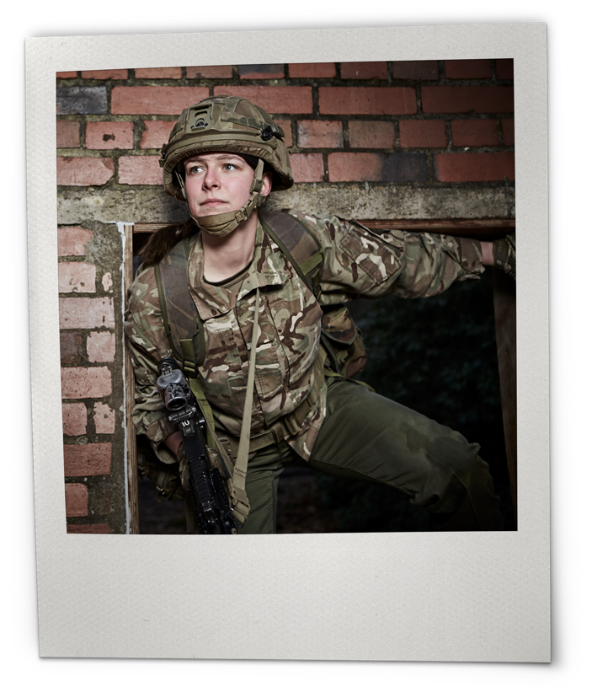



Session
Three
Time:
15–20 minutes
CHALLENGING
STEREOTYPES
DISCUSS THE STEREOTYPES THAT EXIST
AROUND THE ARMY TODAY AND LEARN
HOW TO CHALLENGE THEM.

Slide 9






ARMY STEREOTYPES​
Definition of Stereotype
‘A set idea that people have about what someone or something is like.’
You have one minute to create and draw a person who works in the Army. You must give the following details:
Name
Age
Job role
Clothing / equipment
Hobby / interests
Did you know?
Stereotypes are not always correct, they can be harmful and prevent people from fulfilling their potential. It is important to challenge stereotypes.
Notes:
Army stereotypes
Read slide and set task. Students to work independently or in pairs, as appropriate.
Students feedback to class, teacher to highlight any general themes, e.g. lots of soldiers / lots of male characters / young characters.
Click to reveal and read definition of stereotype. You can use a different definition if you’d prefer.
Explain that a common stereotype of Army personnel is that they are young, white, male soldiers in uniform. Whilst some Army personnel do fit this idea, there are thousands of other Army personnel whose age, gender, job role and responsibilities are different.
Click to read and reveal the focus point.
Key vocabulary​
​
Stereotype: A set idea that people have about what someone or something is like https://dictionary.cambridge.org/dictionary/english/stereotype?q=stereotypes#google_vignette​

Slide 10

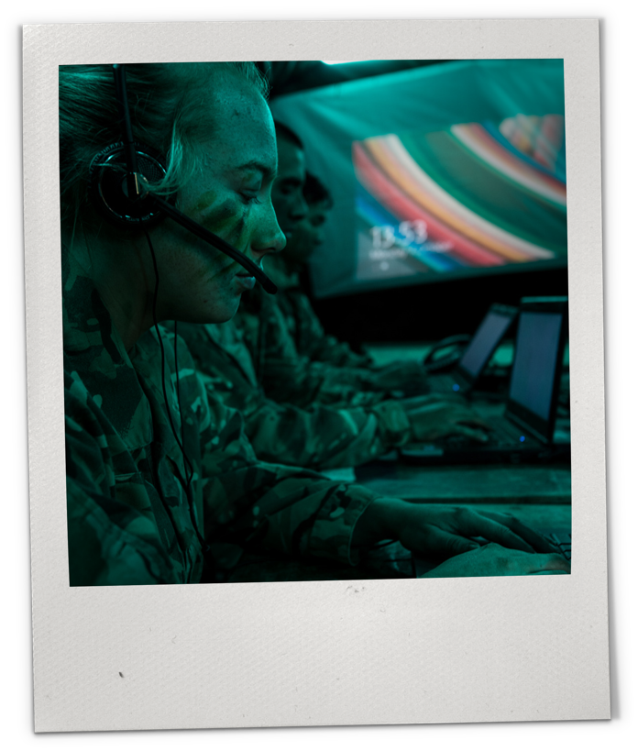
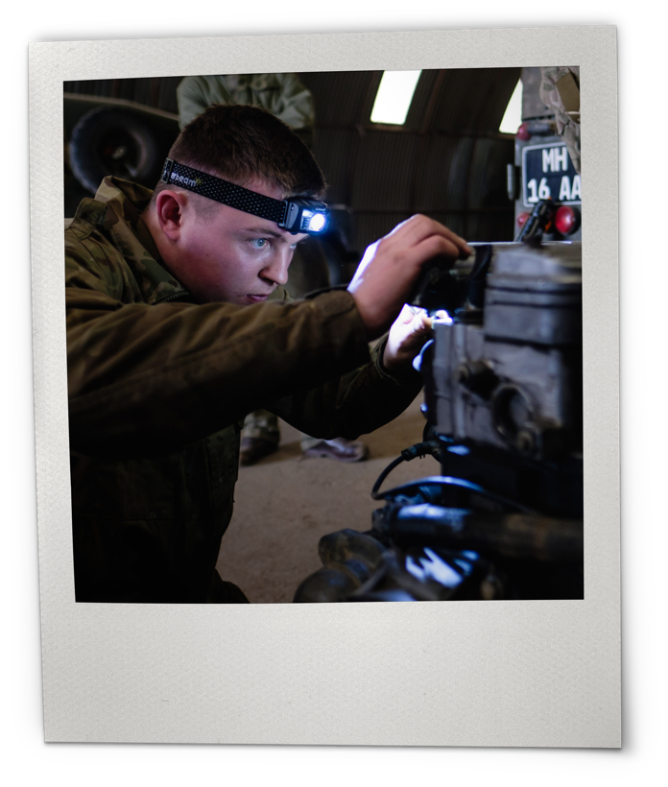
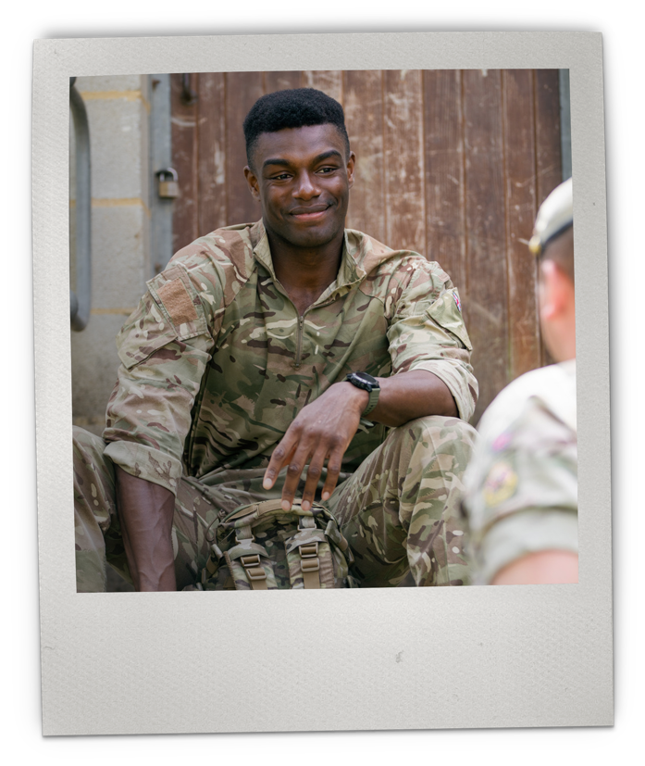



ROLES IN THE ARMY
Infantry Soldier
Serves in operations, missions and on the front line. Infantry soldiers are among the most active soldiers with an incredibly varied role and worldwide travel.
Operator Military Intelligence
Serves by analysing intercepted communications, advising soldiers, Generals and politicians on highly sensitive operations.
Vehicle Mechanic
Serves by knowing how to fix and drive each Army vehicle from tanks to trucks, travelling worldwide.
Notes:
Roles in the Army
Show images of different Army roles and read the brief descriptions.
Support:
Ask students to explain which roles surprised them the most.
Challenge:
Ask students to explain how these job roles challenge stereotypes associated with Army personnel.
Source: https://jobs.army.mod.uk/regular-army/find-a-role/

Slide 11
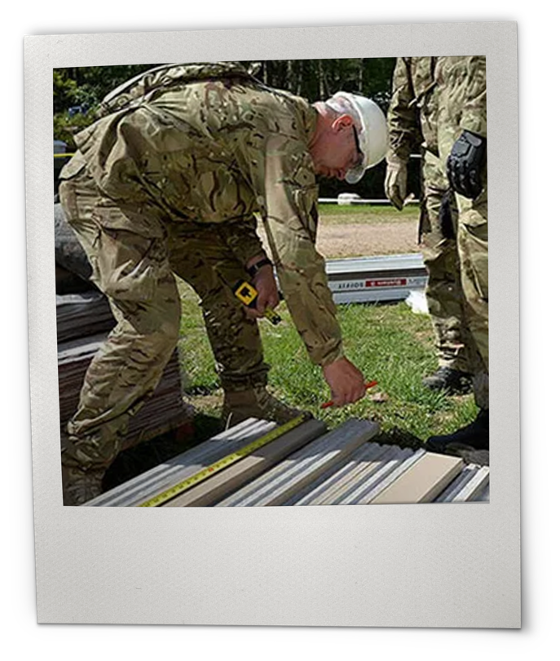
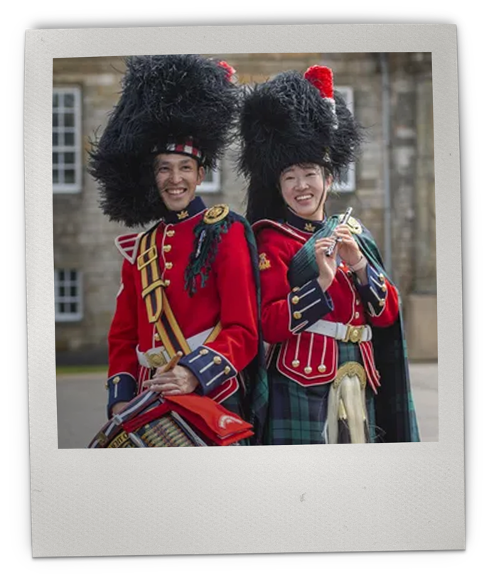
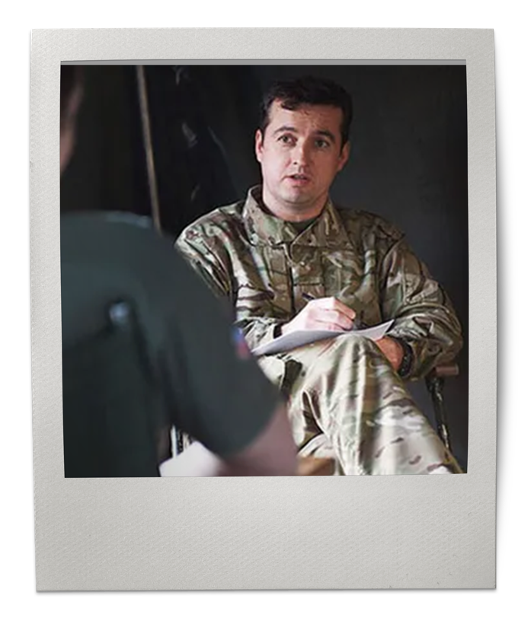



ROLES IN THE ARMY
Infantry soldier
Serves in operations, missions and on the front line. Infantry soldiers are among the most active soldiers with an incredibly varied role and worldwide travel.
Plasterer and Painter
Trained in key trade skills, these personnel work on the Army’s biggest building projects all over the world.
Mental Health Nurse
Serves the Army personnel by giving advice and support on mental health issues, managing a patient case load.
Operator Military Intelligence
Serves by analysing intercepted communications, advising soldiers, Generals and politicians on highly sensitive operations.
Vehicle mechanic
Serves by knowing how to fix and drive each Army vehicle from tanks to trucks, travelling worldwide.
Musician
Talented musicians turn their passion into a career, boosting the morale of troops and performing in national ceremonies.
Notes:
See previous slide notes.
Source: https://jobs.army.mod.uk/regular-army/find-a-role/

Slide 12

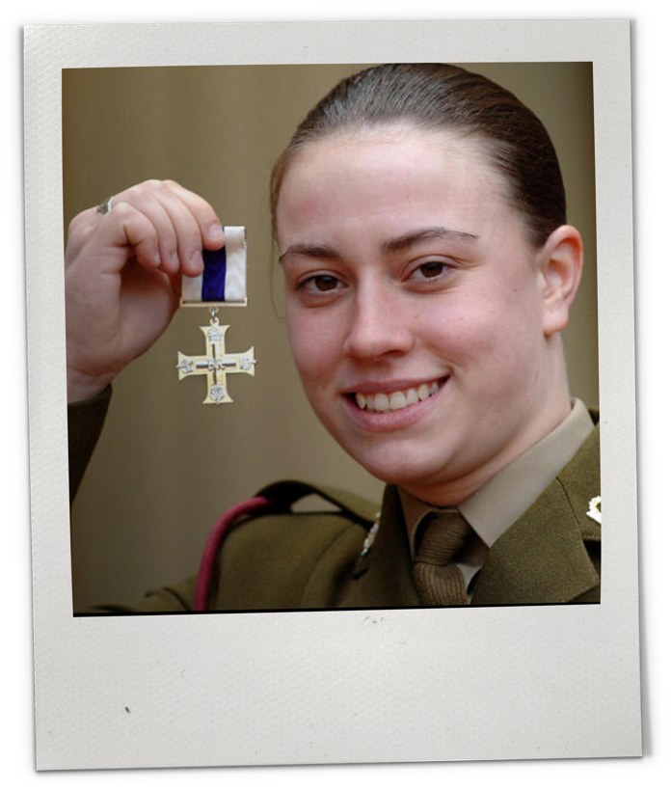
CASE STUDY: PRIVATE MICHELLE NORRIS MC
In 2012, 18-year-old Army medic Private Michelle Norris MC was the first woman to be awarded the Military Cross, one of the highest awards for bravery in battle.
Noris braved sniper gunfire in Iraq, to climb on top of a tank and give life-saving treatment to a severely wounded comrade.
Having recently completed training, it was the first time she had ever had to serve a casualty on the frontline.
She spoke of her pride at receiving the Military Cross – hoping it would clearly show that women can endure frontline combat.
Notes:
Case Study: Private Michelle Norris MC
Read the slide, inviting students to read aloud, as appropriate.
Use this case study to discuss stereotypes, using the following prompts:
Support:
How does the example of Private Michelle Norris MC challenge stereotypes in the Army? Suggested answers: she is female, she is a medic, she was newly qualified when she won the award.
Do you think that she intended to challenge stereotypes and set an example in the way that she did? Suggested answer: no, she was in the moment, doing her job, and had no idea her work would be successful or recognised in this way.
Challenge:
How does a stereotype of ‘young, white, male combat soldier in uniform’ hold up against this example? How can stereotypes be damaging? Suggested answer: the example is the opposite of the common Army stereotype, and stereotypes can be damaging because they can stop people from fulfilling their full potential. Private Michelle Norris MC didn’t let the pressure of stereotypes stop her, and she performed at her best under immense pressure.
How might this story inspire others? This example could inspire young women wanting to join the Army, younger women currently serving in the Army, and women in male-dominated organisations.
Sources:
http://news.bbc.co.uk/1/hi/england/west_midlands/6476635.stm
https://www.standard.co.uk/hp/front/teenage-army-medic-becomes-first-woman-to-win-military-cross-7197591.html
https://collection.nam.ac.uk/detail.php?acc=2007-06-8-26

Slide 13







CHALLENGING STEREOTYPES
How to challenge stereotypes:
1. Identify the stereotype.
Challenging stereotypes is important, and it is everyone’s responsibility. With support, everyone can feel confident, included and able to perform at their best.
Scenario:
During careers week, a supply teacher is discussing future aspirations with a class. One of the classmates confidently shares that she wants to join the Army and train as a combat engineer. She explains how she admires the discipline and physical fitness required, and how excited she is about the idea of contributing to disaster relief and humanitarian efforts. As she finishes, another student comments, “But girls shouldn’t join the Army, especially combat roles.... girls don’t look good with too many muscles.”
2. Question the statement, not the person.
3. Correct the stereotype with a story or example.
What actions can you take to make your school and community more inclusive and stereotype-free?
Notes:
Challenging stereotypes
Explain that it is not always easy to challenge gender stereotypes and sometimes it might make us feel a little uncomfortable. But it is important to be brave and challenge words or actions that might harm our peers. So, we are going to explore some simple and effective ways we can challenge stereotypes.
Read through the flow diagram.
Emphasise that if students hear stereotypes repeatedly being used by peers to be unkind or exclude people, report this behaviour to a teacher or parent/caregiver.
Split the students into pairs and allow them to read the scenario together, taking it in turns to be the challenger.
Support: For younger classes, the scenario could be acted out, and the step-by-step response could be processed as a class, asking students for examples of what they might say.
Challenge: Create their own scenario for their partner to identify and challenge the stereotype.
Optional extension:
Students could:
Write up the step-by-step ‘How to challenge stereotypes’ structure in their homework diary, for reference.
Design a poster to go up in the classroom, to remind them of how to challenge stereotypes.
Follow PSHE best practice when having these conversations. As a teacher, please model how you would challenge the stereotype using appropriate language. You could use 'calling out' vs 'calling in' for this. Calling out is a direct challenge that brings attention to harmful words or actions, while calling in is a more private, open-ended conversation that aims to prevent future harm. For more support on this visit chrome-extension://efaidnbmnnnibpcajpcglclefindmkaj/https://edib.harvard.edu/files/dib/files/calling_in_and_calling_out_guide_v4.pdf or https://diversity.tufts.edu/resources/interrupting-bias-calling-out-vs-calling-in/

Slide 14
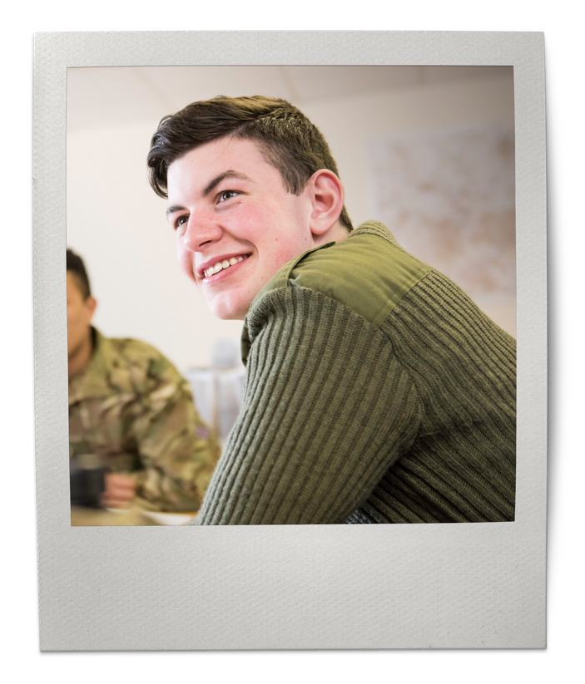
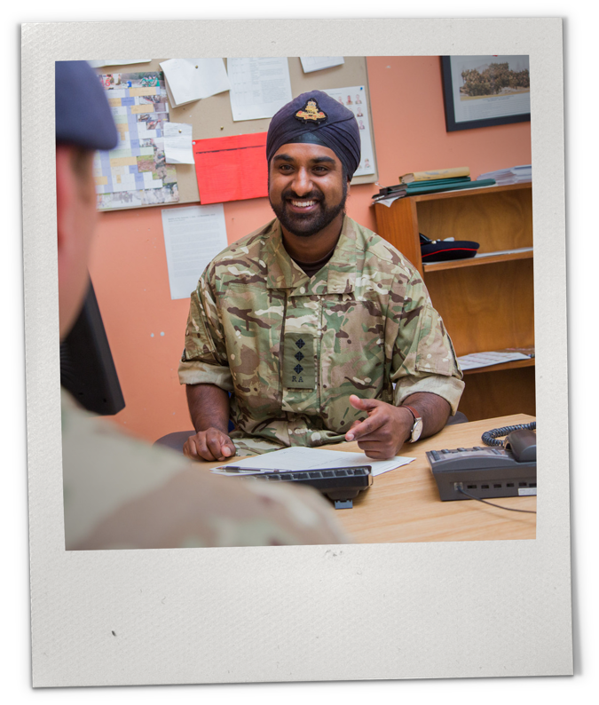

Session
Four
Time:
15–20 minutes
COMMUNITY
VOICE​​
DISCOVER THE IMPORTANCE OF COMMUNITY
VOICE IN THE ARMY ​AND IN SOCIETY.​

Slide 15

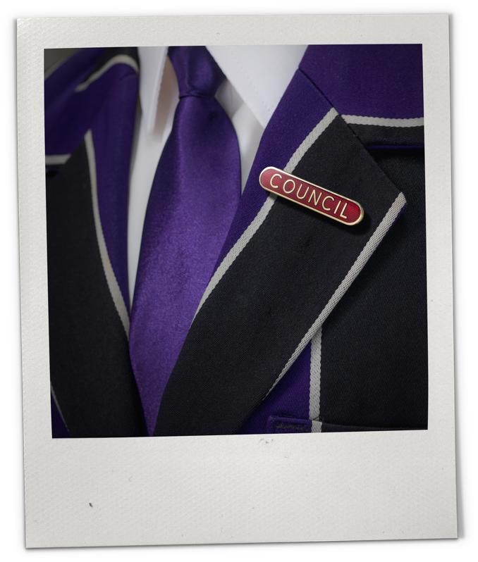
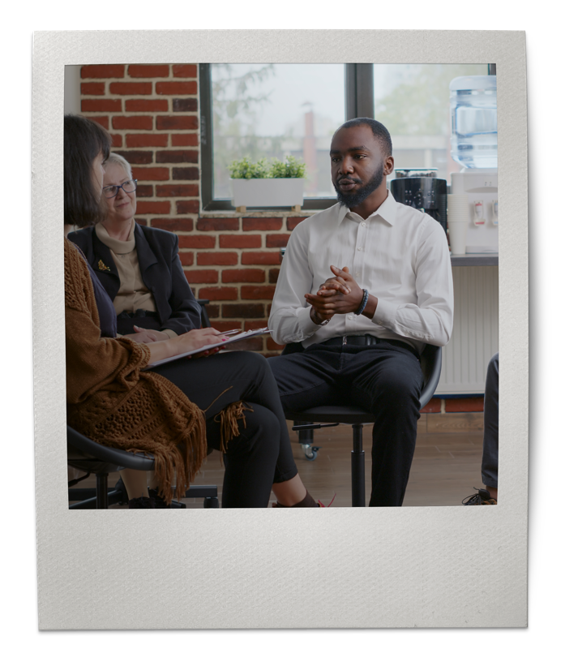


DEFINING COMMUNITY VOICE​
Consider the mission of each of these organisations and groups. What common theme unites them?
Did you know?
These are all examples of community voice groups/organisations. Community voice means that those who are affected by a decision can have their voices heard and provide guidance in the decision-making process.
School council
Parent teacher association
Notes:
Defining community voice
Show slide images and read question, giving students time to respond.
Click to reveal and read the focus point.

Slide 16









HOW COMMUNITY VOICE WORKS
Community voice groups and organisations work from the bottom-up. They provide a way for those at the ‘bottom’ to speak to those at the ‘top’. For example:
The concern is raised with catering and headteachers, who can make a decision about it.
Did you know?
Community voice groups and organisations are the most effective way for people to have their say. Without community voice, lots of people would never have their concerns addressed, or would have to try and work on their own.
Students have a concern about school lunches.
They talk to a school council representative about it.
School council rep raises the issue at the next school council meeting.
Using the example above, suggest how the following community voice organisations might work – whose voices do they capture at the ‘bottom’, and who do they speak to at the ‘top’?
Army Multicultural Network
Parliament
Parent Teacher Association
Charities supporting underrepresented groups
Notes:
​How community voice works
Read through slide and flow diagram.
Set the task and give students time to complete before receiving feedback.
Support:
Students could work as a class, with the teacher, to go through one or two examples to clarify how community voice structures work.
Challenge:
Students to work in pairs to think of how each structure works before feeding back to class for discussion (optional).

Slide 17





USING YOUR COMMUNITY VOICE
As a school council, you need to:
decide on one or more actions you will take to show that you have listened to community voice.
write a statement to explain the concern you received, the action you have taken, and why you think it will be effective.
At school, your school council is an important community voice organisation - a way for all students to have their concerns raised and addressed.
Scenario:
You are on the school council, and your school council representatives have received a range of concerns from students this week:
“As a school, we don’t do enough to make the school inclusive for LGBTQ+ students.”
“Vegetarian students think there are not enough protein options for them at lunch.”
“There have been reports of bullying in Years 8, 9 and 10 – people don’t feel safe at school.”
“I’ve noticed how much paper gets thrown in the main bin at school – we are sending too much to landfill.”
Did you know?
Supporting, engaging with, or volunteering to be involved with Community Voice organisations is an important way to promote diversity and inclusion, tackle discrimination and be an active citizen in your community and promote British Values.
Examples: run an anti-bullying campaign, organise a team to plan the celebrations of Pride Month, deliver an assembly on anti-bullying, run a campaign about the importance of recycling, organise a litter-pick, conduct a survey to ask students about their views and experiences in more detail.
Notes:
Using your community voice
Read through slide with students and set task.
Support:
To support students, run through a scenario as a class. For example: “As a school, we don’t do enough to make the school inclusive for LGBTQ+ students.” Action: Organise a team to plan Pride Month celebrations, order posters from Stonewall to put up in the corridors, organise an assembly on LGBTQ+. Statement: “On hearing that we don’t do enough to include LGBTQ+ students in school, the School Council are excited to announce that we have contacted Stonewall to come and deliver an assembly later this term, and have organised a team to plan accessible, fun activities to celebrate and highlight Pride Month this summer. Any LGBTQ+ or ally students are welcome to get involved with the organisation of these events.” Challenge:
Students to take the activity one step further in predicting what the result of the action could be if it was a success, and what the result of the action could be if it was a failure. If it was a failure, what else would they do?
Click to reveal and read the focus point.

Slide 18


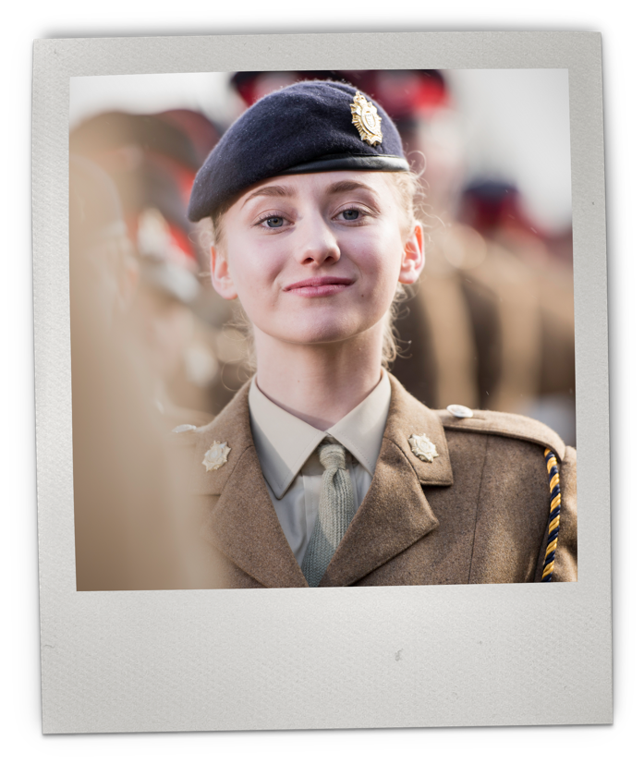
Session
Five
Time:
15–20 minutes
LEADERSHIP
IN ACTION​​​
IDENTIFY PERSONAL LEADERSHIP QUALITIES
AND EXPLORE​ HOW TO USE PERSONAL
EXPERIENCE TO EMPOWER OTHERS.

Slide 19
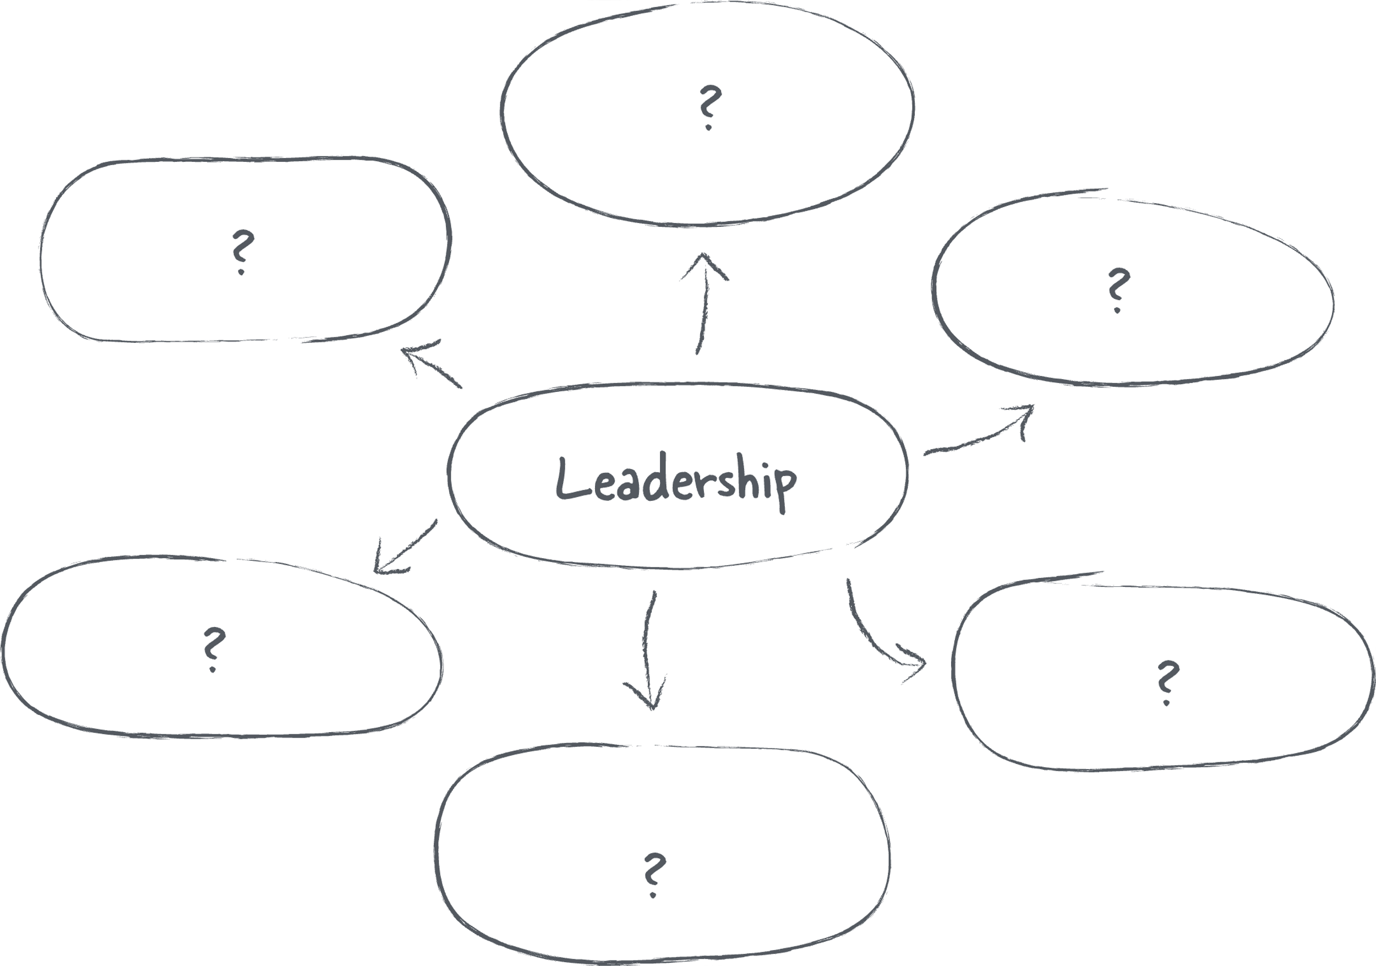
WHAT DOES LEADERSHIP MEAN TO YOU?​
Notes:
What does leadership mean to you?
Show slide and discuss question with students.
Support:
Draw a mind map on the board to capture verbal discussion. Challenge:
Students to work independently to write their own definition of ‘leadership’.
2. Define ‘Leadership’: the ability of an individual to influence and guide members of an organisation or team.
Defining ‘Leadership’: the ability of an individual to influence and guide members of an organisation or team.
Defining ‘Leadership’: the ability of an individual to influence and guide members of an organisation or team.

Slide 20

LEADERSHIP QUALITIES
What do you think are the qualities of a good leader?
Notes:
Leadership qualities
Show slide and discuss question with students.
Support: Add to the mind map from the previous slide to capture verbal suggestions. Support students to think of a leader that they know, e.g. Headteacher / Head of Year, to inspire them to think of qualities and characteristics. Challenge: Students work independently to list 5-10 qualities.
Click to reveal and read the image and identify similarities / differences to student suggestions.

Slide 21

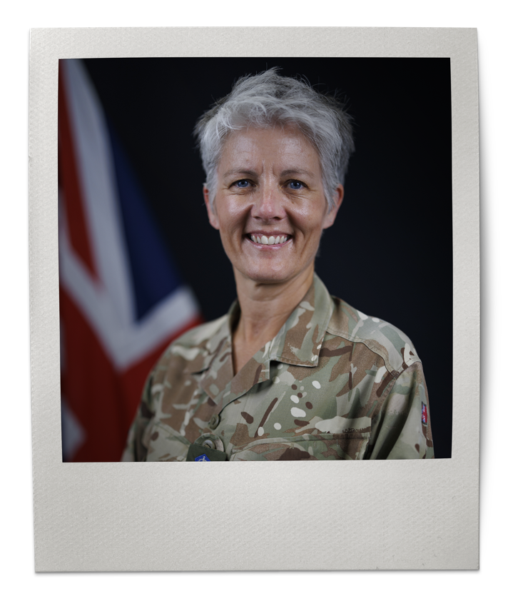
LEADING BY EXAMPLE
Every leader can choose how they want to lead, and people who represent underrepresented groups can lead with an emphasis on supporting diverse voices, empowerment and allyship.
General Sharon Nessmith DCB, ADC Gen is currently recognised as the most senior woman in the British Army. Speaking of her early career, she recognises the challenges she faced. She celebrates that the Army is a much more diverse and inclusive organisation today, with stronger networks, better mentorship, changes to language and process to support people to be the very best they can be. Today she sees herself as an inclusive leader, seeing the value of her own unique perspective and experience, and actively encourages diverse recruitment, and empowering service personnel from different walks of life.
Notes:
Leading by example
Read through the example on the slide.
Key vocabulary
Allyship: Active support for the rights of an underrepresented group without being a member of it. Example: "These sessions should emphasise tangible ways that students can practice allyship, such as supporting underrepresented groups, challenging stereotypes, utilising community voice, honouring heritage and reflecting on leadership styles."
Sources:
General Sharon Nessmith DCB, ADC Gen:
https://armyleadership.podbean.com/e/episode-3-major-general-sharon-nesmith/

Slide 22

WHAT ARE YOUR LEADERSHIP QUALITIES?
Everyone is a leader. Firstly, we all lead our own lives. We may go on to lead our families, social groups, clubs, organisations, teams or businesses. How we lead is up to us.
Reflect, and write down the names of three people who have shaped your life – people who have supported you, helped you develop, changed the direction of your life. These could be family members, teachers, friends, coaches, members of the community.
Next, write down three characteristics that define their style of leadership.
Circle any characteristics that you see in yourself and put a star next to the ones you want to develop.
For those that you have circled, write a brief example of where you see it in yourself. For those that you want to develop, write down how you will try to develop it.
Consider your own unique experience and identity – how might this influence your leadership?
Share your reflections with a partner.
One of the most powerful ways to develop leadership skills is to draw inspiration from our own lives – our own unique story can help to inspire and empower someone else.
Notes:
What are your leadership qualities?
Read through the slide and set task.
Support:
Go through one example as a class, choosing from examples of people that they all know, e.g. Prime Minister, the King, the Headteacher, before setting task for students to work on in pairs. Challenge:
Students to work independently through the task.
Receive feedback from students and discuss as a class.
Optional extension:
Develop this activity by encouraging students to think about these questions:
Think of a time when you lead a group, or a team, and consider what you found easy, and what you struggled with. What did you learn about yourself as a leader?
Does leadership come naturally to you? Do you aspire to be a leader? If so, why? If not, why not?
Consider some of the challenges of leadership, and how you would tackle these if you ever faced any.

Slide 23

SIGNPOSTING
If you enjoyed the topics raised, and want to explore further, visit the British Army Supporting Education (BASE) Hub to explore more lessons and resources:
Women in the Army
LGBTQ+ Voices
Support Networks
Sikh Service
Black History Month
https://jobs.army.mod.uk/base/
If any of the topics raised have concerned you, please reach out for support in the following places:
Speak to a trusted adult, e.g. teacher, form tutor, family member, member of the community.
Call ChildLine to discuss your concerns with a trained counsellor. It is a free, private and confidential service where you can talk about anything. Call 0800 1111 or visit childline.org.uk to chat to a counsellor online.
Notes:
Signposting

