Slide 1
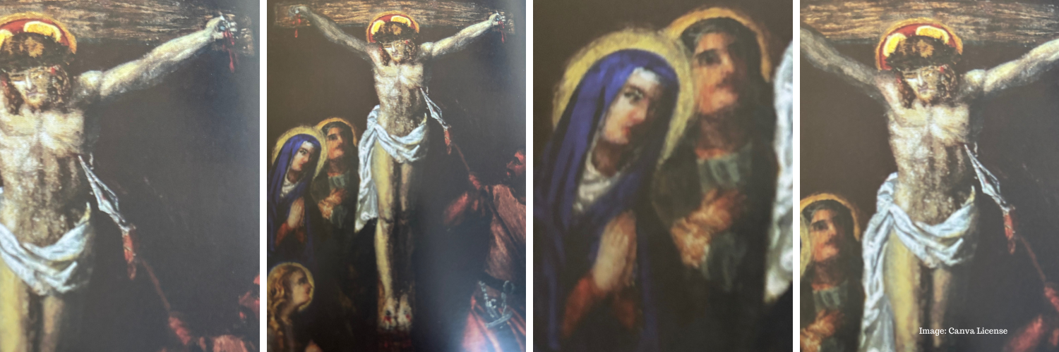
Stations of the Cross For Our Time
Artwork: Sr Clare Augustine Moore

Slide 2
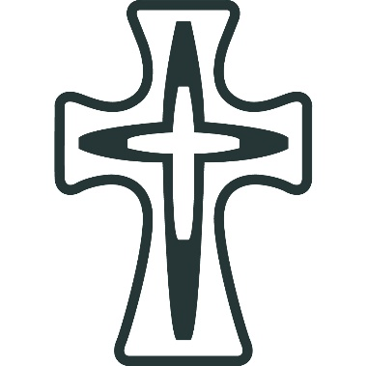
Introduction:
This is a newly written Stations of the Cross For Our Time resource which has been prepared by Mercy International Association.
The reflections are inspired by Catherine McAuley and are offered through the lens of Mercy and Justice.
The images of the Stations of the Cross are from St Leo’s Convent in Carlow Town, Co Carlow, Ireland.
They have been offered to us for this reflection by the Mercy Community in St Leo’s.

Slide 3
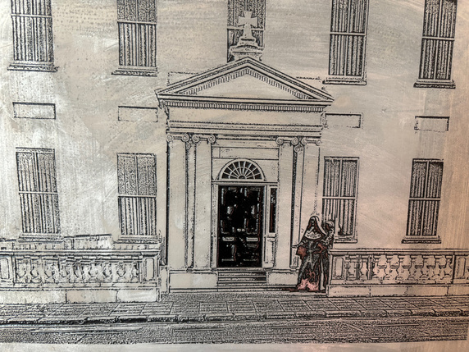
Opening Prayer
God of Mercy,
You walk with the poor,
You stand with the condemned,
You weep with the grieving.
As we walk this Way of the Cross,
open our eyes to suffering in our world today.
Open our hearts to compassion.
Open our hands to justice.
May we learn to live mercy boldly,
in the spirit of Catherine McAuley.
Amen.

Slide 4
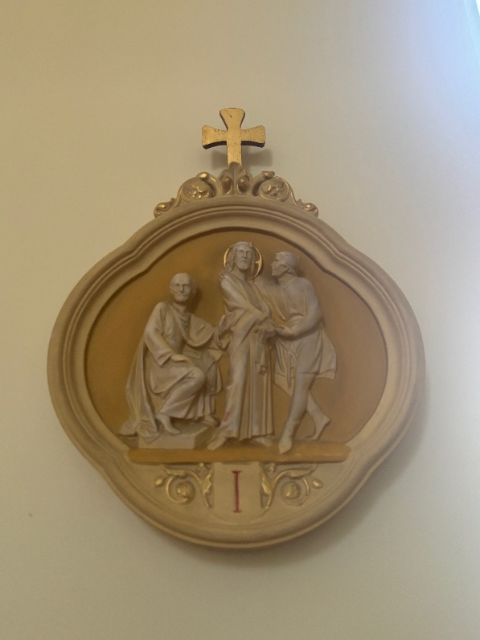
[I] First Station: Jesus is Condemned to Death
ALL: We adore you, O Christ, and we bless you because by your Holy Cross you have redeemed the world.
Jesus, innocent, is judged and sentenced.
Today we remember all who are condemned unjustly:
those caught in broken systems,
those profiled, silenced, or unheard.
In our time, truth is often distorted,
and power outweighs justice.
Mercy calls us to defend the dignity of every person.
Catherine McAuley said: “The simplest and most practical lesson I know is to resolve to be good today, but better tomorrow.”
Reflection:
Where do I see injustice?
Where am I silent when I should speak?
Lord, give us courage to stand for what is right.
Amen

Slide 5
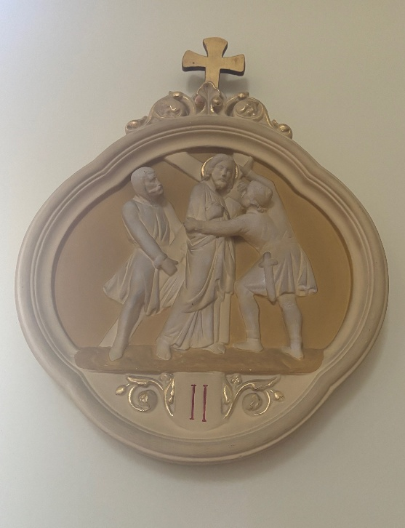
[II] Second Station: Jesus Takes Up His Cross
ALL: We adore you, O Christ, and we bless you because by your Holy Cross you have redeemed the world.
Jesus accepts the weight of suffering.
Today the cross is carried by
refugees fleeing war,
families burdened by debt,
young people carrying anxiety and despair.
Poverty, exclusion, and fear are heavy crosses.
Mercy does not look away.
Catherine McAuley said: “When and how do we expect to take up our Cross and follow Christ, if we are not to meet with it in those with whom we are associated?”
Reflection:
What crosses do others carry that I do not see?
How can I help shoulder the weight?
Lord, help us carry one another.
Amen.

Slide 6
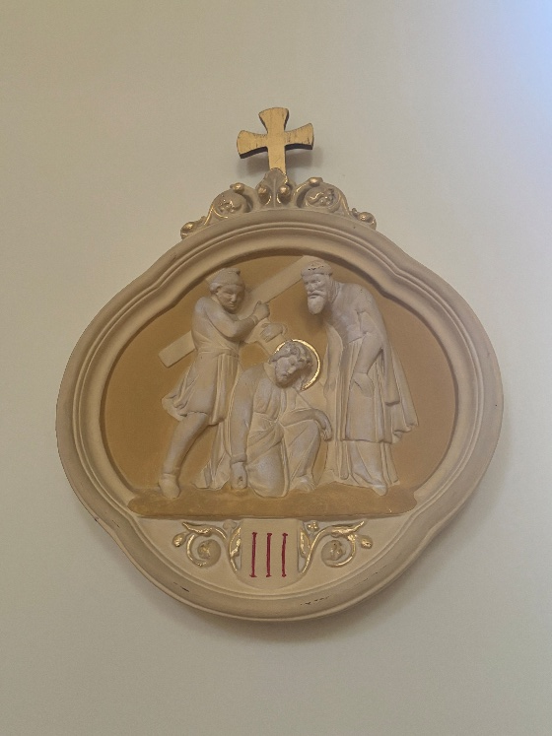
[III] Third Station: Jesus Falls The First Time
ALL: We adore you, O Christ, and we bless you because by your Holy Cross you have redeemed the world.
Jesus stumbles under the load.
We remember those who fall through the cracks -
the homeless person ignored,
the addict seeking recovery,
the child left behind by unequal education.
Systems fail. People fall.
Justice lifts them up.
Catherine McAuley said: “Be ever ready to praise, to encourage, to stimulate, but slow to censure.”
Reflection:
Do I blame the fallen,
or do I ask why they have fallen?
Lord, teach us to restore, not to judge.
Amen.

Slide 7
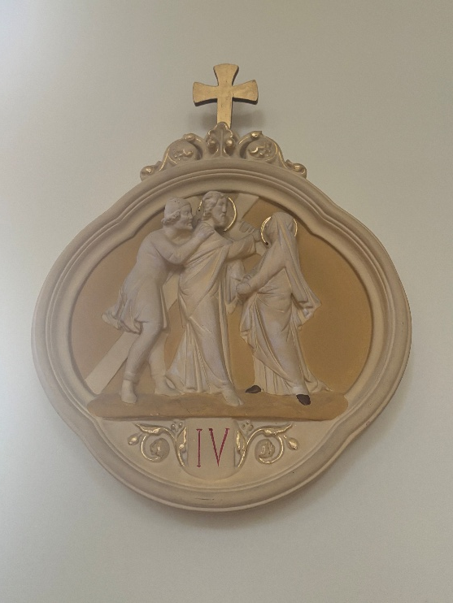
[IV] Fourth Station: Jesus Meets His Mother
ALL: We adore you, O Christ, and we bless you because by your Holy Cross you have redeemed the world.
Mary meets her suffering son.
We remember parents who watch their children suffer -
through violence, hunger, discrimination, or war.
In every grieving mother and father,
Mary stands again at the roadside.
Mercy stays present in pain.
Catherine McAuley said: “We have one solid comfort in all our troubles: we are in the hands of God.”
Reflection:
How can I accompany someone who is hurting?
Lord, make us faithful companions.
Amen

Slide 8
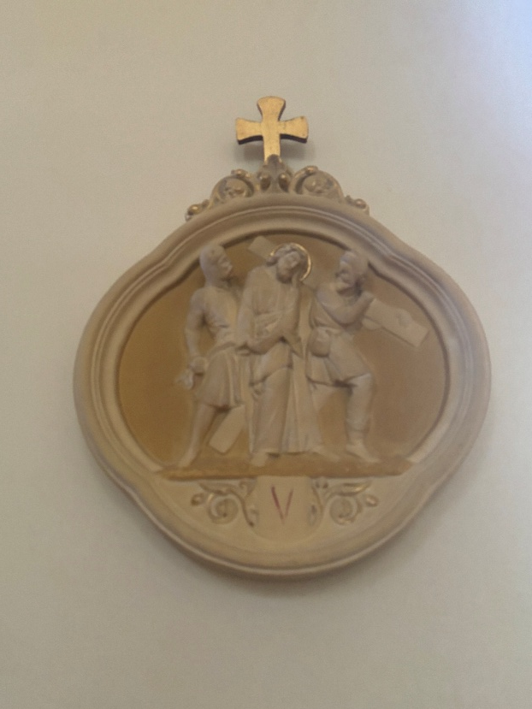
[V] Fifth Station: Simon of Cyrene Helps Jesus
ALL: We adore you, O Christ, and we bless you because by your Holy Cross you have redeemed the world.
Simon is compelled to help.
Today we see Simons everywhere -
caregivers, teachers, advocates,
those who work quietly for change.
Helping may begin as obligation,
but it becomes transformation.
Mercy moves us from reluctance to love.
Catherine McAuley said: “The business of our lives is to do good.”
Reflection:
When have I been Simon?
When is Christ asking me to help now?
Lord, make us willing servants of justice.
Amen

Slide 9
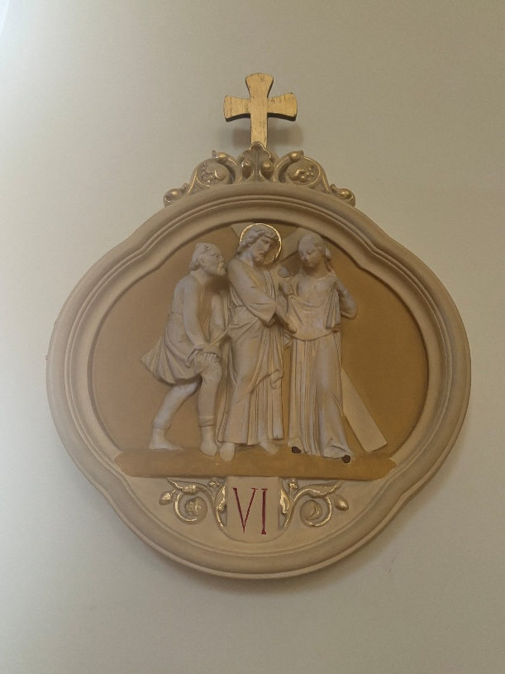
[VI] Sixth Station: Veronica Wipes the Face of Jesus
ALL: We adore you, O Christ, and we bless you because by your Holy Cross you have redeemed the world.
Veronica sees suffering and responds with tenderness.
Today Christ’s face is seen in
the migrant at the border,
the elderly person alone,
the neighbour struggling in silence.
Small acts of compassion reveal holy presence.
Mercy is practical love.
Catherine McAuley said: “It is not sufficient that Jesus Christ be formed in us – He must be recognised in our conduct.”
Reflection:
Do I notice the hidden suffering around me?
Lord, let us recognize Your face in the vulnerable.
Amen.

Slide 10
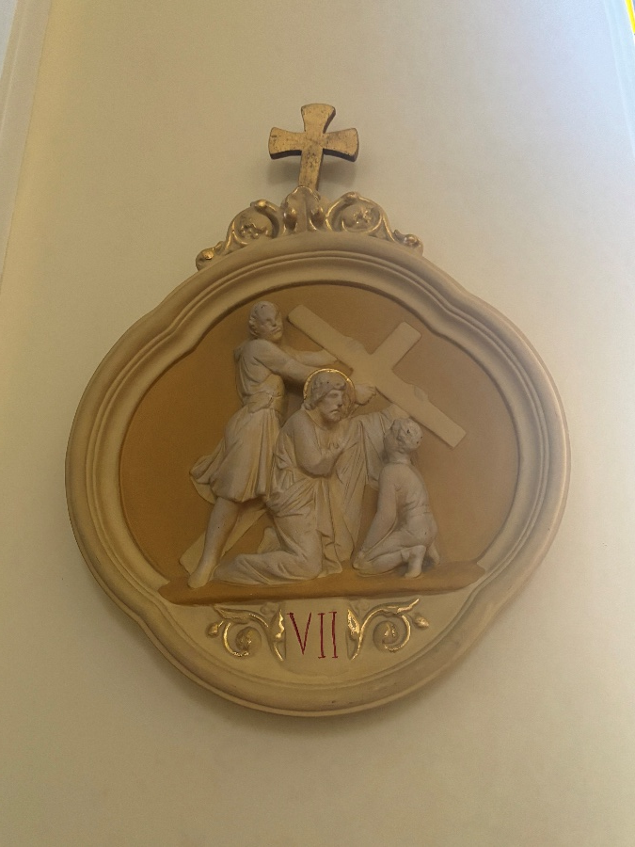
[VII] Seventh Station: Jesus Meets the Women of Jerusalem
ALL: We adore you, O Christ, and we bless you because by your Holy Cross you have redeemed the world.
Jesus tells them not to weep for Him, but for their children.
Today we think of future generations -
children facing climate crisis,
violence, inequality, loss of hope.
The world we shape today
will shape their tomorrow.
Mercy thinks beyond the present moment.
Catherine McAuley said: “We should be shining lamps, giving light to all around us.”
Reflection:
What kind of world are we leaving behind?
Lord, make us guardians of the future.
Amen.

Slide 11
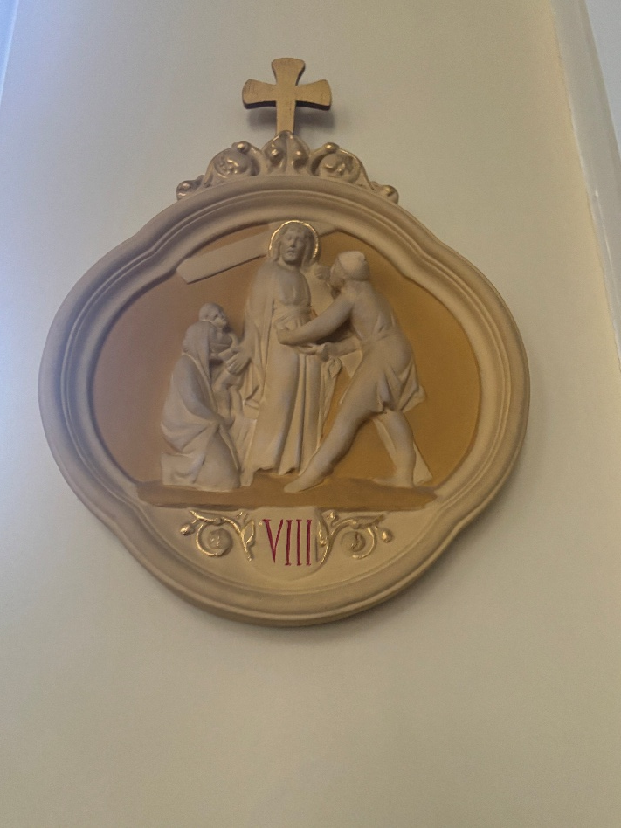
[VIII] Eighth Station: Jesus Falls the Second Time
ALL: We adore you, O Christ, and we bless you because by your Holy Cross you have redeemed the world.
Jesus falls again.
We remember communities crushed by repeated hardship -
cycles of poverty, racism, environmental destruction.
The same wounds reopen.
Justice demands structural change.
Catherine McAuley said: “The poor need help today, not next week.”
Reflection:
What injustices are repeated in our society?
What must be transformed?
Lord, strengthen us to persevere.
Amen.

Slide 12
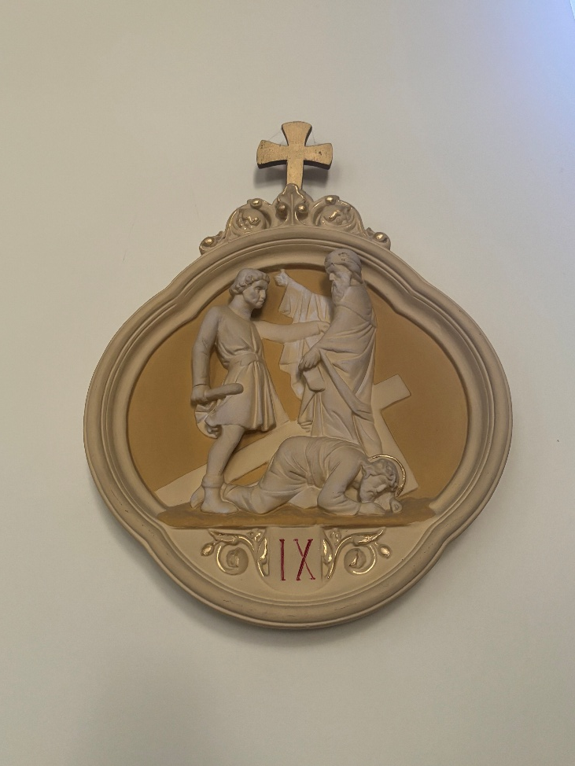
[IX] Ninth Station: Jesus Falls the Third Time
ALL: We adore you, O Christ, and we bless you because by your Holy Cross you have redeemed the world.
Jesus collapses, utterly exhausted.
We remember those who feel there is no strength left -
the depressed, the overworked,
the poor worn down by survival.
Yet even here, Christ does not abandon the journey.
Mercy stays when hope is fragile.
Catherine McAuley said: “Let us never be discouraged.”
Reflection:
How do we respond to despair - our own and others’?
Lord, be strength for the weary.
Amen.

Slide 13
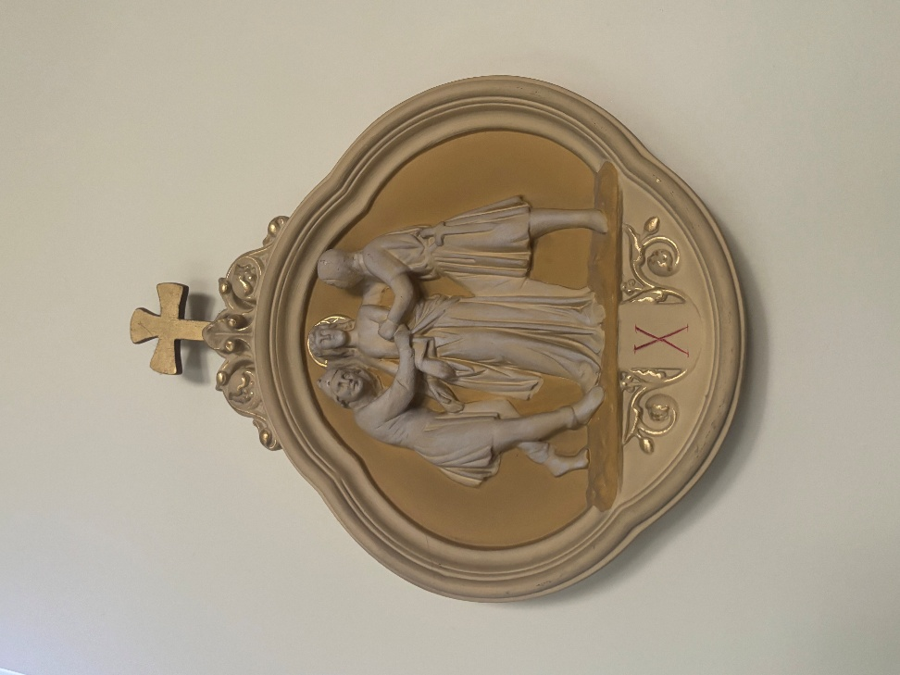
[X] Tenth Station: Jesus is Stripped of His Garments
ALL: We adore you, O Christ, and we bless you because by your Holy Cross you have redeemed the world.
Jesus is stripped of dignity.
Today dignity is stripped away by
human trafficking,
exploitative labour,
shame and humiliation online.
To be stripped is to be made vulnerable.
Justice restores dignity.
Catherine McAuley said: “How can we teach the love of God if our own hearts are cold?”
Reflection:
How do our choices affect the dignity of others?
Lord, clothe every person in worth.
Amen

Slide 14
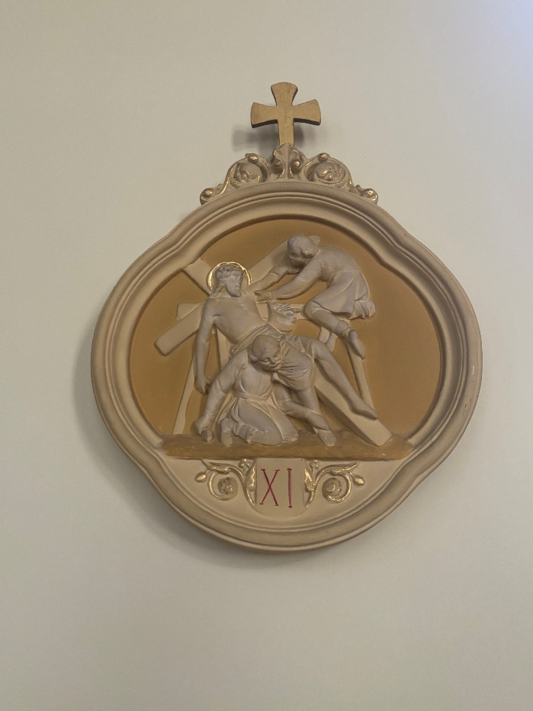
[XI] Eleventh Station: Jesus is Nailed to the Cross
ALL: We adore you, O Christ, and we bless you because by your Holy Cross you have redeemed the world.
Violence fixes Jesus to wood and iron.
We remember victims of war,
gun violence,
domestic abuse,
hatred disguised as righteousness.
Nails still pierce through cruelty and indifference.
Mercy interrupts violence.
Catherine McAuley said: “We must strive to do ordinary things extraordinarily well.”
Reflection:
Where am I called to be a peacemaker?
Lord, break the cycles of harm.
Amen.

Slide 15
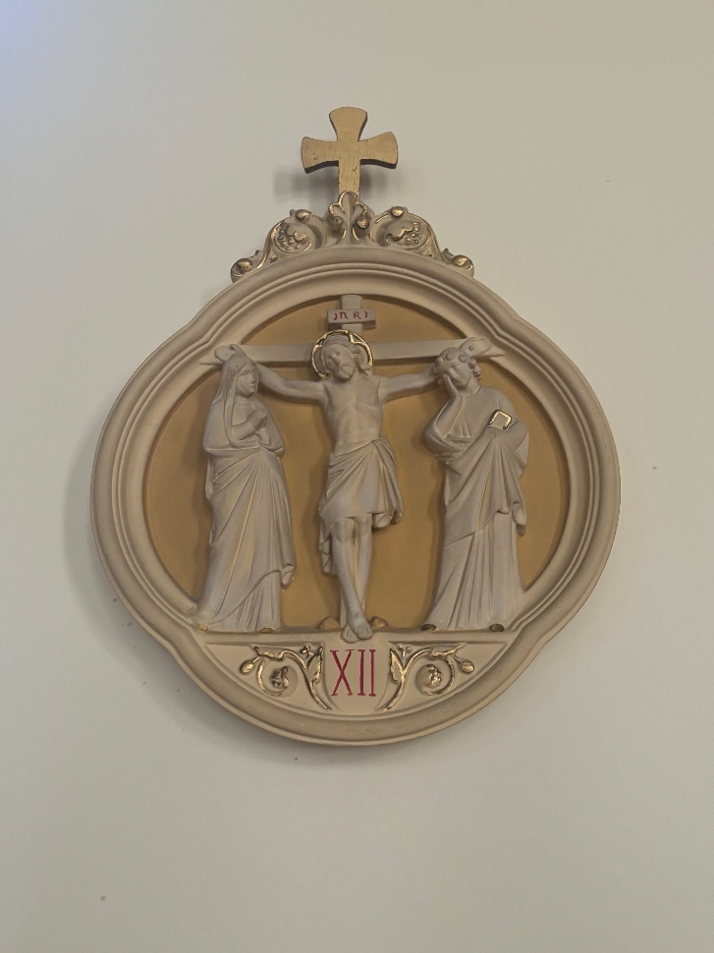
[XII] Twelfth Station: Jesus Dies on the Cross
ALL: We adore you, O Christ, and we bless you because by your Holy Cross you have redeemed the world.
Jesus breathes His last.
In this moment we stand before
the ultimate cost of injustice and sin.
Yet even here, forgiveness is spoken:
“Father, forgive them.”
Mercy is stronger than hatred.
Catherine Mc Auley said: “We have one solid comfort in all our troubles: we are in the hands of God.”
Reflection:
Can I forgive?
Can I seek forgiveness?
Lord, teach us redemptive love.
Amen.

Slide 16
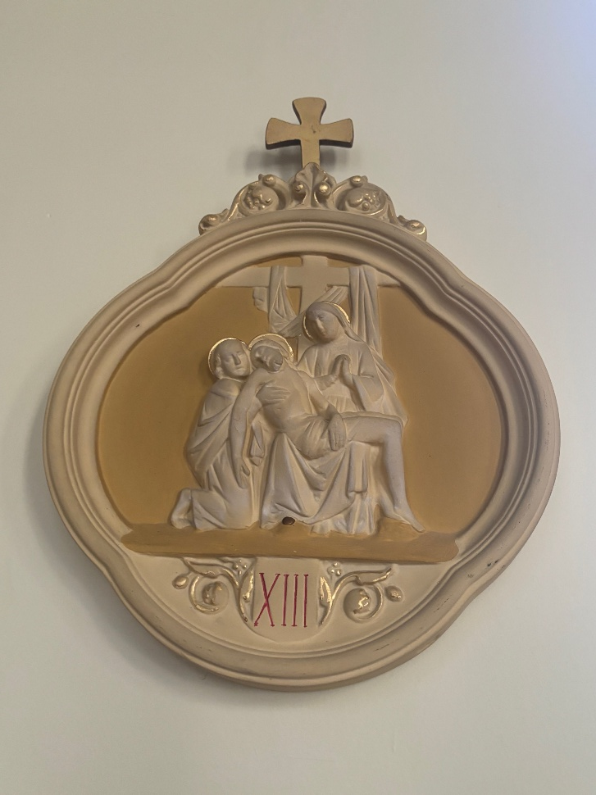
[XIII] Thirteenth Station: Jesus is Taken Down from the Cross
ALL: We adore you, O Christ, and we bless you because by your Holy Cross you have redeemed the world.
Jesus is placed in loving arms.
We remember those who hold broken bodies -
medical workers,
families after tragedy,
communities grieving violence.
Compassion cradles what violence has broken.
Mercy mourns with tenderness.
Catherine McAuley said: “Be sure you have a comfortable place prepared for the poor.”
Reflection:
How do we honour the suffering of others?
Lord, make our hearts gentle.
Amen.

Slide 17
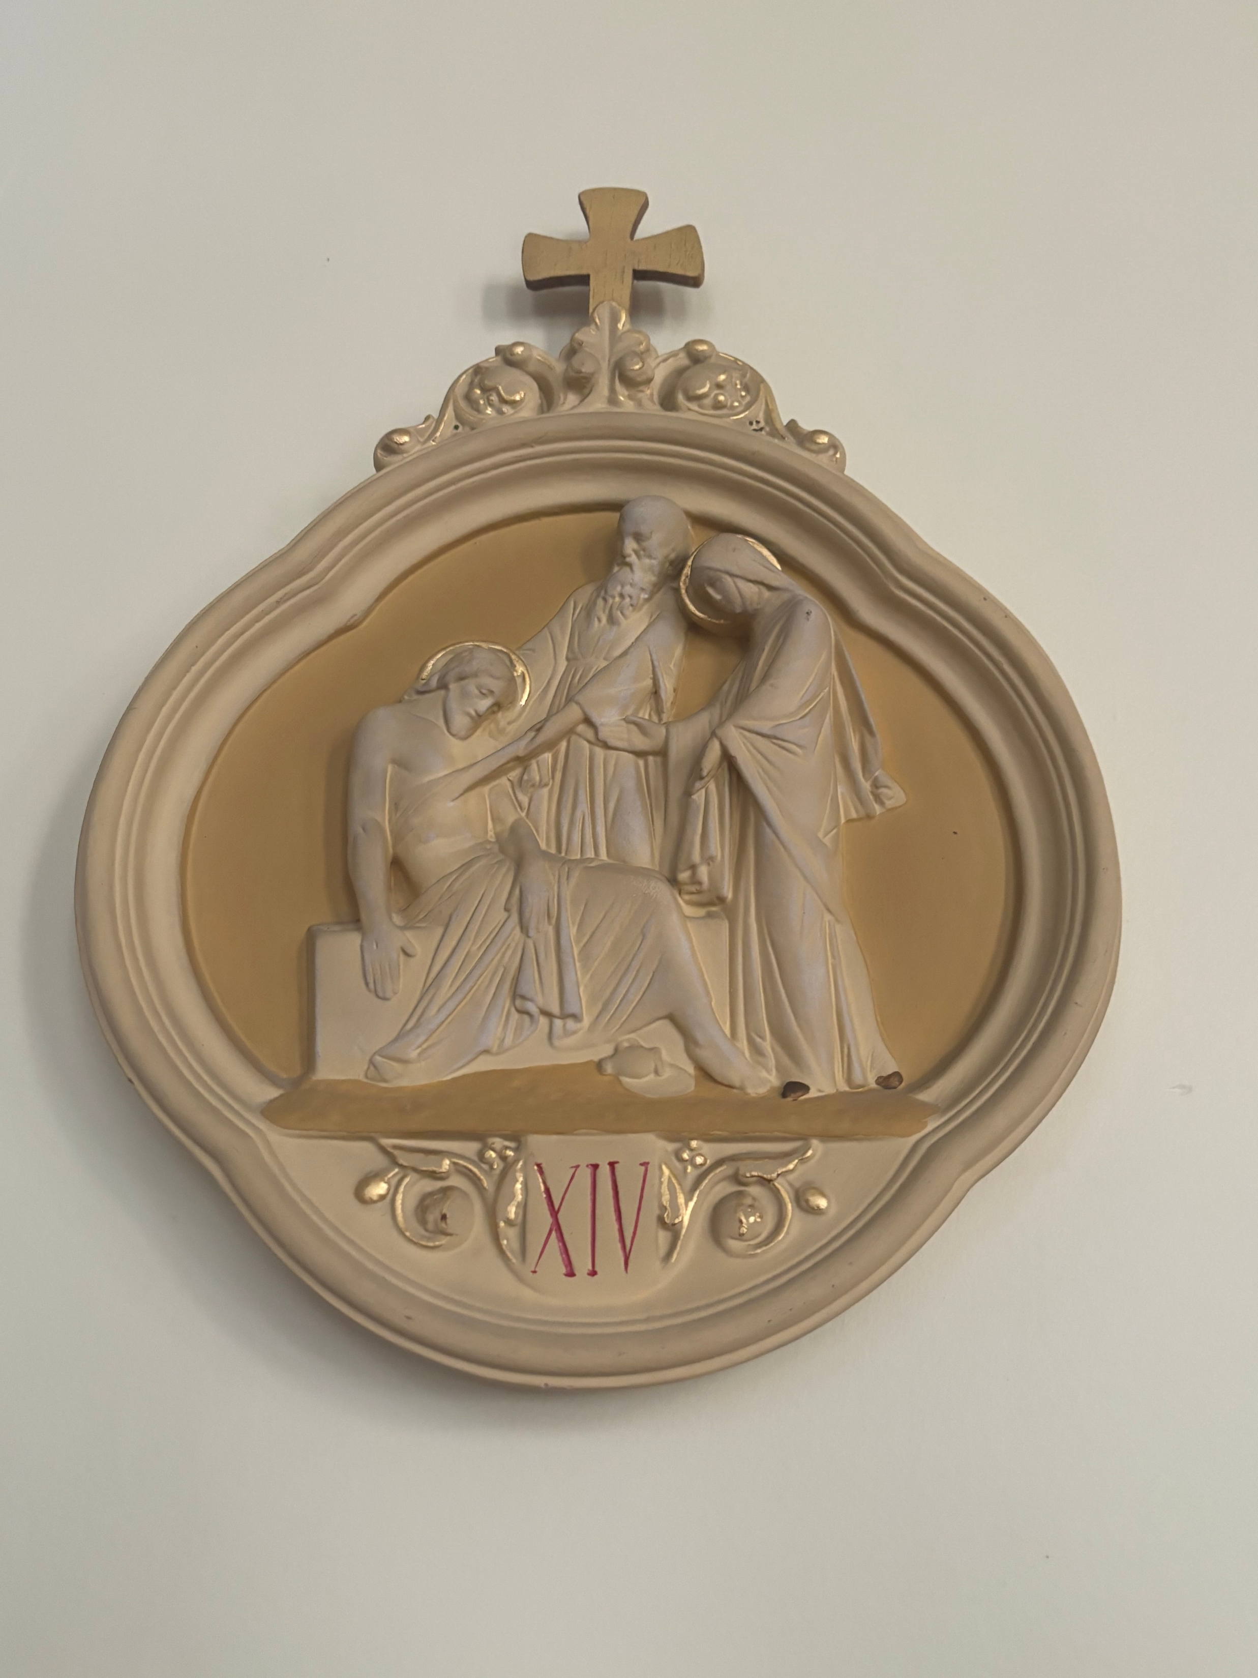
[XIV] Fourteenth Station: Jesus is Laid in the Tomb
ALL: We adore you, O Christ, and we bless you because by your Holy Cross you have redeemed the world.
The stone is rolled into place.
In our world, many situations feel sealed - deep poverty, conflict, division.
Yet we are people of hope.
The tomb is not the end.
Mercy believes in resurrection.
Catherine McAuley said: “Pray for your portion of Easter Grace….Pray fervently and constantly, do not give up until all is given you.”
Reflection:
Where do I need hope?
Where can I bring hope?
Lord, roll away the stones of our time.
Amen.

Slide 18
Closing Prayer
Loving God,
As we leave these Stations of the Cross,
we carry with us the suffering of the world
and the hope of your Resurrection.
May we walk in the footsteps of Jesus,
with hearts full of mercy,
hands ready for justice,
and eyes open to those who are poor, excluded, or forgotten.
Like Catherine McAuley,
may we choose kindness in a harsh world,
compassion in the face of suffering,
and courage when working for what is right.
Help us to be people of mercy in our words,
people of justice in our actions,
and people of hope in our communities.
May we see Christ in every person we meet,
and serve Him with gentle hands and generous hearts.
We ask this in faith and love.
Amen

Slide 19


www.mercyworld.org

