Slide 1


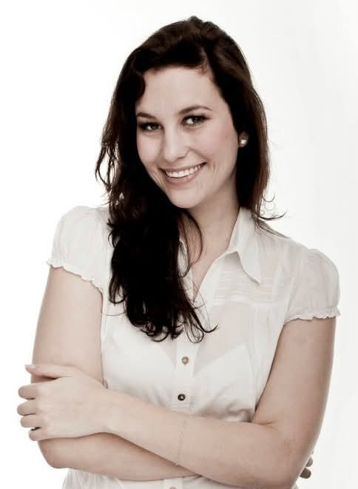
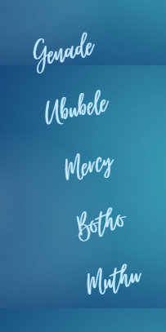
Sarah Terry
MELF Cohort Four
2024 - 2025

Slide 2


ADVICE FROM SISTER MARGARET DALY (Master Mentor and Voice of Reason)
1. STOP – BREATHE - SMILE
2. WHEN YOU SIT DOWN WHAT WOULD YOU LIKE TO HAVE SHARED?
Well…
What indeed, one might ask?

Slide 3


WELL …
I WOULD LIKE YOU TO KNOW THE FOLLOWING …
1. WHAT WE DID.
2. HOW WE DID IT.
3. WHY YOU SHOULD DO IT TOO.

Slide 4

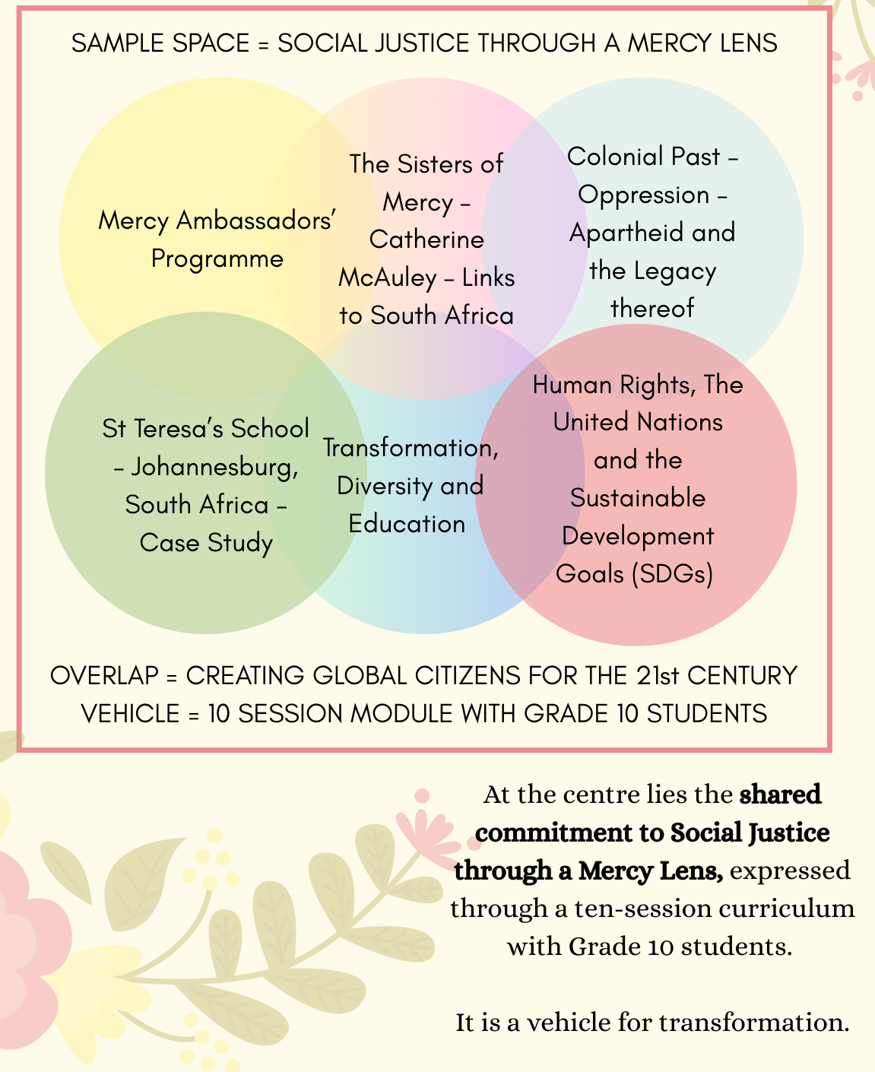
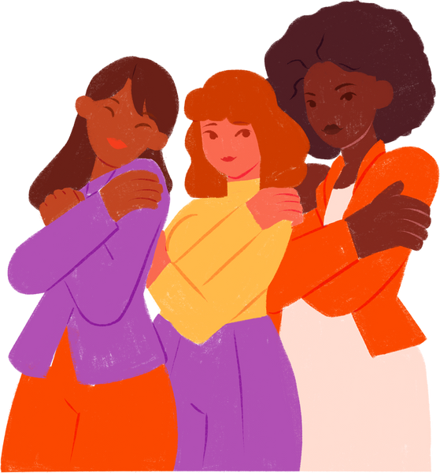

WHY THIS MATTERS …

Slide 5


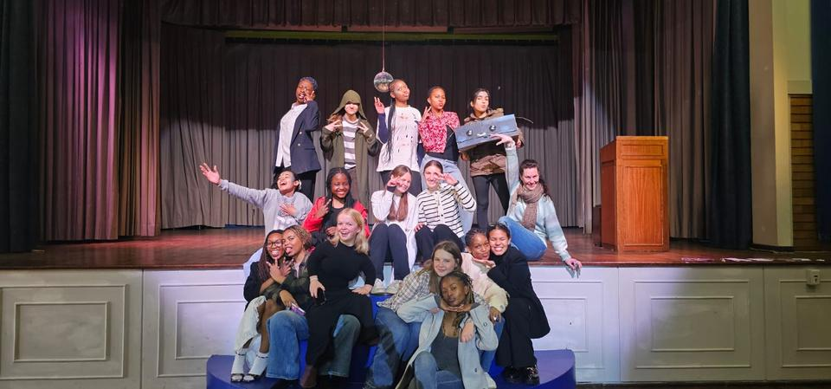

Each space is going
I WOULD LIKE YOU TO KNOW THE FOLLOWING…
THAT CONTEXT IS KEY, AND SO ARE YOUR STUDENTS
Grade 10s. 15-16 year olds. Culturally Diverse.
(Each space is going to be different BUT our link is MERCY)
Get in touch: sterry@stteresas.co.za

Slide 6


I WOULD LIKE YOU TO KNOW THE FOLLOWING…
THE OBJECTIVES OF THE PROGRAMME
Please consider whether you think we achieved these.
(Teacher over here! Always a task to be given, remember!)

Slide 7

The Objectives of the Programme…
•To explore St Teresa’s mission and values of faith, compassion, integrity, excellence, open-mindedness and respect for other people.
•A commitment to the Mercy charism and values.
•Flexibility when facing new or unexpected situations and the ability to adjust to new cultures and ethnic backgrounds.
•Expanding our knowledge of the Sisters of Mercy and their work in different places.
•Understanding social justice, transformation, diversity and advocacy in context.
Individual Reflection and Development.

Slide 8



While it has been piloted in South Africa, the framework is intentionally designed to be adaptable for use in Mercy communities and schools anywhere in the world.
Each of the ten modules in this programme explores a specific theme —ranging from Mercy identity and heritage to feminism, equity, advocacy, and global justice — guided by the voices of Catherine McAuley, contemporary change makers, and the United Nations’ Sustainable Development Goals.
The programme is built around the belief that young people learn best when they are invited to reflect deeply, engage critically, and take meaningful action in their own contexts.

Slide 9
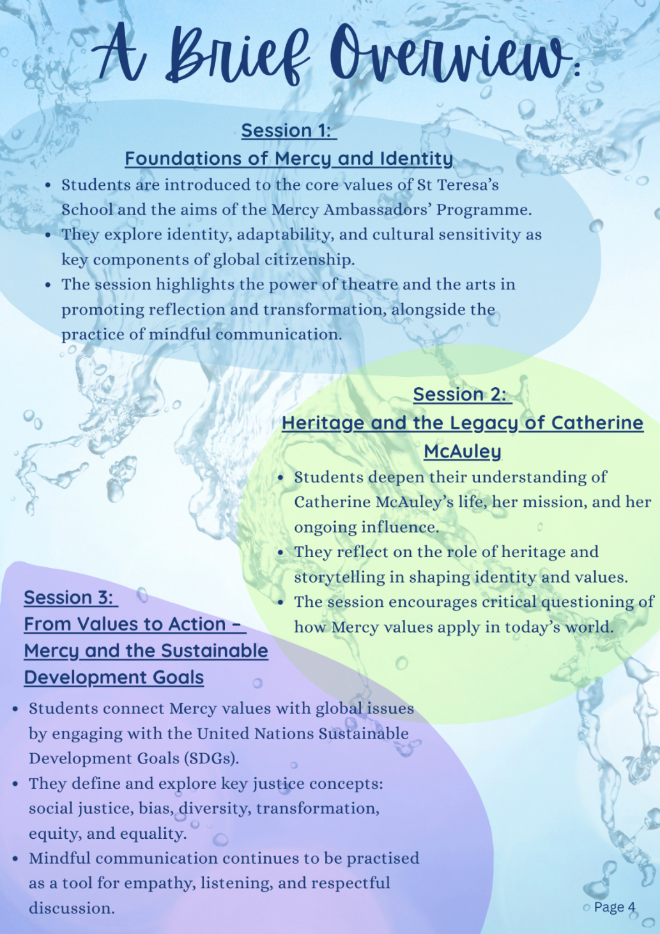
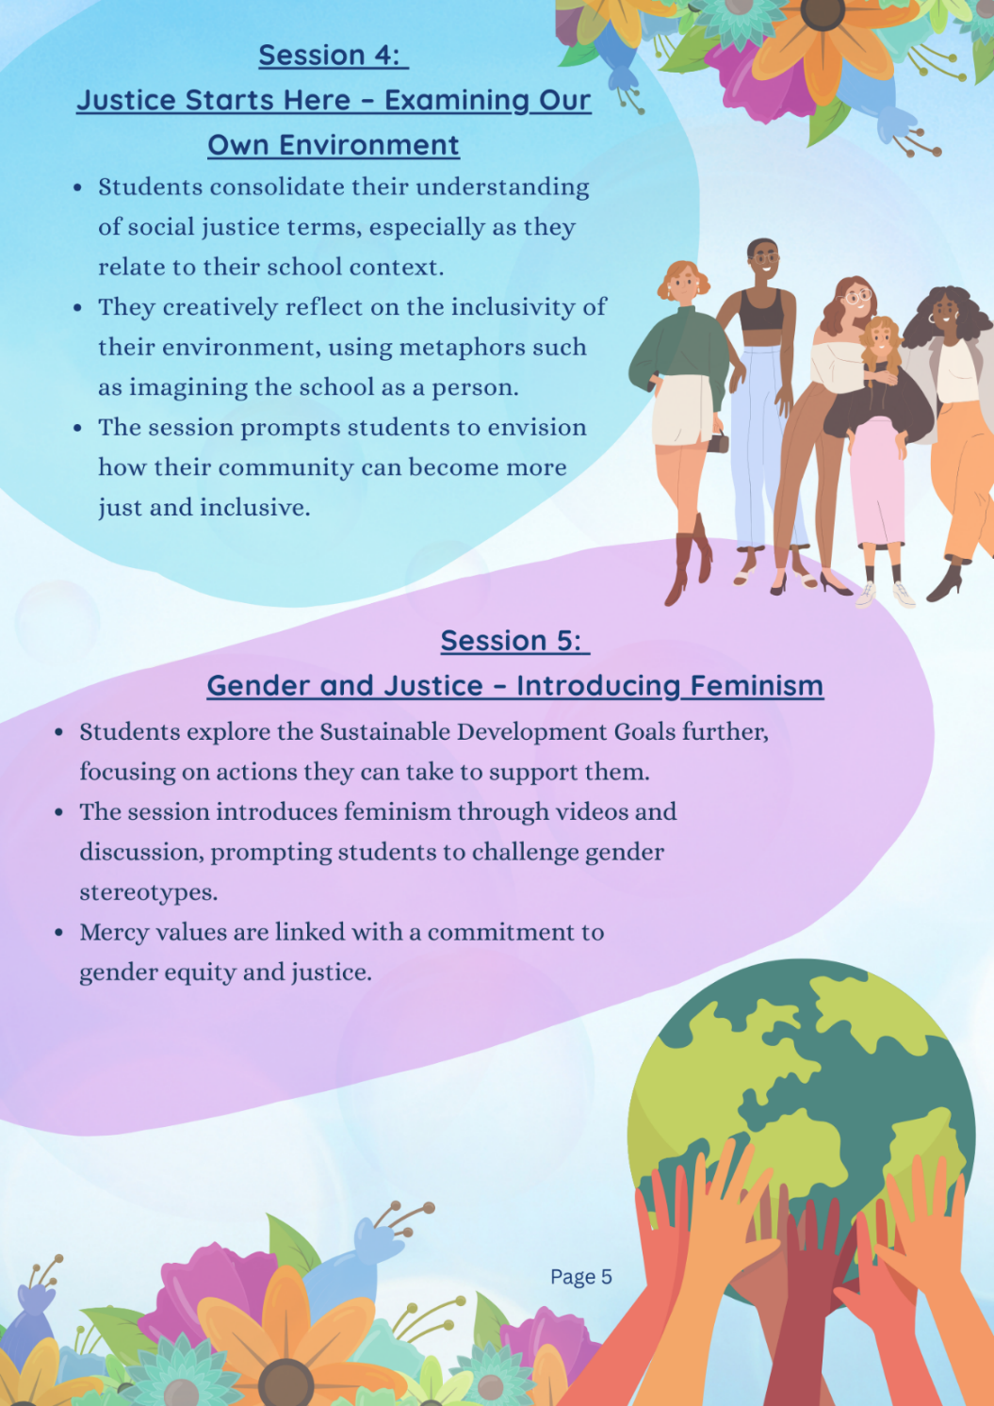
WHAT

Slide 10
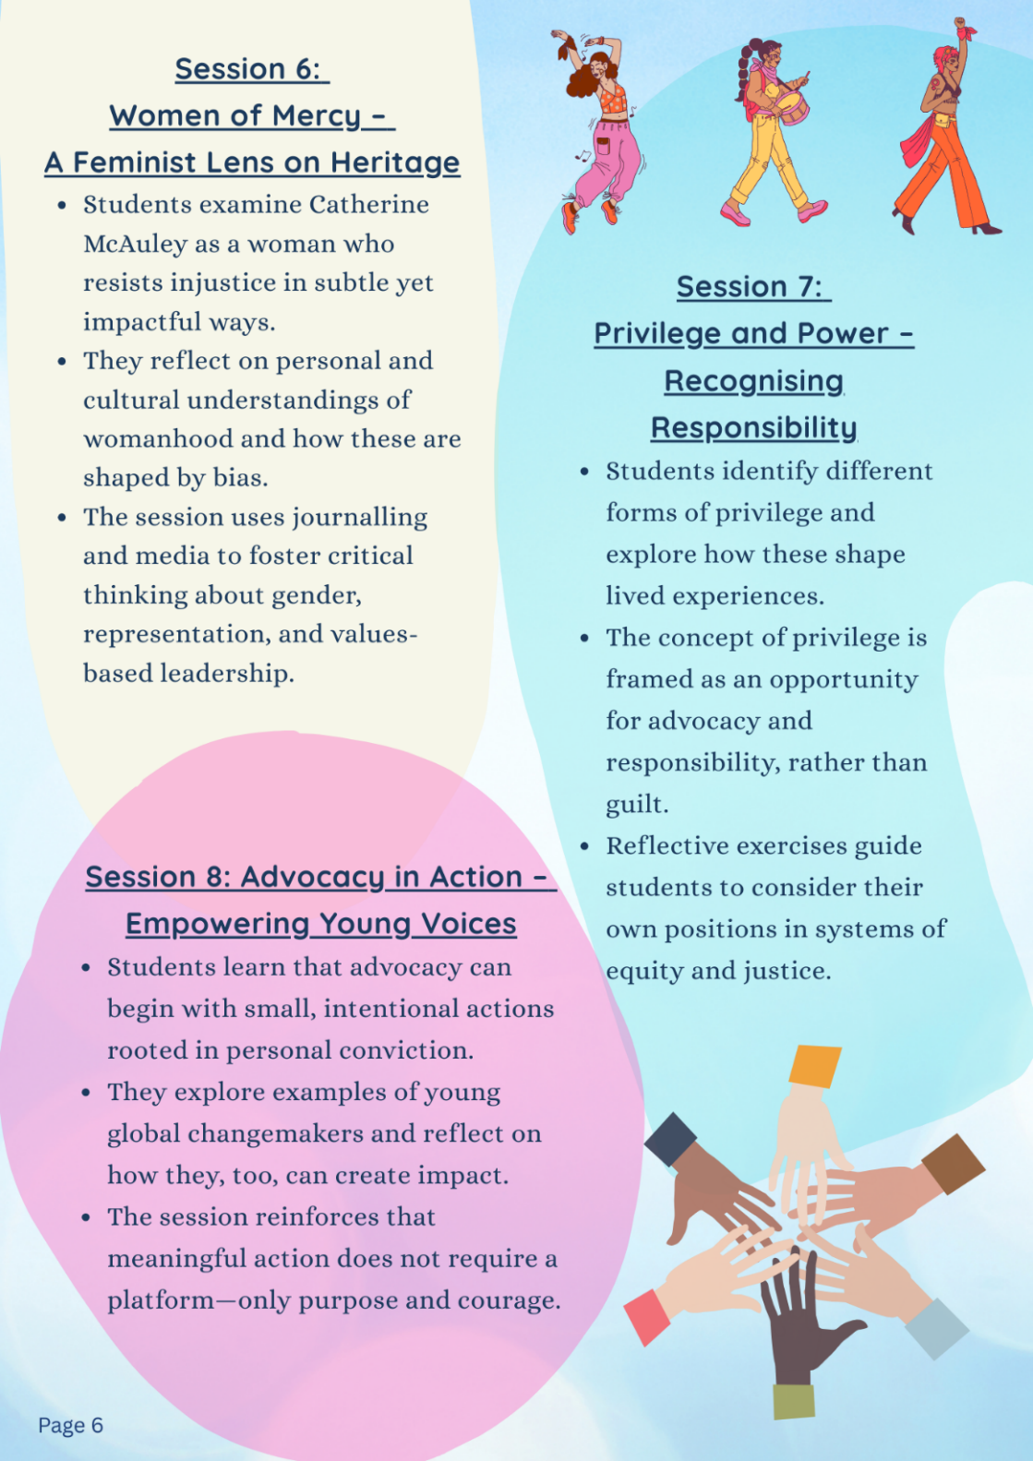
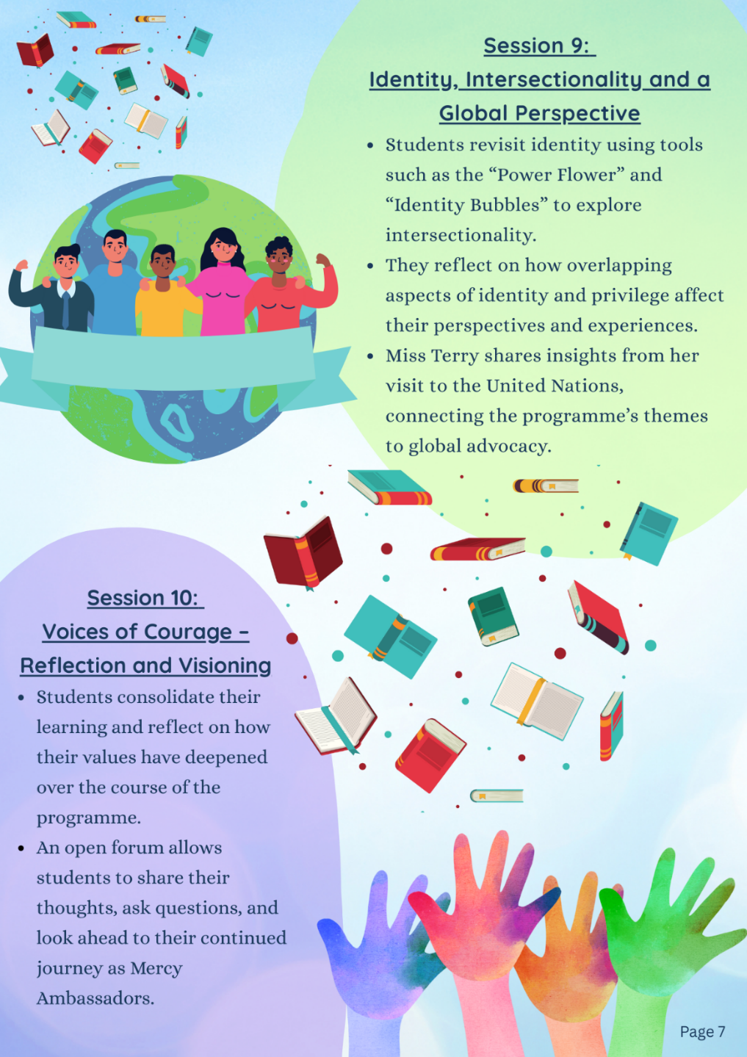

Slide 11
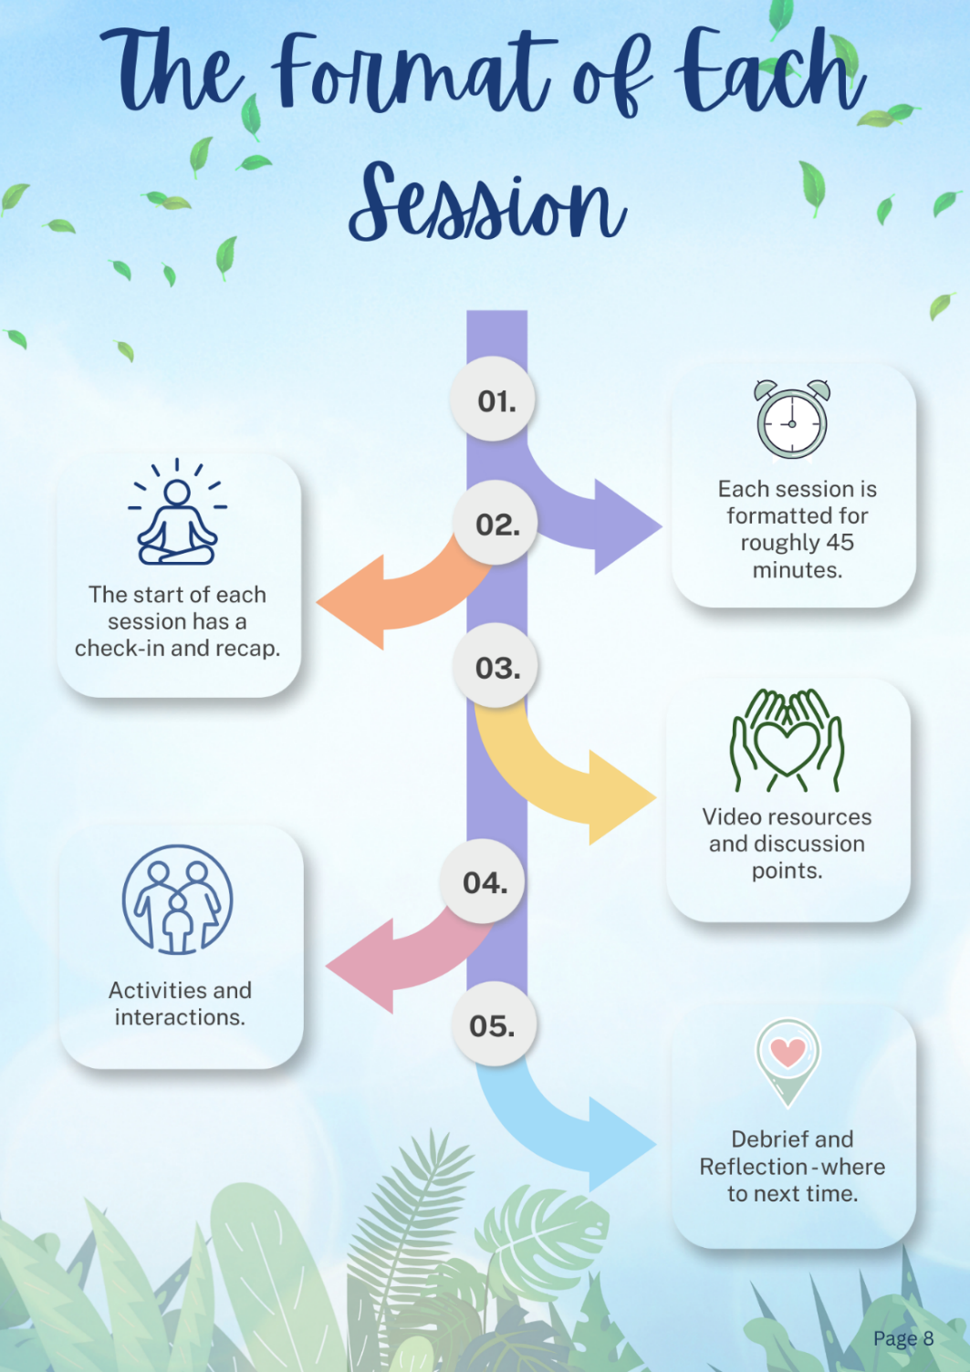
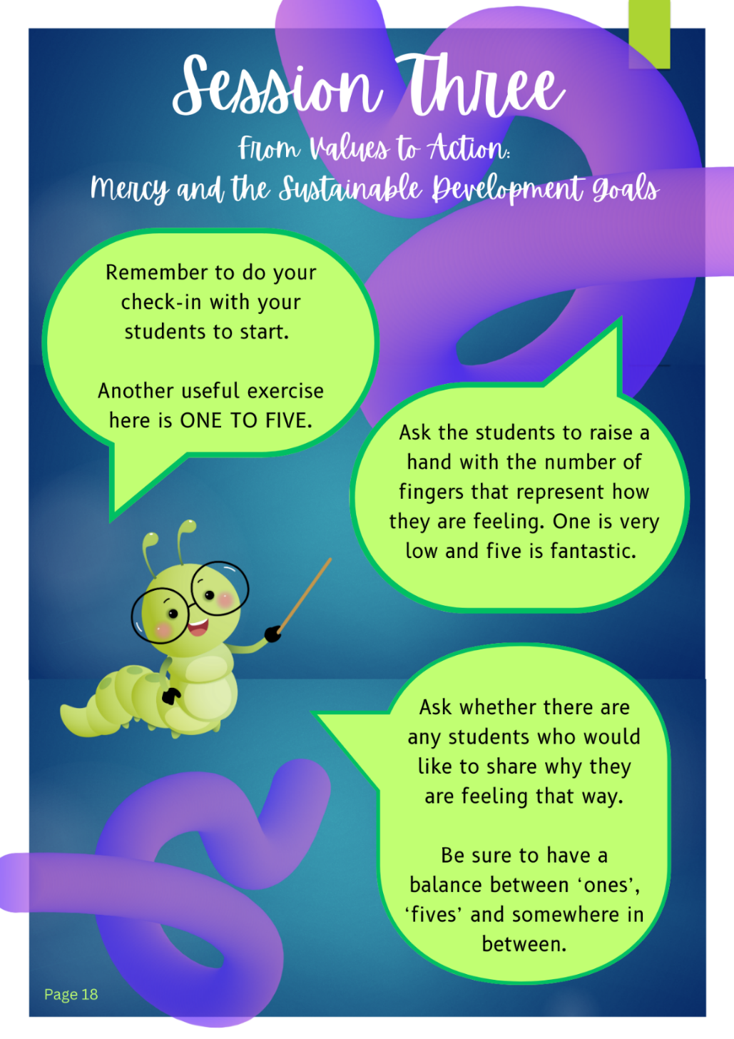
HOW

Slide 12
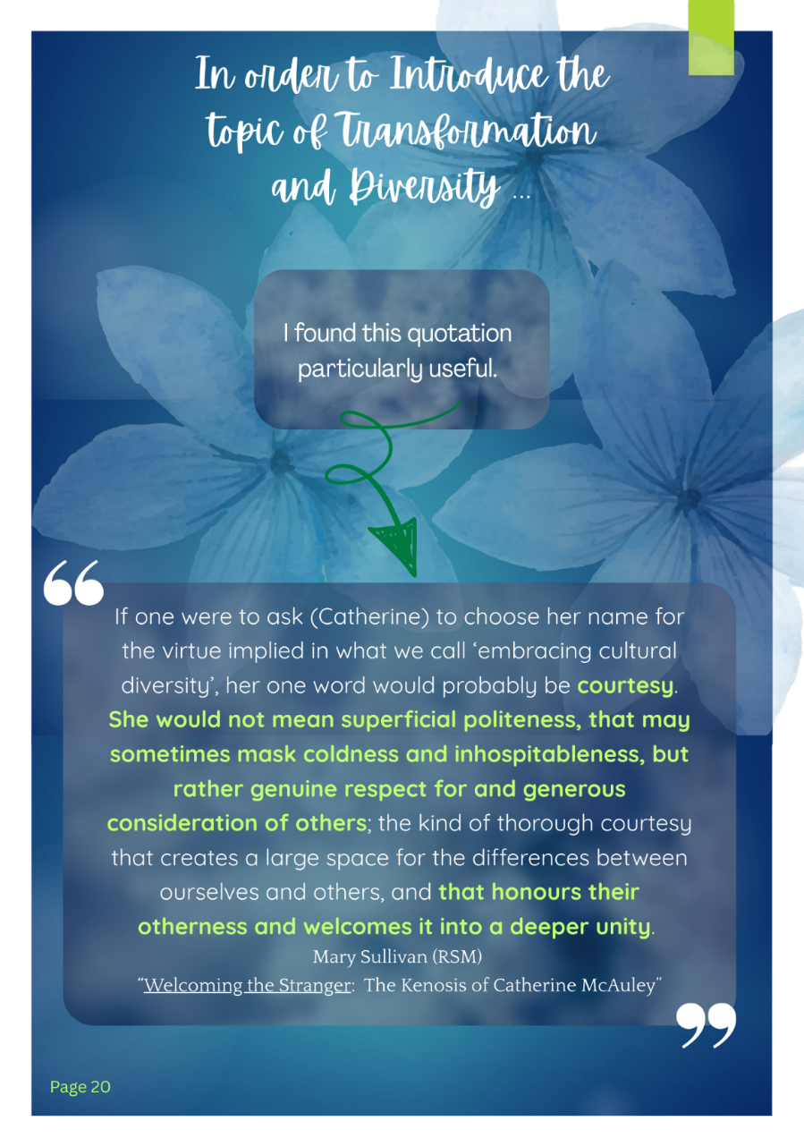
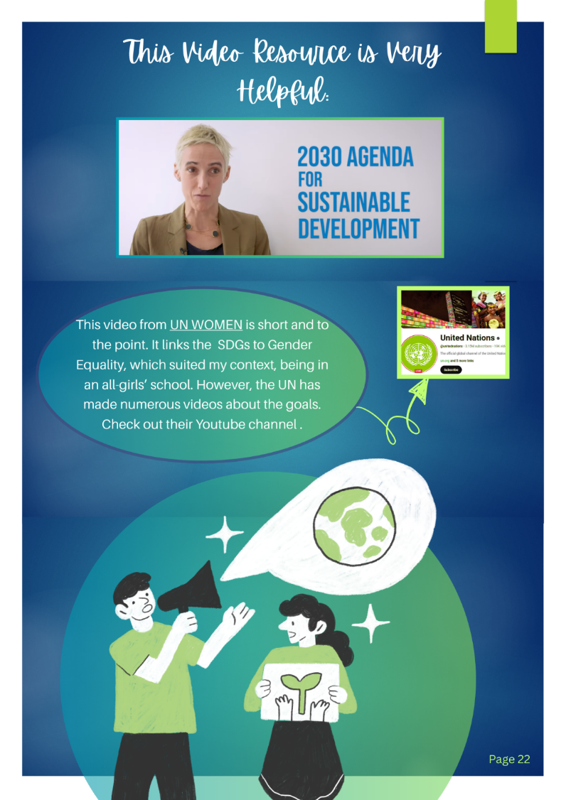
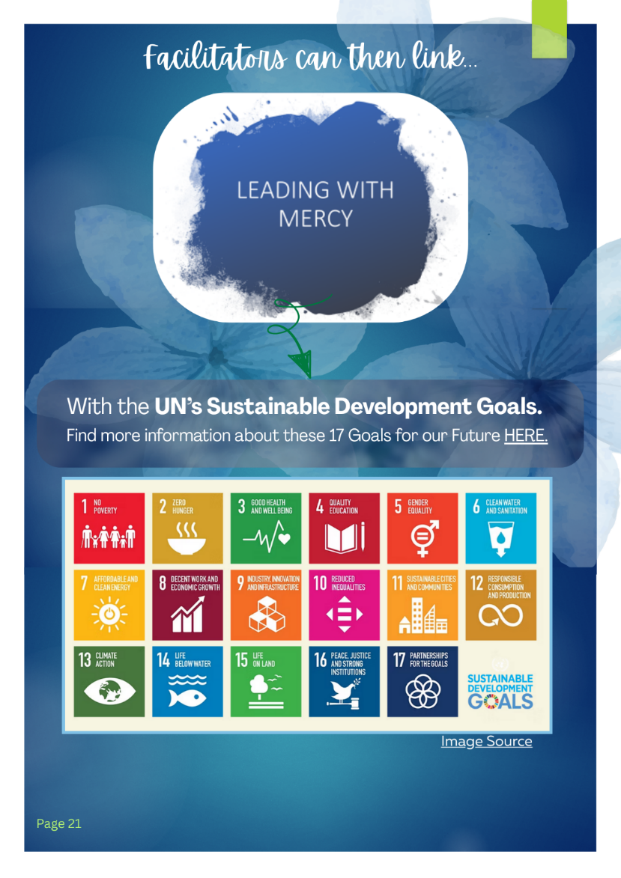
VIDEOS
DISCUSSION
INSPIRATION

Slide 13
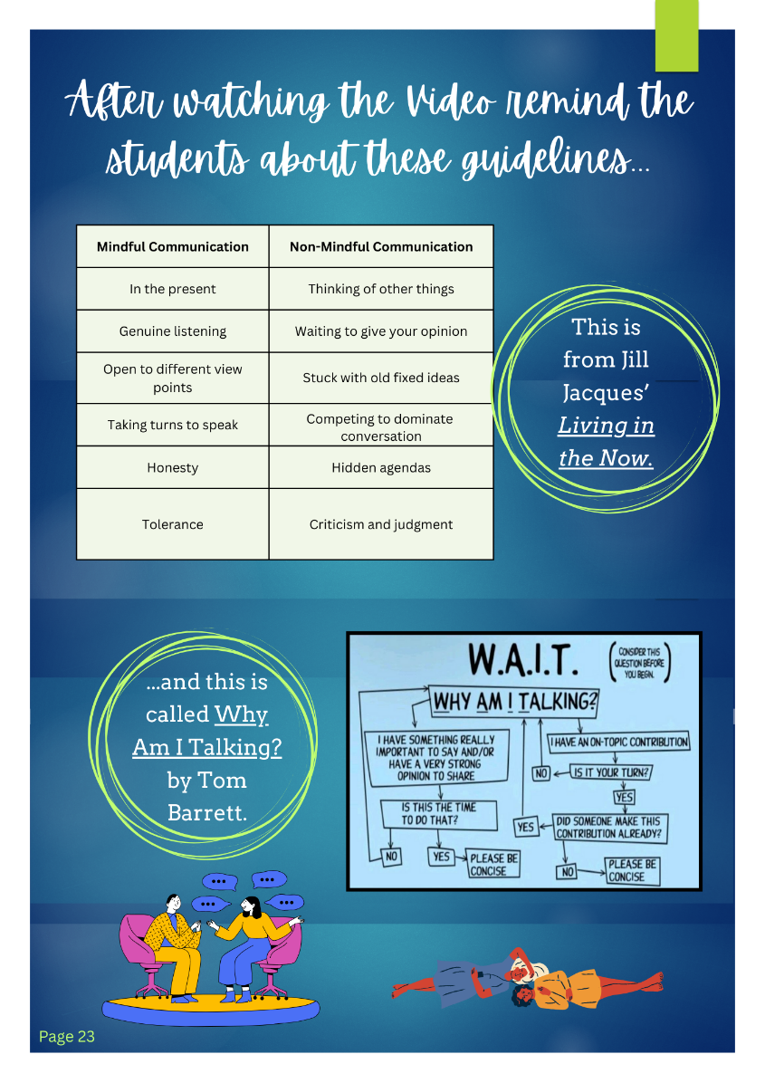
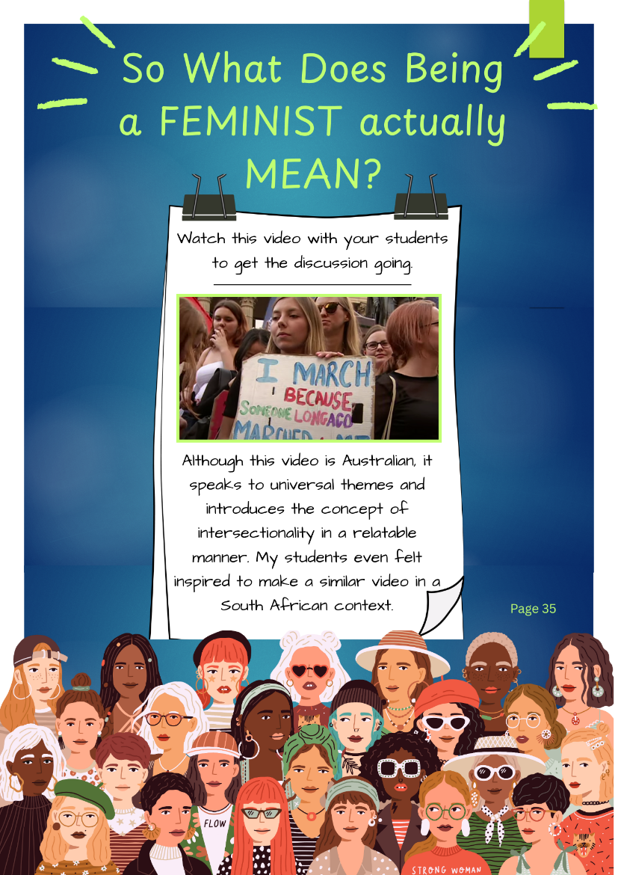
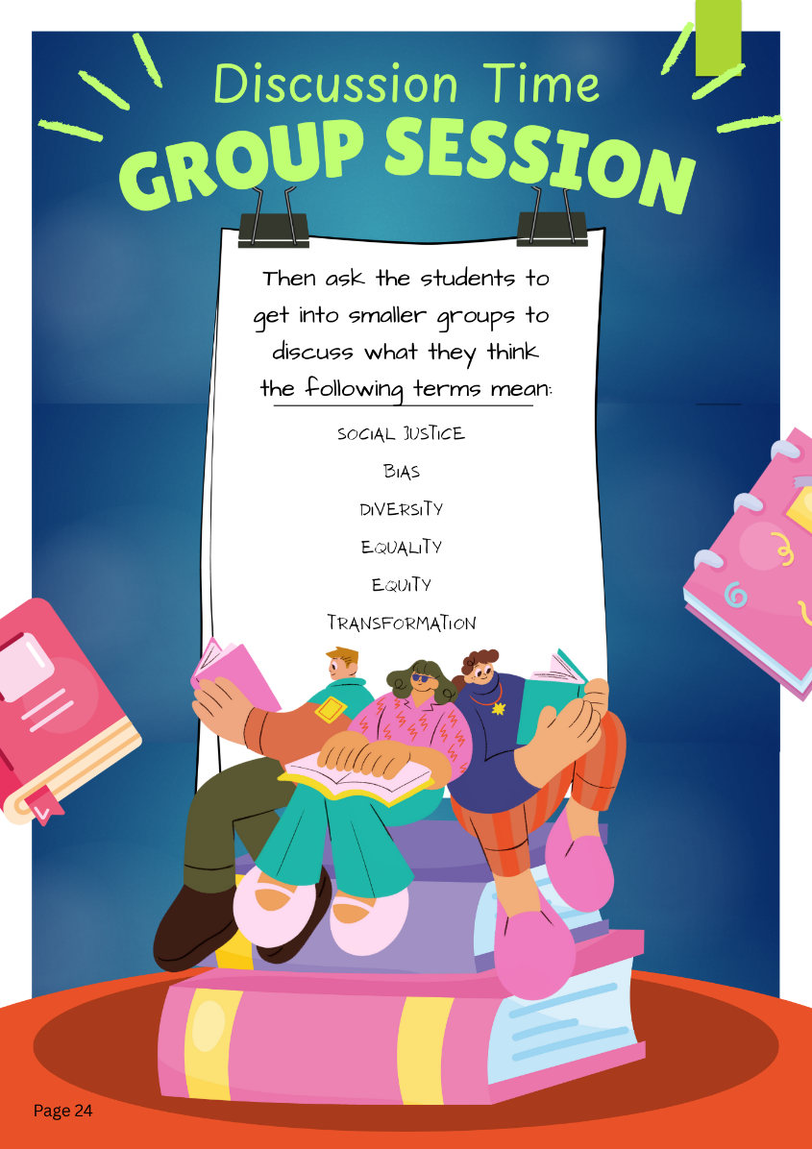
CONTEMPLATING
LISTENING
UNDERSTANDING

Slide 14
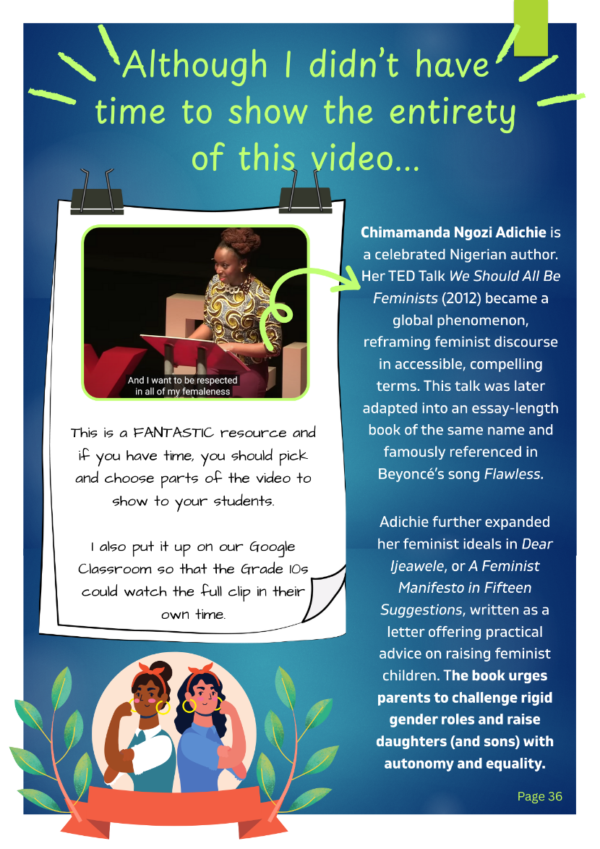
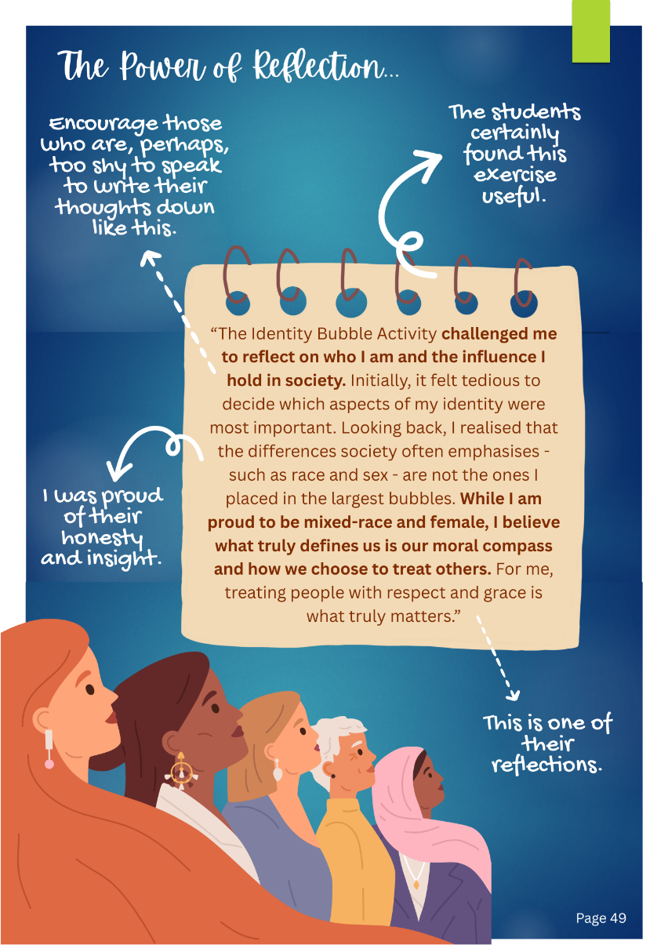
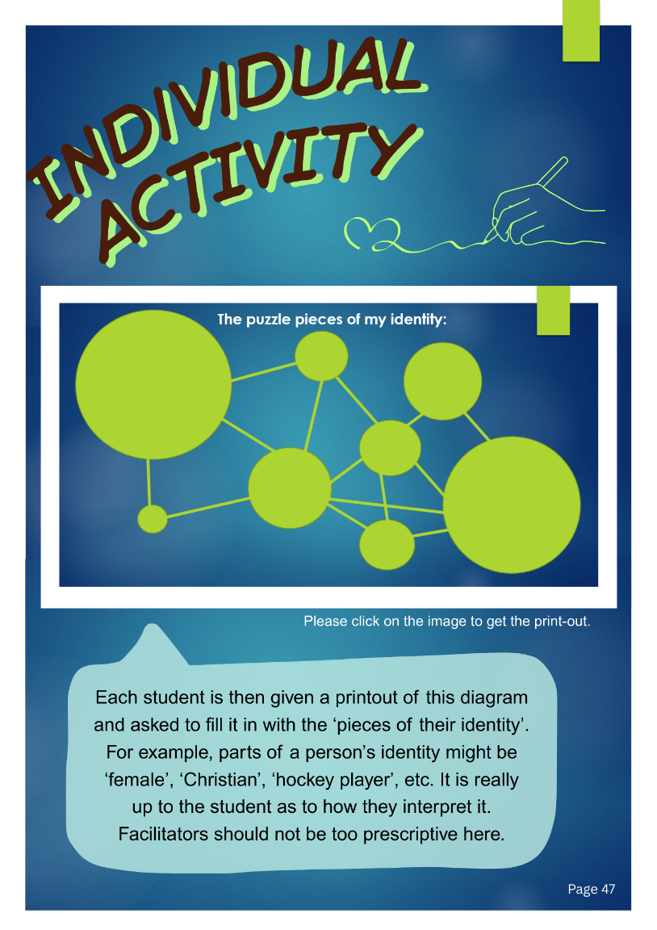
ACTIVITIES
ADDITIONAL RESOURCES
REFLECTION

Slide 15
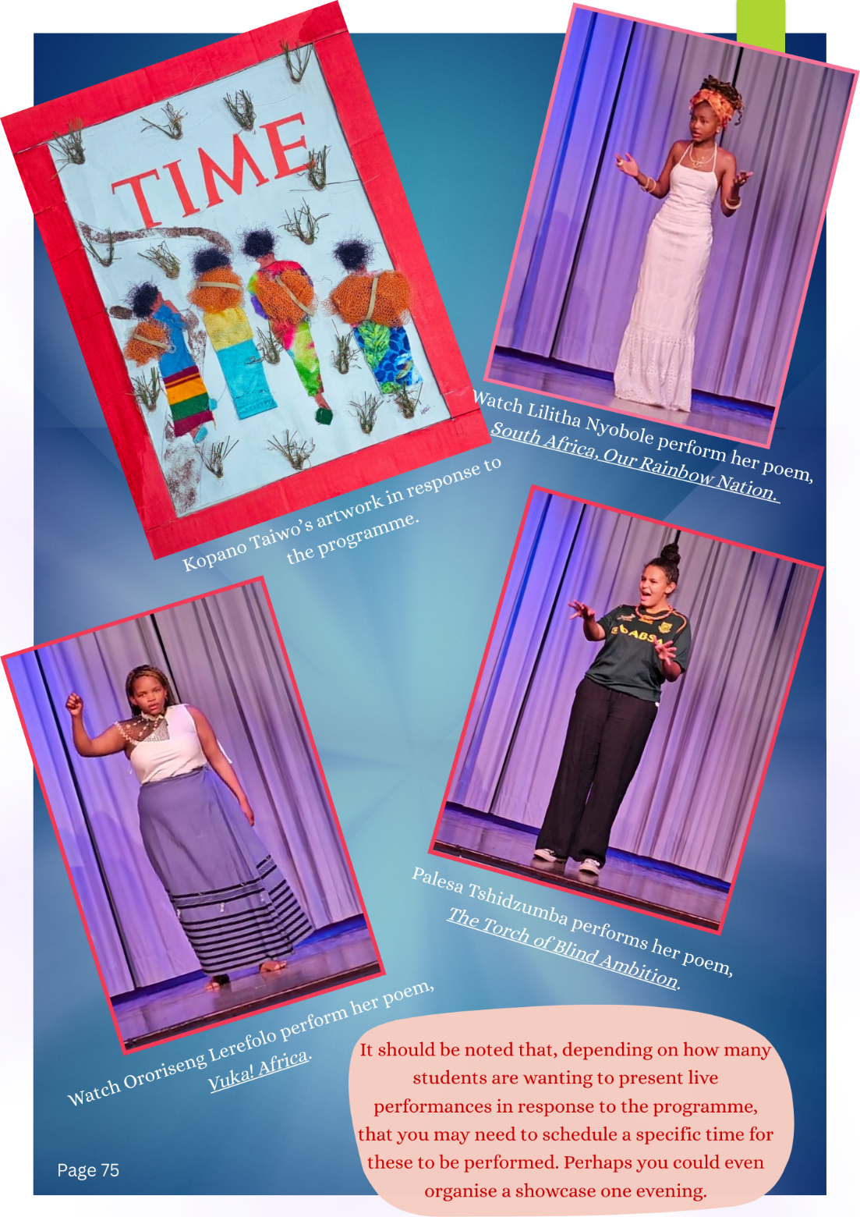
and CREATING….
But we will get back to this bit….
Because it is the best part!

Slide 16
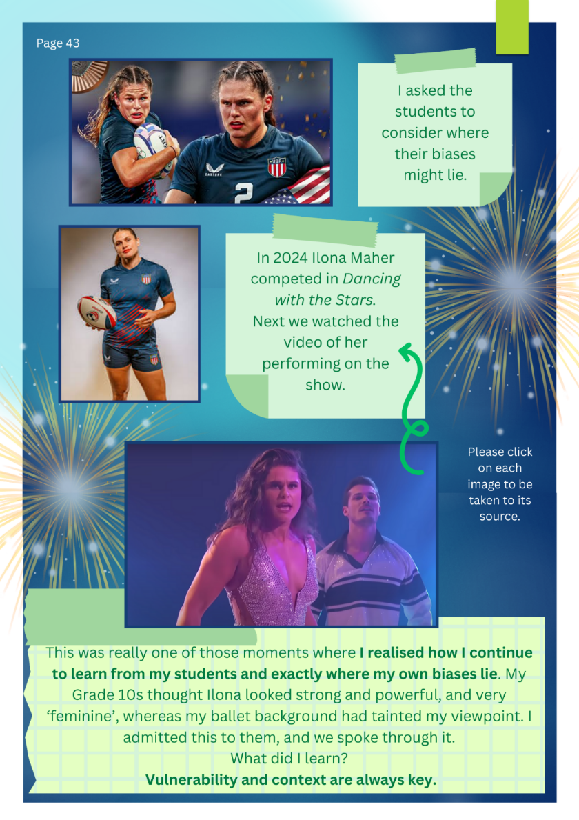
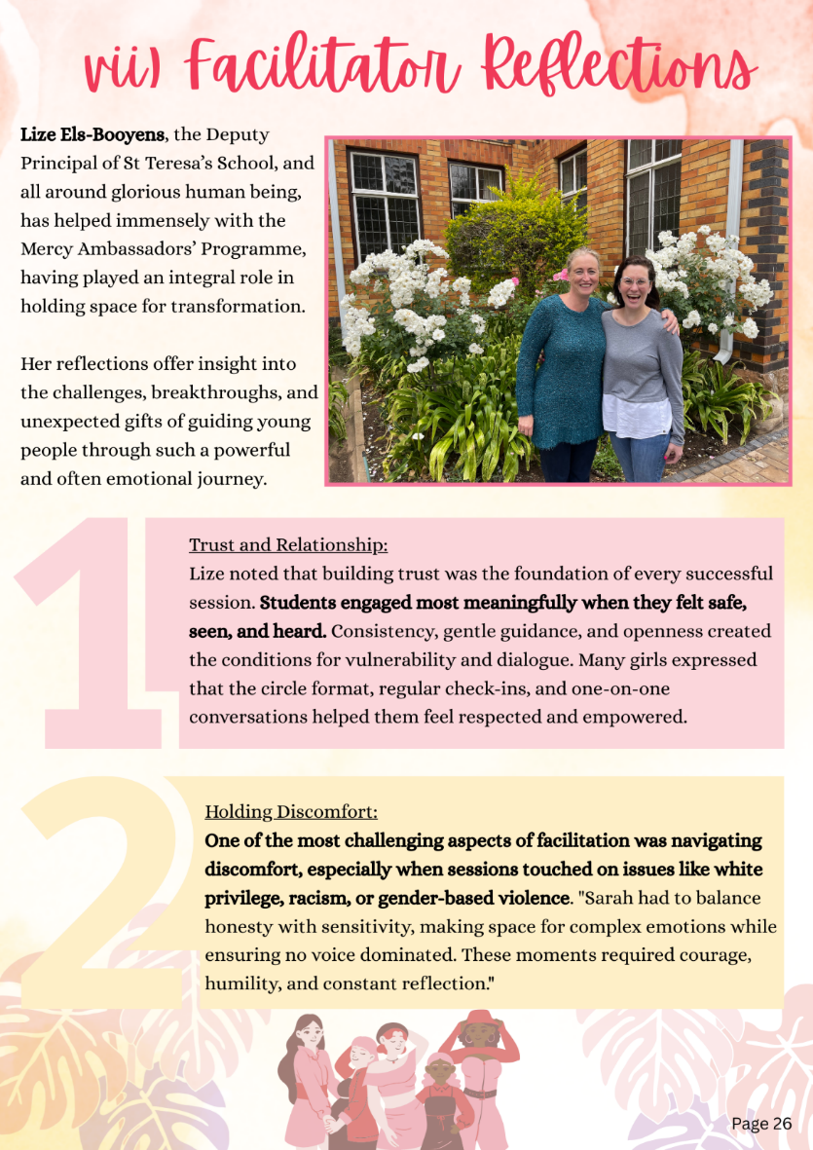
WHAT DELIGHTED OR SURPRISED ME?

Slide 17
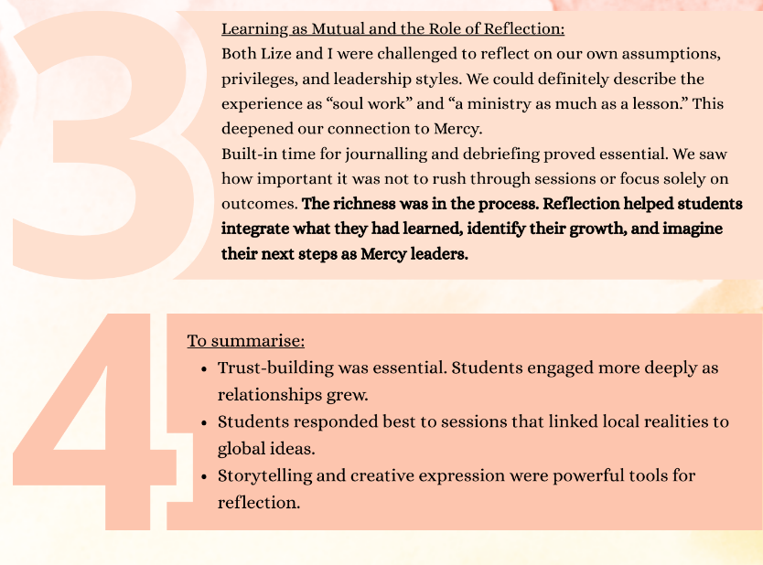
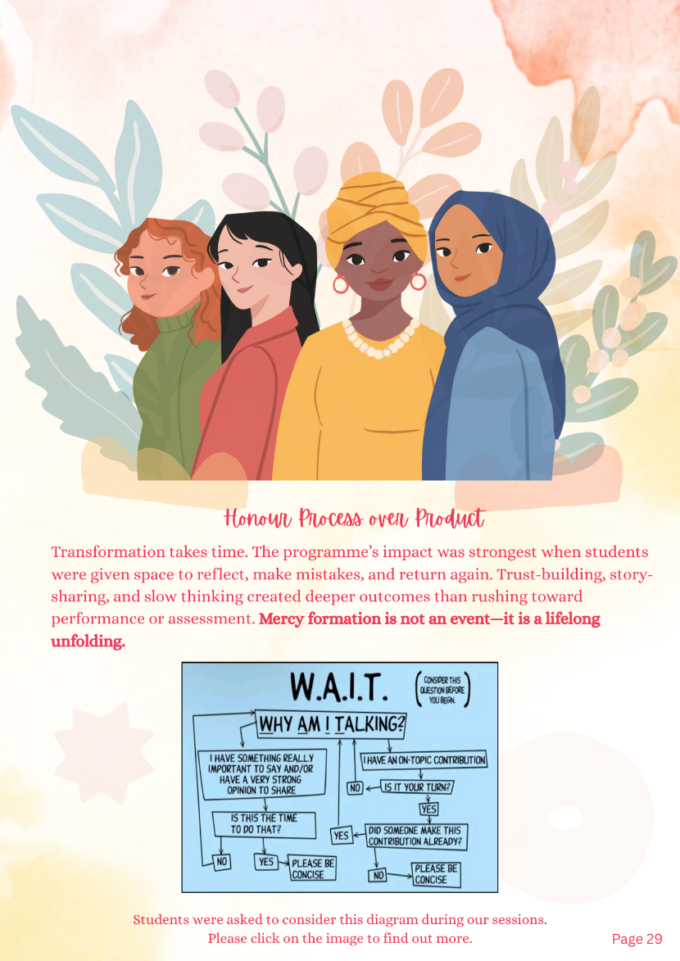
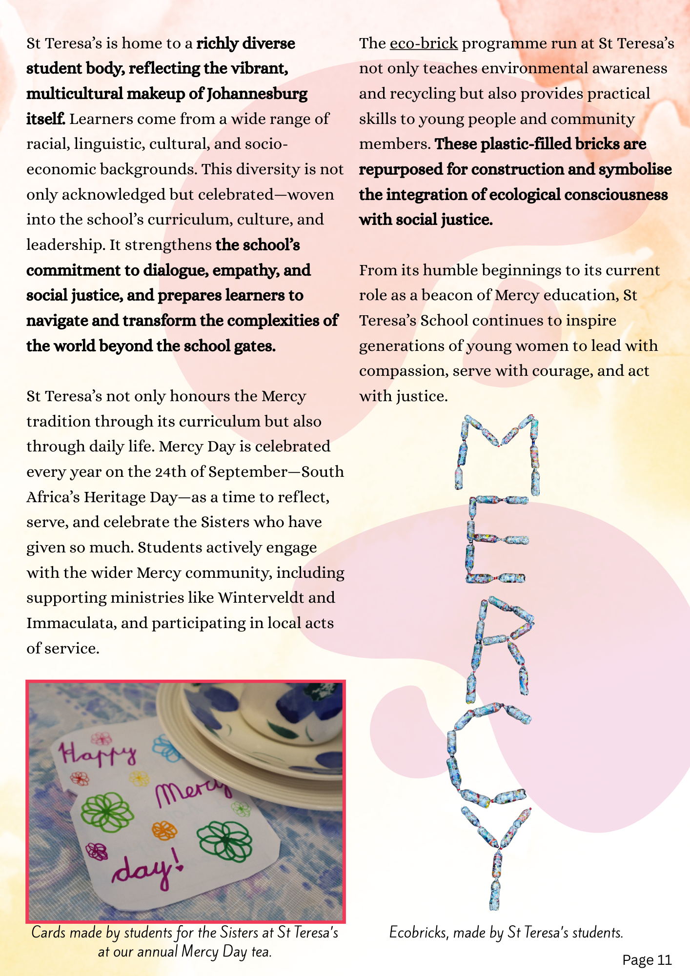


Slide 18
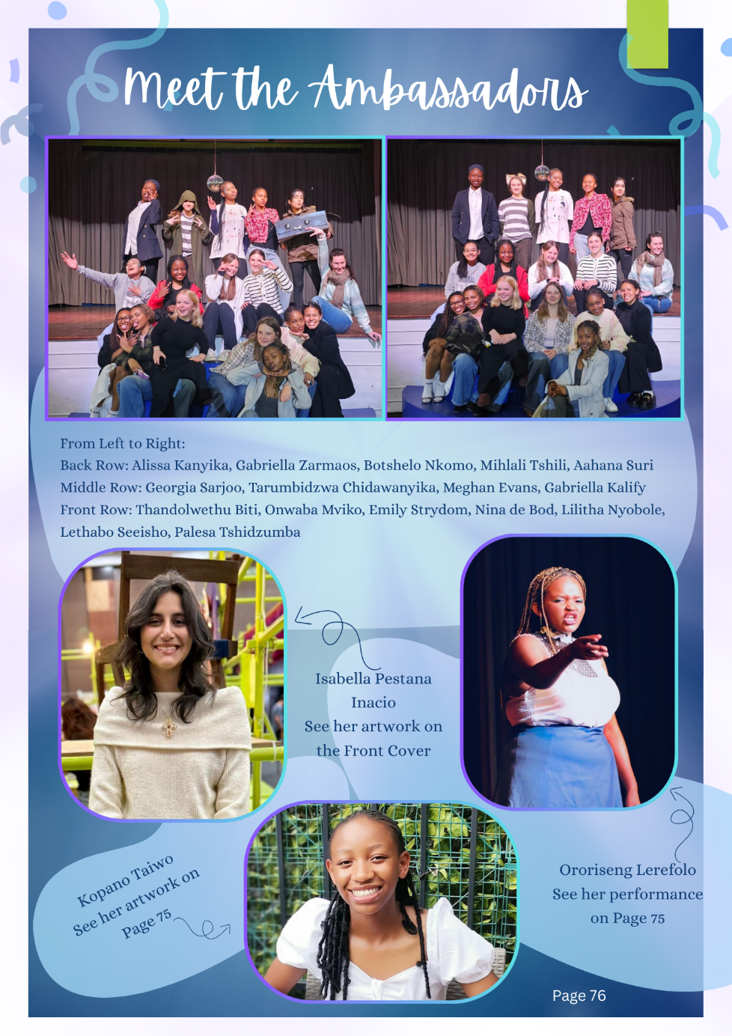
So …
Here is the best bit …

Slide 19
So…. Back to your task… do you think we achieved the Objectives of the Programme?
•To explore St Teresa’s mission and values of faith, compassion, integrity, excellence, open-mindedness and respect for other people.
•A commitment to the Mercy charism and values.
•Flexibility when facing new or unexpected situations and the ability to adjust to new cultures and ethnic backgrounds.
•Expanding our knowledge of the Sisters of Mercy and their work in different places.
•Understanding social justice, transformation, diversity and advocacy in context.
Individual Reflection and Development.

Slide 20

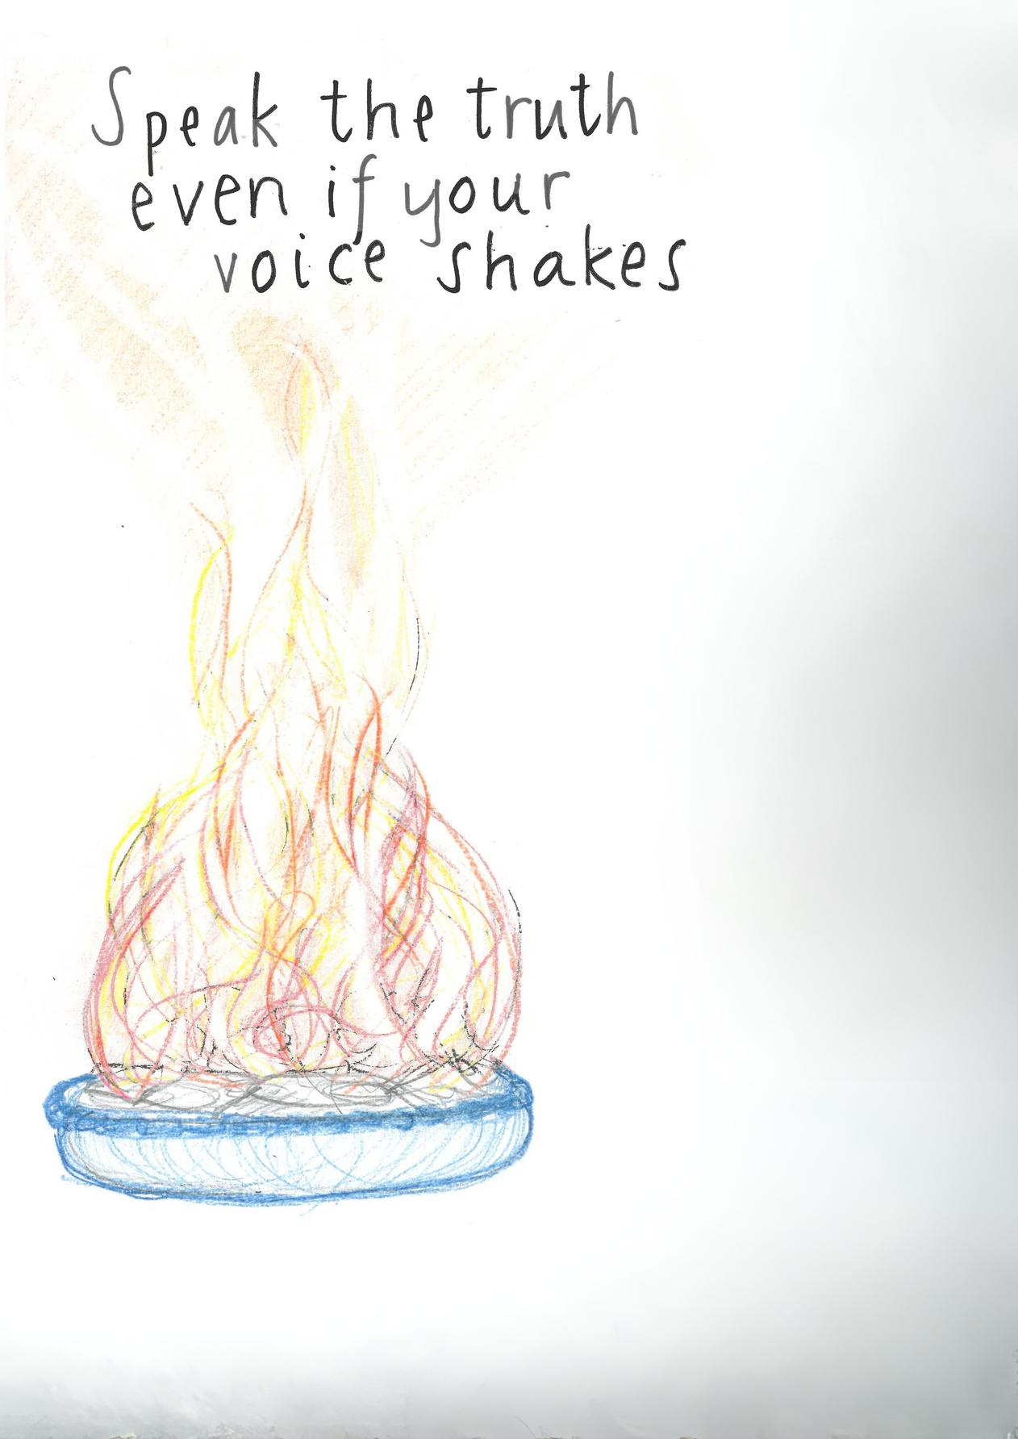
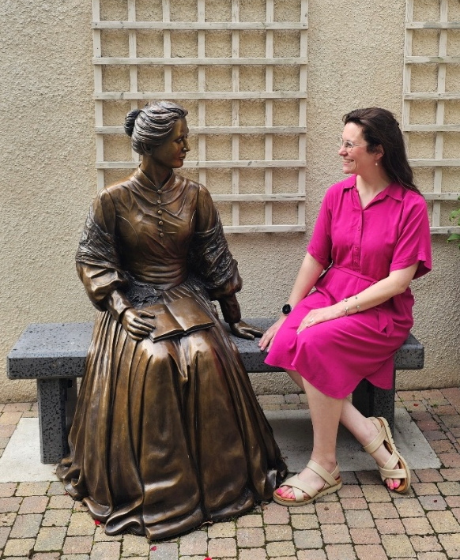
And…
I hope I don’t need to explain why YOU should do this programme, too.

Slide 21
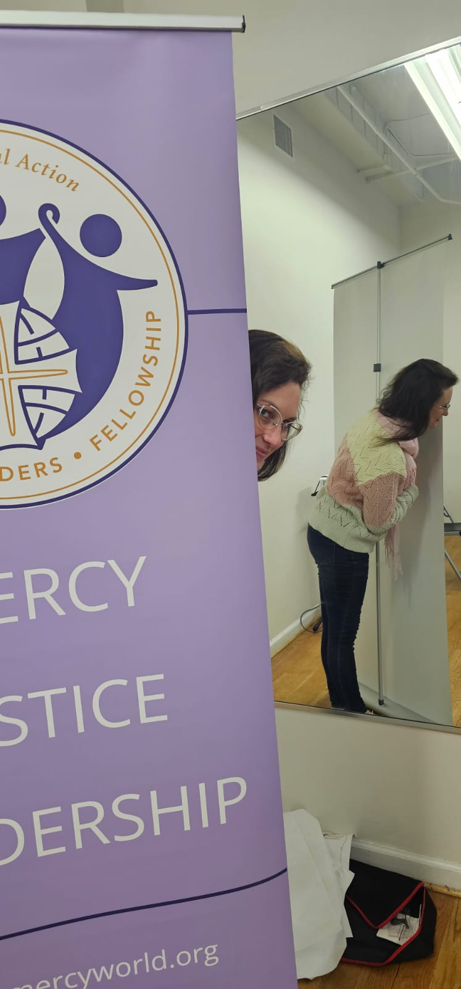


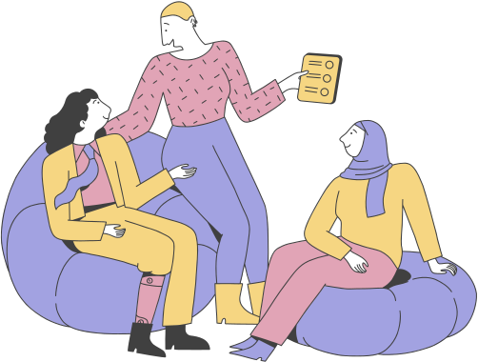
QUESTIONS?

