Slide 1
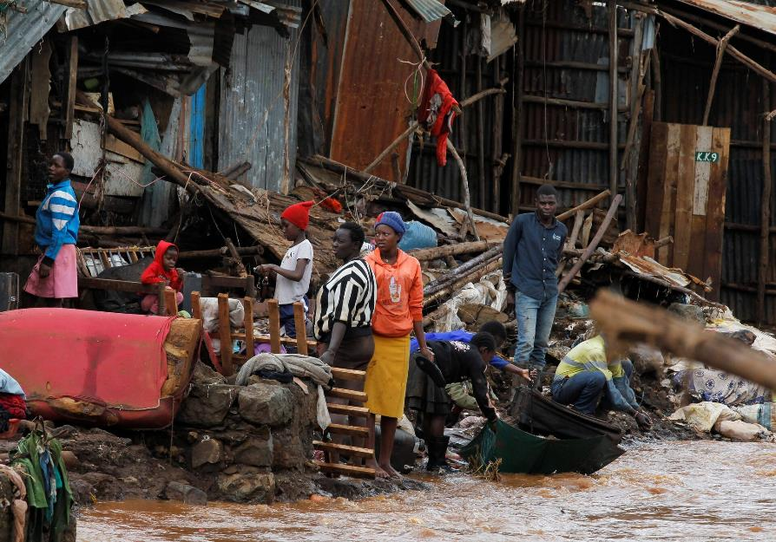
Hope Emerges from the Storms
Homelessness – the traumatic impact on women and children in Mukuru slum.
Luciah W. Njogu MELF Cohort 4

Slide 2
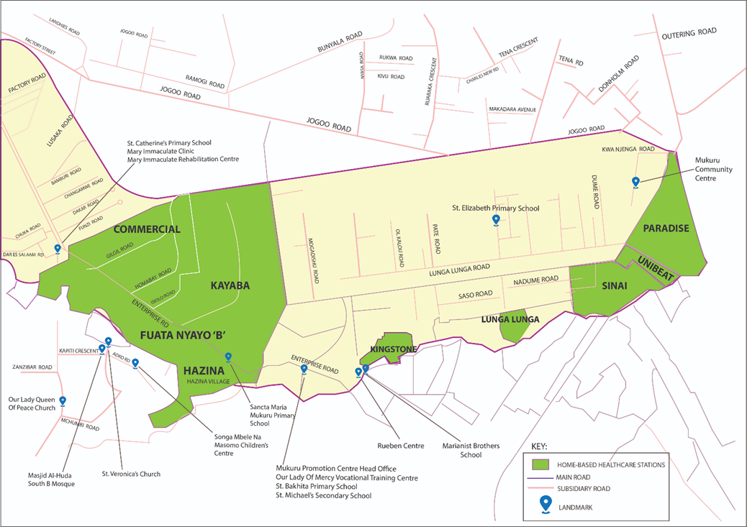
MUKURU SLUMS
14sq km – 700,000 people – Density rate 83,000 people per sq km

Slide 3

Impact of Homelessness
1. Capture and understand the traumatic experiences
2. Assess the psychological impact on women and children
3. Evaluate the effectiveness of interventions
Villages
Kayaba, Fuata Nyayo, Kisii, Mariguini and,
Kambi Moto.
Focus Groups
Structured Questionnaires
One-on-one interviews

Slide 4
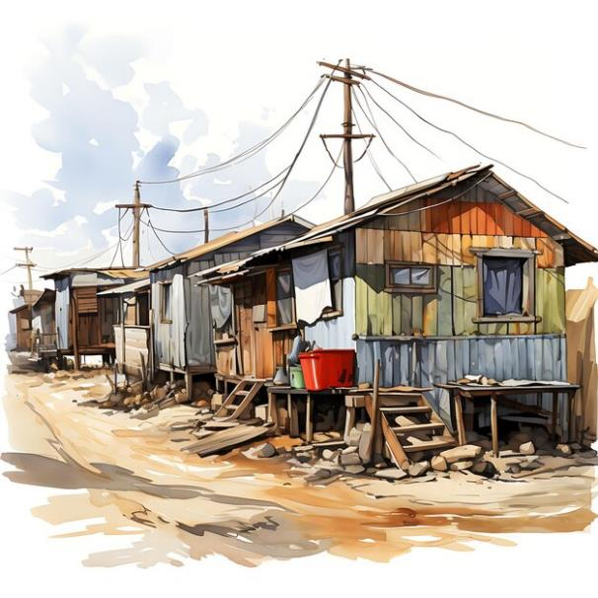
What is Homelessness?
Homelessness is more than just the absence of a physical space to live; it encompasses a broader range of issues.
A house is a home when it shelters the body and comforts the soul” Philip Moffitt
Homelessness can make women and children lose their sense of security, dignity, community relations, livelihood, belonging, and safety (Raphel 2006)

Slide 5
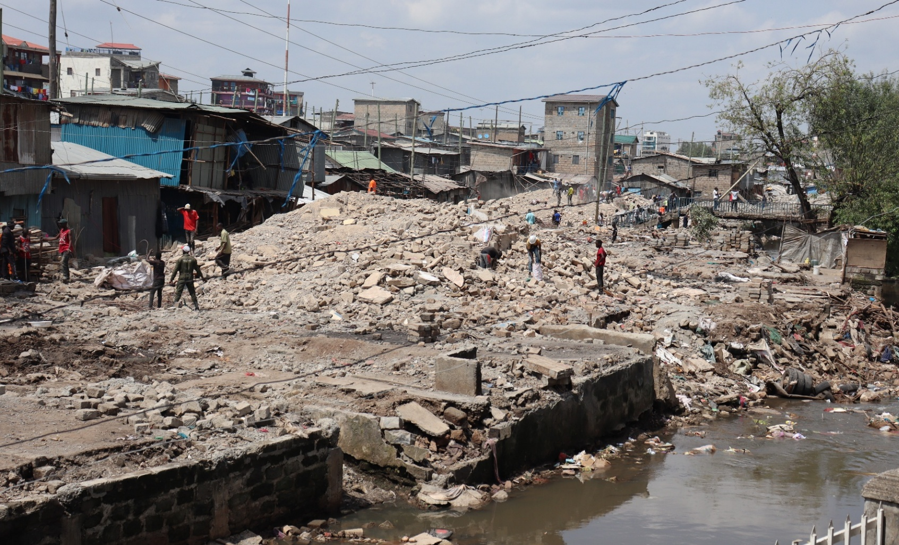
What is a Traumatic Event?
“…Is a negative impact of a distressing event on an individual’s emotional, mental and social well-being”
Raphael B, 2006.

Slide 6

Beginnings of Mukuru Homelessness
March and May 2024, Kenya experienced heavy rains that caused lots of damage.
The government issued an alert advising those along the river to relocate to higher ground.
Before they could move, a more intense downpour occurred, sweeping through the area.

Slide 7
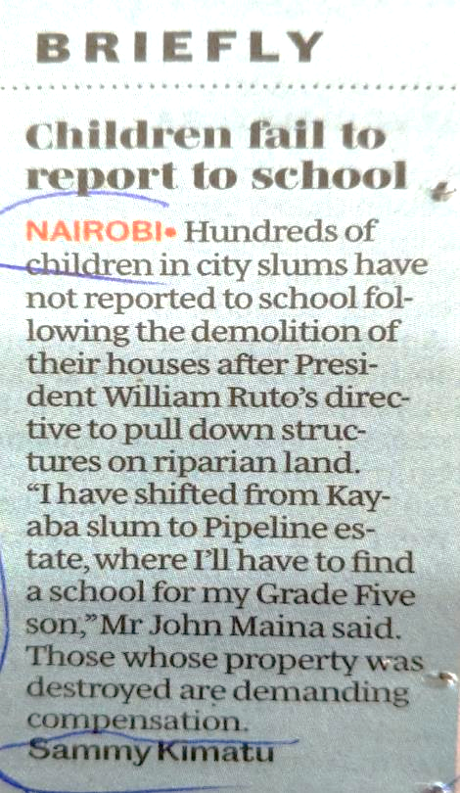
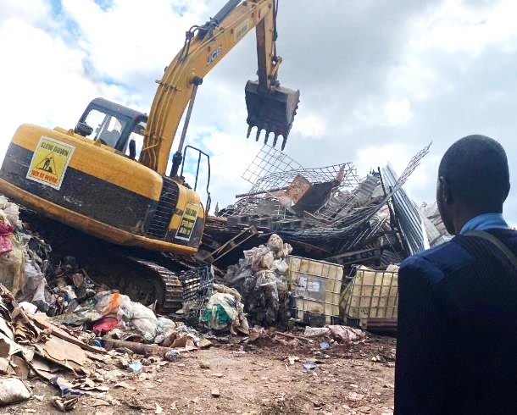
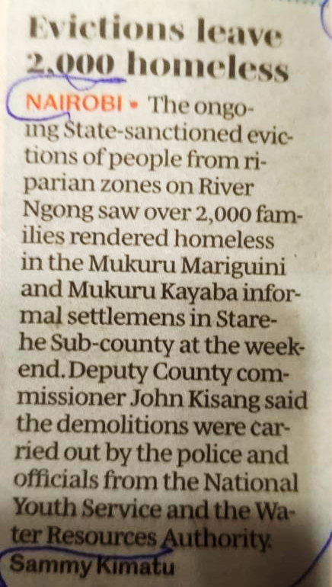
Government-Ordered Demolitions
Guarded bulldozers destroyed thousands of homes and businesses – social injustices
Hundreds of people lost their homes and properties to armed gangs who looted their possessions.
The Area Chiefs' camp became a refuge for women and children, who had nowhere else to go.

Slide 8
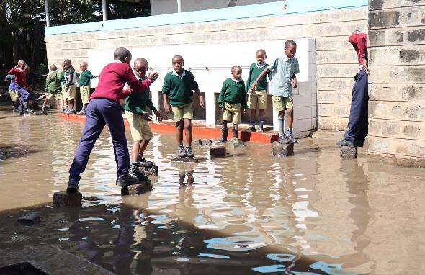
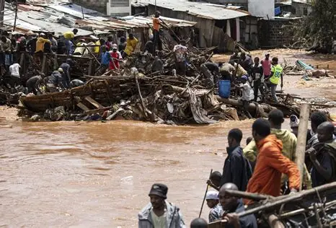
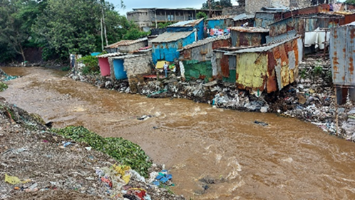
Victims of Floods and Demolitions
Over 5,000 women and children were displaced.
Over 500 houses were submerged or inaccessible.
24 individuals lost their lives.
St Elizabeth Primary School
People looking for their possessions
Ngong River

Slide 9

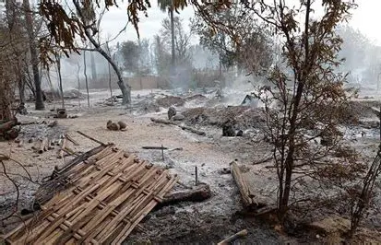

Different Types of Trauma
Herman 1992, Courtois 2022 and Mate 2022
‘ACUTE’
– one-off event e.g. fire, flood.
‘CHRONIC’
repeated events over time
‘COMPLEX’
– prolonged, including interpersonal relational issues. E.g . domestic violence, childhood neglect, human trafficking.

Slide 10
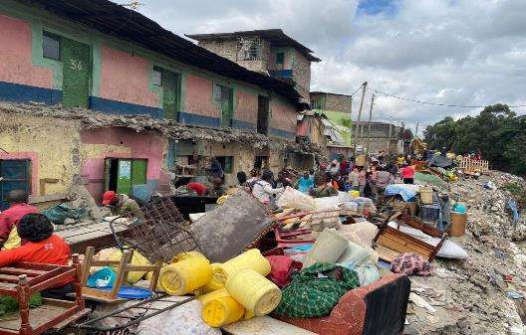
Traumatic Effects of Homelessness
Sanentz 2015
Desperation
Fear
Suicidal Ideations
Rejection
Withdrawal
Anxiety
Neglect & Shame
Abandonment
Depression & Stress

Slide 11

Stories
Trauma Identified
Merceline…
Neglect
Desperation
Abuse
Victimisation
Stress and Shame
Commercial Value

Slide 12
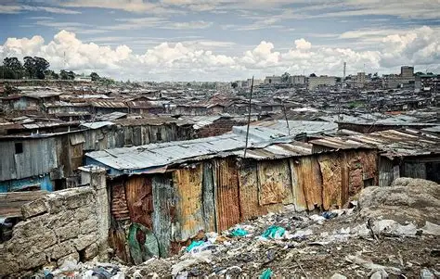
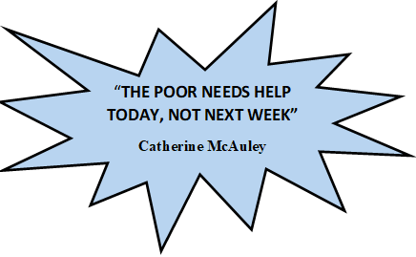
Catherine was a woman of action with a lively spirit for…
Mercy
Hope
Justice

Slide 13
United Nations
Articles Addressing Homelessness
UN Convention on the Rights of the Child
Article 27
This article, while not directly mentioning homelessness, is crucial. It states that all children have the right to adequate housing. Adequate housing is defined as not just having a roof over one's head, but also a safe and healthy environment.
Sustainable Development Goals
Target 11.1
States have agreed to “ensure access for all to adequate, safe and affordable housing and basic services, and upgrade slums” by 2030, which implies, as well, the requirement to eliminate homelessness.
Kenya’s Children's Act
Section 17:
This section empowers local authorities to provide financial assistance and accommodation to entire families, including children, who are in need. This can be particularly important for families facing homelessness or needing support.
Children's Act
Section 20:
It addresses the duty of local authorities to provide accommodation for certain children in need. This ensures that children are not left vulnerable and have access to safe and stable housing.
Instruments
.
Guiding Principles
Supports

Slide 14
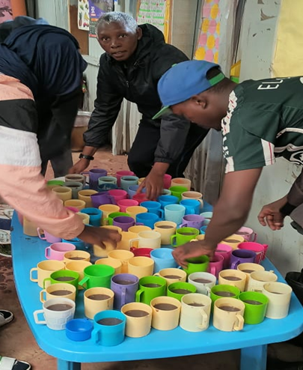
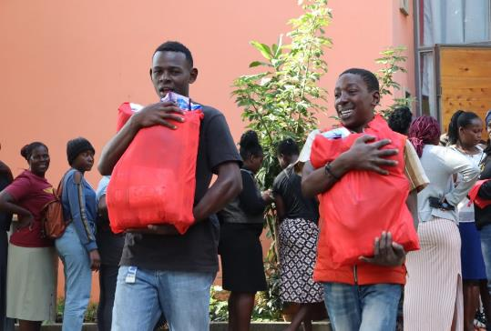
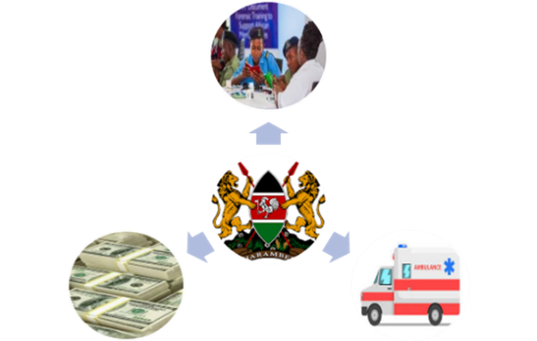
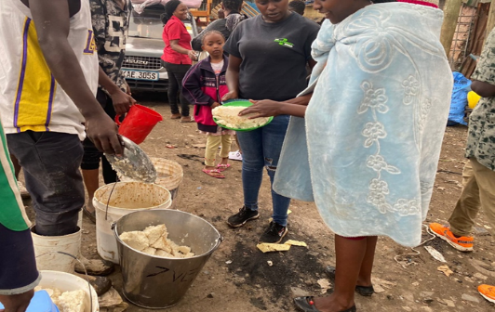

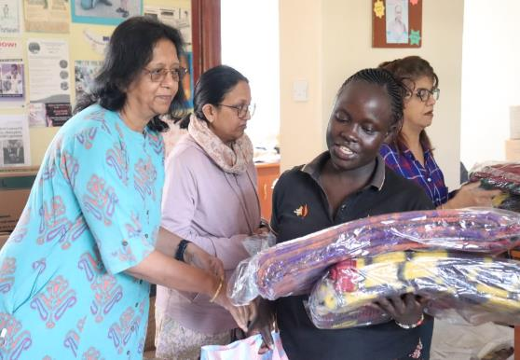
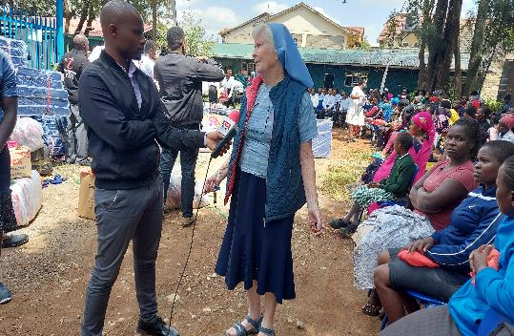
Interventions

Slide 15
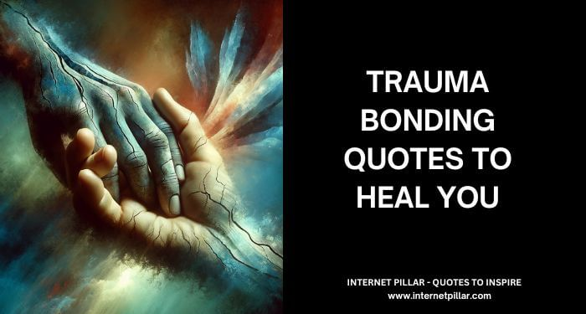
Research Findings…
Trauma impacted the social, mental and
emotional well-being of women and children.
80% of the victims survived the traumatic effects and moved on with life.
20% are still struggling with its effects.
NGOs engaged in all phases of disaster management.
National Housing Corp – only 50,000 units each year instead of 2m.

Slide 16
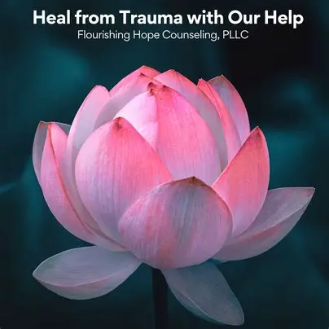
Research Findings…
Lack of Preparedness and recovery strategies to protect lives and infrastructure.
Social injustices (Govt support, compensation, corruption, healthcare access, sanitation, lack of income)
Lack of Public awareness, early warning systems, and efficient resource allocation for communities.
Mukuru community is a resilient group as they have been able to find HOPE amid a storm without much assistance.

Slide 17
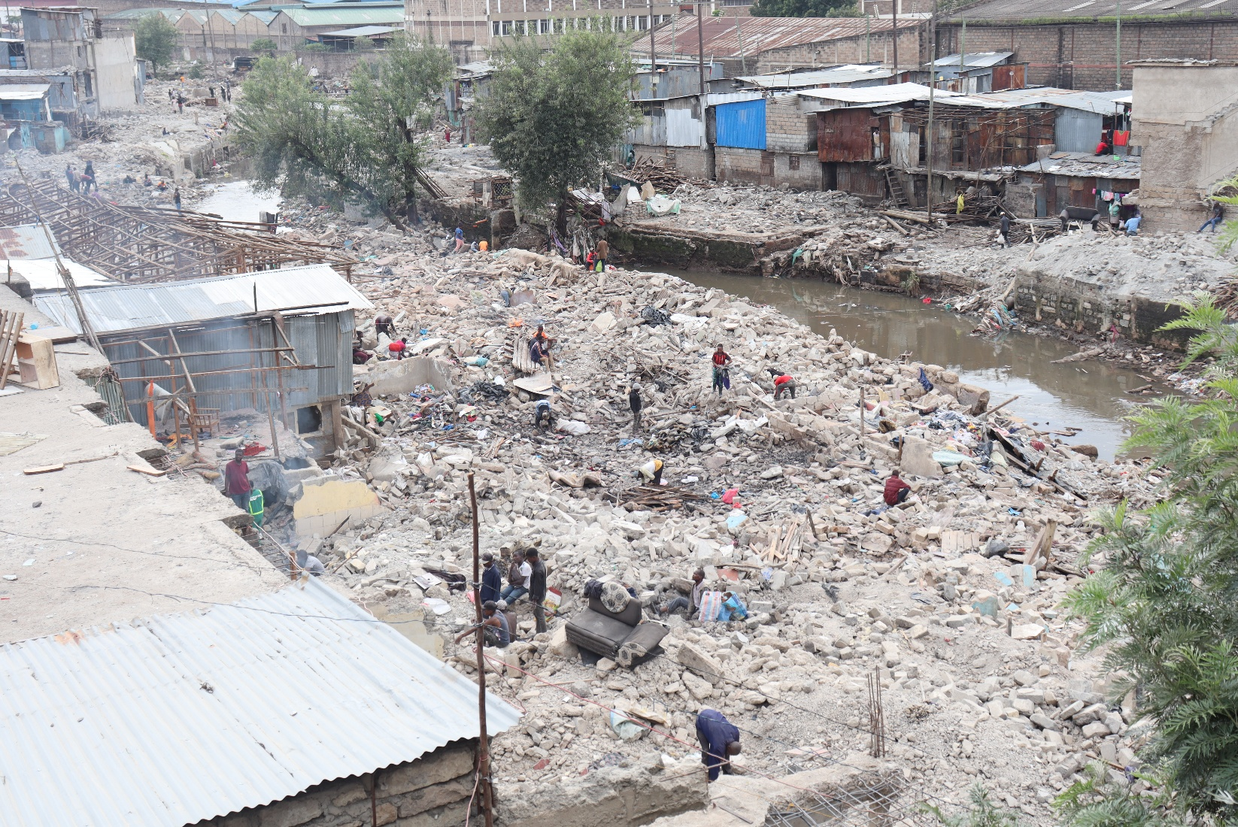
1. Sanitation and health issues
2. Increased insecurity
3. Economic disruptions
4. Hope for compensation
16 Months Later…
Social Injustices
.

Slide 18

Recommendations
Resettling the vulnerable in the affordable housing project.
Stronger mechanisms for early warnings
Allocation of funding to assist the victims
Mercy World online “affordable housing petition” for children – National Housing Corp Report 2023
Child friendly counselling
Targeted mental health services for women and children
Gender sensitive approaches in counselling

Slide 19
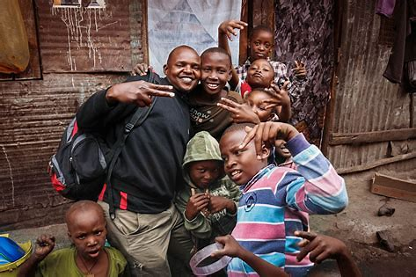
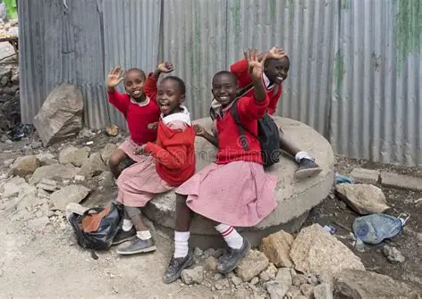
Conclusion
Catherine McAuley can be seen as a survivor of complex trauma, which arguably fueled her mission of Mercy, Justice and Hope.
Mukuru women and children demonstrated resilience, found hope despite limited resources and assistance.
In Catherine’s footsteps, Mercy continues to enable HOPE.

Slide 20

Hope Emerges from the Storms
Homelessness - the impact on women and children in Mukuru slum
Thank Asante
You Sana
Luciah

