Slide 1


Mercy in the Mirror
How Mercy and Justice Can Change Communities
McKenna Smith
MELF Cohort 4
Dublin, Ireland
1 September 2025

Slide 2
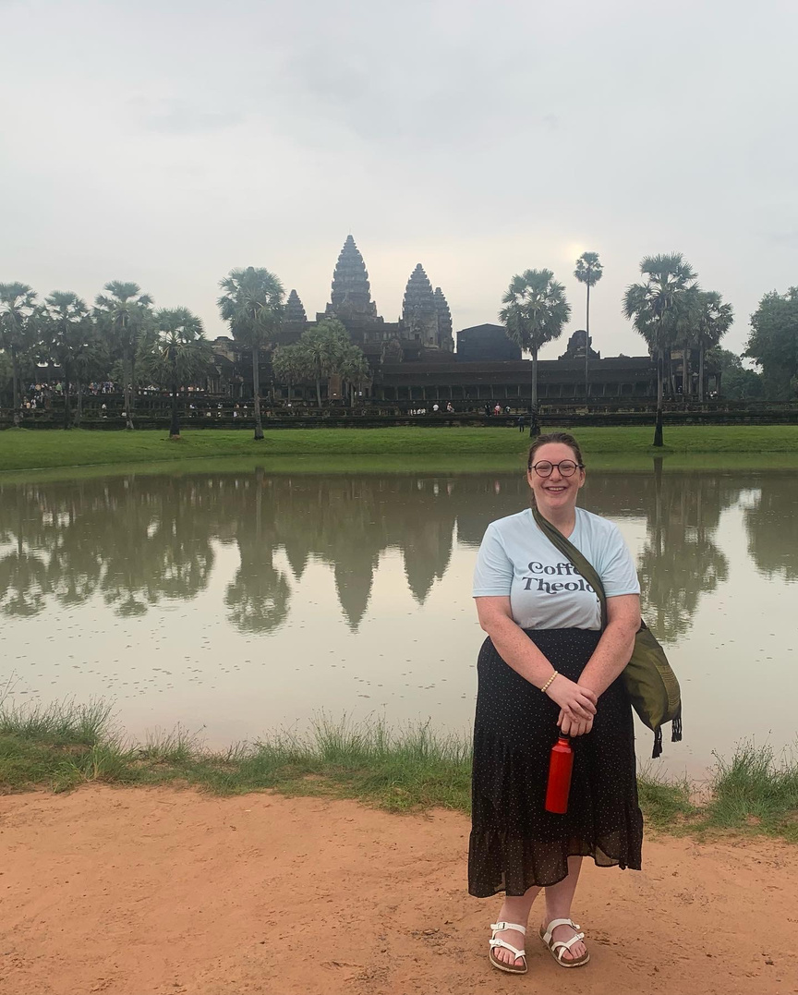
Introduction
Why women who are incarcerated matter to me
Why addiction, mental illness, and poverty are areas of concern that I want to fix
Picture owned by McKenna Smith

Slide 3
Important Definitions
Mercy is the act of compassion (Ruffing, 2021)
Justice is the equitable treatment of all people in a society (UC Law San Francisco, 2022)
Displacement of Women through Incarceration is the systemic imprisonment of women due to conditions such as mental illness, addiction, abuse, and poverty (Prison Policy Initiative, 2024)
Rehabilitative Justice is the practice of addressing the root causes of crime and helping offenders reintegrate into society (Department of Justice, 2025)

Slide 4
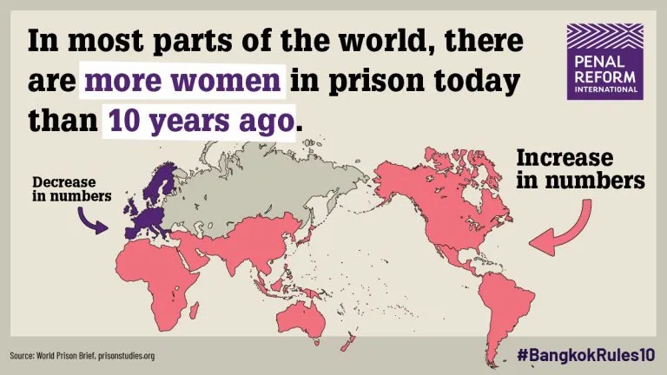
Recognizing the Problem
Since the beginning of the 21st Century, the global rate of women entering prisons has out paced men (World Prison Brief 2025).
Penal Reform International, Triona Leniham, 10 December 2020
Graph source: World Prison Brief, prisonstudies.org
Based on information gathered from the Bangkok Rules

Slide 5
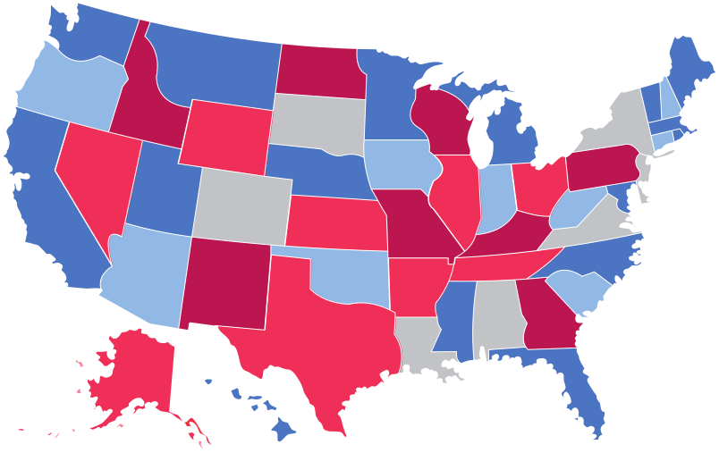
Looking Inward
An Overview of Women’s Imprisonment in the United States
Nearly 200,000 women & girls are incarcerated at any given time.
1 in 8 incarcerated parents lose their parental rights due to their time
behind bars
31% of incarcerated women have a serious mental health disorder versus 4.9% of non-incarcerated women
Prison Policy Initiative, March 2024
Prison Policy Initiative, March 2024
Vera Institute of Justice 2016

Slide 6


A Tale of Two States
How Incarceration & Treatment Vary in North Carolina & Maine
2000% increase in jails
800% increase in prisons
Offers programming for residents, often hard to qualify for and limited space available
Vera Institute of Justice, December 2019
State of Maine Department of Corrections
Lacks significant programming for residents, particularly women.
Does offer some post-release help
1036% increase in jails
356% increase in prisons
North Carolina Department of Adult Corrections
Vera Institute of Justice, December 2019

Slide 7
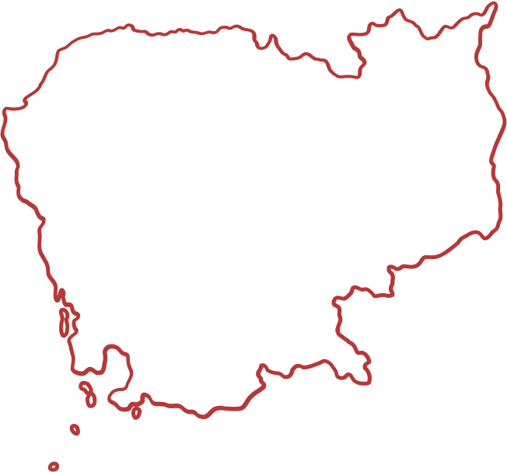
Looking Outward
An Overview of Women’s Imprisonment in
Cambodia
Most face minor drug charges that come with lofty sentences
Women make up nearly 9% of the prison population
Penal Reform International 2019
Penal Reform International 2019
Due to overcrowding,
drug treatment centers were built to help, but the need outpaces the admittance
International Drug Policy Consortium 2024

Slide 8

What has caused this shift?
Poverty
Mental Illness & Addiction
Abuse

Slide 9




A Deeper Look
Motherhood Behind Bars
The War on Drugs
A Lack of Mental Health Intervention
Racial Implications

Slide 10

Globally, women often participate in low level crimes just to survive that result in harsh outcomes.
In the United States, 1 in 2 families have someone who has been incarcerated (EJI).
Additionally, in July 2025, President Donald Trump issued an executive order criminalizing homelessness and certain addictions and mental disorders (whitehouse.gov).
Why does it matter?
Programs that extend merciful compassion are needed now more than ever.

Slide 11
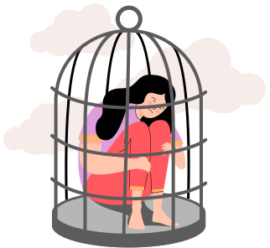
Why We Should Care About Women Who Are Incarcerated

Slide 12


Research Proves
Women who have been incarcerated suffer from low self esteem (Annett et al).
Participation in art therapy, during incarceration, can improve one’s outlook on themselves (CJCJ).
People who participate in art therapy, while incarcerated, have lower recidivism rates than those who do not participate (RTTA).
Art allows for expression of feelings and an exploration of what leads a person to where they are (Creativity in Therapy).
Image is used with Creative Commons License

Slide 13
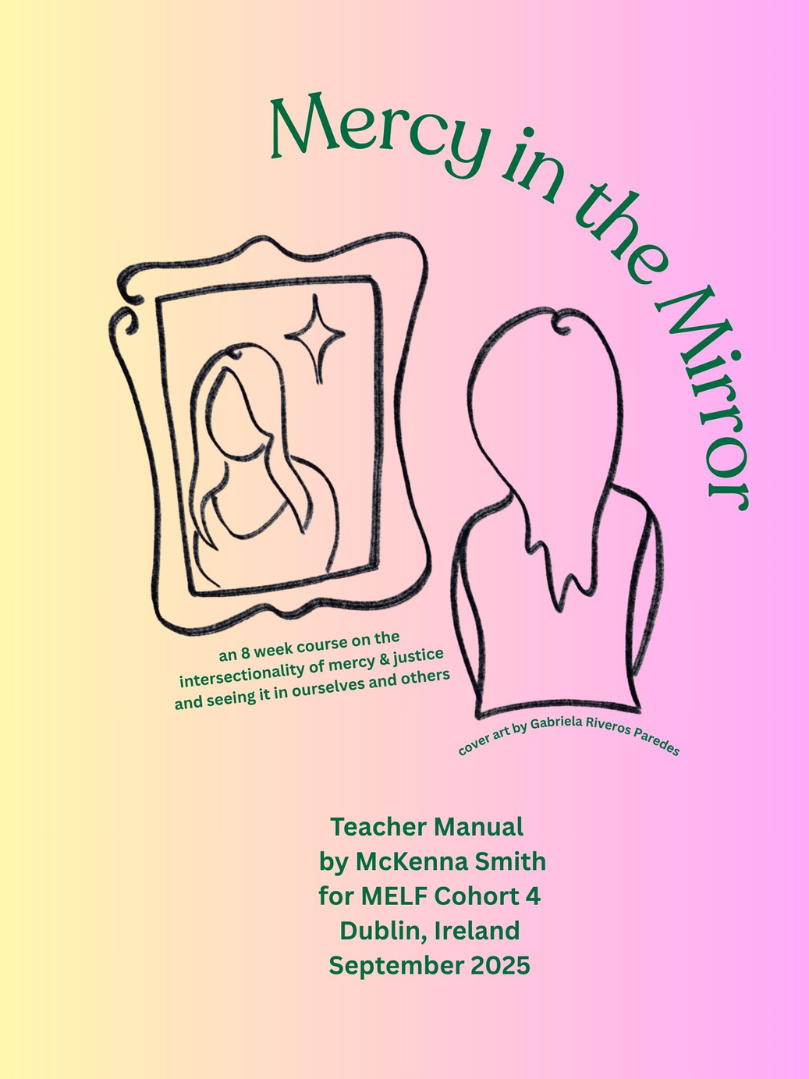
Introducing
“Mercy in the Mirror”
An 8 week course
on the intersection of
mercy & justice through
art and self reflection

Slide 14
“Mercy in the Mirror”
It aims to help lower recidivism rates in women facing incarceration.
The hope is that over the 8 weeks, the women who participate in the program will grow in the love they feel for themselves and others.
This program was designed with the Bangkok and Mandela Rules in mind.
A side effect of incarceration is that it strips people of their worth and dignity.
Mercy in the Mirror is designed to give it back.

Slide 15


The Bangkok Rules
Rule 12 Individualized, gender-sensitive,
trauma-informed and comprehensive mental health care
and rehabilitation programmes shall be made available for
women prisoners with mental health-care needs in prison
or in noncustodial settings.
Rule 13 Prison staff shall be made aware of times when women may feel particular distress, so as to be sensitive to their situation and ensure that the women are provided appropriate support.
Rule 58 “...women offenders shall not be separated from their families and communities without due consideration being given to their backgrounds and family ties. Alternative ways of managing women who commit offences, such as diversionary measures and pretrial and sentencing alternatives, shall be implemented wherever appropriate and possible.
Rule 46 Prison authorities, in cooperation with probation and/or social welfare services, local community groups and non-governmental organizations, shall design and implement comprehensive pre- and post-release reintegration programmes which take into account the gender-specific needs of women.
Women have different needs than men do and will respond to rehabilitative services differently. Often, women are more receptive to rehabilitative approaches to justice.

Slide 16
The Mandela Rules
Prison should not emphasize exclusion from community.
It should encourage and foster participation (88.1)
Governments have a responsibility to ensure that the released prisoner receives “efficient aftercare” that limits “prejudice in their social rehabilitation”
Prison administrations ‘should offer education, vocational training and work, as well as other forms of assistance that are appropriate and available, including those of a remedial, moral, spiritual, social and health- and sports-based nature’ (4.2).
From the beginning of a persons involvement in the justice system, they must be afforded the opportunity to seek rehabilitation (107).
“You can build hope with your own hands.”
Lama*, (name changed for privacy),
a resident at a Women’s Prison in Beirut, Lebanon, whose story was featured in an UNODC article celebrating 10 years of the Mandela rules
UNODC Nelson Mandela Day - July 2025

Slide 17
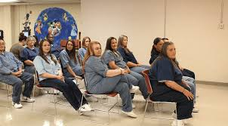
An 8 week course
On the intersection of mercy & justice through art and self reflection
Designed with women who have a history of incarceration, mental illness, addiction, and/or abuse in mind.
So often, women behind bars lack self-esteem, self-love, and the tools or support to break a cycle.
Mercy in the Mirror seeks to shine a light on the goodness that each of us holds, to teach women that their value is inherent, and that they have a community around them who wants them to succeed.
Image is from Creative Commons

Slide 18

A Roadmap to
Mercy & Justice
Week One: Who Am I?
This week focuses on how the women view themselves, the good, the bad, the parts they don’t often talk about.
They will draw two self portraits that depict how they see themselves now and how they hope to be perceived.
Week Two: What is Mercy?
This week focuses on what mercy is, how it appears in our lives, and how we need to give it and receive it.
Participants will create a word cloud of how they see mercy in their lives and draw an image of what mercy means to them.

Slide 19
A Roadmap to
Mercy & Justice
Week Three: Mercy Towards Self & Mercy Towards Others
This week focuses on how mercy and forgiveness go hand in hand.
The women will draw two images, one of them giving mercy and one of them receiving mercy.
Week Four: Practical Applications of Mercy
This week focuses on the corporal works of mercy. We go through the seven corporal works of mercy and discuss where they have appeared in our lives.
Participants will create a word cloud of how they want to see the corporal works of mercy in their lives and then create a visual representation, perhaps through a board game, calendar, or playing cards.

Slide 20
Week Five: Spiritual Works of Mercy
This week focuses on Jesus uses the spiritual works of mercy to help us cleanse and renew ourselves.
The women will create a word cloud based on the spiritual works of mercy and then they will create an artistic piece to remind them of the spiritual works in their lives.
A Roadmap to
Mercy & Justice
Week Six: Intersectionality of Mercy & Justice
This week focuses on what justice is, how it appears in our world, and how we can advocate for better justice.
Participants will create a word cloud of how they have been impacted by injustice and piece of art showing their talents

Slide 21
Week Eight: Conclusion and Graduation
This week focuses on celebrating the hard work that these women have done. Their work will be featured in a community art show.
The women will be celebrated for their perseverance and dedication. The community will be invited to stand with them so they know they are not alone.
A Roadmap to
Mercy & Justice
Week Seven: Mercy in My Life
This week focuses on how mercy and forgiveness have begun to be displayed for these women and talk about steps to take for the future.
The women will draw two images, one of how they view themselves and one of how the value mercy in their life.

Slide 22
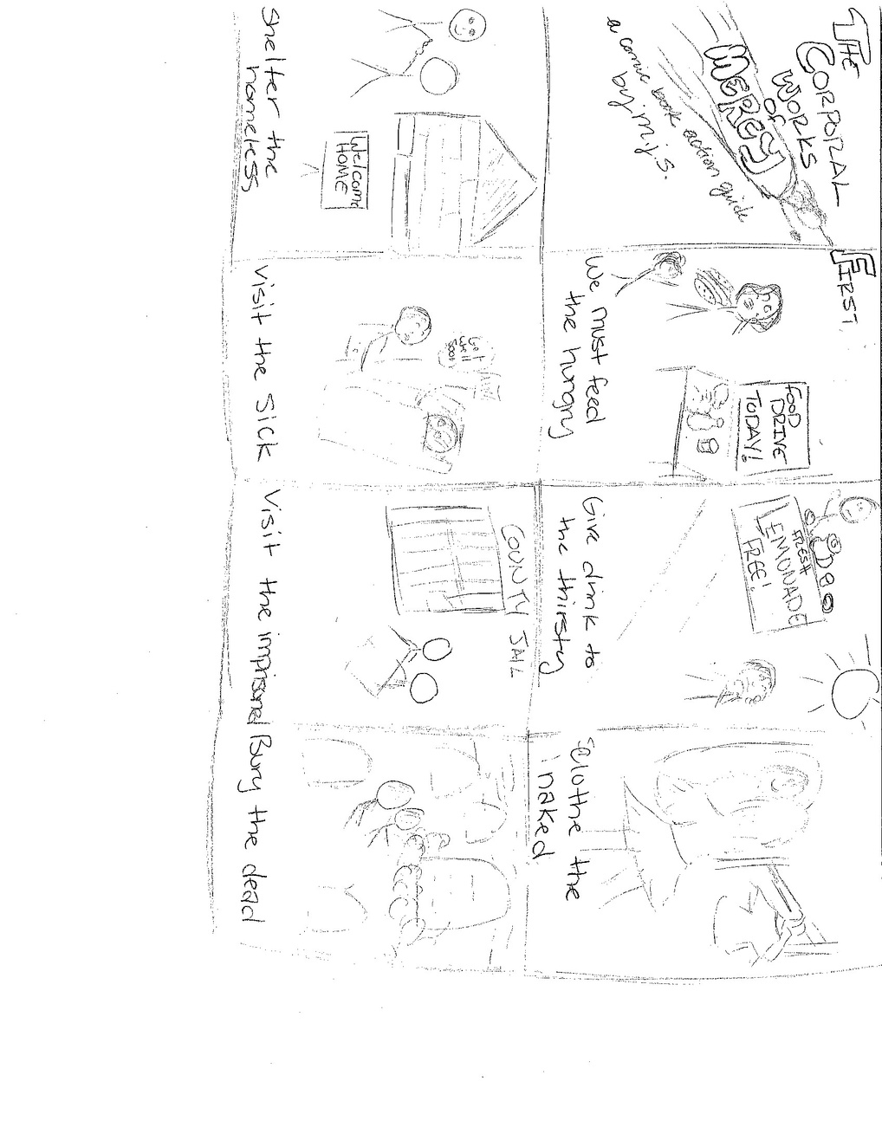
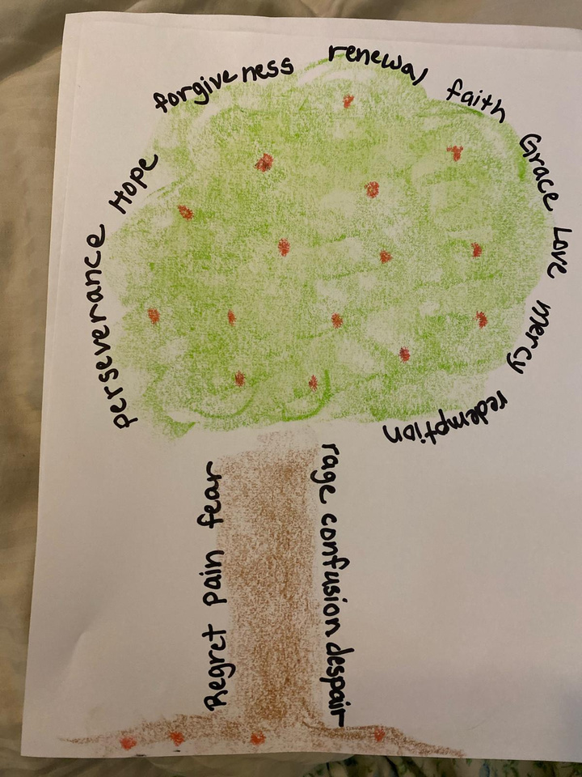

Examples of artwork created
Artwork created by Jen S.
Week 1
Artwork created by M.S.
Week 4
Artwork created by Elizabeth B.
Week 1

Slide 23

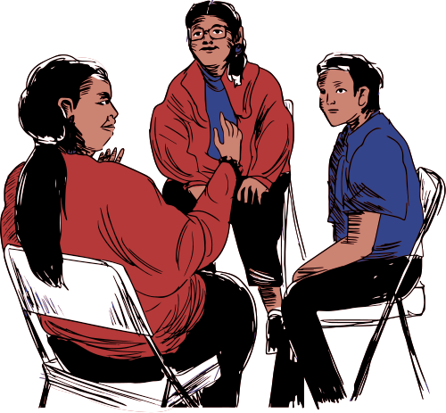
An Overview of Each Week
Coming together
Opening Prayer
Closing
Prayer
Check
In
Closing
Remarks
Lesson Intro
Art
Activity

Slide 24

Framework
Mercy in the Mirror is open to any women who has been incarcerated and wants to value themselves more. The ideal candidate will have a history of mental illness, addiction, or abuse, who wants to find support and hope. This program requires a level of self-awareness that is going to scary and new. It requires compassion for oneself and those around you.
The goal is that Mercy in the Mirror can be done anywhere, at any budget.
Mercy in the Mirror is a community based program that can only work with support. In order to facilitate an 8 week program, there are several moving parts that need to be addressed:
Classroom space
Teachers
Excited Participants
Art Supplies
Teacher Manual
Teacher Training

Slide 25
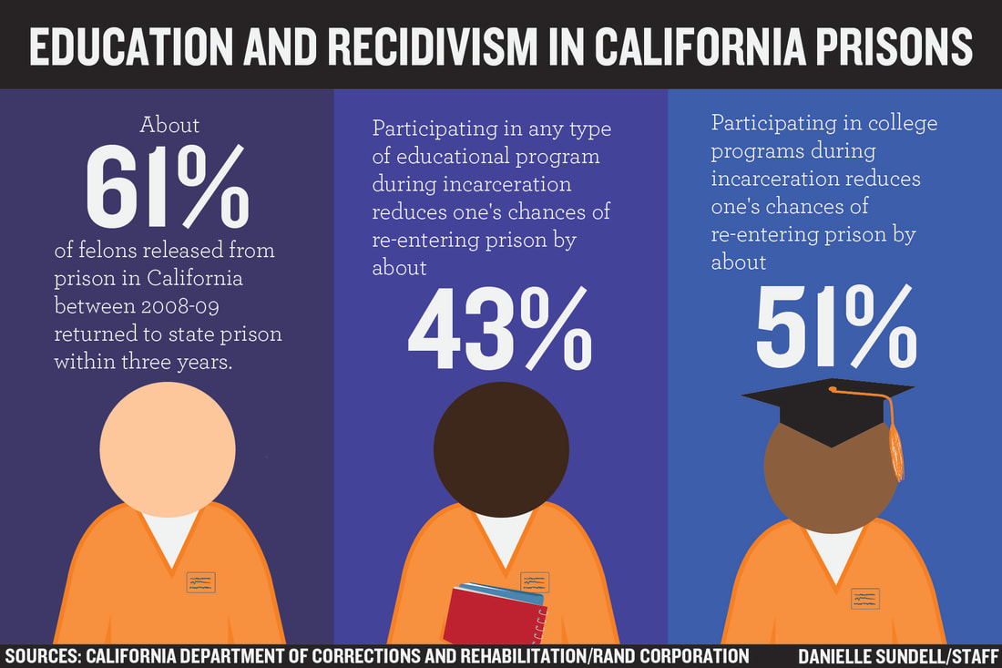
Expected
Outcomes
and where
to next

Slide 26

Expected Outcomes
and where to next
Mercy in the Mirror is part of the framework for an undergraduate course that will be offered at St. Joseph’s College of Maine beginning in the Summer of 2026.
It is being pitched to Prison Chaplains in the southern United States who are looking for ways to better reach women who are incarcerated.
Image used with permission from Saint Joseph’s College of Maine Brand Studio

Slide 27
Expected Outcomes
and where to next
While this program has been designed for women who are incarcerated, it could be useful for many people.
Teenagers, particularly those who are facing hardships or are “at risk”.
Religious spaces, such as women’s groups or youth ministry.

Slide 28

Thank You!
Any Questions?
“Take your broken heart and make it into art”
-Carrie Fisher

Slide 29
Acknowledgements
Mercy Global Action Team, especially Angela & Mayet, and all of Cohort 4, thank you for everything, especially for believing in me.
Gabriela “Gaby” Riveros Parades, my sweet friend and graphic designer for my cover art.
Sr. Dale Jarvis, rsm, my mentor and the reason I even knew about MELF
All the Sisters of Mercy and Mercy Associates (especially in Portland, ME, Belmont, NC, and Concord, NC) for your unwavering faith in me and prayers for me.
My SJC, Hough High, and CPCC colleagues for their continuous support. Also to the Maine Women’s Correctional Center and Kairos for their support.
My brother TJ and my friends, who have been with me through this journey and held me up and brought me through when I thought I could not go on.
My family, especially my Mom, who has shown me kindness, strength and faith, and has reminded me (often) that progress is not made in one night and sometimes we have to keep going even if we do not see the immediate value.
And finally, to Bryan Stevenson, and all who work with people who are or have been incarcerated:
Each of us is more than the worst thing that we have ever done.

Slide 30
Works Cited
Annett, Jaxin, et al. “Adverse childhood experiences and mental health among incarcerated women: Self-esteem as a mediating mechanism.” National Library of Medicine, NIH, 1 October 2023, https://pubmed.ncbi.nlm.nih.gov/37788588/. Accessed 1 July 2025.
Carstensen, TP. “Duration of Pretrial Detention.” Office of Justice Programs, 1980, https://www.ojp.gov/ncjrs/virtual-library/abstracts/duration-pretrial-detention. Accessed 1 July 2025.
Department of Justice. “Prison Reform: Reducing Recidivism by Strengthening the Federal Bureau of Prisons.” Department of Justice, 5 June 2025, https://www.justice.gov/archives/prison-reform. Accessed 17 August 2025
Edwards, Layla, et al. “A systematic review of post-release programs for women exiting prison with substance-use disorders: assessing current programs and weighing the evidence - Health & Justice.” Health & Justice, 3 January 2022, https://healthandjusticejournal.biomedcentral.com/articles/10.1186/s40352-021-00162-6. Accessed 2 March 2025.
Equal Justice Initiative. “Half of Americans Have Family Members Who Have Been Incarcerated.” Equal Justice Initiative, EJI, 11 December 2018, https://eji.org/news/half-of-americans-have-family-members-who-have-been-incarcerated/. Accessed 2 July 2025.
Feucht, Thomas, and Tammy Holt. “Does Cognitive Behavioral Therapy Work in Criminal Justice? A New Analysis From CrimeSolutions.” National Institute of Justice Journal, NIJ, 25 May 2016, https://nij.ojp.gov/topics/articles/does-cognitive-behavioral-therapy-work-criminal-justice-new-analysis-crimesolutions. Accessed 2 July 2025.
IT Cosmetics, and ERANOS. “The Largest Global Study to Understand, Measure, and Increase Women's Confidence.” Women's Confidence Report, 2021, https://womensconfidence.report/. Accessed 25 July 2025.
Higgs, Johanna, et al. “Cambodia: Barriers to accessing alternatives to incarceration for women and young people who use drugs.” International Drug Policy Consortium, 25 September 2024, https://idpc.net/publications/2024/09/cambodia-barriers-to-accessing-alternatives-to-incarceration-for-women-and-young-people-who-use. Accessed 17 August 2025.
Johnson, Deborah. “Connections Among Poverty, Incarceration, and Inequality – INSTITUTE FOR RESEARCH ON POVERTY – UW–Madison.” Institute for Research on Poverty, May 2020, https://www.irp.wisc.edu/resource/connections-among-poverty-incarceration-and-inequality/. Accessed 25 July 2025.
Kajstura, Aleks, and Wendy Sawyer. “Women's Mass Incarceration: The Whole Pie 2024.” Prison Policy Initiative, 5 March 2024, https://www.prisonpolicy.org/reports/pie2024women.html. Accessed 1 July 2025.
Karlsson, Marie E., and Wells Hall. “Sexual Victimization and Mental Illness Prevalence Rates Among Incarcerated Women: A Literature Review.” National Library of Medicine, NIH, 16 April 2018, https://pmc.ncbi.nlm.nih.gov/articles/PMC6761034/. Accessed 1 July 2025.
Kleiman, Mark A. R., and James E. Hawdon. “Encyclopedia of Drug Policy: Cambodia.” Sage Reference, Sage Publications, 18 April 2011, https://sk.sagepub.com/ency/edvol/drugpolicy/chpt/cambodia. Accessed 15 July 2025.
Lenihan, Tríona. “Addressing the 105,000 increase in the global female prison population, ten years after the Bangkok Rules were adopted.” Penal Reform International, 10 December 2020, https://www.penalreform.org/blog/addressing-the-105000-increase-in-the-global-female/. Accessed 2 August 2025.
Museum of Teaching and Learning. “Education Behind Bars: The State of Prison Education: Article One.” MOTAL Articles, Museum of Teaching and Learning, 23 September 2022, https://www.motal.org/motal-articles/education-behind-bars-the-state-of-prison-education-article-one. Accessed 20 July 2025.
North Carolina Department of Corrections. “Programs and Services Catalog.” NCDOC Programs and Services Catalog, NCDOC, nd, https://ncpecapp.knack.com/untitled-app#dac-information-and-contacts/ncciw/. Accessed 15 July 2025.

Slide 31
Works Cited
Office of the High Commissioner for Human Rights Cambodia. “A paradigm shift for incarcerated women with children: Changes in law and practice regarding women prisoners and their children achieved through advocacy and partnerships.” Human Rights Success Story, United Nations Human Rights Office, June 2015, https://cambodia.ohchr.org/sites/default/files/SS%204-Women%20and%20children%20in%20prison%20-%20final.pdf. Accessed 15 July 2025.
Oliveira, TMF, et al. “Vulnerabilities associated with violence against women before entering the prison system.” National Library of Medicine, NIH, 3 October 2022, https://pmc.ncbi.nlm.nih.gov/articles/PMC10085637/. Accessed 1 July 2025.
Penal Reform International, et al. “The rehabilitation and reintegration of women prisoners.” Toolbox on the UN Bangkok Rules, Penal Reform International, May 2019, https://cdn.penalreform.org/wp-content/uploads/2019/05/PRI_Rehabilitation-of-women-prisoners_WEB.pdf. Accessed 20 February 2025.
Rehabilitation Through The Arts. “Breaking the Cycle of Incarceration.” Rehabilitation Through the Arts: Prison Arts Programs, RTTA, nd, https://rta-arts.org/. Accessed 2 July 2025.
Riveros Parades, Maria Gabriella. Mercy in the Mirror Logo. Digital Artwork. 1, 1 ed., 15 June 2025. Digital Art.
Ruffing, Janet K. “Cultivating Compassion: Developing a Habit of Mercy and Recognizing its Interruptions.” Sisters of Mercy, October 2021, https://www.sistersofmercy.org/wp-content/uploads/2021/10/Cultivating-Compassion-Developing-a-Habit-of-Mercy-by-Dr-Janet-Ruffing-RSM.pdf. Accessed 17 August 2025.
Sawyer, Wendy. “Who's helping the 1.9 million women released from prisons and jails each year?” Prison Policy Initiative Briefings, Prison Policy Initiative, 19 July 2019, https://www.prisonpolicy.org/blog/2019/07/19/reentry/. Accessed 28 February 2025.
Schenck, Linda. “The Impact of Prison Arts Programs on Inmate Attitudes and Behavior: A Quantitative Evaluation.” CJCJ.org, 2014, https://www.cjcj.org/media/import/documents/brewster_prison_arts_final_formatted.pdf. Accessed 2 July 2025.
State of Maine Department of Corrections. “Women's Center - Programs.” State of Maine Department of Corrections Women's Center Programs, State of Maine Department of Corrections, nd, https://www.maine.gov/corrections/womenscenter/programs. Accessed 15 July 2025.
UC Law San Francisco. “Social Justice - Center for Social Justice Online Library.” UC Law SF Library Research Guides, 2022, https://libguides.uclawsf.edu/SocialJustice/SJ. Accessed 17 August 2025.
United Nations Office on Drugs and Crime. “THE BANGKOK RULES.” United Nations Office on Drugs and Crime, UNODC, 16 March 2011, https://www.unodc.org/documents/justice-and-prison-reform/Bangkok_Rules_ENG_22032015.pdf. Accessed 15 July 2025.
United Nations Office on Drugs and Crime. “The United Nations Standard Minimum Rules for the Treatment of Prisoners (the Nelson Mandela Rules) - unodc.” Unodc, UNODC, 17 December 2015, https://www.unodc.org/documents/justice-and-prison-reform/Nelson_Mandela_Rules-E-ebook.pdf. Accessed 20 July 2025.
United Nations Office on Drugs and Crime, et al. “Data Matters: Nearly twelve million people imprisoned globally Nearly one-third unsentenced With prisons overcrowded in half of all countries.” UNODC, UNODC, 2021, https://www.unodc.org/documents/data-and-analysis/statistics/DataMatters1_prison.pdf. Accessed 1 July 2025.
UN Office on Drugs and Crime. “"Life doesn't stop with imprisonment": supporting prisoner rehabilitation in Beirut, Lebanon.” UNODC, UNODC, July 2025, https://www.unodc.org/unodc/en/frontpage/2025/July/nelson-mandela-day_-ten-stories-from-prisons-to-mark-ten-years-of-the-nelson-mandela-rules.html. Accessed 25 July 2025.

Slide 32
Works Cited
UN Office on Drugs and Crime. “WOMEN AND DRUGS Drug use, drug supply and their consequences.” UN Office on Drugs and Crime Research, UNODC, June 2018, https://www.unodc.org/wdr2018/prelaunch/WDR18_Booklet_5_WOMEN.pdf. Accessed 1 July 2025.
UN Office on Drugs and Crime, and World Health Organization Europe. “Women’s health in prison Correcting gender inequity in prison health.” FINAL Declaration and background paper Women's health in Prison, UNODC, 2009, https://www.unodc.org/documents/hiv-aids/WHO_EURO_UNODC_2009_Womens_health_in_prison_correcting_gender_inequity-EN.pdf. Accessed 1 July 2025.
UN Women. “1 in every 10 women in the world lives in extreme poverty.” UN Women, 8 March 2024, https://www.unwomen.org/en/news-stories/press-release/2024/03/1-in-every-10-women-in-the-world-lives-in-extreme-poverty. Accessed 1 July 2025.
Vera Institute for Justice. “The Burden of Mental Illness Behind Bars.” Vera Institute, 21 June 2016, https://www.vera.org/the-human-toll-of-jail-2016/inside-the-massive-jail-that-doubles-as-chicagos-largest-mental-health-facility/the-burden-of-mental-illness-behind-bars. Accessed 3 March 2025.
Vera Institute for Justice. “Incarceration Trends in North Carolina.” Incarceration Trends in North Carolina, Vera Institute for Justice, December 2019, https://vera-institute.files.svdcdn.com/production/downloads/pdfdownloads/state-incarceration-trends-north-carolina.pdf. Accessed 24 July 2025.
Vera Institute of Justice. “Incarceration Trends in Maine.” Incarceration Trends in Maine, Vera Institute for Justice, December 2019, https://vera-institute.files.svdcdn.com/production/downloads/pdfdownloads/state-incarceration-trends-maine.pdf?dm=1574810037. Accessed 3 July 2025.
World Bank Group. “Population, female (% of total population) | Data.” World Bank Open Data, 2022, https://data.worldbank.org/indicator/SP.POP.TOTL.FE.ZS. Accessed 26 July 2025.
World Prison Brief. “Female prison population growing faster than male, worldwide.” World Prison Brief, 12 February 2025, https://www.prisonstudies.org/news/female-prison-population-growing-faster-male-worldwide. Accessed 1 July 2025.
Xu, Fei. “EMOTIONAL HEALTH SUPPORT PROGRAM: A NEW TOOL FOR REDUCING RECIDIVISM.” Prison Brief Series, Yale Fox International Fellowship, 2015, https://macmillan.yale.edu/sites/default/files/2024-07/Emotional%20Health%20Support%20Program-%20A%20New%20Tool%20for%20Reducing%20Recidivism.pdf. Accessed 10 January 2025.
Images without a citation are from Canva Edu and Creative Commons

