Slide 1

New Issues, Same Mercy values
Applying Mercy values to today’s issues

Slide 2
Introduction
House of Mercy founded in the 1800s
Some issues are the same
Some issues would be unimaginable
This project aims to show that Mercy values are relevant to modern issues

Slide 3
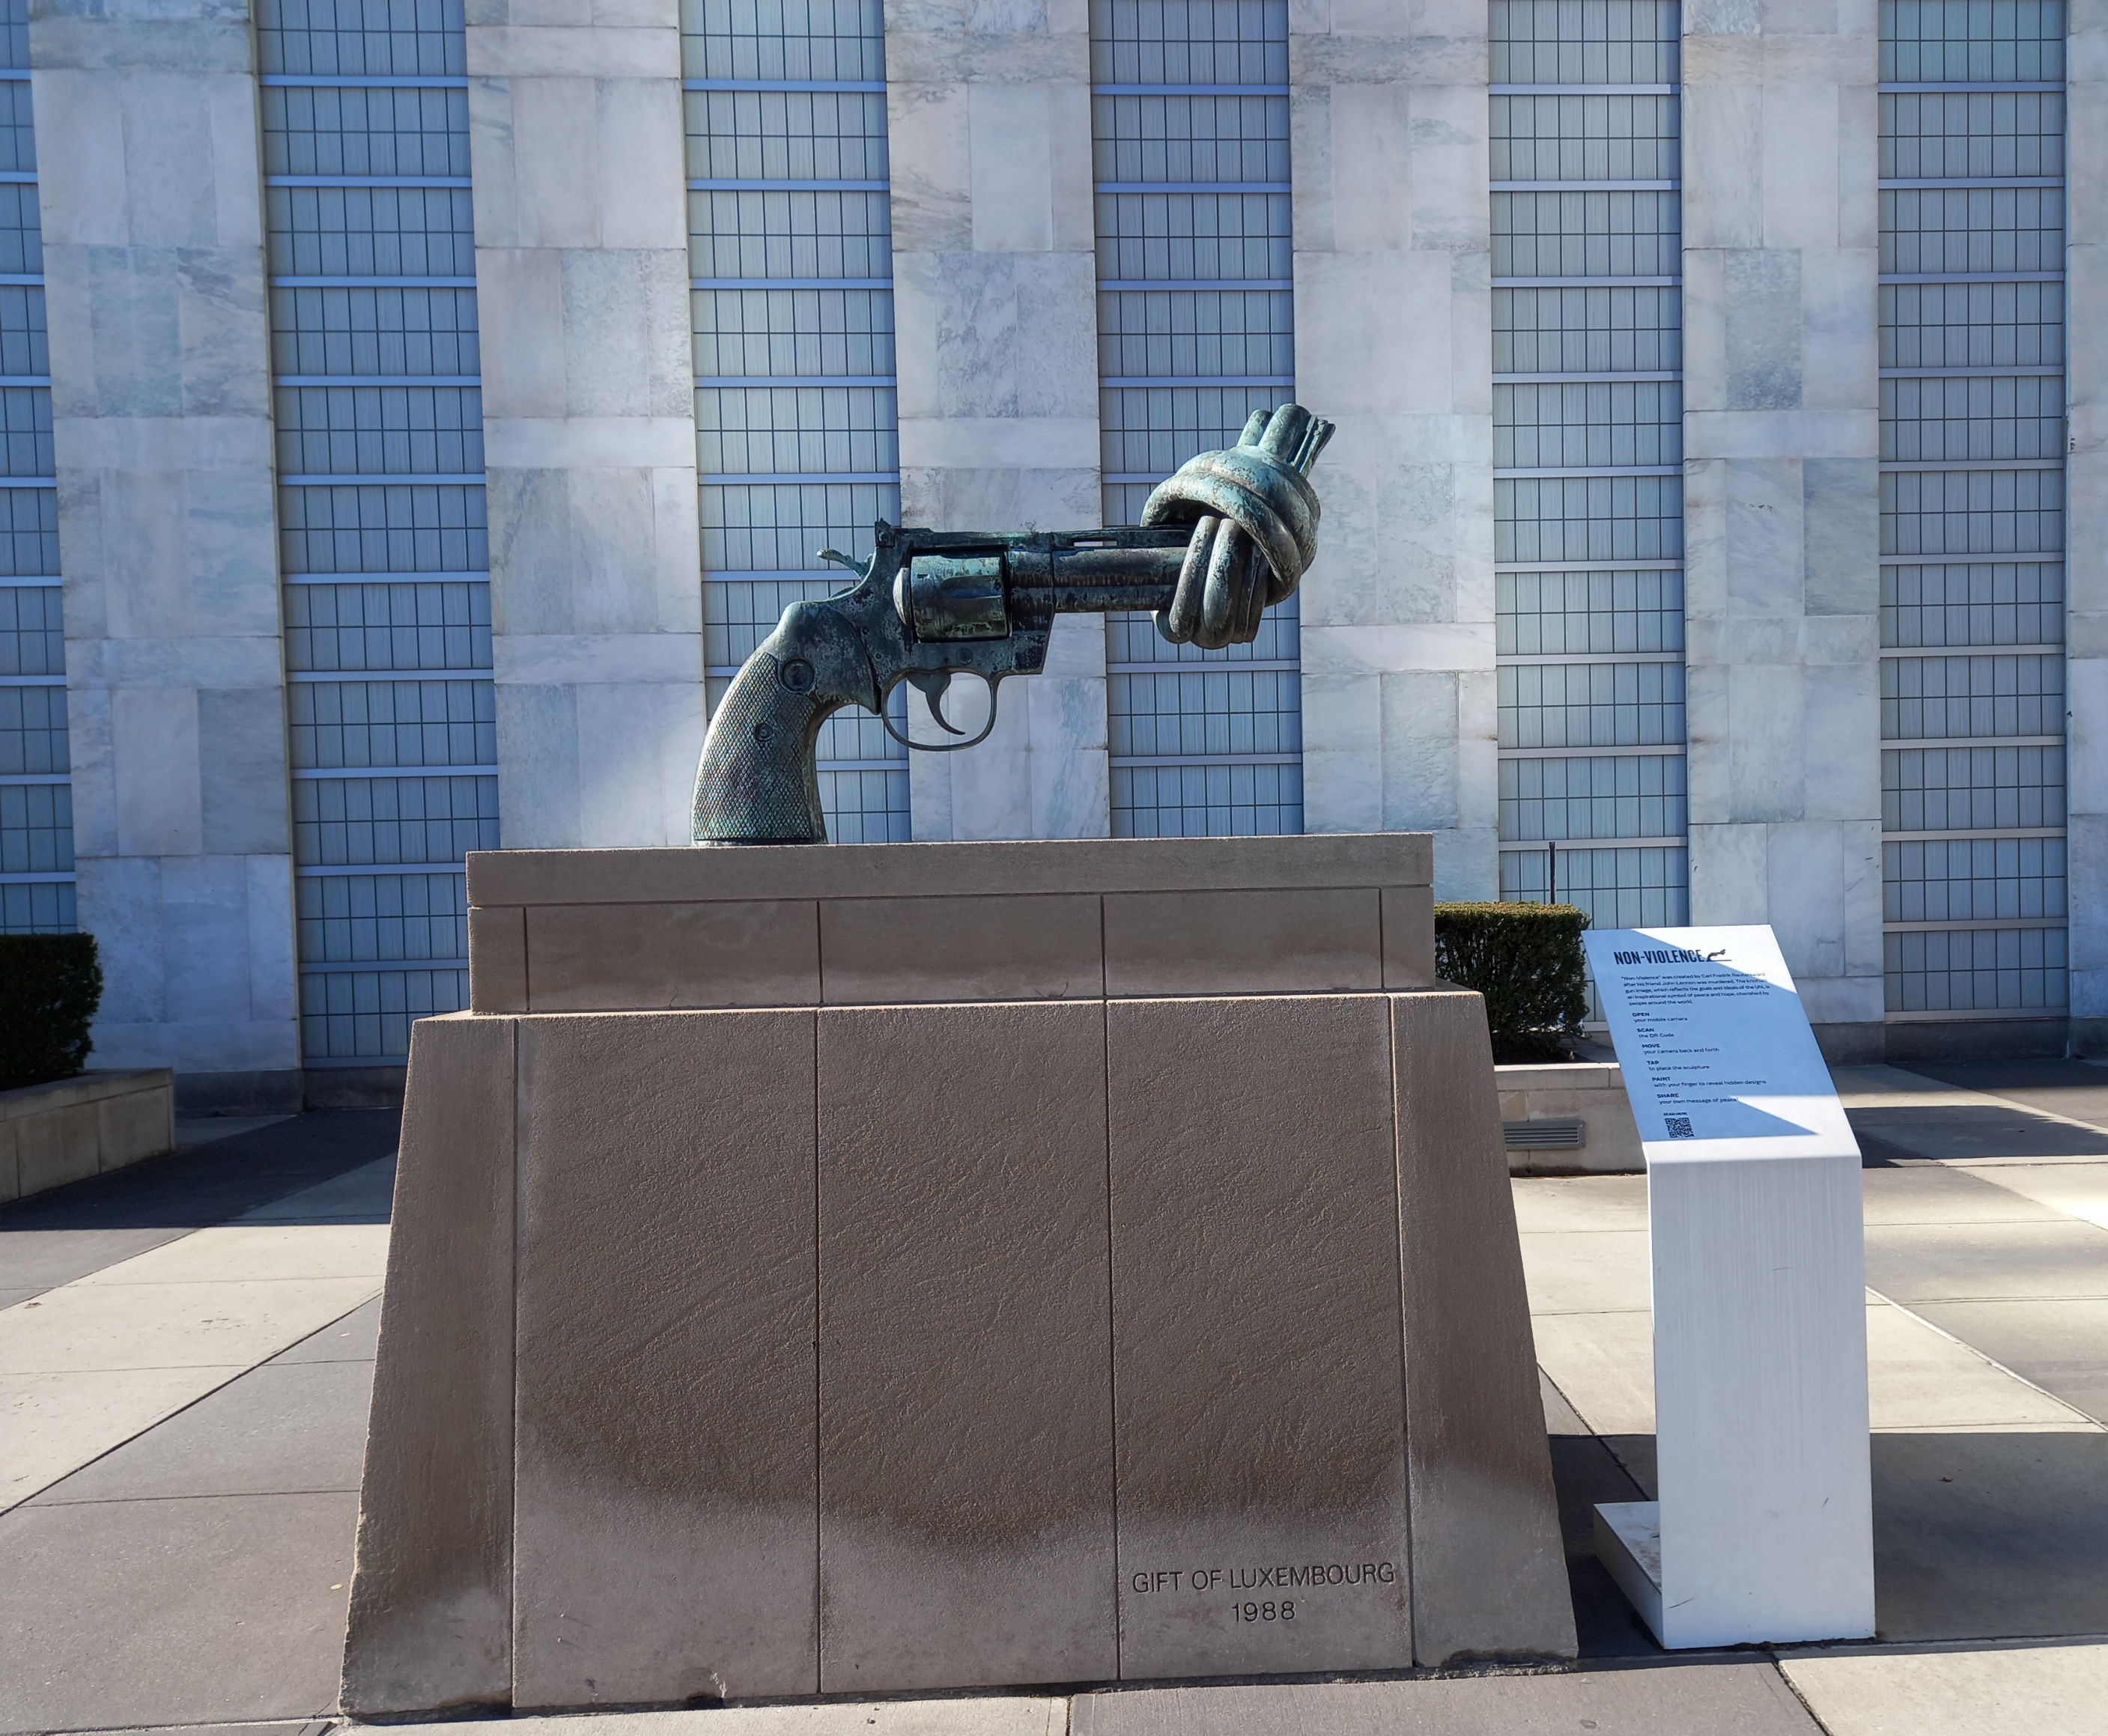
Why arms control?
Affects poor and marginalised disproportionality
Impacts trap people in poverty

Slide 4

Mercy values
Aroha Compassion
Manaakitanga Hospitality
Te Tapu o Te Tangata Respect
Rato/Awhina Service
Tika Social Justice
Te aroha ki te rawakore Concern for poor and vulnerable
Te mana whakahaere Mutual enhancement
Notes:
Articulated in different ways
Taken from Sisters of Mercy Aotearoa so has the value in te reo first (which is the language of the indigenous people of NZ)
Don’t need to go through but already see how mercy values apply to arms control –Social justice, concern fro the poor and vulnerable

Slide 5

Nuclear weapons
Most destructive weapon ever made
Effects of use
Explosion
Radiation
Fallout

Slide 6
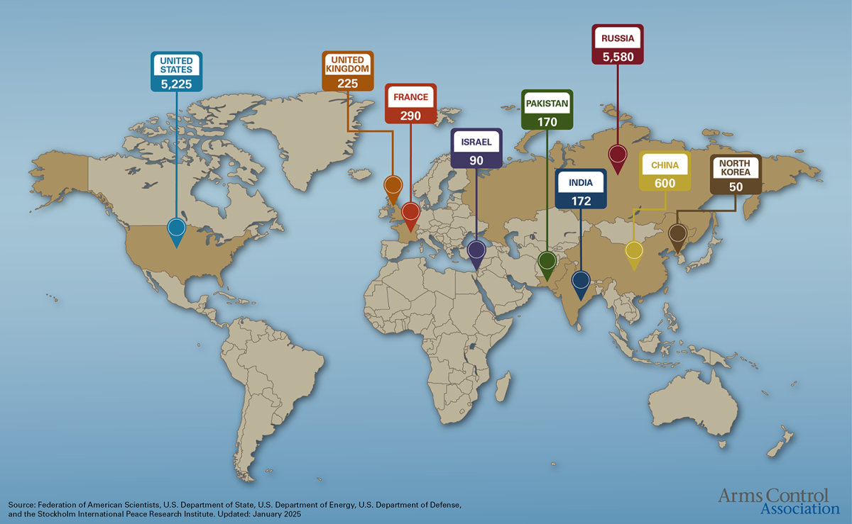

Slide 7
Nuclear weapons
Manufacture
Cost
Nuclear waste
Over 2,000 tests
Lasting impacts
Comprehensive Test Ban Treaty

Slide 8
Arms control efforts
Nuclear Non-proliferation Treaty
Aim to stop spread of nuclear weapons
Promote peaceful used of nuclear energy
The Treaty on the Prohibition of Nuclear Weapons
Effort to promote greater awareness of Humanitarian impacts of nuclear weapons
International Campaign to Abolish Nuclear Weapons

Slide 9
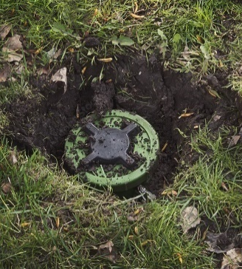
Landmines
Indiscriminate weapons
Remains a threat long after conflict
Makes it difficult for a country to recover after a conflict
In 2023, 5,757 casualties recorded
including over 1,400 children

Slide 10
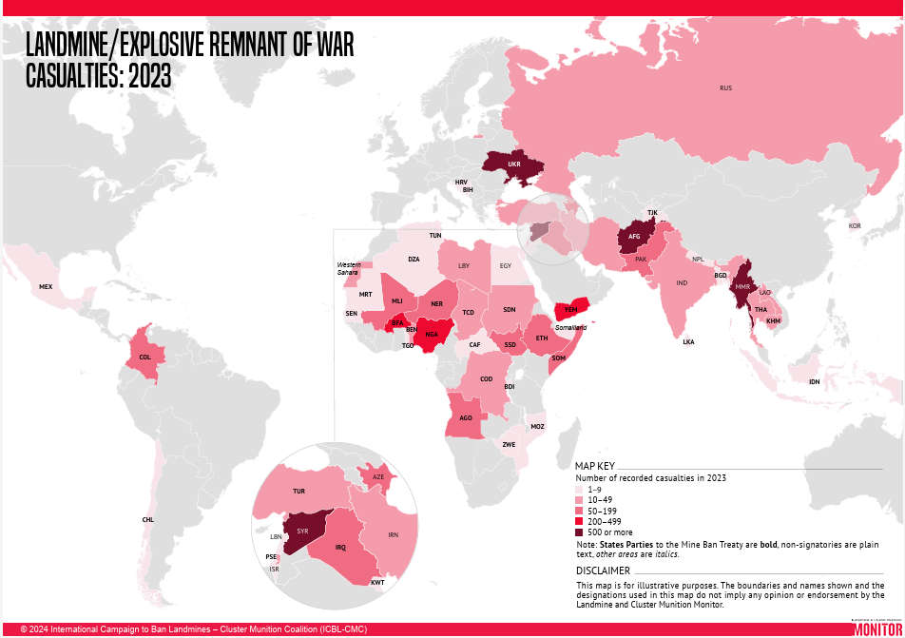

Slide 11
Success stories
Mine Ban Treaty
Cambodian casualties
Afghanistan mine numbers

Slide 12
Resurgence
Increasing strategic competition between countries
Increased importance placed on nuclear weapons
Landmines have been used in Ukraine
Rising threat from Russia been used as reason to pull out of Mine Ban Treaty

Slide 13
“A little bit of mercy makes the work less cold and more just”
Pope Francis

Slide 14
What can we do?
Contact your elected officials and make sure they know these issues are important to you.
Find an organisation working on arms control issues in your country and join their efforts
The International Campaign to Abolish Nuclear weapons website
The International Campaign to Ban Landmines website
Stay informed

Slide 15
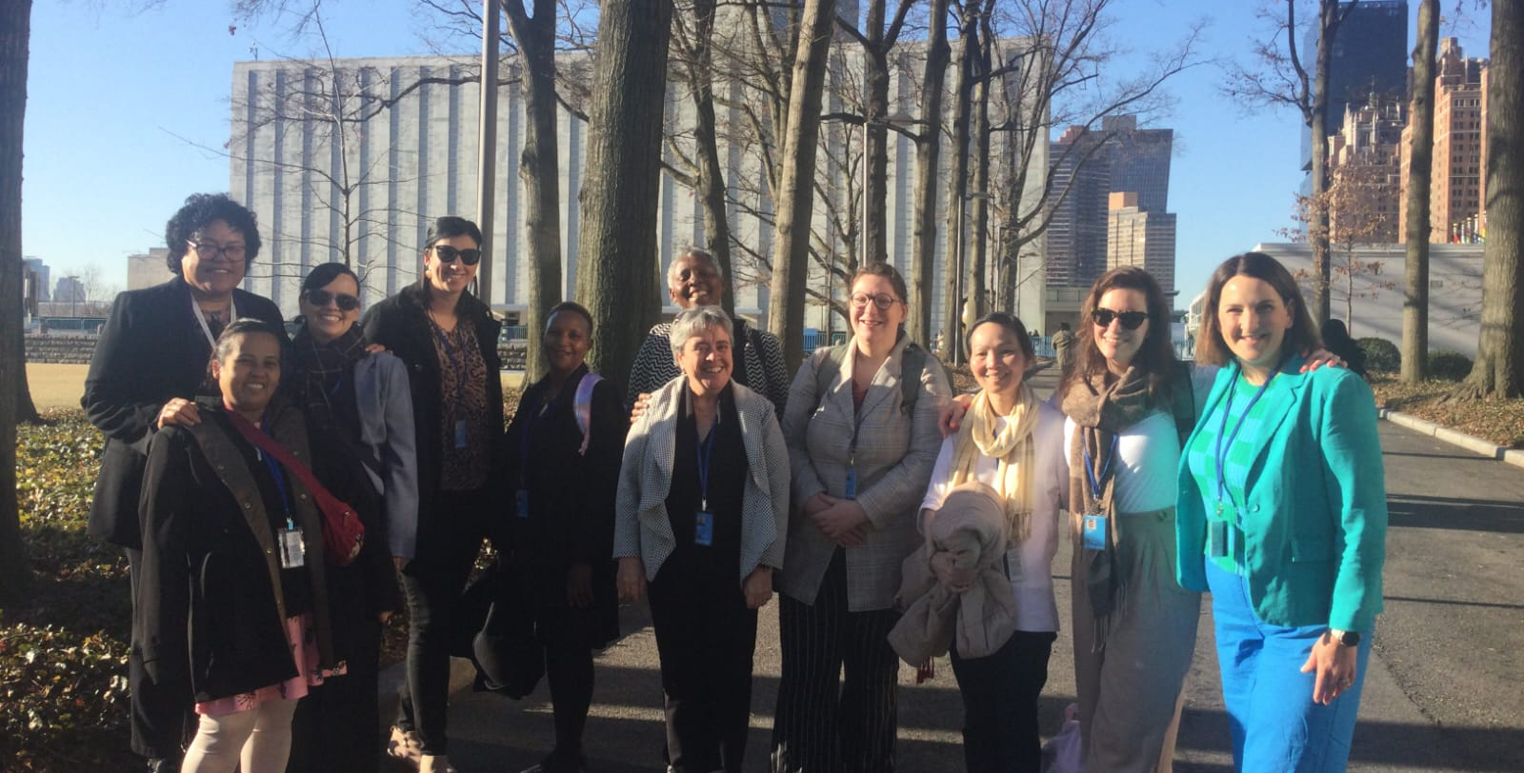
Acknowledgements

