Slide 1
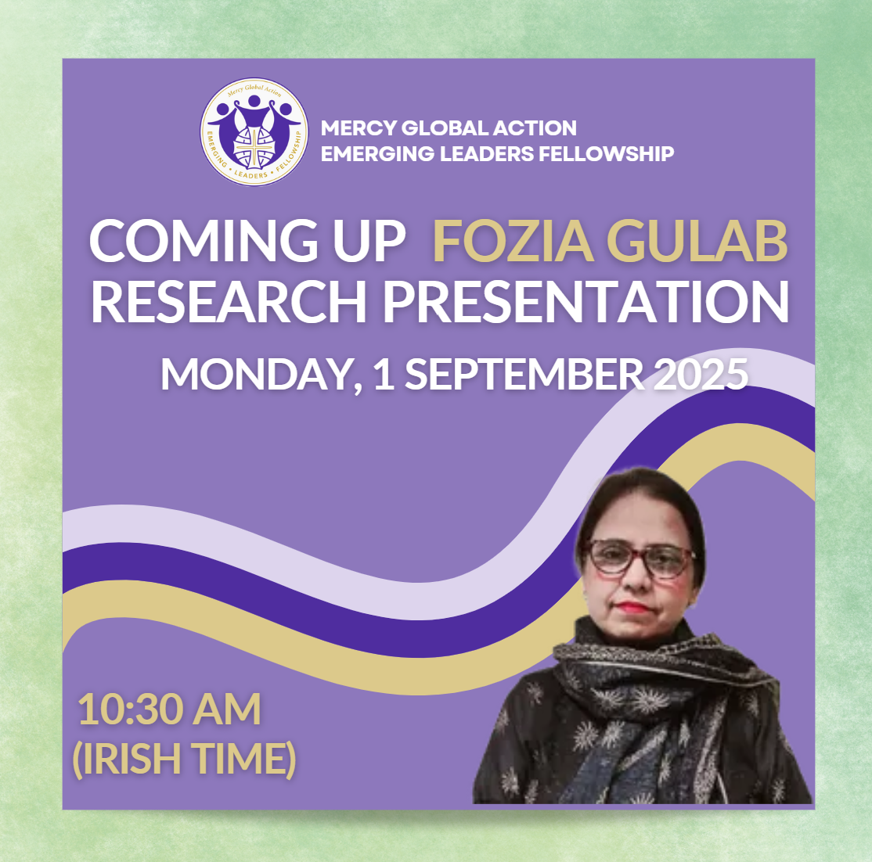
Socithe Selected Districts of Karachi-Pakistan
Fozia Gulab
Pakistan

Slide 2

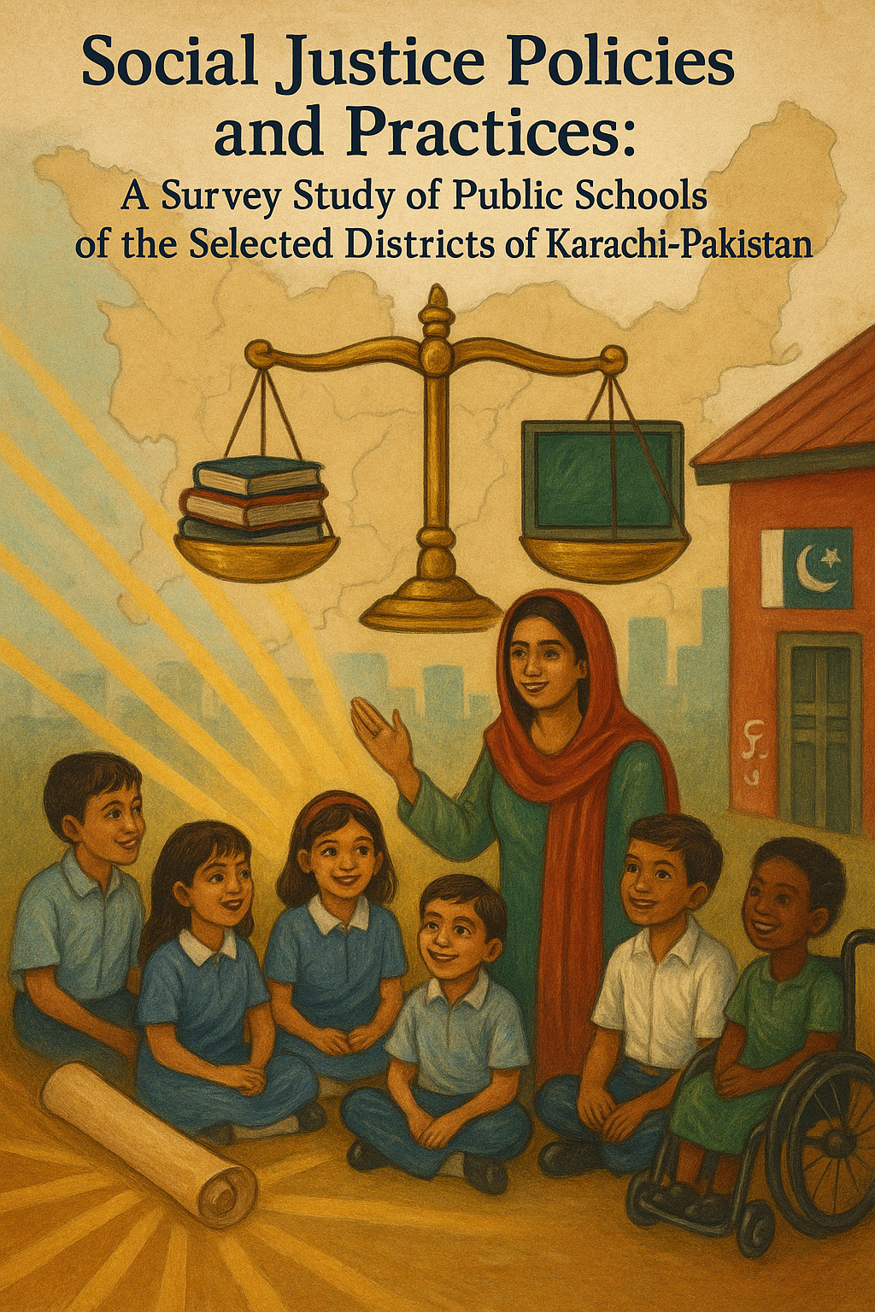
By:
Fozia Gulab
Supervisor:
Sr. Annette Schneider RSM
Supported by:
Mercy Emerging Leaders Fellowship
1st September 2025
Sr. :

Slide 3
Background
🙋‍♀️ Personal Commitment: Lifelong passion for human rights & advocacy for marginalized groups.
🎓 Impact of MELF Fellowship: Shaped understanding of social justice & systemic inequality.
⚖️ Social Justice & Mercy Connection: Framework of equity paired with compassion for a fairer world.
📚 Education & Social Justice in Pakistan: Policies emphasize equity & inclusion, yet exclusion persists.
🌍 Global & National Alignment: SDG 16 strengthens Pakistan’s constitutional right to inclusive education.
🚀 Challenges & Way Forward: Integrate social justice values in classroom practices for lasting change.

Slide 4
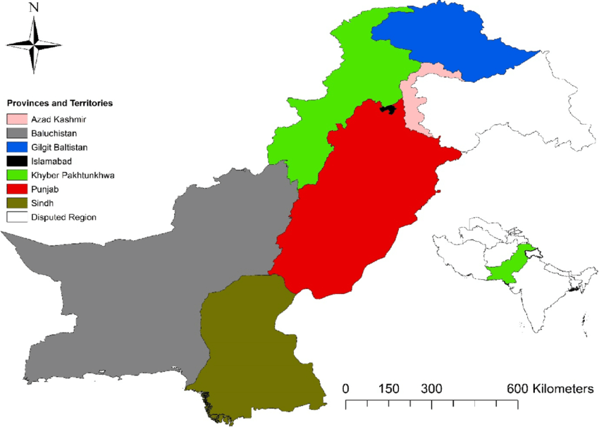
Problem Statement
Lived Experience & Observation: Schooling in Larkana revealed disconnect between democracy, diversity, equity, justice and actual practices.
📚 Curriculum & Pedagogy Gaps: Exam-focused curriculum and authoritarian teaching limited inclusivity and critical thinking.
⚖️ Systemic Inequities: Education favors elites, reinforcing class divides and unequal access for marginalized groups.
🏫 Governance & Quality Issues: Corruption, ghost teachers/schools, favoritism, and poor facilities undermine social justice.
🚀 Need for Transformative Education: Integration of social justice values in teaching is essential for inclusive and just education.

Slide 5
🎯 Research Aim: To investigate classroom norms, routines, and practices to instill social justice values in students, fostering socially aware and responsible individuals who can promote fairness and justice as future leaders and advocates.
📌 Research Objectives:
✔️ To examine the extent to which core social justice values (democracy, equality, justice, diversity, equity, inclusive practices,) are embedded within teachers’ instructional approaches in South and Korangi Districts of Karachi region.
✔️ To investigate the availability, accessibility, and relevance of CPD opportunities for teachers in the South and Korangi districts to help integrate social justice principles in schools.
✔️ To analyze and compare the degree of alignment and variation in the implementation of social justice-oriented educational policies across government schools in South and Korangi Districts.

Slide 6
Research Questions (RQ) and Hypothesis
RQ1 To what extent do teachers in government schools of the South and Korangi Districts of Karachi incorporate social justice values into their instructional strategies?
Ho1 There is no significant difference between teachers in the South and Korangi Districts in the incorporation of “democratic values” into their instructional strategies.
Ho2-6 “Diversity”,“Equality”,“Equity”,“Participation in CPD”, “Access to CPD”
RQ2. To what extent are continuous professional development (CPD) opportunities related to social justice values available and accessible to teachers in the South and Korangi Districts?
Ho7 “Provision of CPD opportunities”
RQ3. Do schools in South and Korangi districts abide by the formally constructed social justice related policies?
Ho8 “Implementation of social justice-oriented educational policies”.

Slide 7
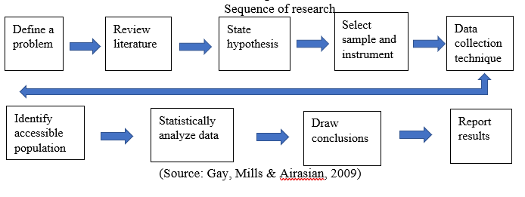
Research Methodology

Slide 8
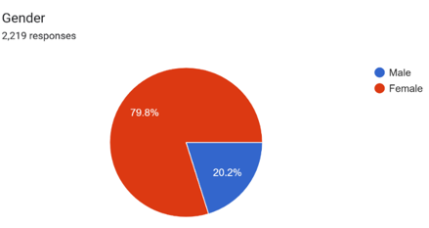
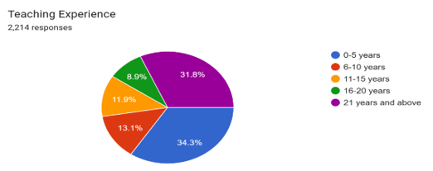
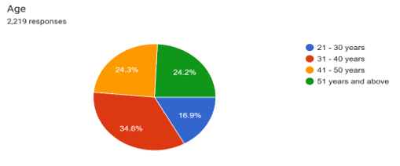
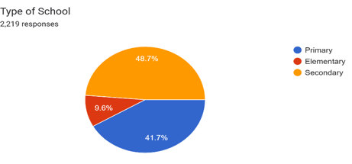
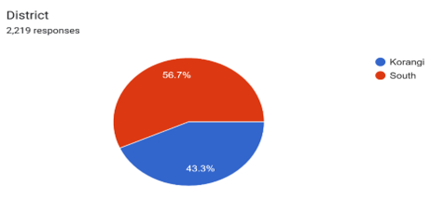
Demographics

Slide 9
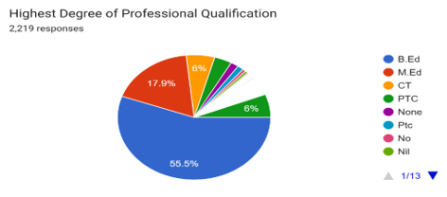
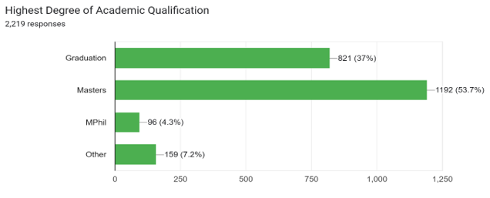
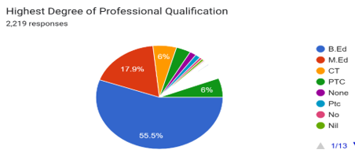
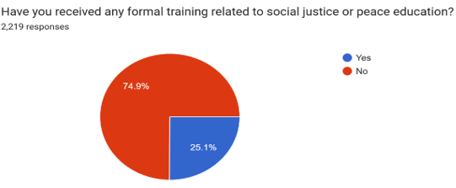
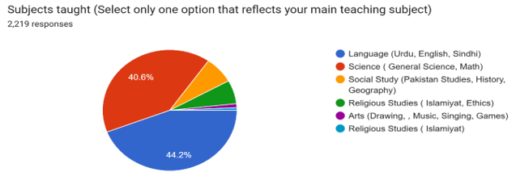
Demographics

Slide 10
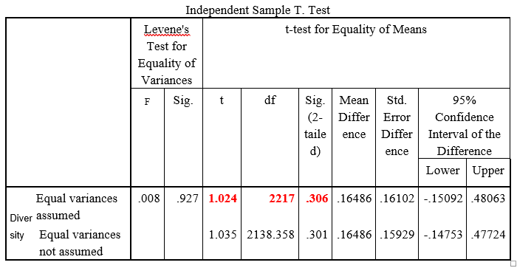
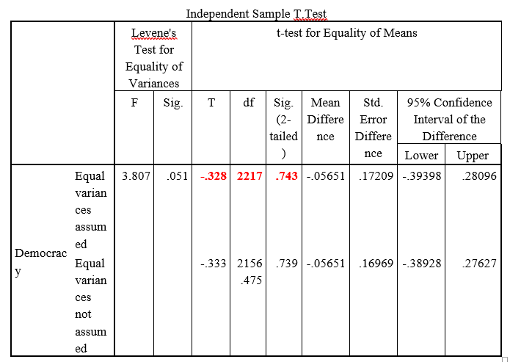
Analysis
Ho2
Ho1

Slide 11
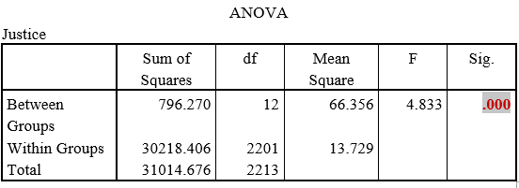
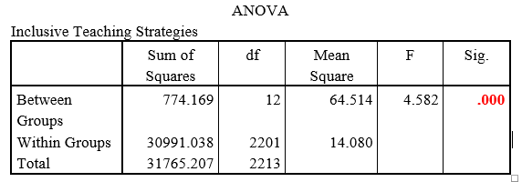
Analysis
Ho5
Ho6

Slide 12
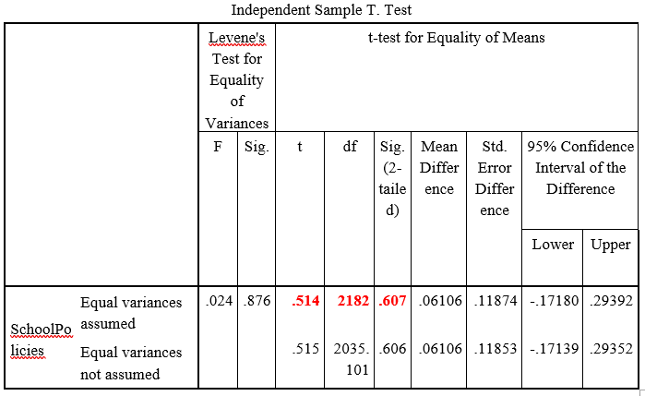
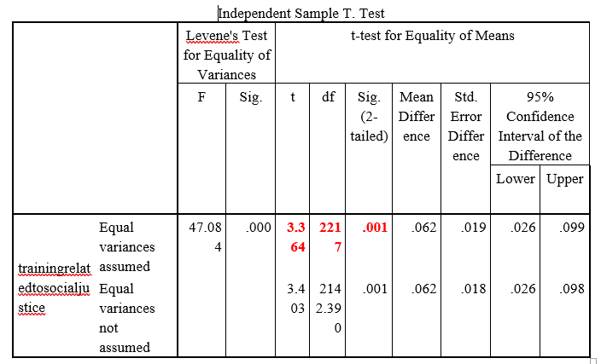
Analysis
Ho8
Ho7

Slide 13
Recommendations
Strengthen Teacher Training Programs Both the districts scored quite low on continuous professional development programs related to social justice. This indicates to design and implement systematic professional development programs such as training workshops and seminars to prepare teachers with the knowledge and pedagogical tools necessary to foster democracy, equality, equity, diversity, and inclusion in the classrooms.
Embed Social Justice in School Policies Although mean scores for school policies were moderate but to further strengthen school policies in relation to social justice, policy frameworks at the school level should explicitly integrate social justice values, including nondiscrimination, inclusive pedagogies, and equitable resource allocation.
Curriculum Integration Curriculum content should be revised to incorporate themes of democracy, equity, equality, diversity, and justice in meaningful ways across subjects. This will provide students with consistent exposure to these values beyond isolated lessons or activities.
Reinforce Teacher Education Program
Teacher education is recommended to offer a mandatory course of three credit hours on teaching about the importance and application of social justice for a peaceful society.

Slide 14
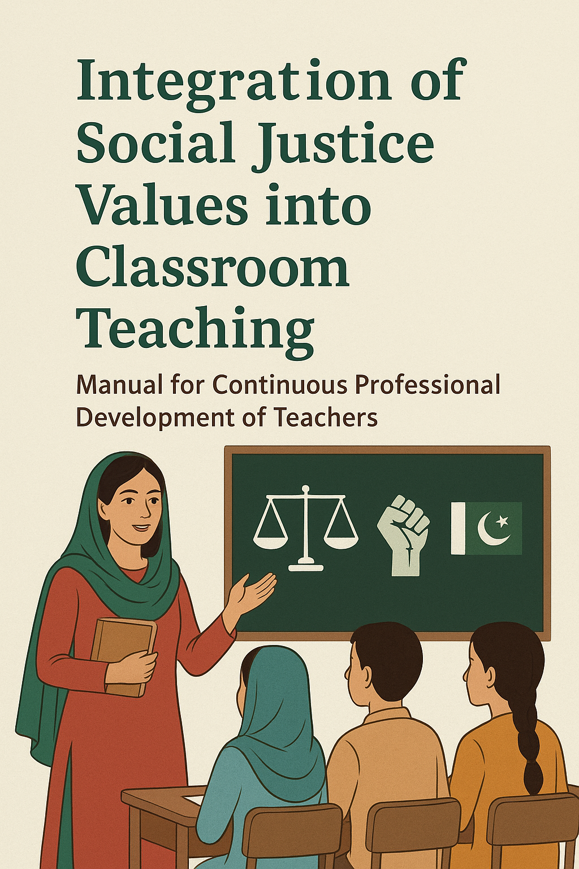
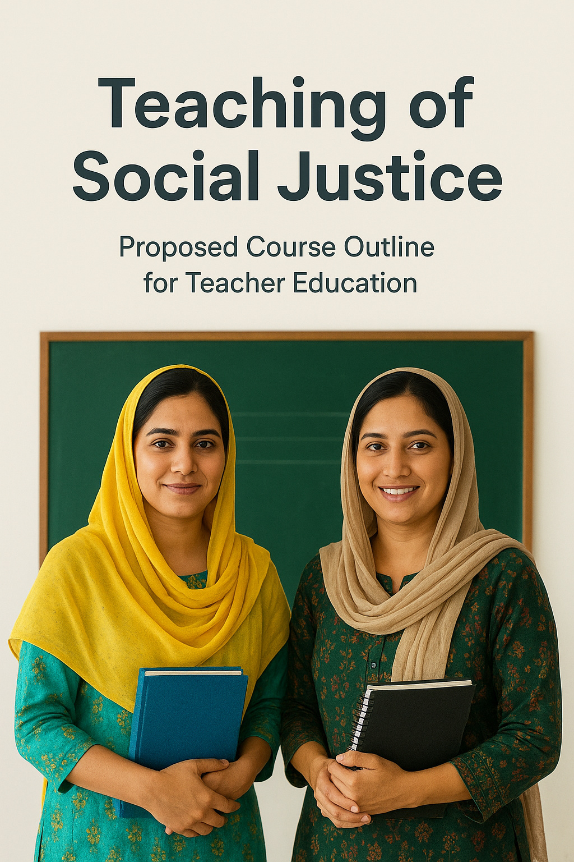
Research Outcome for the Mercy World

Slide 15
Question Based Research Outcome for the Mercy World
1. If social justice is effectively taught in schools, why do inequalities and injustices still persist in society?
2. How do students and teachers perceive the persistence of social inequalities and injustices in society despite the teaching of social justice in schools?
3. Why does there persists a gap between teaching social justice in schools and the continued presence of inequalities in society?”

Slide 16


