Slide 1
Company Presentation 2025

Slide 2
Topics
History
Facts & Figures
Co-extrusion process
Applications
Sustainability

Slide 3
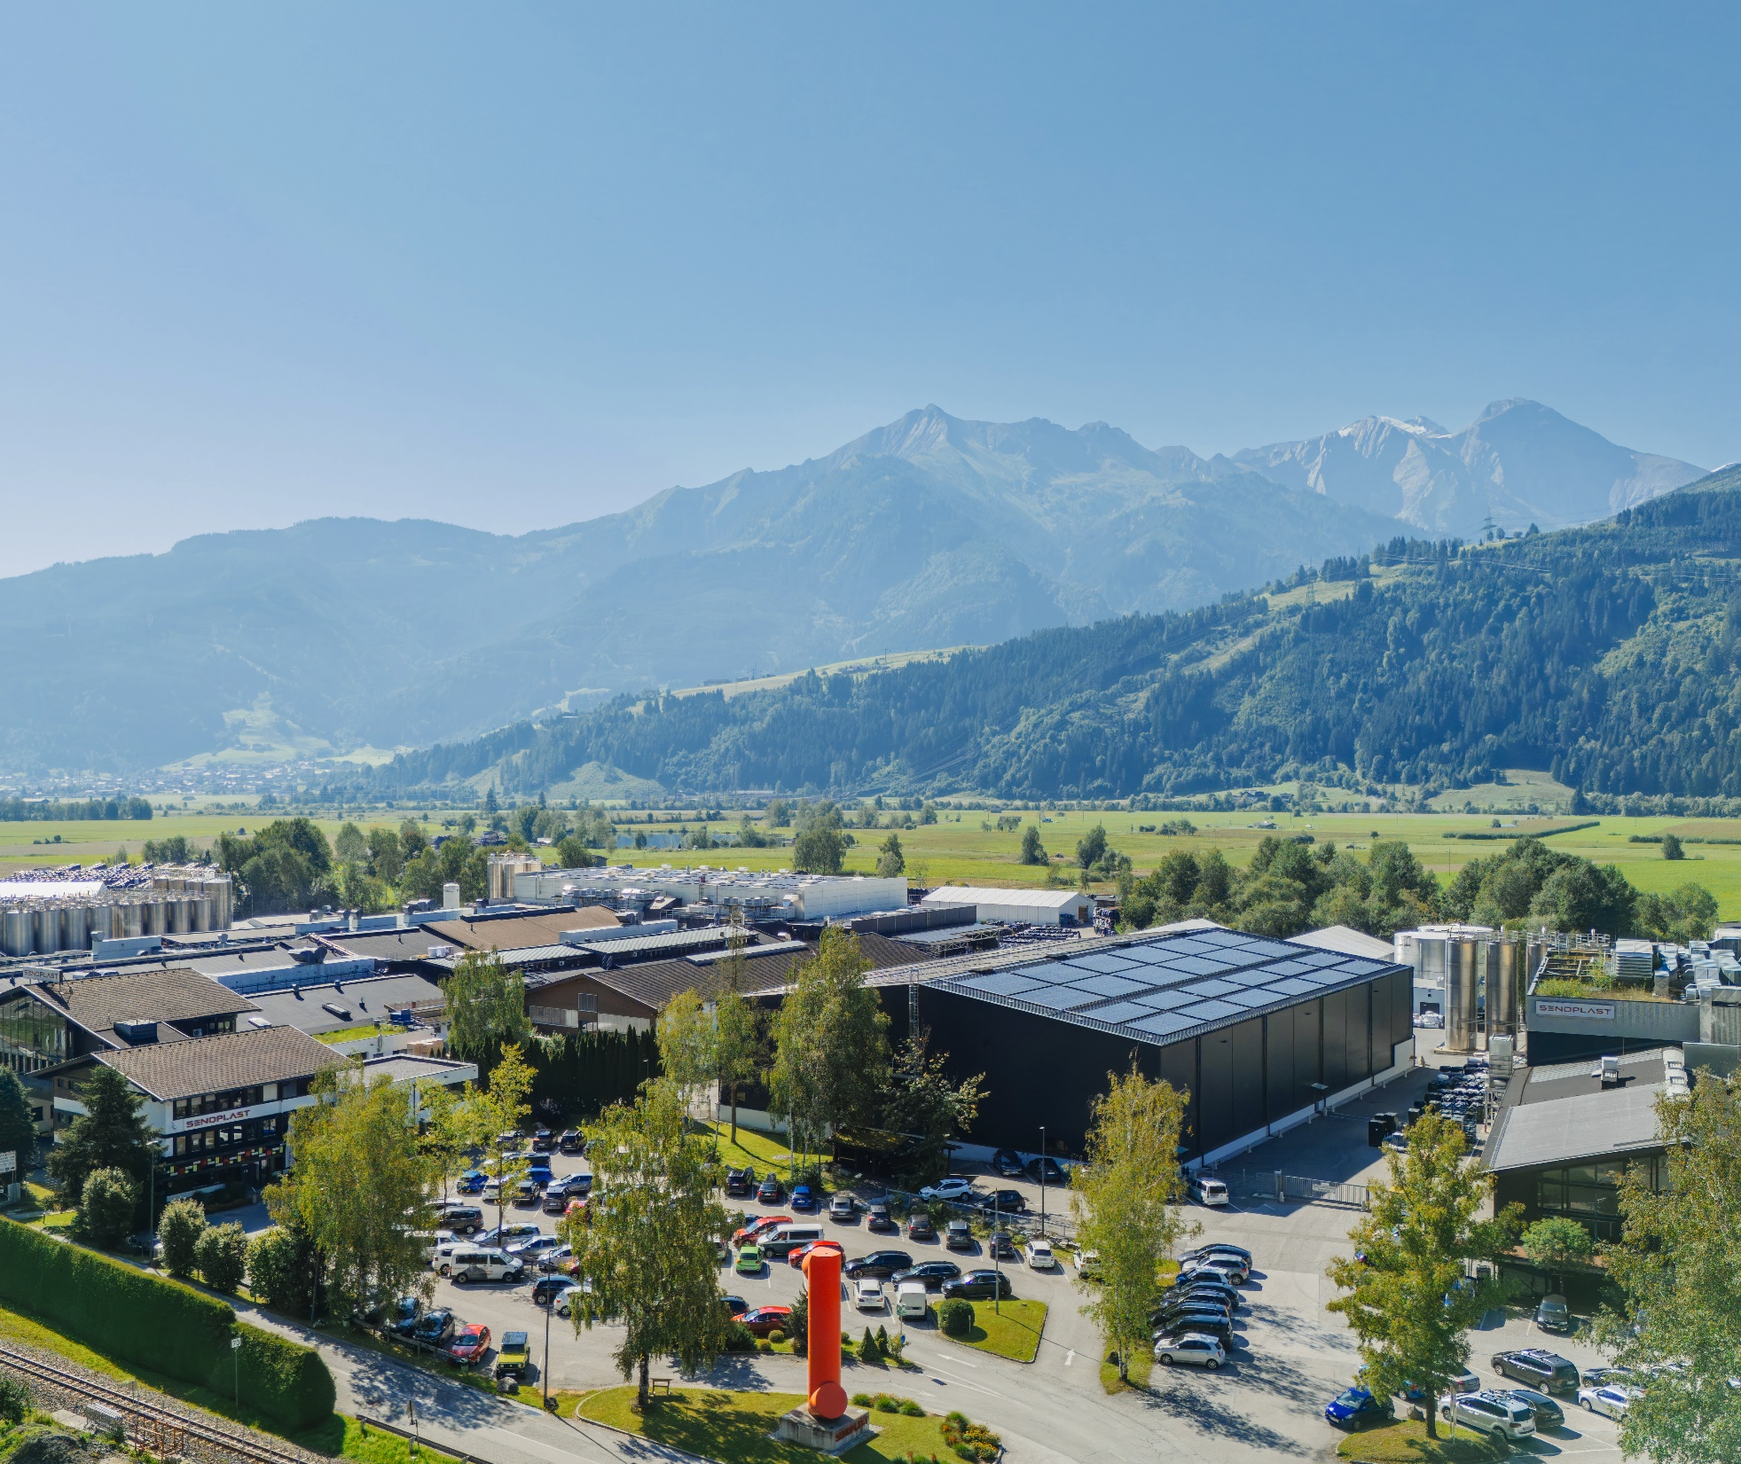
Commited to give you
excellent service
50,000 tons of high quality senosan®
quality plastic sheets and films per year
One of the main employers in the region
Top quality, innovation and protective technologies

Slide 4
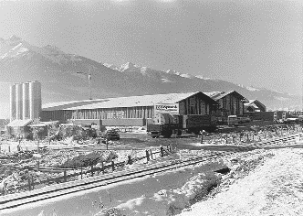
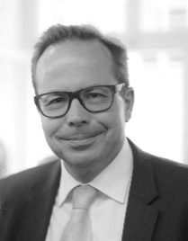
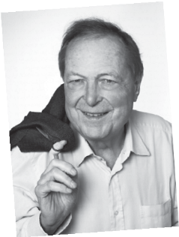

A TRUE SUCCESS STORY
SENOSAN GmbH –
was created to focus especially on the furniture industry
SENOPLAST S.A. de C.V
in Querétaro, Mexico
Founding of SENOPLAST
New Material (Suzhou) Co. Ltd.
Suzhou/Wujiang, China
SENOPLAST was moved to Piesendorf, Austria, where the headquarters are today
SENOPLAST was founded in Kaprun, Austria by Wilhelm Klepsch
1998
2006
2013
2025
1956
1978
2000
2011
2020
Today, SENOPLAST is a globally active corporation with a strong commitment to its community in Piesendorf, Austria. The company employs 810 people worldwide.
Günter Klepsch
takes over management
of SENOPLAST as CEO
Foundation of Senco R&D,
our in-house company for
research and development
Start of production and sales
of senotop® products for the
automotive industry under
cleanroom conditions

Slide 5
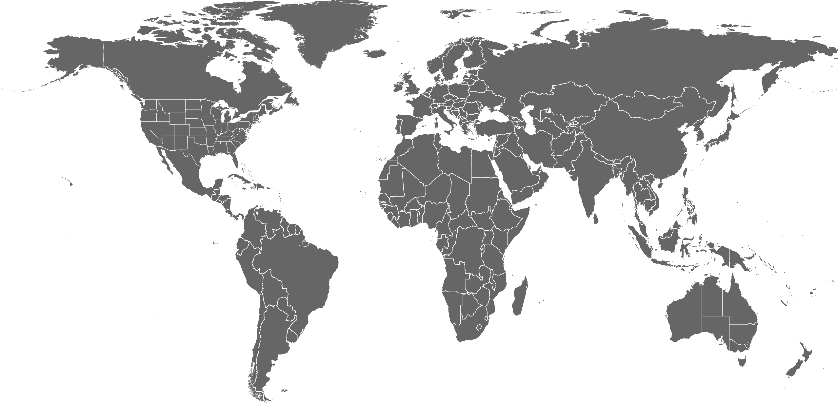



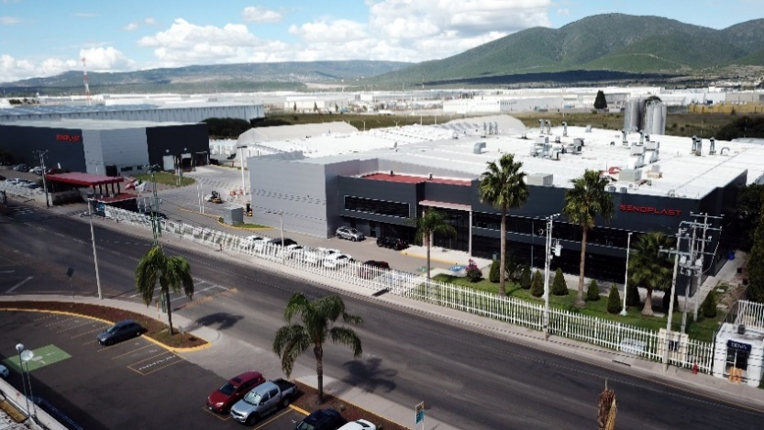

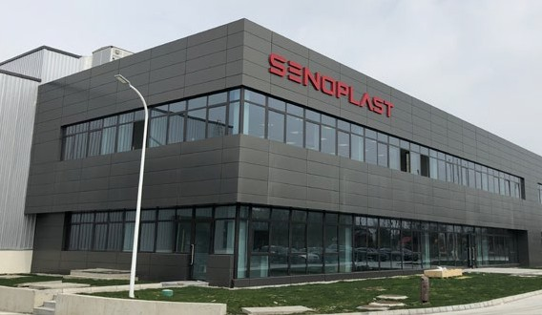
INTERNATIONAL GROUP
3 Production sites
Austria, Mexico and China
17 Sales offices & representatives
worldwide

Slide 6
Brand & Values
VISION
We strive to be the global number one for co-extruded and refined plastic sheets and films in the area of high-quality applications.
MISSION
Senoplast is the leader of innovation and quality in the co-extrusion of plastic sheets and films. We support our customers with comprehensive know how on everything from selecting to processing our products. As a family enterprise we emphasize respect, fairness and longterm relationships with all our business partners and employees. We are committed to a sustainable use of resources, to dealing with nature in a respectful way and to gentle production processes.
Values
Assume responsibility and achieve common goals
Respect, trust and honesty
Fairness and acceptance
Considerate and friendly cooperation without fear
Recognition and appreciation

Slide 7
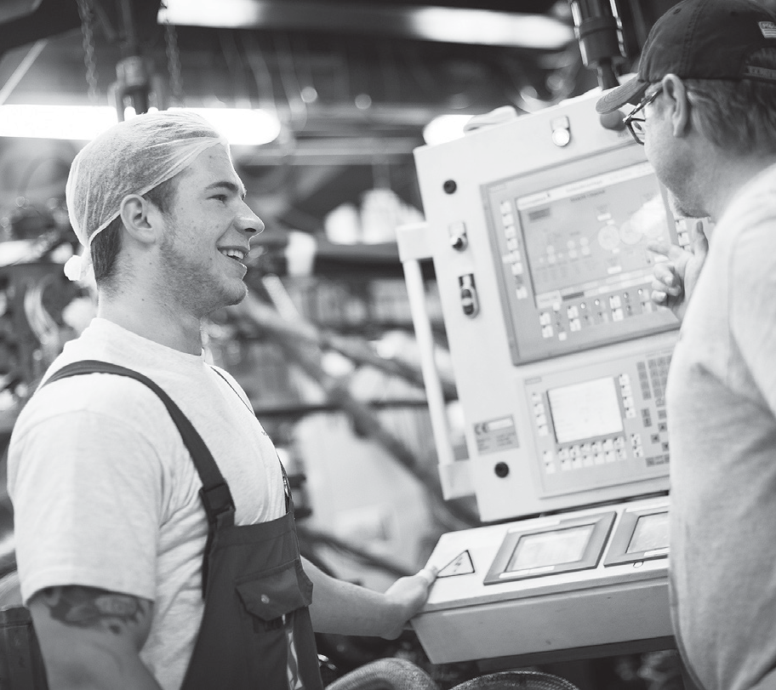
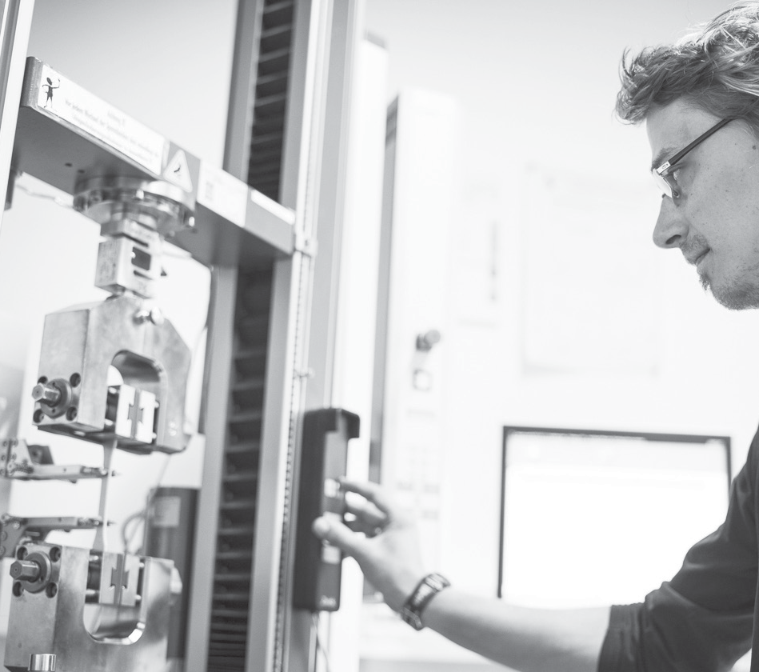
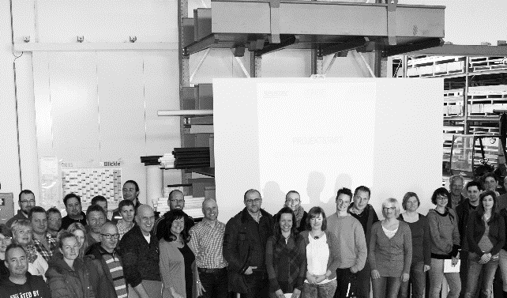
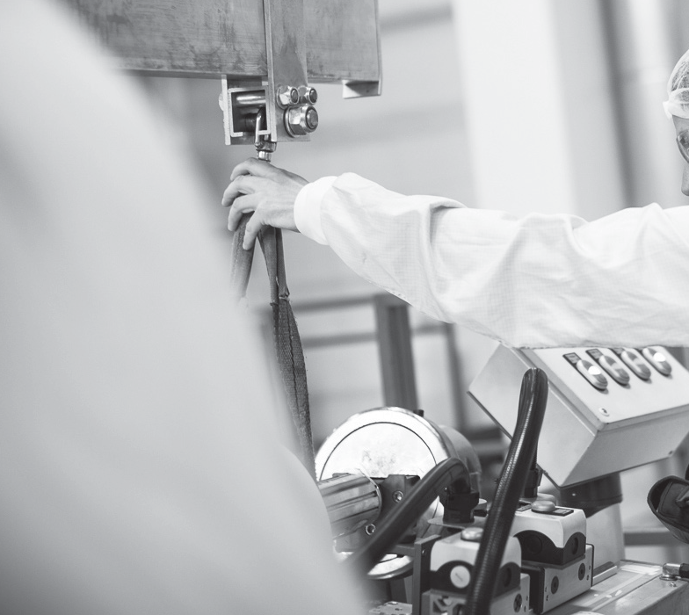








– THE NETWORK FOR PLASTICS TECHNOLOGY
Senoplast Klepsch & Co. GmbH,
Piesendorf (A)
Senoplast S. A. de C.V.,
Querétaro (MEX)
Senoplast New Material (Suzhou)
Co. Ltd., Suzhou/Wujiang (CN)
Senosan GmbH,
Piesendorf (A)
Zell Materials
Engineering Plastics, Kaprun (A)
Zell Parts by Klepsch, Kaprun (A)
ZL Engineering Plastics (USA)
Tecnoplast Sant Angelo Srl., Ischia (I)
Experta (FR)
SALES OFFICE:
Austria
Croatia
France
Senova® Kunststoffe GmbH
& Co. KG, Uttendorf (A)
Seletec Plastic Product GmbH & Co.
KG, Uttendorf (A)
SALES OFFICE:
  Austria
  Germany
  Slovakia
Seno Spezialmaschinen GmbH, Piesendorf (A)
SALES OFFICE:
Australia
Belgium & Netherlands
France
Germany
India
New Zealand
Poland
Sweden
USA
Germany
Türkiye
USA

Slide 8


FACTS & FIGURES
> 90% Export rate
We deliver to more than
60 countries worldwide
Employees
810 Senoplast Group
1025 Klepsch Group
17
Sales offices & representatives worldwide
€ 280 Mio.
Senoplast Group worldwide (2024)
> 50 000 tons
of senosan® products are sold per year
Co-extrusion of the following raw materials:
Abs | asa | pmma | pc | ps
(various combinations)
tpo and tpu
high performance plastics, e.g. lcp
€ 350 Mio.
Klepsch Group worldwide (2024)

Slide 9

TECHNOLOGY LEADER IN THE FIELD OF CO-EXTRUSION
OF PLASTIC SHEETS & FILMS

Slide 10
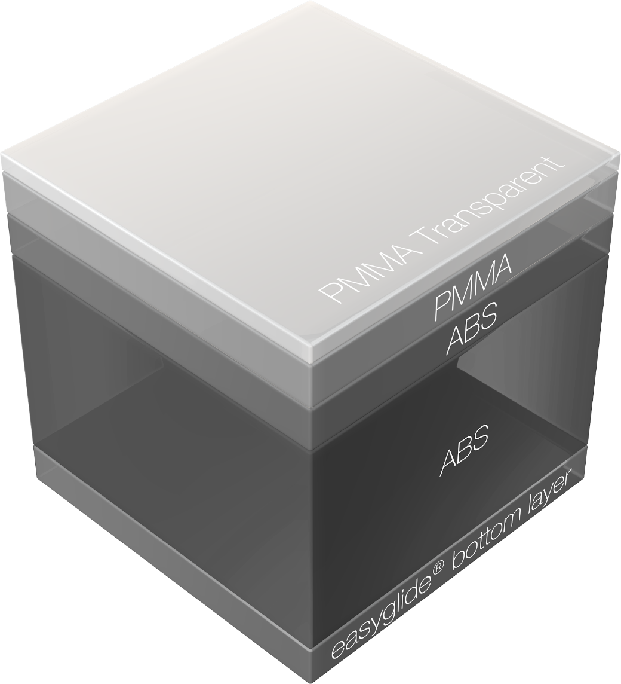
5-layer structure
Example senosan® AM50c solar eg

Slide 11
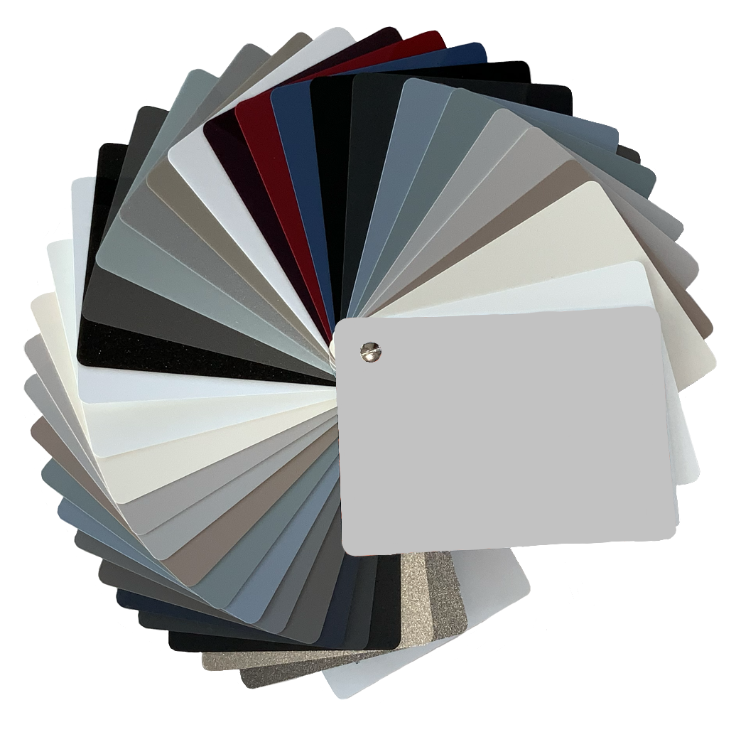
CO-EXTRUSION OF MULTILAYER SHEETS & FILMS
ABS/PMMA
PS SHEETS AND FILMS
Co-extruded multilayer sheets developed for high-quality thermoformed parts used in
outdoor and indoor applications.
Co-extruded sheets and ﬁlms
made of high impact polystyrene.
PMMA SHEETS
Co-extruded sheets made of high
impact PMMA.
ABS+ABS/ASA
Special mono and multilayer sheets developed to fulﬁl high demands of market in respect of design, technology and optical appearance.
SPECIAL FILMS
High gloss ﬁlms for the
Automotive industry as paint replacement.
PC SHEETS AND FILMS
SPECIAL FILMS
Co-extruded and in-house colored multilayer sheets and ﬁlms for the suitcase industry and automotive applications.
Scratch resistant high gloss and supermatt ﬁlms for the furniture industry.

Slide 12
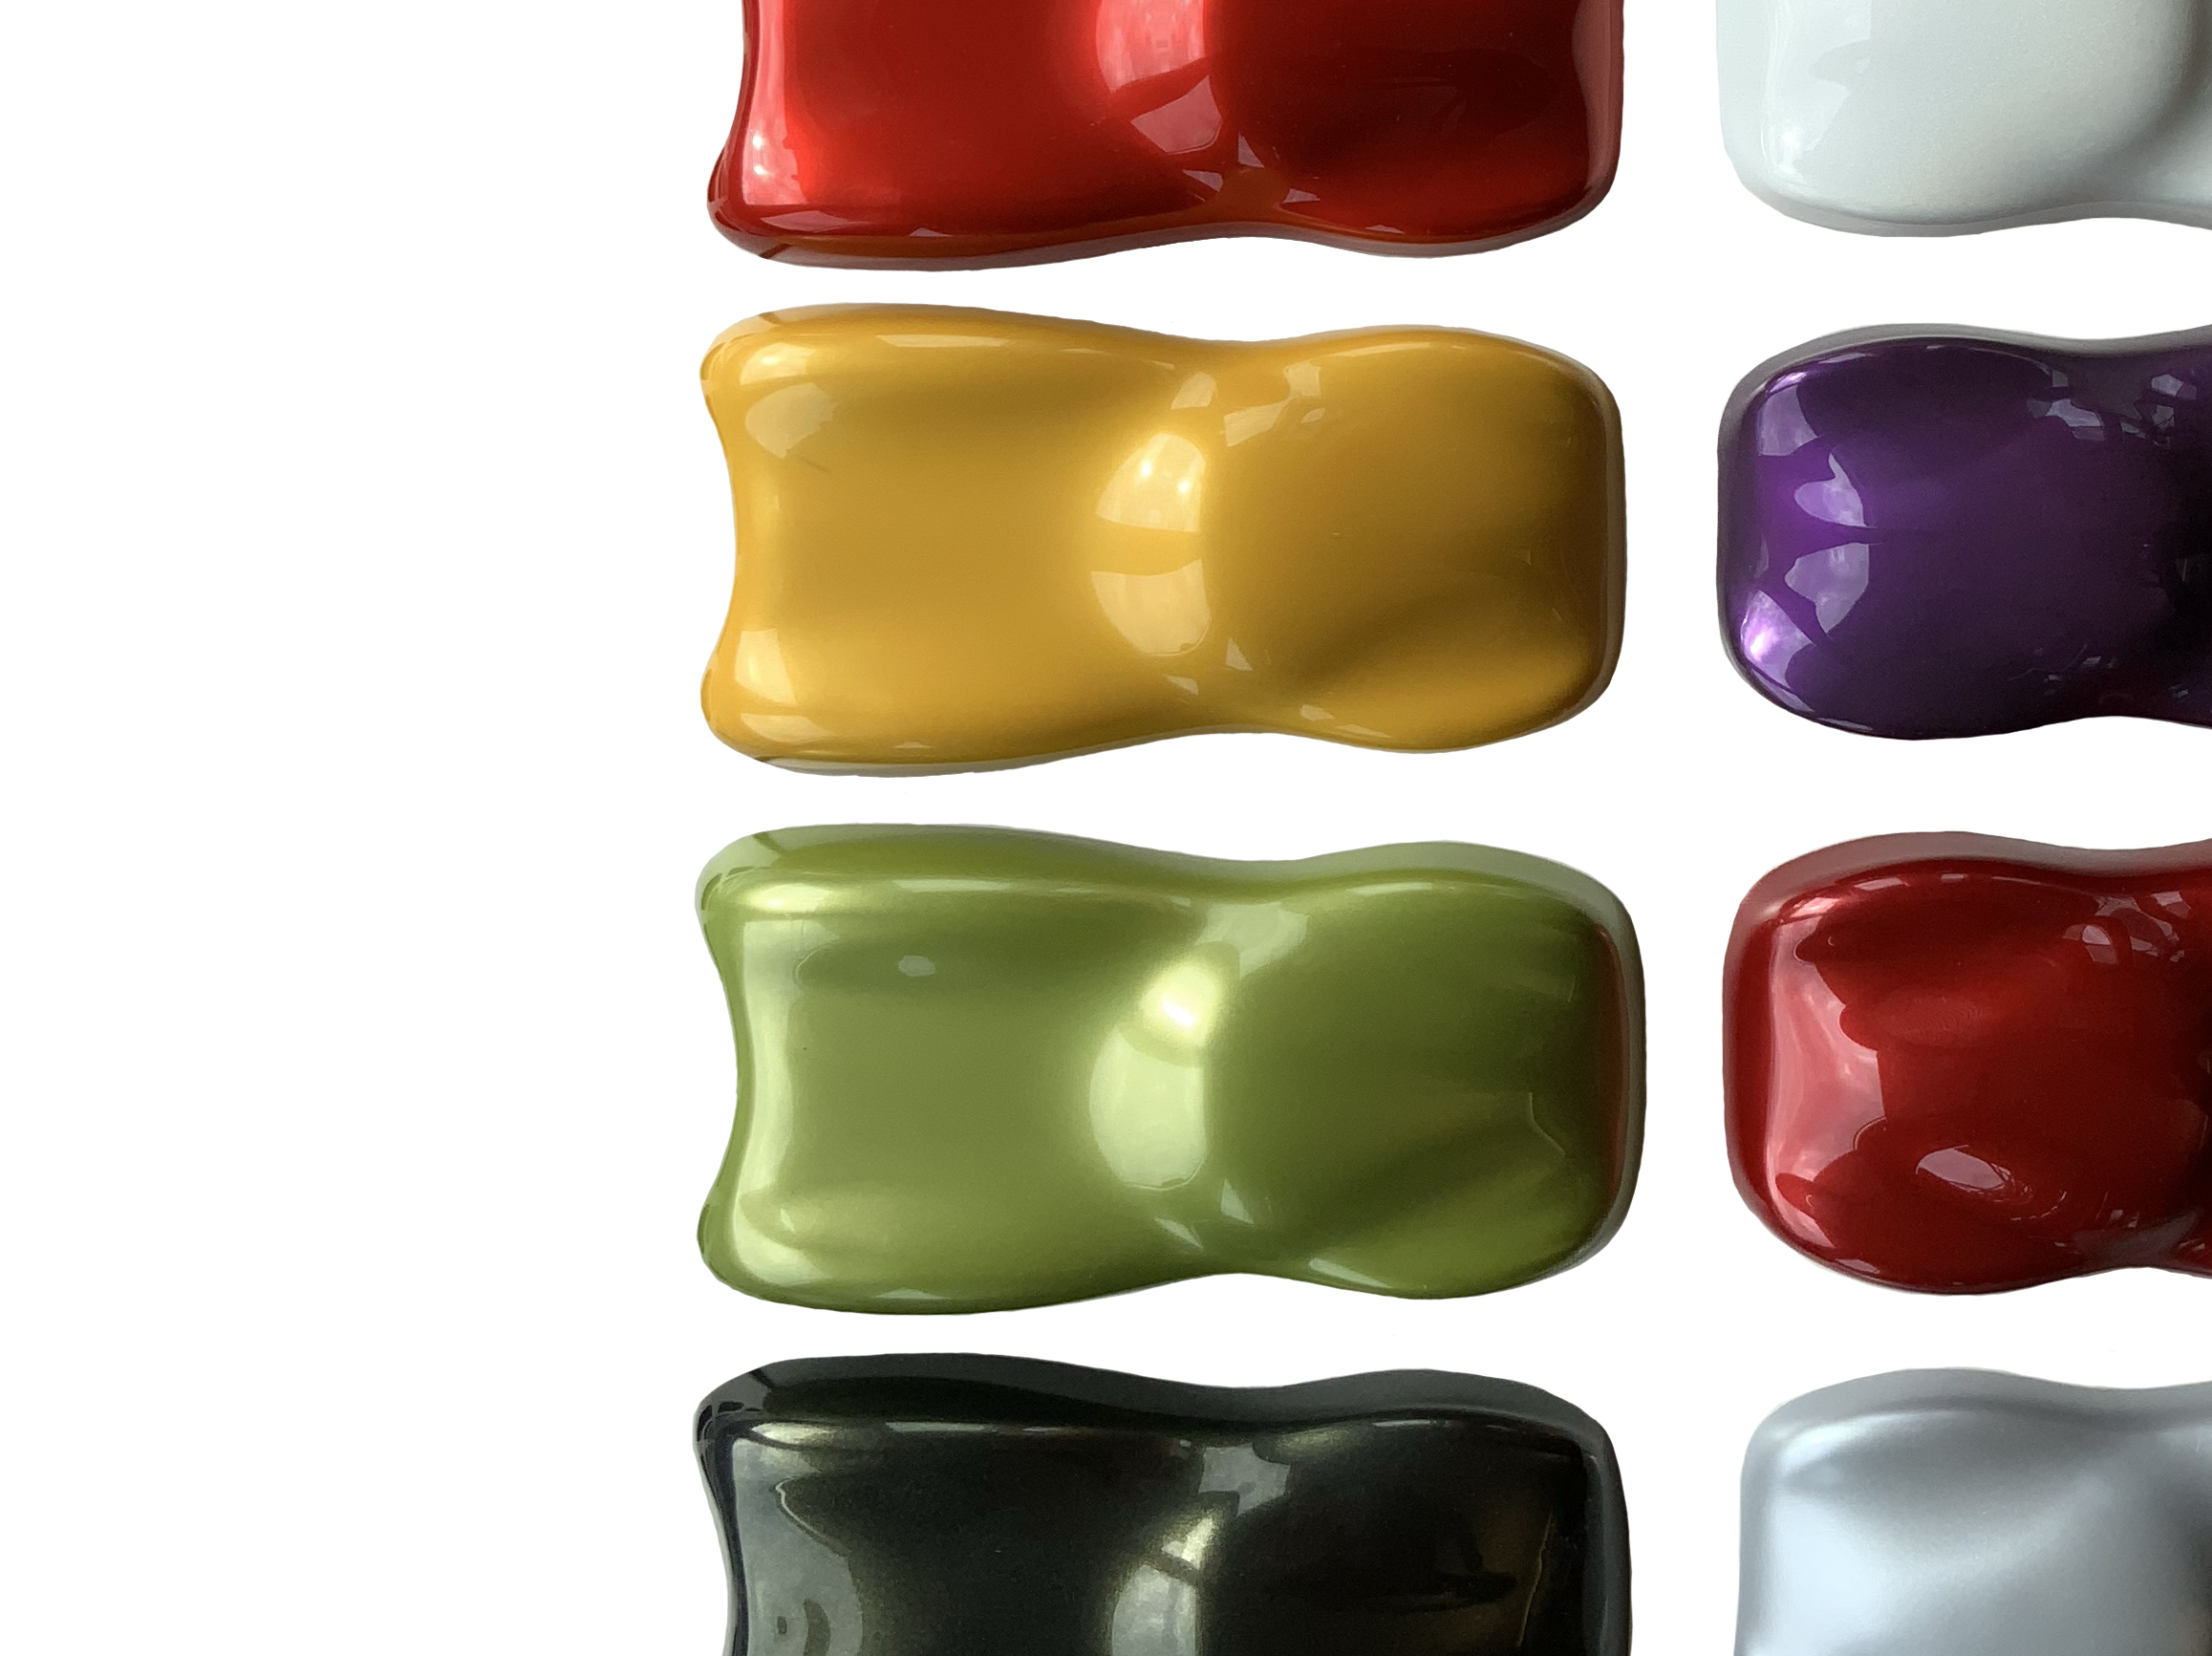

CLASS-A-SURFACE
GLOSSY AND MATT

Slide 13
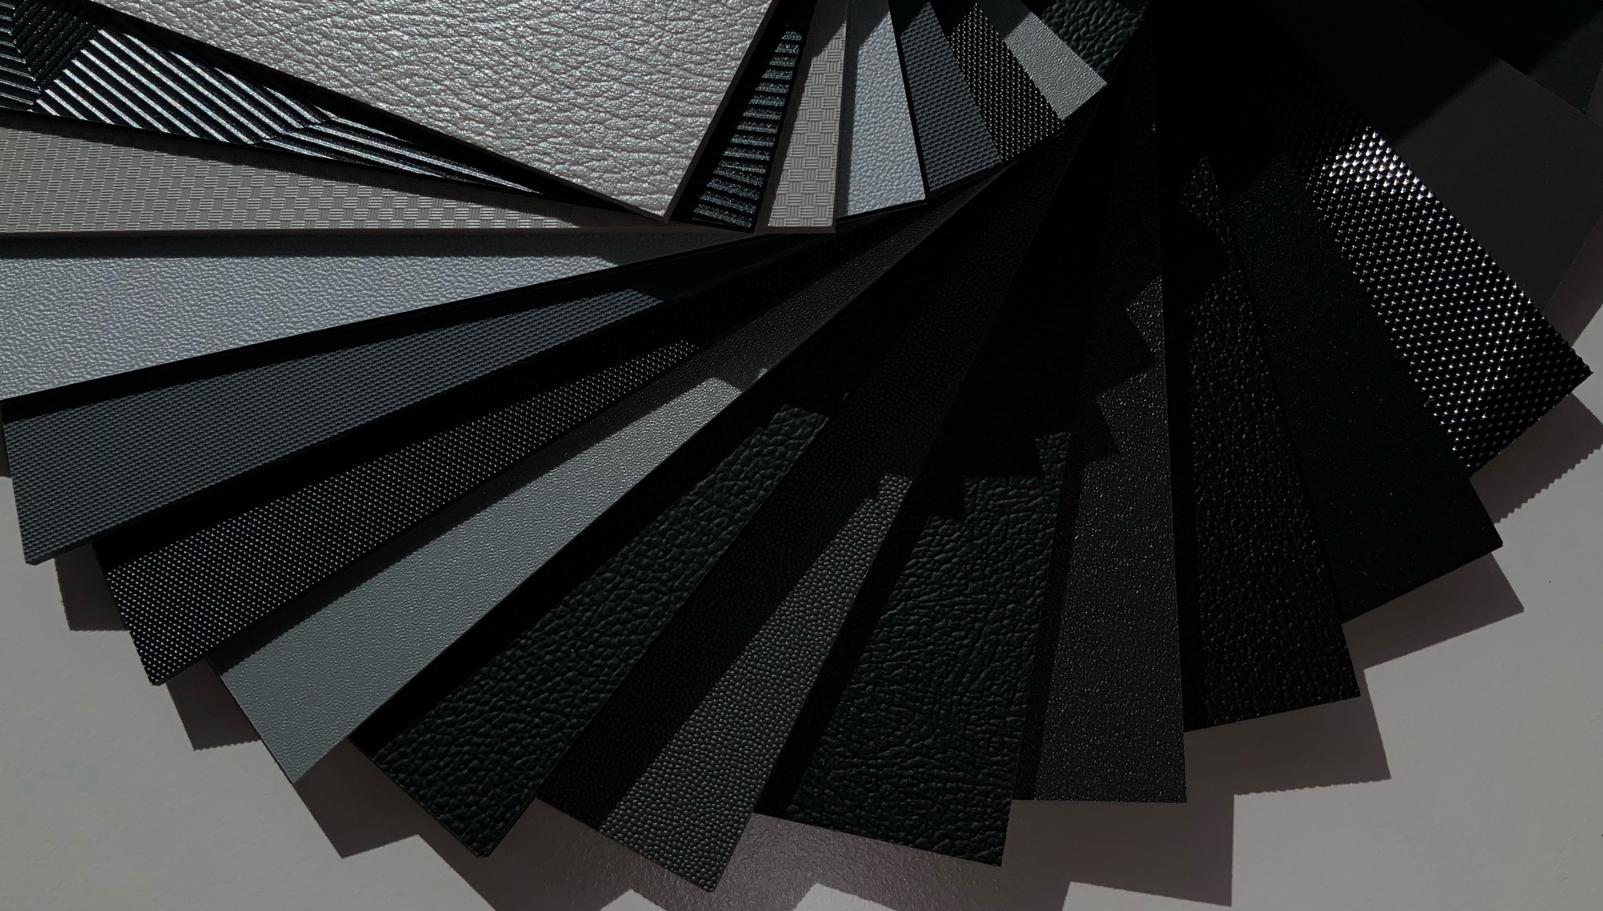


SMOOTH AND EMBOSSED

Slide 14
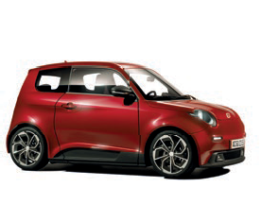
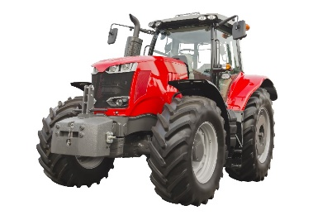
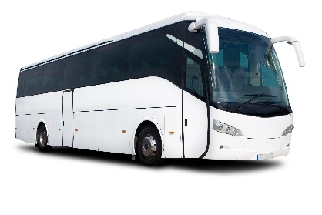
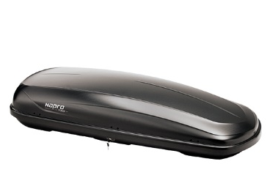



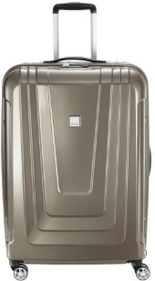
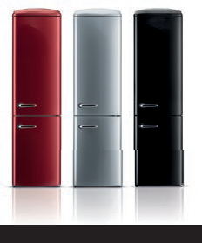

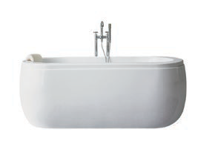

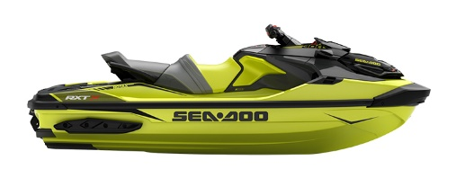

WIDE RANGE OF POSSIBLE APPLICATIONS
Automotive
industry
COMMERCIAL
VEHICLES
Passenger
transport
Caravans &
motorhomes
Roof &
Rear boxes
Suitcase
Applications
FURNITURE
INDUSTRY
Bath &
Wellness
refrigerator INDUSTRY
Other
APPLICATIONS

Slide 15
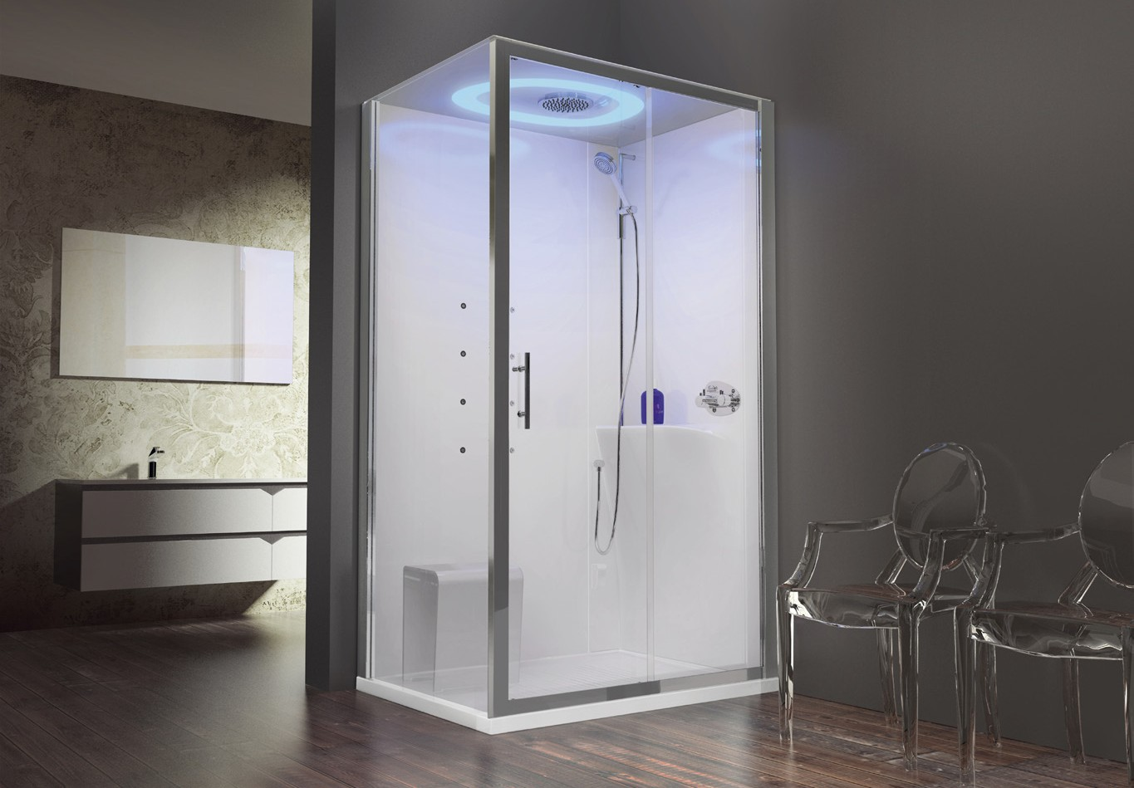
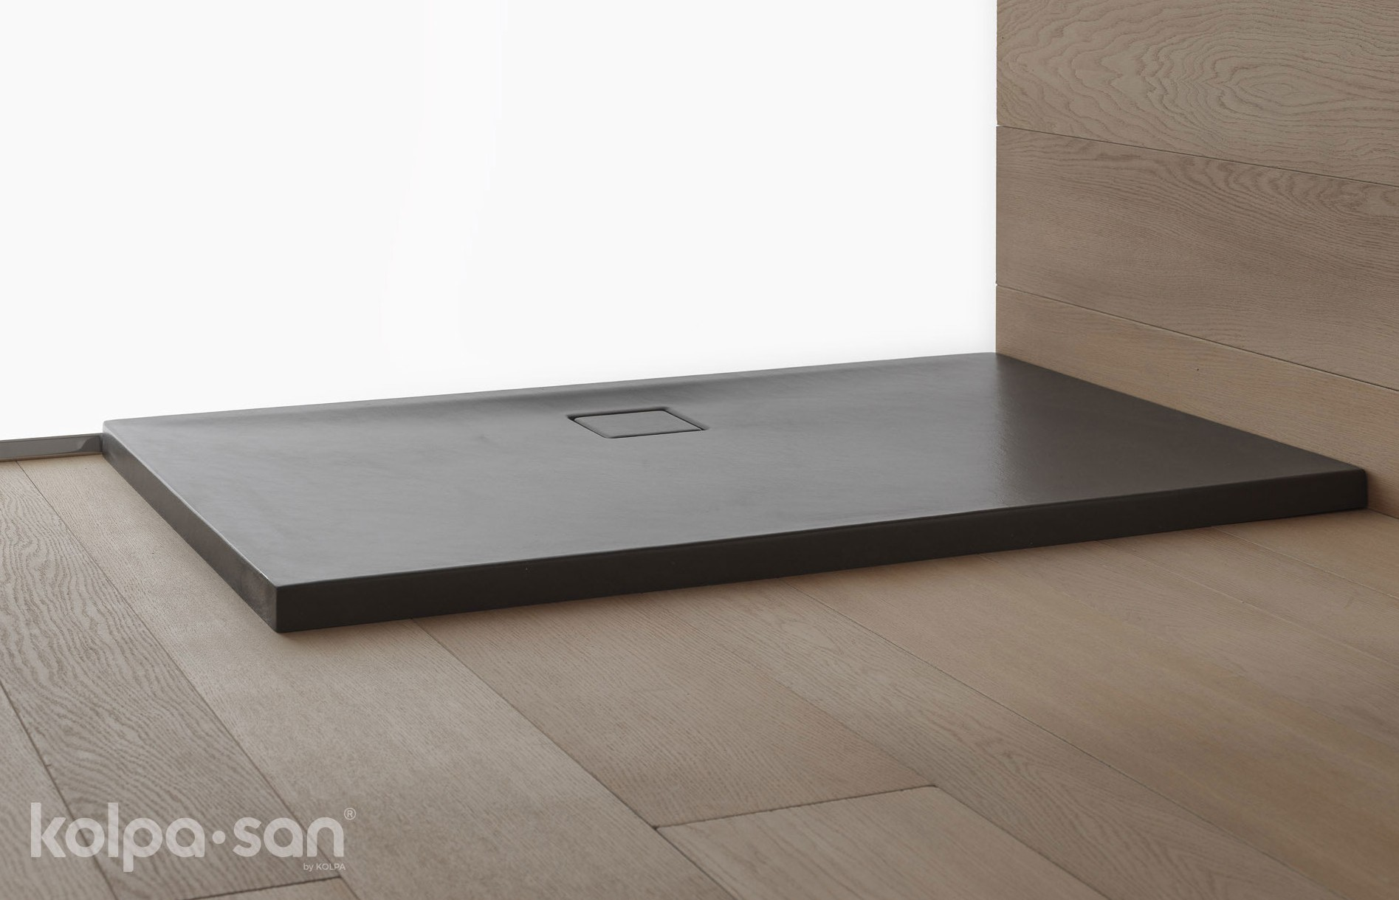
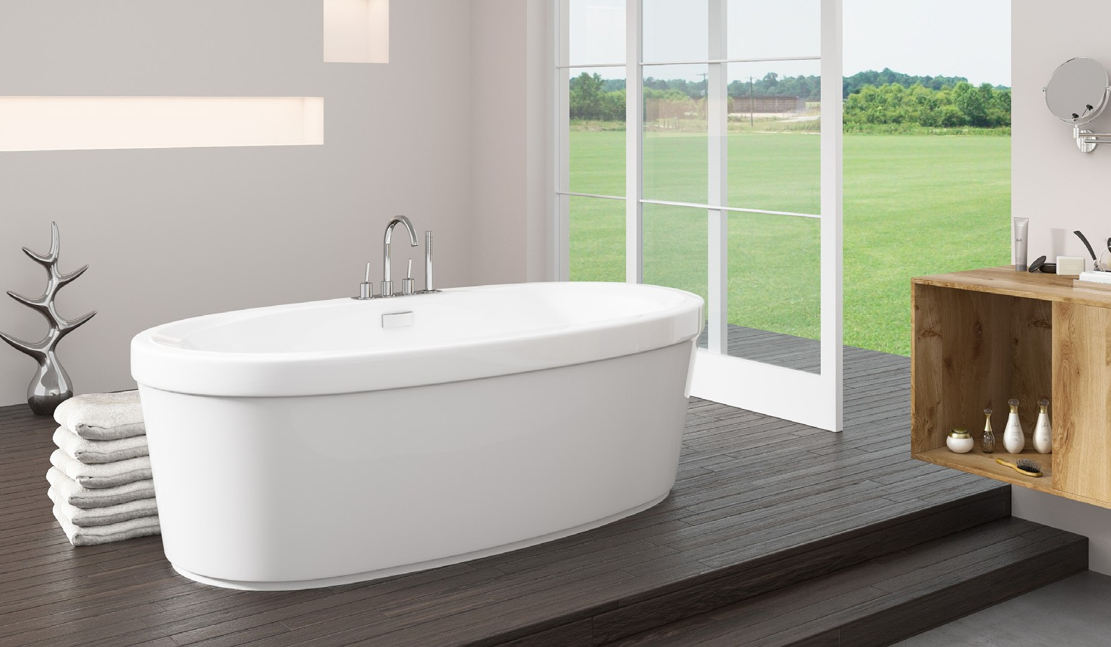
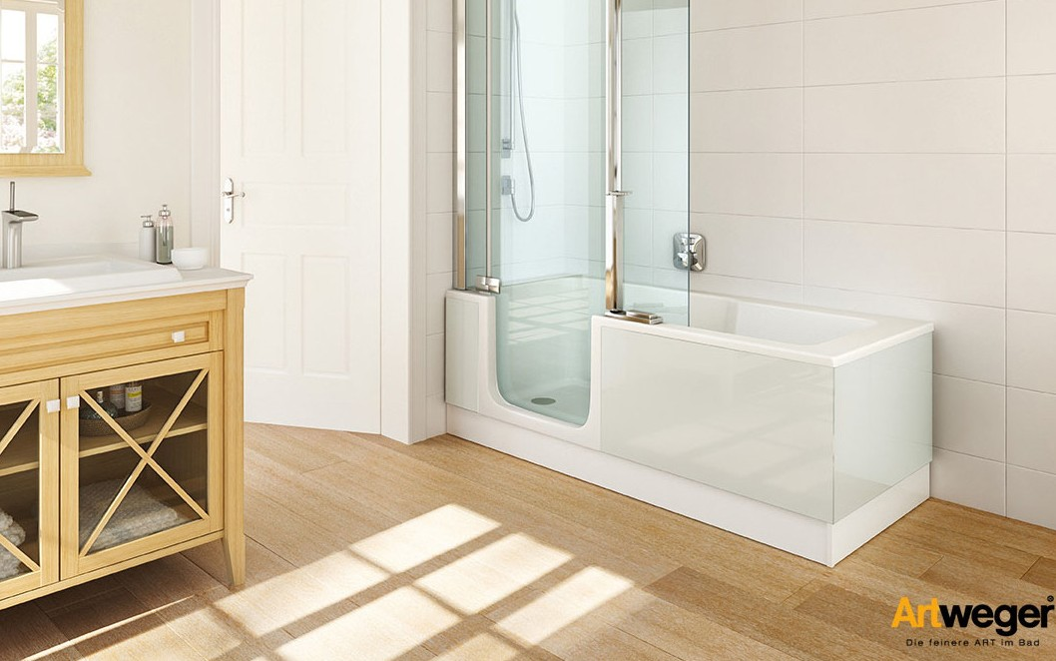

Bath & wellness
Novellini
by Kolpa
Brooke Reveal

Slide 16
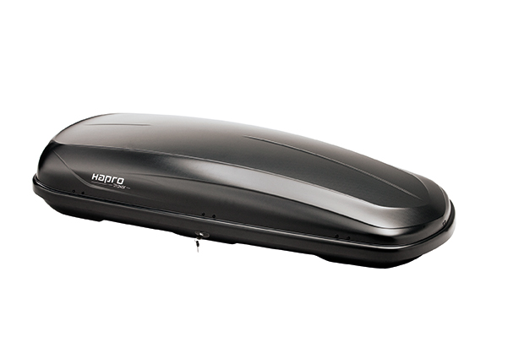
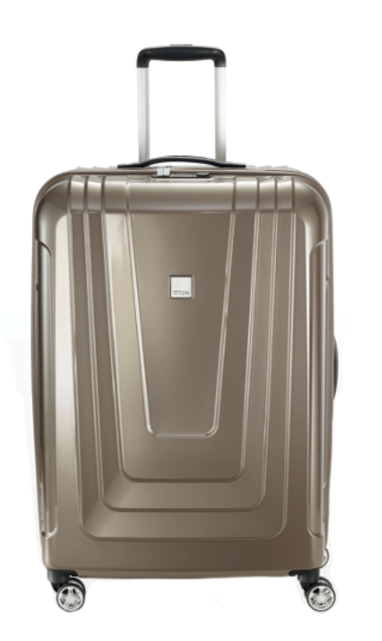
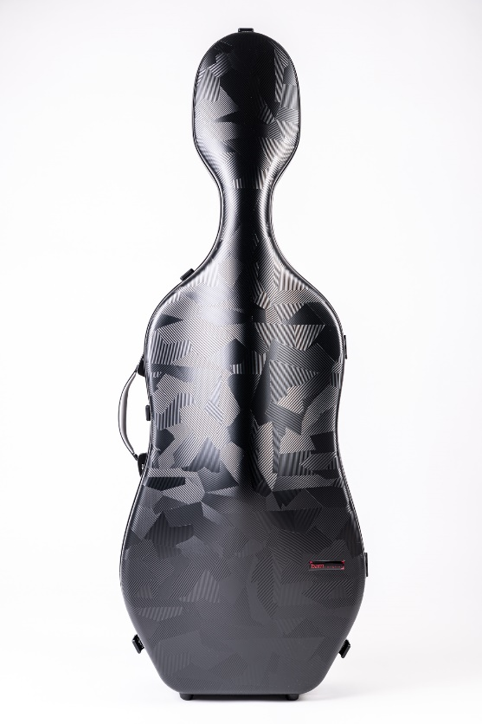
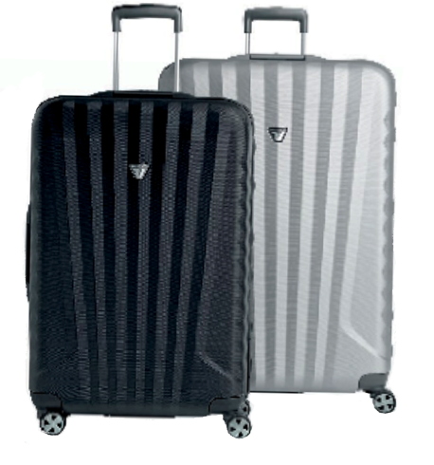
TRAVEL & LEISURE
01. Roof box
02. Cello case
03. Suitcase
01
02
02
03
Valigeria Roncato SPA
BAM S.A.

Slide 17
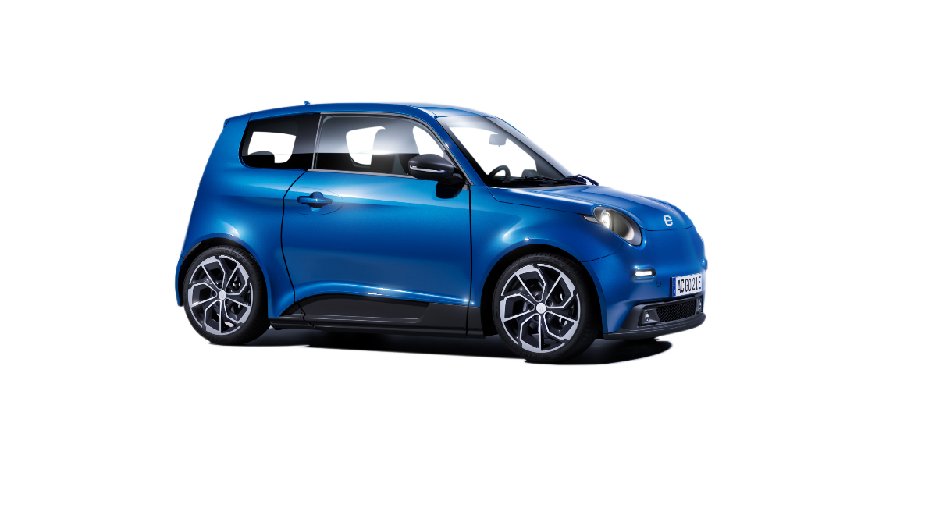
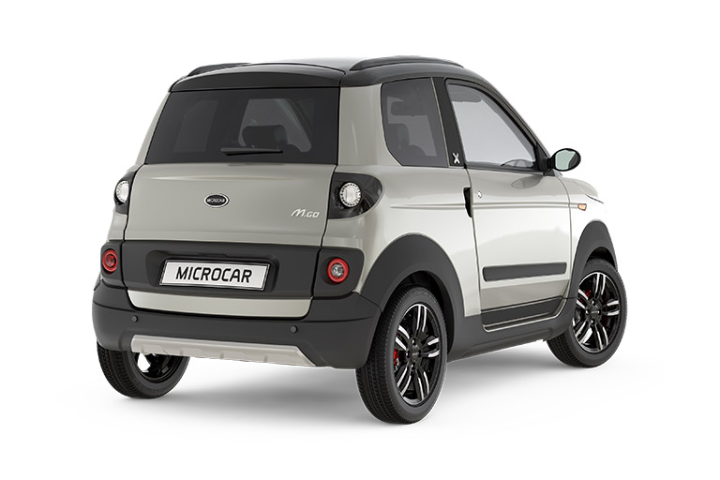
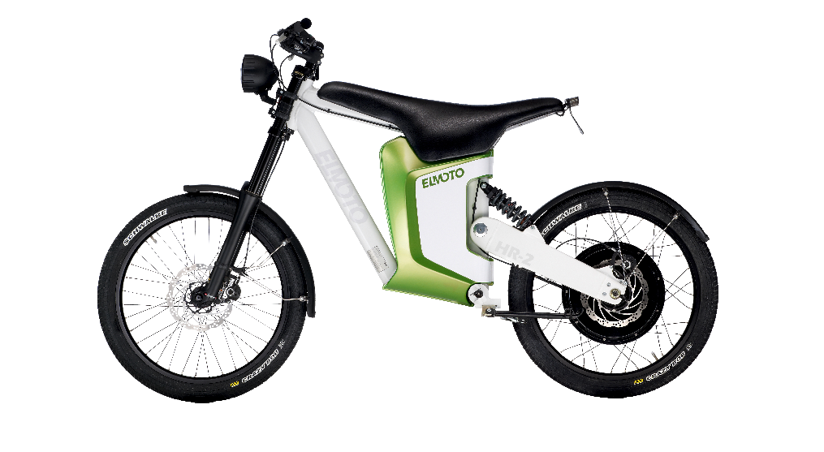
AUTOMOtive INDUSTRY
01. Pedelec
02. Electric vehicles
02
01

Slide 18
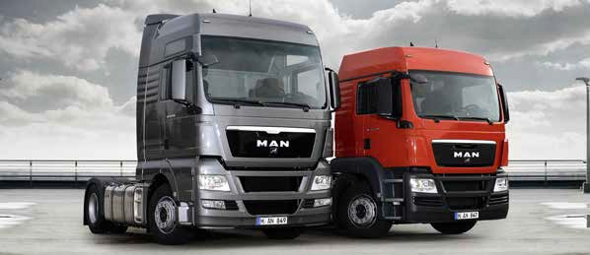

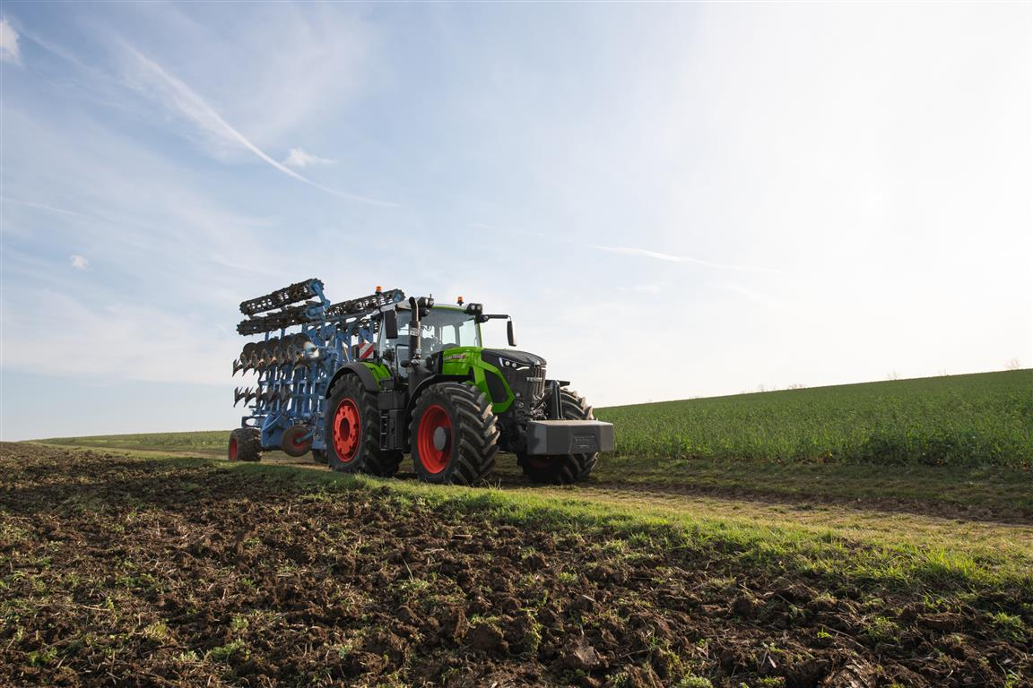
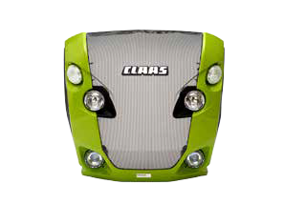
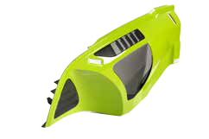
COMMERCIAL VEHICLES
01. Tractor parts
02. Tractors 03. Commercial vehicles 04. Harvesting vehicles
03
02
04
01
AGCO/Fendt

Slide 19
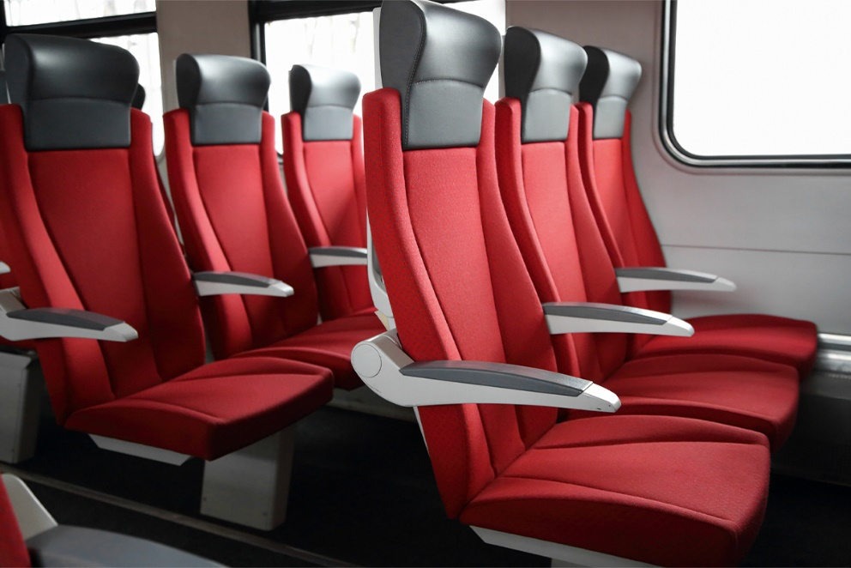
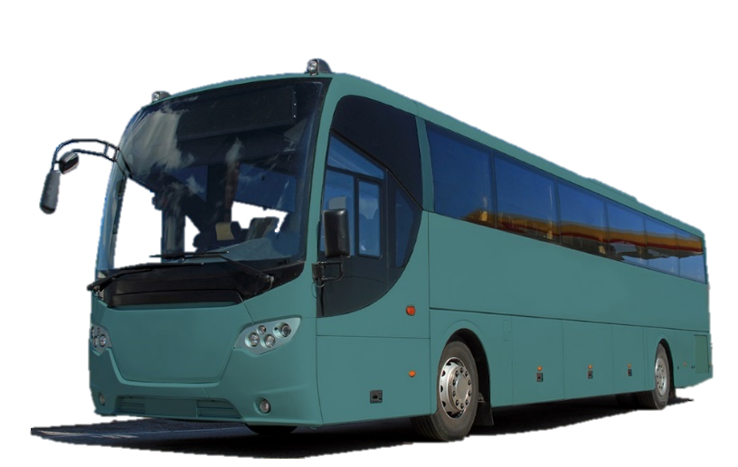
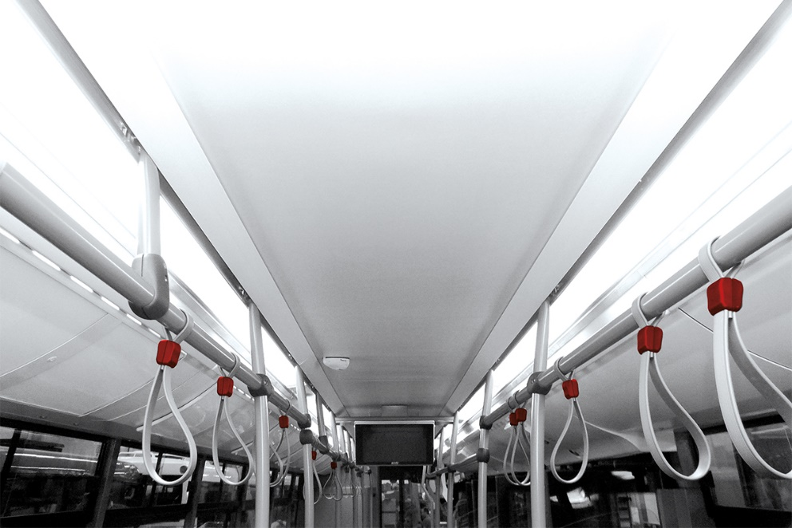
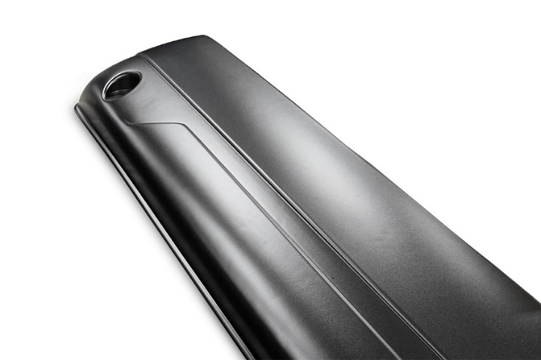
COMMERCIAL VEHICLES
Passenger transport
01. Bumpers
02. Exterior applications
03. Seat shells
04. Ceiling, wall paneling & luggage racks
03
02
01
04
AGCO/Fendt

Slide 20
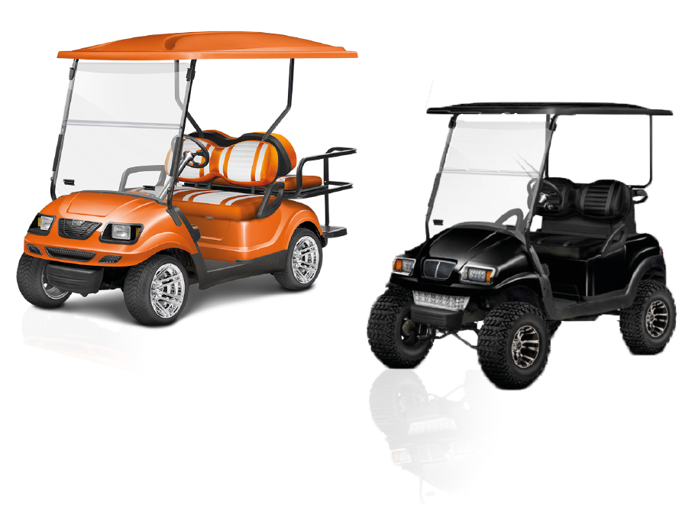
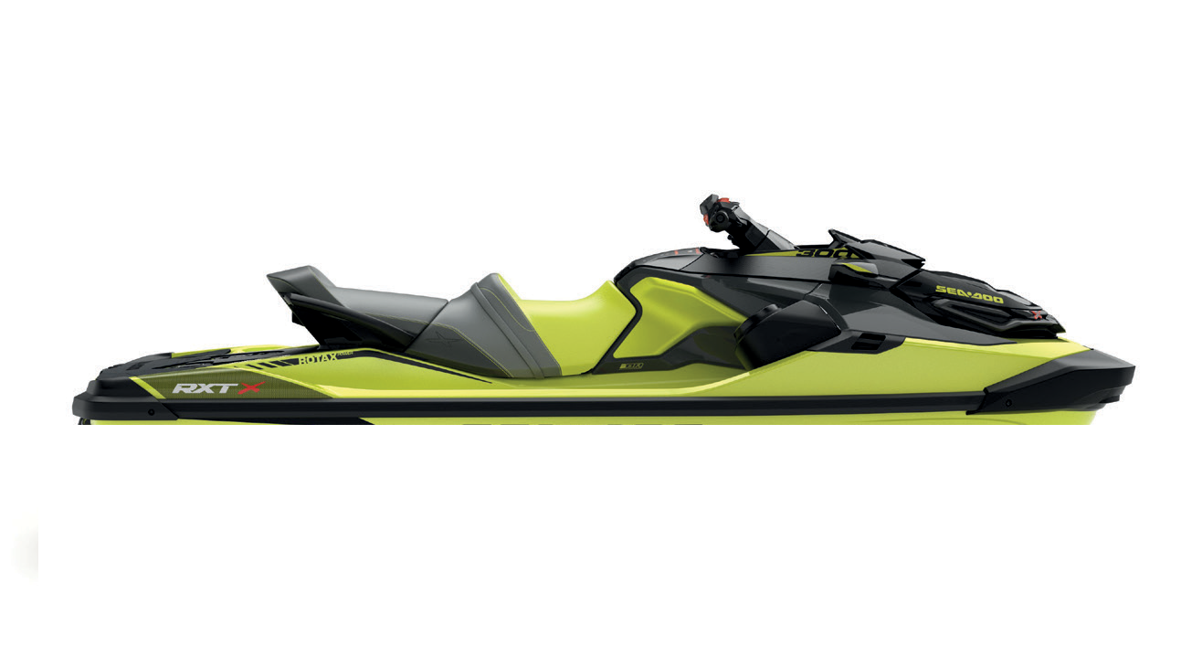
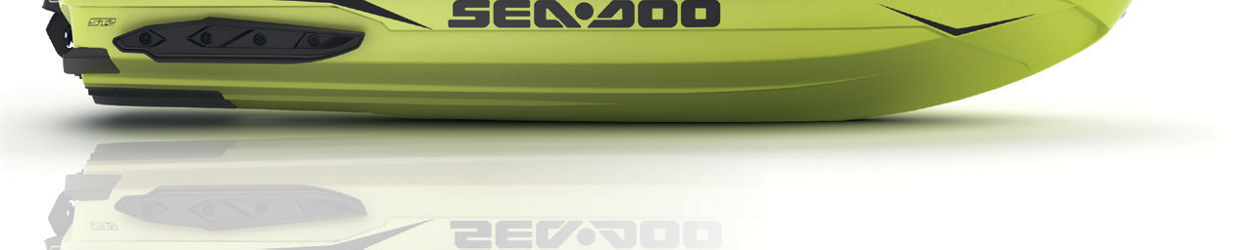

Other APPLICATIONS
01. Water Craft
02. Golfcar
02
01

Slide 21
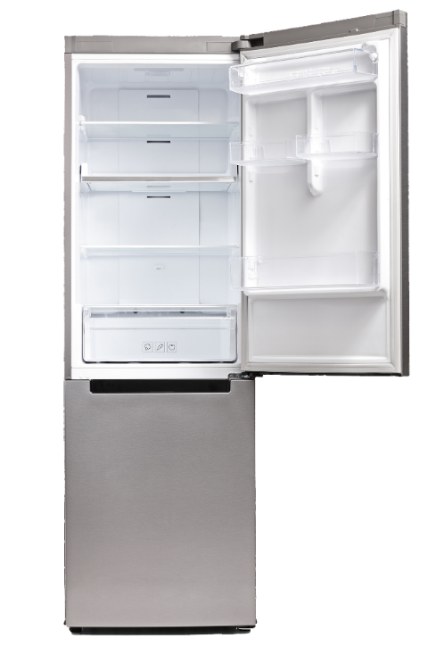
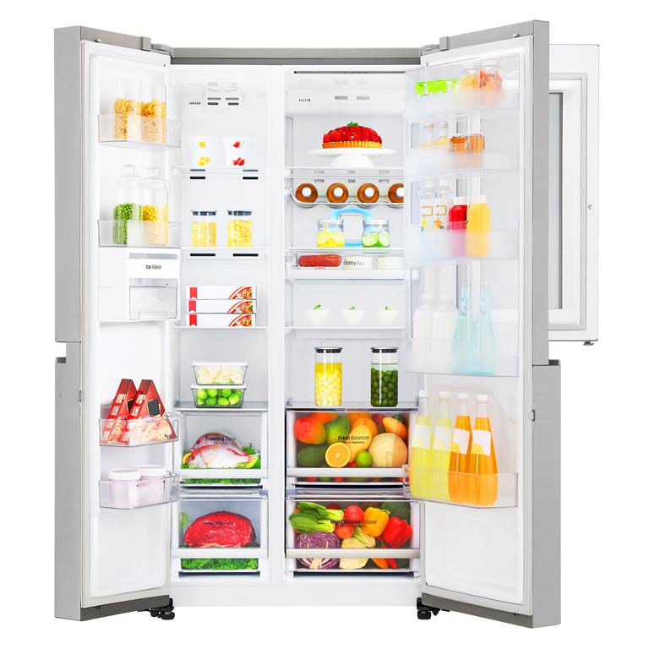
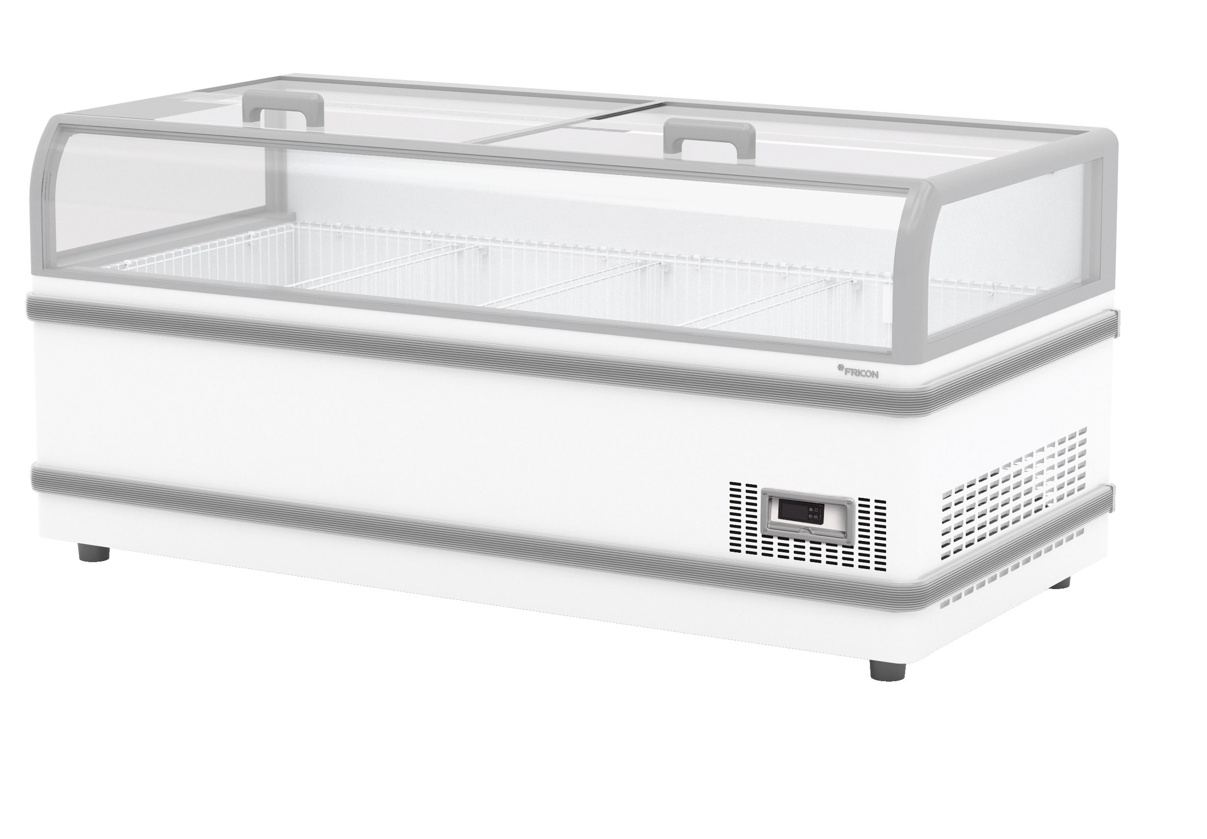
refrigerator INDUSTRY
01. Cooling devices
02. Inner liners
01
02
© FRICON

Slide 22
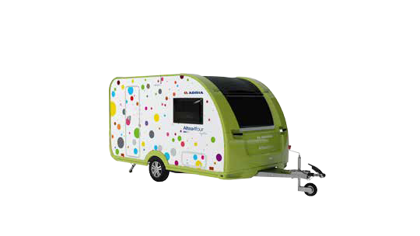
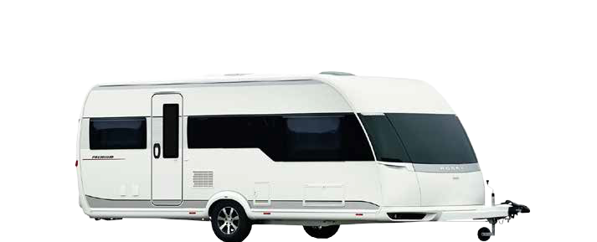


CARAVANs & motorhomes
01. Caravans
02. Motor homes
03. Radiator grill
01
02
03

Slide 23





FURNITURE INDUSTRY
Novellini
by Kolpa
© EWE Küchen
Brooke Reveal
© HAKA KÜCHEN

Slide 24


Slide 25


WE DO A LOT.
We already produce in a
resource-saving way.
Total emissions of CO₂
3.126
tons in 2005
332
tons in 2024
© HAKA KÜCHEN

Slide 26

AND WE DO EVEN MORE.
GREEN ELECTRICITY
We obtain 100% of the energy we need for production from green and sustainable sources.
In addition, we convert our company cars from regular vehicles to electric vehicles and we are investing in photovoltaic systems.
New Products
This year we are introducing a range of new senosan® ECO-B Bioplastics products focusing even more on sustainability.
SENOCIRCLE
The recycling concept developed by SENOPLAST ensures that almost all production and processing wastes can be reused in manufacturing processes.

Slide 27


THE NEXT STEP TO CLIMATE NEUTRALITY
senosan® ECO-B Bioplastics
Product groups:
PS / HIPS
PC
ABS
ASA
PMMA
© HAKA KÜCHEN

Slide 28












RENEWABLE FEEDSTOCK AS A REPLACEMENT FOR FOSSIL
FEEDSTOCK senosan® BIOPLASTICS:
Kitchen and
wood waste,
waste oil
Bio-naphta/
Biogas
Polymer producer
Bio-attributed
styrenic monomers
Thermoformer
Producer / OEM
Sheets and films
ABS / ASA / PS / PC
Fossil fuel and
natural gas
Naphta/
natural gas
Bio-attributed
styrenic polymers

Slide 29











QUALITY AWARDS & CERTIFICATIONS
1987 Austrian National coat of Arms Award
1992 Certified to ISO 9002
2015 Award “Recognized for
Excellence” 5* (EFQM)
1997 Certified to ISO 9001
2000 Certified to ISO 14001 –
environmental management
2015 Austria’s best family business
1st price for Salzburg
2007 EMAS – environmental management
2018 Award of the prize
“environmental leaf Salzburg” for
special environmental commitment
2012 Quality Austria Award
for 20 years ISO certification
2020 Most innovative Company Salzburg
2019 Awarded with seal of quality
for sustainability by Kurier
2020 Export award –
Silver in the category Industry
2022 ISCC PLUS Certification
2021 Nomination –
Austrian State Prize for Innovation
2021 Energy Globe Award
2022 Wikarus Award
2023 Award of prize for
environmental management

Slide 30

we rethink
surfaces
Multilayer sheets for design, functionality and durability
10/2025
© Senoplast

