Slide 1

PRODUCT LAUNCH
A50 SOFT MATT UV

Slide 2
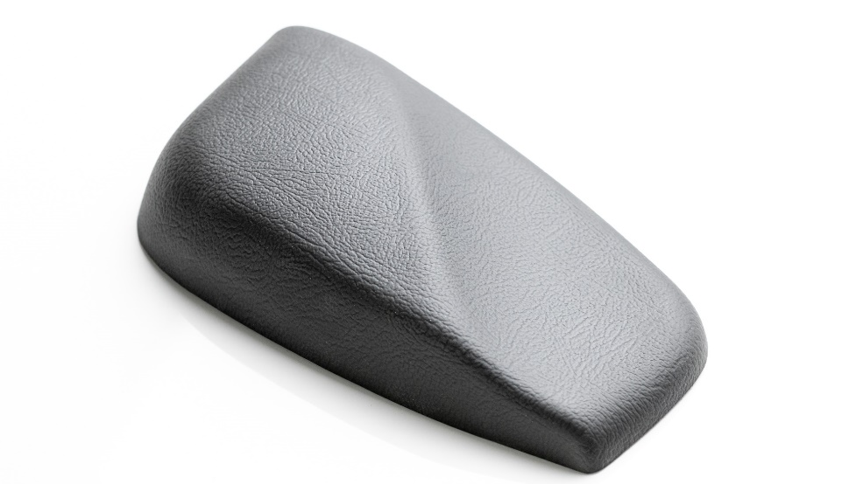
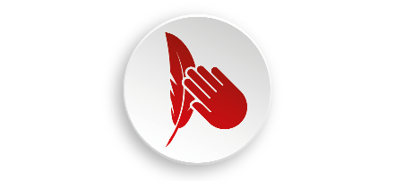
Product AdvantAGES
A50 SOFT MATT UV
flawless softfeel surface
superior matt finish
excellent UV resistance
also available in light colours
various embossing options
attractive pricing

Slide 3
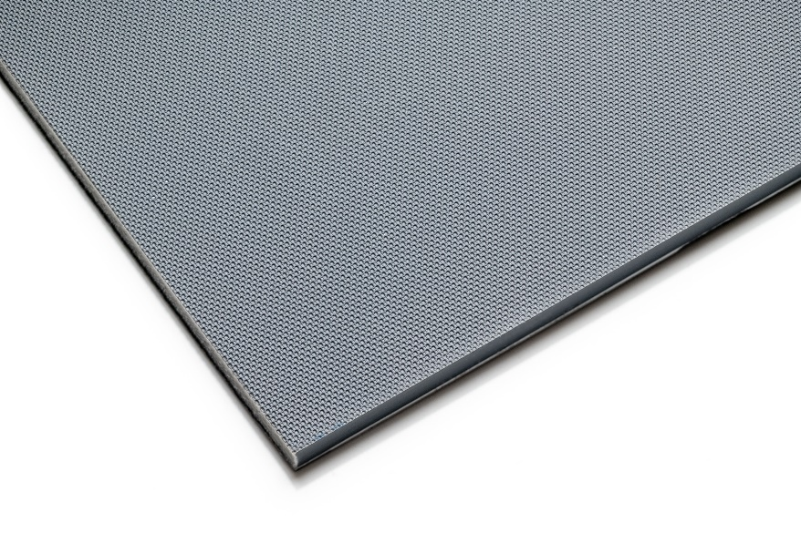
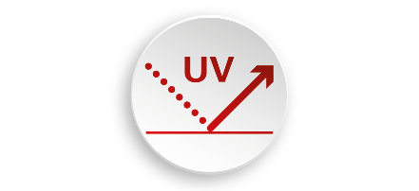

Product Details
A50 SOFT MATT UV
Multi-layer composite with high impact ABS base layer
and co-extruded matt UV resistant TPE top layer.
Featuring our standard easyglide® rear-side.
Thickness: 2 to 6 mm
Width: up to 1,650 mm
M
Other dimensions upon request.
Surface: matt softfeel
Colour: uni, also very light colours
Embossings: 011AS – AIRSKIN
  003FN – LEATHER
  012RN – CORAL
  016LI – DIAMOND
  019SC – BUFFALO
  022HT – CARBON

Slide 4
Technical properties
 | gloss level | UV-resistance hot lamp exposure | scratch resistance
 | embossing 016LI - DIAMOND black 8102 | grey 85226 | embossing 012RN - CORAL
A50 SOFT MATT UV | non-thermoformed < 1 GU thermoformed 0.6 – 0.7 GU | DE 0.5 | 6.5 N
A50 EG SOFTFEEL MATT | non-thermoformed 0.6 – 1.1 GU thermoformed up to 1.2 GU | DE 8.01 | 7 N
A50 EG SOFTFEEL SOLAR MATT | non-thermoformed up to 2 GU thermoformed up to 3 GU | DE 0.54 | 4 N
Notes:
EN

Slide 5
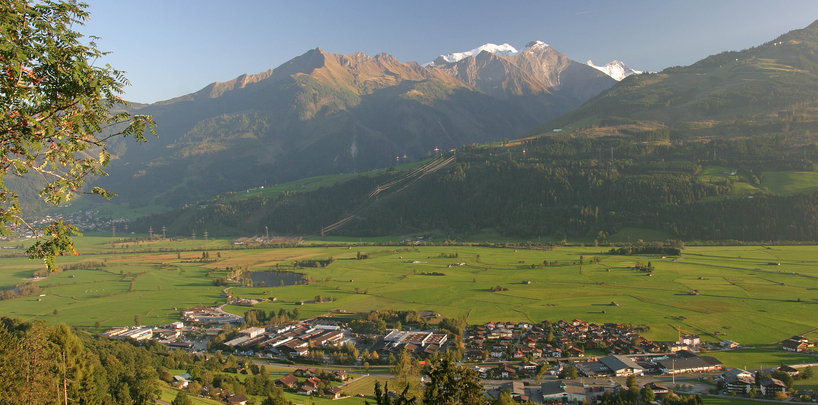
MADE TO FORM THE FUTURE
11.04.2024
© Senoplast

