Slide 1
senosan® sheets for sanitary applications

Slide 2
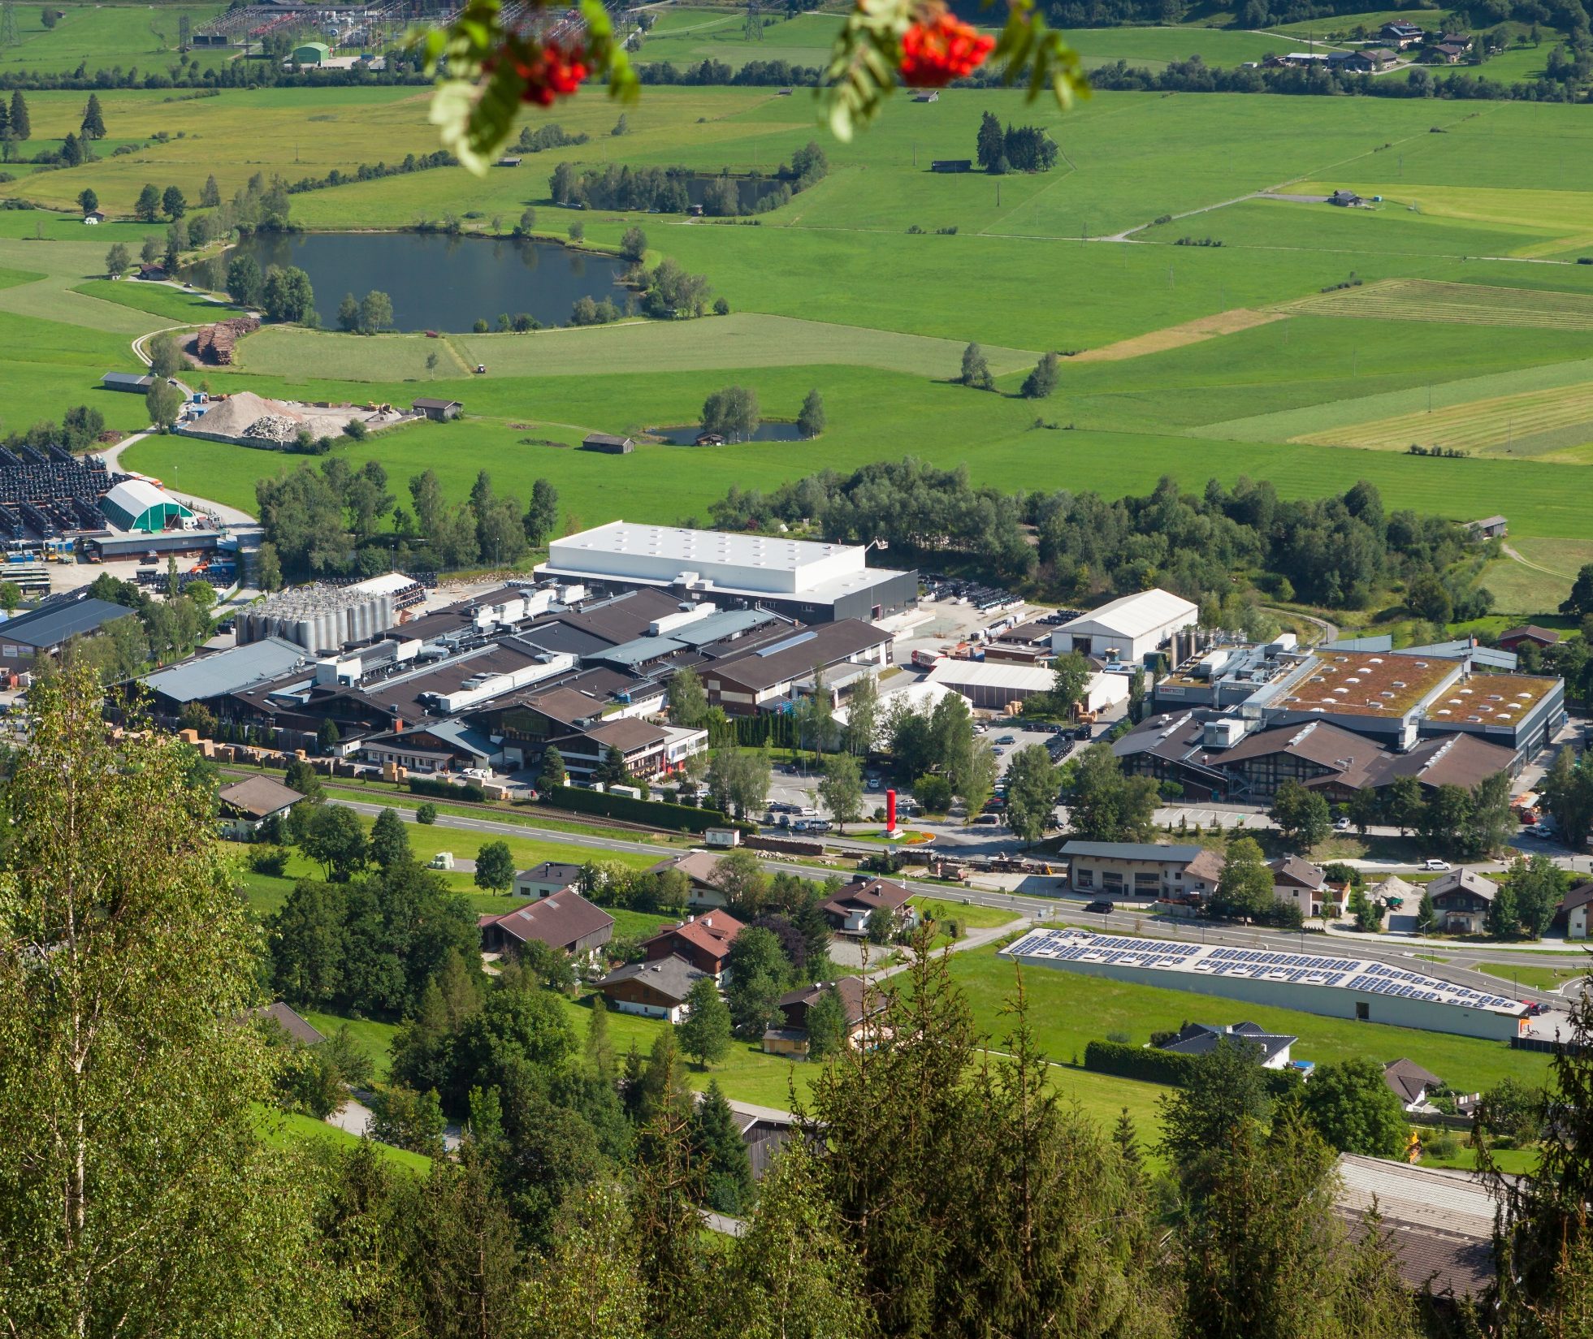
Commited to give you
excellent service
60,000 tons of high quality senosan®
quality plastic sheets and films per year
One of the main employers in the region
Top quality, innovation and protective technologies

Slide 3
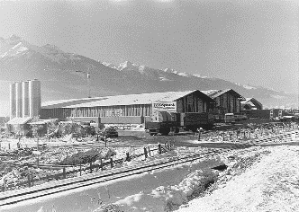

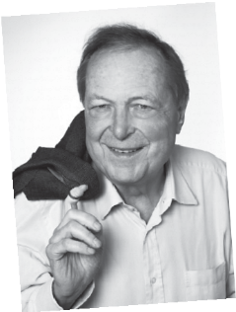

A TRUE SUCCESS STORY
SENOSAN GmbH –
was created to focus especially on the furniture industry
SENOPLAST S.A. de C.V
in Querétaro, Mexico
Founding of SENOPLAST
New Material (Suzhou) Co. Ltd.
Suzhou/Wujiang, China
SENOPLAST was moved to Piesendorf, Austria, where the headquarters are today
SENOPLAST was founded in Kaprun, Austria by Wilhelm Klepsch
1998
2006
2013
2024
1956
1978
2000
2011
2020
Today, SENOPLAST is a globally active corporation with a strong commitment to its community in Piesendorf, Austria. The company employs 810 people worldwide.
Günter Klepsch
takes over management
of SENOPLAST as CEO
Foundation of Senco R&D,
our in-house company for
research and development
Start of production and sales
of senotop® products for the
automotive industry under
cleanroom conditions

Slide 4
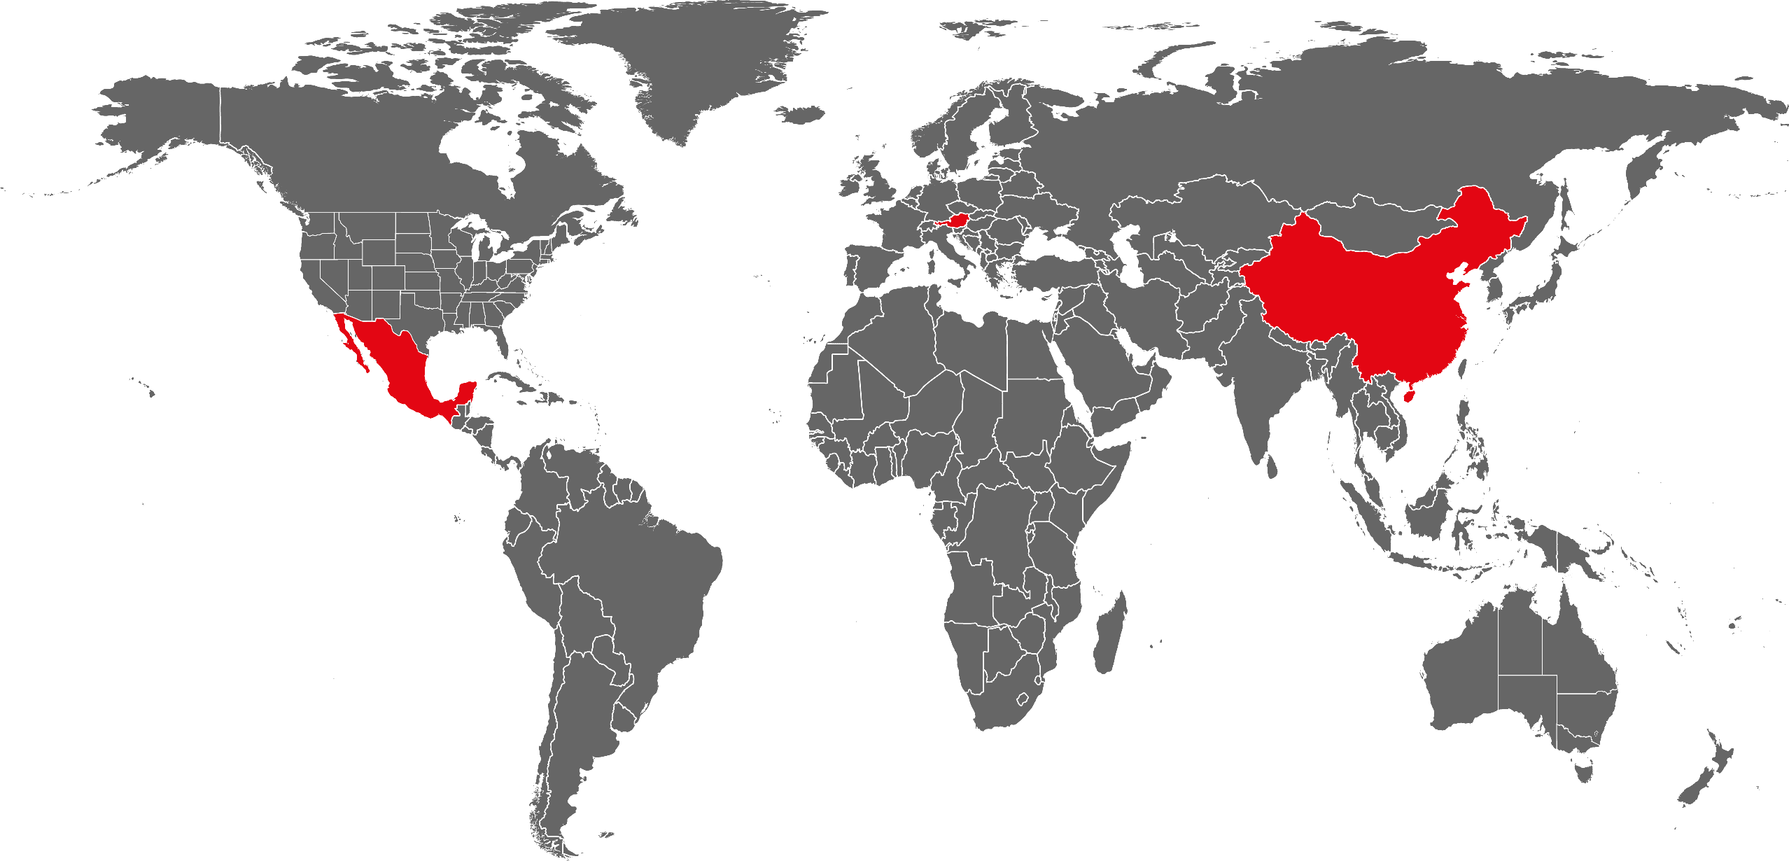




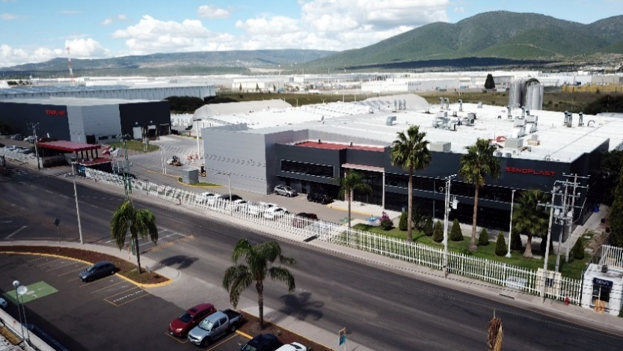
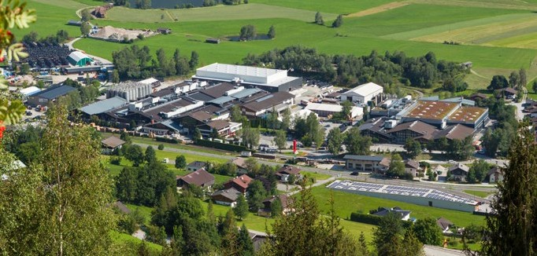
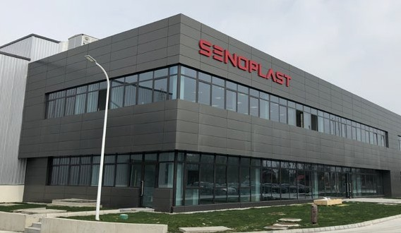
INTERNATIONAL GROUP
3 Production sites
Austria, Mexico and China
17 Sales offices & representatives
worldwide

Slide 5
Brand & Values
VISION
We strive to be the global number one for co-extruded and refined plastic sheets and films in the area of high-quality applications.
MISSION
Senoplast is the leader of innovation and quality in the co-extrusion of plastic sheets and films. We support our customers with comprehensive know how on everything from selecting to processing our products. As a family enterprise we emphasize respect, fairness and longterm relationships with all our business partners and employees. We are committed to a sustainable use of resources, to dealing with nature in a respectful way and to gentle production processes.
Values
Assume responsibility and achieve common goals
Respect, trust and honesty
Fairness and acceptance
Considerate and friendly cooperation without fear
Recognition and appreciation

Slide 6
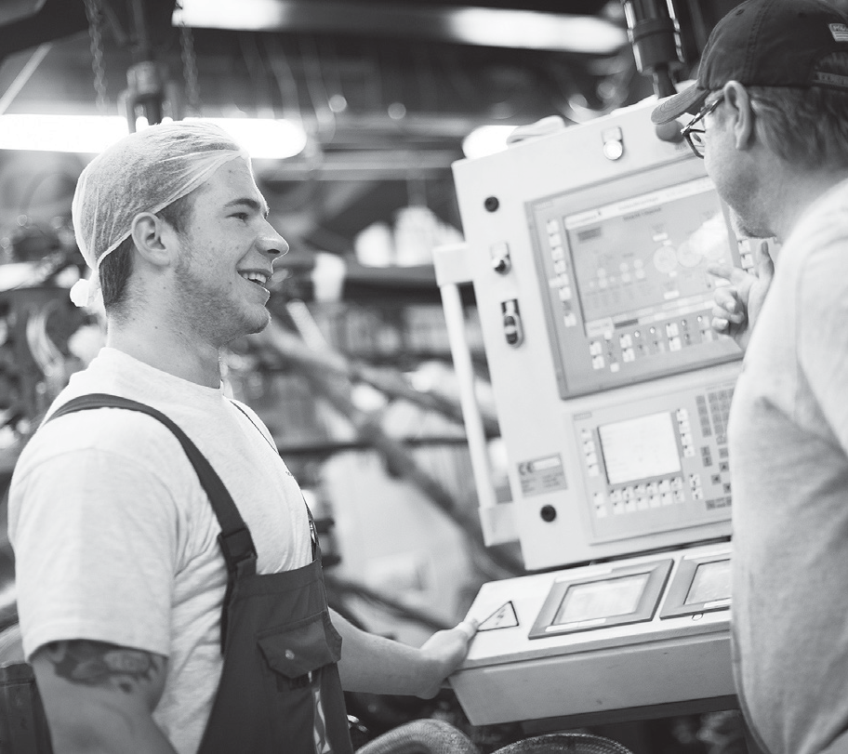
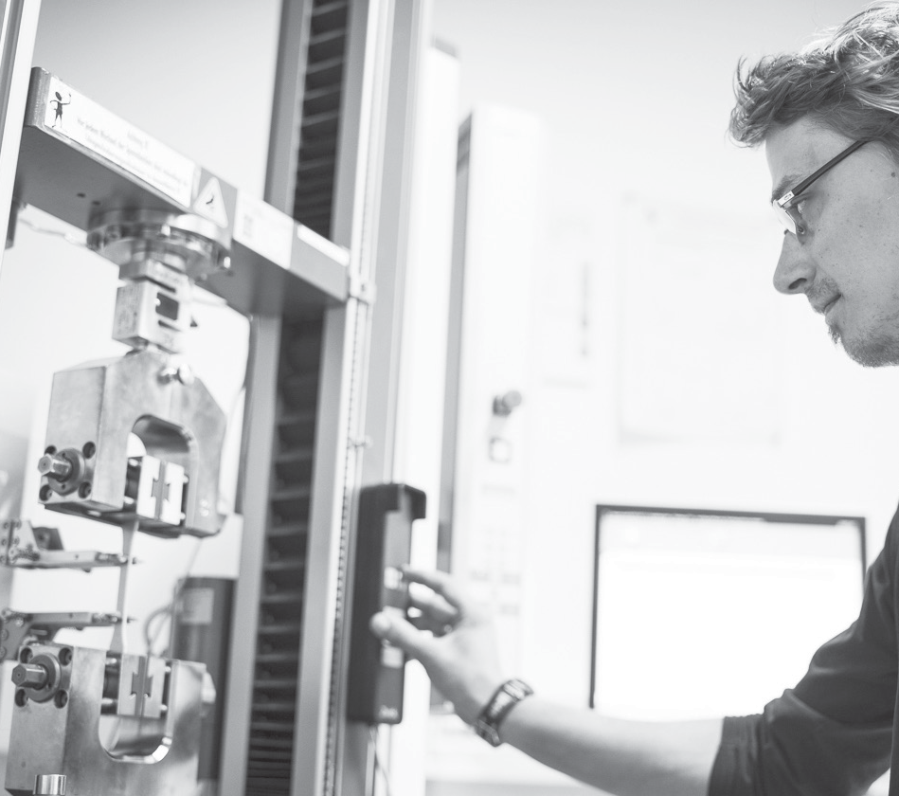
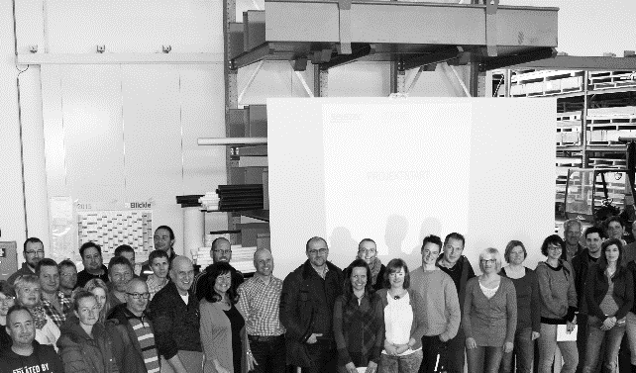
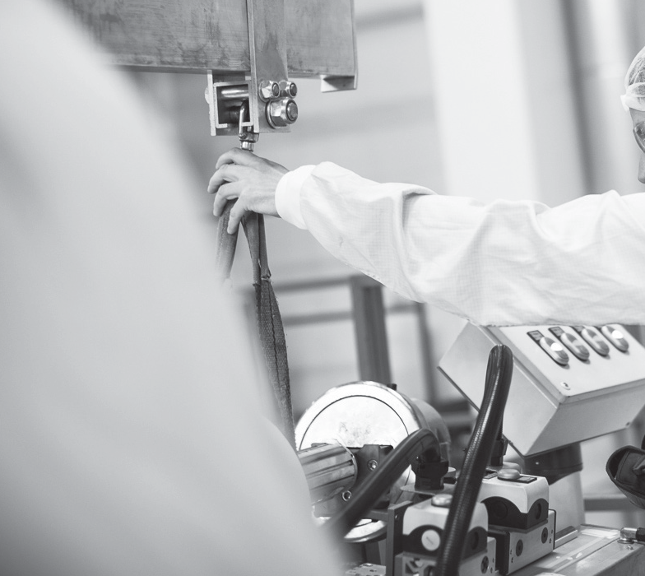









KLEPSCH GROUP – THE PLASTIC POWER NETWORK
Senoplast Klepsch & Co. GmbH,
Piesendorf (A)
Senoplast S. A. de C.V.,
Querétaro (MEX)
Senoplast New Material (Suzhou)
Co. Ltd., Suzhou/Wujiang (CN)
Senosan GmbH,
Piesendorf (A)
Zell Materials
Engineering Plastics, Kaprun (A)
Zell Parts by Klepsch, Kaprun (A)
Zell-Metall USA
Tecnoplast Sant Angelo Srl., Ischia (I)
SALES OFFICE:
Austria · Spain
Croatia · USA
France
Senova® Kunststoffe GmbH
& Co. KG, Uttendorf (A)
Seletec Plastic Product GmbH & Co.
KG, Uttendorf (A)
SALES OFFICE:
  Austria · Italy
  Germany · Slovakia
Seno Spezialmaschinen GmbH, Piesendorf (A)
SALES OFFICE:
Australia
Belgium & Netherlands
France
Germany
Great Britain
India
New Zealand
Poland
Russia
Sweden
USA

Slide 7


FACTS & FIGURES
> 90% Export rate
We deliver to more than
60 countries worldwide
Employees
810 Senoplast Group
1025 Klepsch Group
17
Sales offices & representatives worldwide
€ 320 Mio.
Senoplast Group worldwide (2022)
> 60 000 tons
of senosan® products are sold per year
Co-extrusion of the following raw materials:
Abs | asa | pmma | pc | ps
(various combinations)
tpo and tpu
high performance plastics, e.g. lcp
€ 400 Mio.
Klepsch Group worldwide (2022)

Slide 8

TECHNOLOGY LEADER IN THE FIELD OF CO-EXTRUSION
OF PLASTIC SHEETS & FILMS

Slide 9
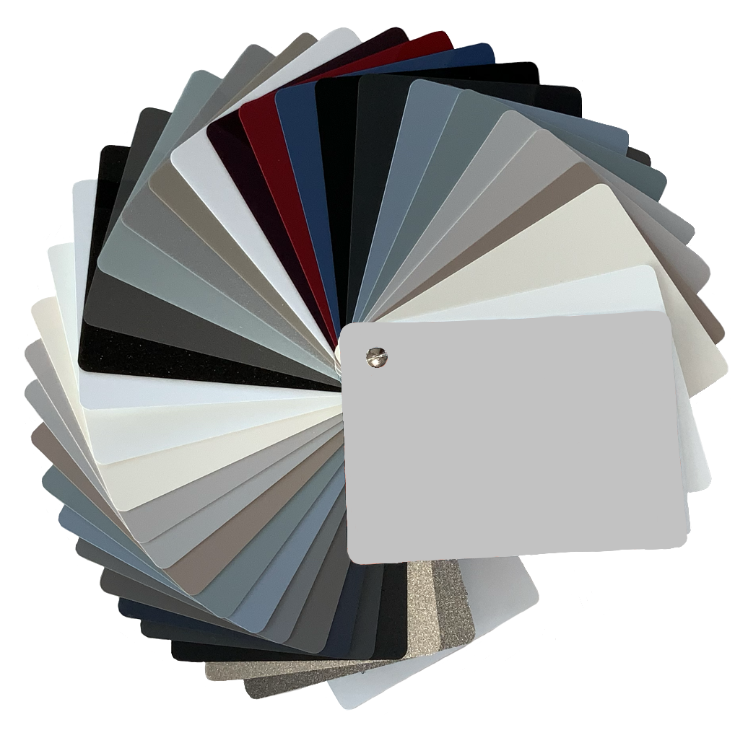
CO-EXTRUSION OF MULTILAYER SHEETS & FILMS
ABS/PMMA
PS SHEETS AND FILMS
Co-extruded multilayer sheets developed for high-quality thermoformed parts used in
outdoor and indoor applications.
Co-extruded sheets and ﬁlms
made of high impact polystyrene.
ABS+ABS/ASA
SPECIAL FILMS
Special mono and multilayer sheets developed to fulﬁl high demands of market in respect of design, technology and optical appearance.
High gloss ﬁlms for the
Automotive industry as paint replacement.
PC SHEETS AND FILMS
SPECIAL FILMS
Co-extruded and in-house colored multilayer sheets and ﬁlms for the suitcase industry and automotive applications.
Scratch resistant high gloss and supermatt ﬁlms for the furniture industry.

Slide 10
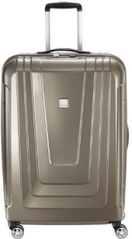
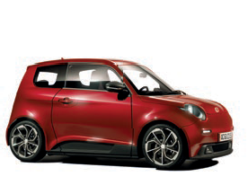
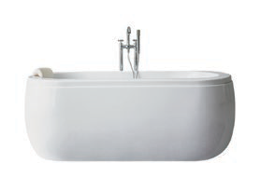
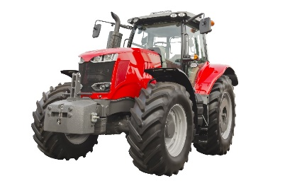
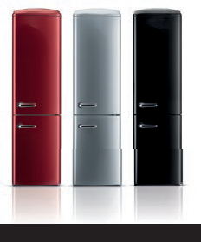

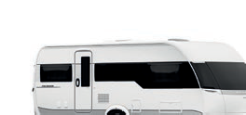
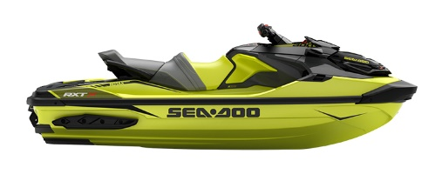




WIDE RANGE OF POSSIBLE APPLICATIONS
Bath & Spa
Travel & leisure
Automotive industry
COMMERCIAL VEHICLES
THERMOFORMING APPLICATIONS
FURNITURE INDUSTRY
FRIDGE INDUSTRY
Caravan INDUSTRY

Slide 11


WE DO A LOT.
We already produce in a
resource-saving way.
Total emissions of CO₂
3.126
tons in 2005
297
tons in 2021
© HAKA KÜCHEN

Slide 12

AND WE DO EVEN MORE.
GREEN ELECTRICITY
We obtain 100% of the energy we need for production from green and sustainable sources.
In addition, we convert our company cars from regular vehicles to electric vehicles and we are investing in photovoltaic systems.
New Products
This year we are introducing a range of new senosan® ECO-B Bioplastics products focusing even more on sustainability.
SENOCIRCLE
The recycling concept developed by SENOPLAST ensures that almost all production and processing wastes can be reused in manufacturing processes.

Slide 13

^{GOOD NEWs.}
^{FOR YOUR FURNITURE.}

Slide 14
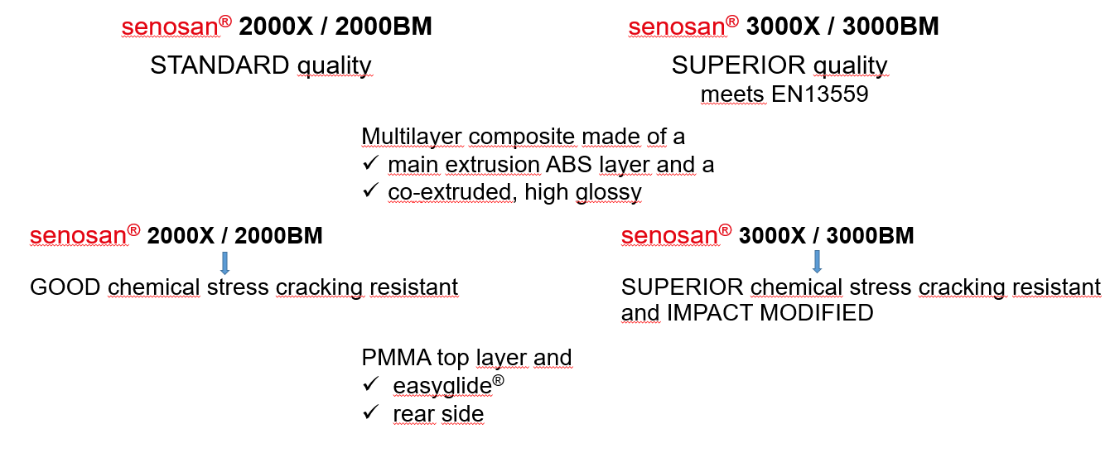
senosan® 2000/3000 – product overview

Slide 15
senosan® 2000/3000
improved chemical resistance
superior surface quality
outstanding thermoformability => easyglide® layer
superior processing behaviour during production
high impact resistance
low specific weight
ABS/PMMA: 1.10g/cm³ – 1.11g/cm³ depending on product
Cast acrylic: 1.18g/cm³ – 1.20g/cm³
recyclable

Slide 16

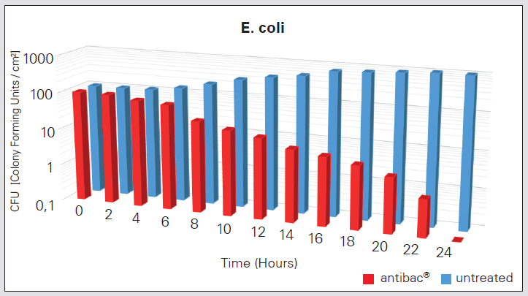
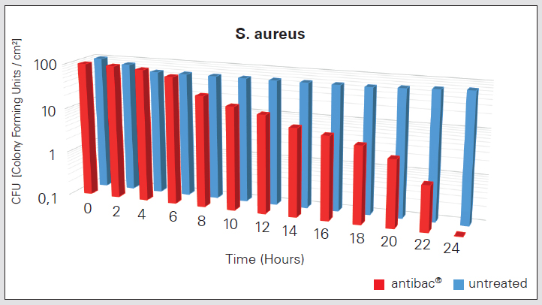
senosan® 2000/3000 antibac
One of the most outstanding properties of senosan® 2000/3000 antibac® sheet is the antimicrobial surface that is up to 99,99% germ free.
surface is protected from attack by microbes
the antimicrobial effect has been tested and confirmed in accordance with ISO 22196 by an independent certified institute

Slide 17
senosan® 2000/3000 – product overview
Available in
thickness of 2.0 to 6.0 mm senosan® 2000X/3000X respectively
thickness of 2.0 to 11.0 mm senosan® 2000BM/3000BM
width of 500-2400 mm
Products are also available with a PMMA rear layer.

Slide 18
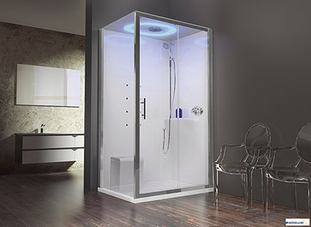
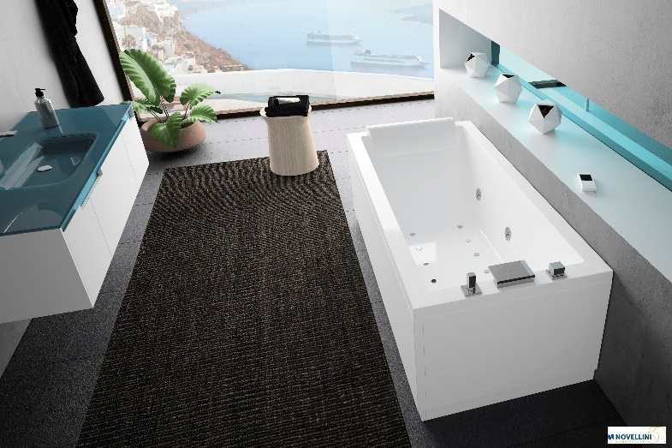
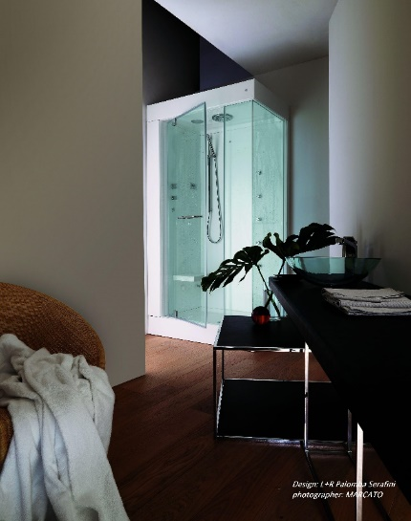
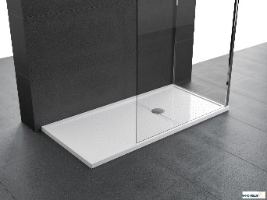
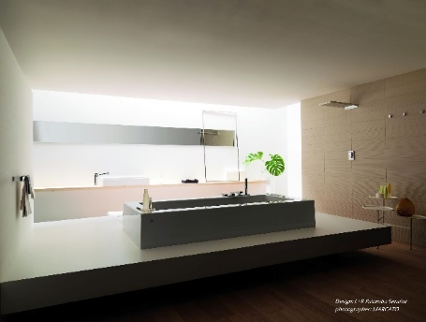
senosan® 2000/3000 – applications
senosan® 2000X / 3000X
shower trays
shower walls
shower cubicles
bath panels
hand wash basins
senosan® 2000BM / 3000BM
bath tubs

Slide 19
senosan® 2000/3000 – european sanitary norms and standards
EN 14516 Baths for domestic purpose
EN 14527 Shower trays for domestic purpose
specifications for baths and shower trays for domestic purpose, requirements for application and test procedure.
=> refers to finished part – not to sheet material!!

Slide 20
senosan® 3000 – european sanitary norms and standards
EN 15719 Baths made from impact modified coextruded ABS/acrylic sheets
for domestic purpose
EN 15720 Shower trays made from impact modified coextruded ABS/acrylic
sheets for domestic purpose
specifications for baths and shower trays for domestic purpose, requirements for application and test procedure.
=> refers to finished part – not to sheet material!!

Slide 21
senosan® 3000 – european sanitary norms and standards
EN 13559 Specifications for impact modified, coextruded ABS/acrylic sheets for
bath and shower trays for domestic purpose
Specifies properties of coxtruded ABS sheet with impact modified acrylic top from which baths and hower trays are manufactured.
Thickness, heavy metal content, colour, thermal stability, colour fastness (UV/hot water), chemical and stain resistance, resistance to wet and dry cycling, shrinkage, resistance to stress cracking.
=> refers to sheet material!!

Slide 22
senosan® 2000/3000 – chemical resistance
ESCR testing according to EN13559

Slide 23
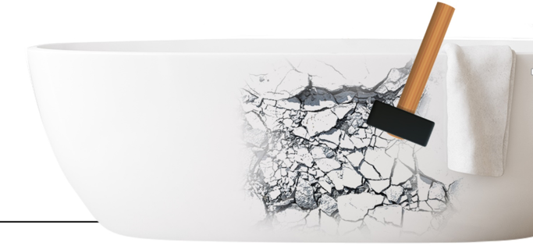
senosan® 2000/3000 – advantages compared to cast acrylic
lower reject rate during the production process
advantages during transport, installation and usage
senosan® multi-layer sheets are
substantially more impact reistant

Slide 24
senosan® 2000/3000 – potential saving
lower thermoforming temperature
cast acrylic 200°C – 220°C/ senosan® 170°C – 190°C
lower energy input compared to cast acrylic
shorter heating and cooling cycles
energy and time efficiency during production
thickness reduction => senosan® 2000BM and 3000BM are available in a thickness as of 2.0 mm (up to 11.0mm)
better thickness distribution due to easyglide®

Slide 25
senosan® X/BM SUPERMATT – product overview
Multilayer composite made of a
main extrusion ABS layer and a
co-extruded, matt, chemical and stress-cracking resistant, impact modified PMMA top layer and
easyglide® rear side
Available in
thickness of 2.0 to 11.0 mm senosan® X SUPERMATT respectively
thickness of 3.0 to 11.0 mm senosan® BM SUPERMATT and
a width of 400-2700 mm (depending on product and thickness)

Slide 26
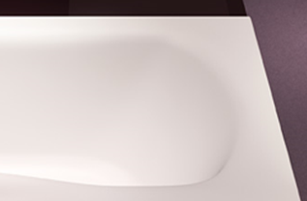
senosan® X/BM SUPERMATT – applications
various sanitary parts

Slide 27
senosan® X SUPERMATT embossed – product overview
Multilayer composite made of a
main extrusion ABS layer and a
co-extruded, matt, embossed, impact modified PMMA top layer and
easyglide® rear side
Available in
thickness of 2.0 to 6.0 mm
width of 400 – 1600 mm

Slide 28
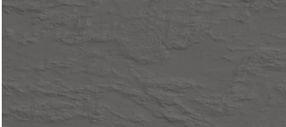

senosan® X SUPERMATT embossed – product overview
Available embossing:
007GR – STONE
002CA – CAMO

Slide 29
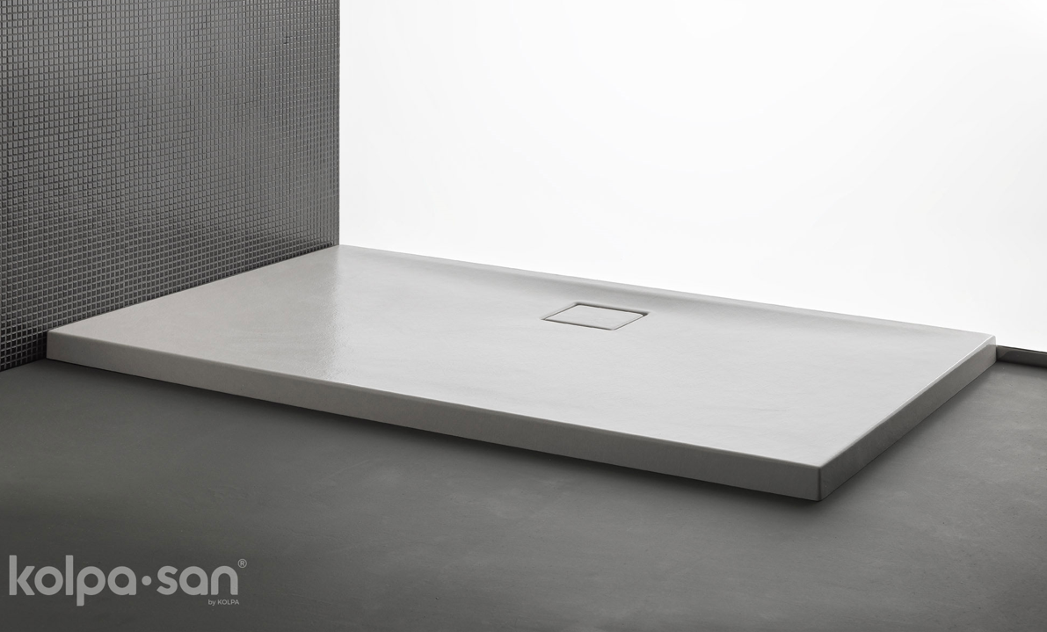
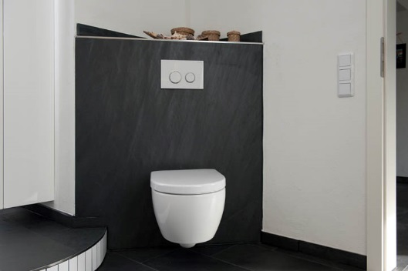
senosan® X SUPERMATT embossed – applications
wall liners
shower bases
shower trays

Slide 30
senosan® X SUPERMATT GRIP – product overview
Multilayer composite made of a
main extrusion ABS layer and a
co-extruded, matt, (embossed), impact modified PMMA top layer and
easyglide® rear side.
Available in
thickness of 2.0 to 6.0 mm
width of 400-1600 mm

Slide 31

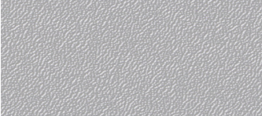

senosan® X SUPERMATT GRIP– product overview
Available embossing:
001SN - SAHARA
007GR - STONE
012RN - CORAL
smooth

Slide 32
senosan® X SUPERMATT GRIP– applications
shower bases
shower trays

Slide 33
senosan® X SUPERMATT – overview standards
DIN EN 16165 Determination of slip resistance of pedestrian surfaces –
Methods of evaluation – Annex
DIN 51097 Testing of floor coverings – Determination of the anti-slip properties – Wet-loaded barefoot areas – Walking method – Ramp test
(this standard is no longer valid since December 2021)

Slide 34
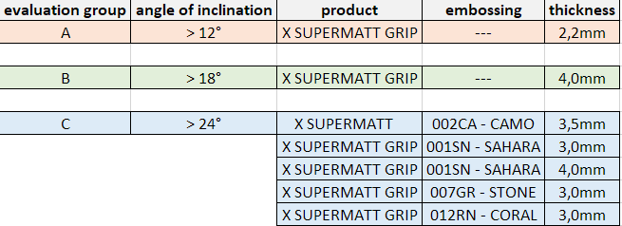
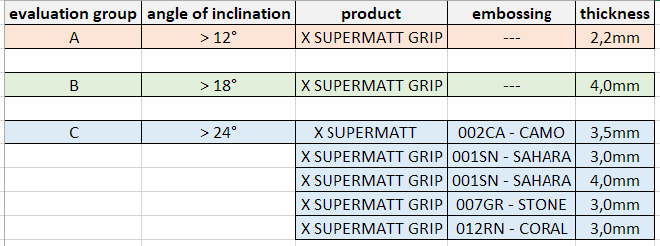
senosan® X SUPERMATT – overview standards
determination of anti-slip properties acc. to DIN EN 16165

Slide 35
senosan® aqua/metalix aqua – product overview
Multilayer composite made of a
main extrusion HI-ABS layer and a
co-extruded, high gloss, high chemical and stress-cracking resistant, impact modified and
UV-resistant PMMA top layer and
easyglide® rear side
Available in
thickness of 4.6 to 11.0 mm
width up to 2600 mm

Slide 36
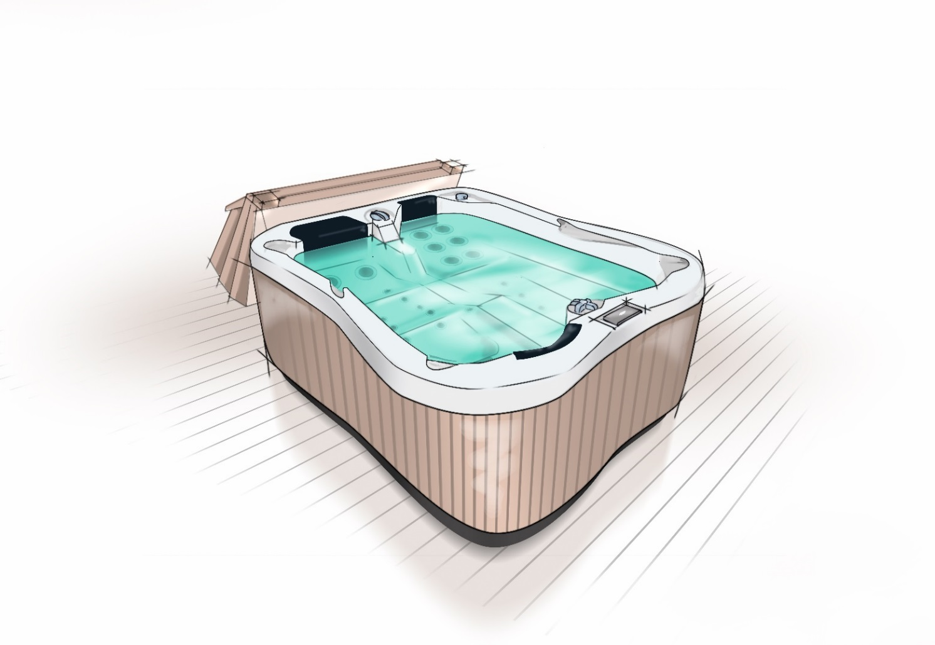
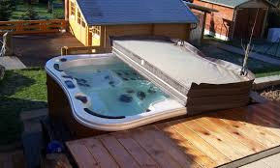
senosan® aqua/metalix aqua – applications
spas
hot tubs

Slide 37
senosan® AM50 (SOLAR) EG / AM50CM (SOLAR) EG – product overview
Multilayer composite made of a
main high impact ABS layer and a
co-extruded, high glossy, (UV resistant), impact modified PMMA top layer and
easyglide® rear side
Available in
white and light colours senosan® AM50 (SOLAR) EG respectively
metallic colours senosan® AM50CM (SOLAR) EG
a thickness of 2.0 to 8.0 mm
a width of 500-2200 mm

Slide 38
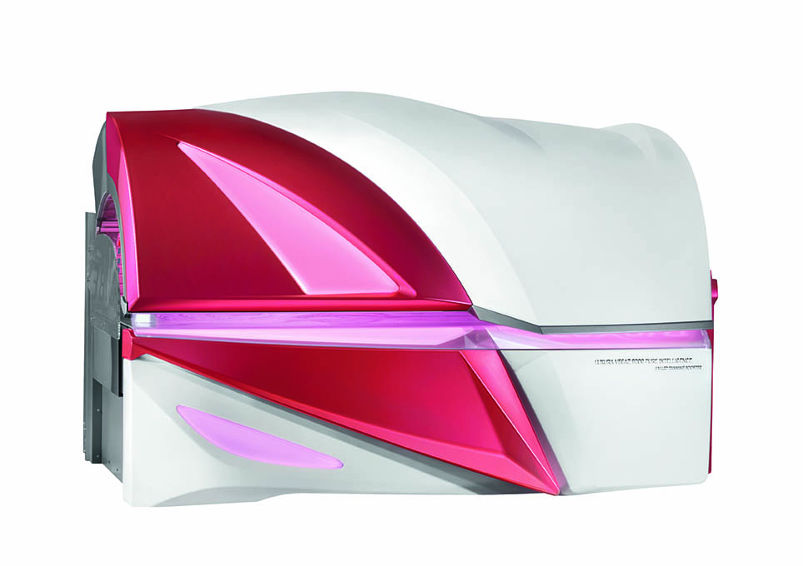
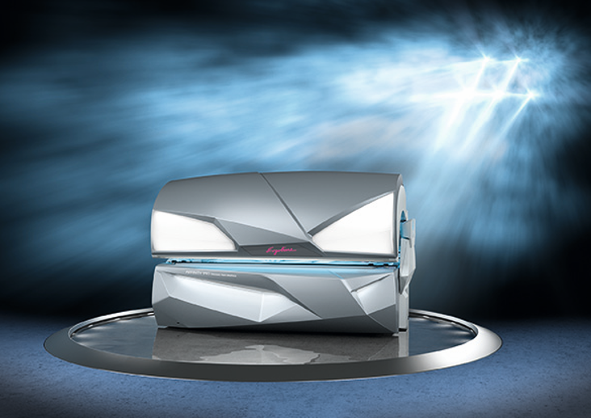
senosan® AM50 (SOLAR) EG / AM50CM (SOLAR) EG – applications
sun beds

Slide 39
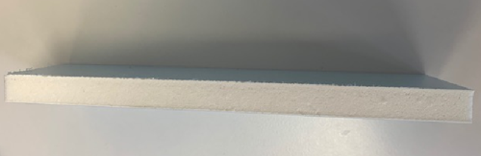
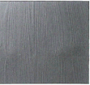
senosan® laminated furniture film for the bathroom

Slide 40
senosan® AM1800TopX / AM1800TopX MET. / AM1800TopMatt
Product overview
Coextruded, highly scratch and chemical resistant film with
high gloss surface senosan® AM1800TopX, AM1800TopX MET. Respectively
matt surface senosan® AM1800TopMatt
Available in
2 standard sizes (2440 x 1220 and 2800 x 1300mm) and
thickness of 0.5 – 0.8mm

Slide 41
senosan® TopX GLASS / TopMatt GLASS – Product overview
High quality surface with glass effect, giving the appearance of depth.
Available in
white 11022, white 11045, white 11145, beige 7516, beige 7529, green 5367, grey 85474, grey 85648, black 81122
2 standard sizes (2800 x 1300 x 2,0mm and 2440 x 1220 x 2,0mm)

Slide 42
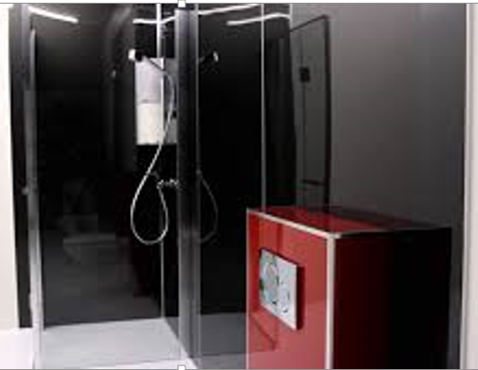
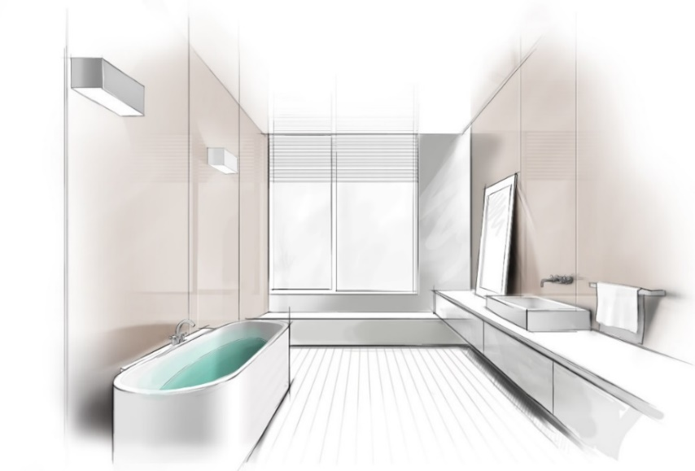
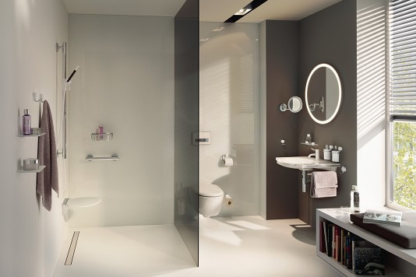
senosan® TopX GLASS / TopMatt GLASS senosan® AM1800TopX / AM1800TopX MET. AM1800TopMatt
APPLICATIONS
flat lamination

Slide 43


senosan® - Sustainability
senosan® sheets are 100% recyclable, helping to
protect the environment
clean production scrap can be recycled in the extrusion
and injection moulding process => monetary gain

Slide 44
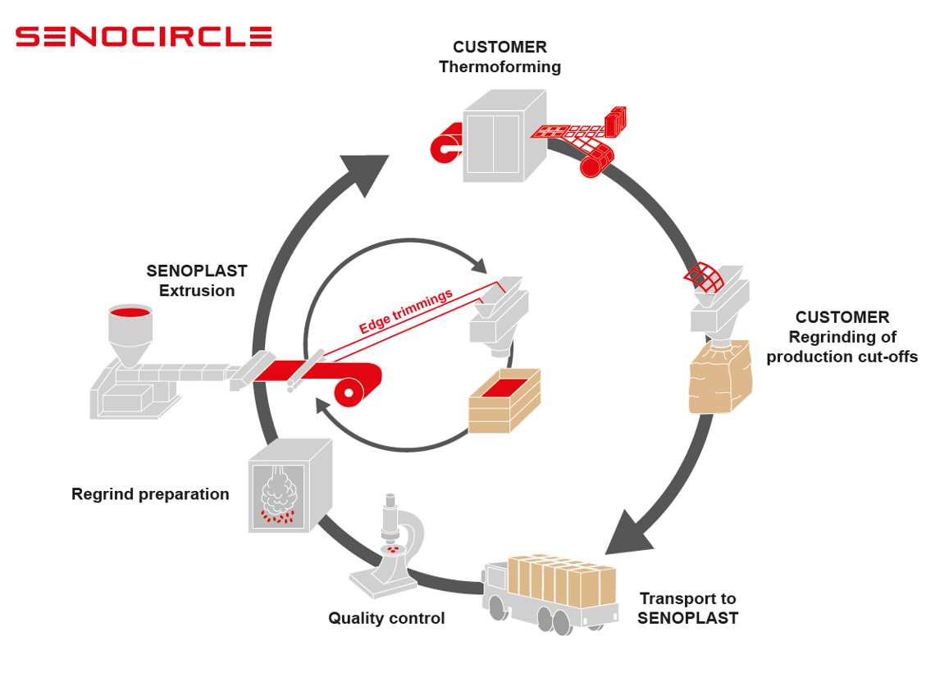
senosan® - Sustainability

Slide 45

MADE TO FORM THE FUTURE
03/2024
© Senoplast

