Slide 1
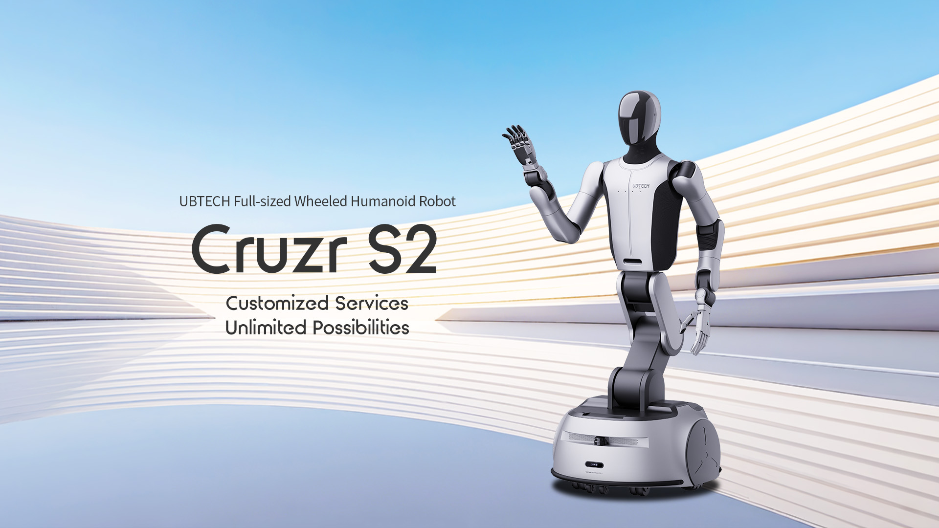

Slide 2
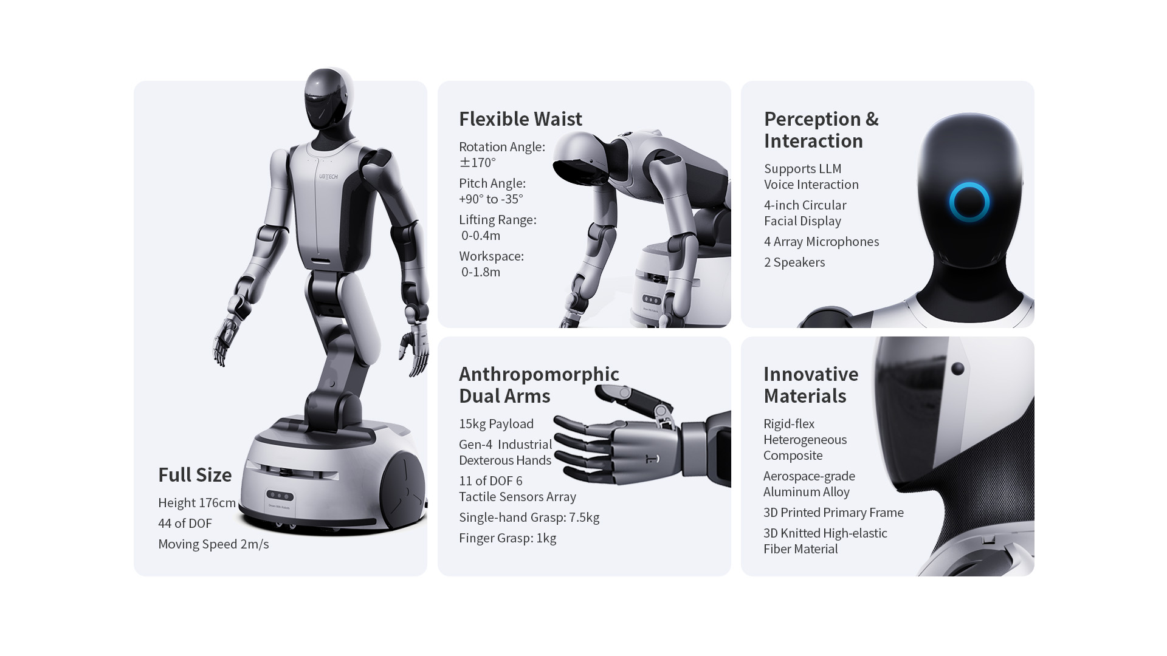

Slide 3
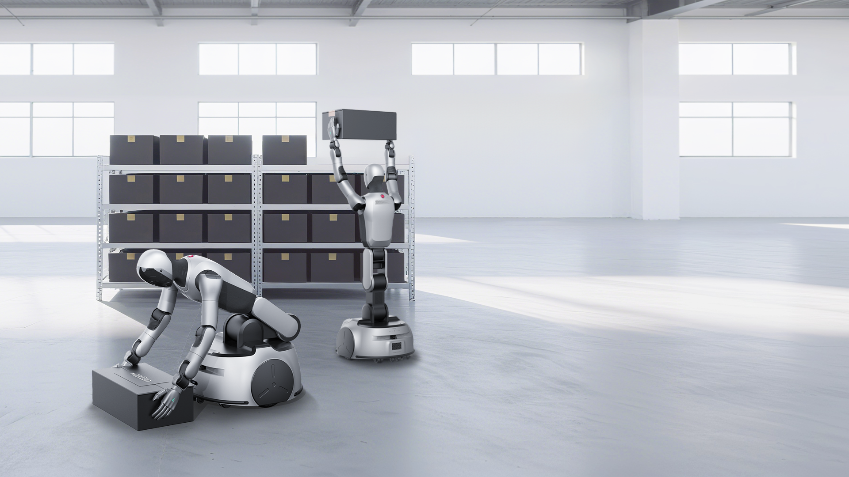
Human-like Dynamic Balancing
Full Spatial Range Handling
Featuring symmetrical body design with bidirectional bending function, Cruzr S2 can rotate ±170° angle within 0.8m passages. Its 0-40cm lifting range design enables Cruzr S2 to handle 15kg payload across 0-1.8m workspace.

Slide 4
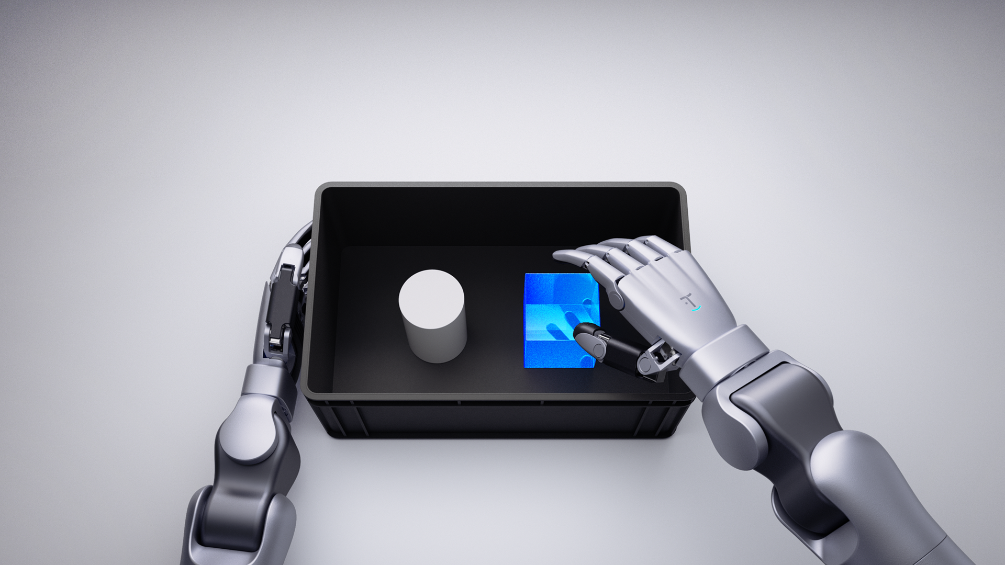
Dexterous Manipulation and Precise Operation
Powered by sim-to-real embodied intelligent data system, Cruzr S2 integrates gen-4 industrial
dexterous hands, achieving sub-millimeter manipulation in sorting, component assembly,
and other multi-scenario grasping operations.

Slide 5
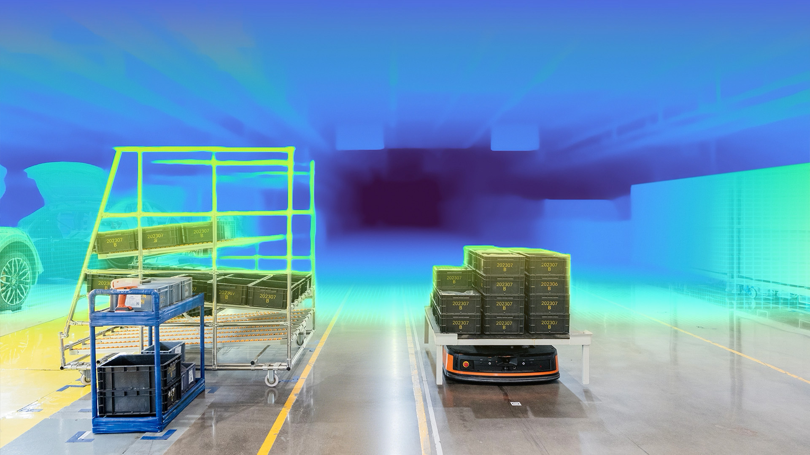
"Human-eye" Binocular Stereo Vision Perception
The pure RGB binocular stereo vision solution is built in Cruzr S2's head. The self-developed passive binocular vision system employs deep learning-based stereo depth estimation algorithms to generate high-precision, left-aligned dense depth maps in real-time. This enables Cruzr S2 to achieve "human-eye" stereoscopic perception capabilities.

Slide 6
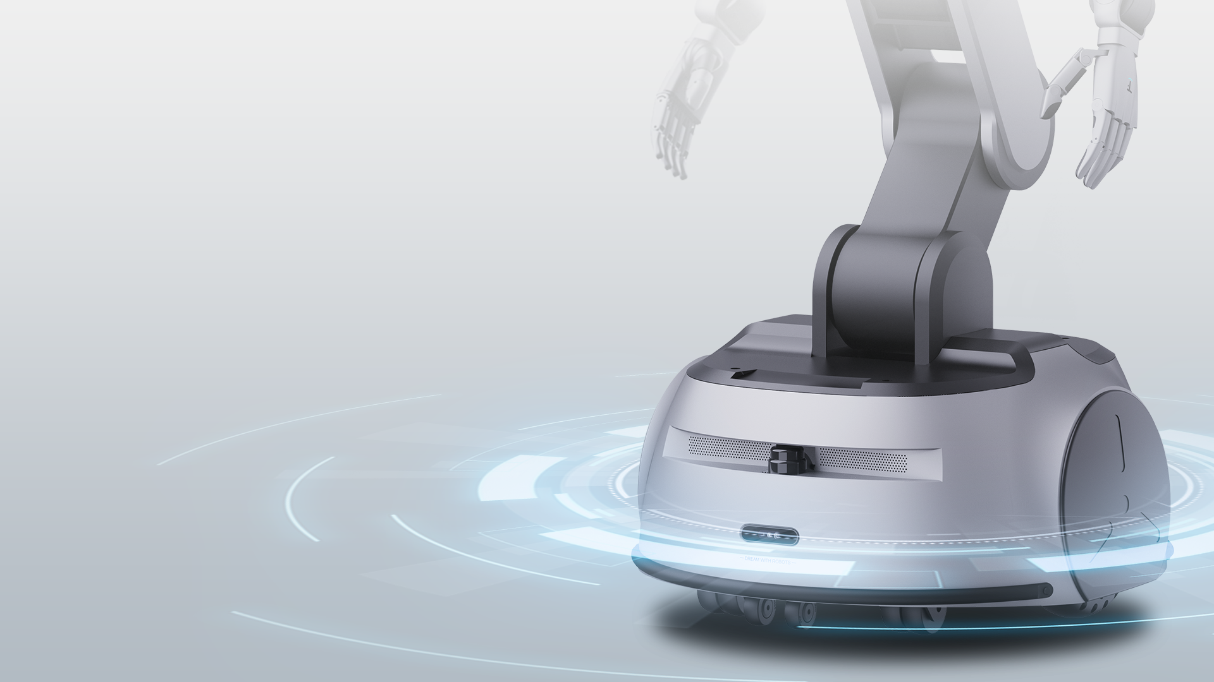
Complex Terrain Adaptability
Human-Robot Collabration Safety
With build-in learning-based motion control technology, Cruzr S2 is able to move with the speed of 2m/s and achieve self-balanced ability in complex terrain, ensuring human-robot collabration safety.

Slide 7
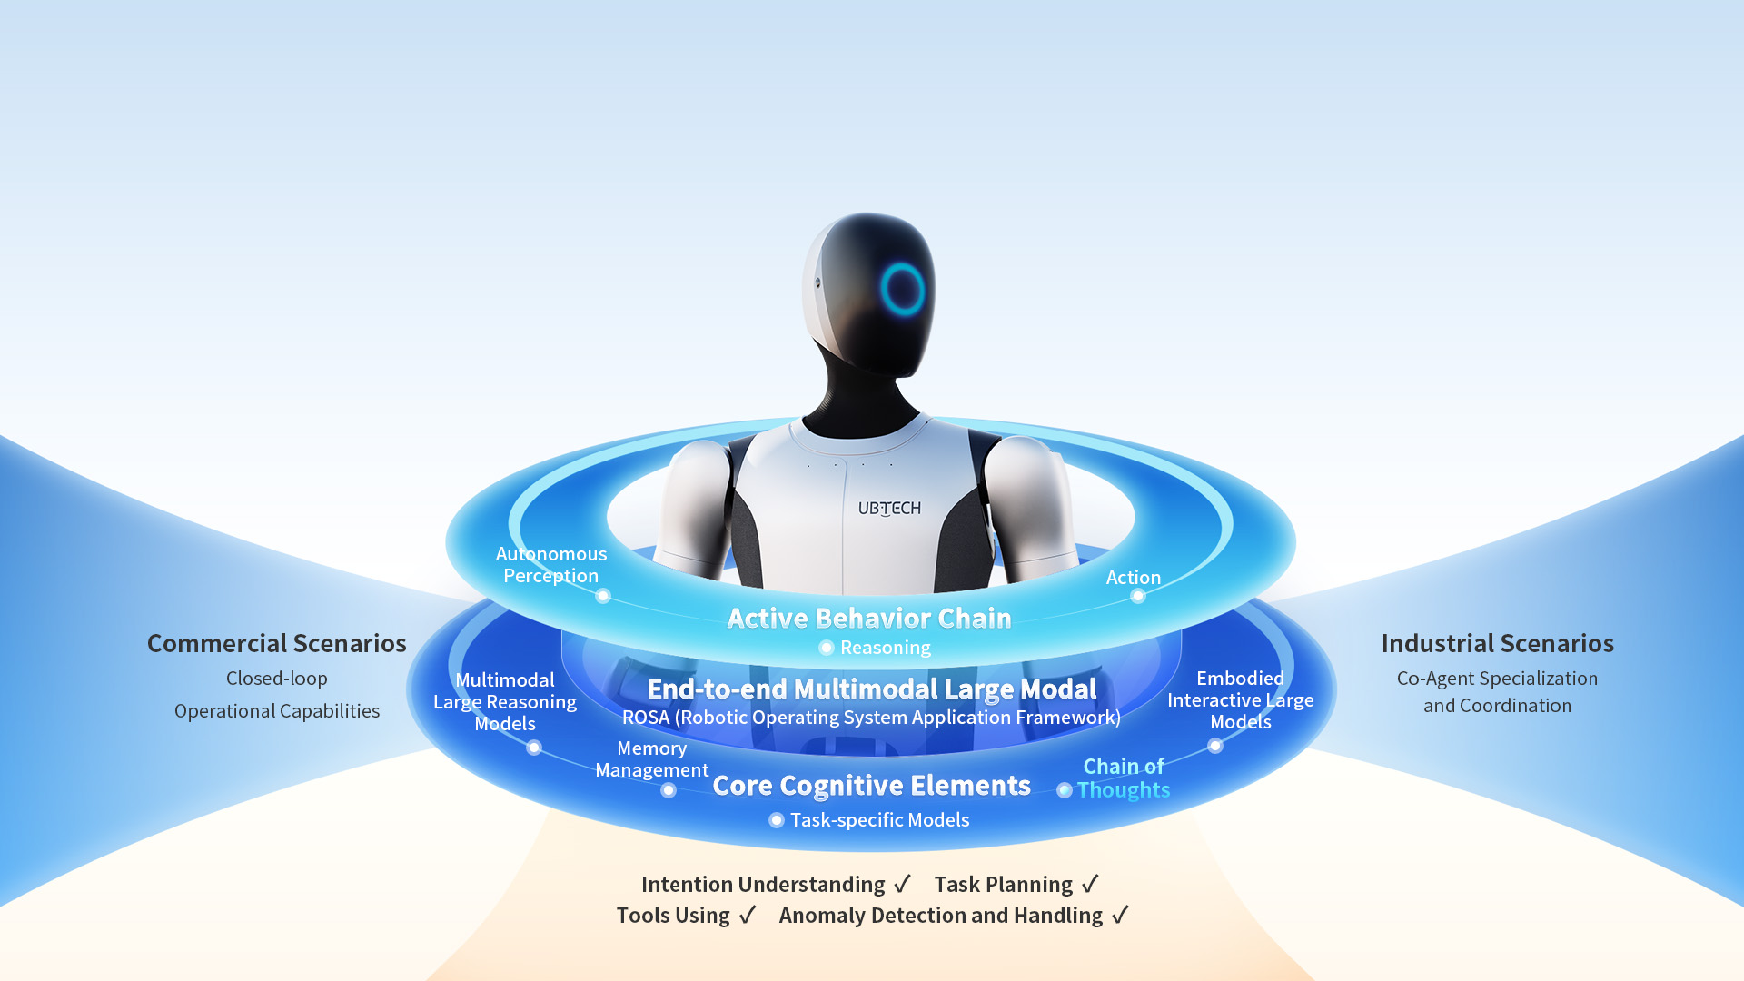
UBTECH's Self-developed Co-Agent
The World's First Industrial Agent for Humanoid Robot

Slide 8
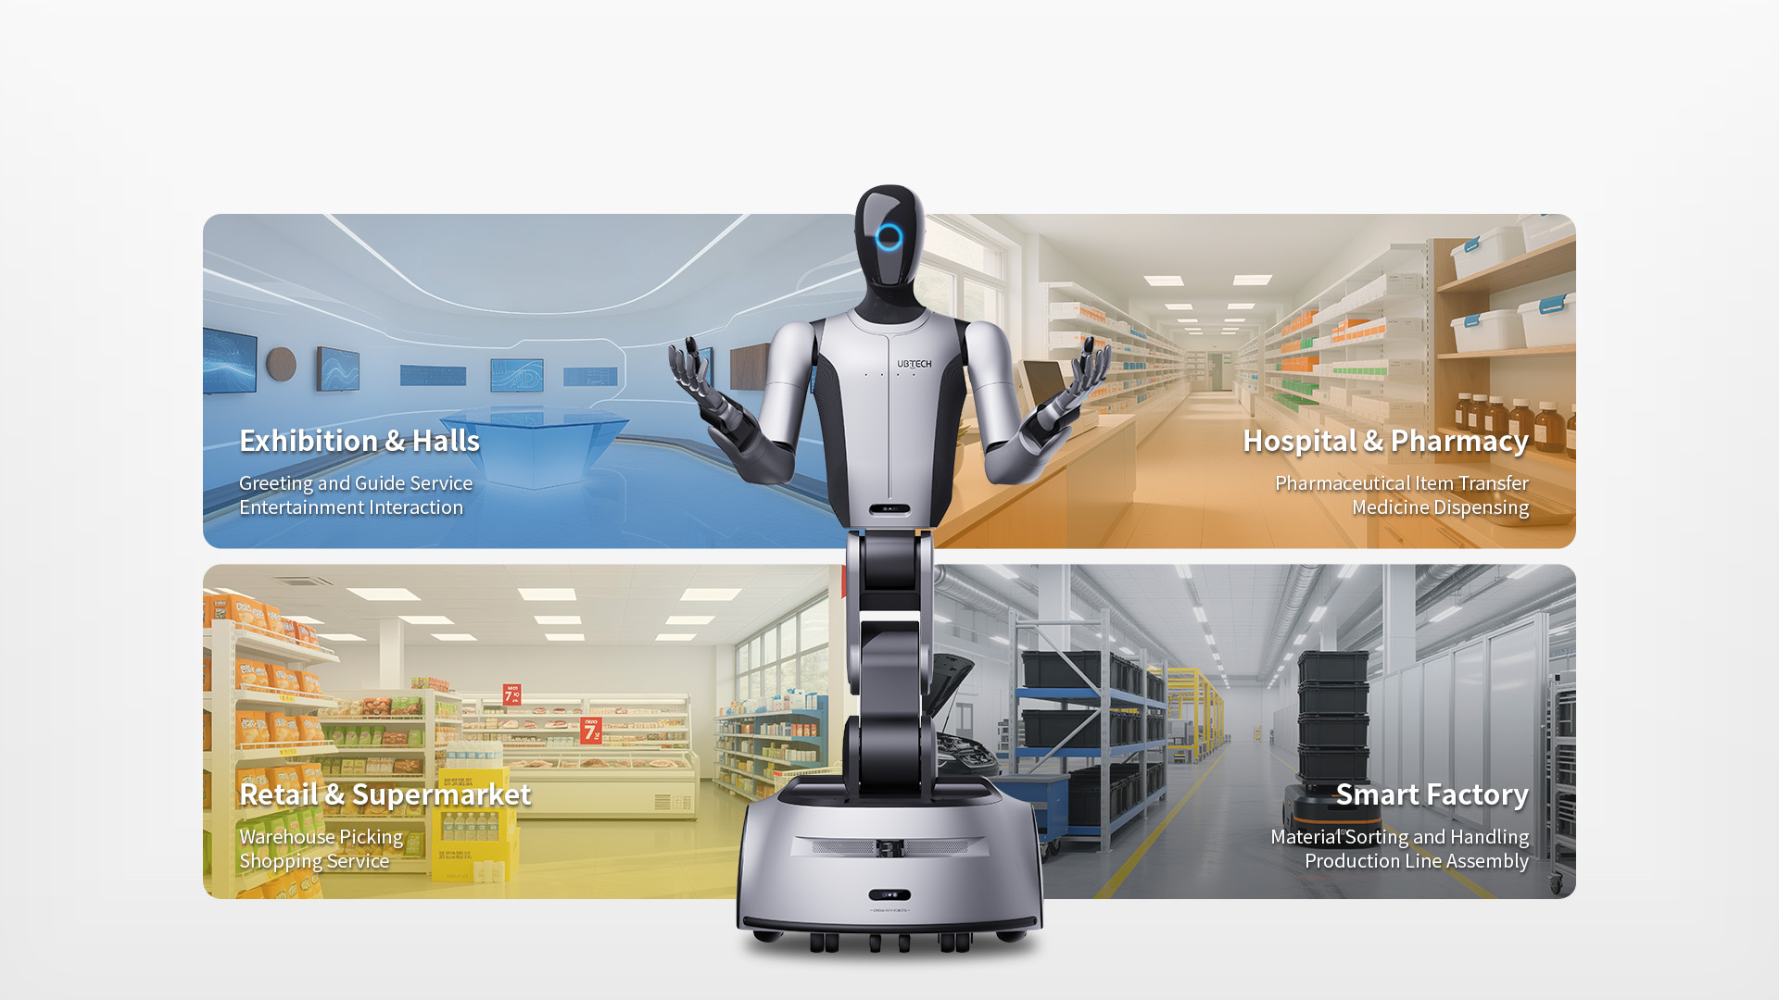
Application Scenarios
Meets multi-scenario operational demands, improves enterprise efficiency and acheives high-quality industrial development.

Slide 9
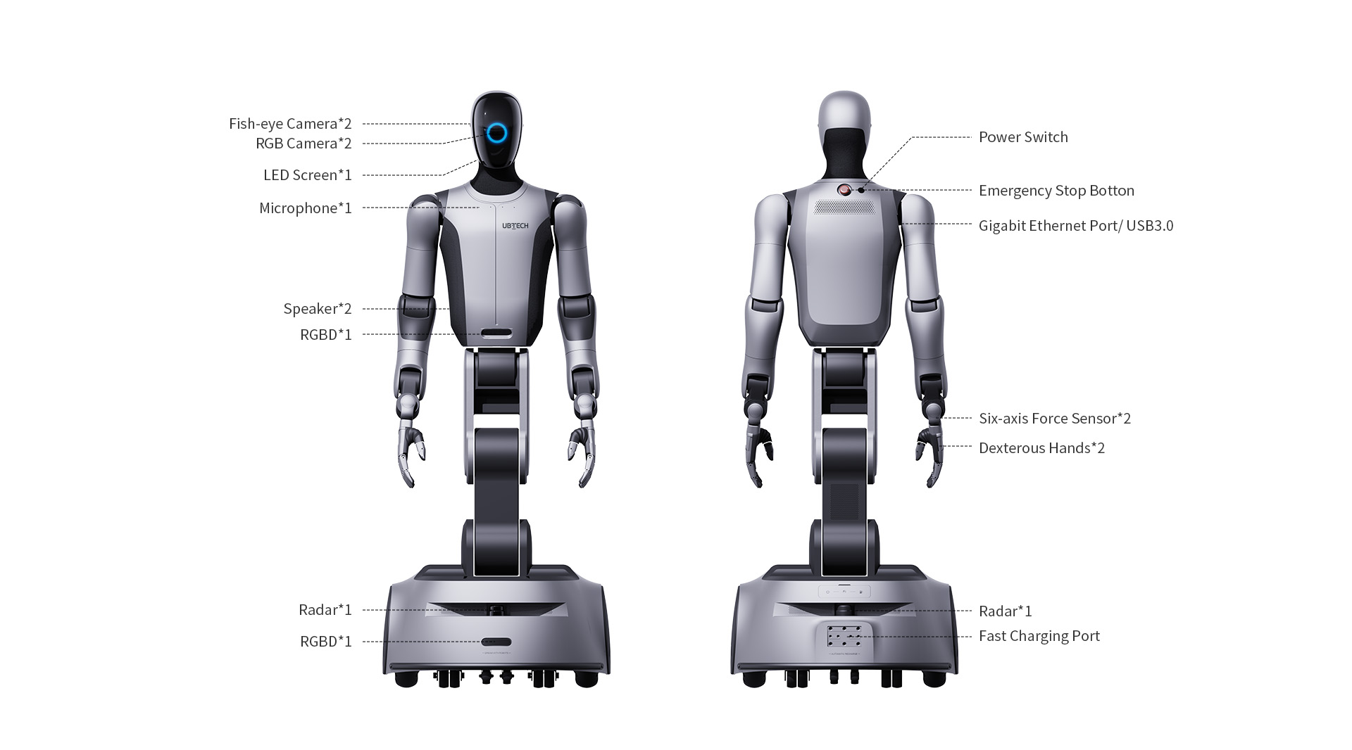

Slide 10
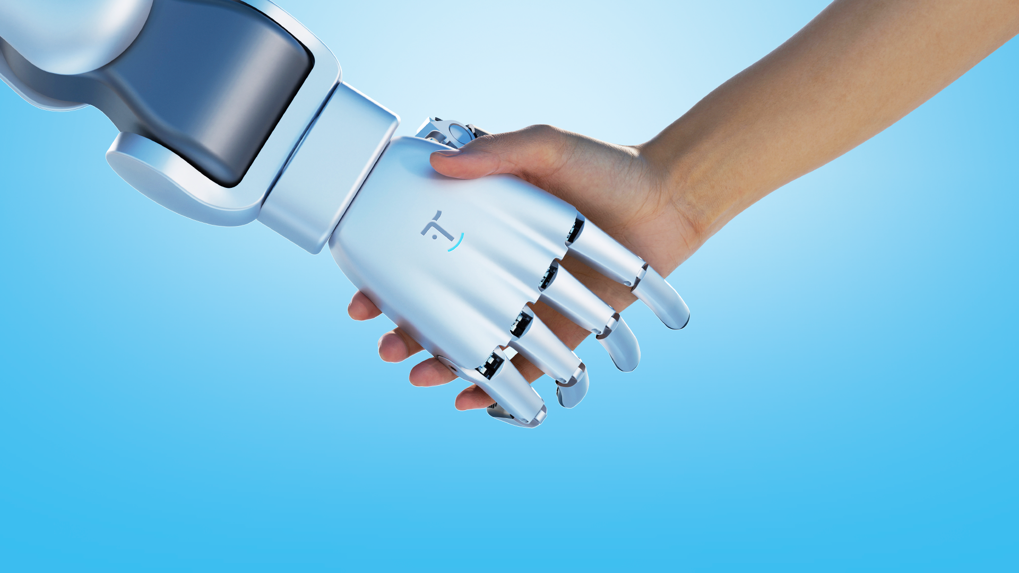
Dream with Robots

