Slide 1


Introduction to Design Thinking
Fall in love with the customer
September 2026

Slide 2

Professor of Strategy, Marketing and Entrepreneurship
Business Transformation Strategist
Innovation Leader, Marketing Expert
LinkedIn: Liliana Caimacan

Slide 3


TODAY’S WORLD IS COMPLEX

Slide 4


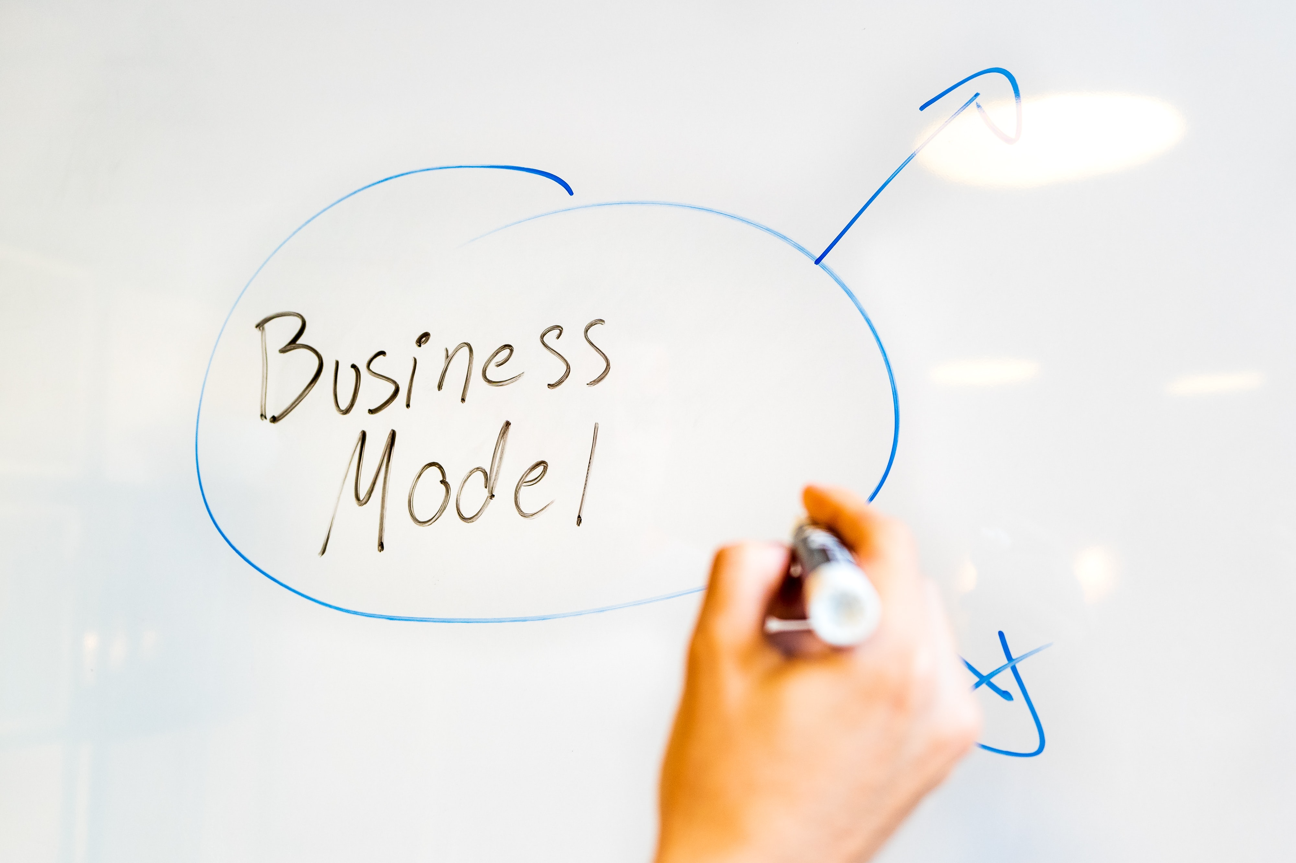
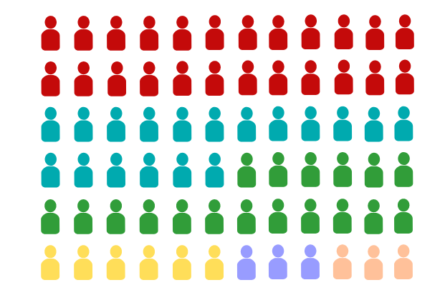


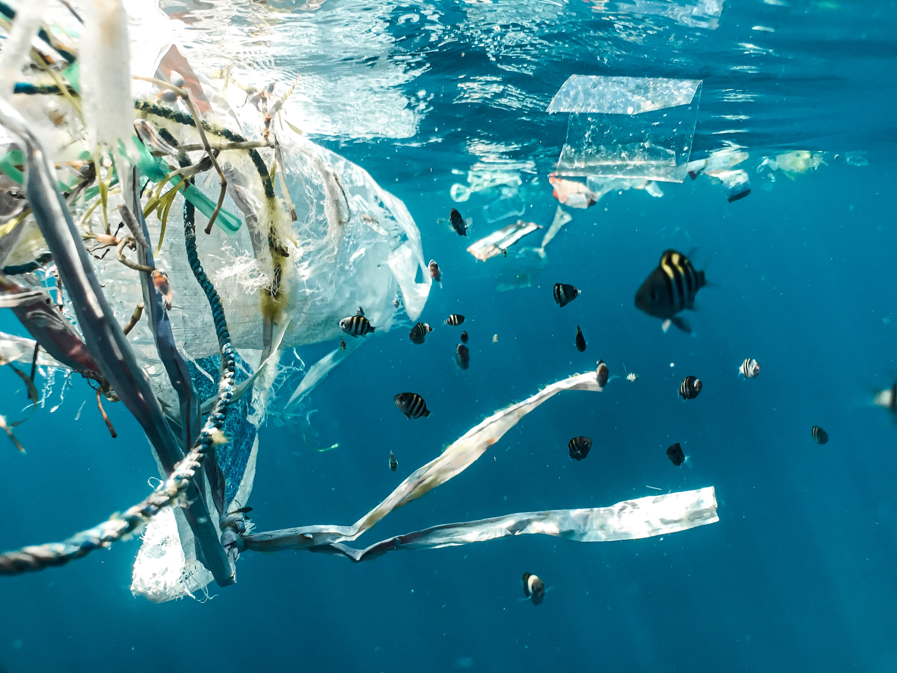
New trends are shaping the future in the face of uncertainty
Pervasive impact of digitization
Reduced barriers to entry
Hyper-segmentation
Intense cost competition
Inequality amid globalisation
Environment front and centre

Slide 5
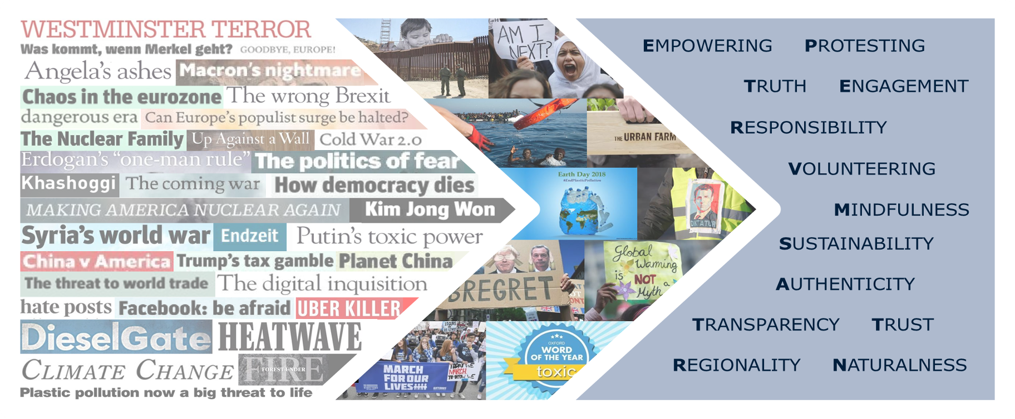
Global Environment
The current uncertain framework leads to more & more empowered humans' takeover responsibility

Slide 6
What is Design Thinking?
Why Shall we Apply it?

Slide 7
What is Design Thinking?
Design Thinking
An iterative 5-step process that leads to effective development of solutions that will help us solve the customer pain points
Human-Centered Design
A mindset that creates a positive, long-term impact for the users of the solution.

Slide 8
How the design thinking journey works…
Design thinking is a human-centred & collaborative approach to problem-solving that is creative, iterative & practical.
- Tim Brown, 2008

Slide 9
What is Design Thinking?
Design Thinking
An iterative 5-step process that leads to the effective development of products/solutions that will be adopted by the desired end beneficiary.
Human-Centered Design
A mindset and tool to be applied alongside Design Thinking that creates a positive, long-term impact for the users of the solution.

Slide 10
Design Thinking – 5-step process
Define
Prototype
Empathies
Ideate
Test

Slide 11
Design Thinking – 5 steps process
Define
Prototype
Design a PROTOTYPE to test your solution
Articulate the CHALLENGE you want to solve
Empathize
Ideate
Test
Engage a continuous short-cycle VALIDATION process to improve your design
Develop a deep understanding of the CUSTOMER
BRAINSTORM relevant and engaging solutions

Slide 12
Design Thinking – an iterative process
Define
Define
Prototype
Prototype
Empathies
Empathies
Test
Ideate
Test
Ideate

Slide 13
Users
Desirability
Design Thinking
- a process for creative problem solving
Market
Technology
Innovation
Viability
Possibility

Slide 14
The 4 Principles of Design Thinking
THE AMBIGUITY RULE
THE HUMAN RULE
Ambiguity is inevitable - experiment at the limits of your knowledge.
All design activity is social in nature.
ALL DESIGN IS REDESIGN
THE TANGIBILITY RULE
While technology and social circumstances may change, basic human needs remain unchanged.
Prototypes help to make ideas tangible, enabling designers to communicate them effectively.

Slide 15
Why study design thinking?
228%
stock performance of design-driven companies over the S&P.
Source: Harvard Business Review
83%
of design-led companies have seen market share increases at twice the average.
Source: UK Design Council
50%
of design-led companies report a relatively more loyal customer base.
Source: Adobe

Slide 16

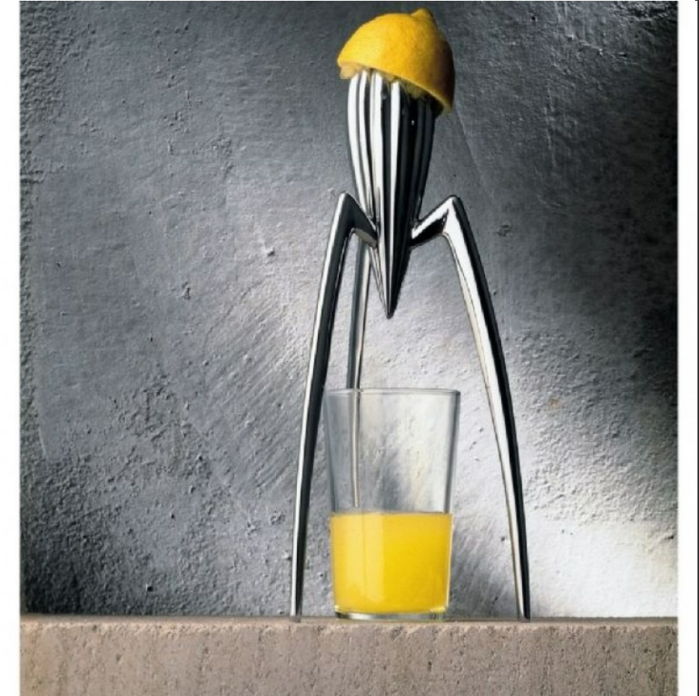
Citrus squeezer
• Diameter (cm): 14.00
• Height (cm): 29.00
• Price ($): 105.00
• Designer: Philippe Starck („Alessi is a merchant of happiness” + „My juicer is not meant for squeezing lemons. It is meant to start conversations ”)
• A 25-YEAR-OLD ICON

Slide 17
Why engage in Human-Centered Design?
  It can help organizations connect better with people they serve
  It can transform data into actionable ideas
  It can help identify new opportunities
  It can help to increase the speed and effectiveness of creating new solutions
  It can bring happy customers, who will stay loyal

Slide 18
Design Thinking Frameworks

Slide 19
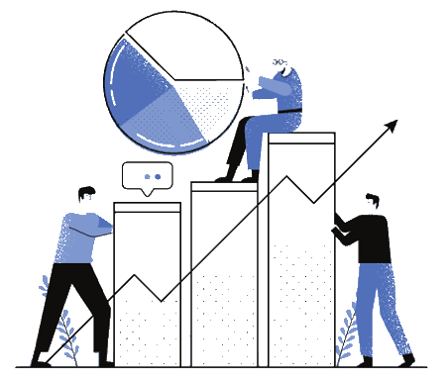
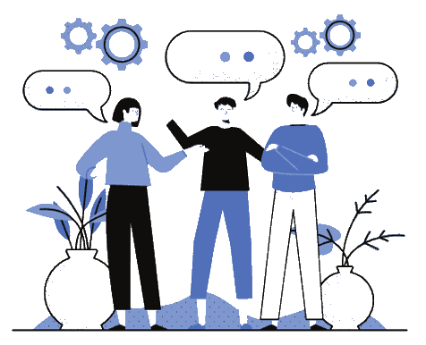
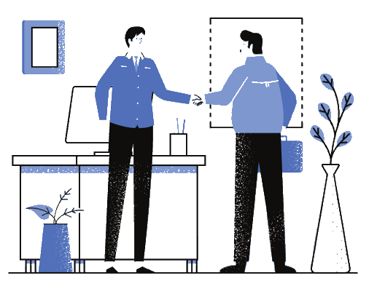
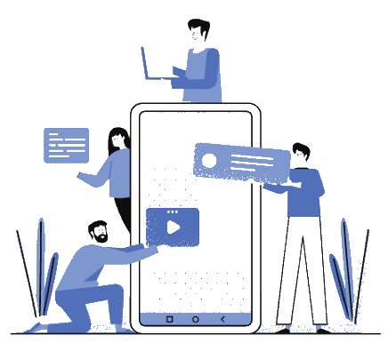
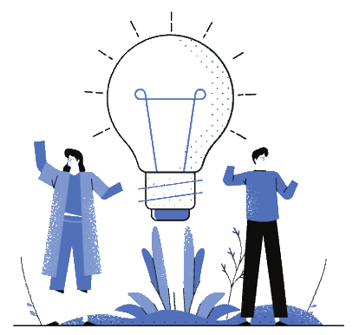
Use Double Diamond Design Thinking Framework to transform Value Opportunities into Disruptive Solutions through
Mindset Change
Market Conditions
Behavioral Trends
Demand Spaces
Consumer Segments
Consumer Understanding
Empathy Mapping
Concept Testing & Prototyping
Re-engineering
Solution
Development

Slide 20
Design Thinking DOUBLE DIAMOND Framework
Doing the right things
Doing things right

Slide 21
Doing the right things
Discover
Define
Develop
Deliver
Research Phase
Synthesis Phase
Ideation Phase
Implementation Phase
Diverging
Conduct
Primary
Resarch
Converging
Diverging
Set ideas,
a Design Vision
& Hypotheses
Converging
Do know
Should be
A
Define research
areas and methods
Deduce Opportunity Areas
Release & Out
Rip the brief
Build Themes & Clusters
Form HMW Questions
Build, Iterate & Repeat
Find Insights
Prorotype, Test & Analyse
Ideate
Evaluate 1st ideas
Learn, Iterate & Repeat
B
Don’t know
Could be
Conduct
Secondary
Resarch
Set ideas,
a Design Vision
& Hypotheses
Question,
Challenge,
Client Brief
Unstructured
Research
Findings
Final Brief,
HMW-Question,
Strategy
First Ideas and visions,
Potential solutions,
Hypothetical answers
Answers,
Product,
Solution

Slide 22
Doing the right things
Doing things right
Discover
Define
Develop
Deliver
Research Phase
Synthesis Phase
Ideation Phase
Implementation Phase
Diverging
Conduct
Primary
Resarch
Converging
Diverging
Set ideas,
a Design Vision
& Hypotheses
Converging
Do know
Should be
A
Define research
areas and methods
Deduce Opportunity Areas
Release & Out
Rip the brief
Build Themes & Clusters
Form HMW Questions
Build, Iterate & Repeat
Find Insights
Prorotype, Test & Analyse
Ideate
Evaluate 1st ideas
Learn, Iterate & Repeat
B
Don’t know
Could be
Conduct
Secondary
Resarch
Set ideas,
a Design Vision
& Hypotheses
Question,
Challenge,
Client Brief
Unstructured
Research
Findings
Final Brief,
HMW-Question,
Strategy
First Ideas and visions,
Potential solutions,
Hypothetical answers
Answers,
Product,
Solution

Slide 23
Doing the right things
Doing things right
Discover
Define
Develop
Deliver
Research Phase
Synthesis Phase
Ideation Phase
Implementation Phase
Diverging
Conduct
Primary
Resarch
Converging
Diverging
Set ideas,
a Design Vision
& Hypotheses
Converging
Do know
Should be
A
Define research
areas and methods
Deduce Opportunity Areas
Release & Out
Rip the brief
Build Themes & Clusters
Form HMW Questions
Build, Iterate & Repeat
Find Insights
Prorotype, Test & Analyse
Ideate
Evaluate 1st ideas
Learn, Iterate & Repeat
B
Don’t know
Could be
Conduct
Secondary
Resarch
Set ideas,
a Design Vision
& Hypotheses
Question,
Challenge,
Client Brief
Unstructured
Research
Findings
Final Brief,
HMW-Question,
Strategy
First Ideas and visions,
Potential solutions,
Hypothetical answers
Answers,
Product,
Solution

Slide 24
Doing the right things
Doing things right
Discover
Define
Develop
Deliver
Research Phase
Synthesis Phase
Ideation Phase
Implementation Phase
Diverging
Conduct
Primary
Resarch
Converging
Diverging
Set ideas,
a Design Vision
& Hypotheses
Converging
Do know
Should be
A
Define research
areas and methods
Deduce Opportunity Areas
Release & Out
Rip the brief
Build Themes & Clusters
Form HMW Questions
Build, Iterate & Repeat
Find Insights
Prorotype, Test & Analyse
Ideate
Evaluate 1st ideas
Learn, Iterate & Repeat
B
Don’t know
Could be
Conduct
Secondary
Resarch
Set ideas,
a Design Vision
& Hypotheses
Question,
Challenge,
Client Brief
Unstructured
Research
Findings
Final Brief,
HMW-Question,
Strategy
First Ideas and visions,
Potential solutions,
Hypothetical answers
Answers,
Product,
Solution

Slide 25
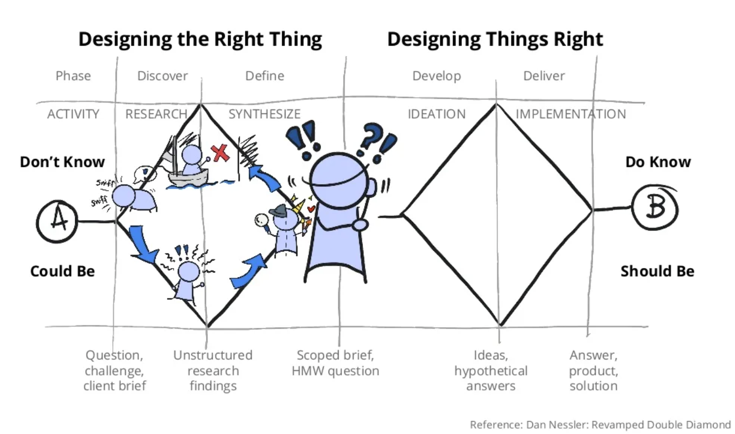

Slide 26

Who is your CUSTOMER?

Slide 27
When your customer is everybody.
Your customer is nobody.

Slide 28
Start by falling in love with the customer
Empathy is the foundation of human-centered design.
Build empathy for your users by learning their values
Understand their pain points and expected gains
The challenges you’re trying to solve are rarely your own

Slide 29
Who is the human behind the name?
OBSERVE: View people and their behavior
ENGAGE: Interact with the person
IMMERSE: Wear your customer shoes.
Experience what they experience

Slide 30
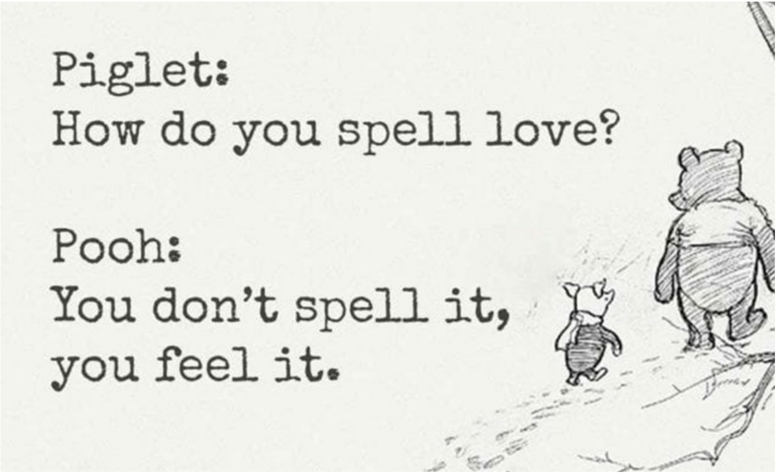

Slide 31
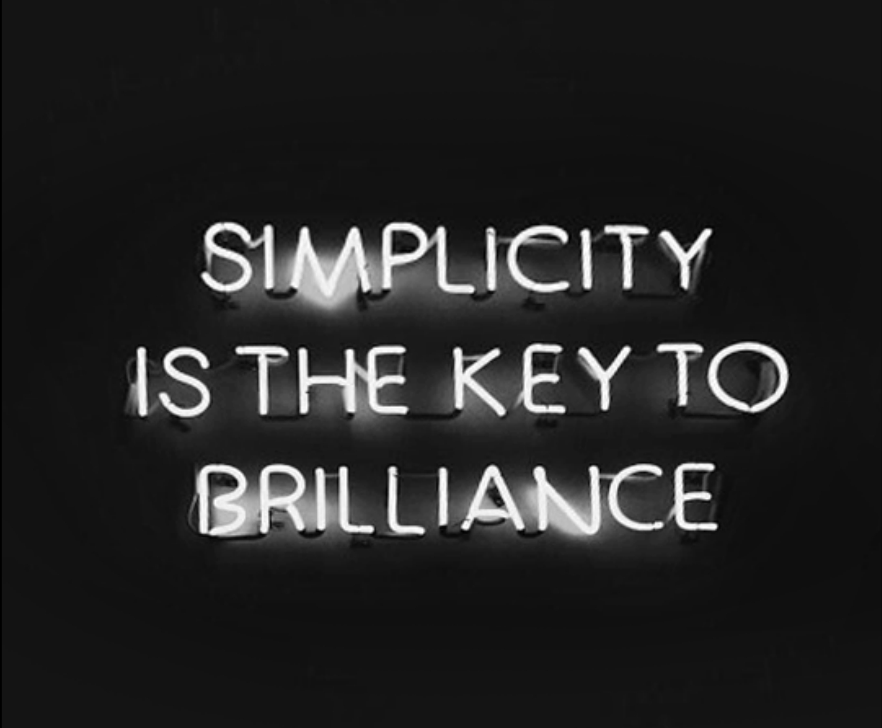

Slide 32


