Slide 1
Market Analysis
Prof. Liliana Caimacan

Slide 2

LILIANA CAIMACAN
Professor of Marketing and Entrepreneurship
Business Transformation Strategist
Innovation Leader, Marketing Expert
Liliana.Caimacan@faculty.hult.edu
LinkedIn: Liliana Caimacan

Slide 3
Market Analysis ➔ WHAT?
Consumer insight ➔ WHY?

Slide 4
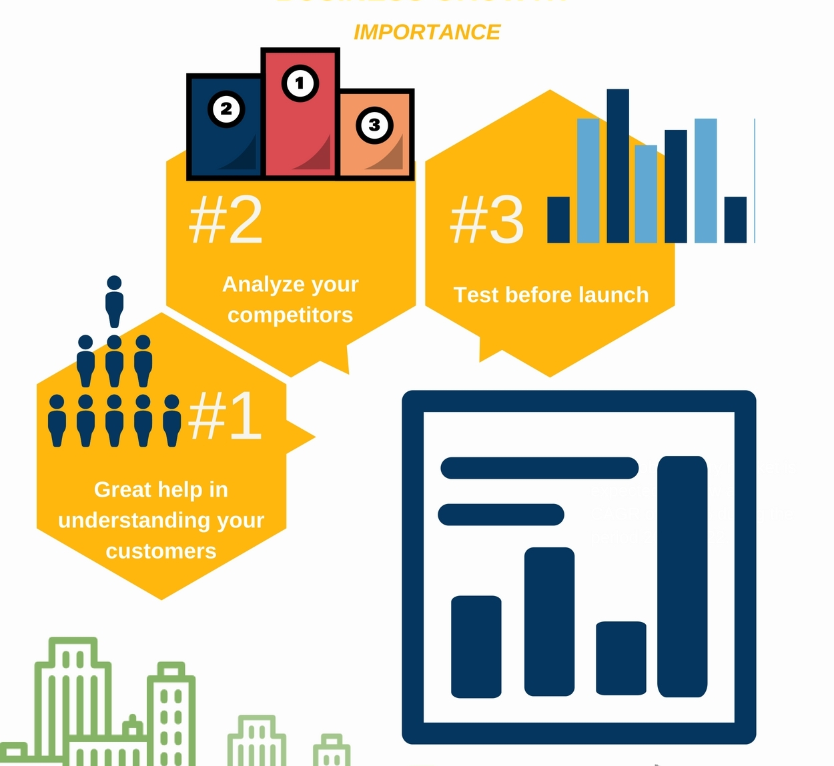
Why is the analysis of a market important?
You are up to date with what is going on with your competitors, customers, market trends, etc
It is a basis for developing better communications with your customers.
You can see different opportunities.
You know what is your reputation.
You can make better business and marketing decisions and strategies.
Forecasting sales for new markets

Slide 5

What Is a Market Analysis?
A market analysis is the process of learning everything you can about your target market
The market analysis is a process of assessment and determining different factors and conditions in a market within a special industry.
Notes:
It’s like doing your homework to prepare before launching and growing your business.
You don’t want to enter a market without knowing who you’re serving, who you’re competing with, and what’s happening in your industry.
That’s a recipe for failure.
Instead, you want to do your research to gather as much data and insight as possible.
You need to clearly know and sense what your customers want, what your competitors do, what is the size of the market, its growth trends, what critical and legal issues you have to face and there are many other questions you must know the answers. In addition, the market analysis is a key part of your business plan and overall strategy.

Slide 6

How to Do a Market Analysis
Determine the Purpose of Your Analysis
Research Your Market’s Overall Landscape
Get to Know Your Target Audience
Analyze the Competition
Perform a SWOT Analysis
Put Your Findings to Work
TAM SAM SOM
Demographics, Psychographic, Geographic, Sociographic
Battle Cards
USPs and Marketing Mix
Notes:
Determine the Purpose of Your Analysis
First off, take a moment to ask yourself why you’re doing this analysis.
Is it because you’re launching a new product and need to evaluate the whole market landscape?
Or maybe you’ve already launched your product but are now looking to find the best channels for marketing.
Your purpose could be related to anything you want to learn about. And it's going to shape your entire analysis

Slide 7
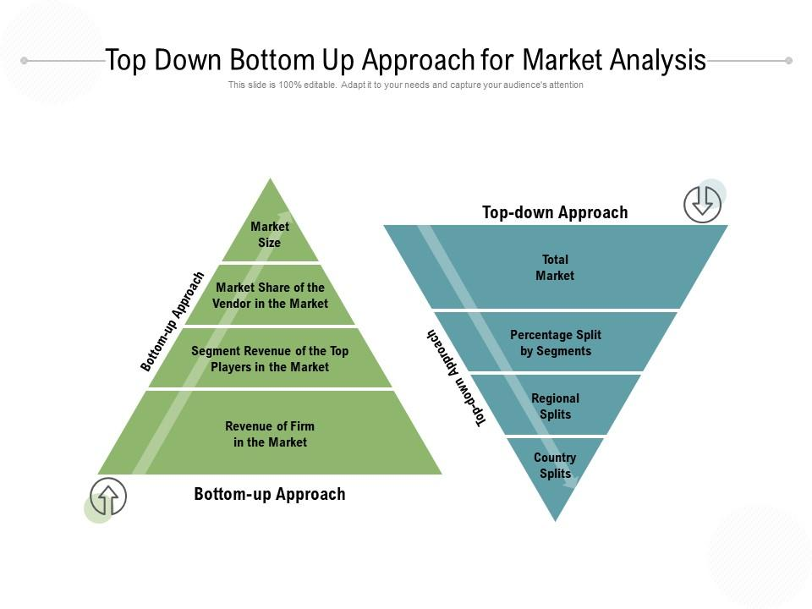
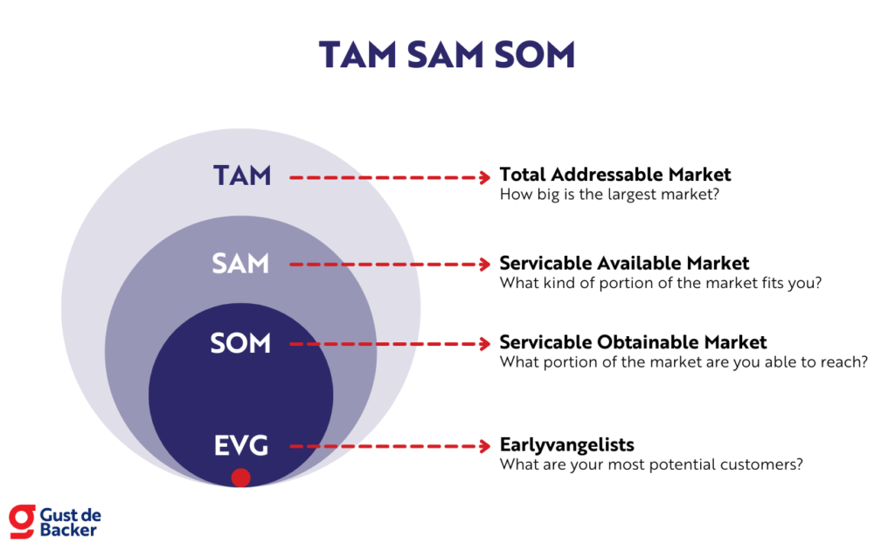
Understanding Key Dimensions of Market Analysis
Market Size
This is the number of people or organizations who are the potential buyers and sellers of a given product/service.
Ever thought/heard questions like:
How big is the used mobile phone market in the UK ?
What is the market opportunity if you introduce a new clothing line ?
What is the market opportunity of launching a cab aggregator in the UK? How did Bolt grew against Uber
Notes:
Many businesses aim to find an as bigger market as possible. And it is a good goal but keep in mind that the bigger market size means also more competitors. So, you need to know how to be better than them.

Slide 8
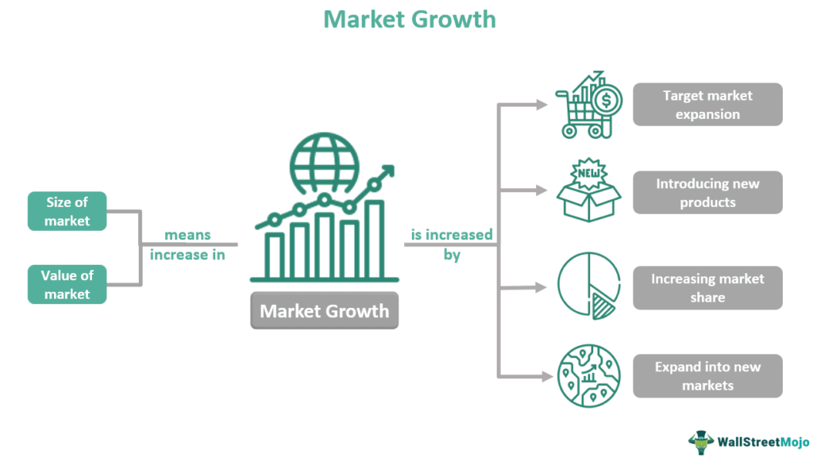
Understanding Key Dimensions of Market Analysis
How to measure market growth?
For estimating the growth you can use indicators such as the year-to-year trend in the industry, the trend in the number of customers, the size of purchases per client etc
Market Growth Rate
The increase in size or/and sales within a particular target market over a given period of time.
Notes:
The fact that market has a size doesn’t mean the size will be always the same. As everything in this world, market size changes and in some industries the changes are dramatically fast and enormous.
Market growth has a crucial role in your business, so you need to know how fast is the growing, what is the market growth potential, is the market increase or decrease and etc.
The market growth rate is also the basic information investors need before making an investment decision. If it is likely to grow then investors can decide to put in more money in it.

Slide 9
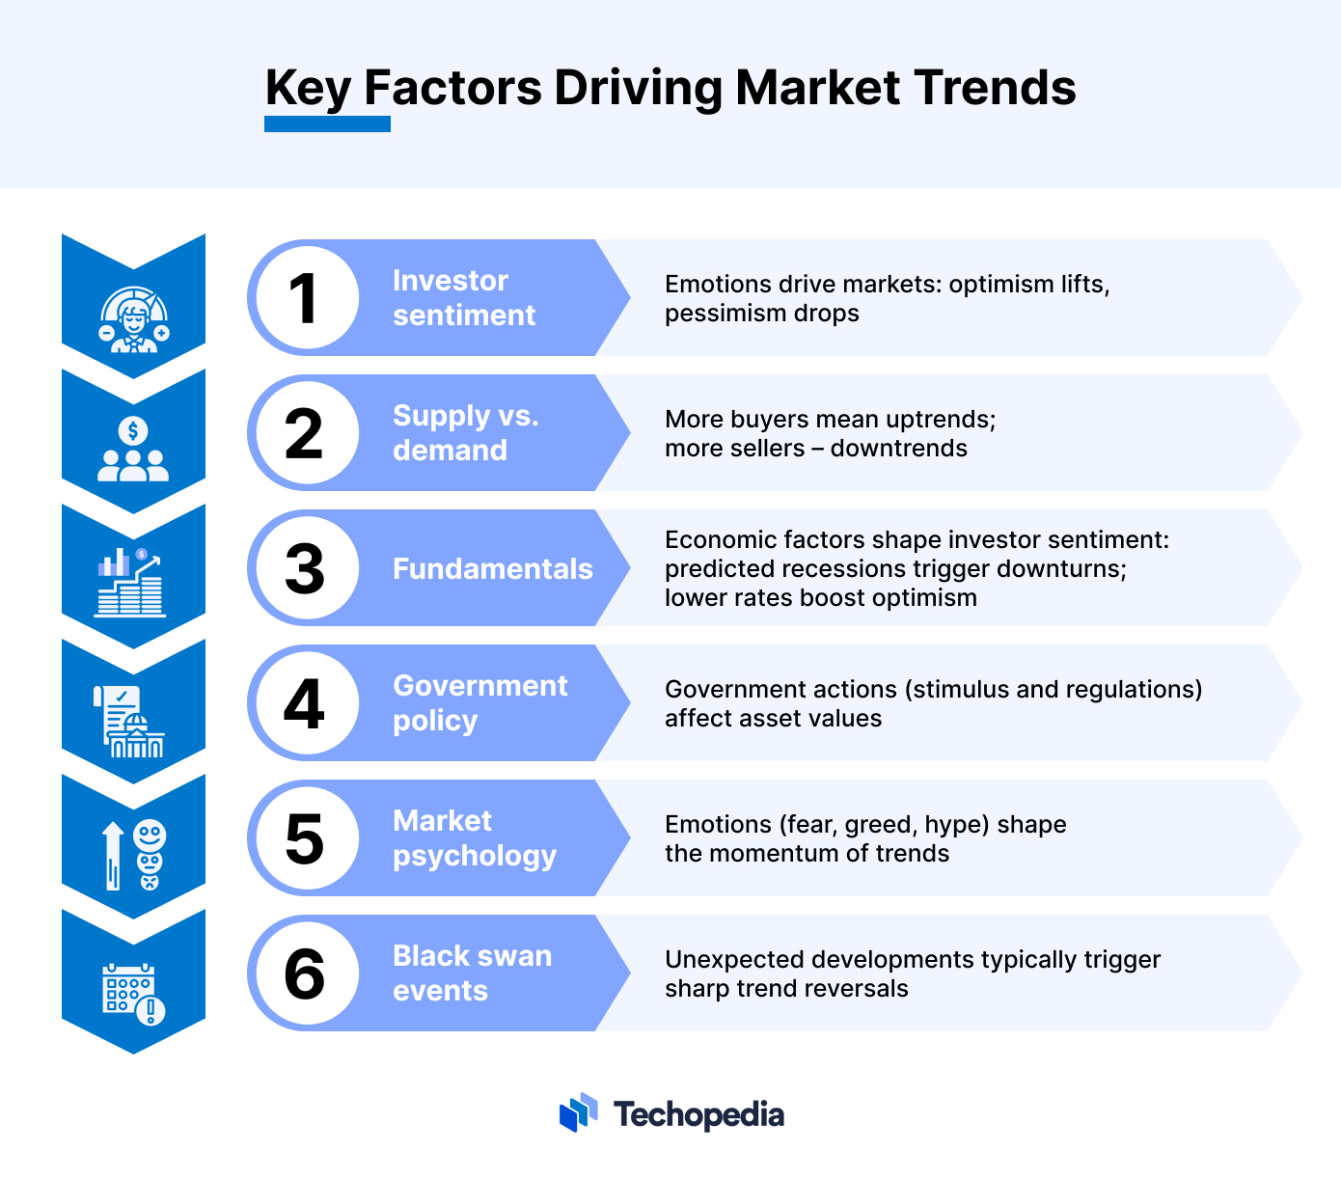
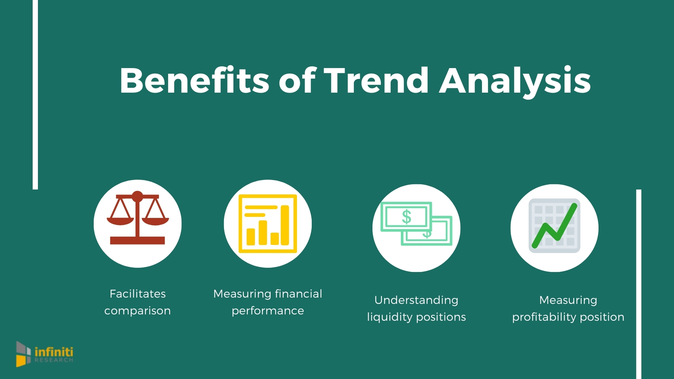
Understanding Key Dimensions of Market Analysis
Market Trends
A market trend is a perceived tendency of a market upward or downward movement over a specific period of time.
Notes:
So if you are about to decide what kind of product you are going to sell, you need to know what is its market trend. Market trends are the key source of new opportunities and threats.
Knowing the trends will give you some important answers to the questions such as what the customers like, how much they are willing to spend on it, what other capture their attention and etc.

Slide 10
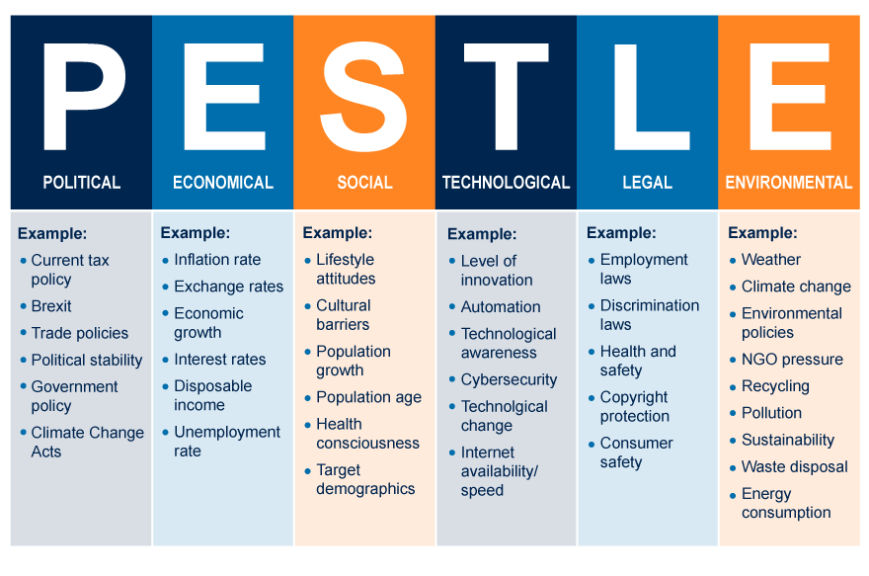
Understanding Key Dimensions of Market Analysis
PESTLE
There are some crucial points you need to be familiar with:
What is the political scene of the country – what is the sort of government leadership, policies, all the taxes laws and etc?
What are the economic factors (the interest rates, the foreign exchange rates)?
What are the main social factors (lifestyles, cultures, demographic picture)?
What are technological innovations likely to affect the market?
Main legal factors (safety standards, consumer laws, etc)?

Slide 11

Industry Analyses
Porter’s Five Forces
Threat of New Entrants
Rivalry among existing competitors
Bargaining power of suppliers
Bargaining power of buyers
Threat of substitute products or services

Slide 12
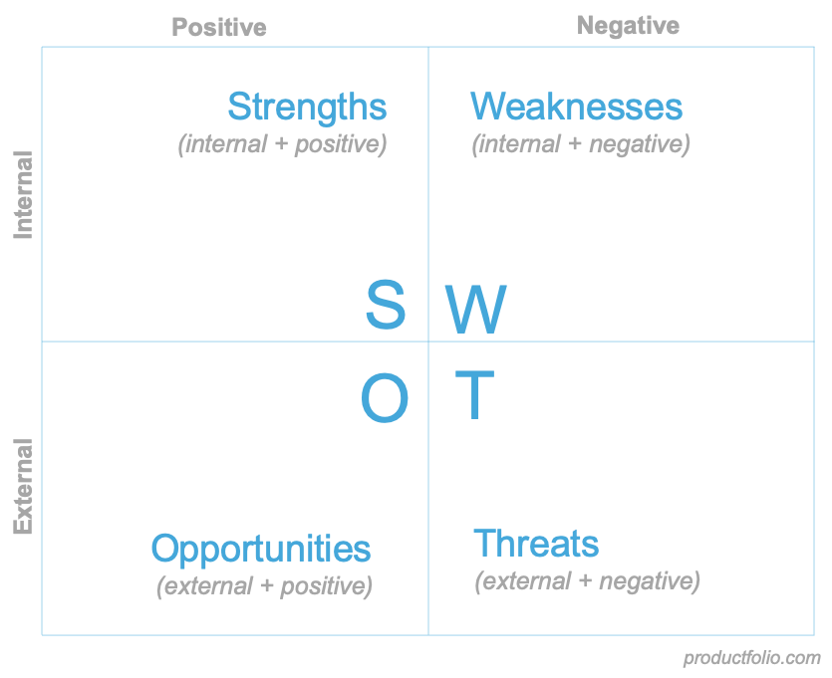
SWOT Analysis

Slide 13
Analysing & Understanding Competitive Advantage
The Macro-Environment
Industry
(or Sector)
Competitors
&
Markets
The Organisation

Slide 14
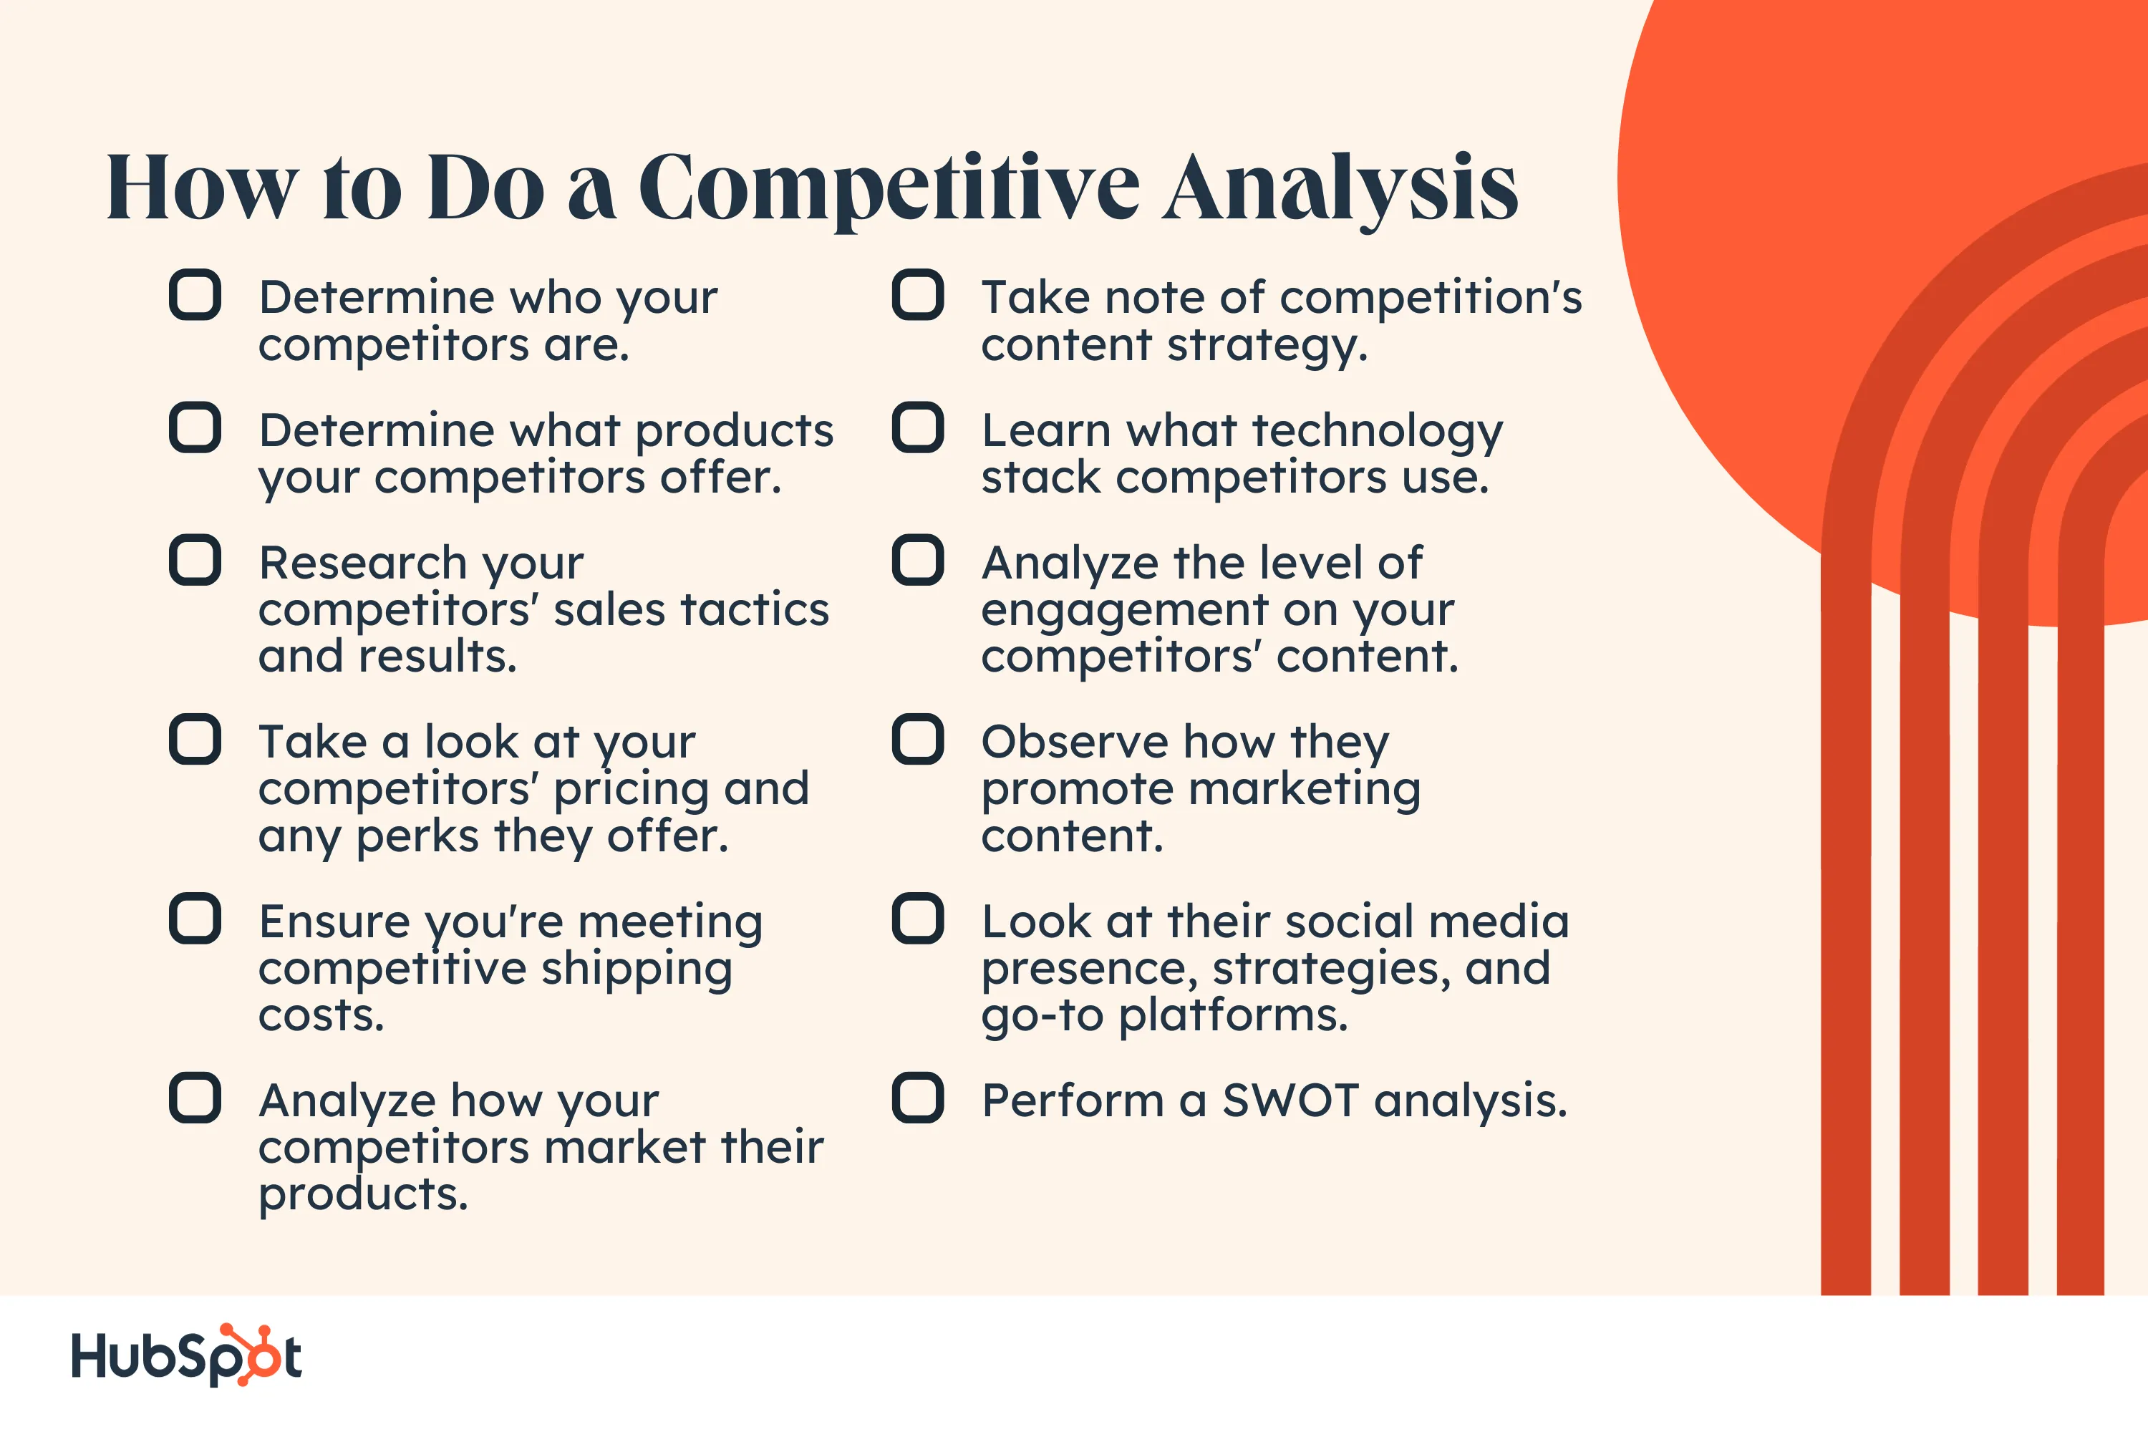
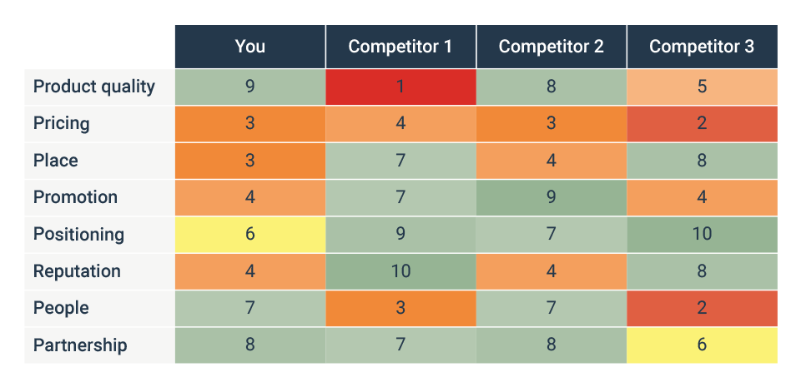
Understanding Key Dimensions of Market Analysis
Assessing The Competition
Some of the best ways to research and assess them are:
investigate their website (look at their products – how are they presented, look at the “about us” page, “mission” page and etc)
shop them yourself
ask your customers what they like about your competitor
follow their news and press releases.
Notes:
Any business aims to be better than competitors as offer products and services that better satisfy the customer needs. In order to achieve this, you need a deep knowledge of who your customers are, what their strengths and weaknesses are, what they are offering and etc.

Slide 15


