Slide 1
Market & Consumer Trends
Prof. Liliana Caimacan

Slide 2

LILIANA CAIMACAN
Professor of Marketing and Entrepreneurship
Business Transformation Strategist
Innovation Leader, Marketing Expert
Liliana.Caimacan@faculty.hult.edu
LinkedIn: Liliana Caimacan

Slide 3
Market & Consumer Trends
Market trends are patterns of change in an industry or market over time, shaped by factors such as technology, competition, economic conditions, regulation and shifts in demand.
Consumer trends are evolving patterns in consumers’ needs, attitudes, preferences and behaviours that influence what, why, where and how they buy and use products or services.

Slide 4
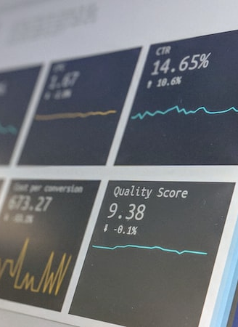
Competitive Intelligence - Tracking competitors' product launches, marketing campaigns, patents etc. to identify disruptive innovations.
Customer Surveys - Regular surveys to gauge changes in customer preferences, satisfaction levels, and buying criteria.
Industry Reports - Reviews of market share, growth trends, technology shifts, and regulatory changes in your sectors.
Sentiment Analysis - Monitoring social media conversations and online reviews to pick up early warning signs.
Big Data Analytics - Identifying correlations, anomalies, and predictive patterns in structured and unstructured data.
Scenario Analysis - Developing scenarios for high-impact but low-probability events. Helps prepare contingency plans.
Horizon Scanning - A systematic approach to detecting early signs of potential threats or disruptions.
Monitoring Market Trends

Slide 5
Tools for Monitoring Market Trends
What are the essential tools for monitoring market trends and identifying potential disruptions?
Google Trends: Provides insights into the popularity of search queries in Google. Useful for understanding consumer interests and market trends.
Social Media Analytics Tools (e.g., Hootsuite, Sprout Social): Track social media conversations and trends, which can be early indicators of market shifts.
SEMrush or SimilarWeb: Offer insights into competitors' online strategies, traffic sources, and keyword rankings, helping to understand market position and dynamics.
IBISWorld and Euromonitor,etc: Provide industry reports, global market research, and trend analysis.
        5. Various Trends reports

Slide 6
Trends and the impact on customer behaviour
Sources for trends:
Specialized research agencies – eg VML / Nielsen / Kantar /FMCG Gurus
Trends and Insights
  Trend Hunter: Trend Hunter Consumer Insights - Trend Database of Crowdsourced Insight
  Mintel: Mintel trends
  Google Trends: google trends
  Gartner: https://www.gartner.com/en/articles/top-technology-trends-2025

Slide 7
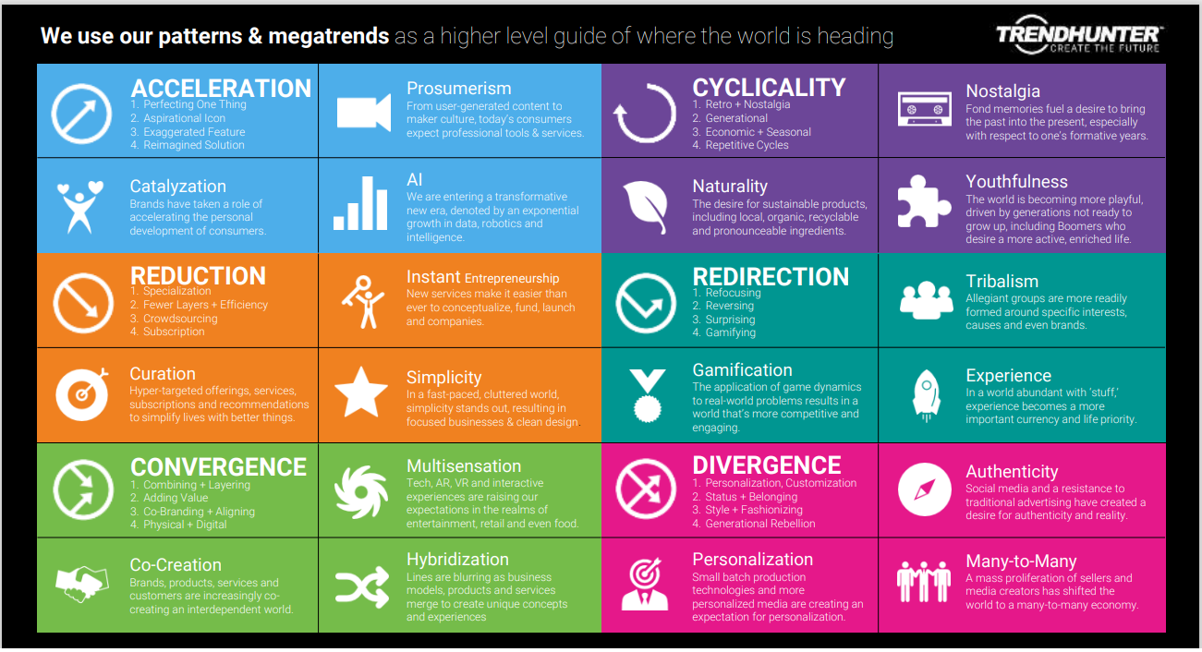
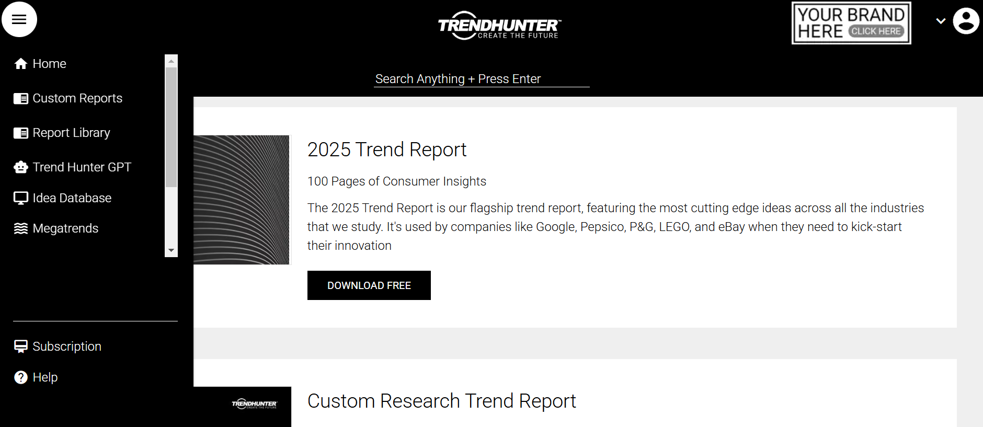
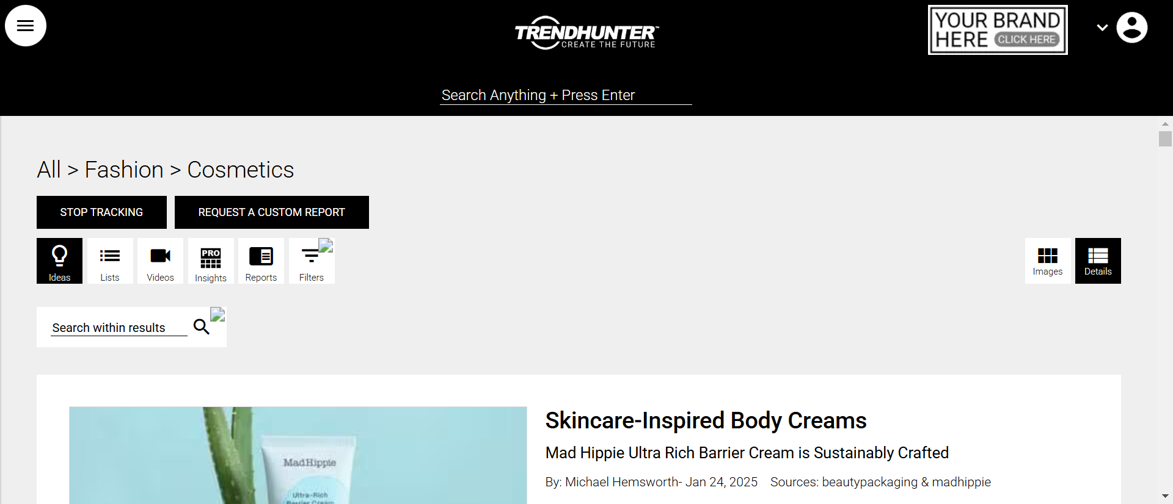
Trends and the impact on customer behaviour –
Trend Hunter
https://www.trendhunter.com/apps/dashboard#p=category&v=77

Slide 8
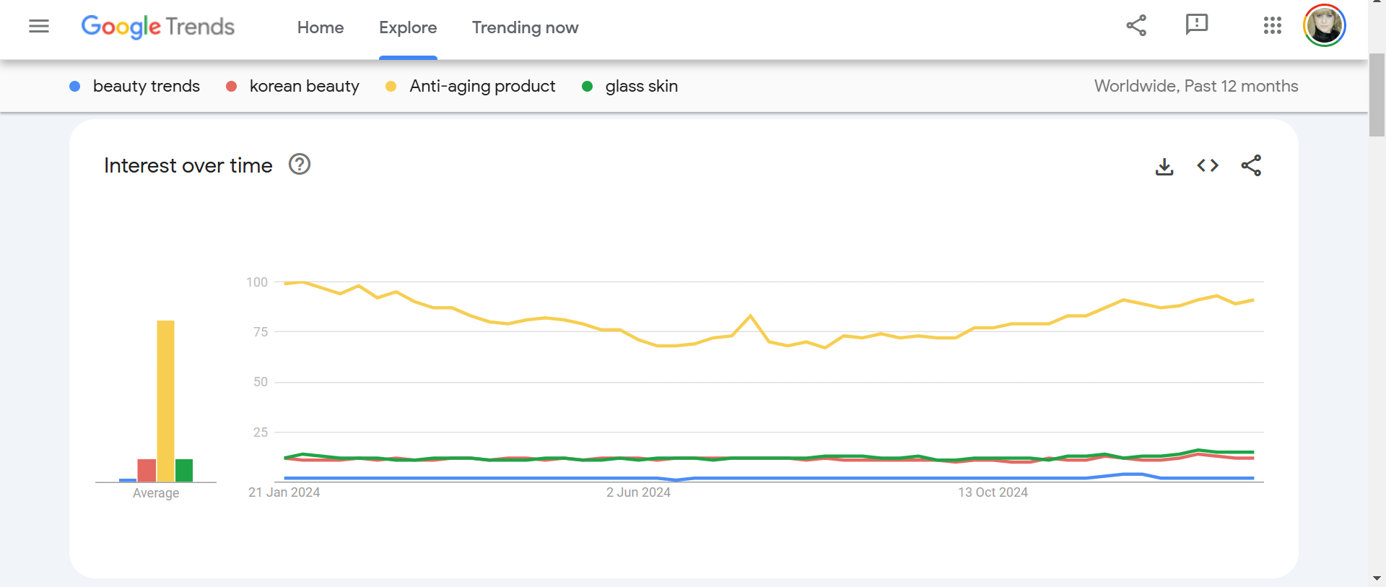
Trends and the impact on customer behaviour – Google Trends
https://trends.google.com/trends/explore?geo=GB&hl=en-GB

Slide 9
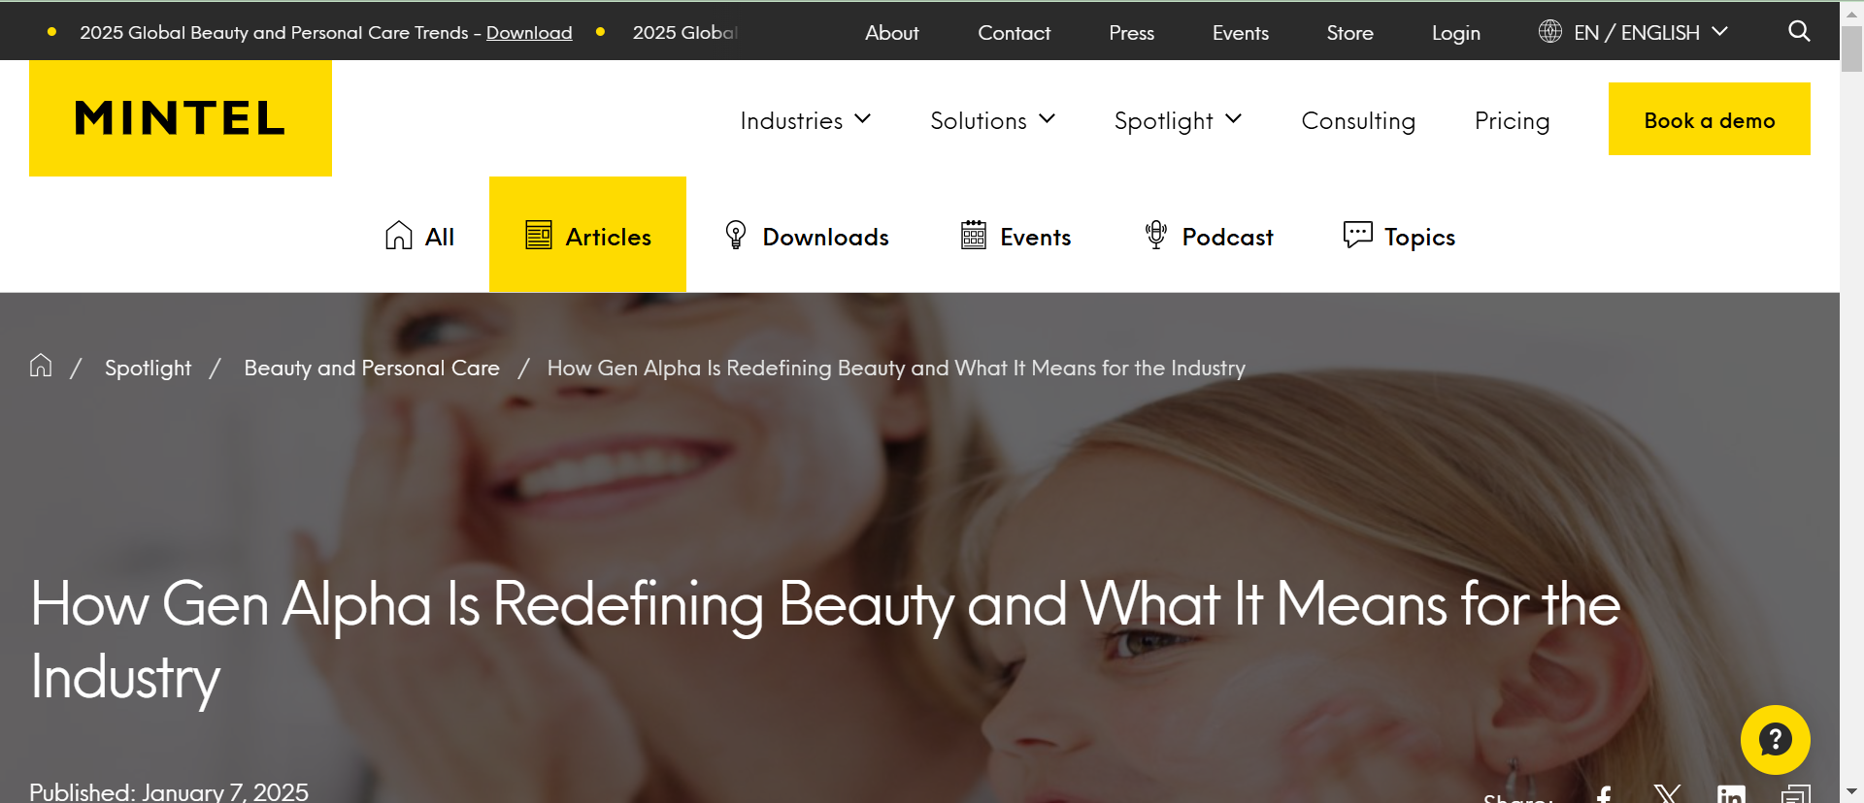
Trends and the impact on customer behaviour – Mintel
https://www.mintel.com/insights/articles/?_gl=1*qlvphf*_up*MQ..&gclid=CjwKCAiAtNK8BhBBEiwA8wVt9zfj0xXcsNjkupzMF7Ro8zEAx0DPNb4WxcYQ60WuLkycHg8DwCeEcBoCGt4QAvD_BwE

Slide 10
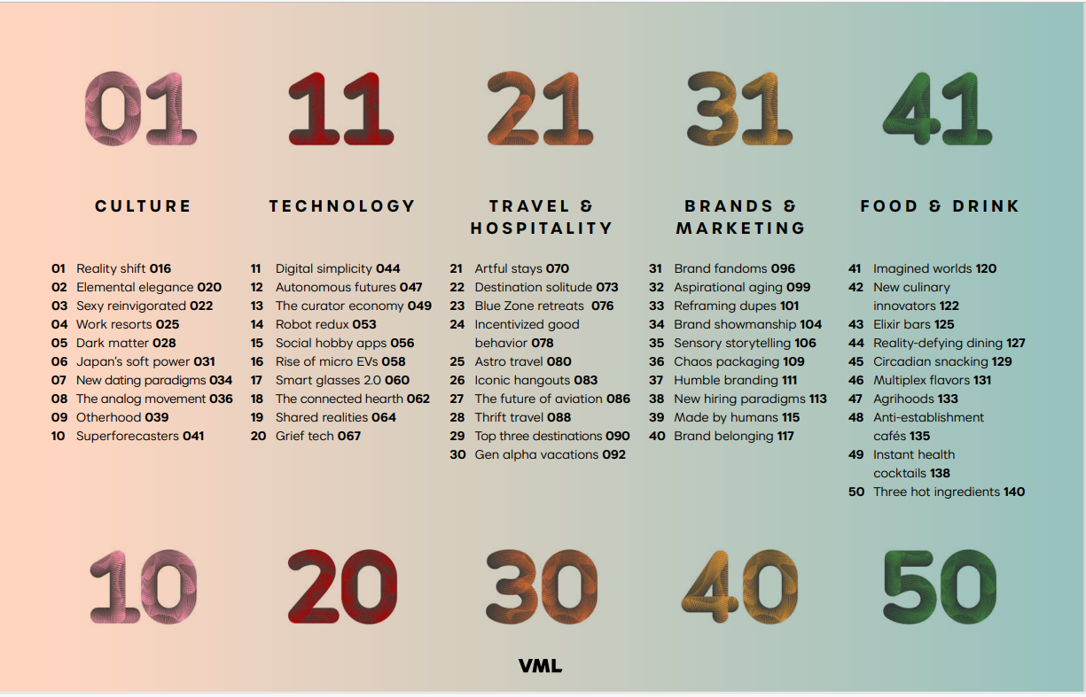
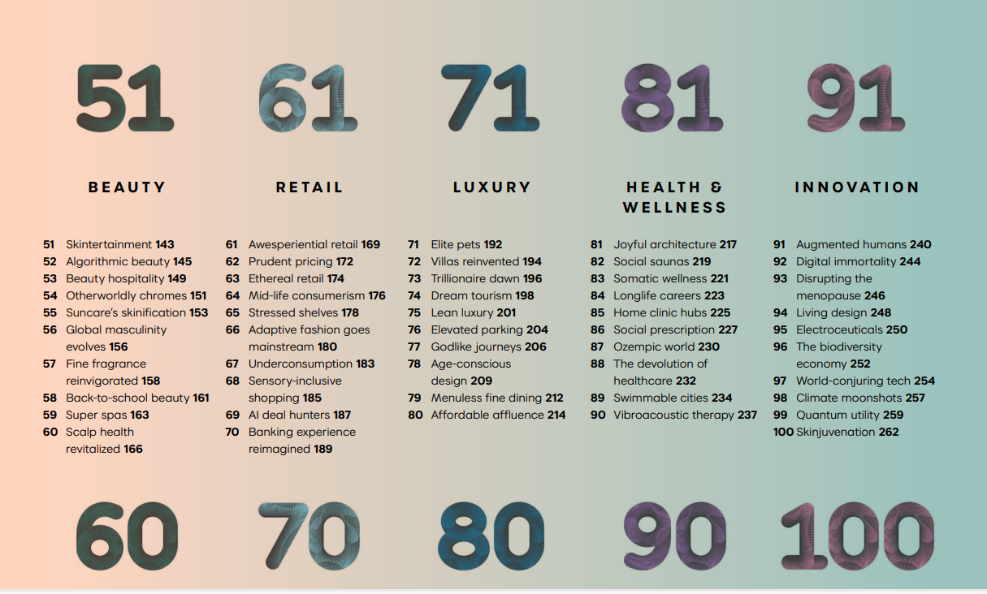
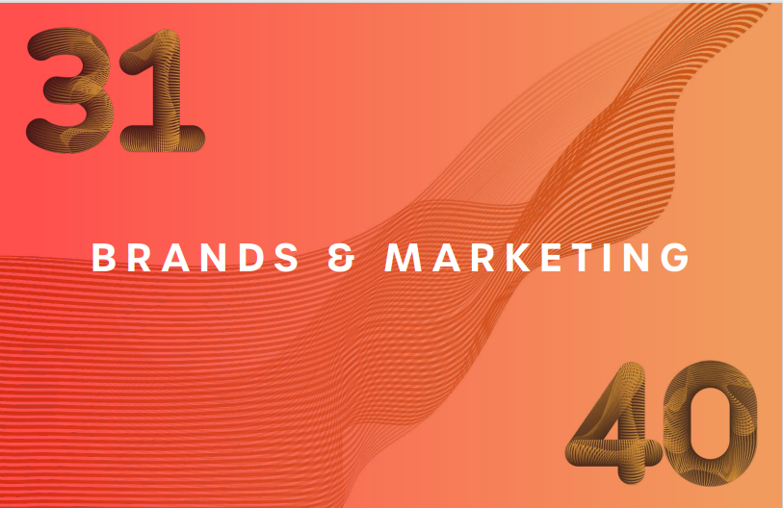
Trends and the impact on customer behaviour –
VML Report

Slide 11
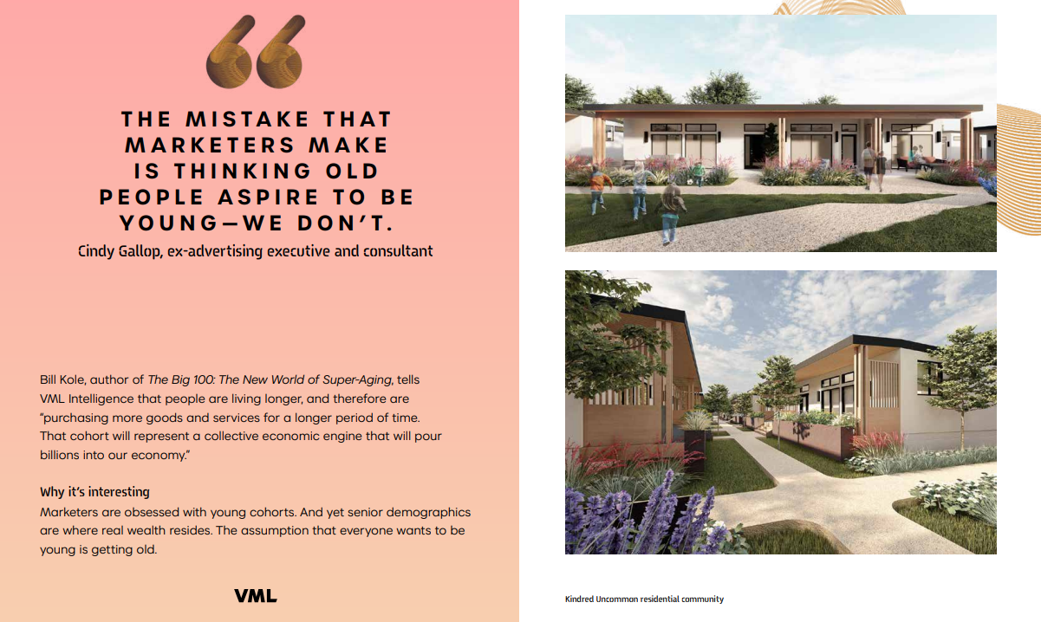
Trends and the impact on customer behaviour –
VML Report
Insight: “I need products which are made for me and addressing my specific needs. I want to be able to understand what are they for, how to use and to help me achieve good results.”
Opportunity: create products addressing specifical needs of senior people who have a high disposable income and tend to spend more for specialized products

Slide 12

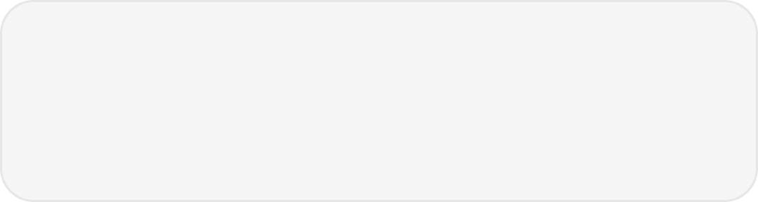

Consumer Behavior Trends
Digital Adoption
        Accelerated digital adoption, e-commerce trends, and omnichannel experiences reshape consumer behaviors, preferences, and expectations, driving businesses to adapt their marketing and sales strategies.
Health and Wellness
        Growing health consciousness, wellness trends, and ethical consumerism influence product choices, brand positioning, and marketing narratives, shaping consumer-brand relationships.
This Photo by Unknown Author is licensed under CC BY-NC-ND
This Photo by Unknown Author is licensed under CC BY
Experience Economy
        Shift towards experiential consumption, personalized experiences, and emotional branding influences consumer loyalty, engagement strategies, & business differentiation in the market.

Slide 13
Integrated Market Trends and Opportunity Identification Report

Slide 14
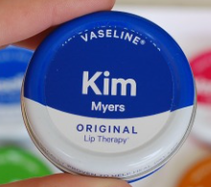
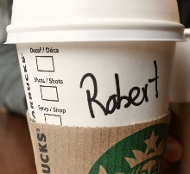
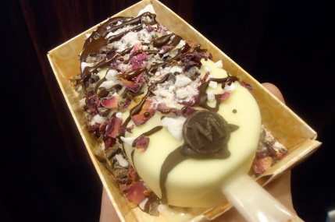

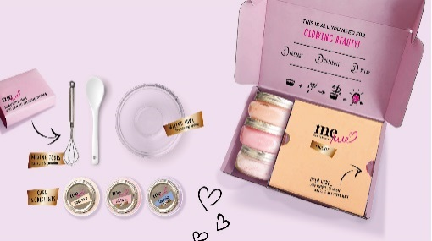
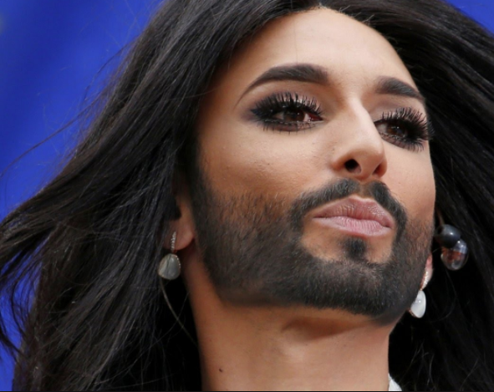


CONSUMER
Individualism & Identity
People become more conscious about their individuality and want personalized solutions.
Personalised solutions and experiences for individuals
Personalised packs, flavours, communication,
promotion, services
Identity is flexible and in the flux.
Gender and ethnic fluidity. New feminism.
Plus-size positivity. Hashtag –Activism.
Unique experiences
Political and societal shocks put identity – who we are and what we stand for – at the heart of trends
Make your own
For You
SMALL
MEDIUM
EMERGING

Slide 15
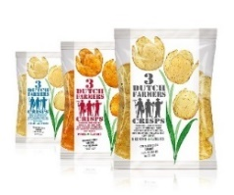
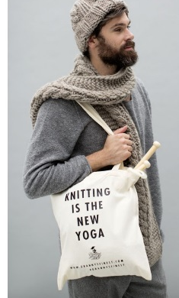
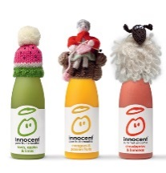
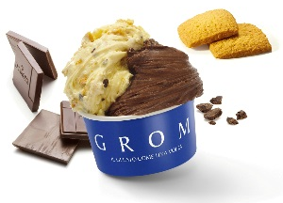
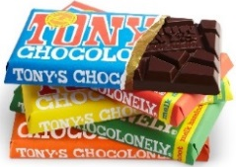

CONSUMER
Explosion of Small
Consumers turning away from anything industrial, large scale and strikingly global.
Authentic, Transparent, Trustworthy Brands and Products.
People are looking for total transparency, authenticity, originality. They look beyond purpose and seek out proof.
From farm to fork, transparent ingredient and product stories
Artisanal, Authentic Brands
More and more people get involved in
DIY
Brands with Purpose
MEDIUM
Artisanal Channels (butchers, cheese shop, bakeries, farmers markets)
FAST
SUSTAINED

Slide 16


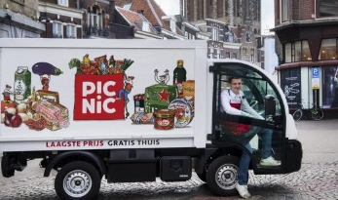
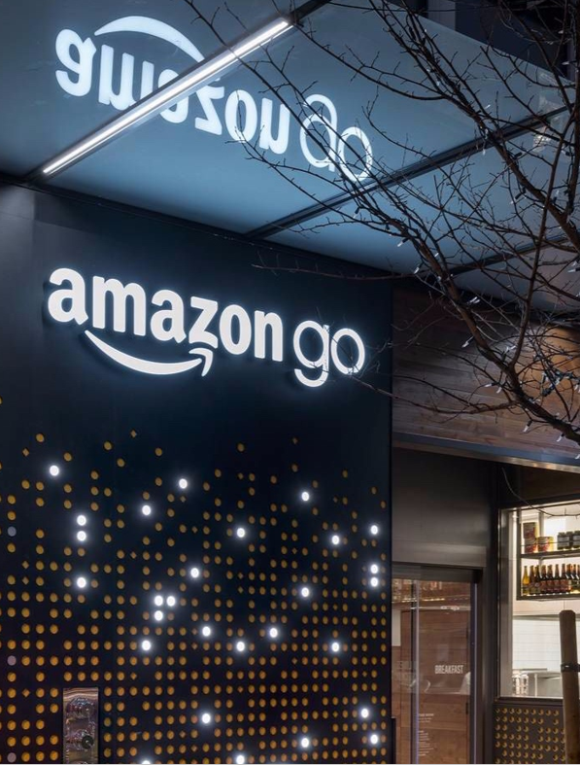

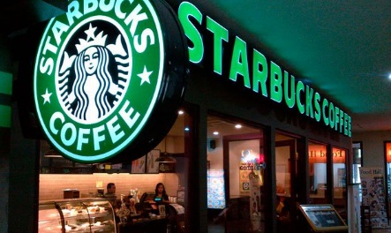

CONSUMER
Hyper-Convenience
as a reaction to time pressure and
a 24/7, on-demand, always-on society
Products and Services that offer new levels of convenience and immediacy
Ready-to-eat, Snacking, On-the Go, Kits, Effortless, Friction-free
Consumers want simple, immediate solutions that bring them convenience and
free up time at any time of the day. IWWIWWIWI.
On-line Shopping
Home Delivery
35 %
HH penetration of Amazon Prime
in UK
Food Delivery
OOH Consumption
MEDIUM
MEDIUM
SUSTAINED

Slide 17
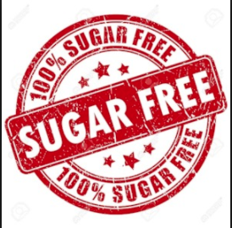




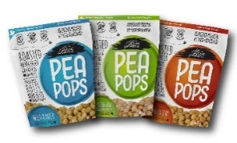
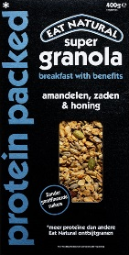


CONSUMER
Health & Wellness
are becoming key consumer drivers across all categories
Products and Services that deliver physical and mental wellbeing.
Organic, Free from,
0%, Vegan, Raw
Increased life expectancy
and youth culture makes
people more conscious to maintain their health
Brands & Packaging
that support a natural, healthy feel
More nutritional
requirements and
lifestyle choices
Obesity rates
doubled in WE since 1990
Therapeutics, Superfood
Science of Nature
Self-improvement
Self-care
MEDIUM
Governments imposing stricter
nutritional regulations.
FAST
Health Food Stores
EMERGING

Slide 18
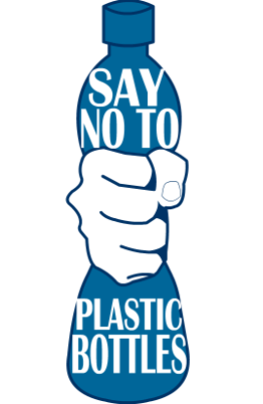

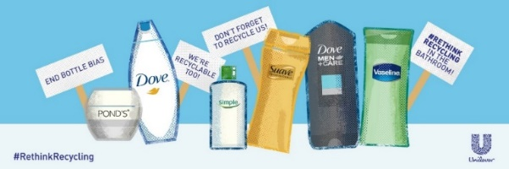
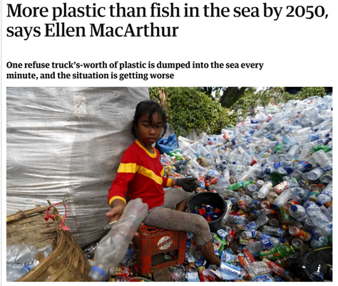
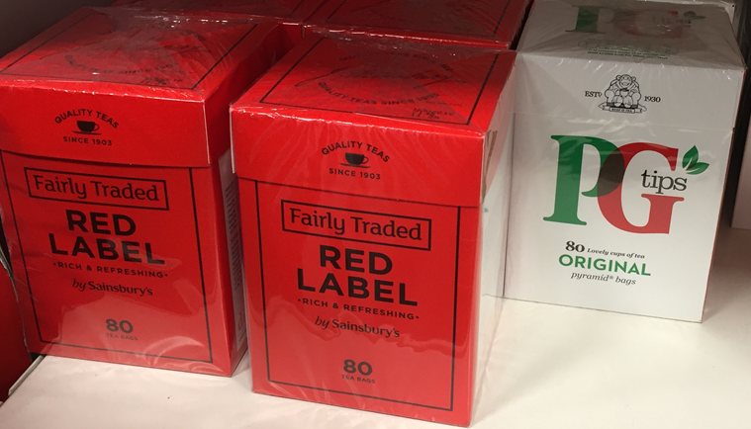
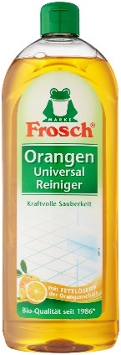
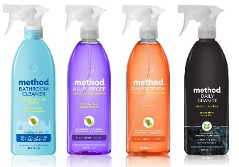
CONSUMER
Sustainability
Ethical Consumerism. Increasing conscious-ness about environmental and social issues make consumers sceptical and mindful.
Recyclable packaging, plastic-free,
eco-friendly, sustainable ingredients
pollution-free, zero waste
66%
of Polish consumers prefer to drink water from recyclable
bottles
Recyclable, reusable,
refillable Packaging
Brand
Activism
Sustainable ingredients
free from chemicals, no microbeads, eco.
Fair trade, sustainable farming
MEDIUM
MEDIUM
SUSTAINED
Notes:
Clear divisions in Europe between countries:
On energy use - the worst-performing countries being up to five times as energy-intensive as the best. (EU Energy in Figures)
Climate change is seen as the single most serious problem facing the world in Sweden (38%) and Denmark (29%), while this view is held by fewer than one in ten respondents in parts of Eastern and Southern Europe (Special Eurobarometer 459, European Commission)
Consumers becoming more climate conscious:
42% of Europeans are buying environmentally friendly products (Special Eurobarometer 435, European Commission)
41% of Europeans say they try to buy locally produced and seasonal (Special Eurobarometer 459, European Commission)
Differences in age:
Older people (55+) care less about climate change than those aged between 25 and 39 (Special Eurobarometer 459, European Commission)

Slide 19
What can we learn from trends?
How can we scope opportunities?

Slide 20
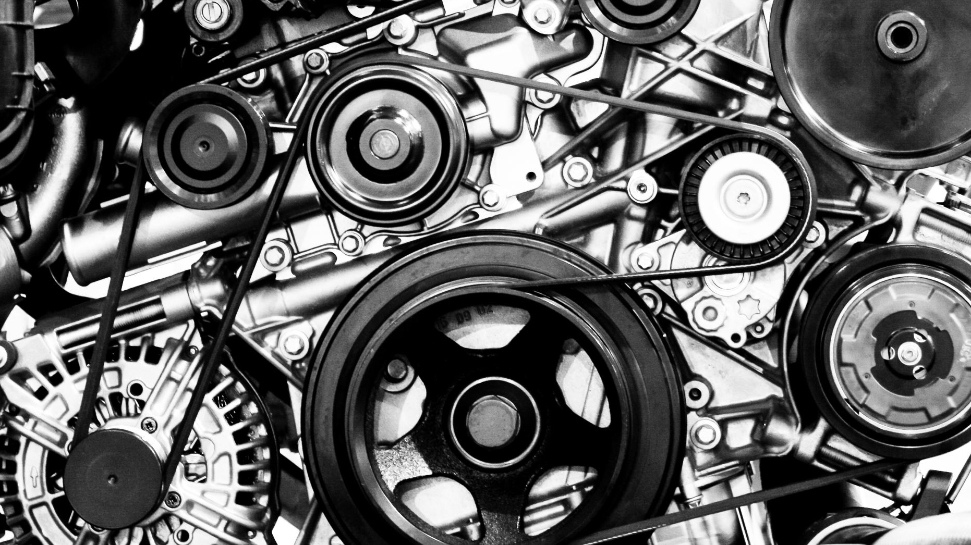
Innovation: The Engine of Resilience

Slide 21
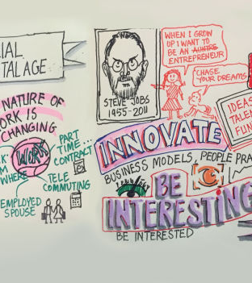
Innovation in the New Context
Innovation is not just about new products; it's a mindset of continual improvement and adaptation.
Innovation can take many forms: product, service, process, or business model innovation.
This Photo by Unknown Author is licensed under CC BY-SA-NC

Slide 22
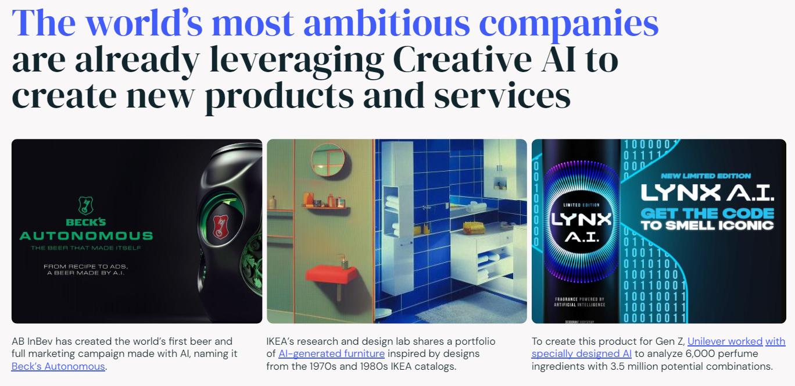

Slide 23
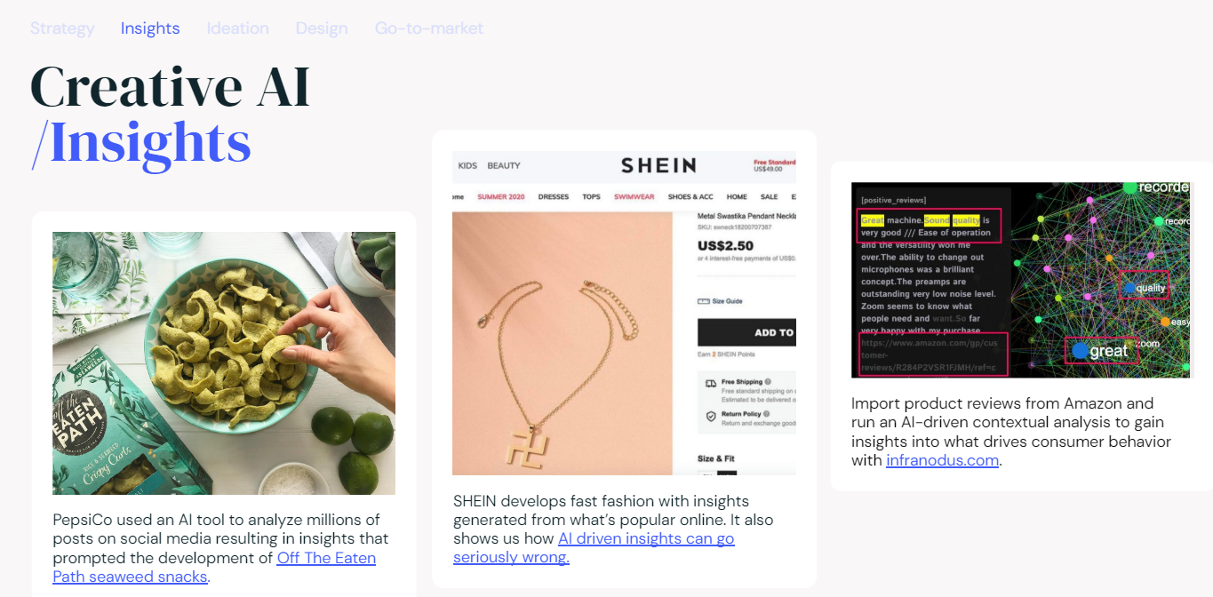

Slide 24
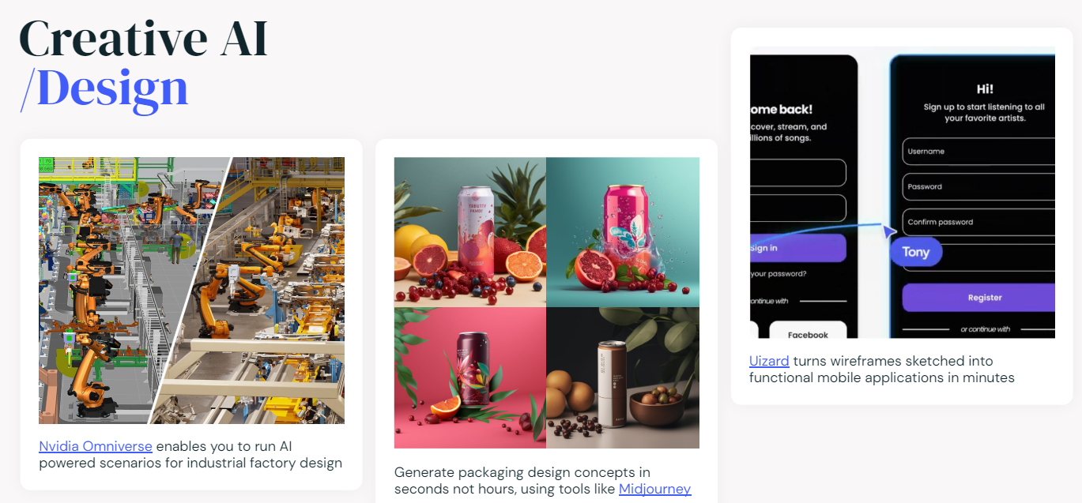

Slide 25
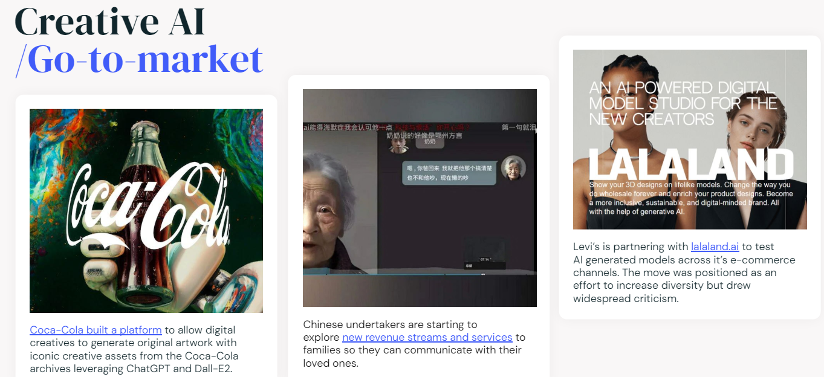

Slide 26


