Slide 1


Introduction to Design Thinking
Fall in love with the customer
September 2026

Slide 2


NINJAGO Legends

Slide 3
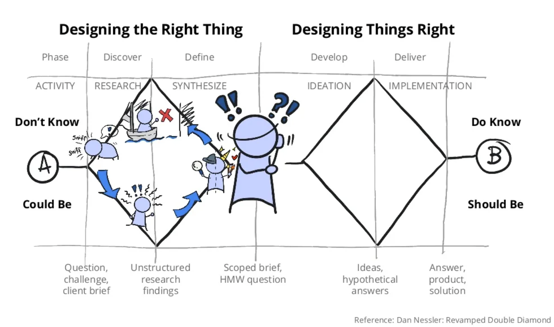

Slide 4

Who is your CUSTOMER?

Slide 5
When your customer is everybody.
Your customer is nobody.

Slide 6
