Slide 1
Consumer Understanding & Insights
Prof. Liliana Caimacan

Slide 2

LILIANA CAIMACAN
Professor of Marketing and Entrepreneurship
Business Transformation Strategist
Innovation Leader, Marketing Expert
Liliana.Caimacan@faculty.hult.edu
LinkedIn: Liliana Caimacan

Slide 3
Market Analysis ➔ WHAT?
Consumer insight ➔ WHY?

Slide 4
Customer Understanding

Slide 5

Wants, Needs and VALUE
• Customer needs, wants and demands
• Market offering – products, services and experiences
• Customer value and satisfaction
• Exchanges and relationships
• What’s In It For Me? (WIIFM)
• Marketing is a complex blend of economics and psychology!

Slide 6
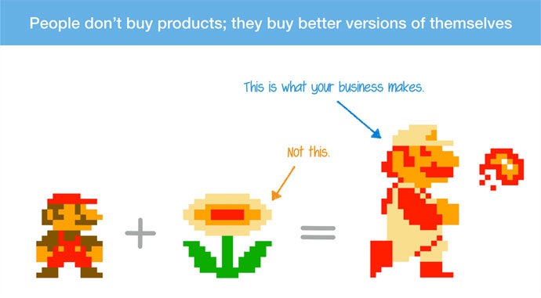

People Don’t Buy Products;
They Buy Better Versions of Themselves

Slide 7
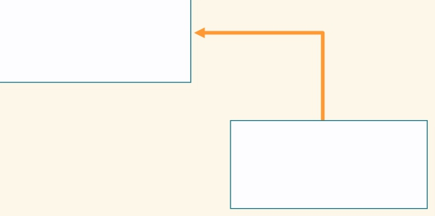
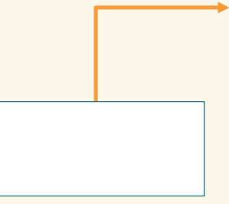
Creating Customer Value
Positive
Perceived
Benefits
Customer
Value
Negative
Perceived
Sacrifice
• Product benefits
• Service benefits
• Relational benefits
• Image benefits
Monetary costs Time costs
Energy costs
Psychological costs
•
•
•
•

Slide 8
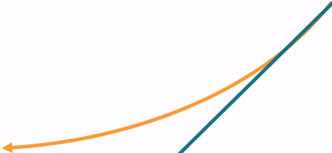
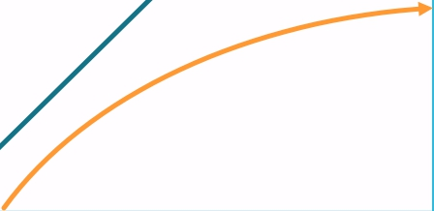
Creating Customer Satisfaction – Kano Model
Delight
‘More is better’
Neutral
Dissatisfaction
Customer Satisfaction
Absent Fulfilled
Presence of the characteristic

Slide 9
Decision-making process

Slide 10
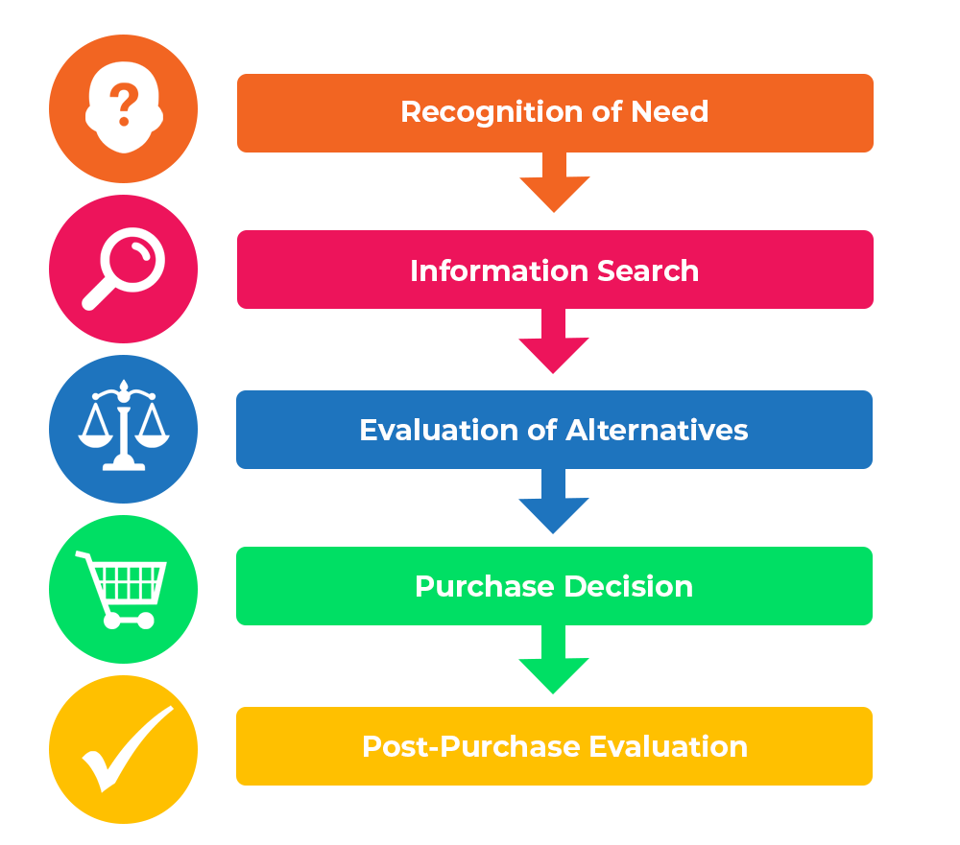
Consumer Decision-Making Process

Slide 11
Humans make
irrational decisions, emotional decisions,
NOT rational, economic ones, most of the time.

Slide 12
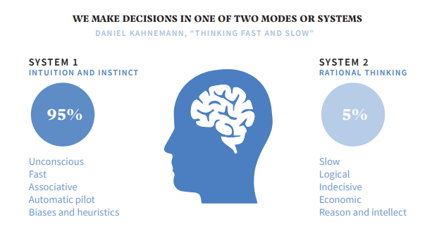
Decision-making process

Slide 13
“You can try to change people’s minds, but this is difficult.
You can bribe people to change their behaviour, but it’s expensive.
Far simpler is to make the new behaviour easy and enjoyable.”
Rory Sutherland, 2017

Slide 14
„The only person who can fire us all is the customer.”
Sam Walton, founder of WalMart
27

Slide 15


