Slide 1
Making Connections : Navigating the Multi Agent Landscape
Gary Olliffe
Notes:
Counterintelligence — Assessing AI Agents, Their Use Cases, Platforms and Risks
Gary Olliffe
Ver 2025-1219
1 © 2025 Gartner, Inc. and/or its affiliates. All rights reserved.
Gartner is a registered trademark of Gartner, Inc. and its affiliates.

Slide 2

The Agents Are Coming
2 © 2025 Gartner, Inc. and/or its affiliates. All rights reserved. Gartner is a registered trademark of Gartner, Inc. and its affiliates.
Notes:
https://unsplash.com/photos/grayscale-photo-of-person-standing-on-train-station-esOA3o92zxE
The promise of agents has been with us for a little while now but the reality is they are here
[CLICK]

Slide 3
The Agents Are Coming
Here
3 © 2025 Gartner, Inc. and/or its affiliates. All rights reserved. Gartner is a registered trademark of Gartner, Inc. and its affiliates.
Notes:
https://unsplash.com/photos/grayscale-photo-of-person-standing-on-train-station-esOA3o92zxE
In the world of espionage those agents are not going to be coming from one place they’re going to be trying to infiltrate your environment from multiple sources whether it be applications that you buy whether it be agents that are sold to you as fully autonomous capabilities for particular roles or whether they are capabilities that your technology teams or your business users start to build to help them solve problems

Slide 4
Two Viewpoints on AI Agent Capabilities
What
AI Agents can reliably do
What people think
AI Agents can do

Slide 5
Three
Two Viewpoints on AI Agent Capabilities
What
AI Agents can reliably do
What people think
AI Agents can do
What AI Agents demos show
Notes:
For humor – “no… who wants to see a demo”
-

Slide 6




Navigating to a Multiagent Future
Agents are Diverse
Agents are Connected
Diverse Agents means Diverse Platforms
Diverse Platforms Demand Managed Connections
Notes:
We’re going to look at this through four different lenses
the first is we’re going to identify the agents what types of agents should we be concerned With what other uses or strengths
then we’re going to look at the classify the use cases and
then we’re going to look at how those agents are contained where do they exist the platforms that are used to deliver them or operate them
and then we’re going to look at how to assess them what are the risks and how do we mitigate some of those risks so that we can get the most benefit from these new tools
Placeholder for text (substitute your own text; delete when not used)

Slide 7
Navigating to a Multiagent Future
Agents are Diverse
Agents are Connected
Diverse Agents means Diverse Platforms
Diverse Platforms Demand Managed Connections
Notes:
We’re going to look at this through four different lenses
the first is we’re going to identify the agents what types of agents should we be concerned With what other uses or strengths
then we’re going to look at the classify the use cases and
then we’re going to look at how those agents are contained where do they exist the platforms that are used to deliver them or operate them
and then we’re going to look at how to assess them what are the risks and how do we mitigate some of those risks so that we can get the most benefit from these new tools
Placeholder for text (substitute your own text; delete when not used)

Slide 8
“AI agents are autonomous or semi-autonomous software entities that use
AI techniques to perceive, make decisions, take actions and achieve goals in their
digital or physical environments.”
Gartner, Innovation Insight: AI Agents
Notes:
https://www.gartner.com/document-reader/document/5332663?
So this has gone as definition for ai agents You’ll notice it doesn’t mention large language models this is intended to cover all agents that use AI to help guide their behaviour and You’ll also know that these are software entities these are not that ai models they are not data science they are not other types of technology they are not hardware these are software entities because the thing that makes an agent an agent is a piece of software And that piece of software uses ai techniques to perceive make decisions take actions and achieve goals in a digital or in some cases a physical environment

Slide 9
Four Key Agent Use Case Categories
Defined task
automation
Information discovery
and response
Task partner/
peer
Open tasking
Notes:
OK so that’s the superset View of use cases and the challenge of our imagination versus the reality
But I think it’s useful if we try and categorise these use cases because that will help us understand which are the more sophisticated and challenging and which are the more practical and perhaps easier to implement
First of all and most simple we’ve got defined task automation think of this like the email responding agent that I mentioned earlier
If that mailbox is your inbound web contacts for sales engagement and you want to provide a quick and friendly response based on the context that the you have about that individual and about your product using an agent that can respond at scale maybe more effective and relatively low risk compared to leaving those emails festering in that mailbox until you’re poor overloaded sales team can get round to responding as a human
Next if we think about information discovery and response this is where research agents might fall if you’re seeking out information and relying on an agent to do some of that discovery work for you Maybe from its own training data maybe from connected knowledge spaces and grounding data rack stores or perhaps through access to tools that grant access to Internet search and browsing or other resources gathering that information summarizing it and presenting it back to the user is a common use case and some of those use cases can remain relatively low risk because you’re often presenting that information back to a user you’re saving them the work of that discovery activity but they’re still responsible for digesting it and applying it to the process or the task that they’re working on Or maybe just learning from I it
Next we have task partnering or peering where the agent is acting as a co pilot to use the commonly used brand or phrase so the agent is not working alone it’s specialized to a particular task that may be for example software engineering a very common domain where we’re seeing AI applied quite effectively but that ai is assisting a developer it’s assisting a developer with a particular set of tasks and that might be dealing with the backlog of issues it may be building test cases it may be generating documentation it may be quite broad in its set of capabilities but it’s targeted at a particular domain and the agent is behaving as a partner or a peer suggesting rather than taking control of the process
And then finally we have what I’ve called open tasking which is as close as we are at the moment To general intelligence artificial general intelligence agi where an agent may present you with a text box and challenge you to ask it anything it has access to a set of tools and capabilities maybe those include code generation and Internet search and browser interaction for example and within that digital environment you can ask it to do anything you can ask it to go and create recipes based on the contents of your shopping basket at your preferred online supermarket or you can ask it to generate you’re an itinerary and schedule activities for your next vacation Or you can ask it to help with the coding task or you can ask it to help with information discovery and response it’s really up to the user and of course you can imagine that while that sounds incredibly powerful it’s very hard to test to verify to secure to constrain and it’s very hard to train users in the best ways of using those tools so while they might feel the most powerful they may not Be the most relevant for your business use cases

Slide 10
Functions Pursuing Agentic AI
Q: Which functions have the highest likelihood of pursuing some form of agentic AI solution? Percentage of respondents
45% CX
23% CIO
Customer Service
Mkting
Sales
Apps/ SW
I&O
R&D/
Product
Teams
Finance
Procurement
Supply Chain
HR
Legal
Other
n = 3973 (June 2025)
Source: Polling from Gartner webinar titled AI Value Creation: Achieving ROI Demands a Labor-based Mindset Shift
Notes:
Author: Frances Karamouzis (Frances.Karamouzis@gartner.com)
Distinguished Analyst & VP
CIO Practice – Artificial Intelligence Team
n = 3973 (June 2025)
Source Polling from Gartner webinar titled AI Value Creation: Achieving ROI Demands a Labor-based Mindset Shift
This webinar were held in June 2025 with 3,973 respondents to the polling. Results of this poll should not be taken to represent all executives as the survey responses come from a population that had expressed interest in generative AI by attending a Gartner webinar on the subject.

Slide 11
Agency Dimensions
Role generalization
5
Learning (behavior)
4
Autonomy
3
2
Memory
(facts/grounding)
1
Proactiveness
0
Act (effecting)
Goal seeking
Act (sensing)
Planning
Notes:
So we have a definition for an ai agent but how do we really recognize one Well there’s a number of dimensions that are important the first is role generalization what this means is whether the agent is designed for a particular task to perform a particular role or whether it’s been generalized and of course at the edge of this we’ve got a agents that are able to be tasked with anything that you can dream of doesn’t mean that they’re going to be good at them but they’re able to make an attempt at those actions
Then we have a group of characteristics and or dimensions around the way that actions are taken we have autonomy the ability to work independently proactiveness rather than waiting for guidance to seek out new ways of doing things or responding to action responding to events goal seeking which allows the agent to navigate to reach a goal Over a number of iterations and planning which means that the agent is working out the steps that it needs to take to reach that goal Rather than being told what they are.
Then on the left of the diagram we’ve got patterns or dimensions related to interaction so we’ve got learning the ability to gather information that helps the agent change its behaviour over time hopefully to make it better we’ve got memory that may be memory from external sources or it may be memory associated with learning and then we’ve got the ability to act Both affecting the environment so that’s making changes and sensing the environment that’s gathering information

Slide 12
Agency Dimensions
Role generalization
5
Q&A assistant
Learning (behavior)
4
Autonomy
Email response agent
3
2
Research agent
Memory
(facts/grounding)
1
Proactiveness
0
Act (effecting)
Goal seeking
Act (sensing)
Planning
Notes:
For example at very low capability on most of these dimensions we would probably call that component or service and ai assistant rather than an ai agent particularly if it doesn’t have much in the way of the ability to affect the environment
If we start expanding the capabilities of a software system to include more sophisticated ability and more autonomy more planning for example more sensing more acting to affect then we’re getting closer to agency and if we keep expanding we can see that for a different requirement we may have different levels of agencies Required there is no one definition of ageing capabilities it should be set up to meet the needs of the problem that you’re solving and the users that you’re supporting
THE EXAPMPLES HERE –
An Assistant – Answering questions based on a knowledge base.
An Email response Agent - monitoring an email inbox, personalizing responses dynamically based on sender context.
A Research Agent – Seeking out information using creative ways of sensing and evaluating information - more sensing than acting, more memory, but less learning.

Slide 13








Functional patterns
Agent architecture patterns
Agent process patterns
Solo agent
Prescribed
plan
Dynamic plan generation
Agent roles
MHQA
Collaborating agents
Emerging Patterns for Building LLM-Based AI Agent (G00823011)
Agent-to-agent handoff
Human-in-
the-loop
Orchestrated agents
Multiagent modularity
Notes:
Now if we drill in a bit further we have some of the patterns that we can use both for implementing the functional capabilities of an agent and for helping with the operation of those agents in our environment
I’m not gonna go through all of these patterns we simply don’t have time today these are from my emerging patterns for building LLM based agents research that published earlier this year but you can see how some of these map onto those capabilities so for example we’ve got the dynamic plan generation that would be higher up on the planning dimension of ageing characteristics collaborating agents similarly orchestrated agents and prescribed plan would be slightly lower on that that same dimension we’ve got the ability to act and sense down in the bottom centre with agent action patterns we’ve got support for memory and learning in the agent memory patterns we’ve got the ability to plan and implement goal seeking in the LLM interaction patterns and then we’ve got overall architecture patterns that include agent roles for role generalization or specialization and then of course the ability for agents to interact with each other Should you need to
Now one of the bigger challenges with ai agents is not actually building them it’s operating them and testing them and evaluating their behaviour over time so it’s very important that you think about how you’re going to gather feedback from your users whether you need to use further ai capabilities such as the LLM as a judge pattern to evaluate their responses either before they’re sent to the user or retrospectively you need to think about whether you need to use deterministic evaluation patterns can you compile or run the code that gets generated for example and then you definitely need to be logging your interactions if you’ve got any kind of sensitivity or compliance requirements or even significant quality requirements Because that logged interactions is going to become a valuable set of data for improving the behaviour of agents overtime particularly when you’re building them yourselves as we learned with chatbots in the late 20 teens it’s very hard to predict how users are going to interact with a chat interface if that’s your interaction mechanism Finally and equally importantly we’ve got our security and identity patterns and whether it is securing the access to the agent whether it’s ensuring that the agent remains on task and can’t be duped into doing things that it wasn’t intended to support with patterns like guardrails or whether it’s simply making sure that the user that the agent is acting on behalf of has the authority to do the things the agent is trying to do you’re going to need to think about security and identity and of course there are more patents here of course you need to secure the infrastructure you need to think about the protection of the data that you’re collecting the interaction logs that I just mentioned

Slide 14







Functional patterns
Agent architecture patterns
Agent process patterns
Solo agent
Prescribed
plan
Dynamic plan generation
Agent roles
MHQA
Collaborating agents
Emerging Patterns for Building LLM-Based AI Agent (G00823011)
Agent-to-agent handoff
Human-in-
the-loop
Orchestrated agents
Multiagent modularity
LLM interaction patterns
Agent action
patterns
Agent memory patterns
ReAct
Retry
limits
Function calling
RAG
f(x)
Chain of thought
Generated code execution
Memory longevity
Structured response
Reflexion
API tool use
Memory
scope
Notes:
Now if we drill in a bit further we have some of the patterns that we can use both for implementing the functional capabilities of an agent and for helping with the operation of those agents in our environment
I’m not gonna go through all of these patterns we simply don’t have time today these are from my emerging patterns for building LLM based agents research that published earlier this year but you can see how some of these map onto those capabilities so for example we’ve got the dynamic plan generation that would be higher up on the planning dimension of ageing characteristics collaborating agents similarly orchestrated agents and prescribed plan would be slightly lower on that that same dimension we’ve got the ability to act and sense down in the bottom centre with agent action patterns we’ve got support for memory and learning in the agent memory patterns we’ve got the ability to plan and implement goal seeking in the LLM interaction patterns and then we’ve got overall architecture patterns that include agent roles for role generalization or specialization and then of course the ability for agents to interact with each other Should you need to
Now one of the bigger challenges with ai agents is not actually building them it’s operating them and testing them and evaluating their behaviour over time so it’s very important that you think about how you’re going to gather feedback from your users whether you need to use further ai capabilities such as the LLM as a judge pattern to evaluate their responses either before they’re sent to the user or retrospectively you need to think about whether you need to use deterministic evaluation patterns can you compile or run the code that gets generated for example and then you definitely need to be logging your interactions if you’ve got any kind of sensitivity or compliance requirements or even significant quality requirements Because that logged interactions is going to become a valuable set of data for improving the behaviour of agents overtime particularly when you’re building them yourselves as we learned with chatbots in the late 20 teens it’s very hard to predict how users are going to interact with a chat interface if that’s your interaction mechanism Finally and equally importantly we’ve got our security and identity patterns and whether it is securing the access to the agent whether it’s ensuring that the agent remains on task and can’t be duped into doing things that it wasn’t intended to support with patterns like guardrails or whether it’s simply making sure that the user that the agent is acting on behalf of has the authority to do the things the agent is trying to do you’re going to need to think about security and identity and of course there are more patents here of course you need to secure the infrastructure you need to think about the protection of the data that you’re collecting the interaction logs that I just mentioned

Slide 15
Functional patterns
Operational patterns
Agent architecture patterns
Agent process patterns
Agent evaluation patterns
Solo agent
Prescribed
plan
Dynamic plan generation
User-in-the-loop
Agent roles
MHQA
Collaborating agents
LLM-as-a-judge
Emerging Patterns for Building LLM-Based AI Agent (G00823011)
Agent-to-agent handoff
Human-in-
the-loop
Orchestrated agents
Deterministic (code-
based) evaluation
Multiagent modularity
LLM interaction patterns
Agent action
patterns
Agent memory patterns
Interaction logging
ReAct
Retry
limits
Function calling
RAG
f(x)
Security and identity patterns
Chain of thought
Generated code execution
Memory longevity
Identity token
propagations
Structured response
Reflexion
API tool use
Memory
scope
LLM guardrails
Notes:
Now if we drill in a bit further we have some of the patterns that we can use both for implementing the functional capabilities of an agent and for helping with the operation of those agents in our environment
I’m not gonna go through all of these patterns we simply don’t have time today these are from my emerging patterns for building LLM based agents research that published earlier this year but you can see how some of these map onto those capabilities so for example we’ve got the dynamic plan generation that would be higher up on the planning dimension of ageing characteristics collaborating agents similarly orchestrated agents and prescribed plan would be slightly lower on that that same dimension we’ve got the ability to act and sense down in the bottom centre with agent action patterns we’ve got support for memory and learning in the agent memory patterns we’ve got the ability to plan and implement goal seeking in the LLM interaction patterns and then we’ve got overall architecture patterns that include agent roles for role generalization or specialization and then of course the ability for agents to interact with each other Should you need to
Now one of the bigger challenges with ai agents is not actually building them it’s operating them and testing them and evaluating their behaviour over time so it’s very important that you think about how you’re going to gather feedback from your users whether you need to use further ai capabilities such as the LLM as a judge pattern to evaluate their responses either before they’re sent to the user or retrospectively you need to think about whether you need to use deterministic evaluation patterns can you compile or run the code that gets generated for example and then you definitely need to be logging your interactions if you’ve got any kind of sensitivity or compliance requirements or even significant quality requirements Because that logged interactions is going to become a valuable set of data for improving the behaviour of agents overtime particularly when you’re building them yourselves as we learned with chatbots in the late 20 teens it’s very hard to predict how users are going to interact with a chat interface if that’s your interaction mechanism Finally and equally importantly we’ve got our security and identity patterns and whether it is securing the access to the agent whether it’s ensuring that the agent remains on task and can’t be duped into doing things that it wasn’t intended to support with patterns like guardrails or whether it’s simply making sure that the user that the agent is acting on behalf of has the authority to do the things the agent is trying to do you’re going to need to think about security and identity and of course there are more patents here of course you need to secure the infrastructure you need to think about the protection of the data that you’re collecting the interaction logs that I just mentioned

Slide 16
June 2025 Snapshot: Agentic AI
Q: With regard to agentic AI only, in which mode is your organization?
Percentage of respondents
Exploration Mode
58%
Piloting Mode
29%
Production Mode
8%
Footnote: remaining 5% responded “unsure”
n = 3973 (June 2025)
Source: Polling from Gartner webinar titled AI Value Creation: Achieving ROI Demands a Labor-based Mindset Shift
Notes:
Author: Frances Karamouzis (Frances.Karamouzis@gartner.com)
Distinguished Analyst & VP
CIO Practice – Artificial Intelligence Team
n = 3973 (June 2025)
Source Polling from Gartner webinar titled AI Value Creation: Achieving ROI Demands a Labor-based Mindset Shift
This webinar were held in June 2025 with 3,973 respondents to the polling. Results of this poll should not be taken to represent all executives as the survey responses come from a population that had expressed interest in generative AI by attending a Gartner webinar on the subject.

Slide 17
Navigating to a Multiagent Future
Agents are Diverse
Agents are Connected
Diverse Agents means Diverse Platforms
Diverse Platforms Demand Managed Connections
Notes:
We’re going to look at this through four different lenses
the first is we’re going to identify the agents what types of agents should we be concerned With what other uses or strengths
then we’re going to look at the classify the use cases and
then we’re going to look at how those agents are contained where do they exist the platforms that are used to deliver them or operate them
and then we’re going to look at how to assess them what are the risks and how do we mitigate some of those risks so that we can get the most benefit from these new tools
Placeholder for text (substitute your own text; delete when not used)

Slide 18










LLM-Based Agents: The Components
Interaction
Core agent components
Resources
Owner
User
Goal
LLM(s)
APIs
MCP
Event
Input
Orchestration
Tools
Sensing/acting
Information
(via RAG)
Service
Result
Memory (short- and long-term)
A2A
Code
execution
Other agent
Notes:
Then on the other side we have really the environment the resources and the environment and some additional capabilities So we have this ability to sense and act often that’s via the use of Apis if we’re looking at external resources of course we’ve got grounding information access via rag or one of the related patterns and
then we’ve got an increasing capability around code execution and that code execution is not code generation that is disposable code being generated by the LLM that completes a task that the plan has identified so for example writing some code that reads a file from the file storage and seeks out some information from it to inform the next step in the process that’s a much more flexible way of interacting with a file system than prescribed tools that only allow certain interactions
So what we have here now is a relatively high level architecture but one that applies to almost all of the llm based agents that we see no matter what kind of platform they’ve been implemented on and we’ll talk about those platforms later but if you’re looking at a low code platform like agent force or co-pilot studio or if you’re looking at a framework like Lang chain land graph or llama index or autogen you’ll see these patterns in all kinds of all of the agents that you can build with those tools and frameworks

Slide 19
Not to mention ACP … x5 … so far.
A2A
Agent Communication Protocol
Agent Connect Protocol
Agent Commerce Protocol
Agent Client Protocol
Ad Context Protocol
A2A

Slide 20
Agent Management
Specifications and interface contracts
Catalog/Registry
Discovery (Design-time and Runtime)
Ownership & Accountability
Access Requests and Approvals
Lifecycle Management
Agent

Slide 21
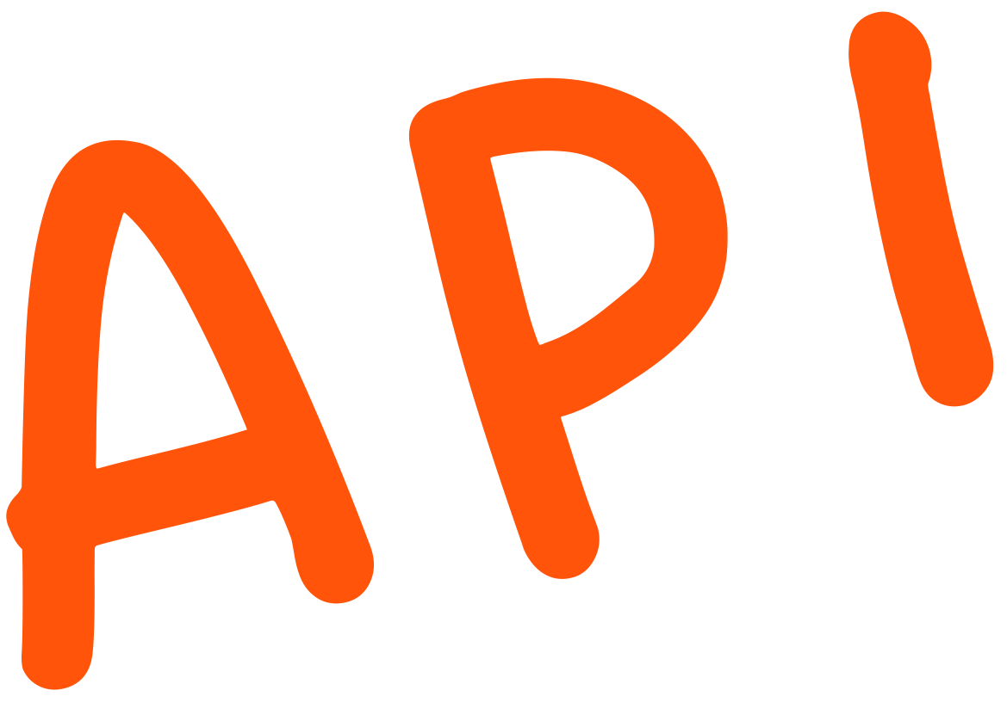
This List Looks Familiar
Specifications and interface contracts
Catalog/Registry
Discovery (Design-time and Runtime)
Ownership & Accountability
Access Requests and Approvals
Lifecycle Management
Agent

Slide 22













MCP Gateways and MCP Marketplaces
Gateways
Registries
Marketplaces, Catalogs & Brokers
… and 35+ others
… and others
Notes:
Market is already reflecting this pattern

Slide 23


A2A Ecosystem is Still Emerging
Gateways
Registries
A2A - Discussion #741
Marketplaces, Catalogs & Brokers
… Not many others… YET

Slide 24
Navigating to a Multiagent Future
Agents are Diverse
Agents are Connected
Diverse Agents means Diverse Platforms
Diverse Platforms Demand Managed Connections
Notes:
We’re going to look at this through four different lenses
the first is we’re going to identify the agents what types of agents should we be concerned With what other uses or strengths
then we’re going to look at the classify the use cases and
then we’re going to look at how those agents are contained where do they exist the platforms that are used to deliver them or operate them
and then we’re going to look at how to assess them what are the risks and how do we mitigate some of those risks so that we can get the most benefit from these new tools
Placeholder for text (substitute your own text; delete when not used)

Slide 25

AI Agent Landscape
Innovation Insight for the AI Agent Platform Landscape (G00825163)
Business orchestration & automation technologies
(Including RPA)
Vertical agents: Healthcare / Government Financial Services/ Education / etc.
Low-code application platforms
Agent stack / agent frameworks
Business-function specific agents: Customer Service / Sales / HR / Service Desk / Marketing / etc.
No-Code Agent Builders
Integration platforms
Simulation platforms (inc. RL agent training)
Task-specific agents: Cybersecurity / Coding / Testing / etc.
DSML platforms
Conversational AI platforms
General-productivity Agents: Personal assistant / Research / etc.
Decision intelligence platforms
Buy
Build
Pre-Built Agents
(Business users)
No-Code Agent Builders
(Citizen Developers)
Agent Development Platforms
(Developers)
Agent Training
Platforms
(AI Experts)

Slide 26
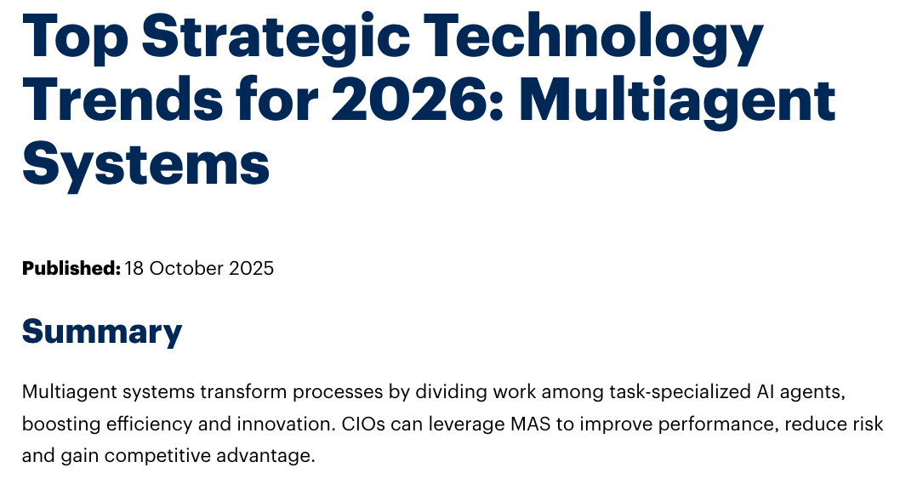
CIOs Need to Plan for MAS

Slide 27

Agents
Calling Agents
Calling Agents
And so on…

Slide 28
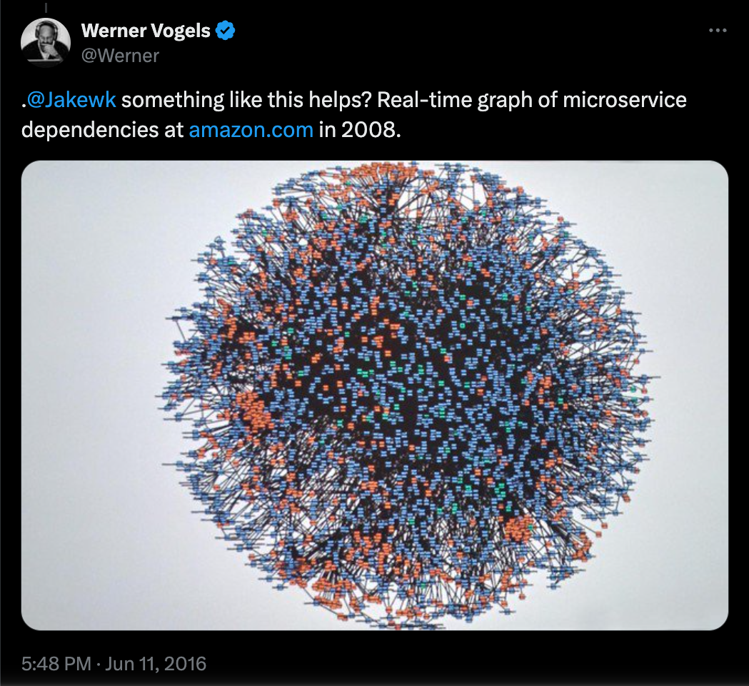
Imagine this, but with Agents…
Source: https://x.com/Werner/status/741673514567143424

Slide 29

We’re Going to Need Multiagent Management
Multiple API
formats
Solutions must weave together:
— Agent Connectivity Control
— Agent Behavioral Control
— Agent Operational Control
- Evaluation
- Observability
Multiple
Platforms
Multiple
Stakeholders
Notes:
But the key point I want to highlight is don’t be afraid to use multiple tools as that is very much in line with the broader trend in API management which is called the unbundling of API management which essentially means that organizations are adoping best of breed point solutions where there current API management providers lack as their needs evolve.

Slide 30
Navigating to a Multiagent Future
Agents are Diverse
Agents are Connected
Diverse Agents means Diverse Platforms
Diverse Platforms Demand Managed Connections
Notes:
We’re going to look at this through four different lenses
the first is we’re going to identify the agents what types of agents should we be concerned With what other uses or strengths
then we’re going to look at the classify the use cases and
then we’re going to look at how those agents are contained where do they exist the platforms that are used to deliver them or operate them
and then we’re going to look at how to assess them what are the risks and how do we mitigate some of those risks so that we can get the most benefit from these new tools
Placeholder for text (substitute your own text; delete when not used)

Slide 31
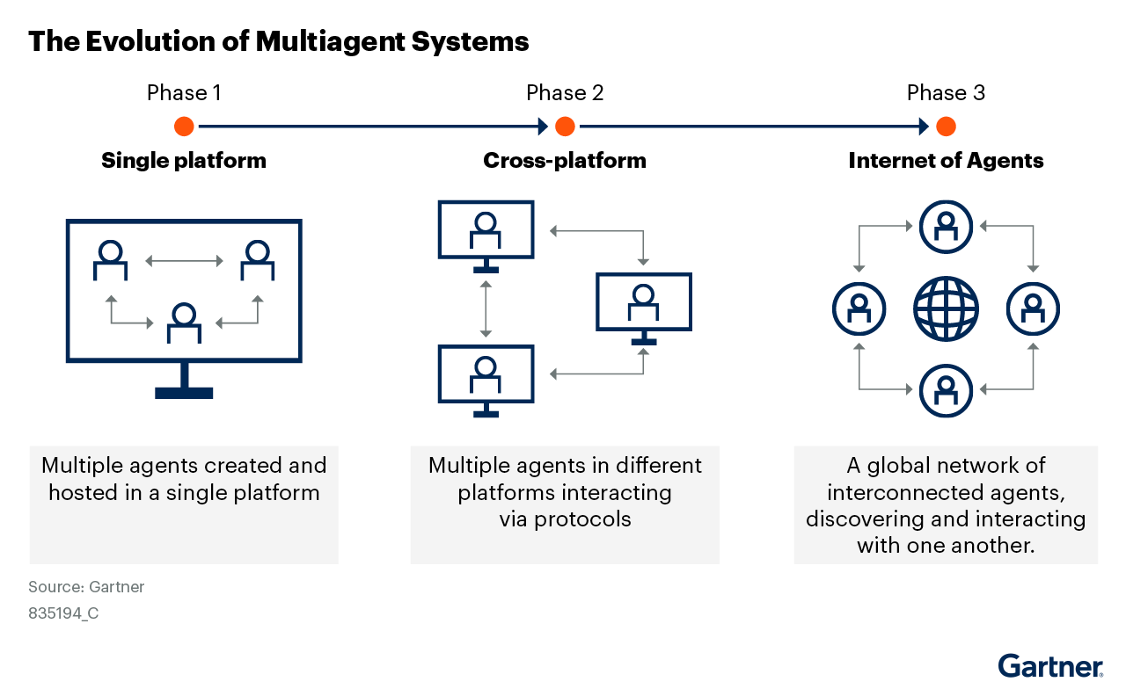
The Evolution of Multiagent Systems
Source: Top Strategic Technology Trends: Multiagent Systems (G00829644)

Slide 32
The Evolution of Multiagent Systems
Most Orgs
Production Mode
8%
Use Cases for A2A
n = 3973 (June 2025)
Source: Polling from Gartner webinar titled AI Value Creation: Achieving ROI Demands a Labor-based Mindset Shift

Slide 33
The Management of Multiagent Systems
Platform-level Agent Supervision
Platform-level Agent Supervision
Platform-level Agent Supervision
Platform-level
Agent Interface
Management
Agent Interface Management
Agent Interface Management
Source: Top Strategic Technology Trends: Multiagent Systems (G00829644)

Slide 34
Remember Agent Management?
Specifications and interface contracts
Catalog/Registry
Discovery (Design-time and Runtime)
Ownership & Accountability
Access Requests and Approvals
Lifecycle Management
Agent

Slide 35
Remember Agent Management?
Specifications and interface contracts
Catalog/Registry
Discovery (Design-time and Runtime)
Ownership & Accountability
Access Requests and Approvals
Lifecycle Management
Agent

Slide 36

Supervising Your Agents vs Governing Interfaces
Agent
Diverse Platforms
Diverse Forms of Agent
Non-deterministic Behaviour
Evaluation and Observation
“Behavioral Trust” as an SLA
Life cycle management
Agent Contract
Network Endpoints
Agent Discovery
Access Control
Communication Management

Slide 37
Takeaways
Classify your agents – don’t treat them all the same
Distinguish and develop agent interfaces from agent implementation
Choose platforms that publish and consume agent interfaces
Compose multiagent systems based on agent interfaces
Govern your agent interfaces, supervise your agent implementations

Slide 38
Takeaways
Classify your agents – don’t treat them all the same
Distinguish and develop agent interfaces from agent implementation
Choose platforms that publish and consume agent interfaces
Compose multiagent systems based on agent interfaces
Govern your agent interfaces, supervise your agent implementations
A2A
A2A
A2A
A2A

Slide 39

Gartner - Helping you navigate
Recommended Gartner Research
Top Strategic Technology Trends: Multiagent Systems
Tom Coshow, Gene Alvarez and others
Emerging Patterns for Building LLM-Based AI Agents
Gary Olliffe and Steve Deng
Choosing API Formats for AI Agents and Applications
Gary Olliffe
Market Guide for AI Gateways
Andrew Humpfreys and others
Schedule a meeting with
a Gartner specialist
Notes:
Learn more which leads to the SWE function page.
Request a demo goals to the Become a Client form.
PUT THIS ONE AT THE END OF YOUR PRESENTATION.

