Slide 1

NRCoP & ANZSOG present:
From capture to co-design: the regulator/regulated relationship.
SPEAKER
Graeme Samuel AC
Professorial Fellow
Monash University
SPEAKER
Chris Ingham
Deputy CEO
VRQA
MODERATOR
Pam White
Chair
VRQA
Friday 1 March 2019

Slide 2
From capture to co-design: the regulator/regulated relationship.
Q & A
Join at
Slido.com
#J596
SPEAKER
Graeme Samuel AC
Professorial Fellow
Monash University
SPEAKER
Chris Ingham
Deputy CEO
VRQA
MODERATOR
Pam White
Chair
VRQA

Slide 3
Key questions
What does an optimal relationship between regulators and regulated entities look like?
How do you establish and maintain working relationships with regulated entities − and stakeholders that represent their interests – in a way that advances the public good at the core of the regulator’s purpose?
Join at
Slido.com
#J596

Slide 4
Regulatory relationship: two ends of a spectrum
Regulatory Capture
Features Proximity, interwoven relationships, sometimes improper. Abundance of (misplaced) trust Power imbalance (regulated > regulator) Carrot instead of stick Asymmetric information flows
Regulatory Discord
Features Distance, little or no relationship Lack of trust Stick instead of carrot Little or no information flows
Join at
Slido.com
#J596

Slide 5
Sometimes the same regulator makes a dramatic shift from one to the other
Regulatory Capture
Features Proximity, interwoven relationships Abundance of (misplaced) trust Power imbalance (regulated > regulator) Carrot instead of stick Asymmetric information flows
NSW Mining Inspectorate
(Gunningham and Sinclair, 2008)
Regulatory Discord
Features Distance, little or no relationship Lack of trust Stick instead of carrot Little or no information flows
Pre-1996
“toothless, passive and acquiescent”
Advise and persuade model
Multiple breaches and deaths, but few prosecutions
Post-1996 (after major accident)
New Investigations Unit, aggressive and muscular.
Prosecution model, including at ‘the low point of the culpability hierarchy’
Relationship with mine managers ‘strained and distant’
Perceived as inherently unfair
An abundance of misplaced trust (regulatory capture) is as bad as the absence of trust (regulatory discord)
Join at
Slido.com
#J596

Slide 6
Common principles: calibrating the relationship (regulator’s perspective)
Purpose | … but regulators should guard against…
Stakeholders help regulators communicate: what are the regulations and what should people do to comply? | a) ‘Gilding the lily’. Communicate about the consequences of poor behaviour. b) Over-reliance; when stakeholders want to tackle all breaches through ‘better communication’.
Ease of implementation: Operationalising the regulations in the field (efficiency, minimising burden). Sparrow: “be less intrusive but more effective.” | Being less intrusive AND less effective (e.g. Hayne’s comments on ASIC and its use of media releases and enforceable undertakings).
Feedback loop and continuous improvement: what’s working? What’s not? | a) A view that client/stakeholder satisfaction is the main evidence of success. It is not. b) The regulated determining the regulatory process. We want input, not control. c) Undue influence and bias.
To build a level of trust that will (theoretically) lead to increased compliance over time. | Slippage to misplaced trust.
Join at
Slido.com
#J596

Slide 7
Beyond the common principles: your particular context
Regulatory Capture
Features Proximity, interwoven relationships, sometimes improper. Abundance of (misplaced) trust Power imbalance (regulated > regulator) Carrot instead of stick Asymmetric information flows
Regulatory Discord
Features Distance, little or no relationship Lack of trust Stick instead of carrot Little or no information flows
What’s your starting point?
Where are you on the spectrum?
What’s going to work?
Join at
Slido.com
#J596

Slide 8

Regulation: a love story
How did we get from this
to this
in one year?
Join at
Slido.com
#J596

Slide 9
What’s your starting point? Four eras in the state/home schooling relationship
1872-1970s | 1970s-2006 | 2006-2017 | 2018-
Ships passing in the night | David and Goliath | Light-touch | ?????
No relationship | No relationship + confrontation. + numbers grow, state concerned. First attempts to introduce regulations; litigation test case. Home schoolers win. | Formal, distant relationship + confrontation Home schooling recognised in legislation. First attempt at formal meetings (2006-2009) Applicants submit a one page form and are placed on a register. | New requirements: applicants submit learning plan and 10% of cohort reviewed annually.
Starting point:
Regulatory Discord + new regulations that substantially increased oversight.
Join at
Slido.com
#J596

Slide 10
Starting Point: The DET RIS case for change based on complete lack of information, an outcome of the ‘ships in the night’, ‘David and Goliath’ and ‘Light Touch Regulation’ eras.
“…some home‑schooled children may not receive a quality education, and Government does not have effective mechanisms to manage this risk. The Department considers this presents a level of risk to the objectives of the Act. Under the current regulatory arrangements, there is no way of ensuring or monitoring quality in home schooling because the regulator requires no information from an applicant, aside from the names, addresses and ages of the children to be home schooled. Little is known about how instruction is delivered, which educational style is used, or what outcomes home‑schooled students achieve.”
Join at
Slido.com
#J596

Slide 11
Strategy: build legitimacy
DET got the RIS process right.
Address bias.
Sudden shift to radical transparency.
Communicate to address understandable fears.
Tap expertise and knowledge.
Join at
Slido.com
#J596

Slide 12
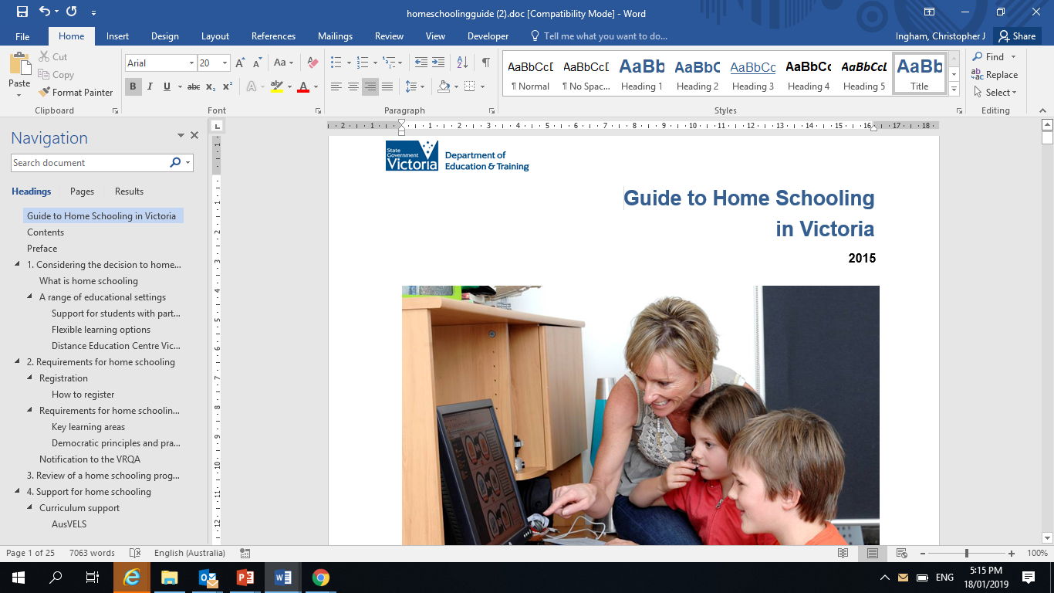
Address bias (1)
A distinctive tone. Really a guide to alternatives to home schooling.
“You may be considering home schooling your child for a variety of reasons. Whatever your reasons, it is important that your decision to home school is an informed one. You should discuss your options with a local principal to explore the range of options available within a school setting before you make a decision.”
“The decision to home school has consequences for your child’s current and future schooling including their access to senior secondary school qualifications, work experience and post school pathways.”
Join at
Slido.com
#J596

Slide 13
Address bias (2) – corridor conversations
Worst case examples of when regulators don’t respect their clients: Flint Water Crisis
“Throughout 2015, as the public raised concerns and as independent studies and testing were conducted and brought to the attention of MDEQ, the agency’s response was often one of aggressive dismissal, belittlement, and attempts to discredit...” (Flint Water Advisory Taskforce).
Citizens are in the best position to tell the regulators about what’s wrong. The EPA and MDEQ dismissed complaints from the blue collar, African American community, characterising them as uneducated and susceptible to rumours and fear mongering.
Join at
Slido.com
#J596

Slide 14
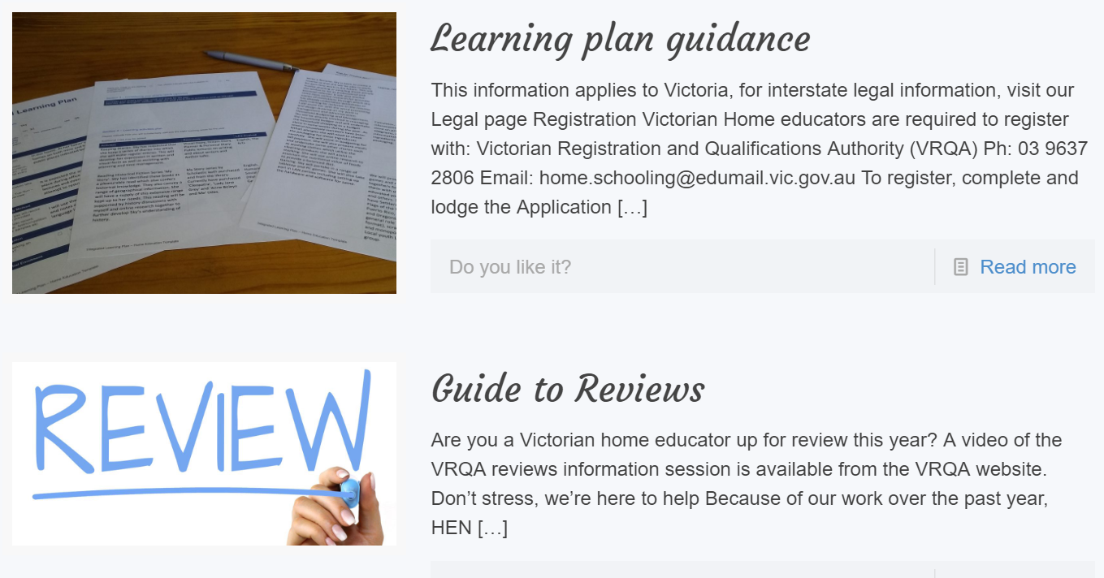
Sudden shift to radical transparency
Offer to home schooling representatives:
Sit on selection panel to recruit the new home schooling team.
Join us at state-wide information sessions – co-presentations. Help us inform people about what’s changing and what they need to do.
Co-create all regulatory processes and tools.
Join at
Slido.com
#J596

Slide 15
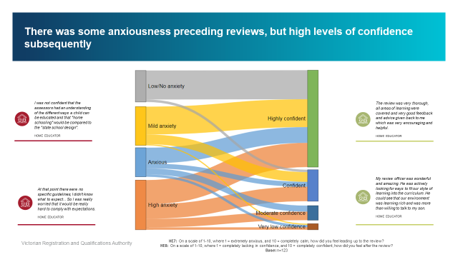
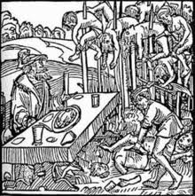






Join at
Slido.com
#J596

Slide 16


Check out the National Regulators Community of Practice page on the ANZSOG website with links to our new LinkedIn Group
anzsog.edu.au/communities/regulators

