Slide 1

Turnover/Leavers
 | Jun-22
Directorate | Turnover
CHTE | 9.06%
COMMS | 27.73%
DIT | 12.64%
FST | 10.23%
HSC | 23.56%
NICE CfG | 8.05%
P&P | 19.24%
SEA | 12.20%
Grand Total | 11.89%
103
Leavers in past 12 mths
BAME leavers 10% of total
Dir. | No of Leavers
CHTE | 21
COMMS | 14
DIT | 9
FST | 7
HSC | 15
NICE CfG | 22
P&P | 6
SEA | 9
Grand Total | 103

Slide 2
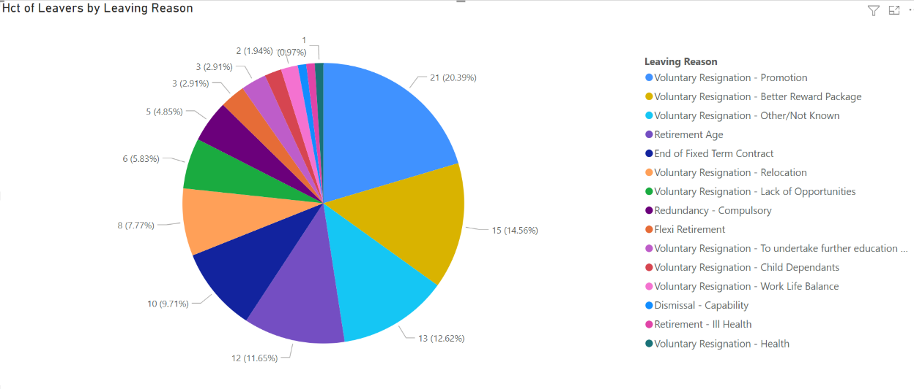
Reasons for Leaving
Turnover/Leavers

Slide 3
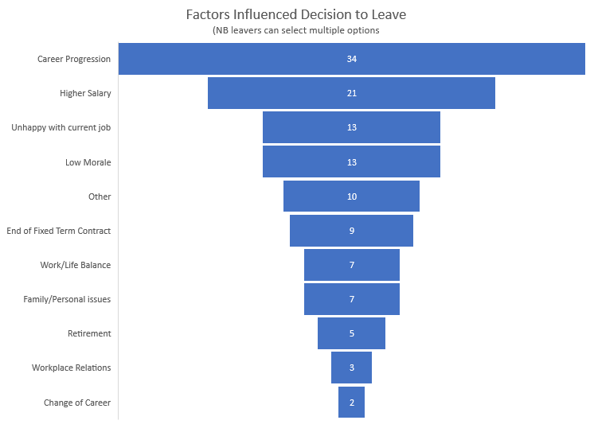
Exit Interviews
Dir. | No. Rec'd | % Rec’d
CHTE | 15 | 71%
Comms | 8 | 57%
DIT | 2 | 22%
FST | 4 | 57%
H&SC | 4 | 26%
NICE CfG | 14 | 63%
P&P | 6 | 100%
SEA | 6 | 66%
TOTAL | 59

Slide 4

Exit Interviews Themes

