Slide 1
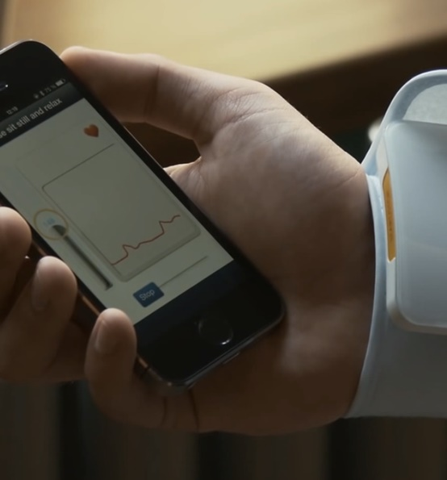
Priority 3
Early Value Assessment for Medtech
Conditional recommendations for digital products, devices and diagnostics

Slide 2
Purpose
To give a brief summary of the approach compared to the “as is”.
Goal, themes and technologies for 22/23.
To provide a headline update on the project’s latest position.
4: To share the successful steps thus far.
5: Board challenge and discussion.

Slide 3
Current approach versus new approach
Current approach
Topic selection
Scoping
Evaluation
Guidance development
Evidence generation
New approach
Topic intelligence and selection
Early value assessment
Evidence generation
Guidance development
Scoping
Evaluation
Recommendations – use while collecting real world evidence.
Evidence generation plan.

Slide 4

10 pilot topics 22/23
Test and learn approach across pilots:
Efficiencies in guidance product pathway
Different approaches to methods and processes
System engagement
Key considerations:
Mental health, early cancer detection, cardiovascular, elective recovery
Different types of technology, use case and data infrastructure
Technologies:
6-lead ECG for measuring cardiovascular risk in people having antipsychotic medication
Digital therapeutics for childhood anxiety and low mood
AI solutions for analysing x-rays in cancer
AI solutions for predicting cardiovascular risk

Slide 5





Benefits/ Outcomes
Quicker early value signals to the health and care system on promising medical technologies that address national unmet need
Better evidence to inform clinical and long-term commissioning decisions
Earlier access for patients
Clearer pathway to market access for industry
Collective contributions to system wide productivity and efficiency

Slide 6
High-level timeline
Long list of topics
First topic selection
Second topic selection
First tech selected through scoping
Finalised methods, processes and templates for pilot (July)
EVA evidence principles developed
First pilot data sourcing complete
APRIL
22
MAY
22
JUNE
22
First conditional recommendation awards
Ongoing conditional recommendation awards (10 conditional recommendations by end 22/23)
Pilot stakeholder feedback
Resource model, final methods & processes, and implementation plan for 2023/24
First pilot starts - first technologies start evaluation period
JUNE
22
OCTOBER
22
MAR 23
JAN TO FEB 23
NOV 22 TO MAR 23

Slide 7
Topic Intelligence Sources
EXTERNAL ENGAGEMENT
Conferences
NHSE/I/X
OLS
AHSNs
Web Searches
MHRA CE Register
INTERNAL ENGAGEMENT
Adoption and Impact
NICE Associates
ORCHA
NHS AAC
NICE International
Guidelines Team
Topic
Intelligence
Hub
Horizon Scanning Agencies
ICS Innovation leads
MedTech / Diagnostics
Medicines Team
NCDs/
Advisors
International DH experts
Implementation Team
Analytics Team
Industry
Royal Colleges
Innovation Competitions/Awards
Innovation Service/HTC

Slide 8
Positive Progress to date
First and foremost the Early Value Assessment programme has clearly signalled the importance of Medical Technology for the system and priorities within NICE.
There is a focus on Digital Health technologies within the pilots, however important to emphasise this is a programme for the wider Medical Technology sector.
EVA; we are looking at parallels to Medicines programmes as this could be considered ‘Managed Access’.
Assessment groups have been commissioned with the first Technologies undergoing assessment.
Notes:
Bullet: 1: We emphaise as important as

Slide 9
Positive Progress to date (continued)
Methods and Process draft will be delivered internally end July i.e. next week
  These two elements in particular illustrate the internal teams appetite to challenge the historic process and way of working.
  Developing the pragmatism that is required and will be required ever more going forward, but no less rigorous.
Partnering with colleagues within the system we have identified challenges for example interoperability standards; using the test, learn and adapt philosophy we are remedying and solving these challenges as they arise.
Given the favourable feedback from stakeholders, We will be incorporating where appropriate the ESF and RWE standards NICE have developed.
Stakeholder engagement is encouraging with 900 attendees at the recent EVA webinar. The honesty around the ‘test and learn’ was well received as was the clear signal that work programmes would be linked to national priorities.
Notes:
Bullet: 1: We emphaise as important as

Slide 10
Summary
To date progress should be viewed as positive.
While a couple of timelines have slipped this is due to the complexity of the challenge.
We anticipate that all the learnings will see a steady state emerge as we progress with further topics.
The next theme within Mental Health will allow for further discovery as this will be a multi technology approach.
To reassure the Board and attendees that the ‘Test, Learn and Adapt’ approach will deliver the over aching aims of the EVA programme.
Delivering on our commitment to support innovation assessment in the Medical Technology field and creating a platform off which we will build further support and simplification in this area.
Driving innovation into the hands of health and care professionals to enable best practice, support recovery and improve patient outcomes.
Notes:
Bullet: 1: We emphasise as important as

