Slide 1

Cyber Security & Business Continuity Update
Last updated: 28th November 2024

Slide 2
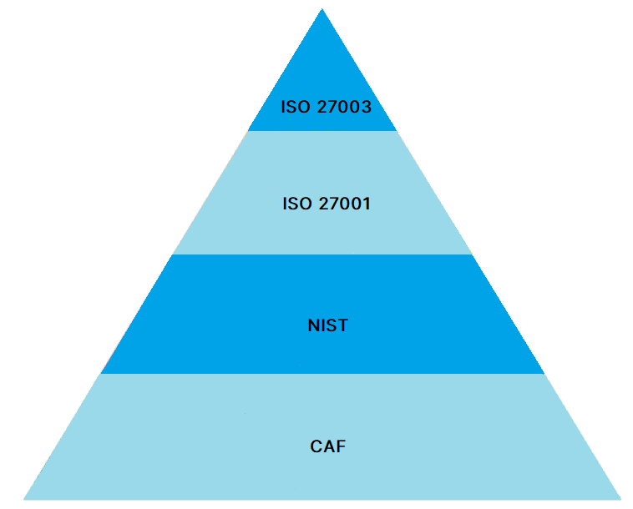
Cyber Strategy - background
Assurance & Certification
NICE has aligned its assurance strategy against industry standard frameworks and best practice for IT & Information Security to assure against cyber threats and risks. Through alignment and certification against such frameworks as the Cyber Assessment Framework (CAF) and government backed best practice initiatives such as Cyber Essentials, NICE are committed to continual strengthening our cyber security posture, business continuity and disaster recovery.

Slide 3
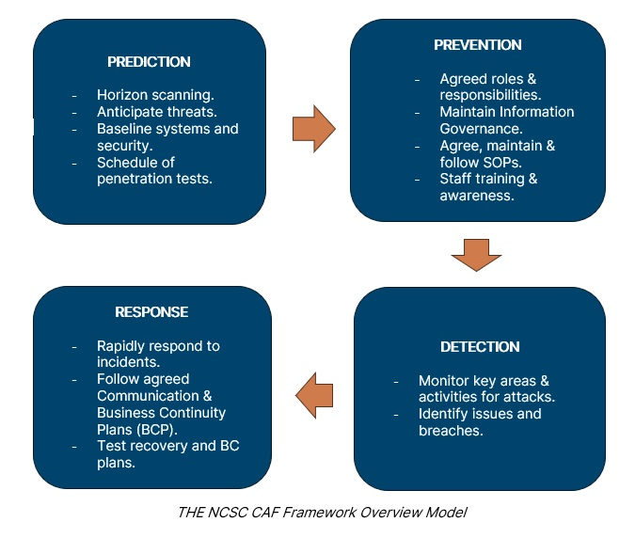
Cyber Strategy - methodology
CAF & the NHSE DSP Toolkit
The NHSE DSP Toolkit is undergoing a transformation to become aligned to the industry standard CAF certification, which mirrors NICE’s cyber strategy. NICE is committed to this journey for DSP Toolkit certification and CAF assurance.

Slide 4
Cyber Strategy – Approach
Approach
Our cyber strategy approach, aligned to NICE's cyber security strategy, was approved in January 2024. This approach presented two phases for continuous improvement:
Phase 1 (2024/25) - Foundational
  Modernise on-premise infrastructure & removing technical debt
  Focusing on preventative measures and controls
  Establishing governance assurance model, aligned with our cyber strategy of industry standard and best practice compliance and certification
Phase 2 (2025/26) - Transformative
  Focusing on reactive measures, controls and process
The phases above cover the 3 themes of security:
Prevention: Controls and measures to prevent success of an attack
Reactive: Process and measures related to business continuity, data protection and disaster recover to be able to react and recover quickly in event of a successful attack
Governance: Following industry best practice overall and established compliance and certifications
* - these are subject to prioritisation and funding

Slide 5
2024 – Key Highlights
Prevention
Responsive / Reactive
Governance / Oversight/Assurance
Implementation of zero-trust model and controls to securely manage access to NICE services
Overarching Business Continuity Plan (BCP) and pandemic BCP reviewed and ratified
Yearly certification achieved against 2024/25 NHSE DSP Toolkit
Modernising Core Infrastructure – new data centre, introduction of next generation firewall technology
ET and ARAC Board Reporting
Rolling penetration testing and vulnerability management of NICE infrastructure and Live Services web applications
Monitoring & Reporting
NICE generative AI Policy
MTI / NHSE external tech reviews
Implementation of enhanced network vulnerability solution, allowing for network and user device vulnerability monitoring

Slide 6
Cyber Strategy – Risks
Risks
Resourcing: This is being mitigated by a flexible resourcing blend of external specialist partners and internal resource to deliver this programme of work.

