Slide 1



Greggs Foundation
Summer term update 2026
Notes:
Good evening, everyone!
I’m always delighted to get the opportunity to stand here and reflect on what we’ve achieved together and what a year it’s been and great to be able to share with you the challenges – but exciting changes - we have been going through in 2025.

Slide 2

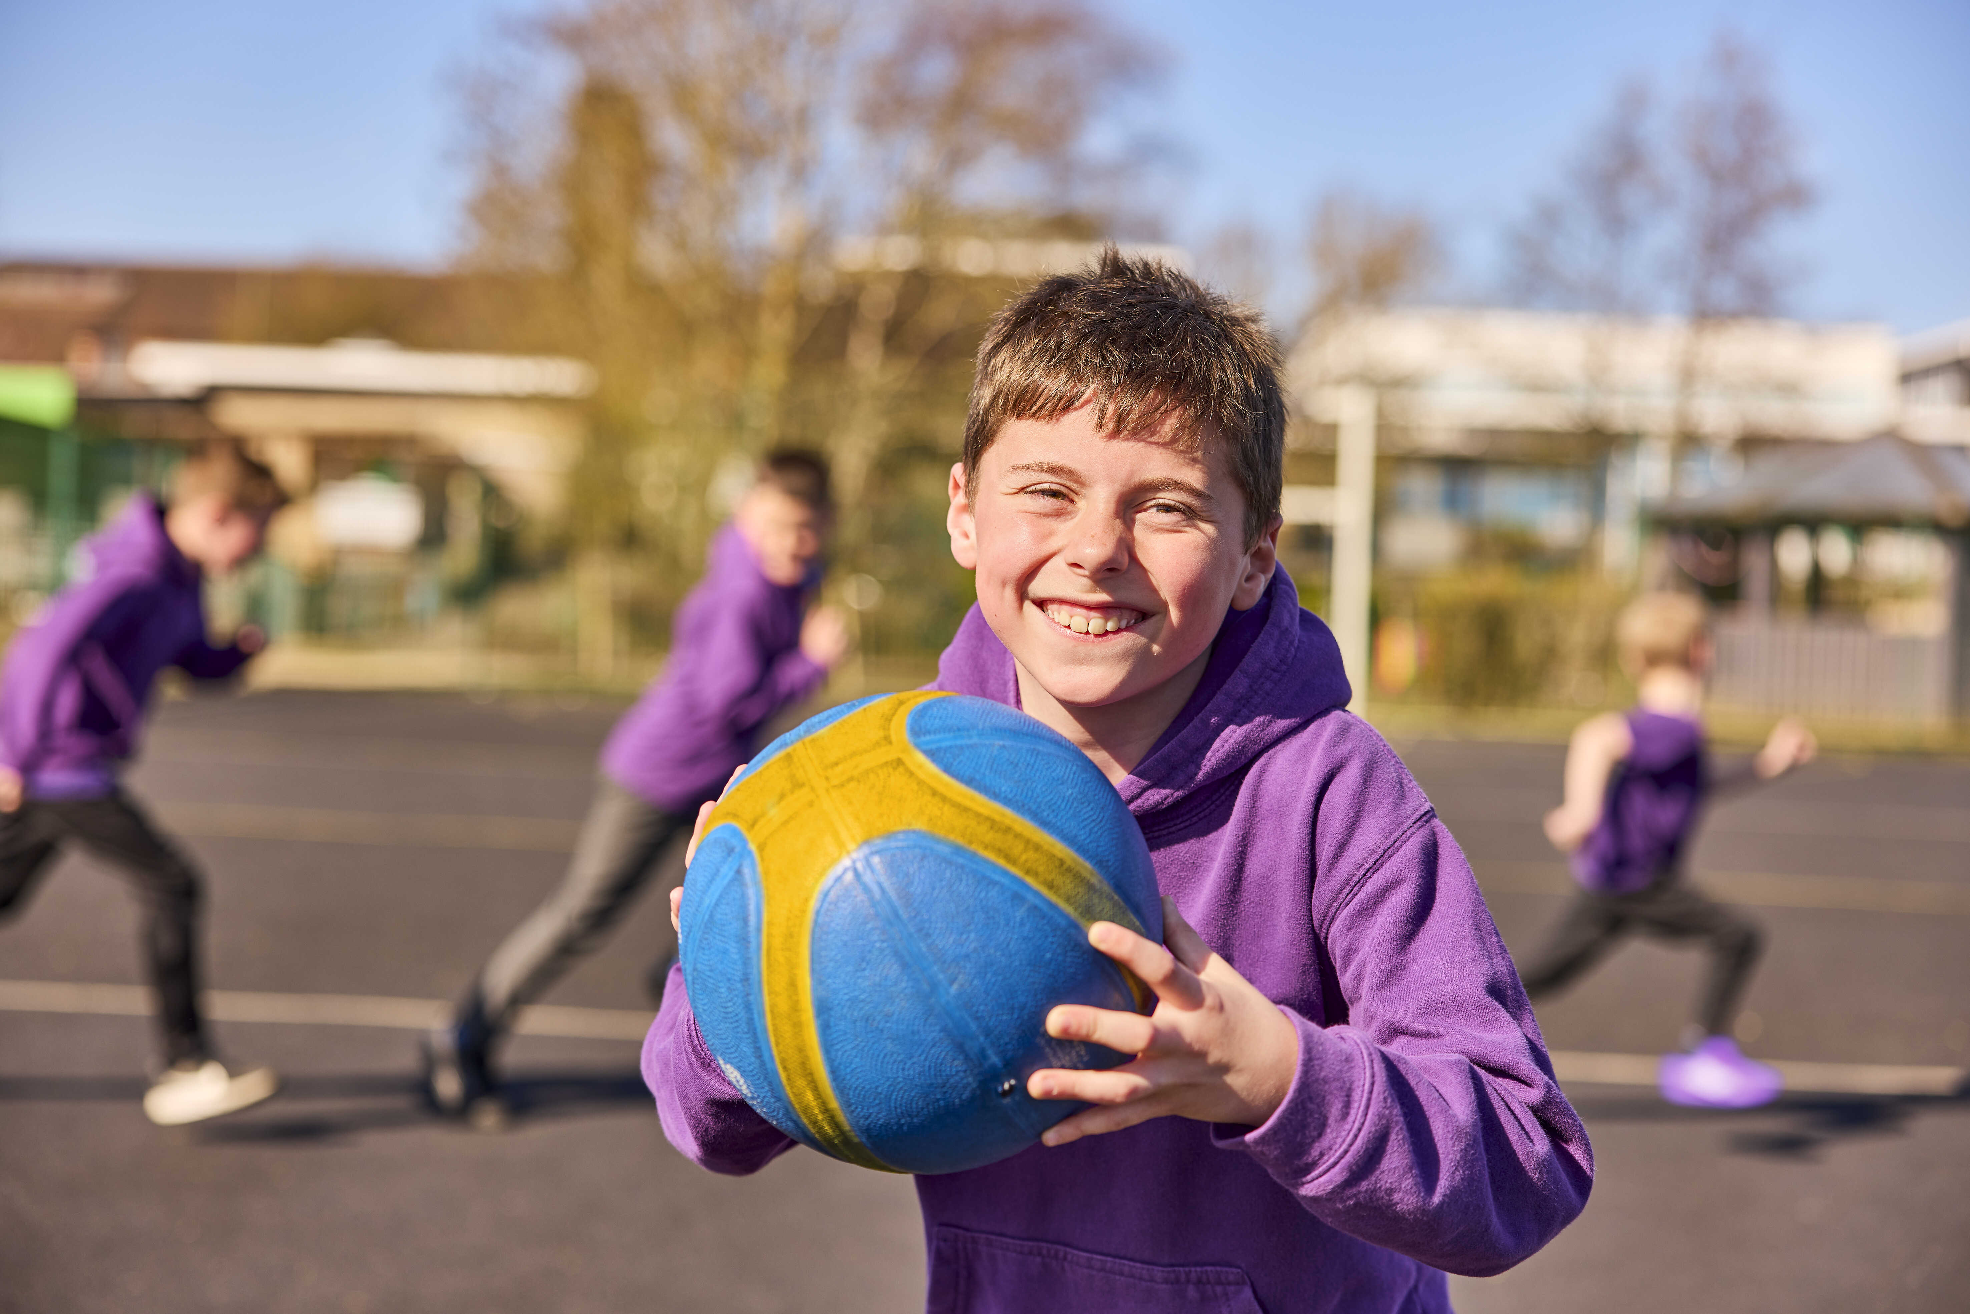

What is Feeding Brighter Futures?
£1000 x 3 terms
119
ACCESS TO RELIEF GRANT
Schools can access a cash grant of £1000 per term to fund a range of extra-curricular activities outside of the classroom
194 schools in our network are now receiving funding for extra-curricular activities following their transition to the government free breakfast club scheme
All schools in our Feeding Brighter Futures network can still apply for a relief grant for families facing challenging circumstances

Slide 3
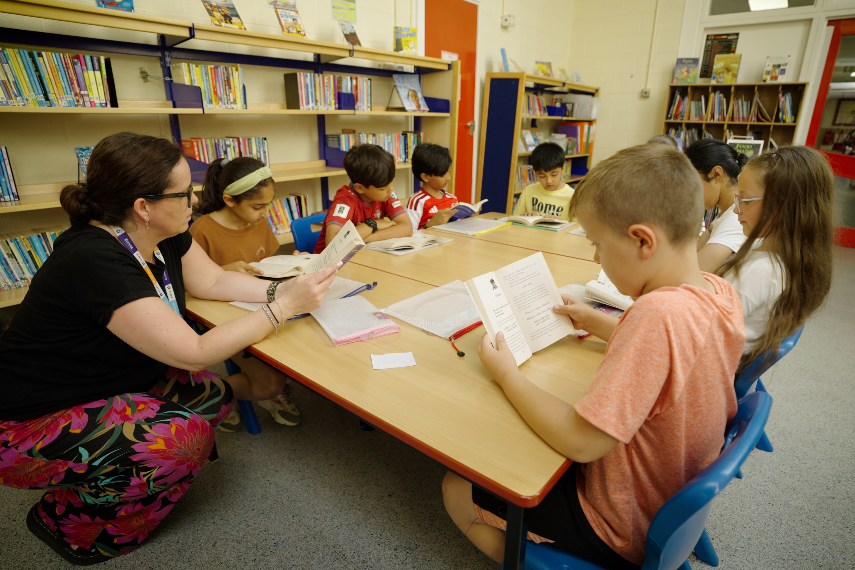
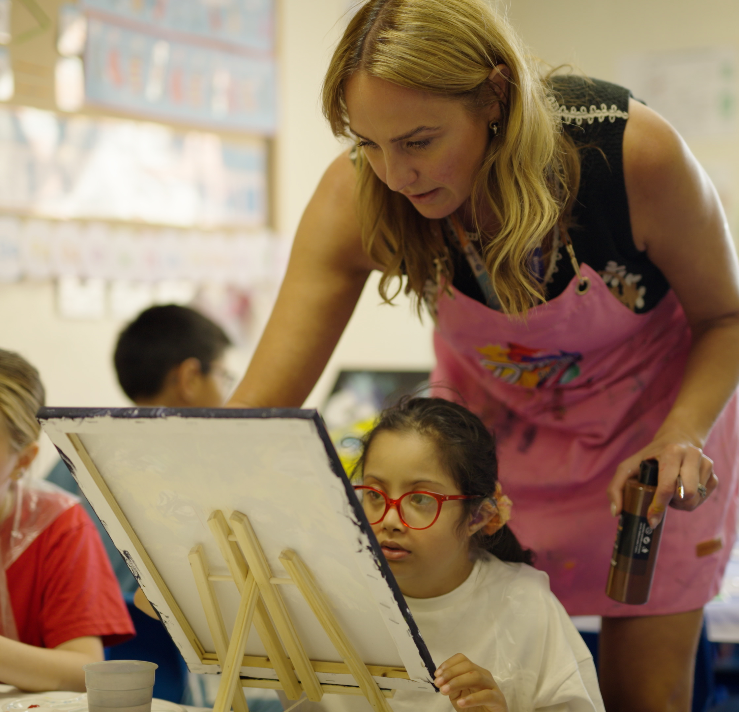
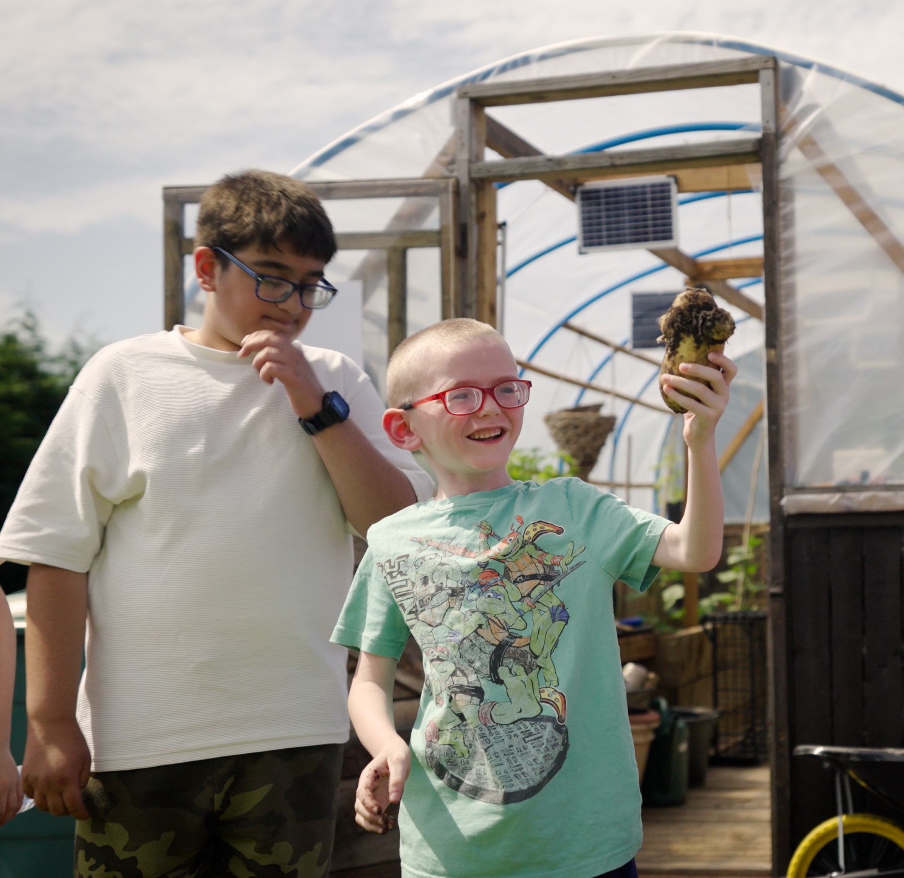

Stories from our schools
How does Casterton Primary School create
opportunities using Feeding Brighter Futures?
Click for short film

Slide 4
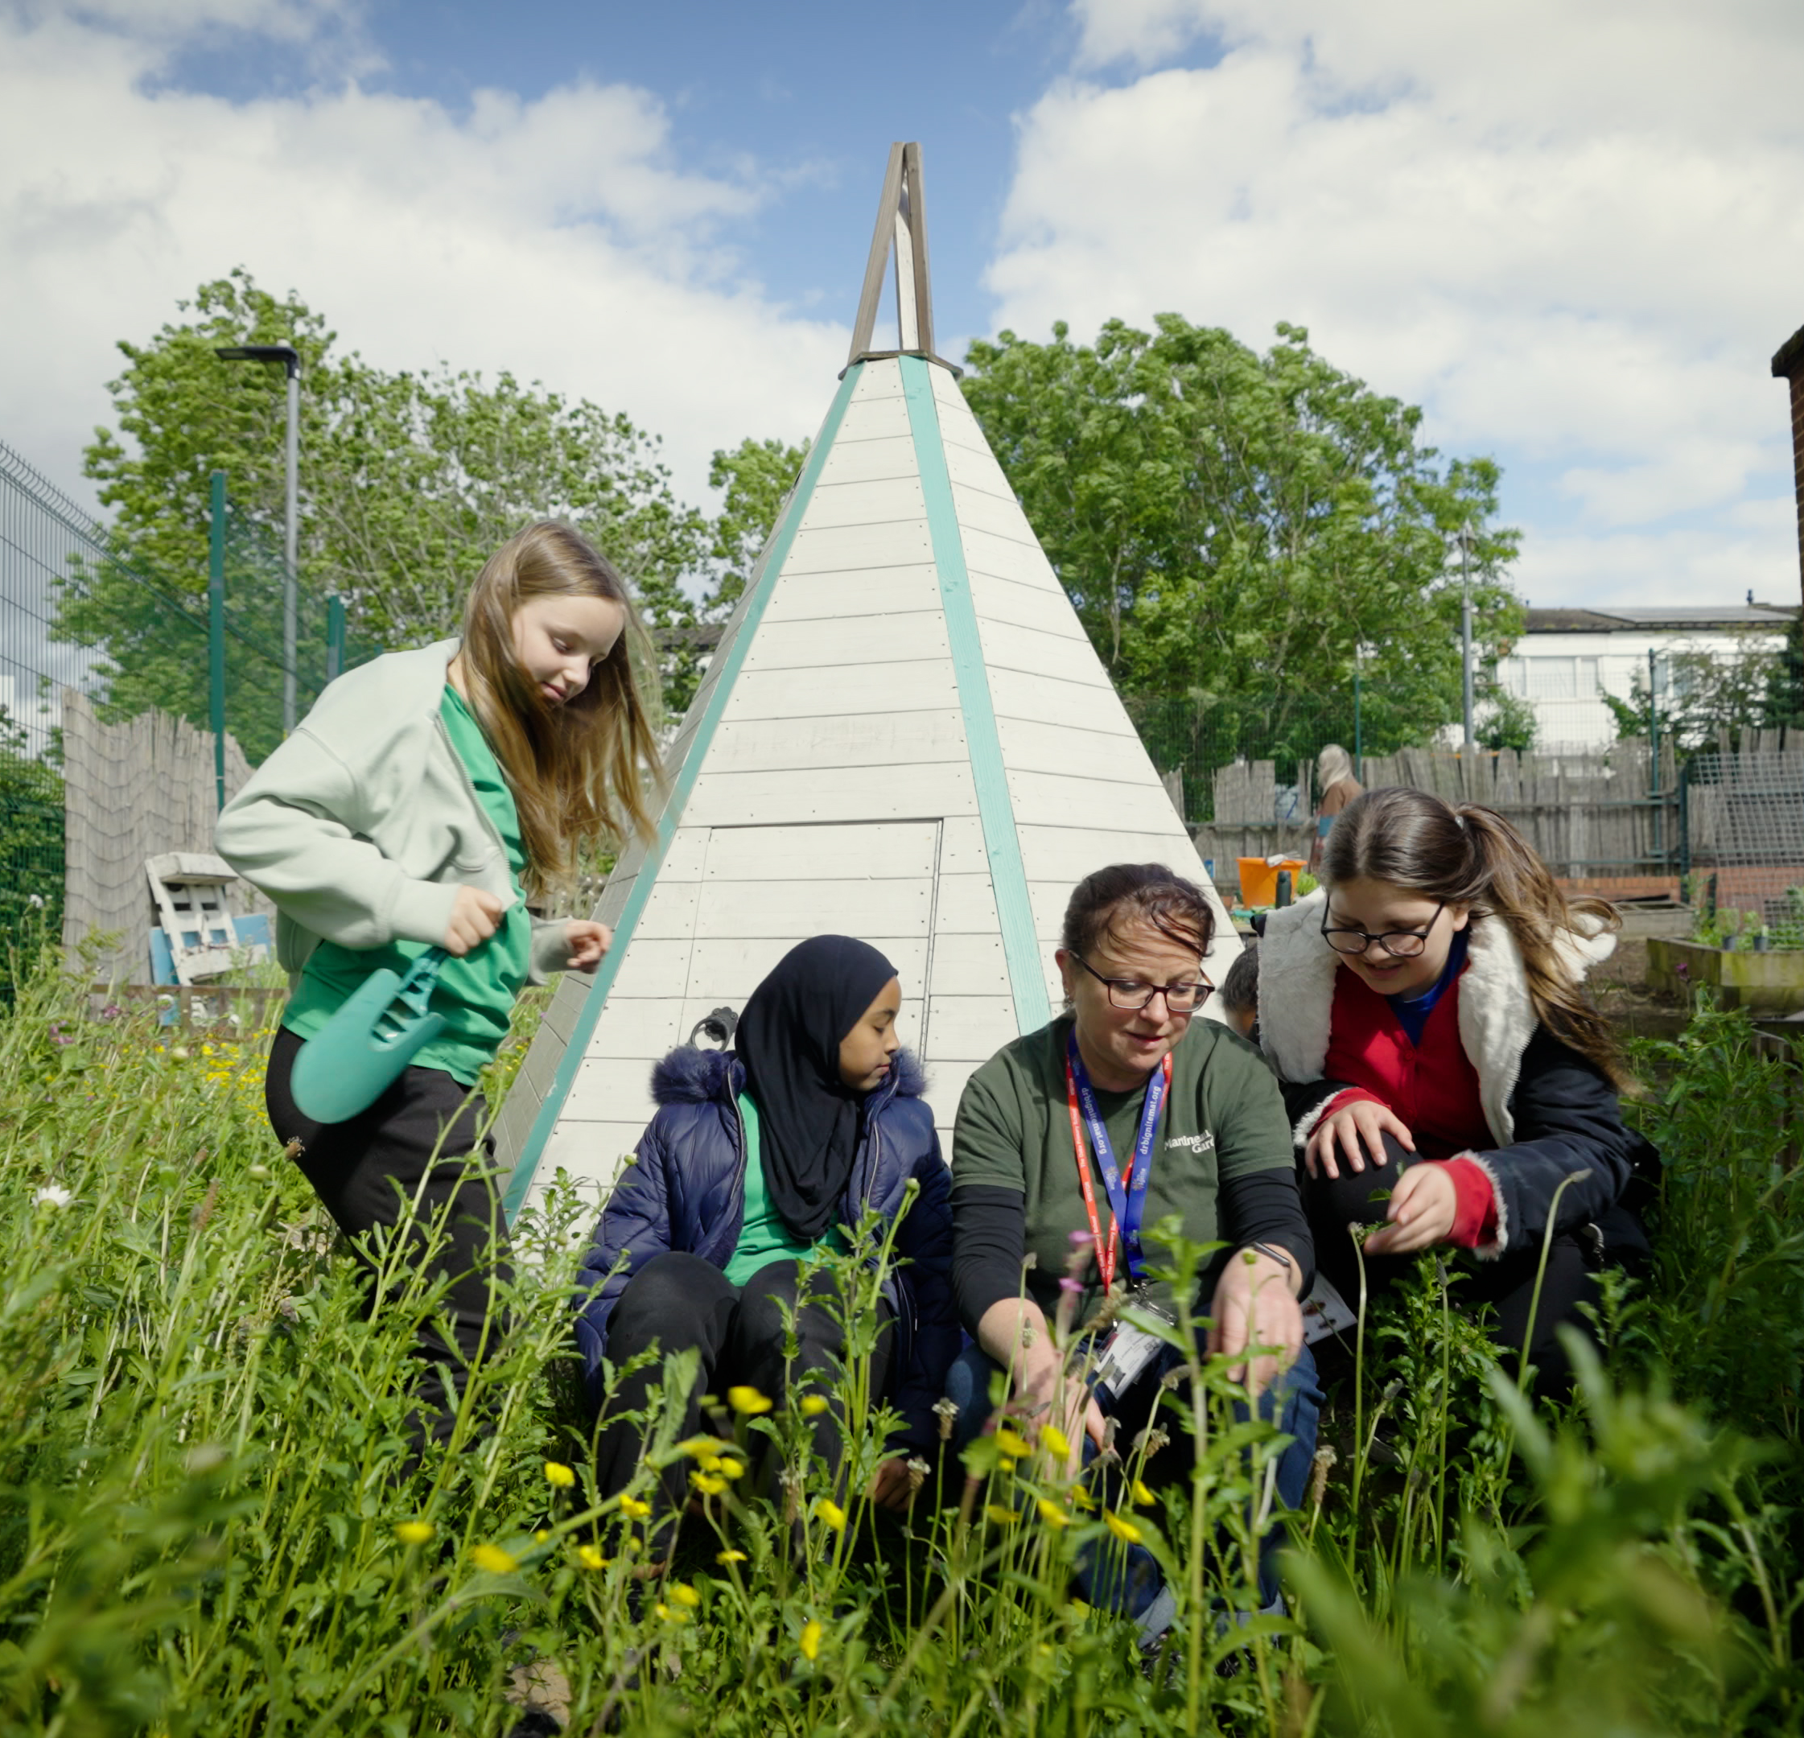
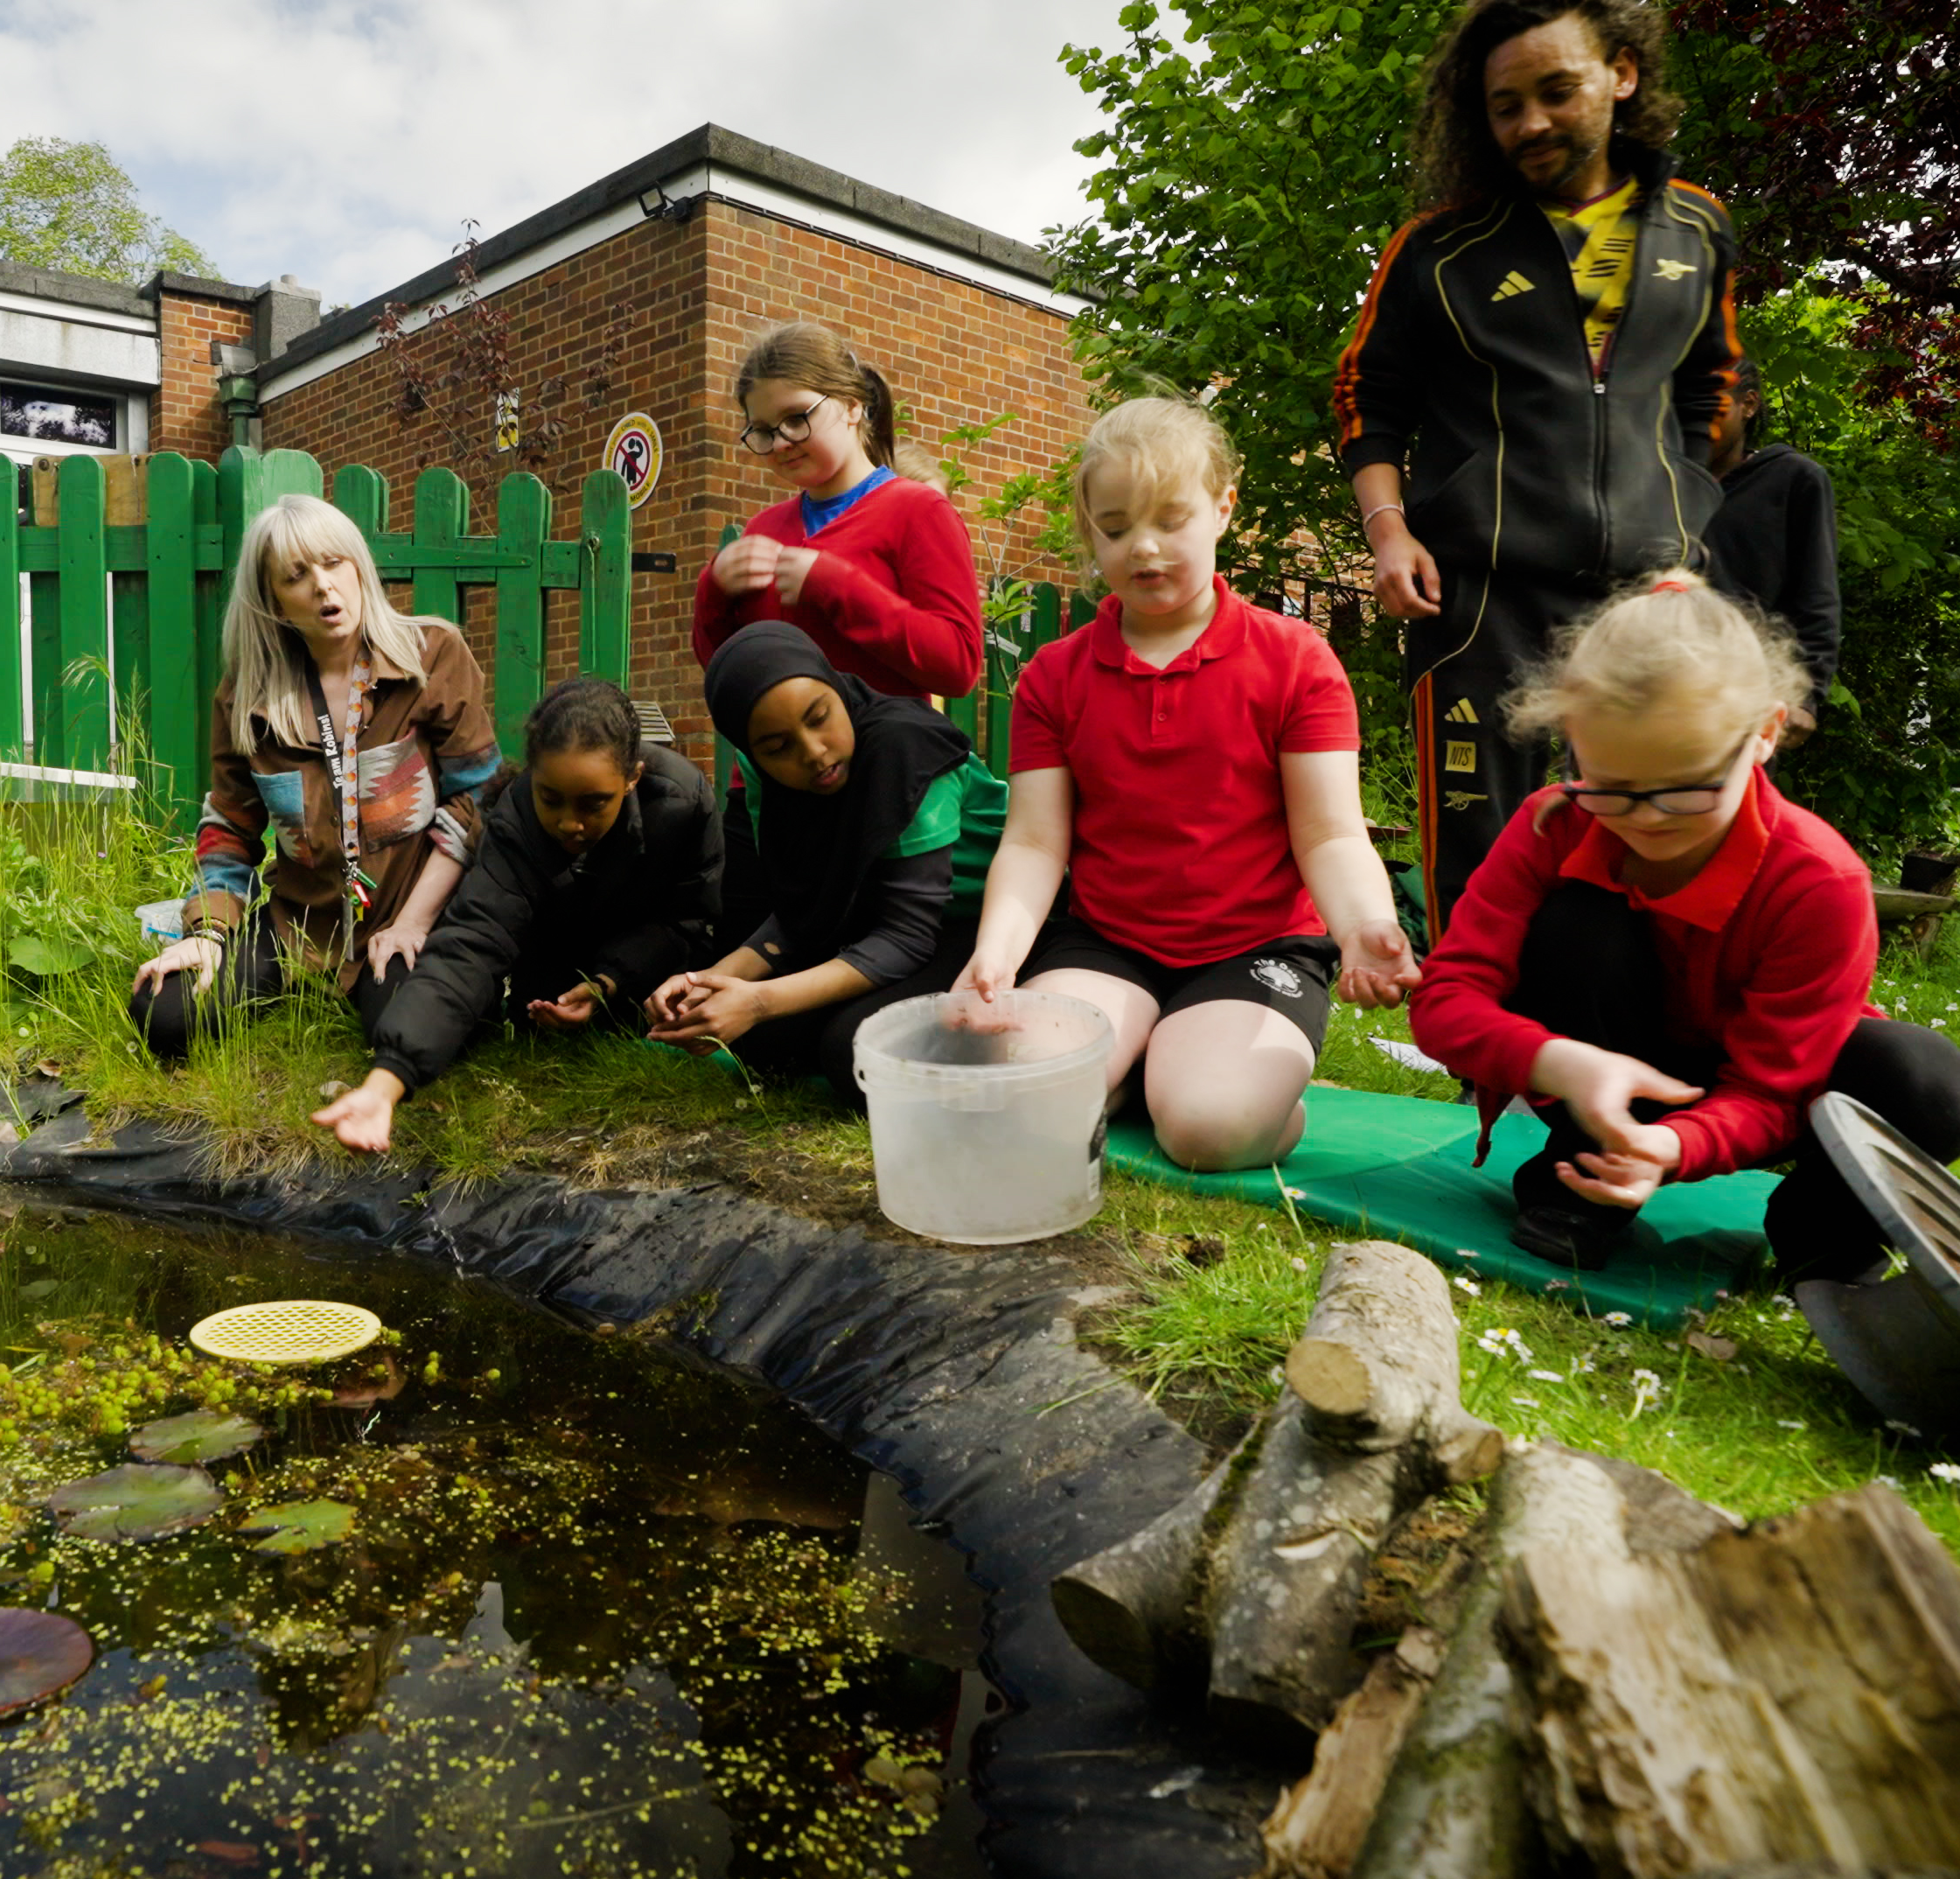
See how The Oaks Primary
is growing brighter futures
for pupils in Birmingham
Click to
watch
short film

Slide 5

Helping Us Reach More Children
A key benefit of being part of our school network is schools have access to our Relief Grant programme.
Over £138,500 in relief grants awarded to schools between January - June 2026
THANK
YOU
FOR YOUR
SUPPORT

