Slide 1
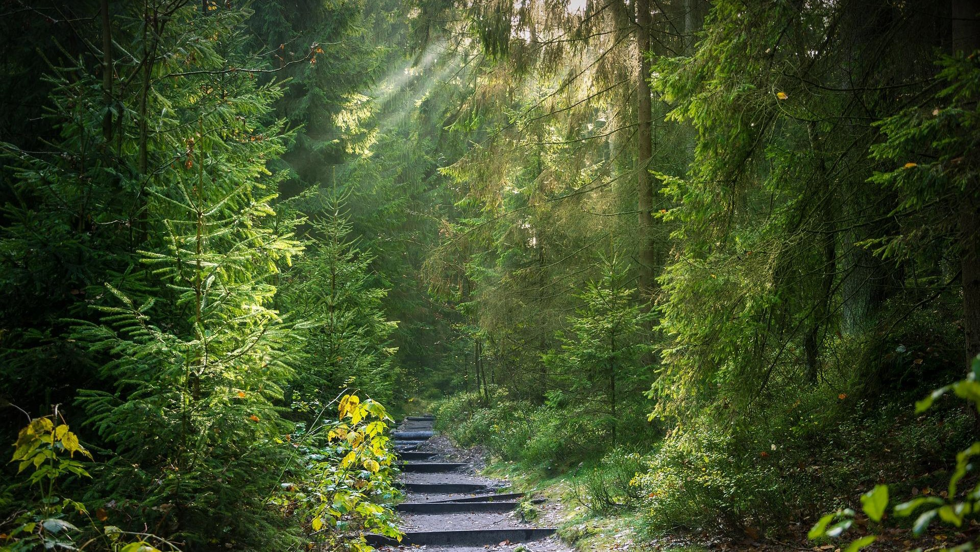
No
W O O D - B A S E D
P L A S T I C
M A T E R I A L
INTRODUCTION

Slide 2
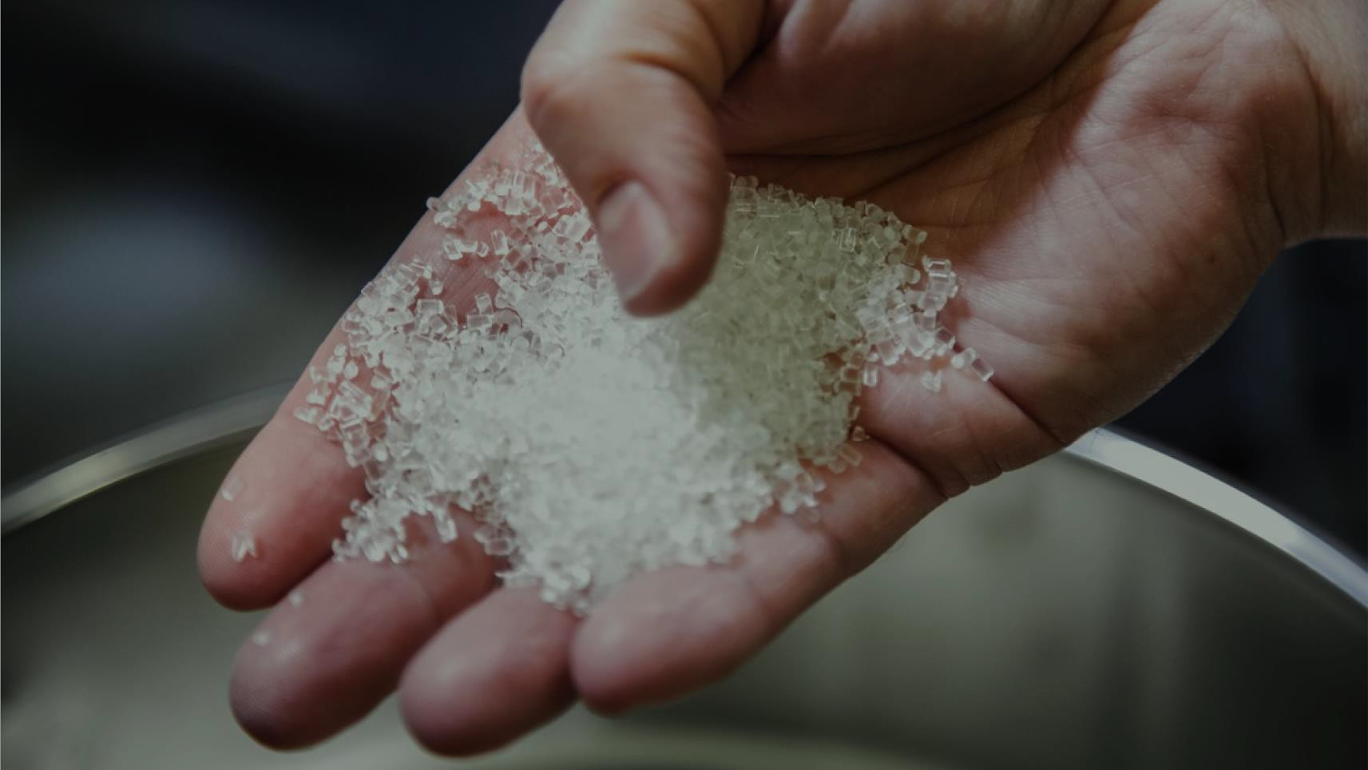
Woodly® is entirely new kind of carbon neutral plastic based on wood

Slide 3


Enables replacing 15% of fossil plastics
(5x recycling)
10 million tons Woodly in 2035
~5% of pulp production capacity
Attained market $100B

Slide 4
100 million tons CO₂ reduction

Slide 5

Woodly Ltd
Finland based technology startup developing wood-based bioplastic called Woodly®
Team:
  CEO Jaakko Kaminen
  CTO Tommi Vuorinen
  CCO Tomi Nyman
  Director sustainability Tiina Tuominen
  Lead Circular Economy Veera Virtanen
  Application specialist Upi Anttila
  Social media specialist Patrik Kuitunen
First commercial Woodly material launched in 2020 in packaging application
Business model based on selling Woodly granulate and licensing IPR

Slide 6
Woodly properties
Wood-based
Carbon-neutral
Transparent
Recyclable (easier to recycle than conventional plastics)
Value-adding technical arguments
Food packaging:
  Food contact approved (EFSA)
  Controlled permeability (vs OPP) for short-term food storage
  Reduced food-waste (vs OPP)
Drop-in: Woodly can be converted using existing equipment
High-impact strength (vs e.g. GPPS or SAN)
Controlled tearing (machine direction)
Stiff and rigid film
Safe:
  No BPA, BPF or BPS
  No phthalates
  No CMR chemicals

Slide 7

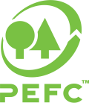

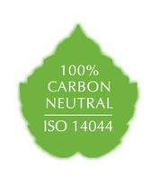
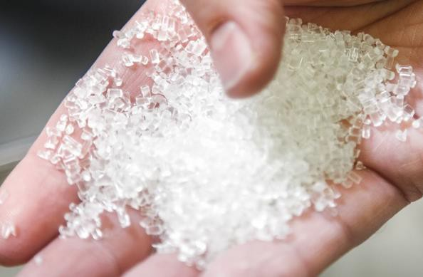


Cellulose from sustainably managed
forests
Naturally occuring and edible compounds as additives
Woodly technology
Food contact approved
LCA study follows the regulations and guidelines of ISO 14040 and ISO 14044

Slide 8
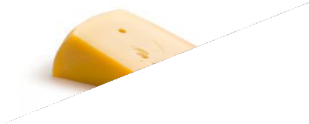
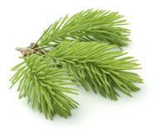
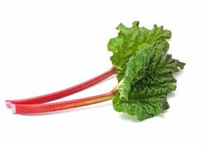
Woodly-material explained:
What is Woodly made out of?
Woodly is made by chemically modifying cellulose to make it thermoplastic. In addition, other polymeric components
and additives are used to produce the different Woodly grades and meet converting and customer demands
Non-toxic and edible additives that can be found for example in cheese.
Cellulose from sustainably managed forests.
Due to the current high price and a lack of commercial availability, some of the additives used in Woodly are currently bought from chemical industry instead of harvested from nature.
These molecules are not produced for us specifically, but for other purposes as well such as for food industry to be used in the food we eat every day.
Non-toxic and edible additives that can be found in vegetables such as garden rhubarb.

Slide 9
Woodly – Good to know
Challenges
High water vapor transmission rate
  not yet suitable for beverage bottles or long-term storage of fresh food
Machine operators need to adjust to using Woodly
  Short time in the machine – “do not leave Woodly inside for lunch break”
  Temperatures
Frozen film strength and sealability in frozen packaging still needs to be improved
Expensive – roadmap to reduce price available, but requires major investments (beyond 30 kt/a)

Slide 10
Woodly – Converting
Woodly has replaced these plastics in some applications
 | micron | LDPE | LLDPE | HDPE | PP | OPP | PET | PS | SAN | ABS | PC | PMMA | PVC | PA6/66 | PLA | 2k PU
Film-blowing | 30-100
Cast film | 100-850
Sheet extrusion | 2000-
Extrusion coating | 9-
Lamination | 30
Injection molding |  |  |  |  |  |  |  |  |  |  |  |  |  | *
Injection blow molding
3D printing
Rotary molding |  |  |  | **
Vacuum forming | not tested
Textile extrusion | tested
Foam extrusion | tested
Tube extrusion | tested
Cable coating | tested
* composite
** requires pulverization
 | Confirmed
 | Tests
Woodly converting techniques
NB!! Use LDPE to heat up the machine and in film blowing, change grade to Woodly while the machine is running

Slide 11

1
2
3
Reduces dependency
on fossil feedstock
End-of-life
Verified solution to
tackle climate change
Main raw material of Woodly is FSC Certified cellulose.
Woodly can be detected with NIR and separated from the plastic waste stream.
Woodly’s Life Cycle Assessment Study (LCA) concluded, that Woodly is carbon neutral.
Woodly has a TÜV Austria Certificate for 40-60%
bio-based content.
We are constantly working to increase the bio-based and recycled content in our material.
Woodly performs exceptionally well in mechanical recycling and can be recycled at least 5 times with no change in properties.
The LCA study was made by Pöyry and in accordance with ISO14040 and ISO14044
standards.
Incineration of Woodly leads to 70% reduction in emissions vs fossil plastics

Slide 12
4
5
6
Drop-in granulate
Processing efficiency equal to fossil-based plastic
Supports brand´s core messages on responsibility
Third party consumer studies have been done with more than 400 consumers: Woodly can increase the consumers likelihood of purchase, preference and the willingness-to-pay.
No capital investments needed for manufacturing of the end products.
Woodly can be processed in higher temperatures and with faster speeds than other bio- based or biodegradable materials.
Woodly can be converted using existing equipment.
Woodly production can be easily scaled up.
Key claims: Wood-based Carbon-neutral Recyclable Better for nature

Slide 13
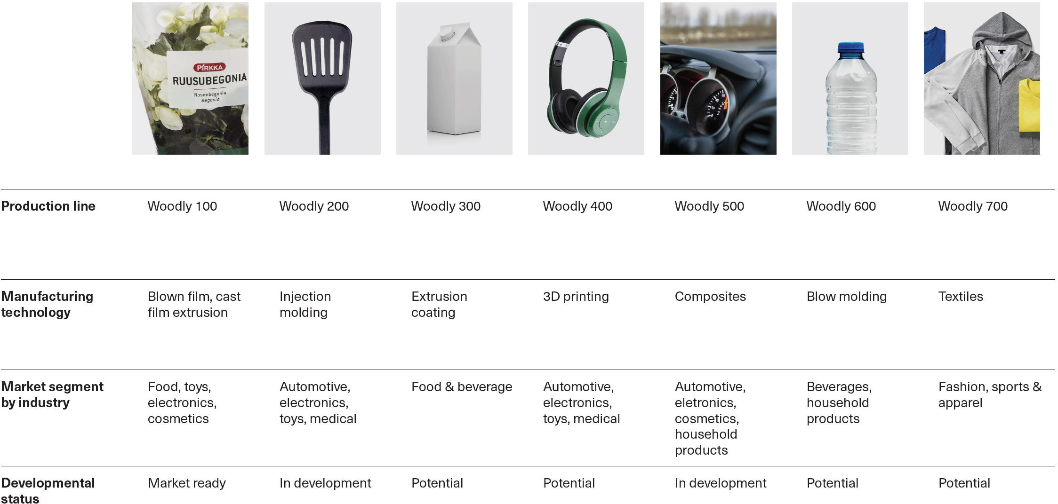

Slide 14

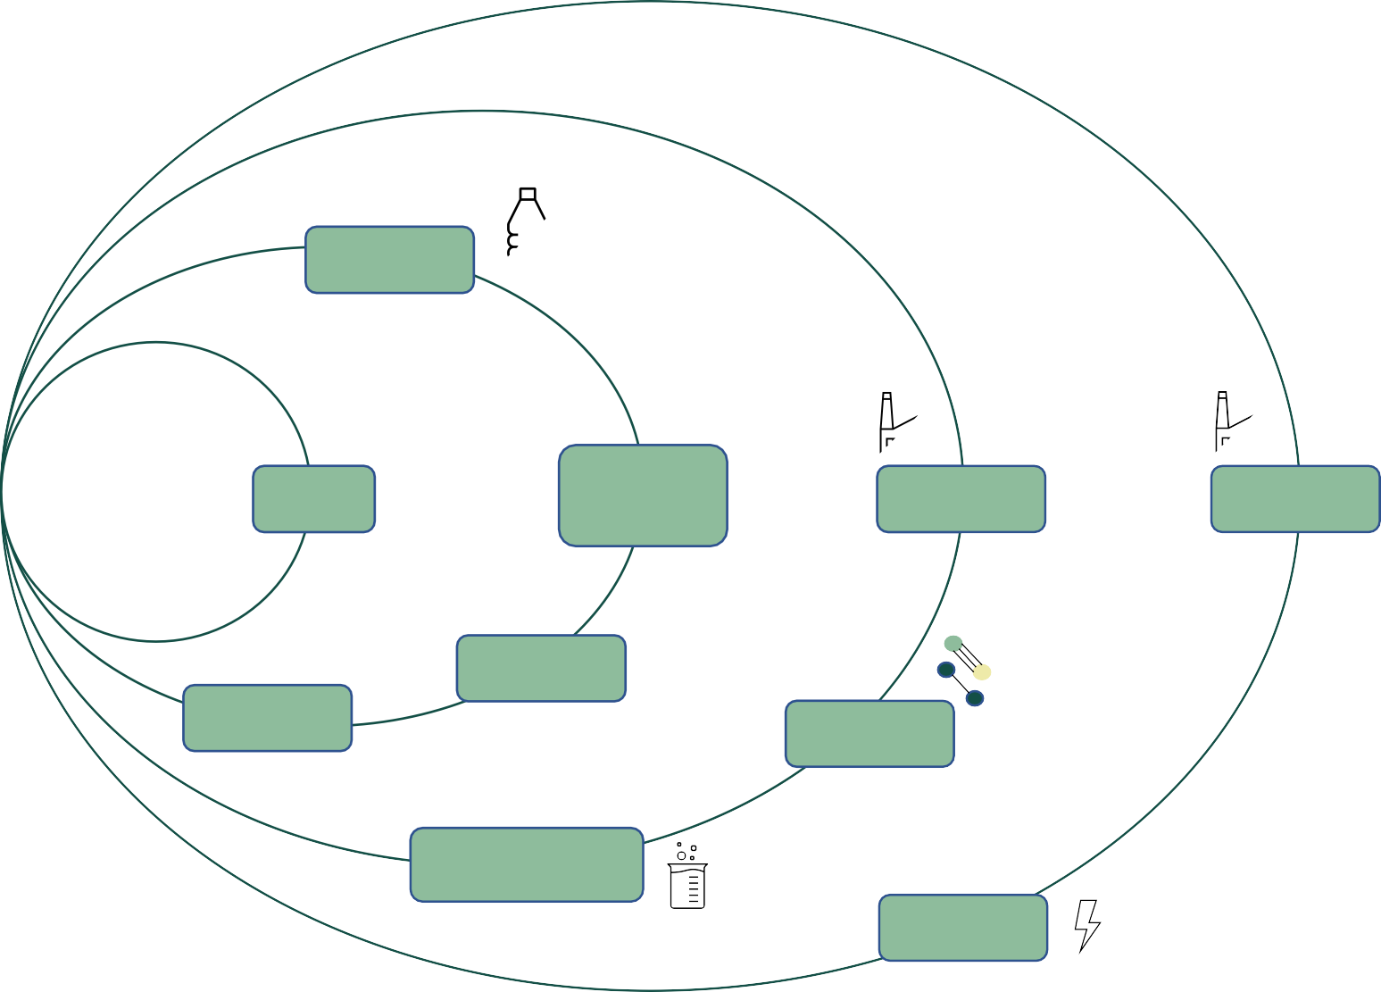







Woodly End-of-life
Reuse
Durable consumer goods made from Woodly
suitable for decades of use
Mechanical recycling
Woodly can be easily separated using NIR and endures several cycles of recycling very well and new products can be made from recycled Woodly Includes collection, separation, grinding, melting, washing, regranulation
Collection
Washing
Mechanical and Physical recycling
Chemical recycling
Waste-to- energy
Reuse
Chemical recycling
Via gasification mixed plastics and Woodly can be turned into syngas that then is used to make methanol or hydrocarbons and further to produce feedstock for petrochemicals
rWoodly
Converting
Syngas
Waste-to-energy
When incinerated for energy, the emissions from burning are 70% lower compared to conventional fossil plastics
Building blocks for chemical industry
Electricity and heat
Woodly is not biodegradable or compostable

Slide 15
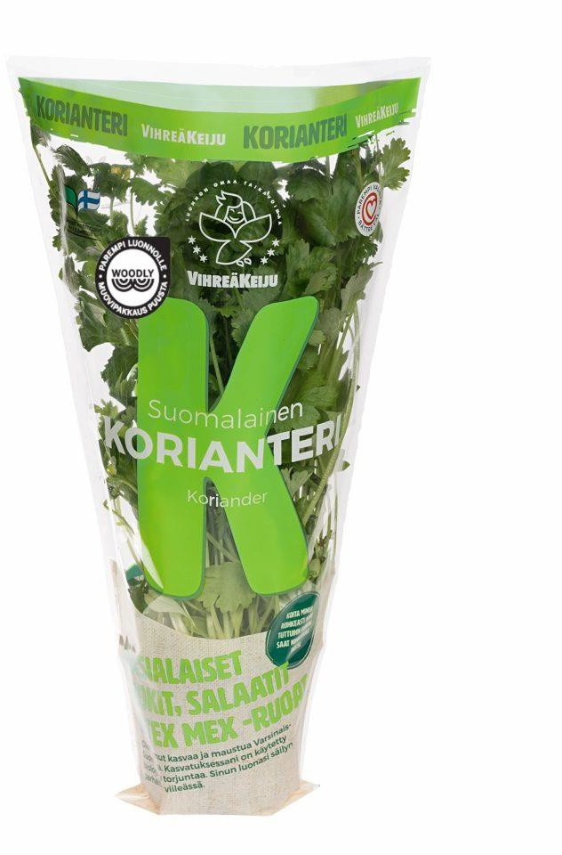
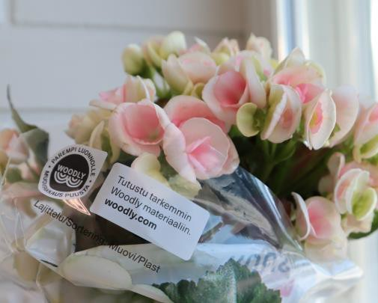
PACKAGING LAUNCHES
Commercial products
Customer:
Vihreä Keiju
Solution:
Film packaging for herbs and salads.
Customer:
Kesko Oyj
Large retail chain in Finland Global 100 Most sustainable grocery trade company in the world 2020
Solution:
Film packaging for flowers.
Woodly can replace LDPE, LLDPE, HDPE, PP, OPP, PET in films

Slide 16
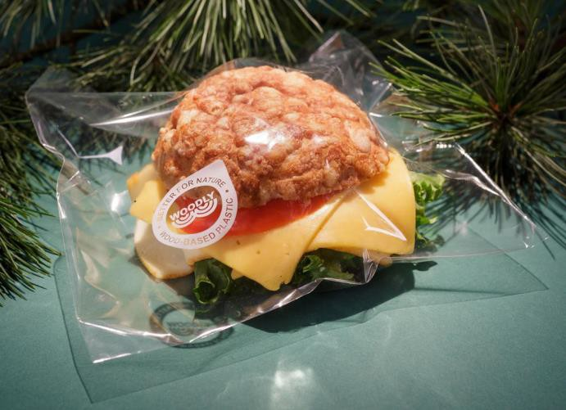
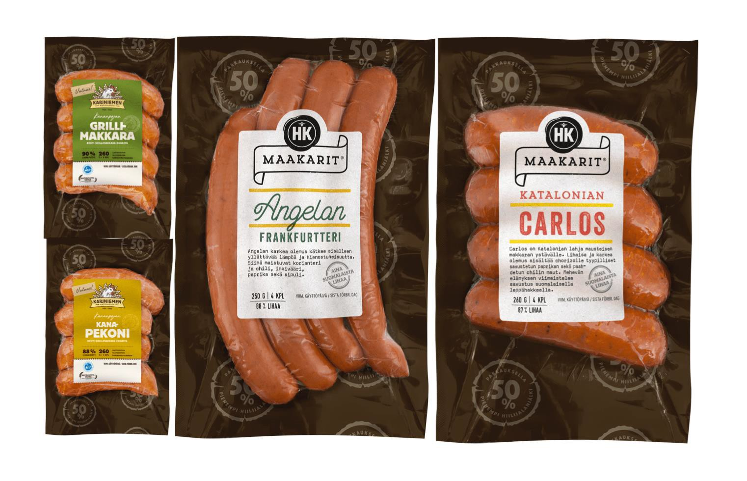
PACKAGING LAUNCHES
Commercial products
Converter:
Amerplast
Customer:
HKScan Oyj
Solution:
Fresh sandwich packaging
Solution:
Film packaging for sausages and meat products
Woodly can replace LDPE, LLDPE, HDPE, PP, OPP, PET in films

Slide 17
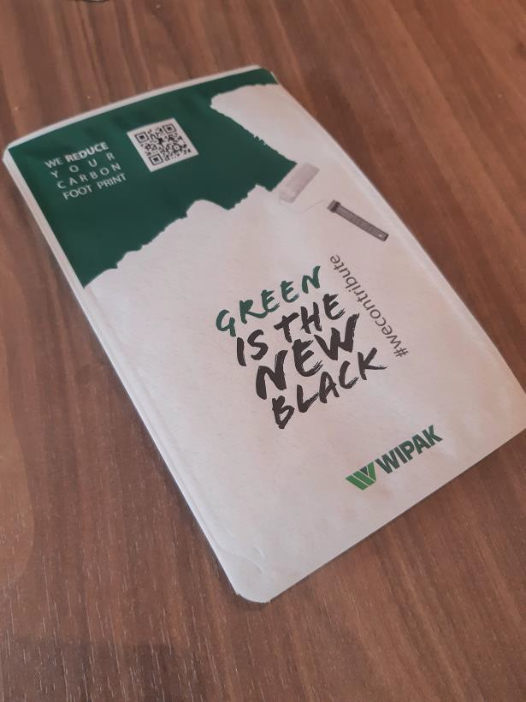
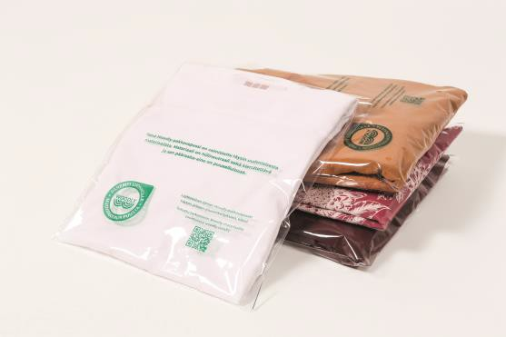
PACKAGING PILOTS
Prototypes
Converter:
Wipak
Announced customer:
Black Moda
Solution: Modified atmosphere packaging
Solution:
Textile bag with or without hanger for retail and e-commerce
Woodly can replace LDPE, LLDPE, HDPE, PP, OPP, PET in films

Slide 18
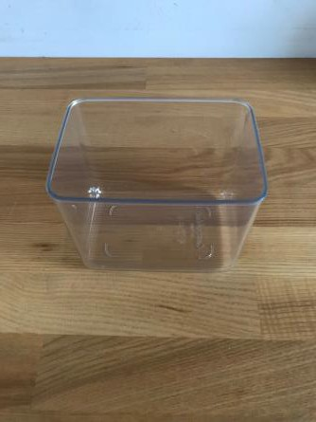
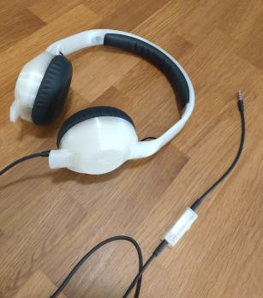

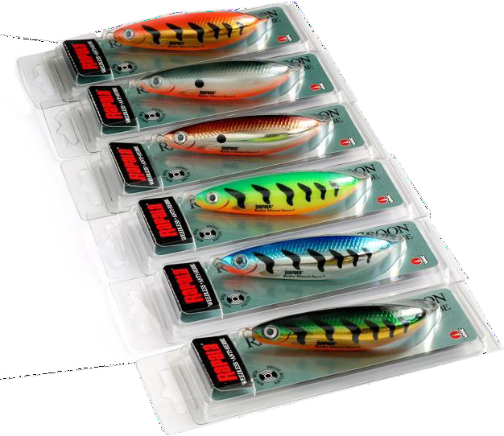
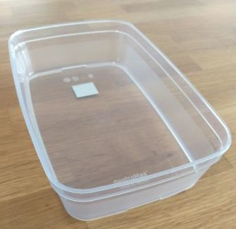
PRODUCT PILOTS
Prototypes
Pilot customer: Rapala VMC
Solution: Rigid thermoformed packaging for fishing lures.
Announced customer: Orthex
Pilot customer:
NN
Solution:
Headset
Solution: Kitchenware Replaced SAN and PP with same molds
Replacing PC/ABS
Woodly can replace HDPE, PP, OPP, PET, PS, PC, ABS, SAN

Slide 19
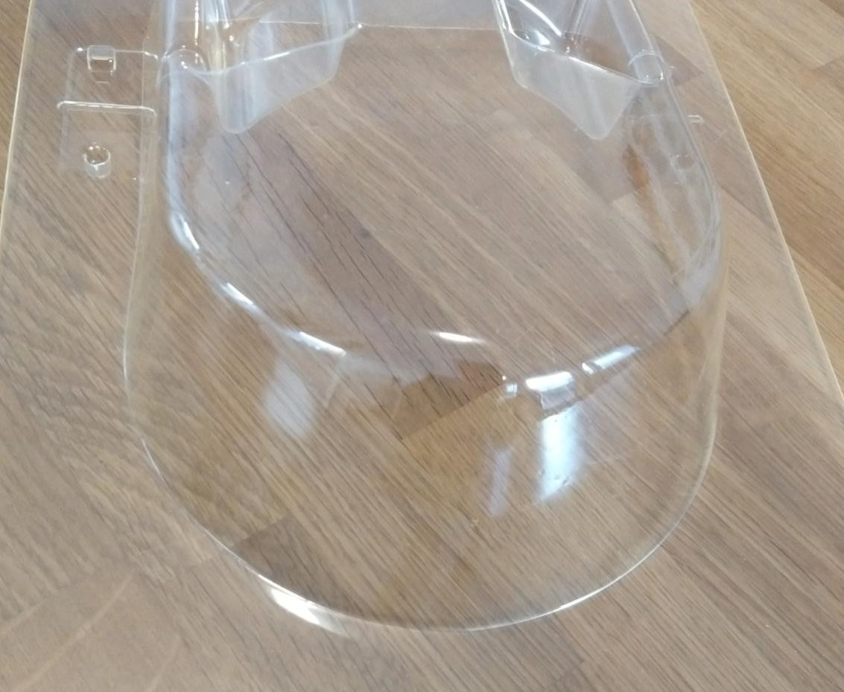
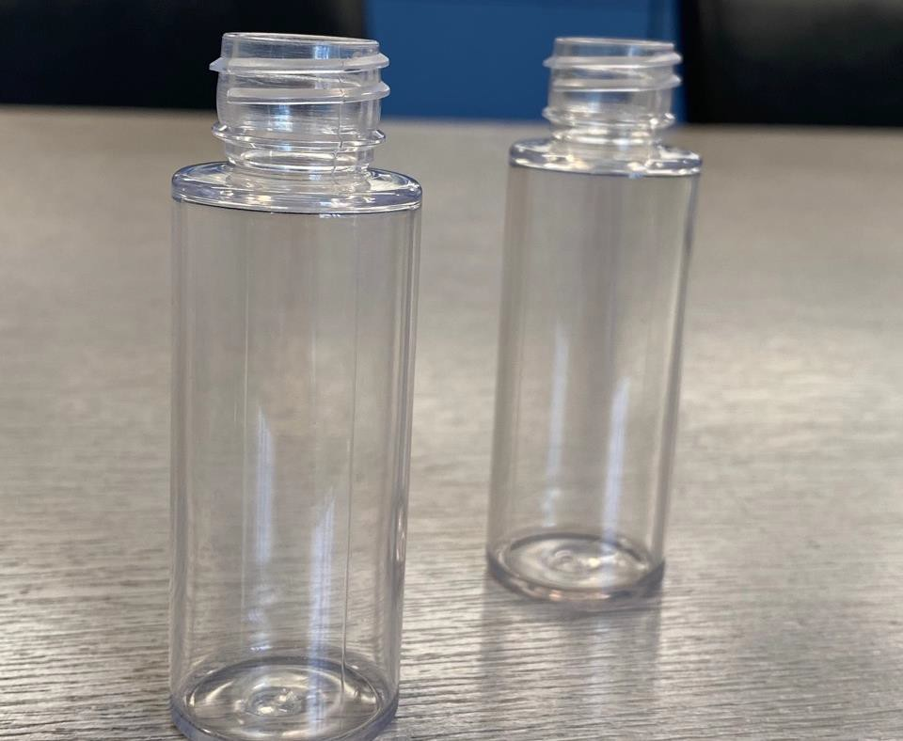
Woodly bottles
A thermoformed facemask with 83mm depth from

Slide 20
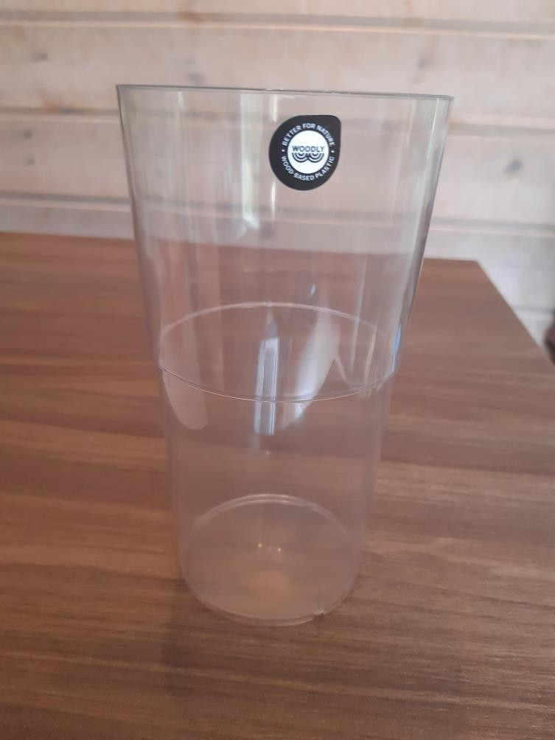
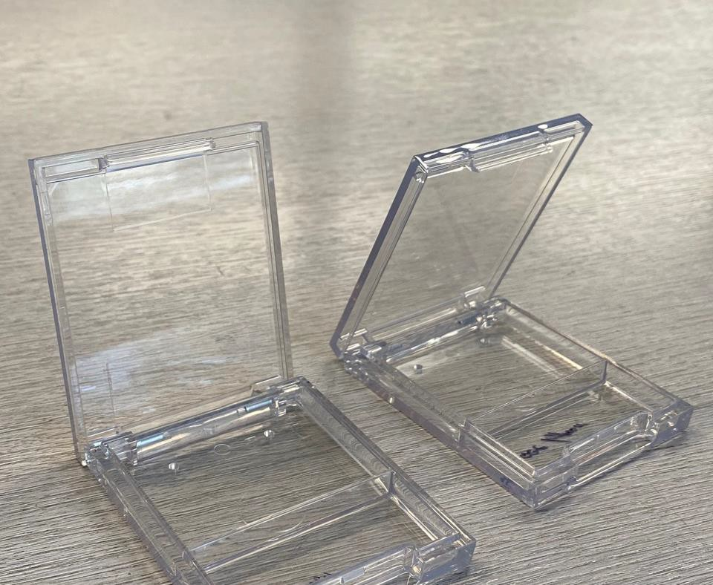
Woodly products for cups and make-up packaging made by injection molding

Slide 21
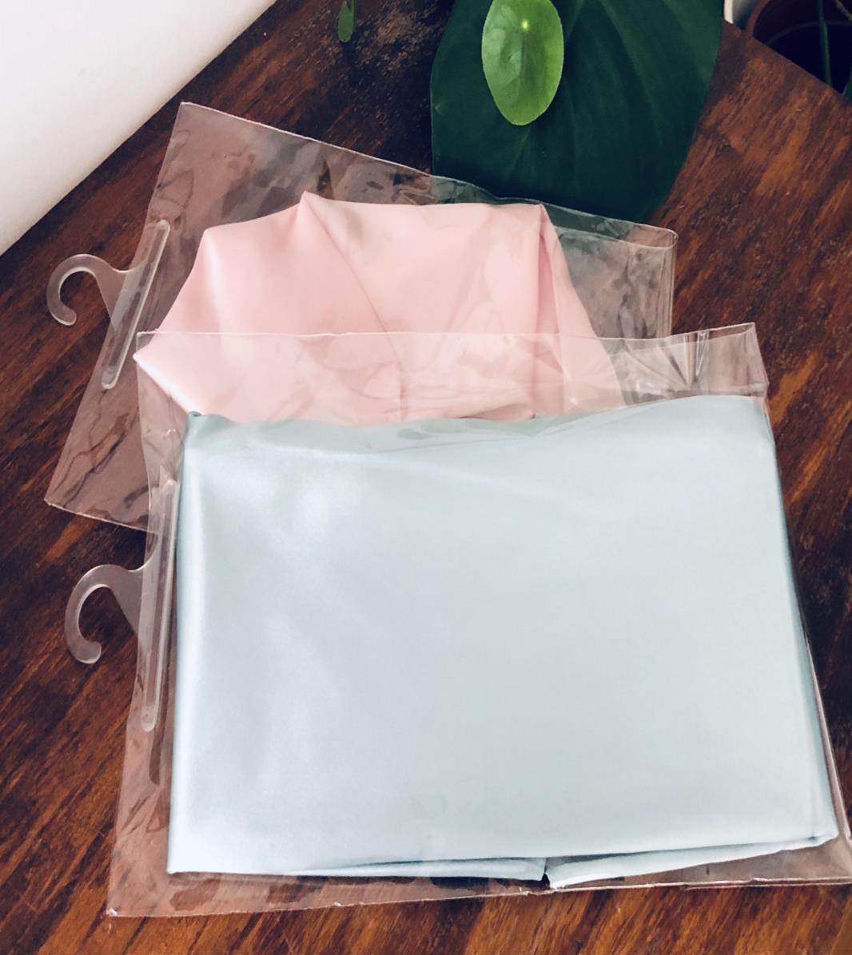
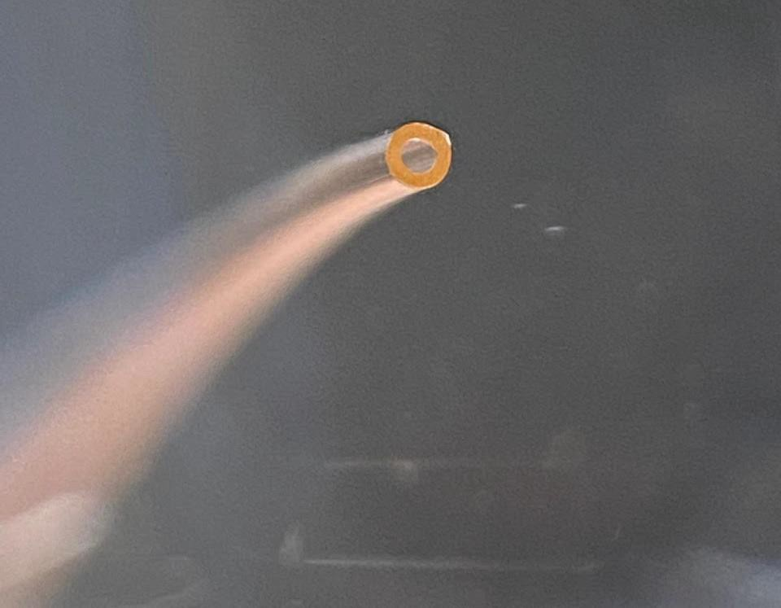
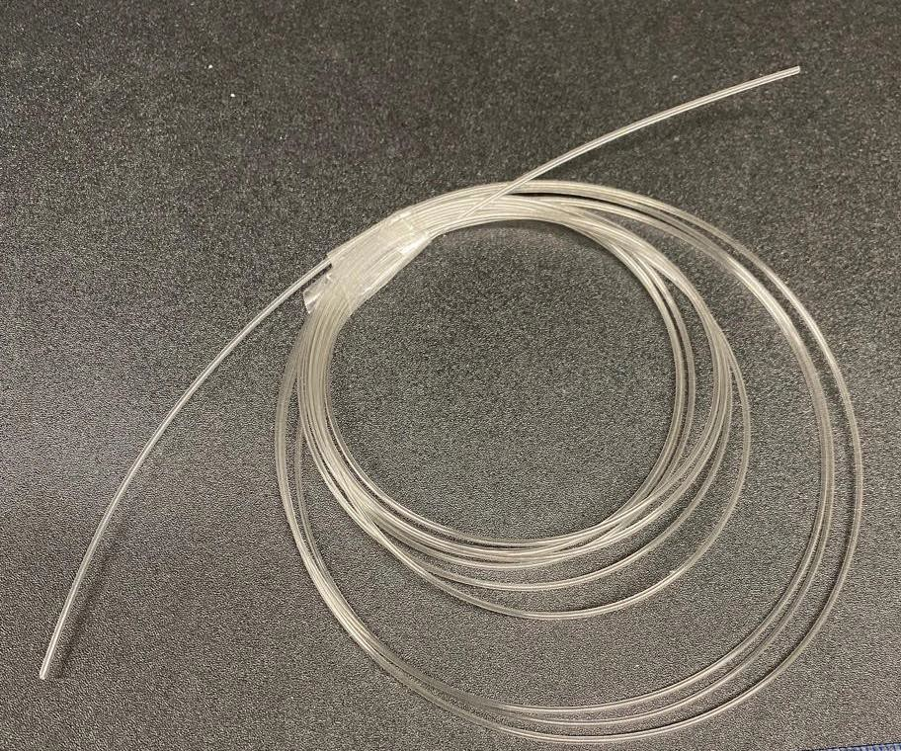
Woodly tube and cable coating
Woodly textile bags with a hanger

Slide 22


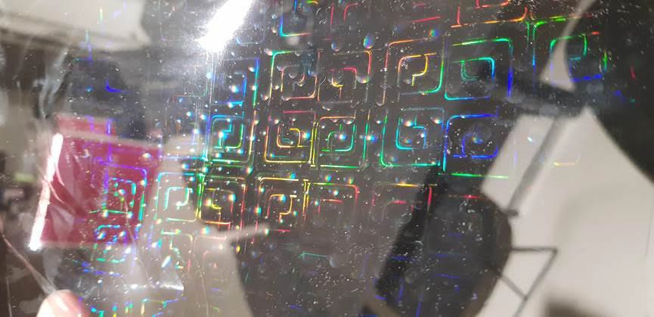
Woodly holographic film

Slide 23

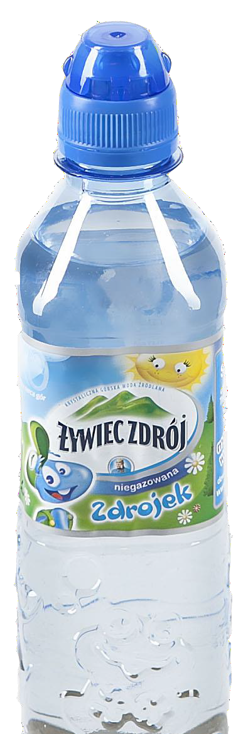
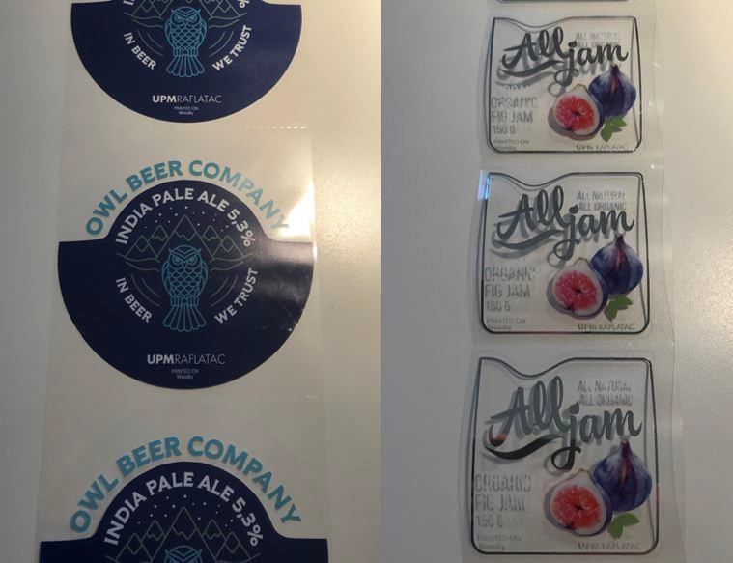
Woodly adhesive laminate labels
Wrap-around labels

Slide 24
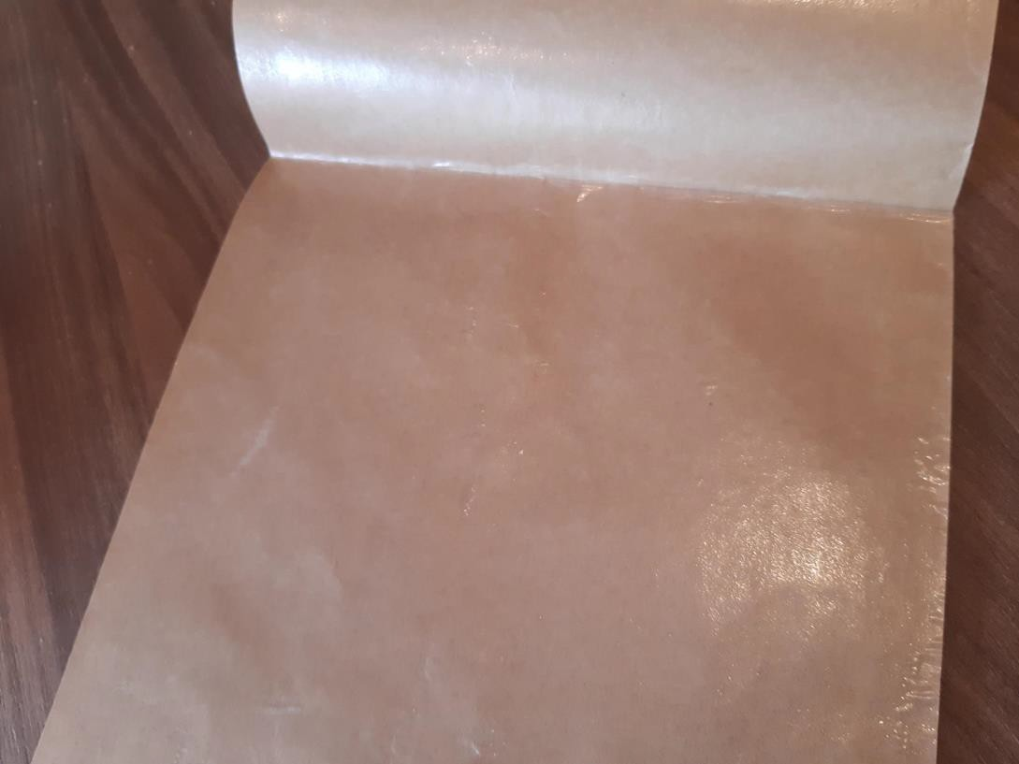
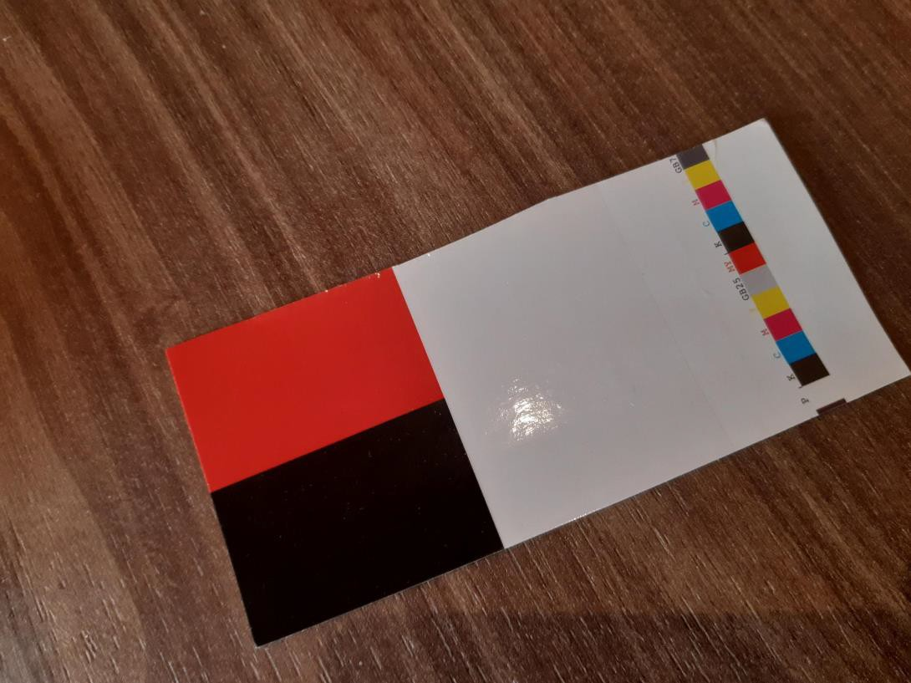
Extrusion coated Woodly on paper
Laminated Woodly on board

