Slide 1



Introducing
WELL for residential
© 2024. International WELL Building Institute PBC. All rights reserved.

Slide 2


Slide 3


Slide 4
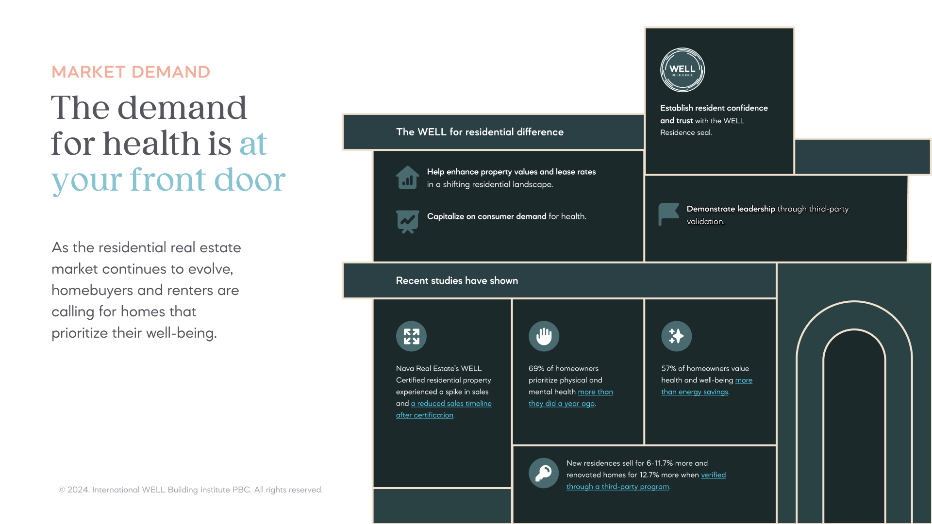

Slide 5
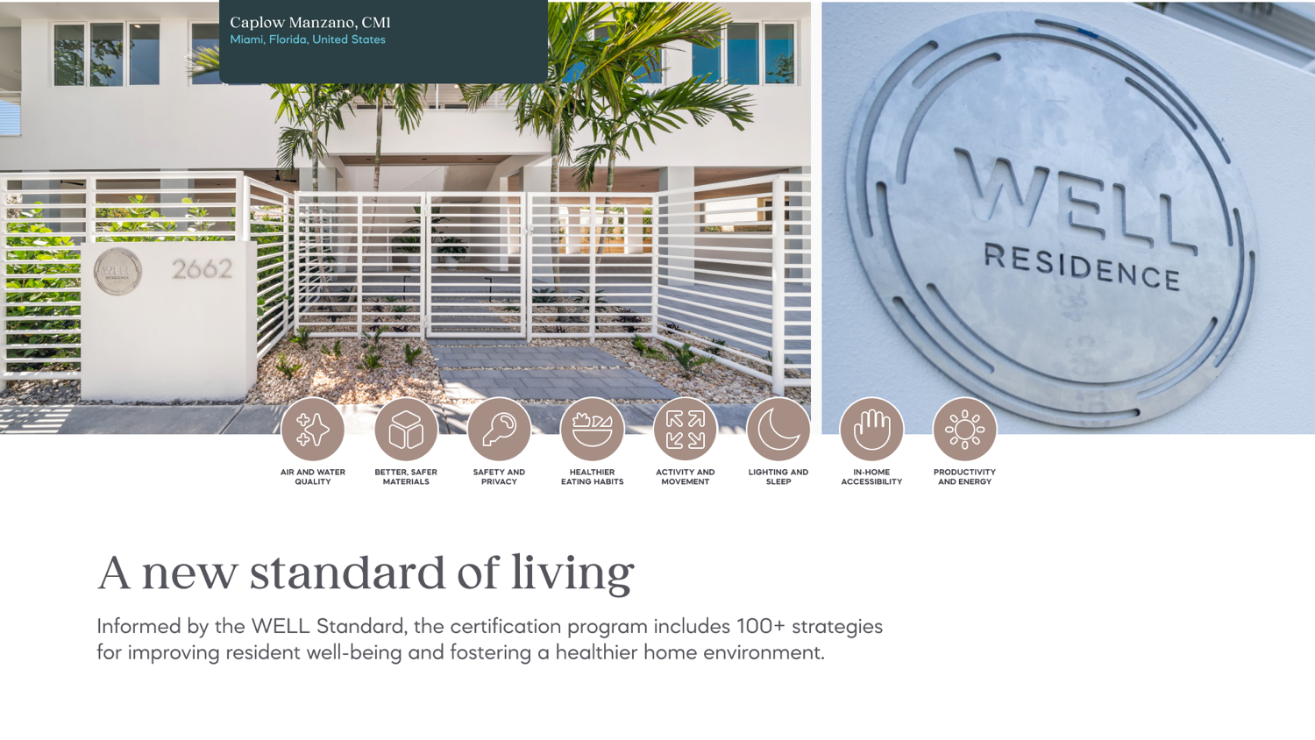
© 2024. International WELL Building Institute PBC. All rights reserved.

Slide 6
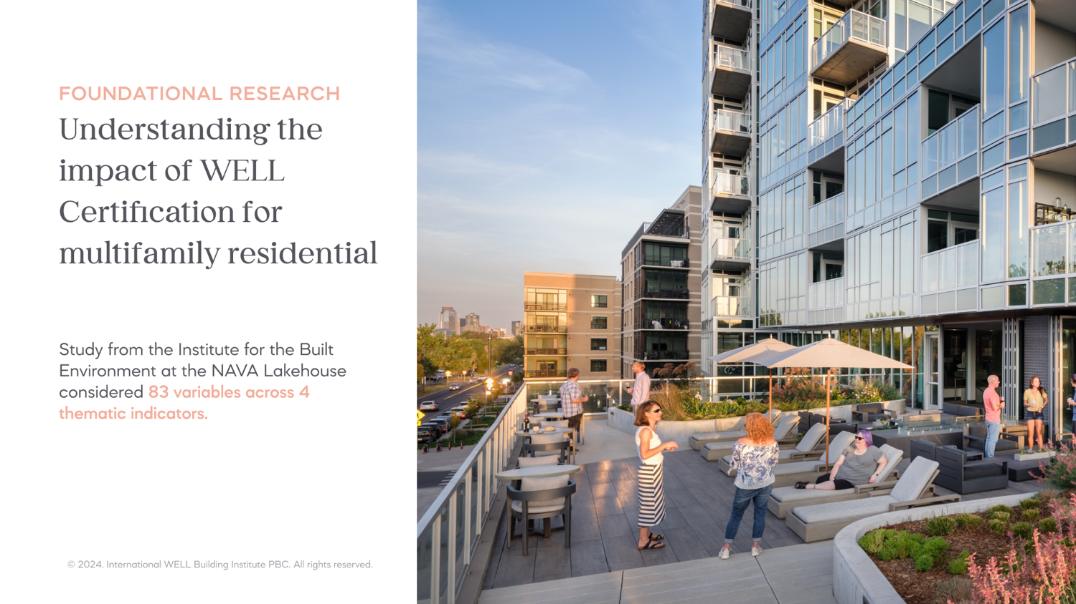

Slide 7
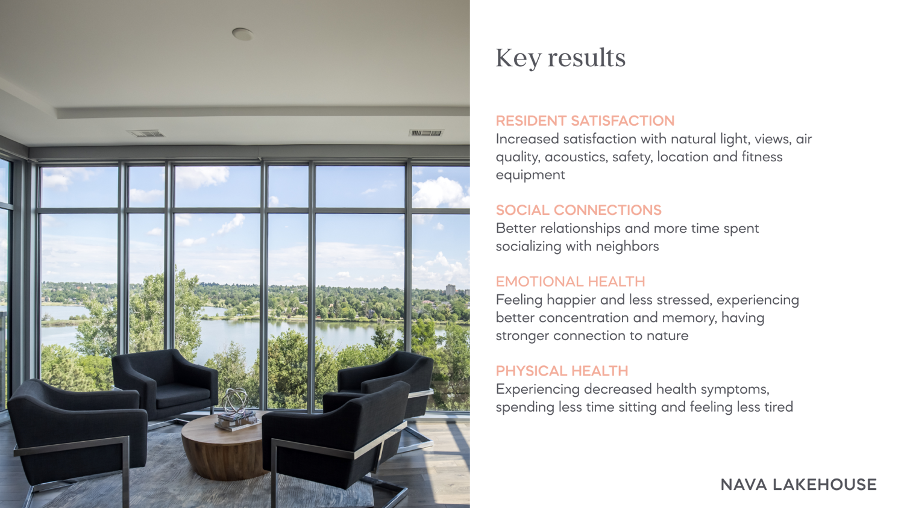
© 2024. International WELL Building Institute PBC. All rights reserved.

Slide 8


Slide 9
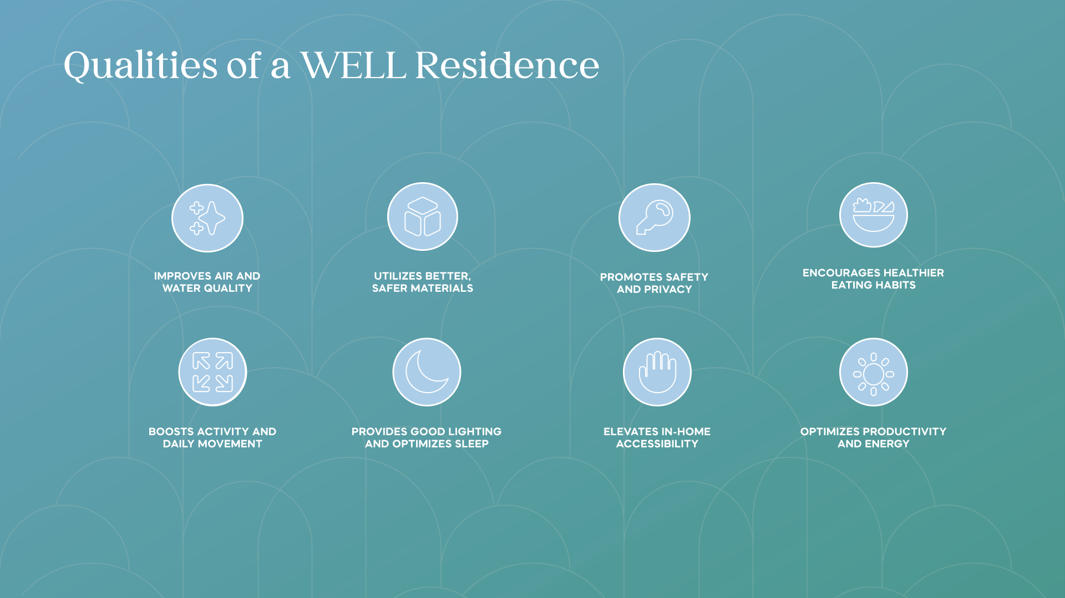
© 2024. International WELL Building Institute PBC. All rights reserved.

Slide 10
Strategies within the 10 WELL Concepts
Air
Ventilation Design
HVAC Filtration and Treatment
Pollution Infiltration Management
Construction Pollution Management
Combustion Minimization
Air Quality Monitoring
Indoor Air Quality Testing
Radon Risk Mitigation
Electric Vehicle Charging
Smoke-Free Environment
Water
Plumbing Design and Sizing
Water Testing
Non-Potable Water Capture and Use
Moisture Management Design
Flow and Temperature Sensing
Water Quality and Plumbing Maintenance
Nourishment
Supportive Cooking Environment
Onsite Food Production
Food Access and Support
Food Hygiene Support
Light
Design for Daylight
Electric Light Control and Quality
Visibility at Night
Movement
Pedestrian, Transit and Bike-Friendly Places
Outdoor and Indoor Activity Space
Adjustable Workstations
Staircase Design
Thermal Comfort
Thermal Performance and Control
Insulation and Fenestration Efficiency
Humidity Control
Radiant Heating Systems
Operable Windows
Outdoor Heat Management
Sound
Sound Barriers
Quiet Products
HVAC and Building Service Noise Levels
Environmental Noise Levels
Materials
Site Assessment and Remediation
New Materials Selection
Pest and Pesticide Minimization
Cleaning Products and Practices
Mind
Nature and Place
Design for Reassurance
Digital Connection
Household Storage and Space Management
Community
Universal Design
Affordable Housing
Integrative Design
Healthy and Supportive Construction Sites
Resident Education
Disaster Resilience
Fire Mitigation
Innovation
WELL AP
Residential Green Programs
Carbon Accounting, Disclosure & Reduction
© 2024. International WELL Building Institute PBC. All rights reserved.

Slide 11
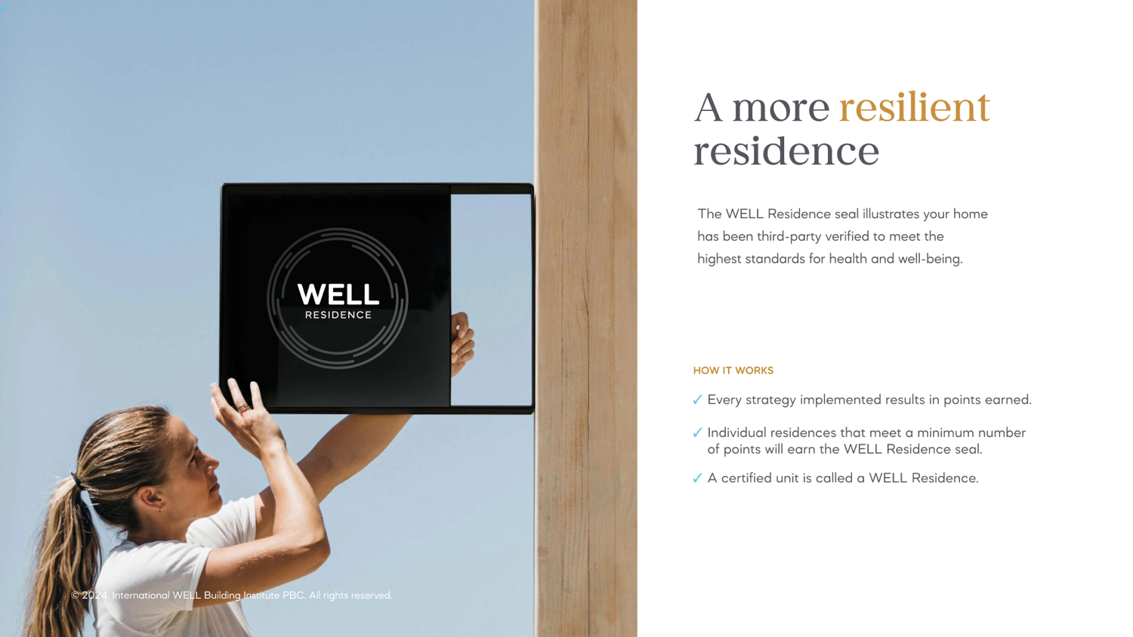

Slide 12
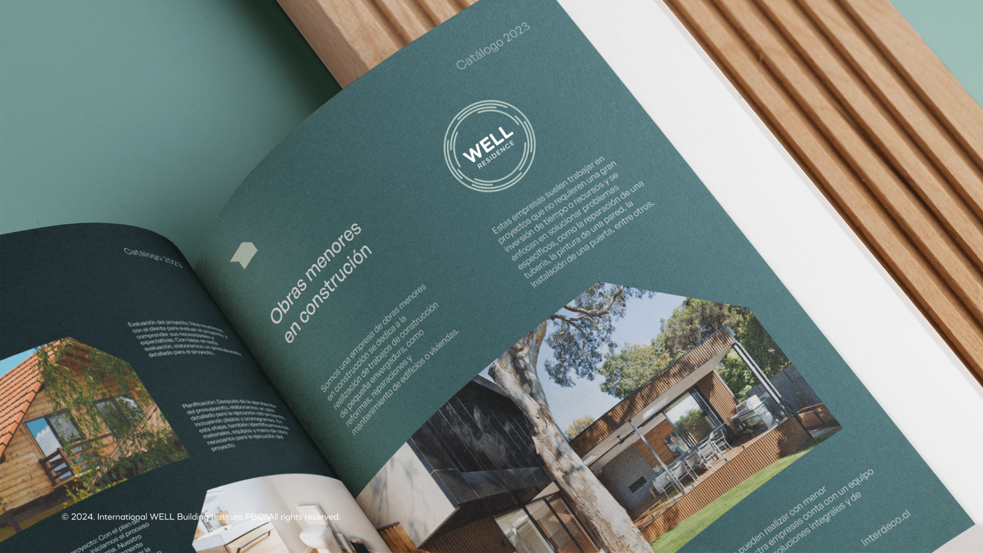

Slide 13

© 2024. International WELL Building Institute PBC. All rights reserved.

Slide 14


Slide 15
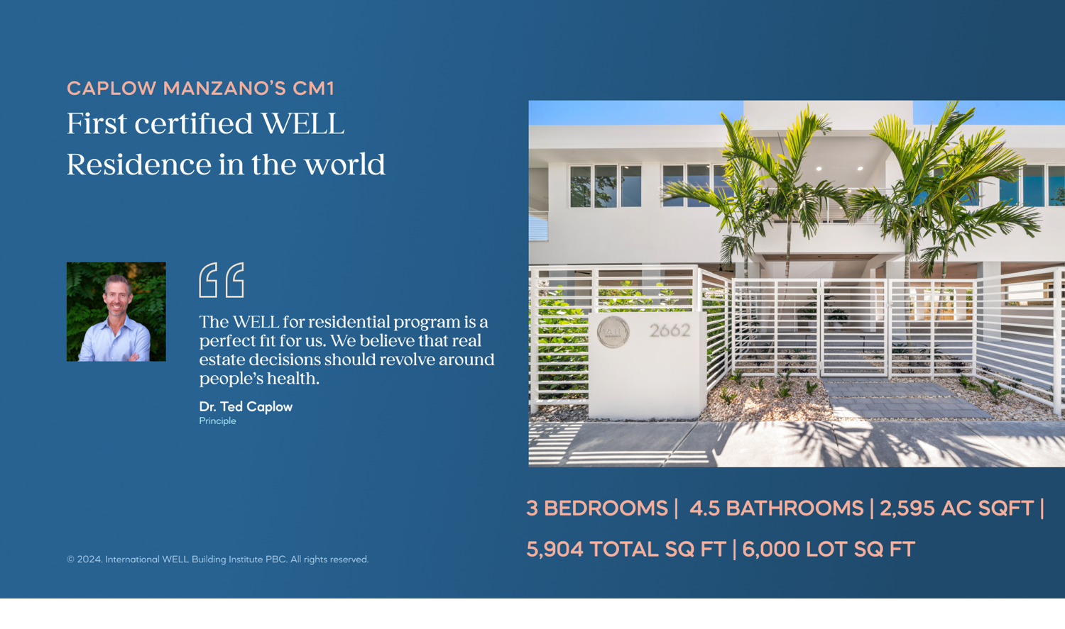

Slide 16



Packages and pricing
ANNUAL SUBSCRIPTION
Number of single-family homes
Number of multifamily buildings
Annual cost
SINGLE ENROLLMENT
5-1,000
Up to 50
$30,000
SINGLE-FAMILY
$100*per home
MULTIFAMILY
$0.08*per sq ft
Up to 2,000
Up to 100
$65,000
WHAT’S INCLUDED
Up to 4,000
Up to 200
$112,500
Program enrollment
One documentation review for precertification (optional)
Up to 6,000
Up to 300
$190,000
One documentation review for certification
Dedicated coaching support
Up to 8,000
Up to 400
$225,000
Digital marketing materials and guidelines
Enrollment fee: $3,000
Up to 200,000
Up to 500
$250,000
*Program fees start at $8,000 and are capped at $98,000
WHAT’S INCLUDED
Program enrollment
Dedicated coaching support
Two documentation reviews per year (may include dwelling units that are pursuing up to five different sets of WELL strategies)
Digital marketing materials and guidelines
Interim precertification reviews (an incremental design milestone)
One printed seal per unit, up to 1,600 seals per year (shipping and custom fees are not included)
© 2024. International WELL Building Institute PBC. All rights reserved.

Slide 17


Pricing
CONSIDERATIONS
SINGLE ENROLLMENT
Enrollment fees are captured at the onset and are valid for three years
Program fees are captured at time of documentation submission
All dwelling units must*:
  Be in the same building or community
  Pursue the same WELL strategies
  Submit for review at the same time
Submit for interim precertification review (an incremental design milestone) for $62.50/home for single-family and $0.05 /square foot for multifamily; these fees will be credited towards program fees at certification review
Does not include onsite testing fees that may be incurred when pursuing performance-based strategies
Extend your enrollment by one year for an additional $1,000
Qualifying sectors, small business and emerging markets save 25% on program fees
IWBI Cornerstone and Keystone members save an additional 5% and 15% on program fees, respectively
Contact us for more information about special pricing considerations in mainland China, Hong Kong, Macau and Taiwan
* Separate enrollments are required for units in different buildings or communities, units that are pursuing different strategies, and units submitting for review at different times.
Enrolling multiple buildings or communities? Consider our annual subscription or ask us about volume pricing by emailing us at residential@wellcertified.com.
SINGLE-FAMILY
$100*per home
MULTIFAMILY
$0.08*per sq ft
WHAT’S INCLUDED
Program enrollment
One documentation review for precertification (optional)
One documentation review for certification
Dedicated coaching support
Digital marketing materials and guidelines
Enrollment fee: $3,000
*Program fees start at $8,000 and are capped at $98,000
© 2024. International WELL Building Institute PBC. All rights reserved.

Slide 18
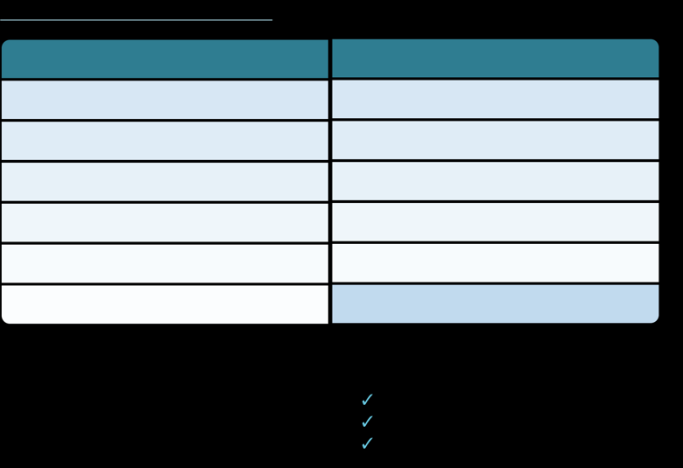


Pricing
ANNUAL SUBSCRIPTION
ANNUAL SUBSCRIPTION
Number of locations
Annual cost
Number of single-family homes
Number of multifamily buildings
Annual cost
CONSIDERATIONS
Up to 50
$30,000
Recurring annual subscription
Pricing is based on the number of single family homes or multifamily buildings subscribed - to combine, use the multifamily buildings column and apply the conversion ratio of 20 single family homes to 1 multifamily building
When all units under ownership are subscribed, earn a score showing incremental progress across entire portfolio (in addition to earning certifications at individual homes)
Does not include onsite testing fees that may be incurred when pursuing performance-based strategies
Contact us for more information about special pricing considerations in mainland China, Hong Kong, Macau and Taiwan
* Shipping is not included as part of your complimentary seal order. International orders may also be subject to customs fees. Domestic orders (USA): $9.95; International orders: $24.95.
Not ready to pick a subscription tier? Ask us about volume pricing by emailing residential@wellcertified.com.
5-1,000
Up to 50
$30,000
Up to 100
$65,000
Up to 2,000
Up to 100
$65,000
Up to 200
$112,500
Up to 4,000
Up to 200
$112,500
Up to 300
$190,000
Up to 6,000
Up to 300
$190,000
Up to 400
$225,000
Up to 8,000
Up to 400
$225,000
401 – 10,000
Cap of $250,000
Up to 200,000
Up to 500
$250,000
WHAT’S INCLUDED
WHAT’S INCLUDED
Program enrollment
Dedicated coaching support
Program enrollment
Dedicated coaching support
Two documentation reviews per year (may include dwelling units that are pursuing up to 5 different sets of WELL strategies)
Digital marketing materials and guidelines
Two documentation reviews per year (may include dwelling units that are pursuing up to five different sets of WELL strategies)
Digital marketing materials and guidelines
One printed seal per dwelling unit, up to 1,600 seals per subscription year (shipping and custom fees are not included)*
Interim precertification reviews (an incremental design milestone)
One printed seal per unit, up to 1,600 seals per year (shipping and custom fees are not included)
Interim precertification reviews (an incremental design milestone)
© 2024. International WELL Building Institute PBC. All rights reserved.

