Slide 1
Healthy Living
for Everyday Life
Eating for Health
Laura Roche
DI016307
HSE Senior Dietitian,
Health Promotion & Improvement, Co Wexford

Slide 2
Welcome!

Slide 3
This presentation is written and delivered by a registered dietitian. It is intended for information only. It is not a substitute for personalised dietetic or medical advice, diagnosis or treatment. Medical concerns should always be discussed with a doctor. For any medical conditions requiring dietetic input, a referral should be made to a HSE (public) CORU registered dietitian or a CORU registered private dietitian (visit www.indi.ie/find-a-dietitian).
Date of production: October 2025. Information correct at time of production.
Notes:
Discuss

Slide 4
Getting started
  Start time: 10.30am
  Break: 11.05 – 11.15am
  Finish time: 12 midday
  Toilets and fire exit
  Phones
  Today there will be some group work and discussions. Feel free to “pass”
  We will be talking about “Joe”
  Please complete the before and after talk questionnaires.

Slide 5
What we will talk about today:
  What eating for health means
  The stages of changing behaviour
  How Joe changed his eating habits
  The Food Pyramids
  Building a balanced meal
  Where to go for more information
  Planning ahead

Slide 6
Lets break the ice!
Tea or coffee
Starter or dessert
Summer or winter
Early bird or night owl
Who thinks it is important to eat for health?
Who thinks it is important to enjoy food?

Slide 7
What does eating for health mean?
a range of different foods
all of the nutrients we need
healthy, feel well and have plenty of energy.

Slide 8
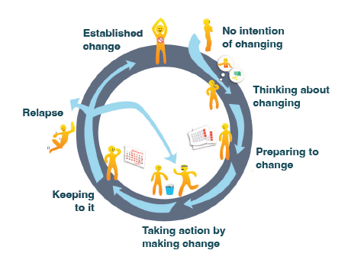
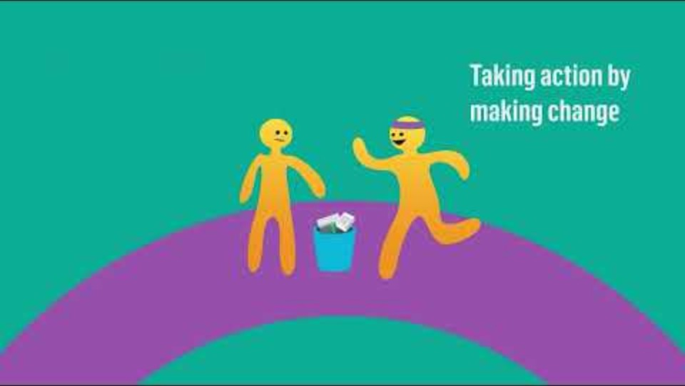
Stages of Change
Link to video

Slide 9


Joe’s story
Joe isn’t thinking about making any changes

Slide 10
Joe’s story
Joe is thinking about making changes

Slide 11
Benefits of Eating for Health
Lowers risk of developing type 2 diabetes, heart disease and cancer
Helps to keep a healthier body weight, and lowers risk of overweight / obesity
Good for dental health
Good for mental health
Good for physical health and energy levels
Good for children’s health – gives the fuel they need to grow, learn and play. Good for children’s future health too.

Slide 12
Do you think the “healthy” choice is always the easy choice?
Safefood Video

Slide 13

Joe’s story
Joe is preparing to make changes

Slide 14
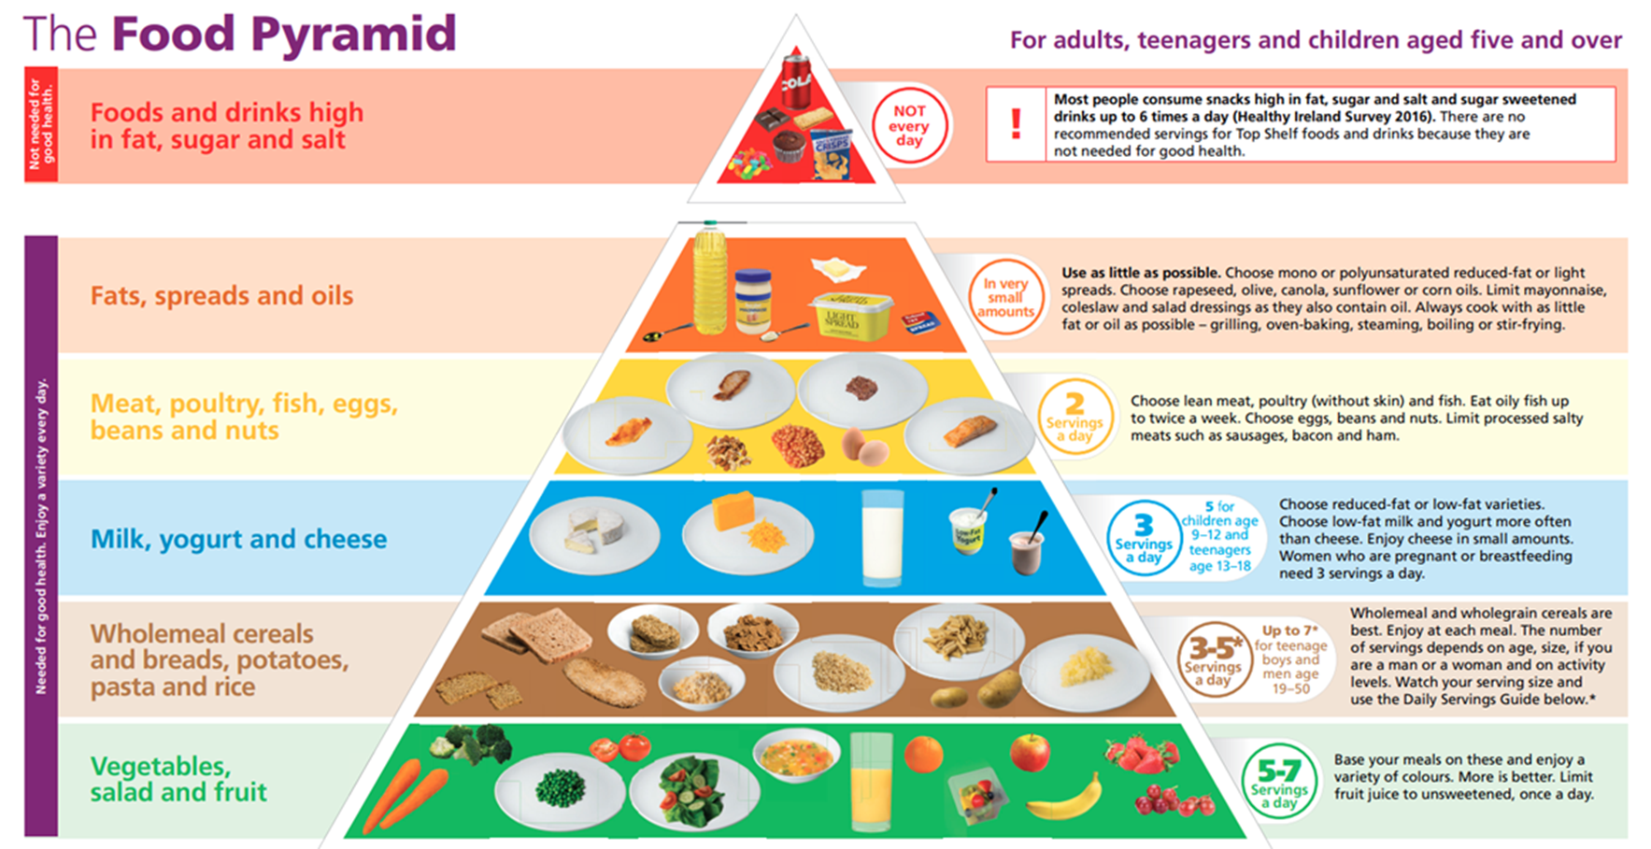
5 – 65 year olds

Slide 15
Please note
The treatment of some medical conditions (for example kidney disease and liver disease) may involve following a particular diet or restricting certain foods.
Using the food pyramid as a guide for healthy eating may not be right for some people.
Please follow your doctor or dietitian’s advice if you have a medical condition where you have been advised to follow a particular diet or dietary restriction.

Slide 16

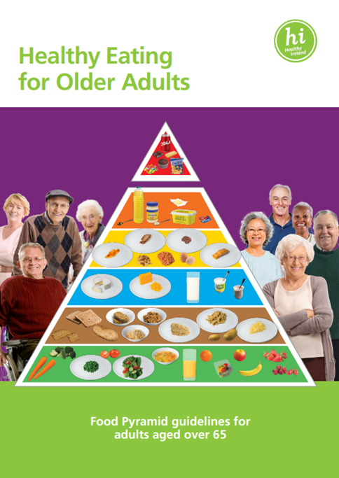
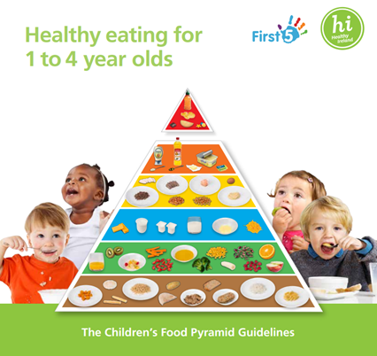
Healthy Eating Guidelines (Department of Health)
5 - 65 years
1 - 4 years
Over 65 years

Slide 17
5 – 65 year olds

Slide 18
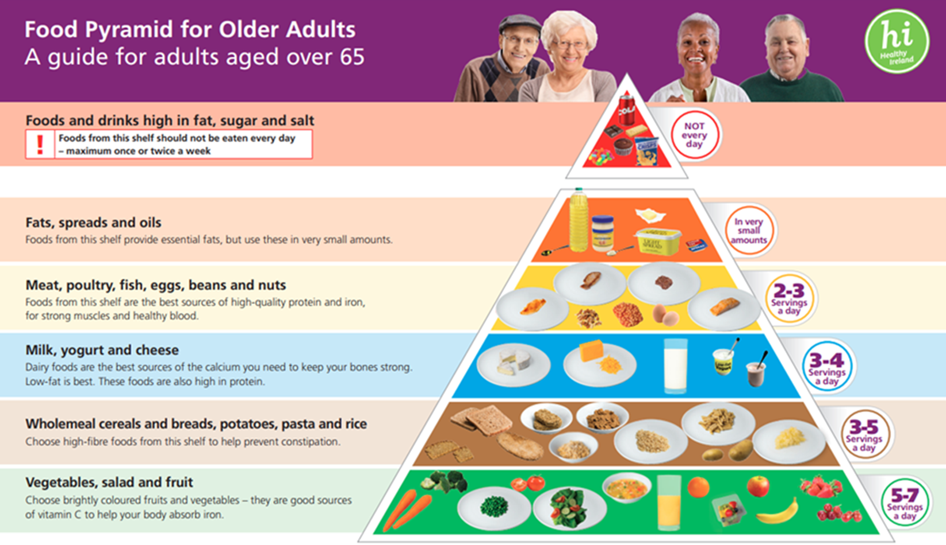

For adults over 65 who are in good health, mobile and living at home

Slide 19
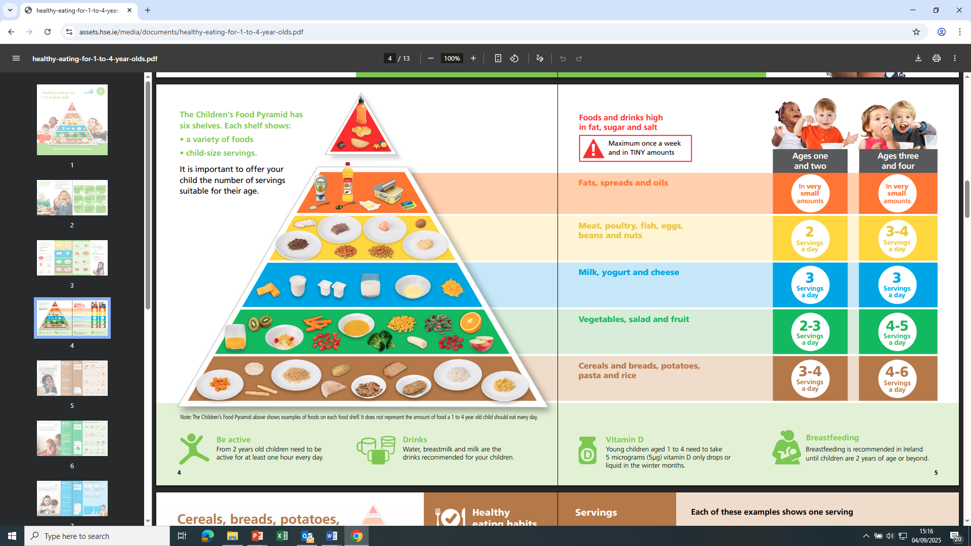

Slide 20
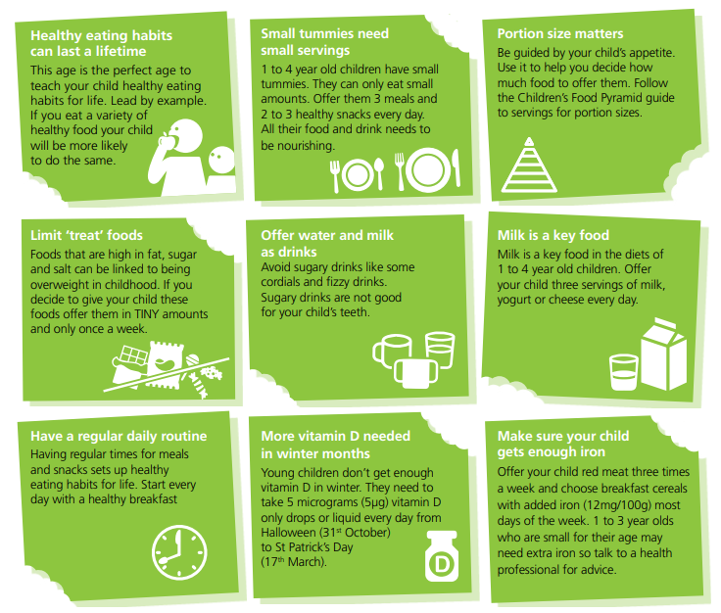

Slide 21
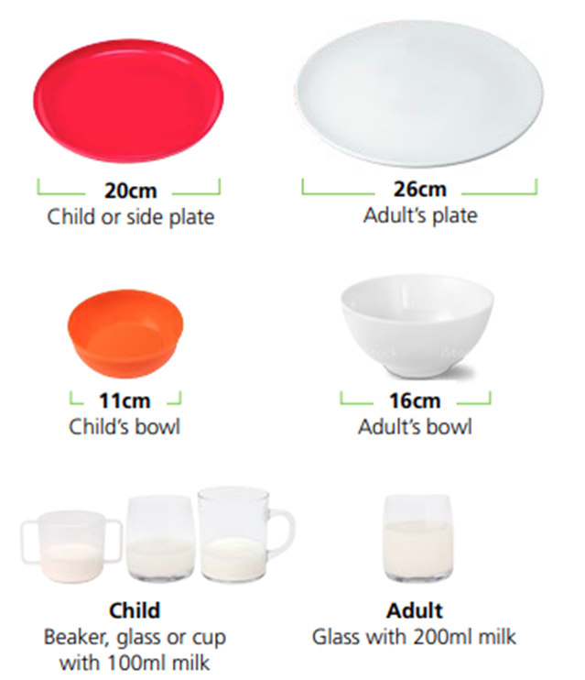
Portion Sizes
Notes:
Refer to serving size guides

Slide 22

From Pyramid to Plate
Milk, yogurt
or cheese
½ Veg, fruit, or salad
¼ wholemeal cereals, breads, potatoes, pasta or rice
Very small amount of fat,
oil or spread
¼ meat, poultry, fish, eggs, beans or nuts

Slide 23
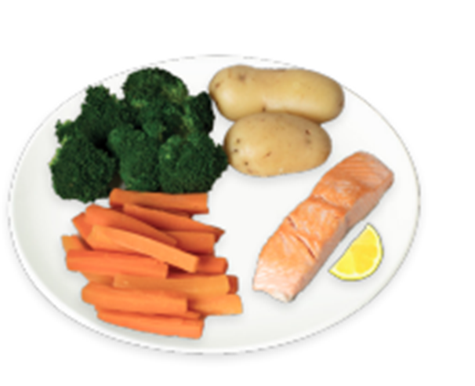
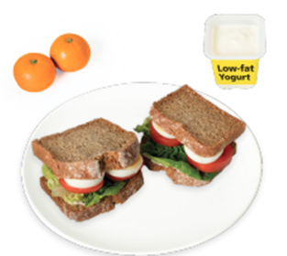
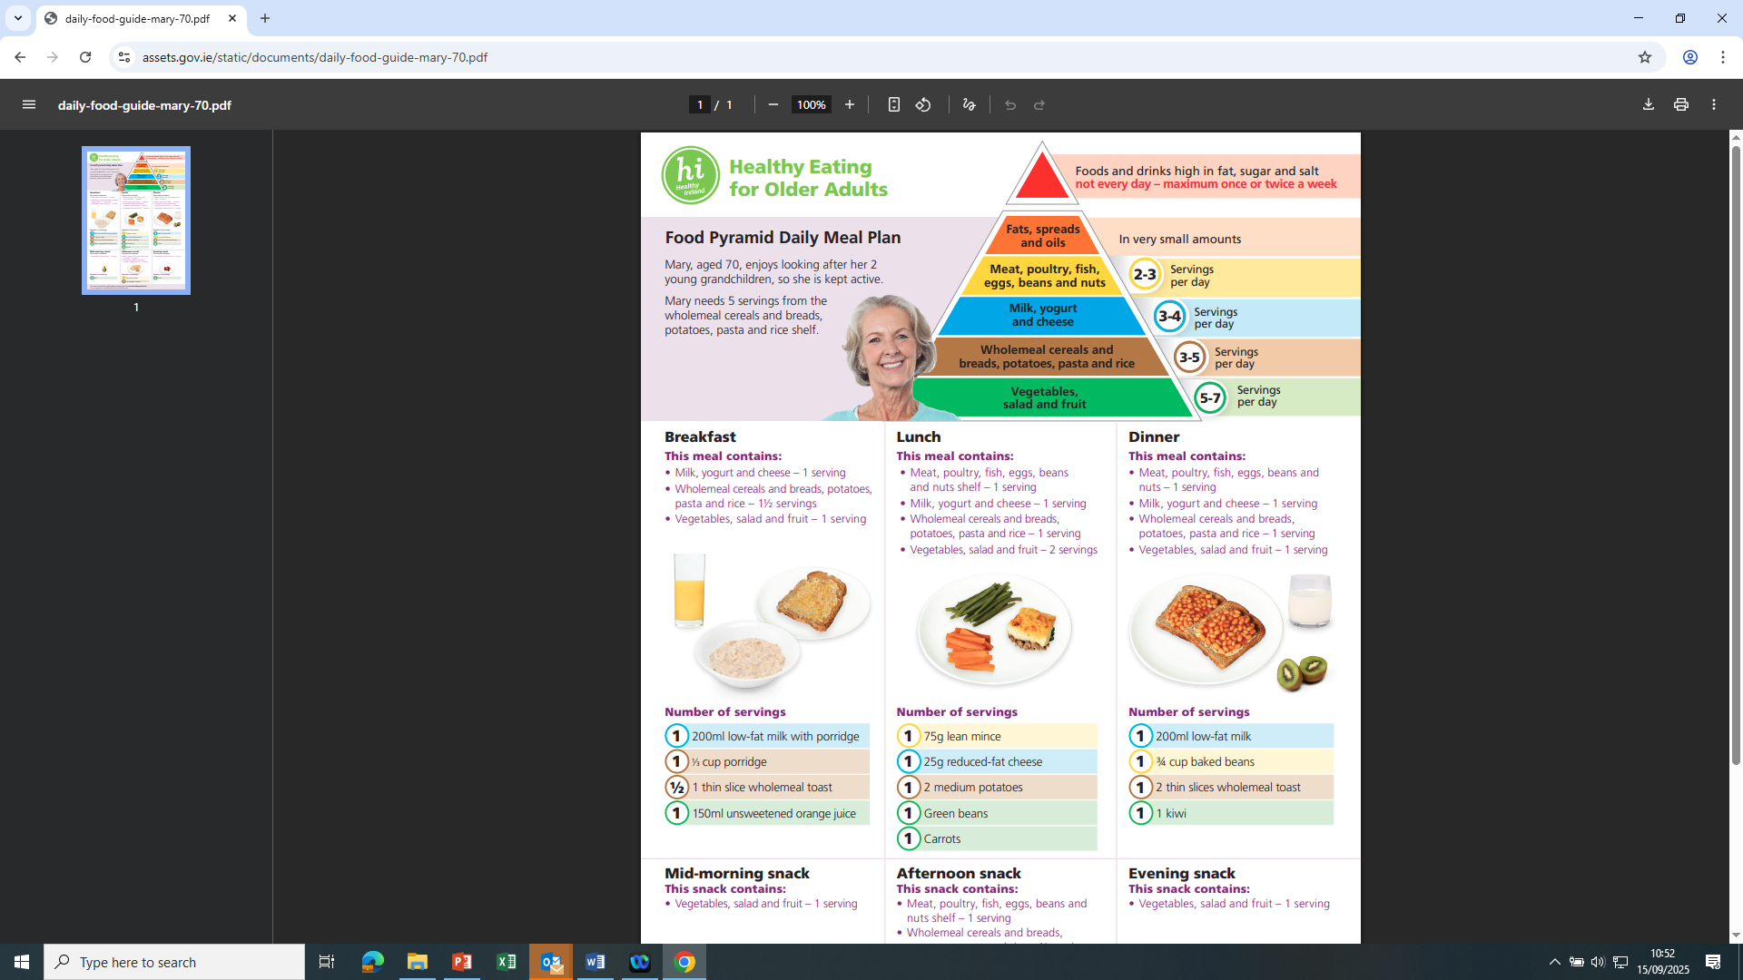
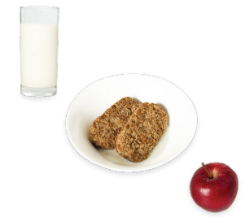
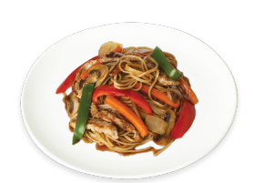
Meal ideas

Slide 24
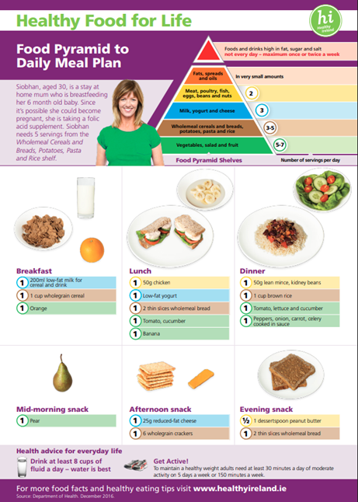
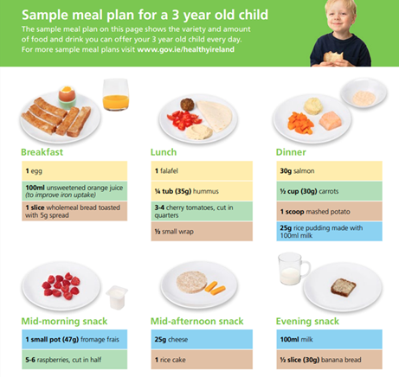
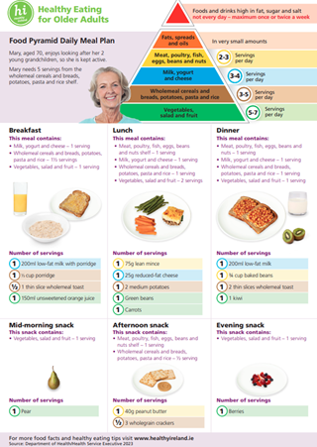
Sample meal plans
Also see Safefood.net : How to make a weekly meal plan (includes 3 weeks of meal ideas)
101 square meals recipe book

Slide 25
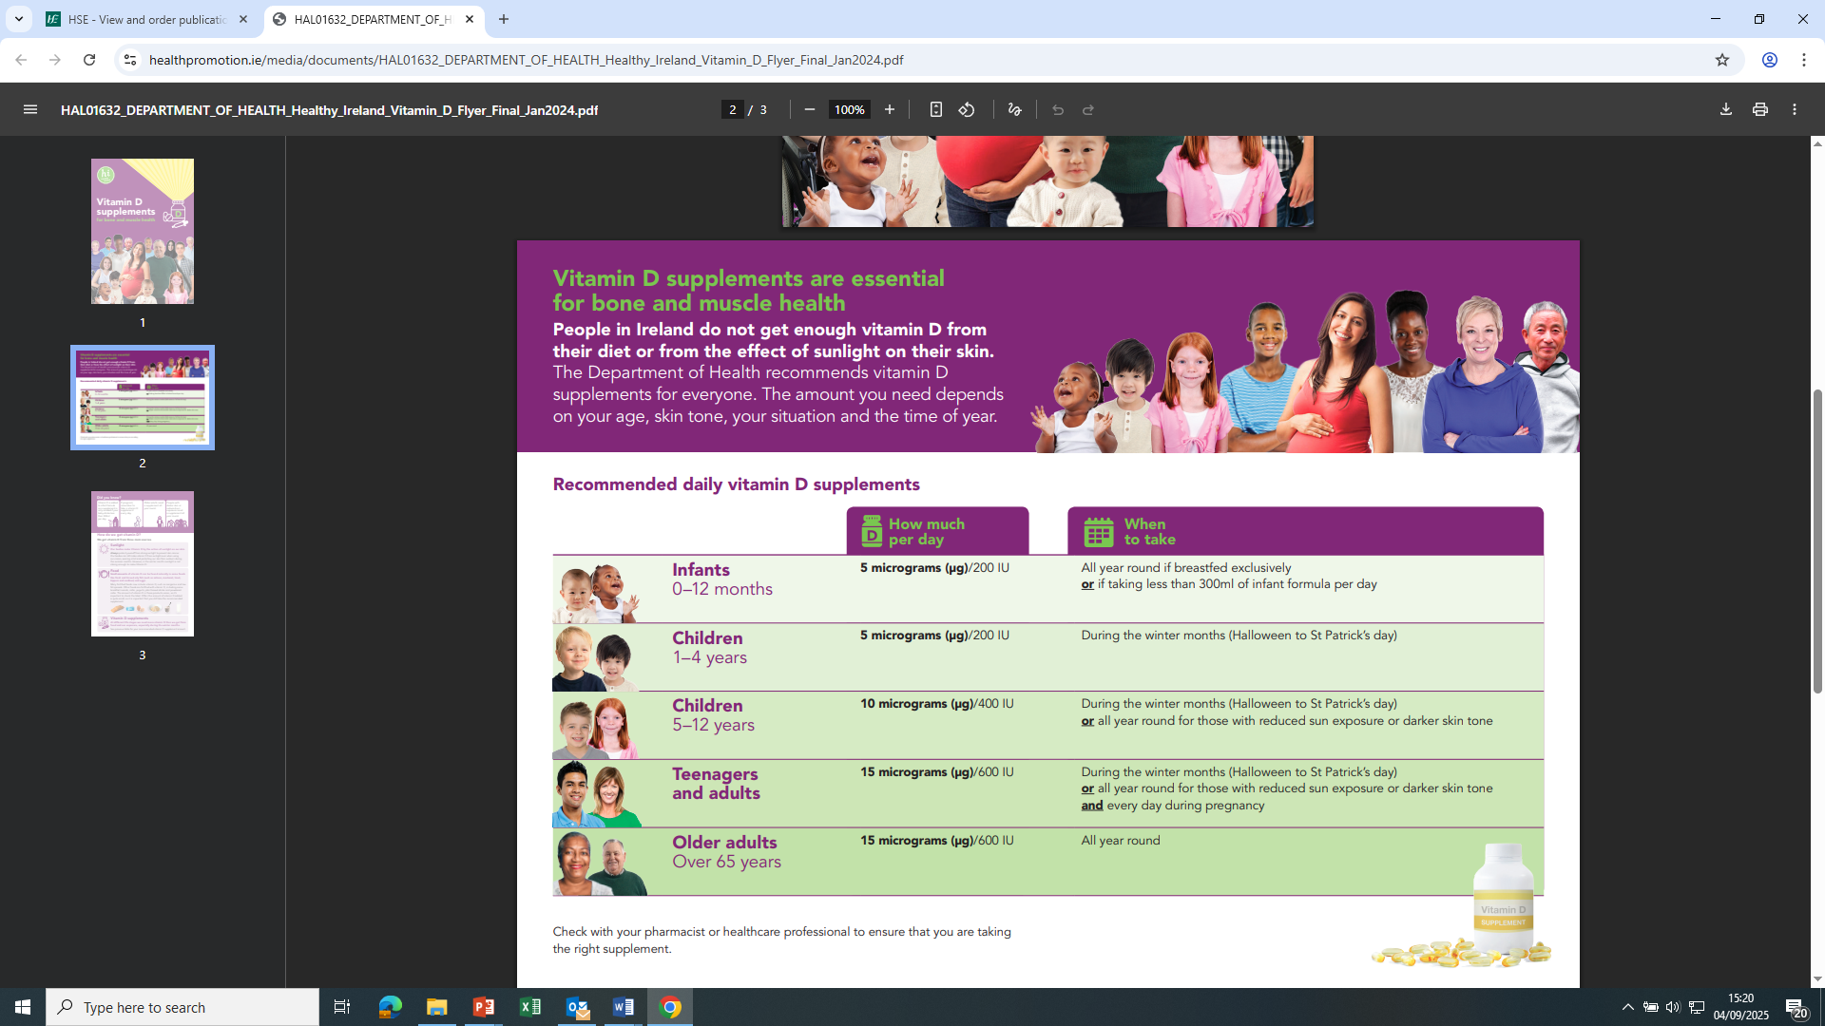
Vitamin D

Slide 26

Joe’s story
Joe is taking action and making changes
Breakfast at home.
More fruit and veg. Aiming for 5-7 portions per day.
Cut back on sweets, chocolate and crisps.

Slide 27

Joe’s story
Joe is sticking to the plan

Slide 28
Where to go for more information
Please see table with lots of information here today!

Slide 29
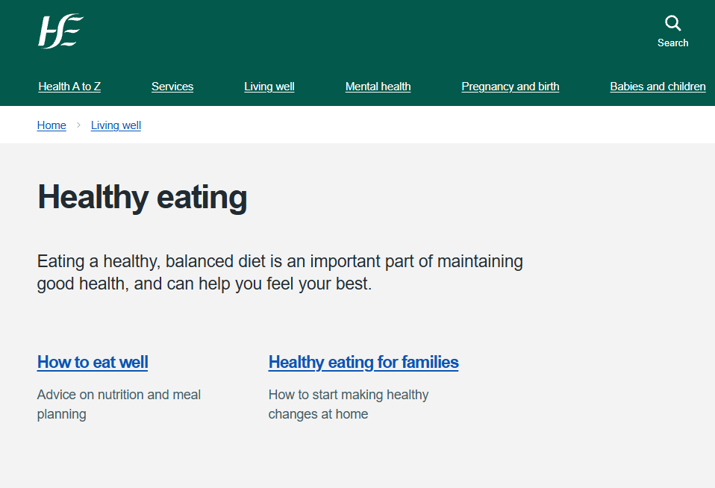
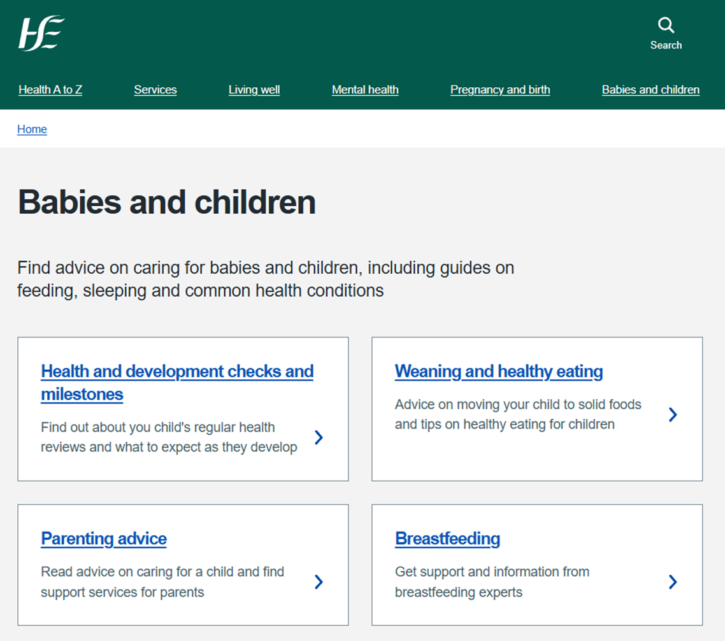
www.HSE.ie and www.mychild.ie

Slide 30
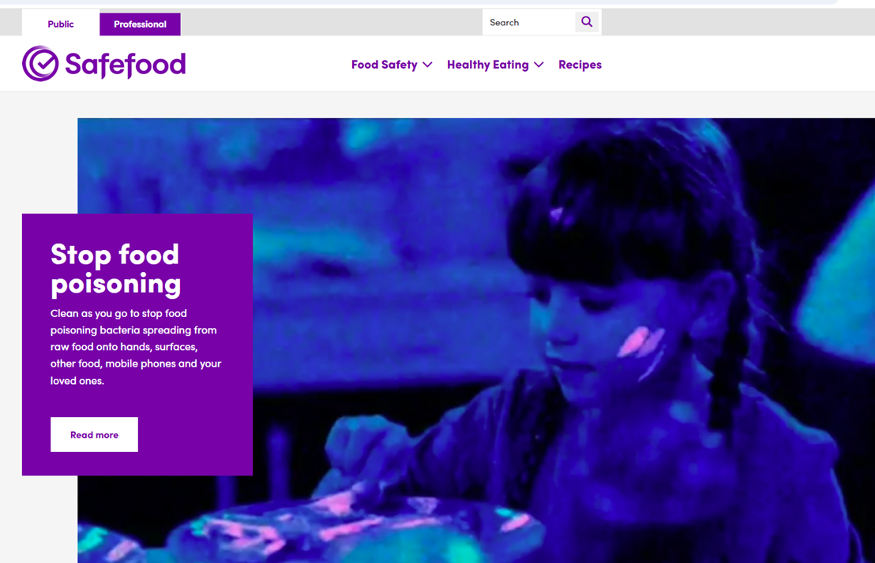
Safefood
www.safefood.net
healthy eating, recipes, food safety, cooking tips
“Foodwise” family food newsletter
‘101 square meals’ free recipe ebook
Safefood YouTube channel

Slide 31
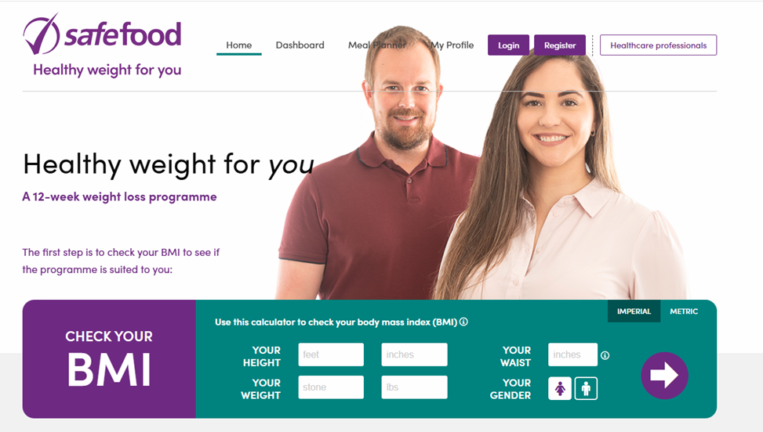
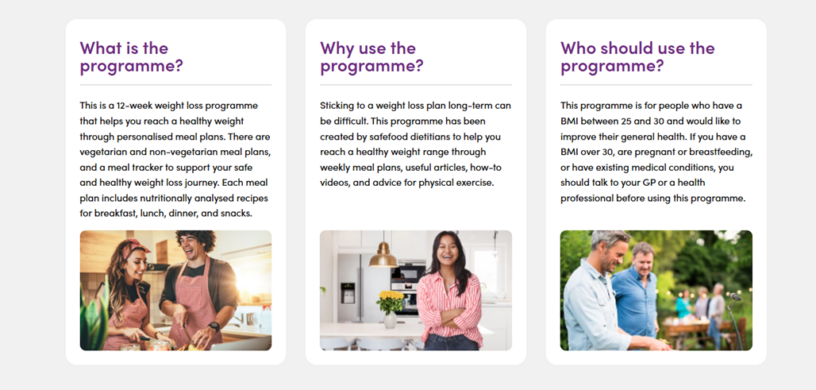

Slide 32

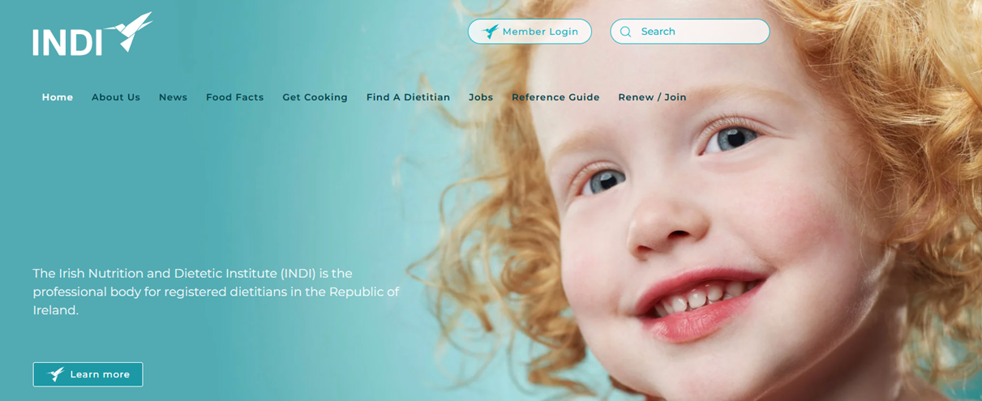

www.INDI.ie
National body of CORU registered Dietitians
Provides reliable info on dietary issues/ conditions
‘Find a dietititan’ (private) based on your location or clinical need
Download food fact sheets

Slide 33

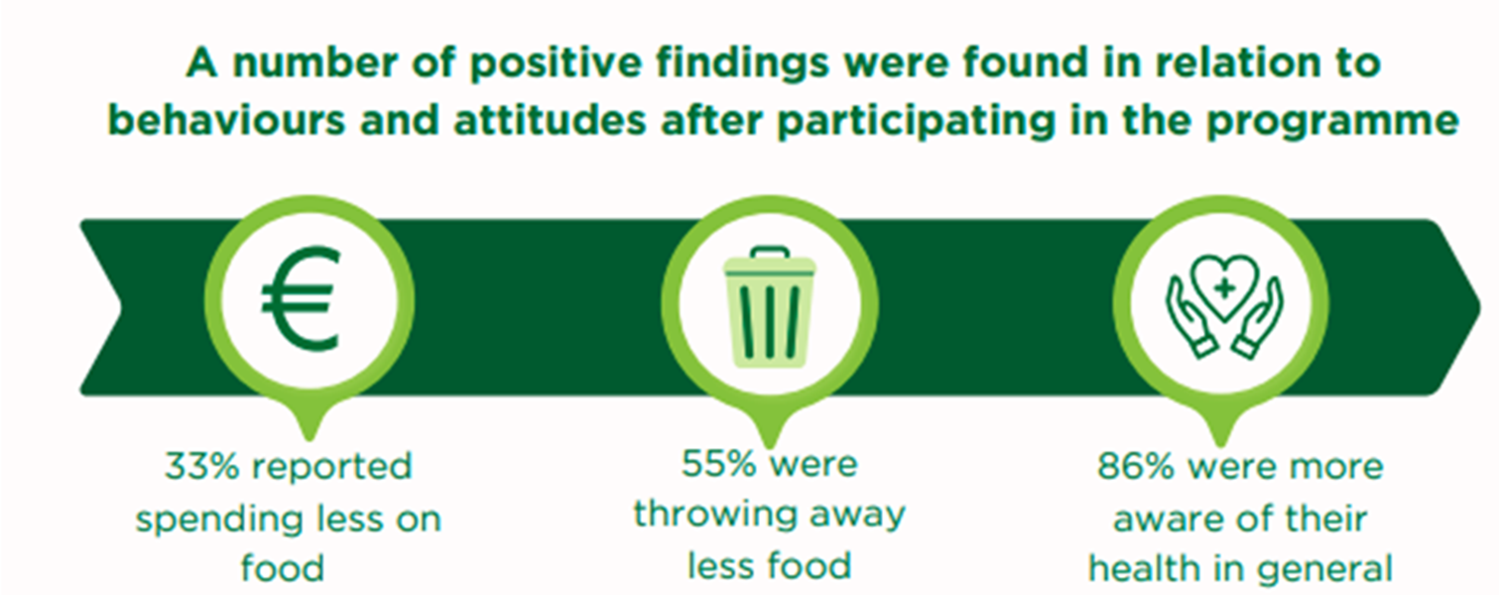
Healthy Food Made Easy
A six week programme
Healthy eating and cooking
Local community
Free of charge
Please write your name on list if interested
Notes:
Hyperlink https://www.youtube.com/watch?v=AGbwkNZzhwY

Slide 34


Dietitians
Dietitians are the only qualified and regulated health professionals who assess, diagnose and treat dietary and nutritional problems at an individual and wider public health level.
Speak to your GP or PHN if you feel you need to see a HSE dietitian.
A list of private dietitians can be found at www.INDI.ie

Slide 35
Planning ahead

Slide 36
Thank you!

Slide 37
References and resources
HSE: https://www2.hse.ie/living-well/healthy-eating/
https://www2.hse.ie/babies-children/weaning-eating/
www.Safefood.net
Healthy Eating 1- 4 Year Olds https://assets.hse.ie/media/documents/healthy-eating-for-1-to-4-year-olds.pdf
Healthy Food For Life (5-65years) https://assets.hse.ie/media/documents/healthy-eating-for-1-to-4-year-olds.pdf
Healthy Food For Life food plans and food group guides:
https://www.gov.ie/en/healthy-ireland/publications/healthy-ireland-food-plans-and-guides/
Older Adults: Guide, food plans, food group fact sheets https://www.gov.ie/en/healthy-ireland/publications/healthy-eating-for-older-adults/
Vitamin D https://www.healthpromotion.ie/media/documents/HAL01632_DEPARTMENT_OF_HEALTH_Healthy_Ireland_Vitamin_D_Flyer_Final_Jan2024.pdf

