Slide 1
Healthy Living
for Everyday Life
Alcohol Awareness
Aoise Meyler
Irish Heart Foundation,
Health Promotion Officer

Slide 2

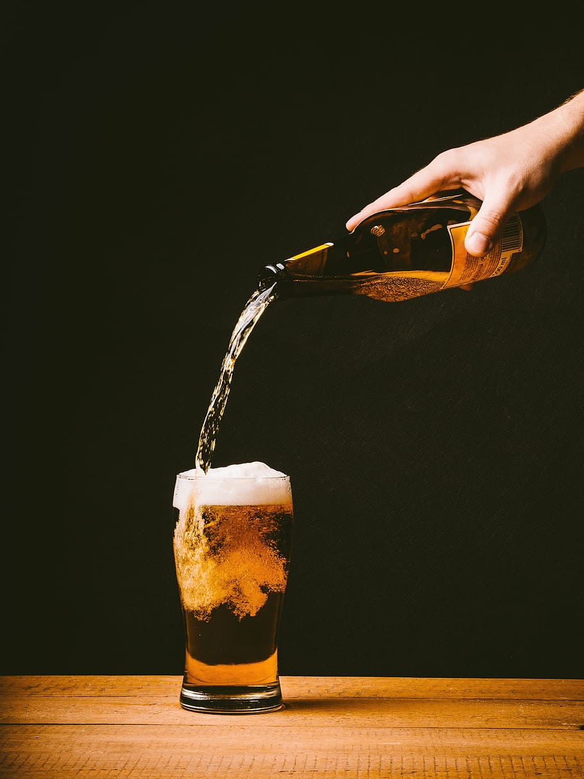
Introduction Ice Breaker!
House keeping
What is your name?
Can you name one brand of alcohol?

Slide 3
Workshop Objectives
  By the end of this workshop you will be able to:
  Know your risk factors of drinking alcohol
  Understand the ‘Stages of Behaviour Change’
  Know your alcohol limits and how to reduce it
  Find support services

Slide 4
Why talk about alcohol?
Alcohol is legal but can have serious health and social consequences.
Body
Relationships
Responsibilities
  Sleep
  Mood
  Health
  Addiction
  Arguments
  Loss in trust or connections
  Feeling alone
  Missing work
  Caring for self and others
  Money problems

Slide 5
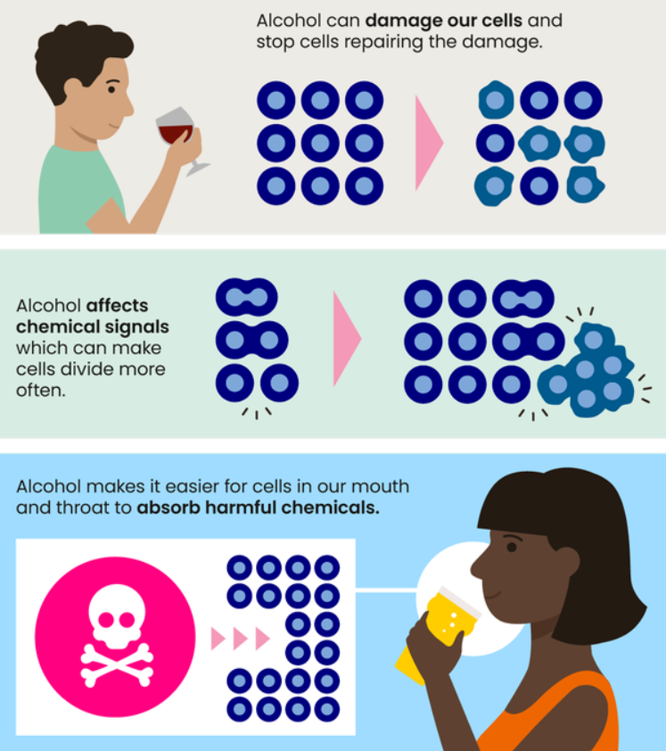
Alcohol Class 1 Carcinogen- what does this mean?
It groups substances based on their potential to cause cancer.
Class 1 = strong proof it causes cancer
It doesn’t matter what form of alcohol you drink!
To lower your risk, reduce the amount you drink.
Smoking is also classified as class 1

Slide 6
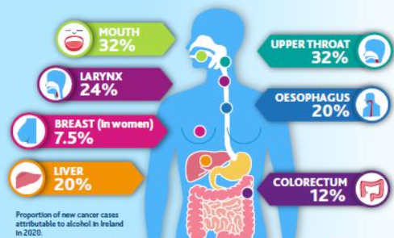
Alcohol and Cancer
📊 Impact in Ireland
Alcohol has caused:
1,000 cases/year of alcohol-related cancers.
260 breast cancers and 400 bowel cancers annually
🧬 How Alcohol Causes Cancer
Damages DNA.
Prevents cell repair.
Increases hormones (oestrogen), raising breast cancer risk.
Reduces nutrient absorption.
Increases the effect of tobacco

Slide 7
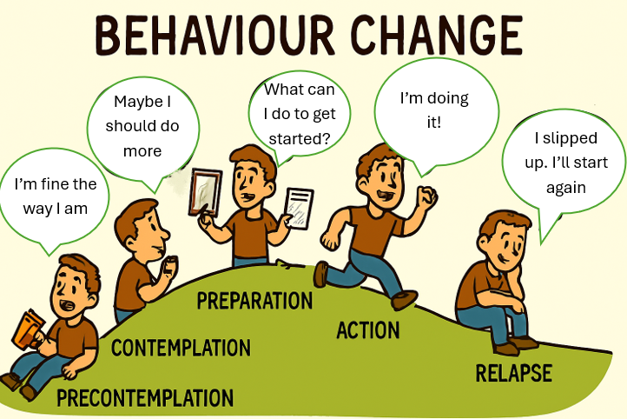
What is Behavioural Change?
Changing how we act, especially when we want to build a healthy habit or stop doing something that’s not good for us.
It's how people change habits like drinking alcohol.

Slide 8
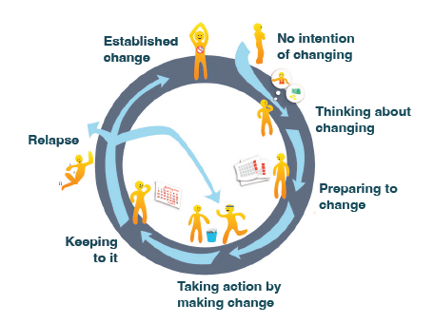
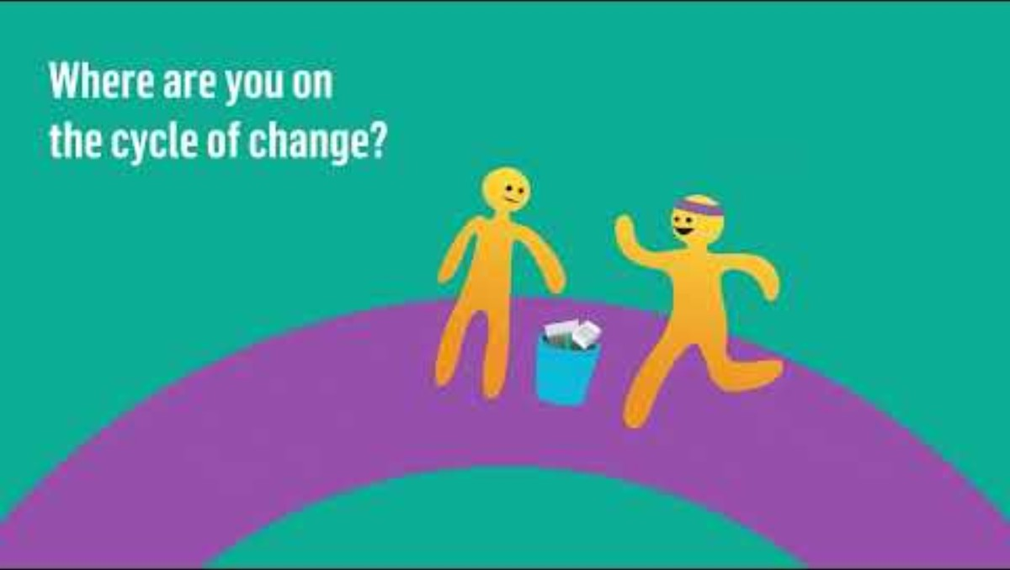
Stages of Change
Link to video
www.youtube.com/watch?v=uNQpnrroCPo

Slide 9


Case study
Lets Meet Sarah
We’ll follow Sarah, a woman in her 40s who drinks wine every night.
- Let’s see how she moves through the 5 stages of change.
Click on the speaker:

Slide 10
Precontemplation – “I’m fine the way I am”
Sarah thinks there is nothing wrong.
Hear how she is doing:

Slide 11
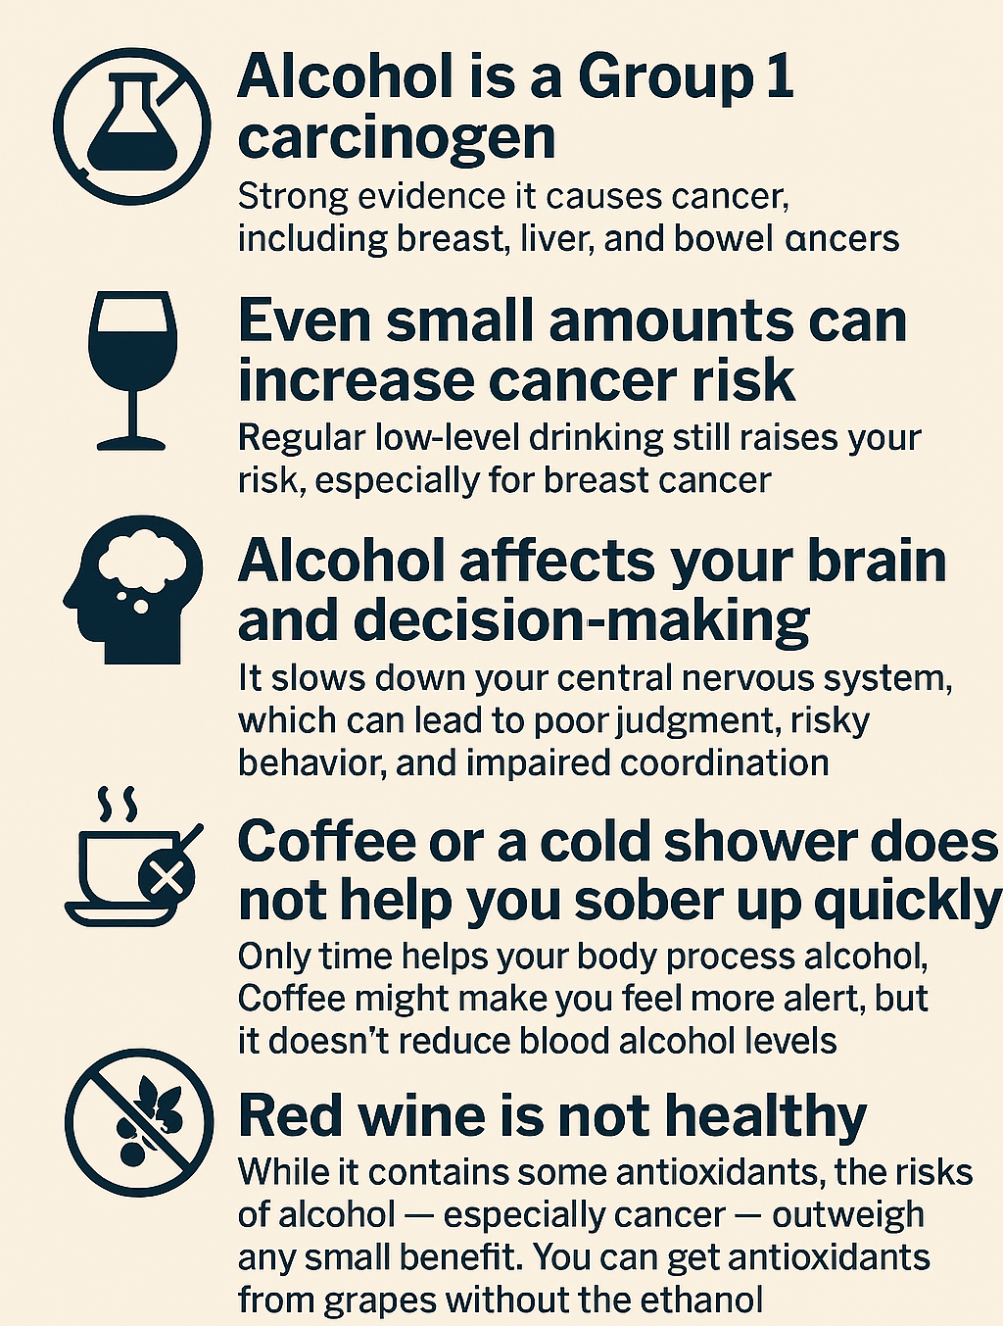
Be alcohol aware

Slide 12
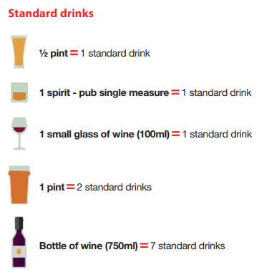
How Much is Too Much?
Low-risk drinking limits:
Women: up to 11 standard drinks/week
Men: up to 17 standard drinks/week
drinks-calculator

Slide 13
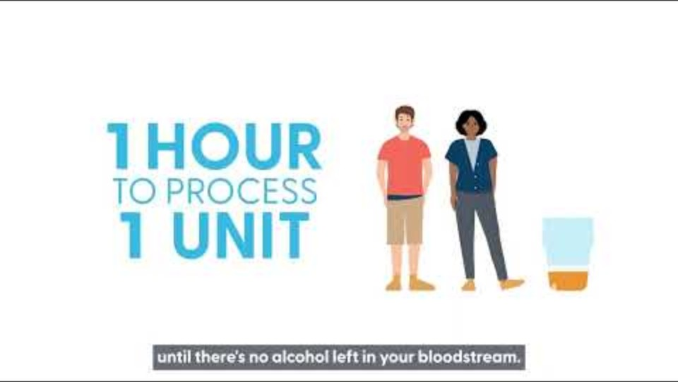
Understanding low – risk drinking limits

Slide 14
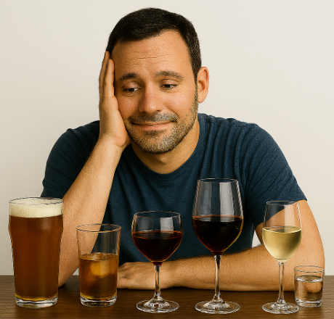
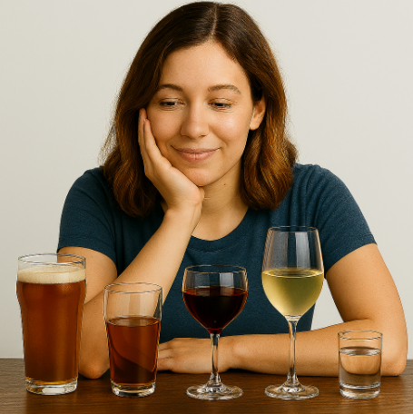
🚨 Binge Drinking: Know the Risk
🍻 What Is Binge Drinking?
Consuming 6+ standard drinks in one sitting (men), or 4+ drinks (women).
Often occurs during social events, weekends, or celebrations.

Slide 15
Binge drinking effects
Short-Term:
Impairs judgment, memory and balance
Accidents & injuries Alcohol poisoning
Risky sexual behaviour
Aggression & violence
Long-Term:
Reliant on alcohol
Cogitative decline
Liver damage
Heart disease
Mental health issues
Increased cancer risk (especially breast, liver, bowel)

Slide 16
Contemplation – “Maybe I should do more”
Sarah starts to wonder: 'Maybe I drink too much?'
Hear how she is doing:

Slide 17
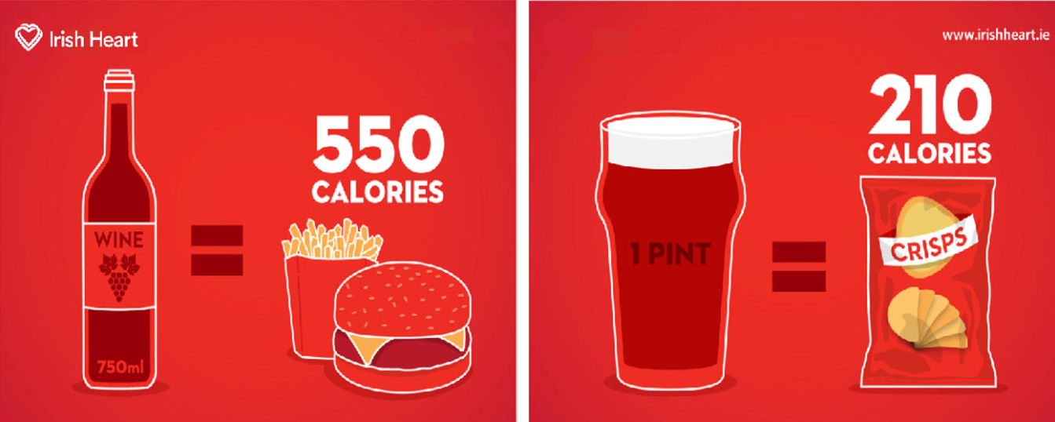
Calories in alcohol

Slide 18
Activity: Pros and cons to drinking
Pros
Helps some people relax or unwind
Social bonding in certain settings
Temporary escape from stress or emotions
Enjoyment of taste or ritual (e.g., wine with dinner)
Cons
Poor sleep quality
Increased risk of cancer, liver disease, and heart problems
Reduces the effect of medication & antidepressants
Mood swings, anxiety, or depression
Memory and concentration issues
Risk of dependence or addiction
Financial cost
Impact on relationships or responsibilities

Slide 19
Activity: Pros and cons to cutting down
Pros
Better sleep and energy
Improved mood and mental health
Lower risk of cancer and other diseases
Clearer thinking and memory
More control over choices and habits
Saves money
Positive impact on relationships
Cons
Social pressure or feeling left out
Breaking old habits can be hard
Withdrawal symptoms (for heavy drinkers)
Finding new ways to relax or cope

Slide 20
Preparation- “What can I do instead?”
Sarah decides to make a change.
Hear how she is doing:

Slide 21

Preparation Phase – Practical Tips
Understand 🧠
Understand Your Triggers:
  Notice when and why you drink (e.g., stress, boredom, social events).
Challenge 👥
Challenge Social Norms:
  It's okay to say no. Practice responses like 'I'm taking a break from alcohol.'
Expect 📉
Expect Setbacks:
  Life events can make change harder. Plan ahead for tough times.
Motivation 📊
Use a Motivation Scale:
  Ask yourself: 'On a scale of 1–10, how motivated am I to cut down?'
Confidence 💪
Use a Confidence Scale:
  Ask: 'How confident am I that I can make this change?'
Make 📝
Make a Simple Plan:
  Choose one small step (e.g., skip one drink, talk to a friend, call a support line).

Slide 22
Finding Your Motivation
🧠 What matters to you? 💬 What do you want more of in life?
Better health (more energy, sleep, fewer headaches)
More time and connection with family
Saving money
Feeling proud and in control
Self-respect and confidence

Slide 23
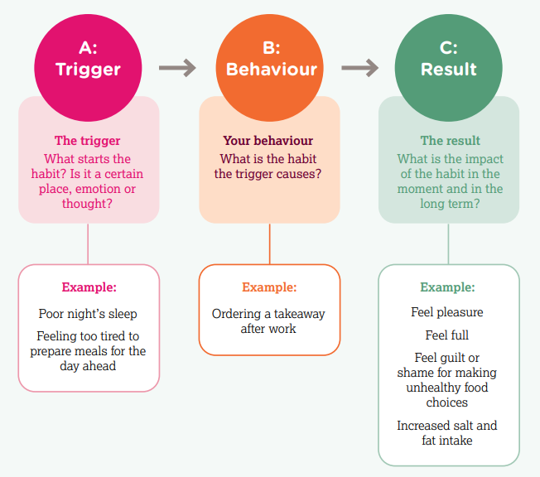

Map Your Triggers

Slide 24
Be prepared
Drink low-alcohol alternatives.
Suggest alcohol-free activities with friends
Learn some stress-management techniques, like controlled breathing or mindfulness
Change your route to avoid pubs or off-licenses.
Avoid having alcohol in the house.

Slide 25
Action- “I’m doing it!”
Sarah has managed to reduce her drinking
Hear how she is doing:

Slide 26
Barriers to reducing alcohol
Cravings or habits
  Distract yourself with a walk, call a friend, or drink water instead
Social pressure
  Practice saying 'No thanks' or bring your own non-alcoholic drink.
Stress or emotions
  Deep breathing, journaling, or talking to someone.
Feeling alone
  Try reach out to support services or join a group in the commuinty.

Slide 27
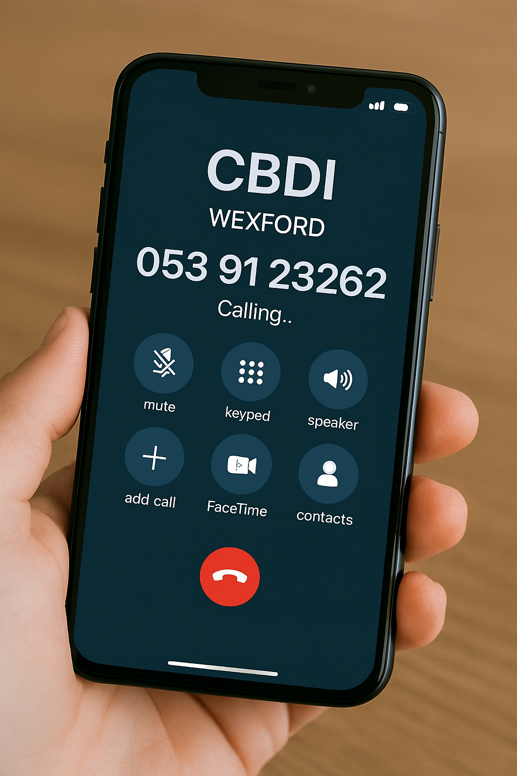
Calling a Support Service – What to Expect
When you call:
  A friendly person will listen
  You can talk about your drinking
  They may ask:
    How often do you drink?
    How much do you drink?
    Do you want to cut down?
  You don’t have to give your name
  They will offer support or suggest next steps

Slide 28
Relapse- “I slipped up. I’ll start again”
Sarah has slipped up
Hear how she is doing:

Slide 29
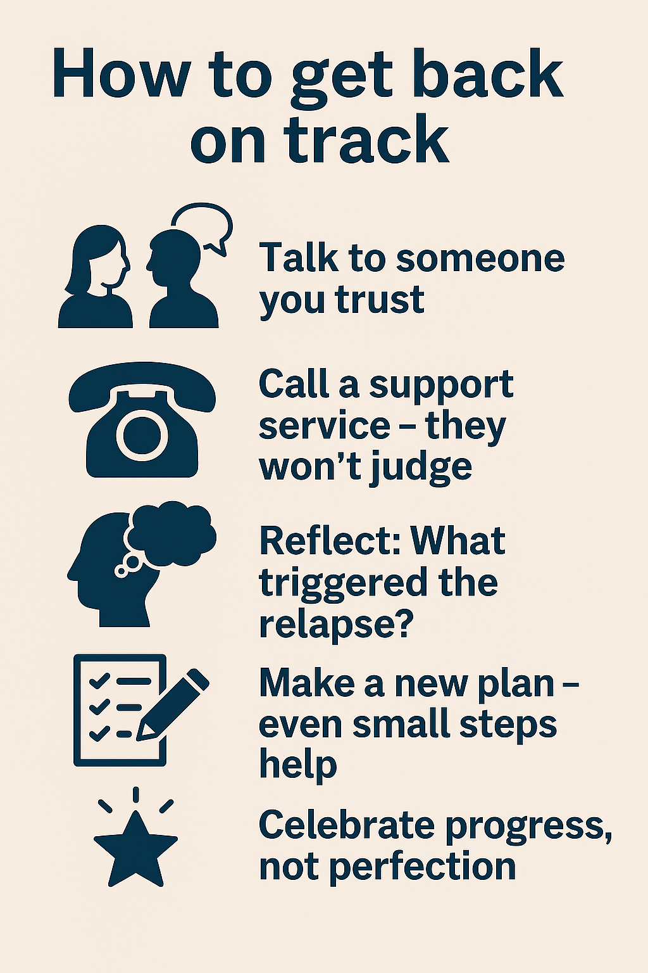
Relapse
Relapse is a step in the journey – not the end!
💬 Common feelings:
Shame, guilt, frustration – these are normal.

Slide 30
Maintaining your progress
Reflect regularly
Celebrate milestones
Visualise setbacks
Stick to a schedule
Make it automatic
Track progress
Surround yourself
Avoid triggers
Seek help
Be flexible
Learn from slip-ups
Keep growing

Slide 31
Maintenance “I feel great. I need to keep going”
Sarah has managed to stay on top of reducing her drinking
Hear how she is doing:

Slide 32
Support Services
Wexford Community Based Drugs Initiative 📞053 912 3262 📞087 935 1765 🌐 www.fdys.ie 📧 johnpaul.oneill@fdys.ie 📧 niamh.clancy@fdys
County Wexford Substance Misuse Service 📍 St John's Hospital, Enniscorthy 📞 053 925 9825 🌐 www.hse.ie 📧 annemarie.walshe@maila.hse.ie
Aiséirí Wexford 📍 Roxborough, Wexford 📞 053 914 1818 🌐 www.aiseiri.ie 📧 info@aiseiri.ie 🕒 Opening times available on website
Alcoholics Anonymous – Wexford 📞 01 842 0700 🌐 www.alcoholicsanonymous.ie 📧 gso@alcoholicsanonymous.ie
Cornmarket Project Info 🧠 Cornmarket Project 📍 Block A, Old County Hall, Spawell Road, Wexford 📞 053 915 5817 📧 cmpadmin@cornmarketproject.com

Slide 33
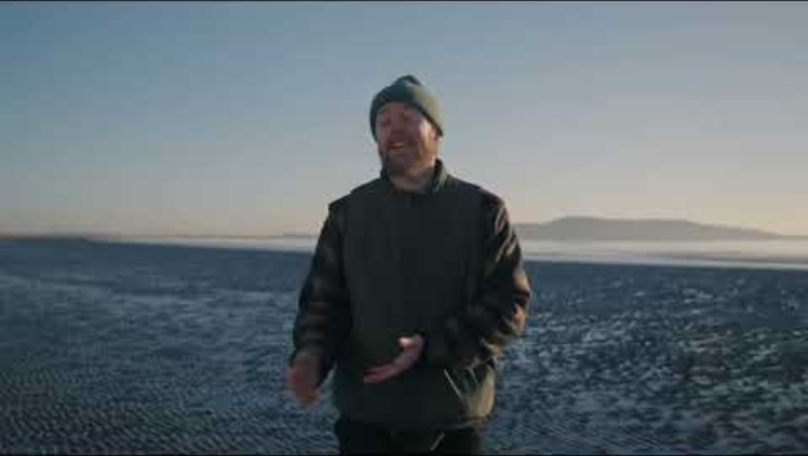
Final Reflection
What’s one thing you learned today?
What is one thing you can change from today?
Remember: Change is a journey, not a race.

Slide 34
My Contact Details
Aoise Meyler
Health Promotion Practitioner
Irish Heart Foundation

Slide 35
