Slide 1
Healthy Living
for Everyday Life
Understanding Smoking and Vaping
Elaine Banville
HSE Health Promotion Officer
Notes:
Introduce Facilitator and organisation they work in and then Briefly the workshop and what it will be about - 1Min

Slide 2
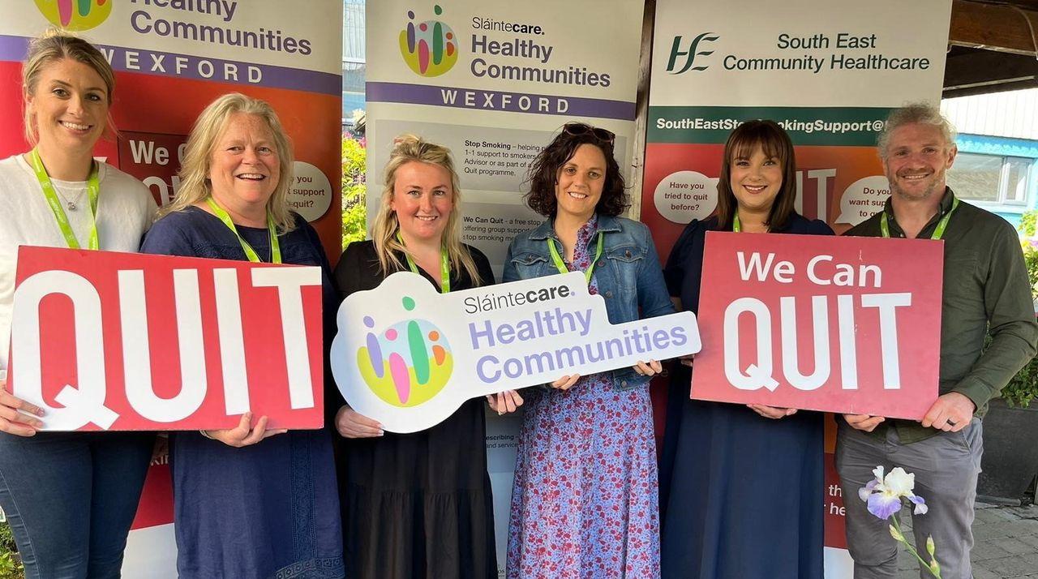
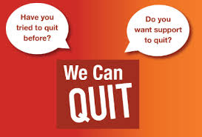
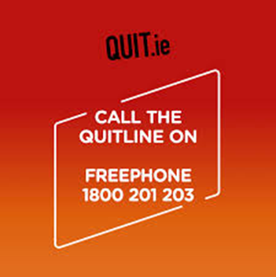


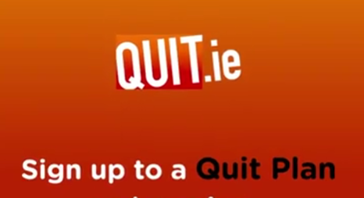
Notes:
Health Promotion Officers in each town in Wexford and one of our roles is to deliver the Quit Smoking Support Programme

Slide 3




Housekeeping
Talk Finishes at 12 noon
Refreshment Break at 11.15am

Slide 4

What to Expect
Want you to all feel comfortable and at ease
Case Study as the example- No need to tell personal stories
Discussions had in small groups, feedback invited to larger group-No pressure
Nobody will be asked direct questions
Nobody asked to complete handouts or forms (Other than feedback form & help available)
Always a right to pass on any discussions or step out at any time during the talk
Notes:
• focus of workshop will be on a case study example and all conversations will centre around her experiences so no need for anybody to speak personally today,
• all conversations will be in small groups/partners and can feedback to larger group if wanted-nobody to feel worried about being asked direct questions
• No requests for forms etc to be filled in, pens/paper available if desired. One exception is evaluation, it will be anonymous and if anybody would like assistance with that just pop the hand up to me at the end.
• right to pass on any conversations being had

Slide 5
Feedback forms
What is it?
7 Questions for you to answer. Page 1 before the talk and Page 2 after the talk (same questions)
Why do it?
To see if the talk was useful (Hopefully do more of them if so)
To see if we need to make any changes to the talk to make them more useful
How to do it?
I will read out the questions and ask you to tick which smiley face meets your response to it, if the faces are confusing just base it on a yes or no answer, colour coded as Green for yes and Red for no.
Keep the form and complete it again at the end of the talk
Fold it up and pop it in the box

Slide 6

Icebreaker
Take a green and red thumbs up/down sign
I will read a statement such as “I had breakfast this morning”
If the statement applies to you/describes you then you hold up the green thumbs up sign
If the statement does not apply to you/describe you then hold up a red thumbs down sign
Notes:
who had toast for breakfast
who walked here
who came with someone they know
who has come to a talk/workshop in the library before
You are a bit nervous about coming to this group
who has ever smoked or vaped
who tried their first cigarette/vape before age 13
who has a family member or friend that smokes/vapes
who would consider themselves to be a smoker/vaper at the moment?
who has ever consider quitting smoking/vaping
who would really like to give up smoking/vaping
who would like to support a family or friend to quit smoking/vaping
who has quit smoking previously
who thinks they could give up smoking if they wanted to
who thinks it would be too hard to quit
After Activity Discuss the purpose of the icebreaker:
“We are all coming here today with different experiences and for different reasons, the aim of the talk today is to for it to be of interest and value to all people this could be for people who currently smoke or vape whether or not they have any plans to quit, and for people who have family members and friends who smoke/vape that they would like to support”

Slide 7
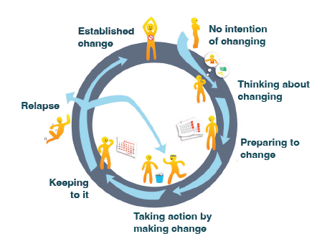
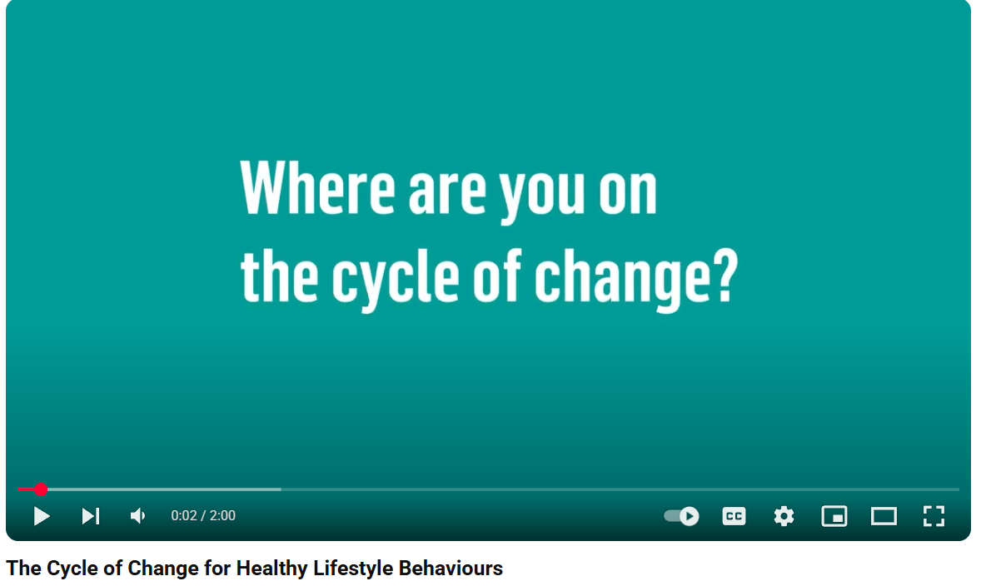
Stages of Change
https://www.youtube.com/watch?v=i1bd8Mai6O4o
Notes:
Introduce behaviour change stages by showing video And poster
Mention why it is important that this is part of the way we approach our understanding of smoking and vaping
“at every stage there are supports that can be put in place to help move people along the wheel of change.”
“Different actions/supports needed depending on which stage people are at for example if a person is not ready to change then telling them all the bad things that smoking can do to their health is not likely to be very supportive and will likely just make them feel bad and angry and not willing to talk about it”

Slide 8


Introducing Sandra
Click the speaker Icon to hear her story
Notes:
Introduce Case study example Sandra (Photo) and Stages of Change Poster
“Sandra is going to move with us throughout the whole talk today while we talk about what support people might need at different stages of readiness to quit smoking, any questions or discussions we have during this workshop will all focus on Sandras story rather than on our own personal stories, but hopefully you will all find something to relate to throughout the morning”
“Now we will hear from Sandra to begin telling us her story” ….
Play audio clip (if problems with sound read script below)
Hi, my name is Sandra, I’m 50 and from Wexford. I work part time as a receptionist. I have 2 grown up children, 1 grandchild and I currently care for my Mam who lives with me.
I started smoking when I was 12 years old, so it feels like I have always been a smoker really, and I smoke around 20 cigarettes a day.
Lately I have been feeling really tired, stressed out and not able to sleep well. I’ve also noticed I get breathless when I’m doing things like house work or walking.
I don’t have any illnesses as such but I do take medicine for high blood pressure and high cholesterol so I go to the doctor every so often to get these checked.

Slide 9
Sandra
No Plans to Quit
Notes:
Place Photo of Sandra onto the first Stage: “Not thinking of changing” and briefly mention what this stage of change is then play audio clip
I went to the doctor yesterday to get my blood pressure and cholesterol checked, and to see if there might be anything going on that would explain how Ive been feeling lately. The doctor said everything looks fine in the results but he mentioned to me AGAIN about the fact I need to quit smoking. He brings this up every time I come for an appointment which kind of frustrates me because it’s not what I came here to talk about, and I don’t really see how it will help with anything that I have going on at the moment anyway. I was quick to shut down his suggestion that he would refer me for support to quit! He gave me a quit smoking booklet anyway that explains what support is available with phone number and some QR code thing…To be honest, I couldn’t understand much of the information that was in the booklet, it was all big words in small writing, and I didn’t even have my glasses! After I pretended to read it for a while the doctor asked me if I had questions about it but I was too embarrassed to tell him I couldn’t actually really read or understand it, so I just said no.
I’ve been smoking for more than 30 years, never tried to quit once so what would be the point now at my age! I threw the leaflet in the bin at the pharmacy when I was collecting my usually prescription.
Discuss the stage of change that Sandra is in now briefly using some key terms and some of her examples from the audio clip.
Not ready or interested in quitting smoking or even in thinking or talking about it. Gets annoyed when doctor brings it up. Cant see the point in discussing it, maybe not aware of what the benefits of quitting would be etc etc. She mentioned that she couldn’t see how quitting smoking would even relate to her symptoms at the moment etc.
Ask participants to take a minute to think about whether they or a loved one have ever been in this stage of change in relation to smoking or vaping.

Slide 10
What does Sandra Need?
Why does Sandra not want to quit smoking?
What support would help Sandra at this stage to move her along to starting to think about quitting smoking?
Notes:
Split group in 2 and Ask participants to turn to person beside them. 1 Side of the room discusses Q 1 and other side Q2. Ask for Feedback to larger group and then put up own examples on next 2 slides
Alternatively, if stuck for time or shy group etc, don’t split into groups, just ask to call out feedback from large group and write on clipboard

Slide 11
Why does Sandra not want to quit
Not fully aware of health and wellbeing implications
Not enough information clearly given to her
in denial or has never really wanted to hear them
too many myths
Addiction
Doesn’t feel it is in her control
Nicotine cravings
Emotional Impact
Sees it as a treat
A “Break”
A “Reward”
Her time
Part of her identity
Has “Always been a smoker”
Thinks it helps with stress
Fear of failing/Fear of what it would be like to quit
Worried anxiety/stress would get worse-not able to cope
Notes:
Discuss the potential reasons for Sandra based on what we have heard so far and then mention the fact that it is important to understand why people are reluctant to make change to their health behaviours, it is not always as simple as just not wanting to….sometimes they might not even fully know the answers themselves until they are asked to discuss it and think about it

Slide 12
What support will help Sandra
Needs someone to understand her situation and help her understand it
No judgment and no guilt tripping
Create awareness on benefits of quitting for her
Support to change her beliefs/values
Boost confidence and show help is available
“why” she smokes.
“Myth Bust” around smoking and give factual and understandable information on benefits of quitting
Fear/confidence/emotional attachment
Notes:
Tell participants that for people in this stage of change the most supportive approach is to try and change the persons beliefs around the lifestyle habit (smoking/vaping in this case)…this can be in the form of providing information and creating more awareness and also through “Myth busting” and ensuring that people have clear and accurate facts to support their decision making.

Slide 13
Quiz/Walking debate
Take a green and red thumbs up/down sign
I will read a statement
If you think the statement is true hold up green sign/ move to green side of room
If you think statement is false hold up a red thumbs down sign/move to red side of the room
Notes:
Myth busting Example
Explain how the quiz will work, can be walking debate or sitting quiz depending on group and room. See appendix of session plan template for quiz Qs and answers

Slide 14
Myth Busting
Everyone who smokes enjoys it.
A nicotine addiction has similar chemical characteristics as a heroin addiction
Cigarette smoking is the leading cause of COPD.
Smoking a few cigarettes a day is no big deal.
Vaping is a healthier alternative to cigarettes.
How you smoke can affect how much nicotine gets into your body.
Taking a puff of a cigarette can reduce your craving for more.
Smoking and vaping helps people to relax
Smoking helps you deal with stress and anxiety
When you quit smoking, your heart rate and blood pressure return to normal levels.
Smoking cigarettes causes you to inhale carbon monoxide which is the same gas that can cause poisoning
If you are over 50 years old, there is no point in quitting smoking
Notes:
Everyone who smokes enjoys it.
False
7 out of every 10 people that smoke actually want to quit. Most people smoke not because they enjoy it but because they feel miserable if they don’t have a cigarette. Those who want to quit find it
really hard to give up because of the nicotine addiction.
A nicotine addiction has similar chemical characteristics as a heroin addiction
Answer: True
Research has shown that the way in which a person addicted to nicotine behaves, is similar
to that of a person with a heroin addiction. A person grows a nicotine receptor in their brain,
which they have to feed regularly with a cigarette or e-cigarette because the body will crave the
nicotine. When a person inhales, it takes 7 seconds for the nicotine to reach the brain. A person
has withdrawal symptoms when they quit smoking or vaping because the body is craving a hit.
Cigarette smoking is the leading cause of COPD.
Answer: True
smoking causes about 80% of all COPD cases. The more you smoke, the higher your risk of COPD. Other risk factors for COPD include secondhand smoke, pollution, or being exposed to certain fumes and gases at work.
Smoking a few cigarettes a day is no big deal.
False
There is no safe number of cigarettes smoked. Each cigarette contains 4,000 chemicals and poisons, 40 of which cause cancer. Consuming three to five daily can lead to cardiovascular diseases and trigger sudden heart attacks and death.
How you smoke can affect how much nicotine gets into your body.
True
You may take in more nicotine if you inhale deeply into the lungs and take a lot of puffs. This is because nicotine gets absorbed into your body through the lining of your mouth and as well as your lungs.
Taking a puff of a cigarette can reduce your craving for more.
False
The correct answer is myth. One puff of a cigarette will make your craving stronger. Instead, look for other ways to satisfy your craving, such as chewing sugarless gum or eating a piece of fruit or other low-calorie snack. Take walks or ride a bike. Exercise helps relieve the urge to smoke.
Vaping is a healthier alternative to cigarettes.
False
The danger lies in the heated ingredients that may include a mix of potentially harmful chemicals. And although e-cigarettes don’t contain tobacco, many include nicotine, which is a highly addictive chemical compound that comes from tobacco. Nicotine can change the way the brain works and cause physical and psychological dependence.
Another risk: There are no testing requirements, which means there’s no way to know how safe products are and what chemicals may be lurking inside.
Researchers continue to study the long-term health risks of e-cigarettes, what is known is that the aerosols (vapor) created by e-cigarettes and vape products contains harmful chemicals, such as diacetyl, formaldehyde and other volatile organic compounds — the same cancer-causing chemicals found in cigarette smoke.
Smoking and vaping helps people to relax
Answer: Myth
While people feel relaxed when inhale nicotine from tobacco or e-cigarettes, these are actually
stimulants. This means that they accelerate the heart rate, raise the blood pressure and suppress
appetite. It is thought that the deep breathing when inhaling relaxes the person and getting their
nicotine hit prevents them from going into withdrawals. However, there are other ways to relax,
which are much healthier than smoking and vaping. Young people who use smoke or vape are
more likely to report irritability, bad temper, feeling low and less happiness with life.
Smoking helps you deal with stress and anxiety
MYTH: Smoking actually increases anxiety and tension. Nicotine creates an immediate sense of relaxation so people smoke in the belief that it reduces stress and anxiety. This feeling is temporary and soon gives way to withdrawal symptoms and increased cravings and actually increases the physical stress on your body. You start to "need" a cigarette to control the nicotine withdrawal symptoms - it does not reduce your stress levels or deal with the underlying causes. Non-smokers usually have lower stress levels than smokers. You'll feel much healthier once you quit smoking and this can help reduce your stress levels.
When you quit smoking, your heart rate and blood pressure return to normal levels.
True
Smoking raises your heart rate and blood pressure, and stopping helps them come back down. When you quit, you'll have less carbon monoxide in your blood, so it can carry more oxygen to your body. Your senses of taste and smell will improve.
Smoking cigarettes causes you to inhale carbon monoxide which is the same gas that can cause poisoning
True
Burned Tobacco created Carbon monoxide which is inhaled when you smoke, Carbon monoxide steals the O2 in your lungs making your blood thicker and harder for your heart to pump around the body, lower levels of Oxygen also makes it more difficult for all other organs to function including the brain. For someone who smokes 20 a day the amount of CO2 in their lungs can be between 30-45ppm, a CO monitor will general begin to beep to warn people that CO Levels are too high in a room at 50ppm. After 48 hours of quitting smoking your body clears all of the Carbon monoxide out of your lungs.
If you are over 50 years old, there is no point in quitting smoking
Answer: False: The sooner you quit, the sooner your health can improve. Within 20 minutes of your last cigarette, your blood pressure and heartbeat start to normalise. Within two to five years, your risk of having a stroke could fall to about that of a non-smoker. In 10 years, your risk of lung cancer is cut by half. At the same time, stopping smoking protects the health of your family. Breathing in second-hand smoke increases the risk of lung cancer, heart disease and stroke, as well as respiratory diseases like asthma and bronchitis. It is never too late to quit smoking and everyday smoke free will be a day lived with better quality of life simply because you are not breathing in CO2 or relying on the addictive substance of nicotine.

Slide 15
Sandra
Thinking about Quitting
Notes:
Play audio and then discuss where Sandra is on the cycle of change.
In this stage of change when people are starting to think about making a change the type of support they usually need is a bit of persuasion and encouragement, they are weighing up the pros and cons and some support around that process can be really useful to help guide them towards being ready to change

Slide 16



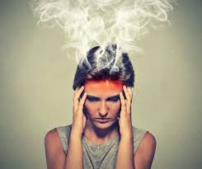
Thinking about Quitting
7 out of 10 people who smoke would like to quit smoking
Decisional Balance: Weighing Scales effect of deciding whether to quit
Notes:
In any behaviour change we spend a lot of time thinking about change and weighing up the positives and negatives of making that change.
This is like a constantly tipping weighing scales in our minds and trying to balance it can be exhausting mentally…. Sometimes in just taking the leap into action people can experience some relief.
It can be helpful to spend time writing down these thoughts of pros Vs cons and in doing this we can help to persuade ourselves that taking action to change is the right thing to do.
Activity
Image of Weighing scales on flip chart, ask participants to call out all the benefits Sandra could gain by quitting smoking and all the possible negative things that could happen if she quits or all the reasons that might be holding her back. Write these on a sticky note and stick onto the scales (have some pre-prepared), allow participants to write their own and stick up or call out suggestions
Explain that there is mostly always more pros of quitting than cons, but sometimes until we allow ourselves to see these all we can think about and see are the cons. Go on to discuss some of the benefits of quitting

Slide 17
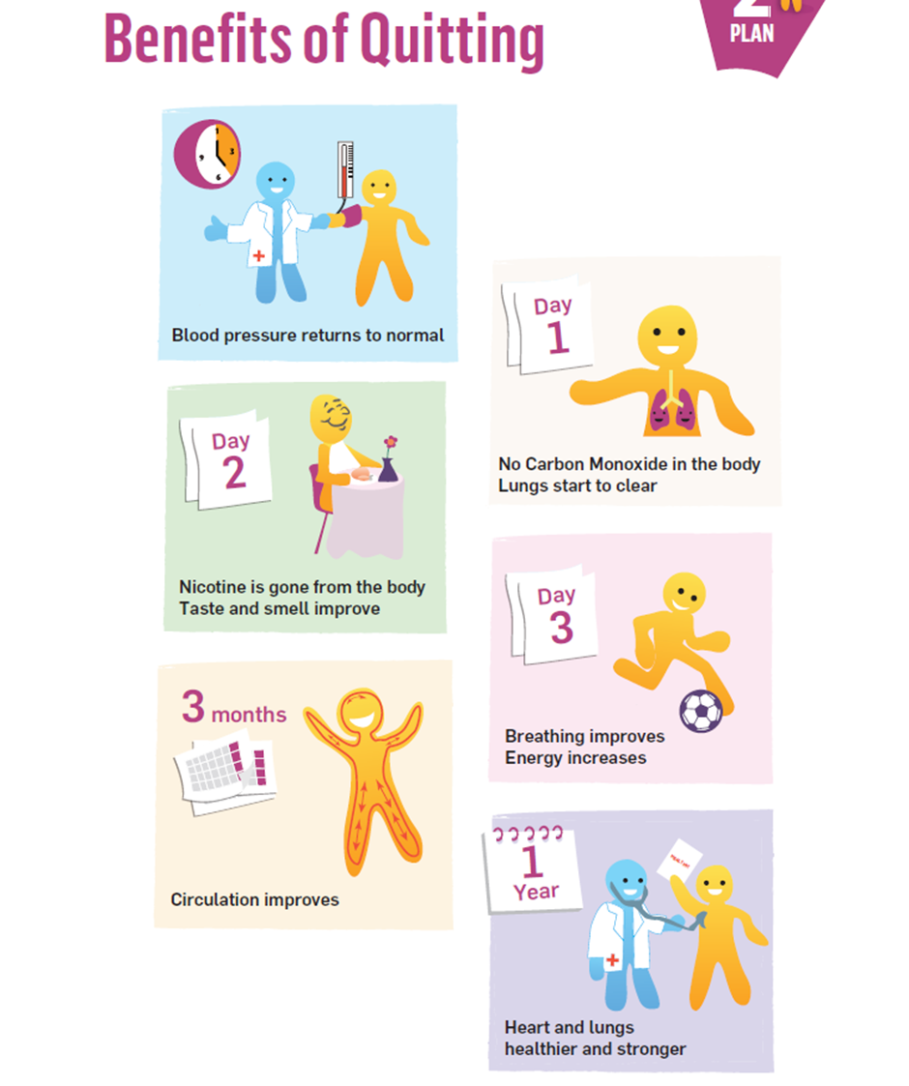
Physical Health Benefits of Quitting Smoking
Blood pressure and heart rate lower so risk of heart attack already reduced
Carbon Monoxide leaves the body so oxygen levels rise, sense of taste and smell comes back and breathing starts to improve
Breathing and energy levels improve as all the carbon monoxide leaves the body

Slide 18
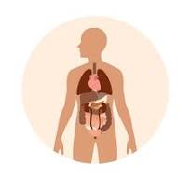

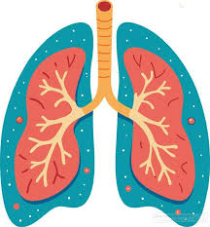
Physical Health Benefits of Quitting Smoking
5 Years
10 years
15 years
Lungs heal and regenerate up to 30%
Chance of having a heart attack drops by half
Risk of smoking related cancers is greatly reduced
Risk of smoking related cancers is greatly reduced
Your risk of having a heart attack is now the same as a non-smoker.

Slide 19


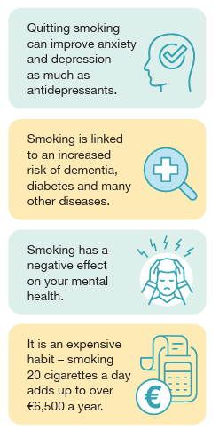
Mental Health Benefits of Quitting Smoking
Quitting smoking can improve anxiety and depression as much as antidepressants
3 out of 10 people who do not smoke report feeling “frequently stressed”
5 out of 10 current smokers report feeling “frequently stressed”
3.5 out of 10 former smokers feeling
“frequently stressed”
Notes:
https://www.pewresearch.org/social-trends/2009/04/08/smokers-cant-blow-off-stress/

Slide 20
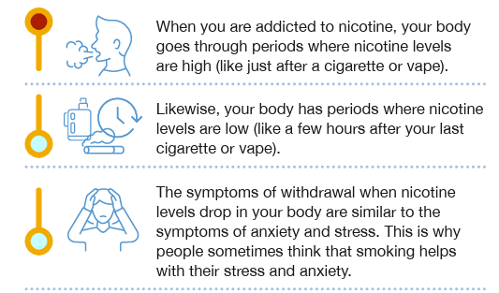
Mental Health Benefits of Quitting Smoking
When addicted to nicotine your body goes through times where nicotine levels are high
(like just after smoking)
And your body has times where nicotine levels are low
(like a few hours after your last cigarette or vape)
Symptoms of withdrawal when nicotine levels drop in your body are similar to symptoms of anxiety and stress.
People can sometimes think that smoking helps with their stress and anxiety but actually it has just helped to relieve the feelings of withdrawal

Slide 21
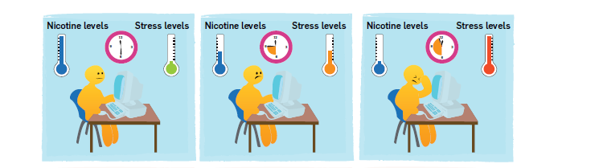
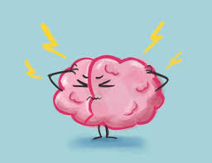
Mental Health Benefits of Quitting Smoking
In the same situation during the day a persons stress levels rise due to withdrawal symptoms not the stress in the environment
Able to “cope” when nicotine levels are high but not when nicotine levels are low
Repeated cycle throughout the day= constantly in a stress/withdrawal cycle and higher stress levels overall
Cortisol and Stress response
Notes:
In the same situations during the day, where the actual stress is unchanged, people who smoke will become significantly more stressed when they are craving their next smoke/vape.
When they smoke/vape they feel better and think it has helped with the stress of a situation but actually it has just helped with the withdrawal feeling.
The cycle continues and leads to increased overall stress levels in the body.

Slide 22

How can the HSE Quit programme help at this stage of change?
Motivation:
help you identify your personal reasons for quitting and build confidence to make a successful quit attempt
Behavioural Support:
helping you address the psychological and emotional dependence on smoking.
Trusted Information:
Helping you to understand the benefits of quitting, debunk myths and advise on supports available
Notes:
Mention the 4 main ways HSE Quit is set up to support
Quitline: phone support
We Can Quit: Group support led by smoking advisor
You Can Quit-1:1 support with smoking advisor
Quit.ie: online quit plan and information about quitting
Social meda: encouraging posts and information

Slide 23
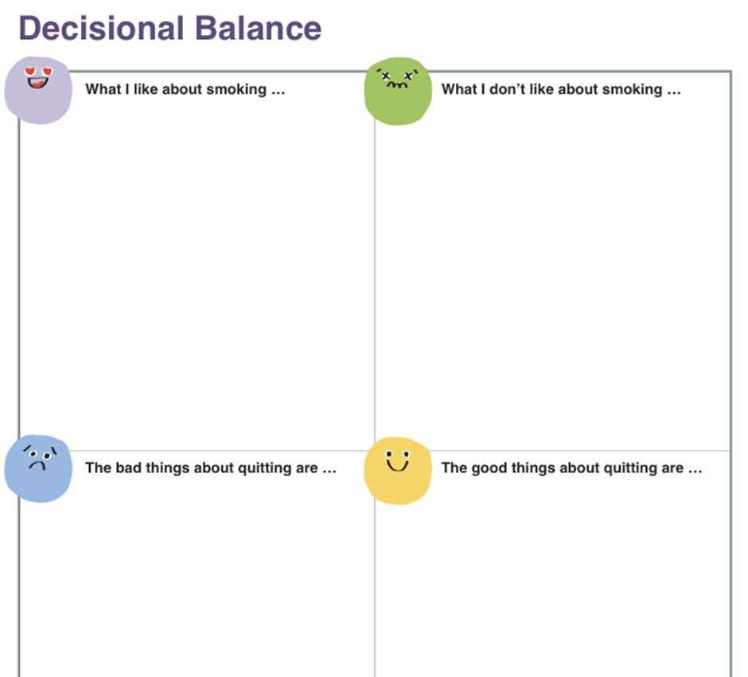
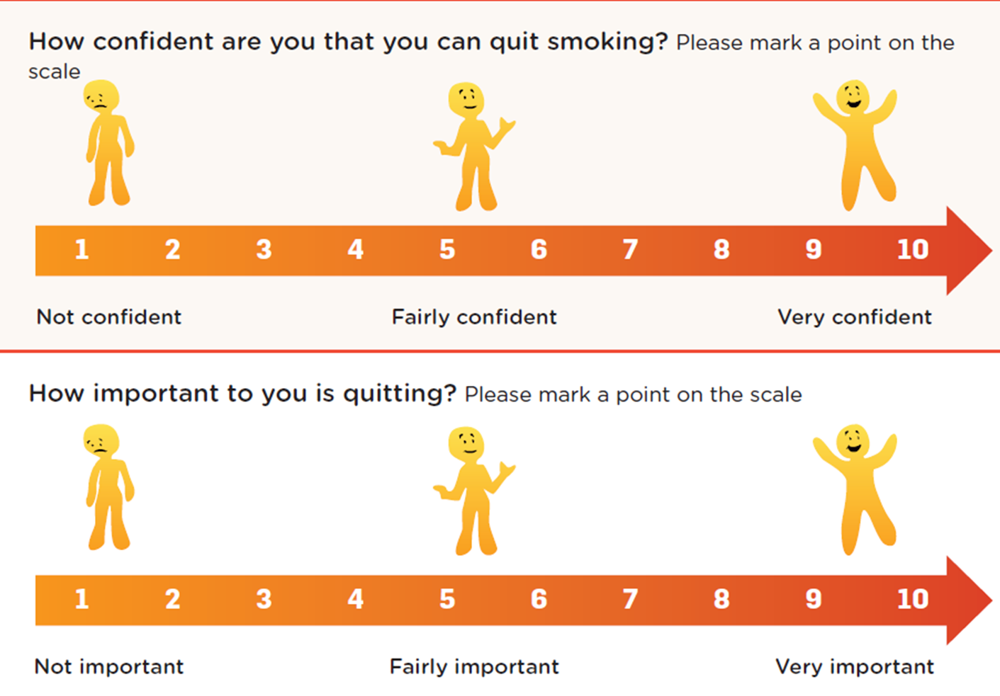
How can a Quit smoking advisor can help?
Notes:
Show examples here of the quit booklets, quit online supports, handouts etc

Slide 24
Sandra
Planning and Preparing to Quit
Notes:
Today I phoned the doctor and spoke to the receptionist, I told her that the doctor had mentioned to me a few weeks ago about quitting smoking and getting signed up for some support but I lost the leaflet and didn’t know how to sign up. The receptionist said she would send a note to the doctor and he would refer her into the quit team asap. The quit team would contact me then to get the ball rolling but if I wanted to get going quicker I could call the Freephone quitline and sign up myself. I was a bit too nervous to do that so I asked if she could go ahead and ask the doctor to do it for me.
A few days later Amy from the quit team called me and took some details from me, we had a chat about my smoking habit at the moment and plans I had around quitting. She explained that the next step is to book in an appointment for a “Pre Quit” session and that this could be in person or over the phone. I booked in for a phone appointment for a couple of days later and spent half an hour on the phone talking to Amy that day all about how I could actually approach quitting and what supports would help me. She explained all about Nicotine Replacement Therapy –like patches and gum etc.and tips to cope with cravings. I wasn’t quite ready to set my quit date by the end of the call but had loads of information to get me started with planning. Amy made another appointment for the following week and on that call I actually set a quit date…I could hardly believe the words were coming out of my mouth but I just wanted to give it ago at this stage. I was a mixture of nerves and excitement as we made a plan for our next appointment which would be on my quit day. I was also just really worried I’d completely fail but Amy assured me there’s no such thing as a failed attempt.
.
Show Sandra on the cycle of change at new stage and briefly discuss after playing the clip that at this point in time the support Sandra needs is to help her make a plan and get ready to put the plan into action. She needs encouragement and confidence boosting to increase her self esteem and belief in herself that she can do it and she needs to feel like she is going to be supported through the change.

Slide 25
Planning and Preparing to Quit
Quit Smoking Group
https://www.youtube.com/watch?v=wWyKsspiiG4
1:1 HSE Quit smoking advisor in person
https://youtu.be/ghYYHlr_eQg
Notes:
Discuss that there are many ways to get support to get prepared and make a plan to quit smoking. Mentioned these ways here and show a video of one if time allows

Slide 26
Planning and Preparing to Quit
You double your chances of quitting smoking for good when you get support from a trained stop smoking advisor.
Pre Quit Appointment
Taking details of smoking habit- how much smoked, routines, triggers, times of day smoking the most etc.
Taking details of previous quit attempts
Discussing medical conditions, any relevant personal details etc
Discussing reasons to quit versus reasons to keep smoking
Carbon Monoxide Monitor
Nicotine Replacement Therapy-Stop Smoking Medication
Notes:
Discuss that there are many ways to get support to get prepared and make a plan to quit smoking. Mentioned these ways here and show a video of one if time allows

Slide 27
Planning and Preparing to Quit
A list of questions will be used by the quit smoking advisor to help decide what type and strength of Nicotine Replacement Therapy will be best for each person
Called a “Nicotine Dependency Test”
The questions asked might seem strange but they are evidence based ways of checking what your dependency to nicotine is and can also tell you and the quit smoking advisor a lot about the other habits that drive your smoking/vaping.

Slide 28
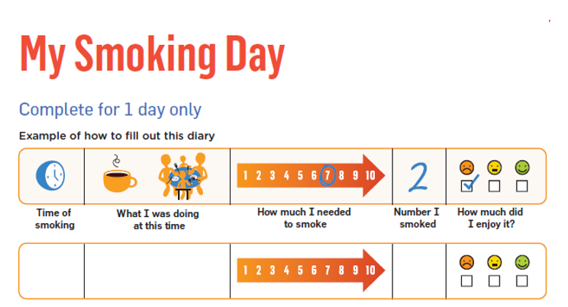
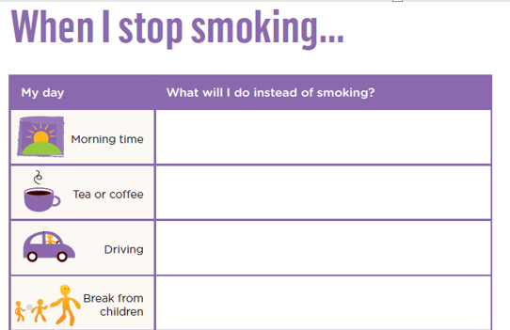
Planning and Preparing to Quit
Notes:
Have a look at handouts and if time allows refer to completed example for “Sandra” to illustrated how it can help people to prepare to quit smoking

Slide 29
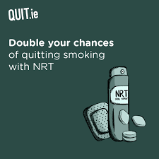
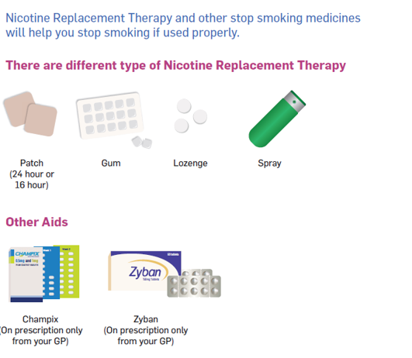
Planning and Preparing to Quit
All Nicotine Replacement Therapy (NRT) will be Free of Charge for 12 weeks
HSE Video Explaining how to use NRT
https://youtu.be/G2Qbd5EYGsg Gum
https://www.youtube.com/watch?v=34MhMWVlAC0 Patch
Notes:
Discuss NRT usage and types and show video. Mention the dual therapy usages and value in getting advice from trained quit smoking advisor on the use of these medications.

Slide 30
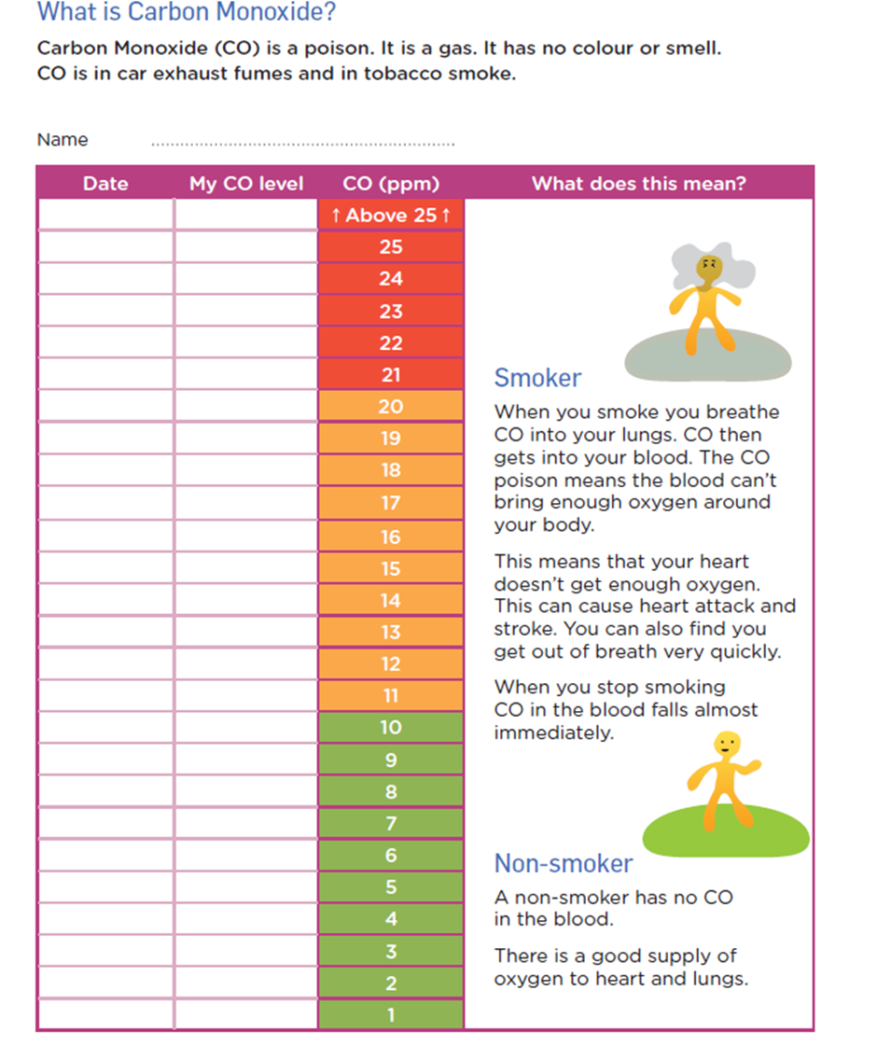
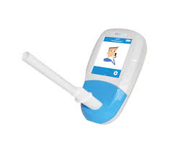
Notes:
Explain how the CO Monitor works and is used to help people in their quit attempt, facilitator takes the test to provide an example and then offers to allow participants the opportunity to try it out.

Slide 31
Refreshment Break

Slide 32

Sandra
Taking Action: Quitting Smoking
Notes:
Move Sandra to this stage of change on the poster and Discuss this stage of change- action-
it can be a difficult stage to get to and feels a bit like taking a leap of faith. You don’t always have to feel completely “ready” to do it and sometimes the action needs to come before the motivation rather than pushing it out until “the right time”.
What people need during this time is continued connection with support, checking in, reminding and reinforcing of the plan and the being able to answer questions about challenges being faced that could prevent the person from continuing on the right path.

Slide 33

Don’t Dwell on it
5
Each Craving will normal last no longer than 3-5 minutes
Notes:
Mention that a craving normally passes in 3-5 minutes so Don’t Dwell on it is often also mentioned as a 5th D

Slide 34
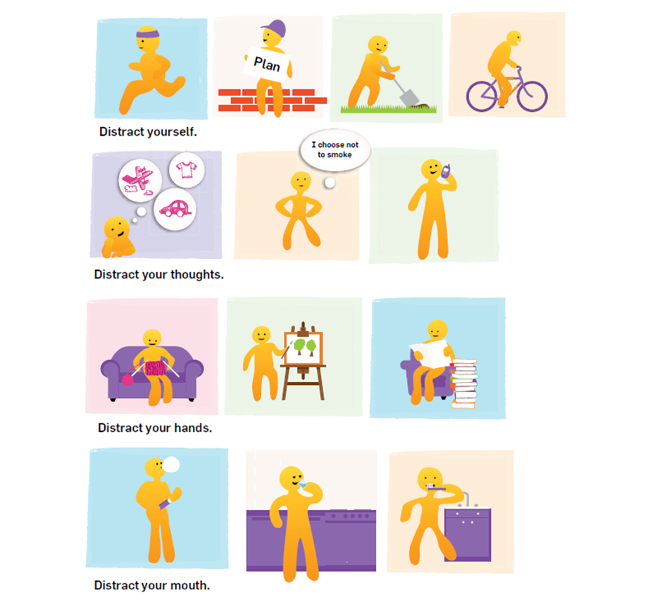
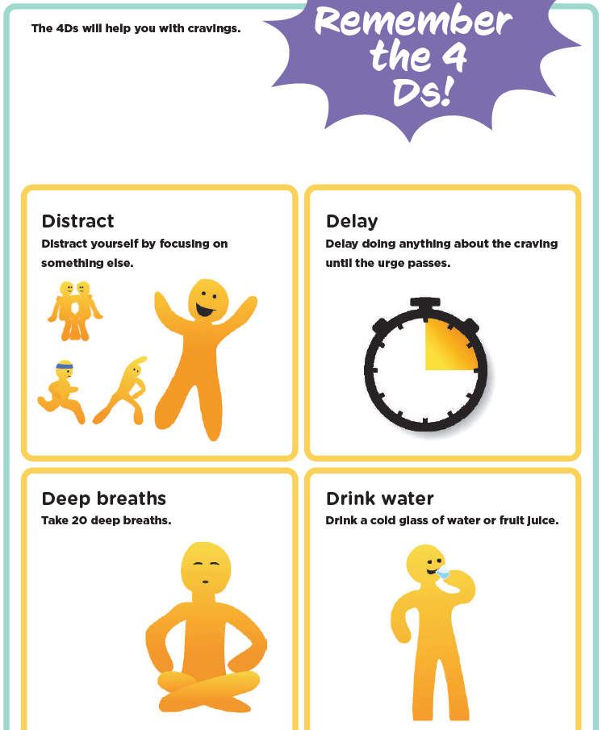
Coping methods
Notes:
Discuss the fact that the Quit smoking advisors can help to guide you through a variety of ways to help you cope with cravings. One way of discussing this is using the 4 Ds, briefly give example of this.

Slide 35
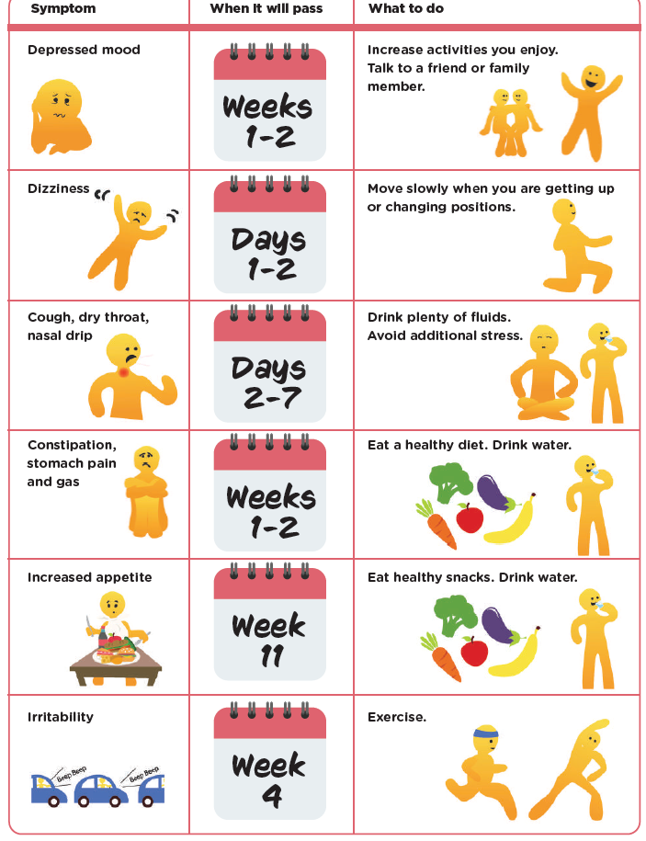
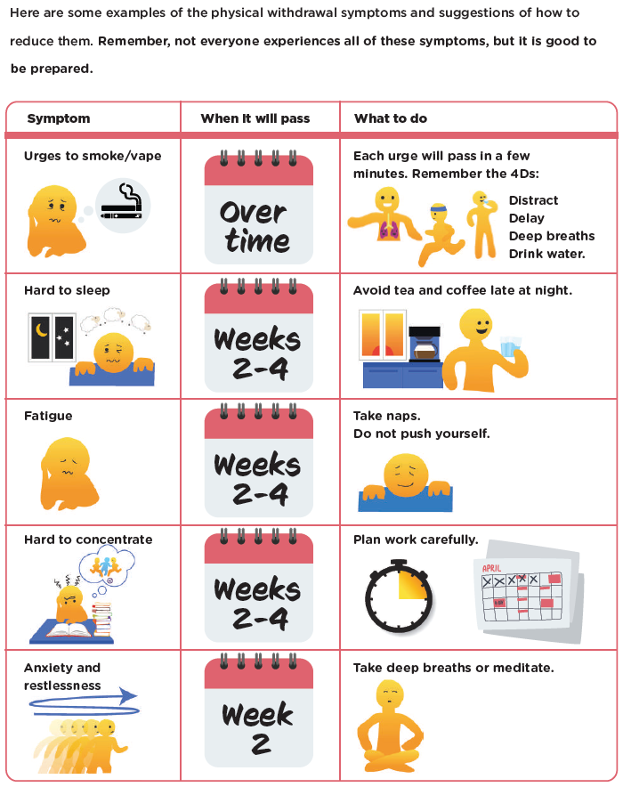

Withdrawal Symptoms
Notes:
Activity (2 options)
1.
Each pair of participants gets a withdrawal symptoms sheet (pictures) and a bunch of cut out timelines (1 day/2 weeks etc), participants must try to match up the timeline with the withdrawal symptom to give their guess on how long the withdrawal symptom usually lasts.
2. List out the withdrawal symptoms on the screen and ask participants to call out how long they feel each would last before it passes

Slide 36
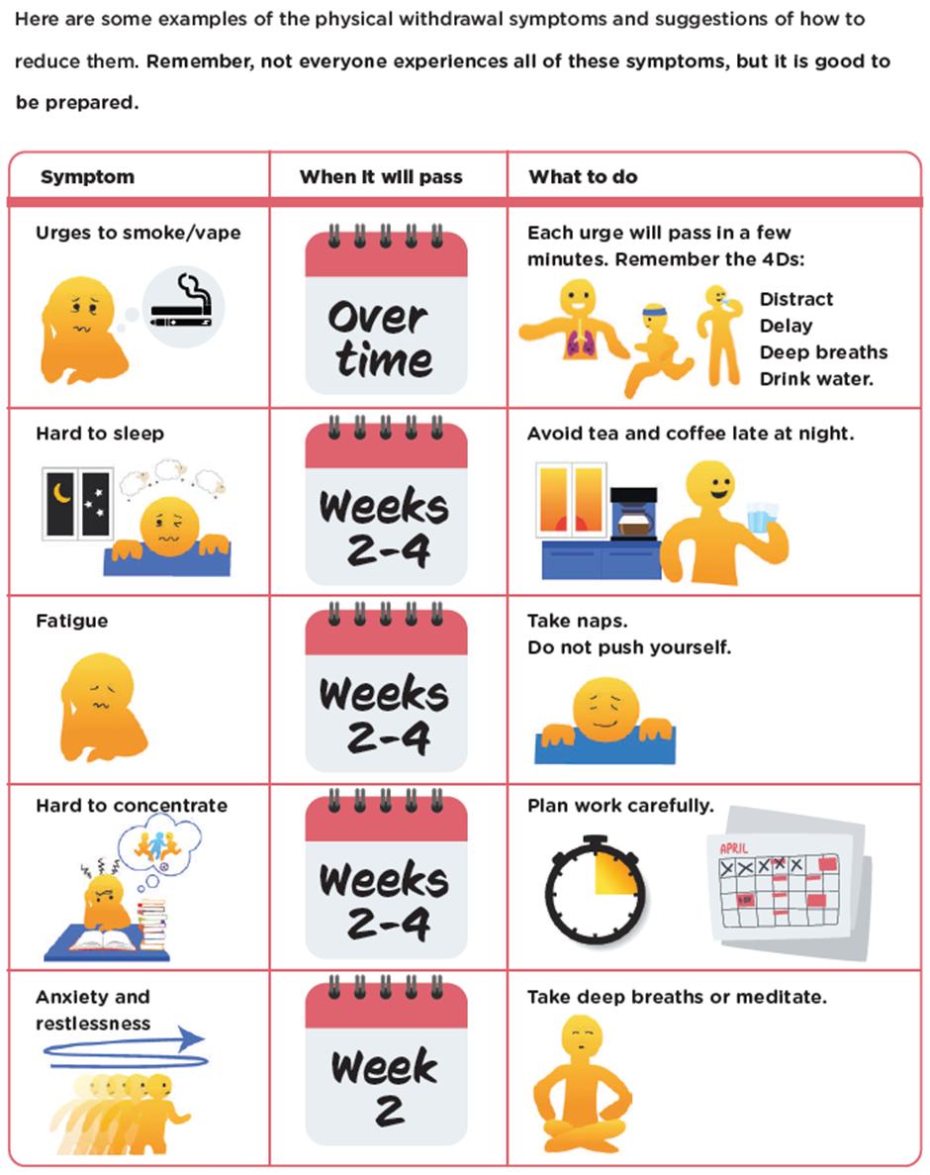


Slide 39
Withdrawal Symptoms

Slide 40
Withdrawal Symptoms

Slide 41
Withdrawal Symptoms

Slide 42
Withdrawal Symptoms

Slide 43
Withdrawal Symptoms

Slide 44
Withdrawal Symptoms

Slide 45
Withdrawal Symptoms

Slide 46
Withdrawal Symptoms

Slide 47
Sandra
Sticking to it and Staying Quit

Slide 48

Sticking to it and Staying Quit
Space to Choose and keeping on the right path
Sticking to your quit plan and taking NRT
Positive Self Talk
Bingo Card
Rewards
Ticking off the Calendar
Notes:
The journey to staying quit will not always be straight forward, like this image of the blob people on the ladders, there are days when you will feel like you have conquered it and your winning and days when you feel you are close to falling back to start again, or feeling angry and frustrated with the whole thing. This is normal and there are some things you can do to try and stick with it and stay in control of your quit attempt.
Space to Choose Pg 34 SCB
Keeping on the right path pg 41 SCB
Positive Self Talk (Q4Y pg 40)
Space to Choose and keeping on the right path
Sticking to your quit plan and taking NRT
Positive Self Talk
Bingo Card
Rewards
Ticking off the Calendar

Slide 49
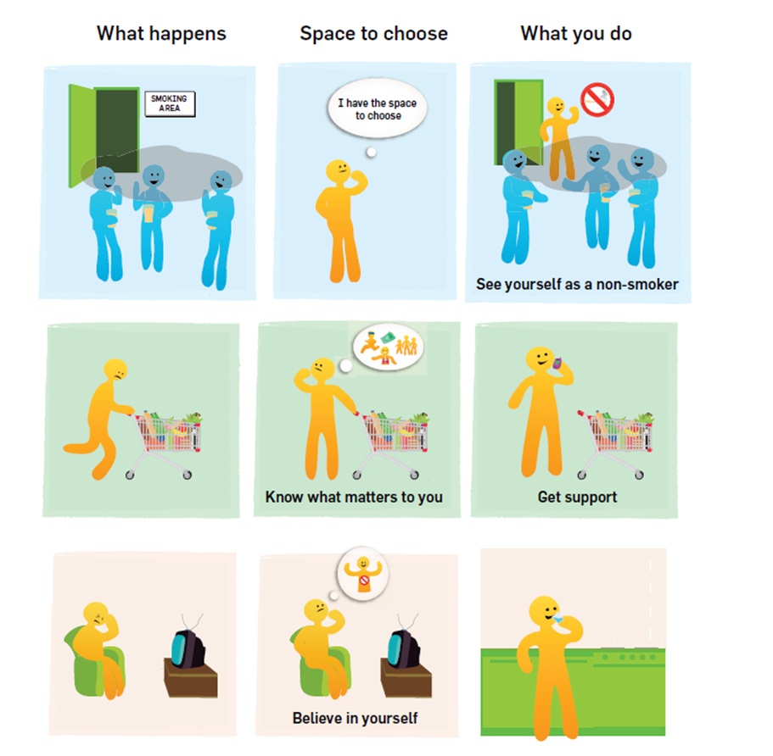
Your space to choose
You cannot always control your circumstances but can always control your responses…
your choice and your power.
Notes:
Discuss the fact that Cannot control every situation or how you will always feel on the journey to quitting but you can control how you respond

Slide 50
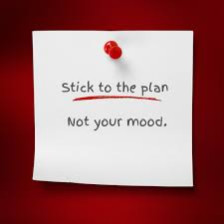
Stick to the plan
One day at a time
Motivation, Will Power and mood will not always be enough to keep you on track……
Make a strong plan and stick to it
Trust the Process!

Slide 51
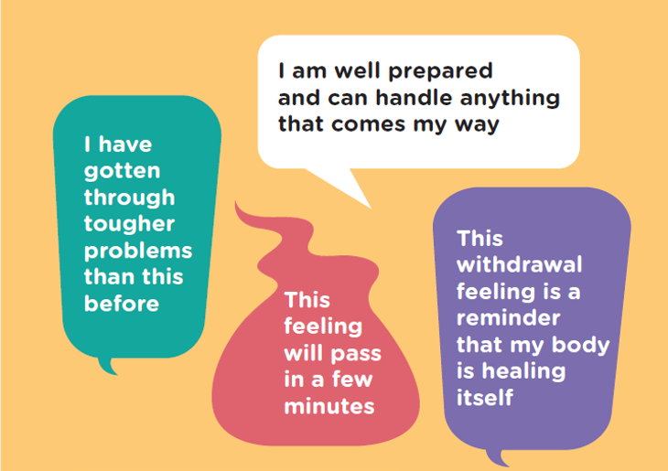
Positive Self Talk
Notes:
Having some positive self talk quotes written down to repeat to yourself to get you through difficult times can be really powerful way of turning your thoughts around and getting through moments of struggle

Slide 52
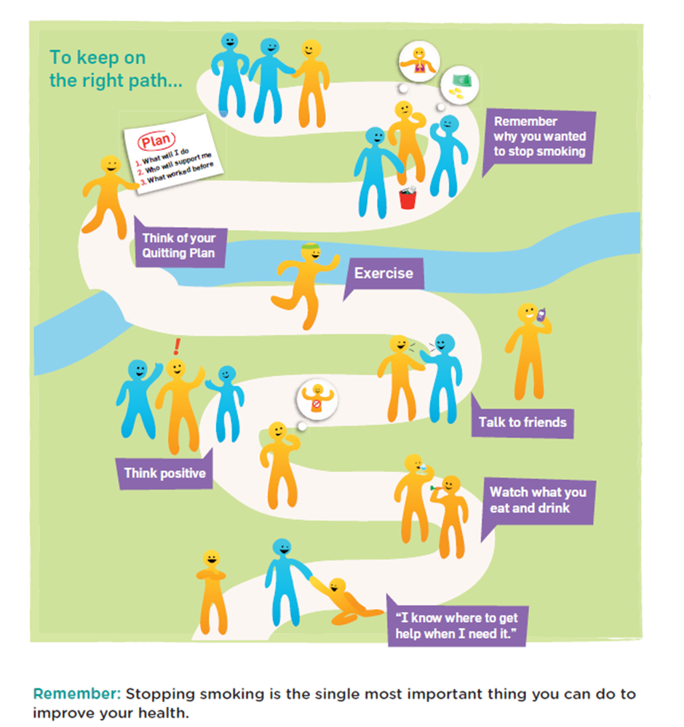
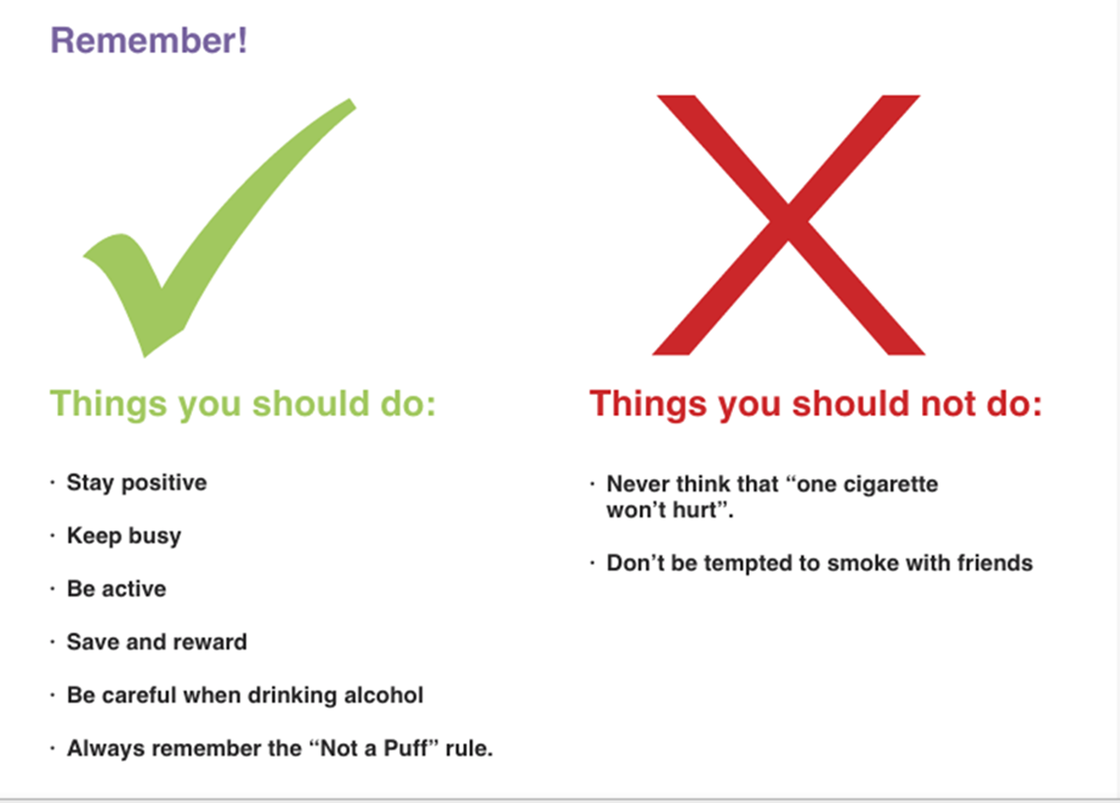
Stay Positive
Keep Busy
Be Active
Save and Reward
Be Careful when drinking alcohol
Always remember the “Not a Puff” Rule
Never think that one puff won’t hurt
Don’t be disheartened if some days are harder than others
Don't be afraid to be proud of yourself
Don’t put yourself in risky situations-be selfish!

Slide 53
Sandra
Relapsing and Trying again
Notes:
Introduce this stage by saying that learning to be smoke/vape-free is a lifelong process and will come with ups and downs.
Brainstorm
-ask the group to come up with some examples of situations/triggers that typically cause relapse for quitting smoking (provide additional reasons if any missed)

Slide 54
Why do people relapse?
not approaching the quit attempt with a plan
not having support in place to help with quit attempt
came off NRT too quickly or didn’t use correctly
thinking they can have “just one”
cigarettes/vapes in the house/easily accessible
family/friends/social circle all smoking
holidays
duty free
alcohol consumption/social situations
stressful life event
death of somebody close
Notes:
Show this list to compare to what was discussed by the group and discuss some examples

Slide 55
Tips for staying motivated if you relapse
Congratulate yourself on achievements to date with quitting-”no such thing as a failed attempt”
Think about what triggered the slip up and make a plan for how to handle that situation differently in the future
Promise yourself you wont make the same mistake twice
Look back at quit plan and see if anything needs to change this time
Remember the supports that are available to you and use them- there is no judgement and no shame in relapsing
Get back on track asap-the quicker you do the easier to succeed
Don’t quit on quitting!
Notes:
Discuss talking points above
Relate to Sandra in case study and ask participants questions to prompt discussion:
What went well for Sandra with this quit attempt?
What could Sandra have done to avoid this relapse?
What lessons can Sandra bring with her into her next quit attempt?
Don’t quit on quitting and don’t see it as a failure, see it as an opportunity to learn from and try again using that learning to do better this time.
Maybe show video
https://youtu.be/Mod2F5rYXSE?si=xWj0Wxpq-sB-_kcN

Slide 56


Sandra
A Non Smoker
Notes:
Direct to the cycle of change poster and read script below:
The last stage on the cycle of change is called established change, it is the peak of the mountain and where we all want to get to….getting here does not guarantee that you will stay here but at this stage we are imagining that Sandra has gotten to a point where she is feeling confident that she is able to call herself a non smoker and there is no going back.
Activity (if feels suitable-guided imagery)
We purposely did not put any audio for this piece to hear from Sandra because we wanted to leave it to you the participants here today to be able to imagine for yourselves how Sandra might be feeling at this point (Pause), if you are comfortable to do so maybe close your eyes or just look down now and think about this as I talk…. how might Sandras tone of voice have changed if we did play a clip of her here? (Pause)…maybe she would be sounding happy, energetic, confident…..(Pause), how might she look if we were to see her- maybe brighter, smiling, looking proud of herself, walking a little taller.… (Pause)…what might her daughters say if they could speak about the impact that their mum quitting smoking has had on them, maybe they are feeling proud of her and relieved that she is looking after her health (pause), what might Sandra say that she is spending her money saved on (pause), has she been able to take some more holidays?.....and what about if we asked Sandra what is the single best thing that has happened to her because of quitting smoking………well the options there are endless and we will only know the answer if we go on the journey!
Discuss the value in being able to imagine what it would feel like to get to this point in the quit smoking journey. Taking time to think about how your life would change and benefit is a really positive vision to hold close to you in your quit attempts.

Slide 57
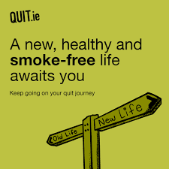

Slide 58
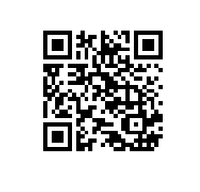
Face to Face Appointments with a Stop Smoking Advisor
Debbie.roche@fdys.ie
0863921525
*Sign up on sheet today
southeaststopsmokingsupport@hse.ie
Phone: 0870957126
QR Code
Notes:
Discuss that there are many ways to get support to get prepared and make a plan to quit smoking. Mentioned these ways here and show a video of one if time allows

Slide 60
Contact Details
Elaine Banville
HSE Health Promotion Officer
Wexford Primary Care centre
Elaine.Banville@hse.ie

