Slide 1
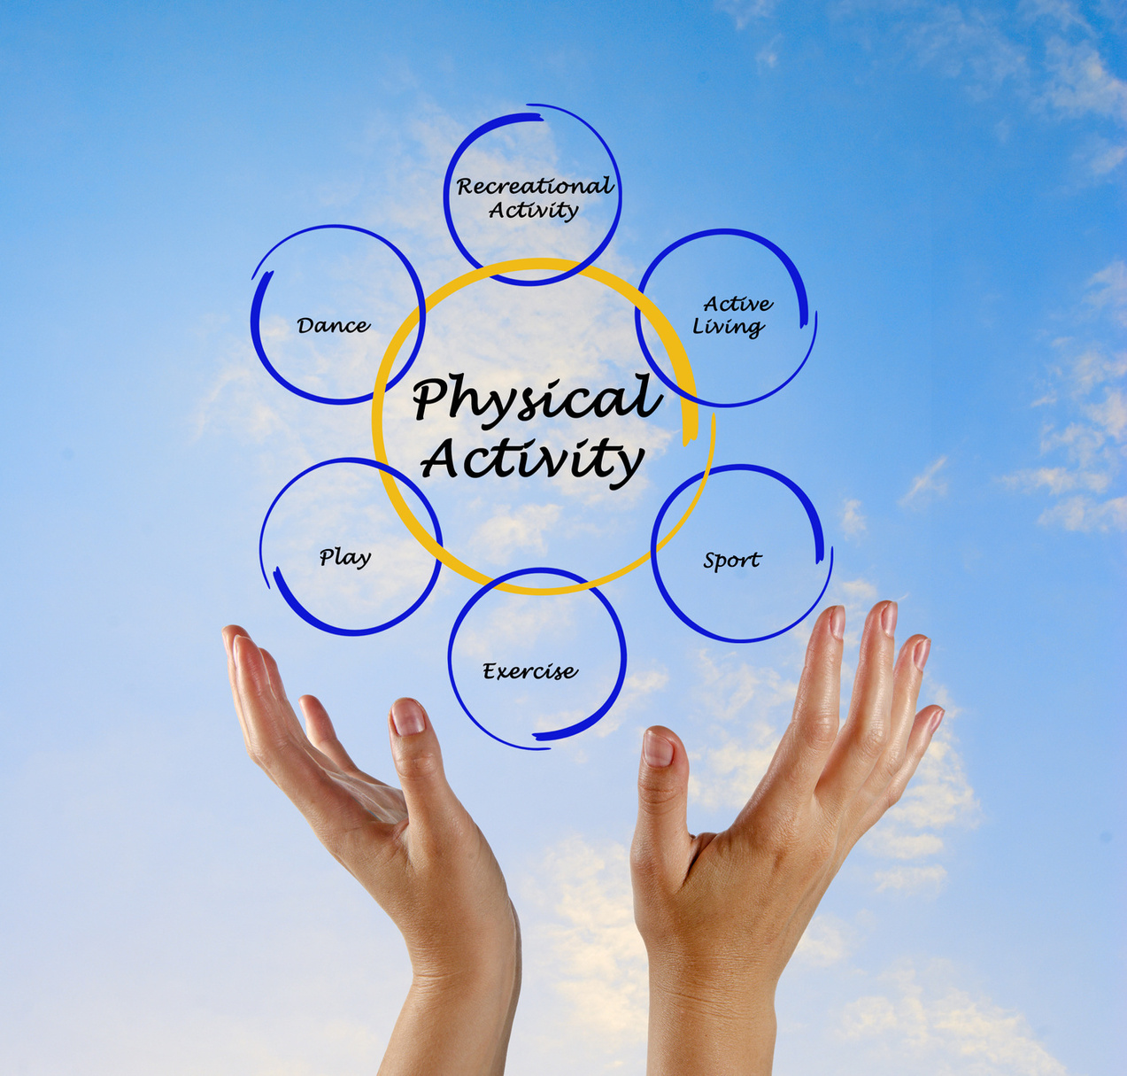







Movement Matters
Understand and Access Exercise
Ben Hunt - Physical Activity for Health Officer Sports Active Wexford

Slide 2
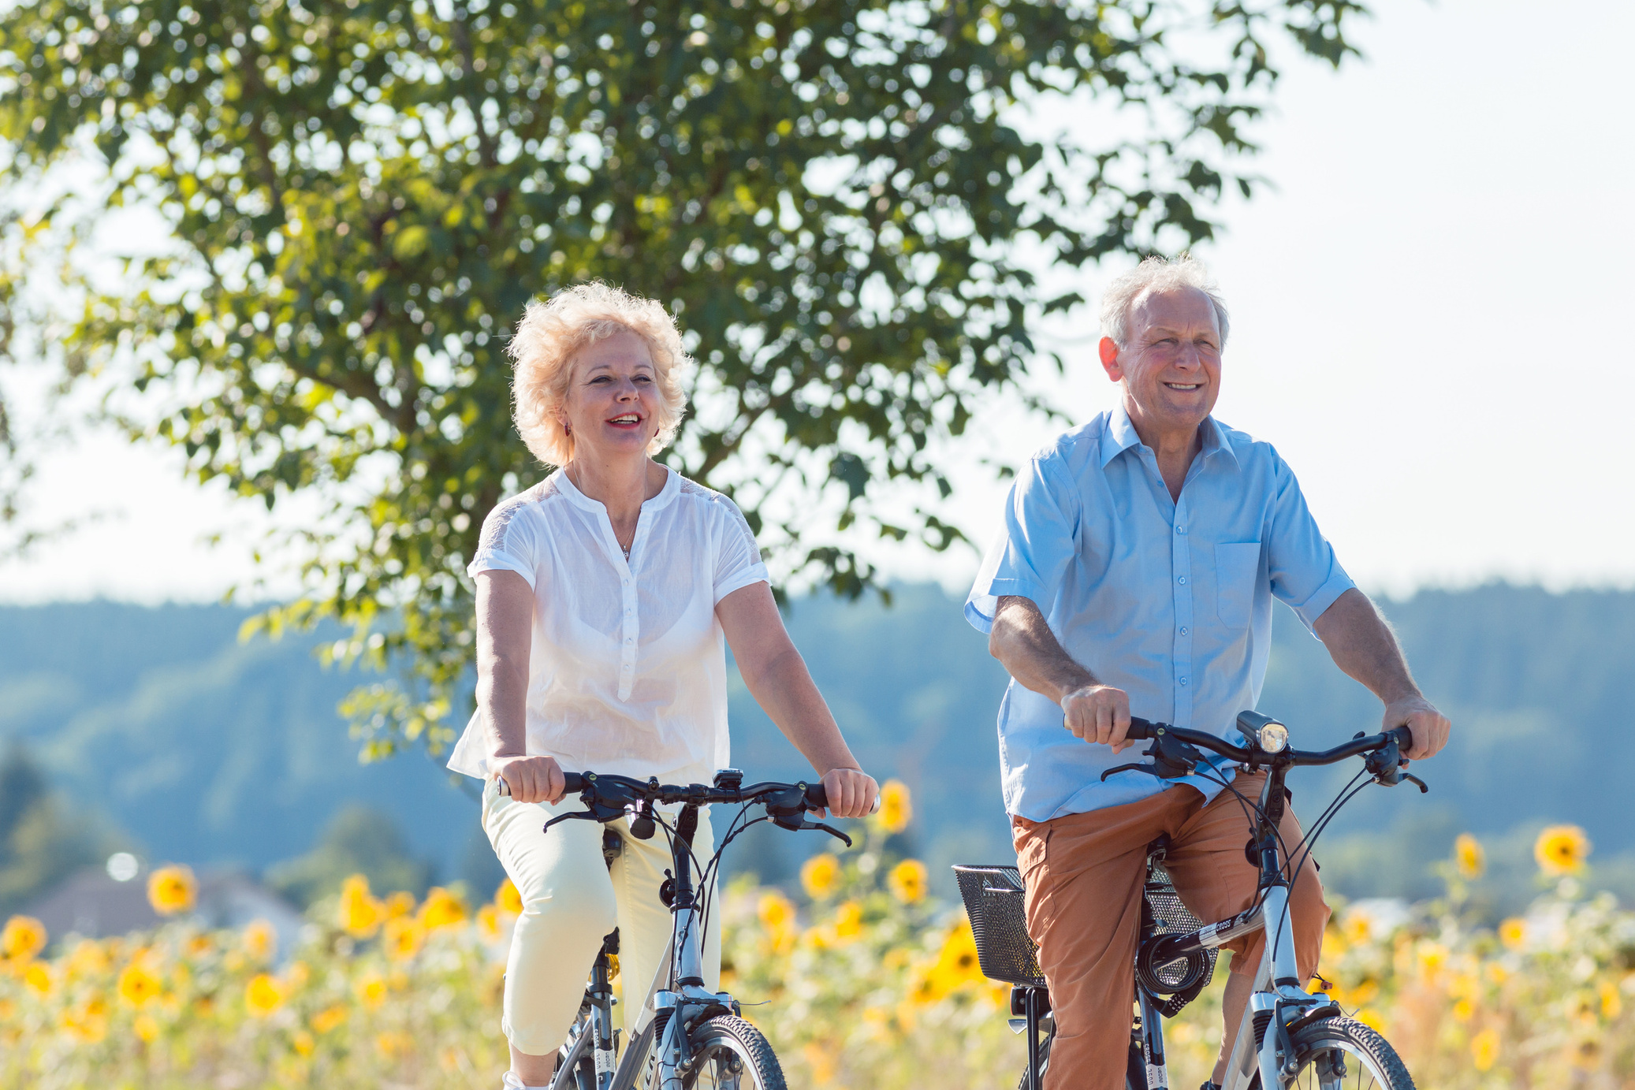






What is Physical Activity?

Slide 3

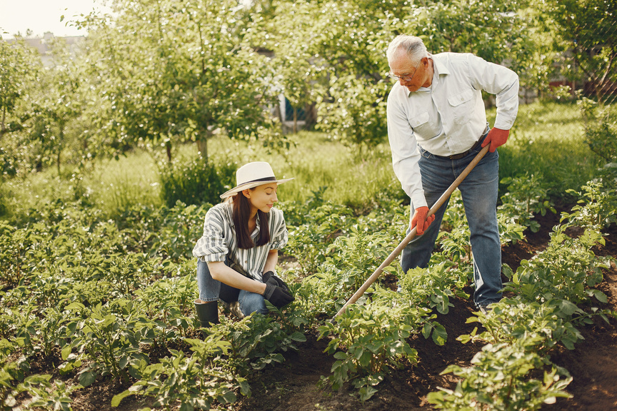
What is Physical Activity?
The World Health Organisation (WHO) defines physical activity as any bodily movement produced by skeletal muscles that requires energy expenditure.
Physical activity refers to all movement including during leisure time, for transport to get to and from places, or as part of a person’s work or domestic activities.

Slide 4
What is Physical Literacy?

Slide 5
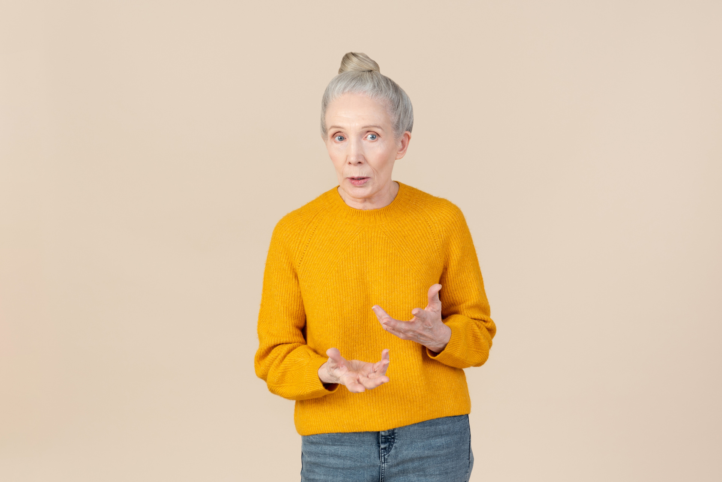
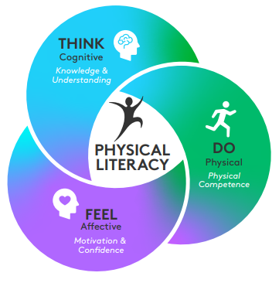
What is Physical Literacy?
Physical Literacy is the motivation, confidence, physical competence, knowledge and understanding that enables a person to value and participate in physical activity throughout life

Slide 6
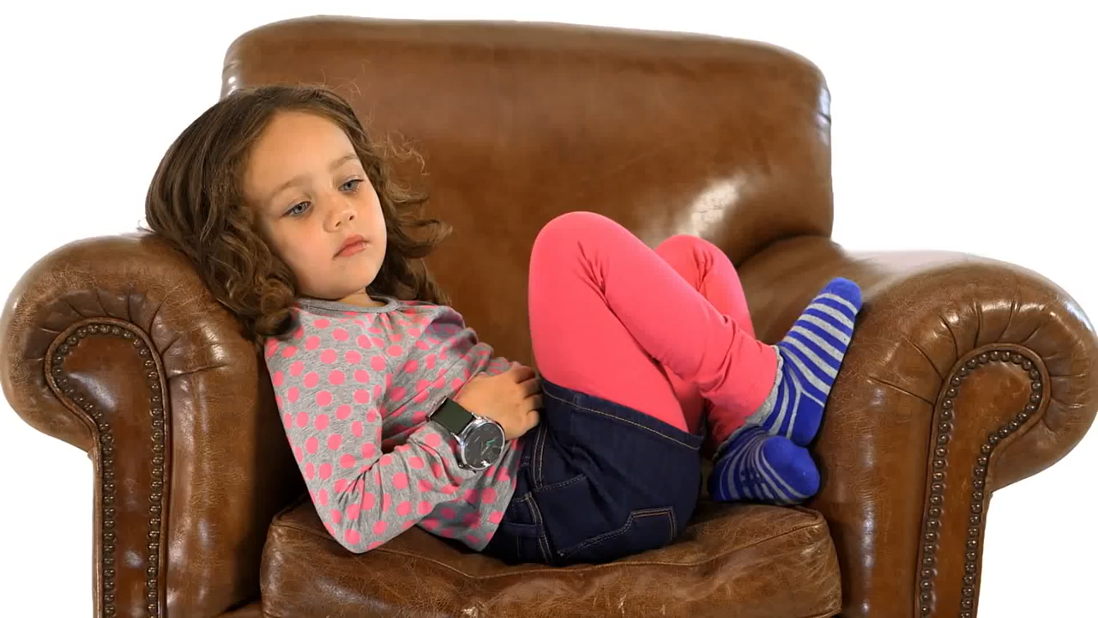
What is Physical Literacy?

Slide 7
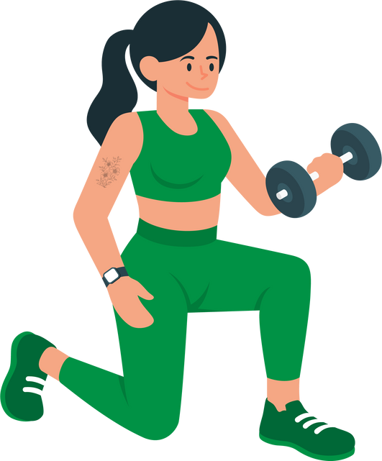


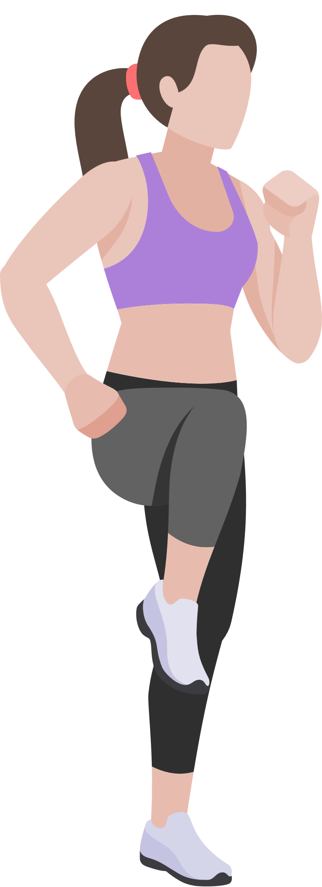
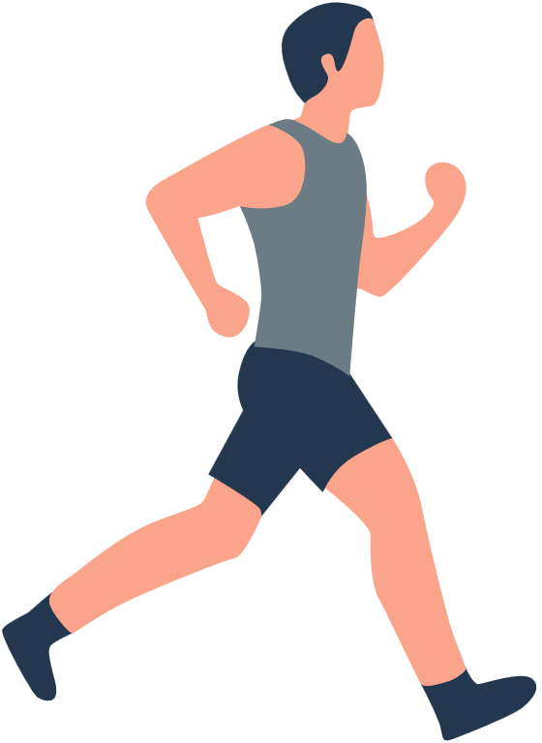

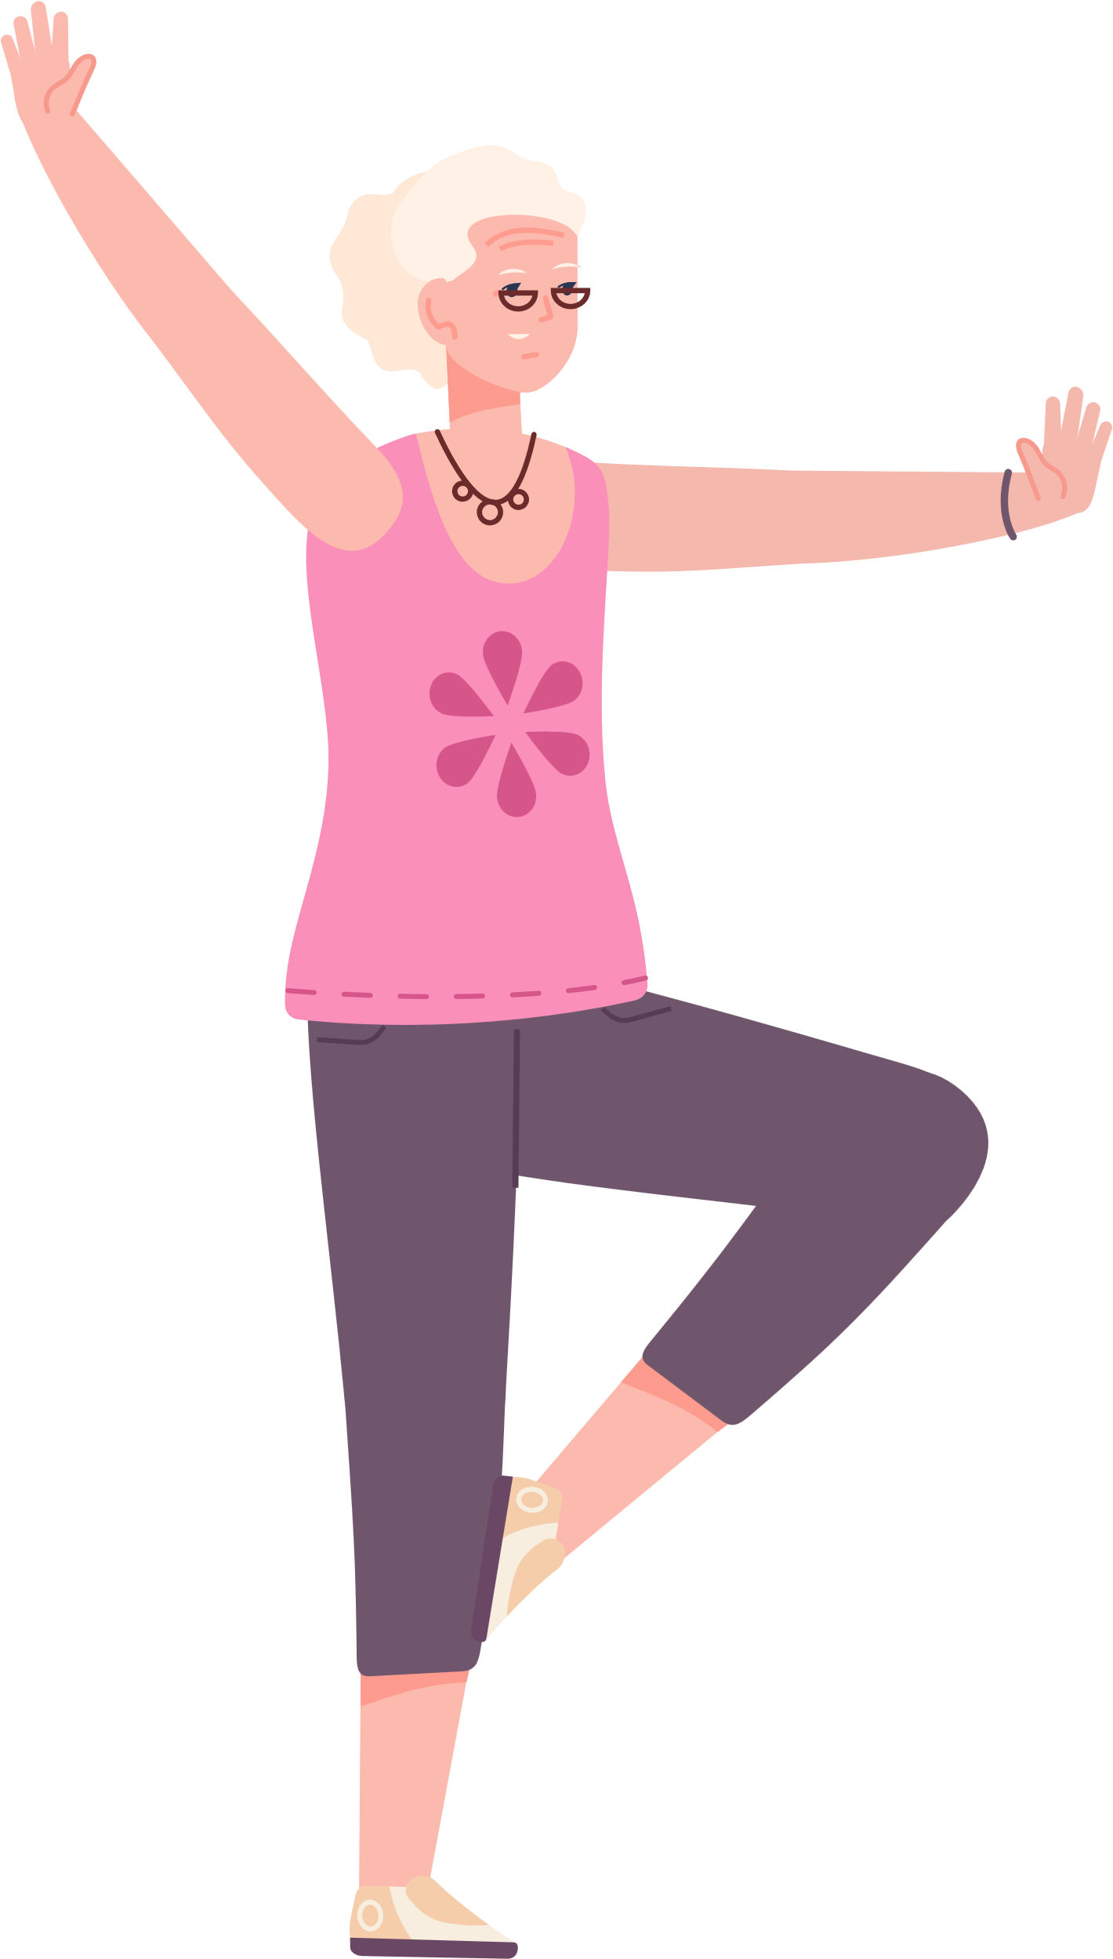
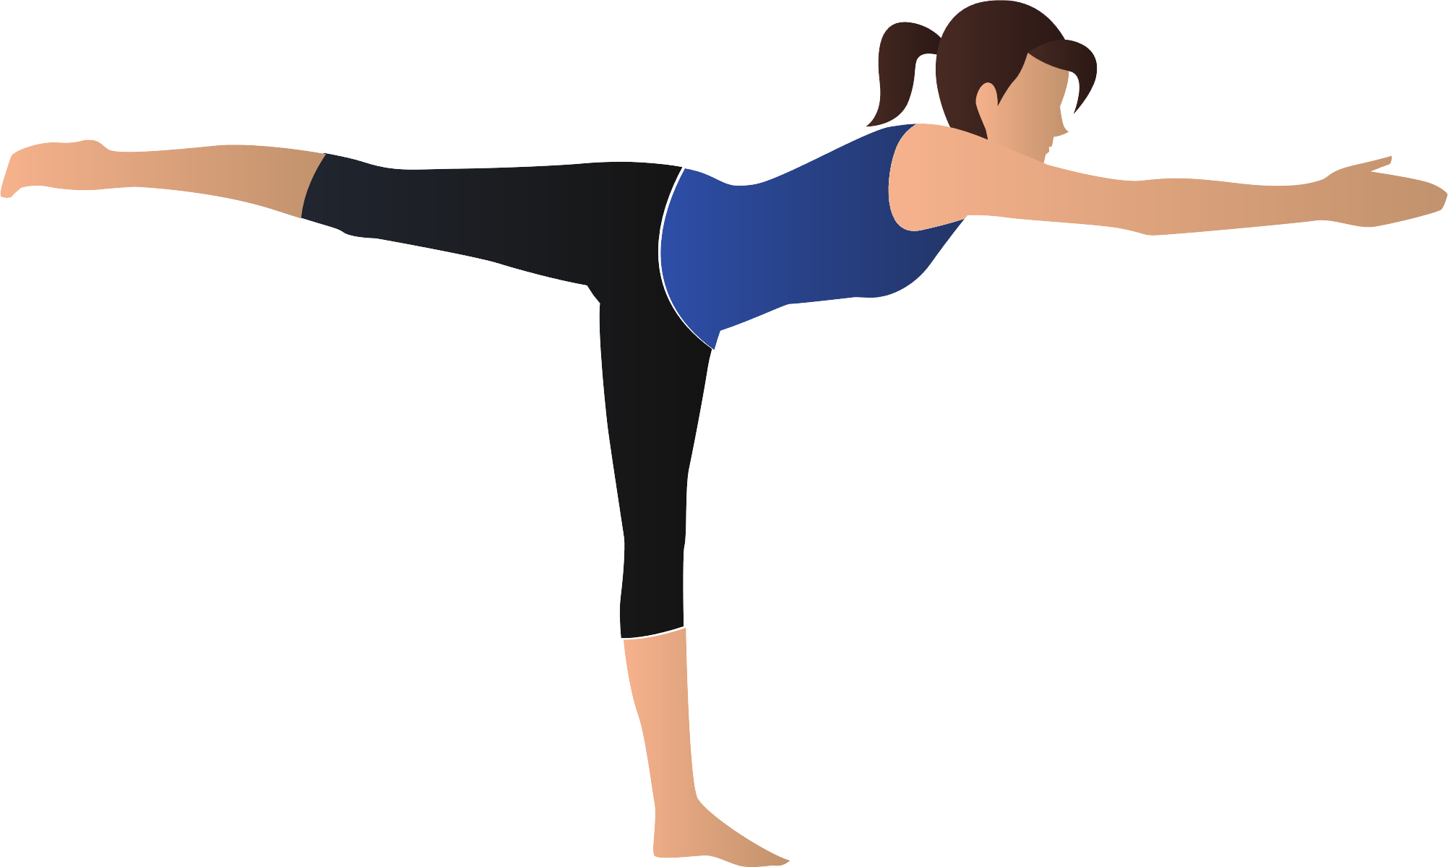
Examples of Types of Physical Activity

Slide 8
Examples of Types of Physical Activity
Aerobic
Balance
Strength/REsistance

Slide 9
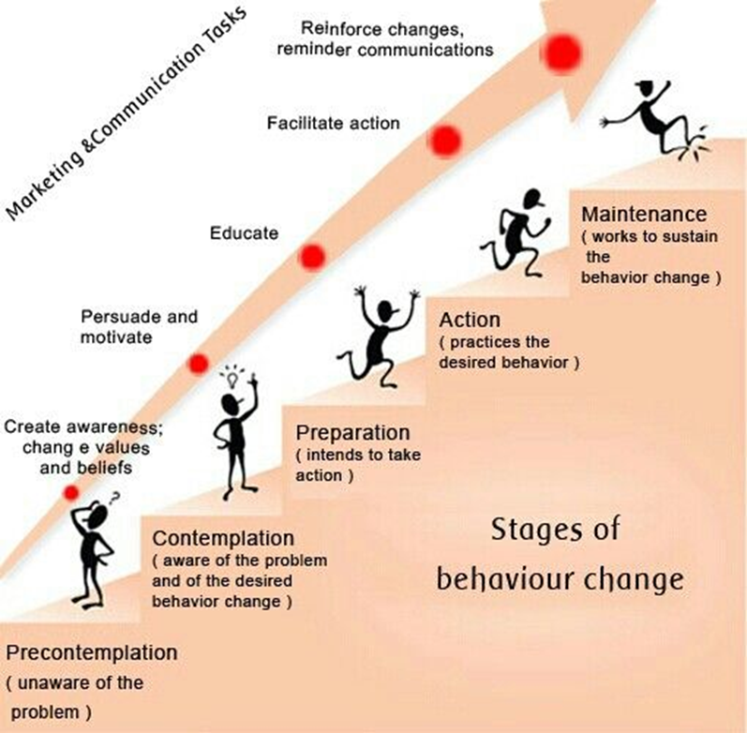


Slide 10



What Physical Activity do you currently do?
Lets build your physical activity in the last week
Green = Moderate intensity 30mins
Yellow = Vigourous intensity 30mins
Red = Strength
Blue = Balance
Moderate/Vigourous
Strength
    Brisk Walking
    Aqua Aerobics
    Cycling Slowly
    Housework/Gardening
    Tennis Doubles
    Farming
    Golf
    Dancing
    Hiking
    Running
    Swimming
    Sports (eg Tennis)
    Martial Arts
    Walking up Stairs
    Gymnastics
    Lifting Weights
    Working with Exercise Bands
    Body Weight Exercises
    Yoga/Pilates
    Climbing
    Repetitively Lifting Children or Heavy Objects
    Repetitive Stair Climbing

Slide 11



Example
Write down how many minutes per week you take part in
1: Moderate/Vigourous intensity Physical Activity: 150mins Moderate 120 Vigourous mins
2. How many times you do Strength Exercises: 1 Yoga Session
3. Give yourself a score out of 10: ?/10

Slide 12
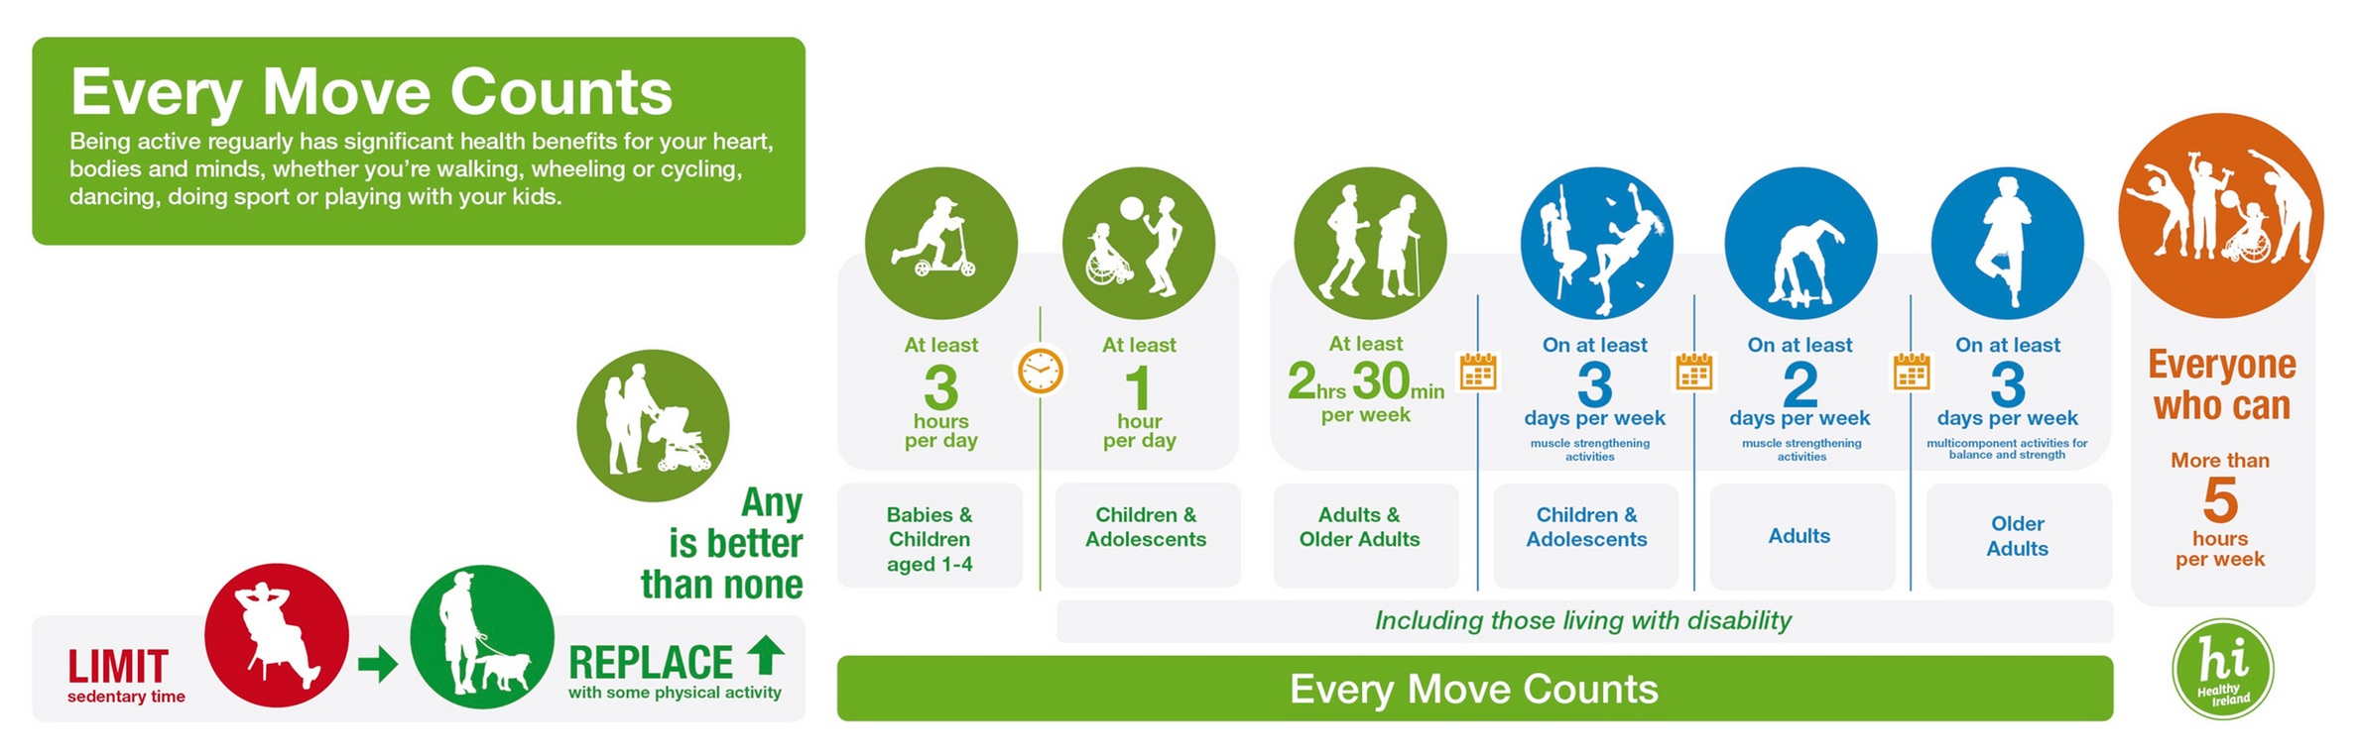
National Physical Activity and Sedentary Behaviour Guidelines

Slide 13
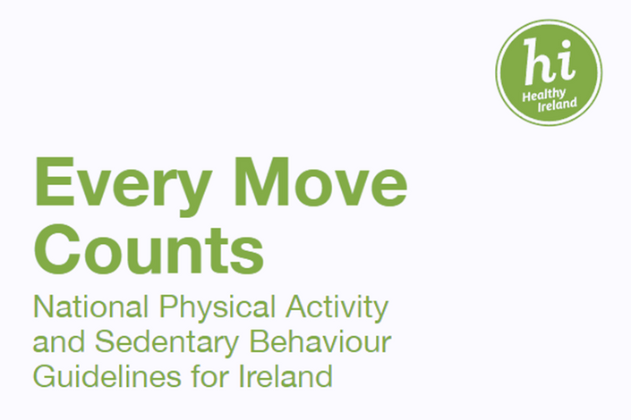




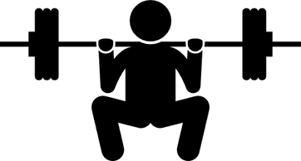

Moderate Intensity
Physical Activity
Vigorous Intensity
Physical Activity
OR
2hrs 30mins 5hrs
1hr 15mins 2hrs 30mins
Or a combination of Moderate and Vigorous
Adults: 65+ years old
Strength and Balance Activities
on 3+ Days
Provides Additional
Health Benefits

Slide 14

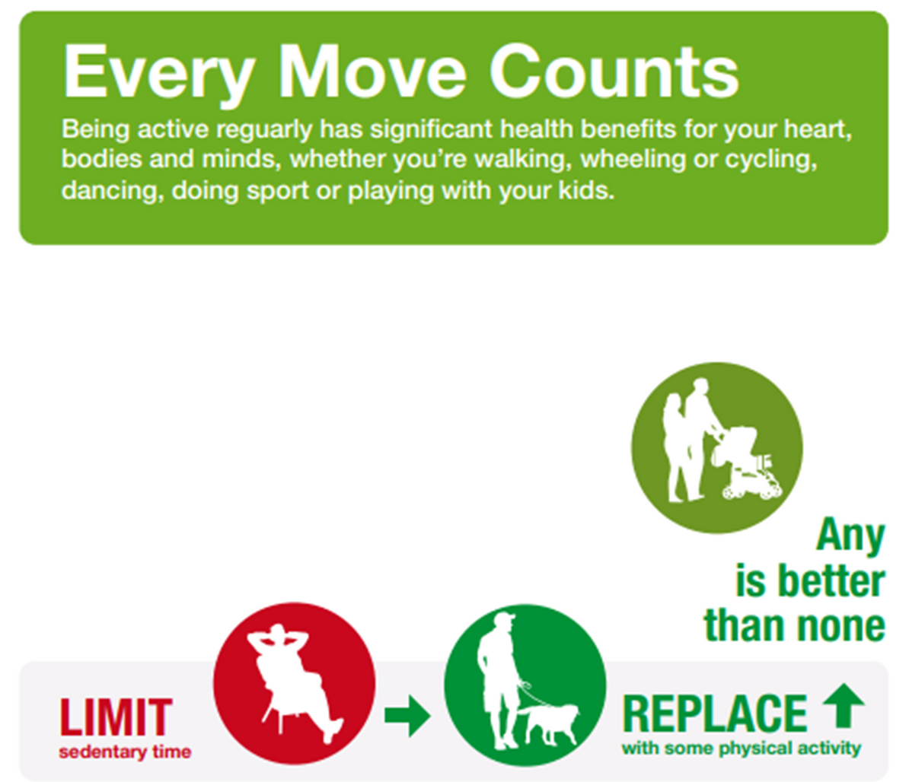
• We recommend trying to limit the amount of time you spend sitting still
• Breaking up and replacing some of your time spent sitting still with some movement can benefit your health
• Move your body and be active in a way that you enjoy – any physical activity is good physical activity

Slide 15







How Can We Be Physically Active?
Sports Active Wexford - Local Sports Partnership
053 919 6557
sports.active@wexfordcoco.ie

Slide 16
Lets sign up to a Sports Active Programme
Sports Active Wexford - Local Sports Partnership
QR Code
Link through instagram/facebook

Slide 17
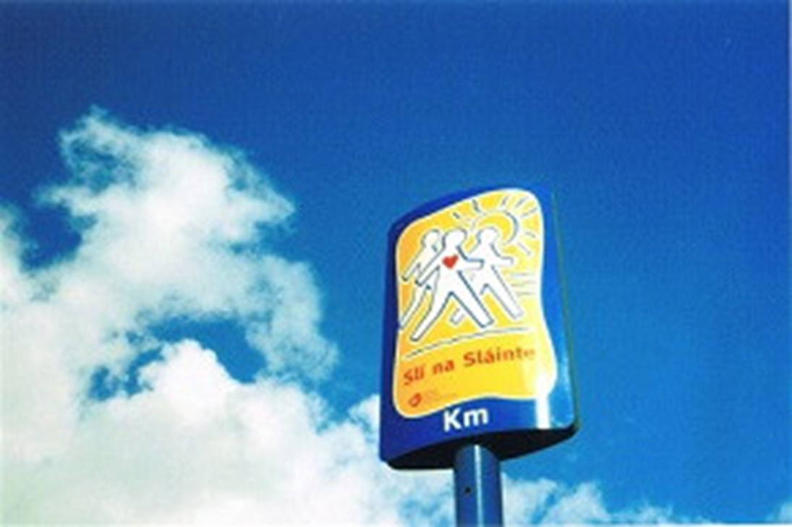
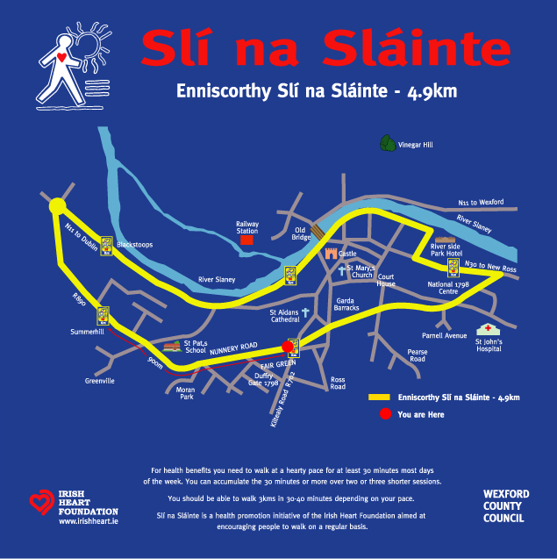
How Can We Be Physically Active?
Walking - Slí na Sláinte Routes (www.irishheart.ie)

Slide 18

How Can We Be Physically Active?
HSE Online Exercise Videos
Yoga
Pilates
Strength and Conditioning
https://www.hse.ie/eng/about/who/healthwellbeing/exercise-videos/

Slide 19
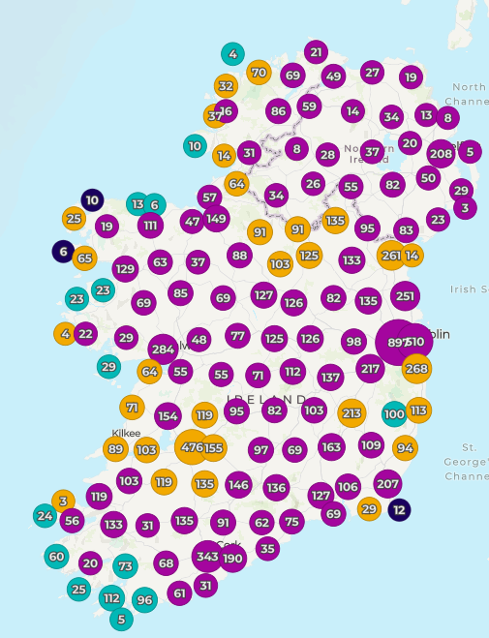

How Can We Be Physically Active?
https://getirelandactive.ie/

Slide 20
What is Physical Literacy?
Physical Literacy is the motivation, confidence, physical competence, knowledge and understanding that enables a person to value and participate in physical activity throughout life

Slide 21
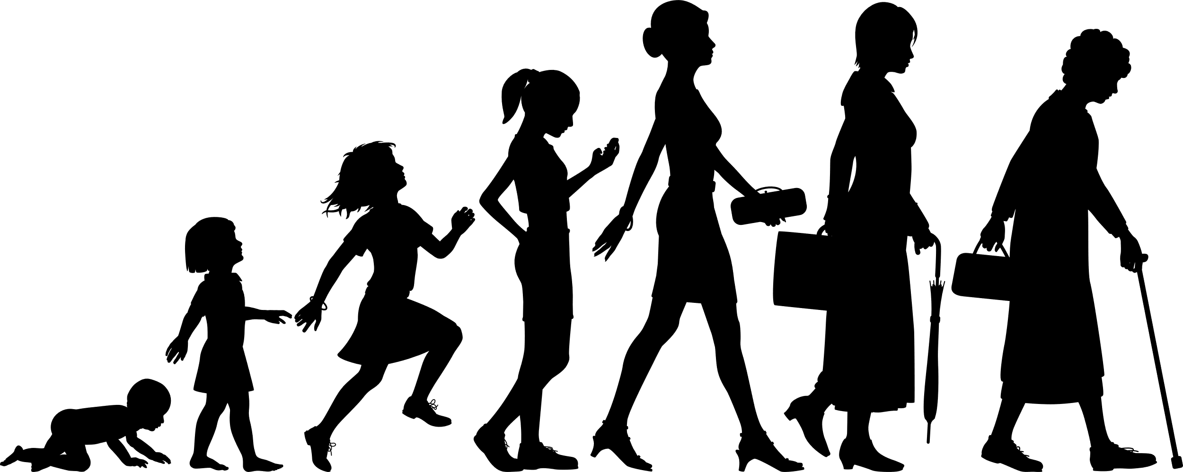
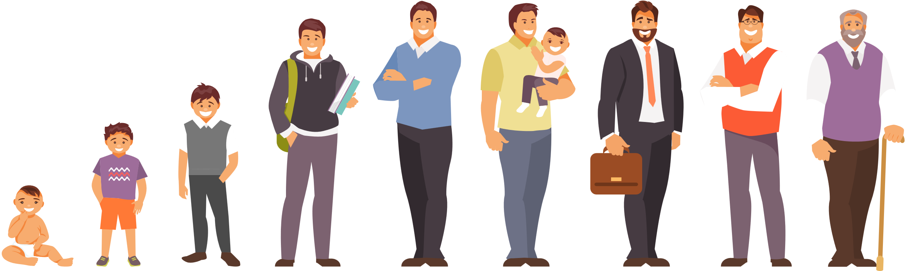
Last Activity!
Write down or think of 1 small change you can make toward your physical activity
What are the key takeaways from the session?
Is there anything that surprised you during the session today?

Slide 22
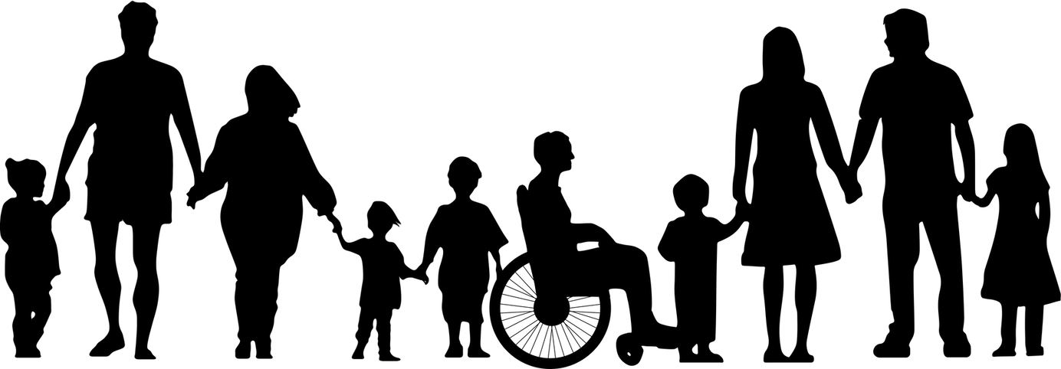
Physical Activity is for Everyone!

Slide 23

Movement Matters
Understand and Access Exercise
Ben Hunt - Physical Activity for Health Officer Sports Active Wexford

