Slide 1

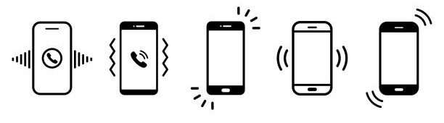
Smart Cafe
Ballyogan Library

Slide 2
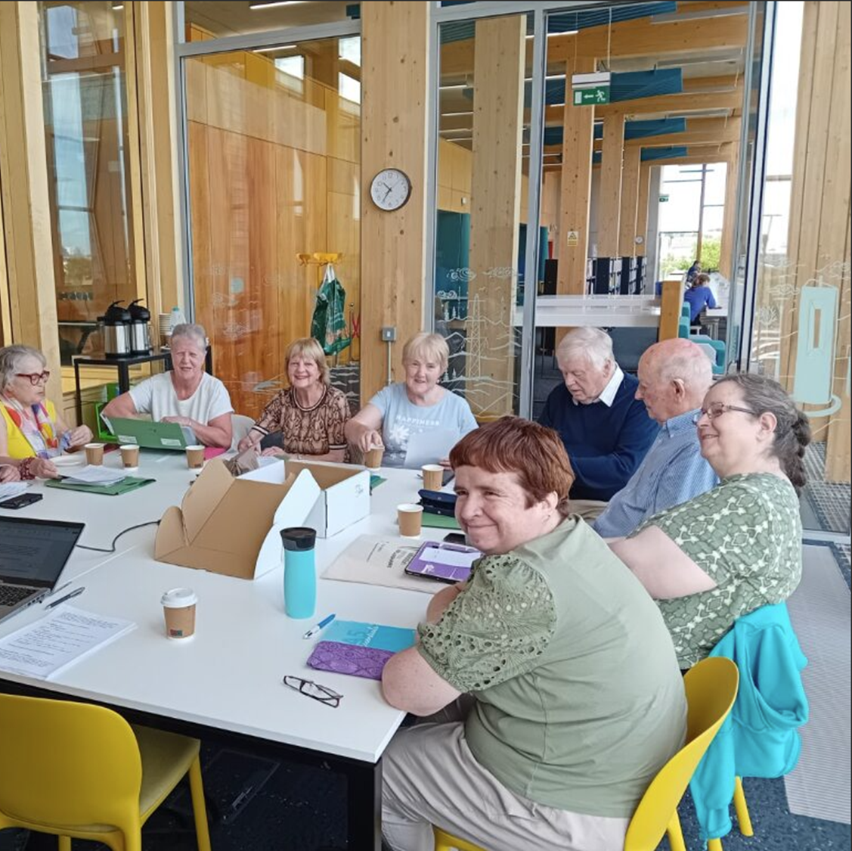
A relaxed, informal style of learning advertised as a drop-in café to support learners with using their smartphones and digital devices.
Stand-alone workshops meant people could join at any stage throughout.

Slide 3
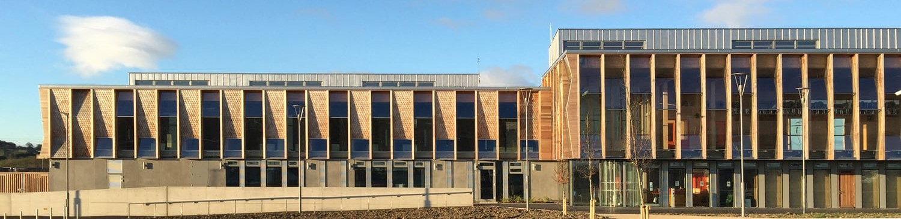
Ballyogan is a new library and an ideal location, accessible to a hard to reach and disadvantaged target group, helping us to promote our literacy supports to many who may not be aware of it.
The Ballogan Community Centre with a creche is attached to the library and helped to ensure our promotion of the programme reached many parents and grandparents that could benefit from the support of our service.

Slide 4
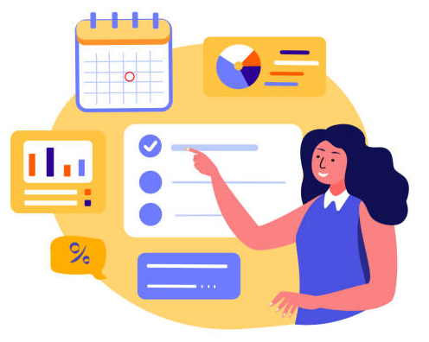
Timeframe
We had a total of 12 sessions with two tutors
Held each Wednesday and Friday for 6 weeks
Started 2ndJuly ended 8th August.

Slide 5
Aims
To support learners with digital skills relevant/specific to them.
To reach people in the community who may not otherwise have support with digital skills.
To reduce apprehension and fear around using digital devices.
To promote safe use of devices, internet and apps and making people aware of potential scams.
To remind people to think critically about what they view online, the dangers of misinformation and disinformation.
To build confidence in using their devices to access useful services.
To cross promote our literacy and numeracy services within the wider community.

Slide 6
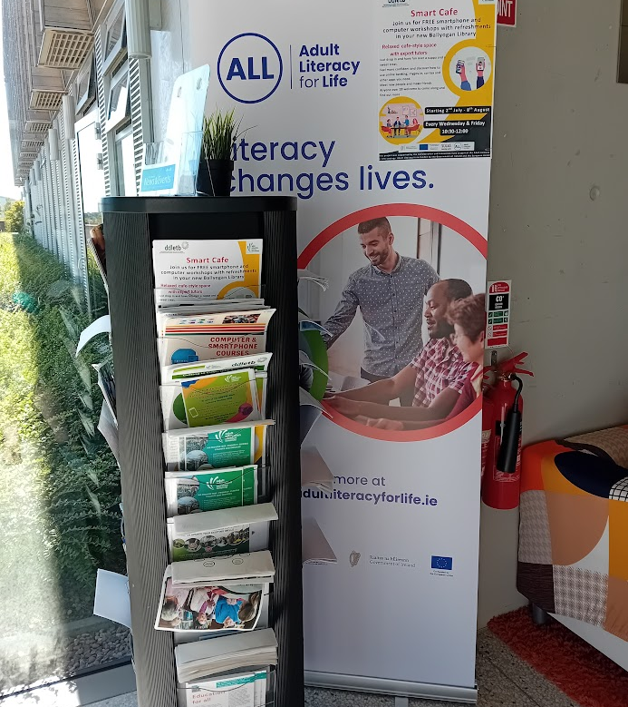
We promoted the ALL strategy through the library for the 6 weeks.
We promoted other structured classes that would be of benefit in the library reception.

Slide 7
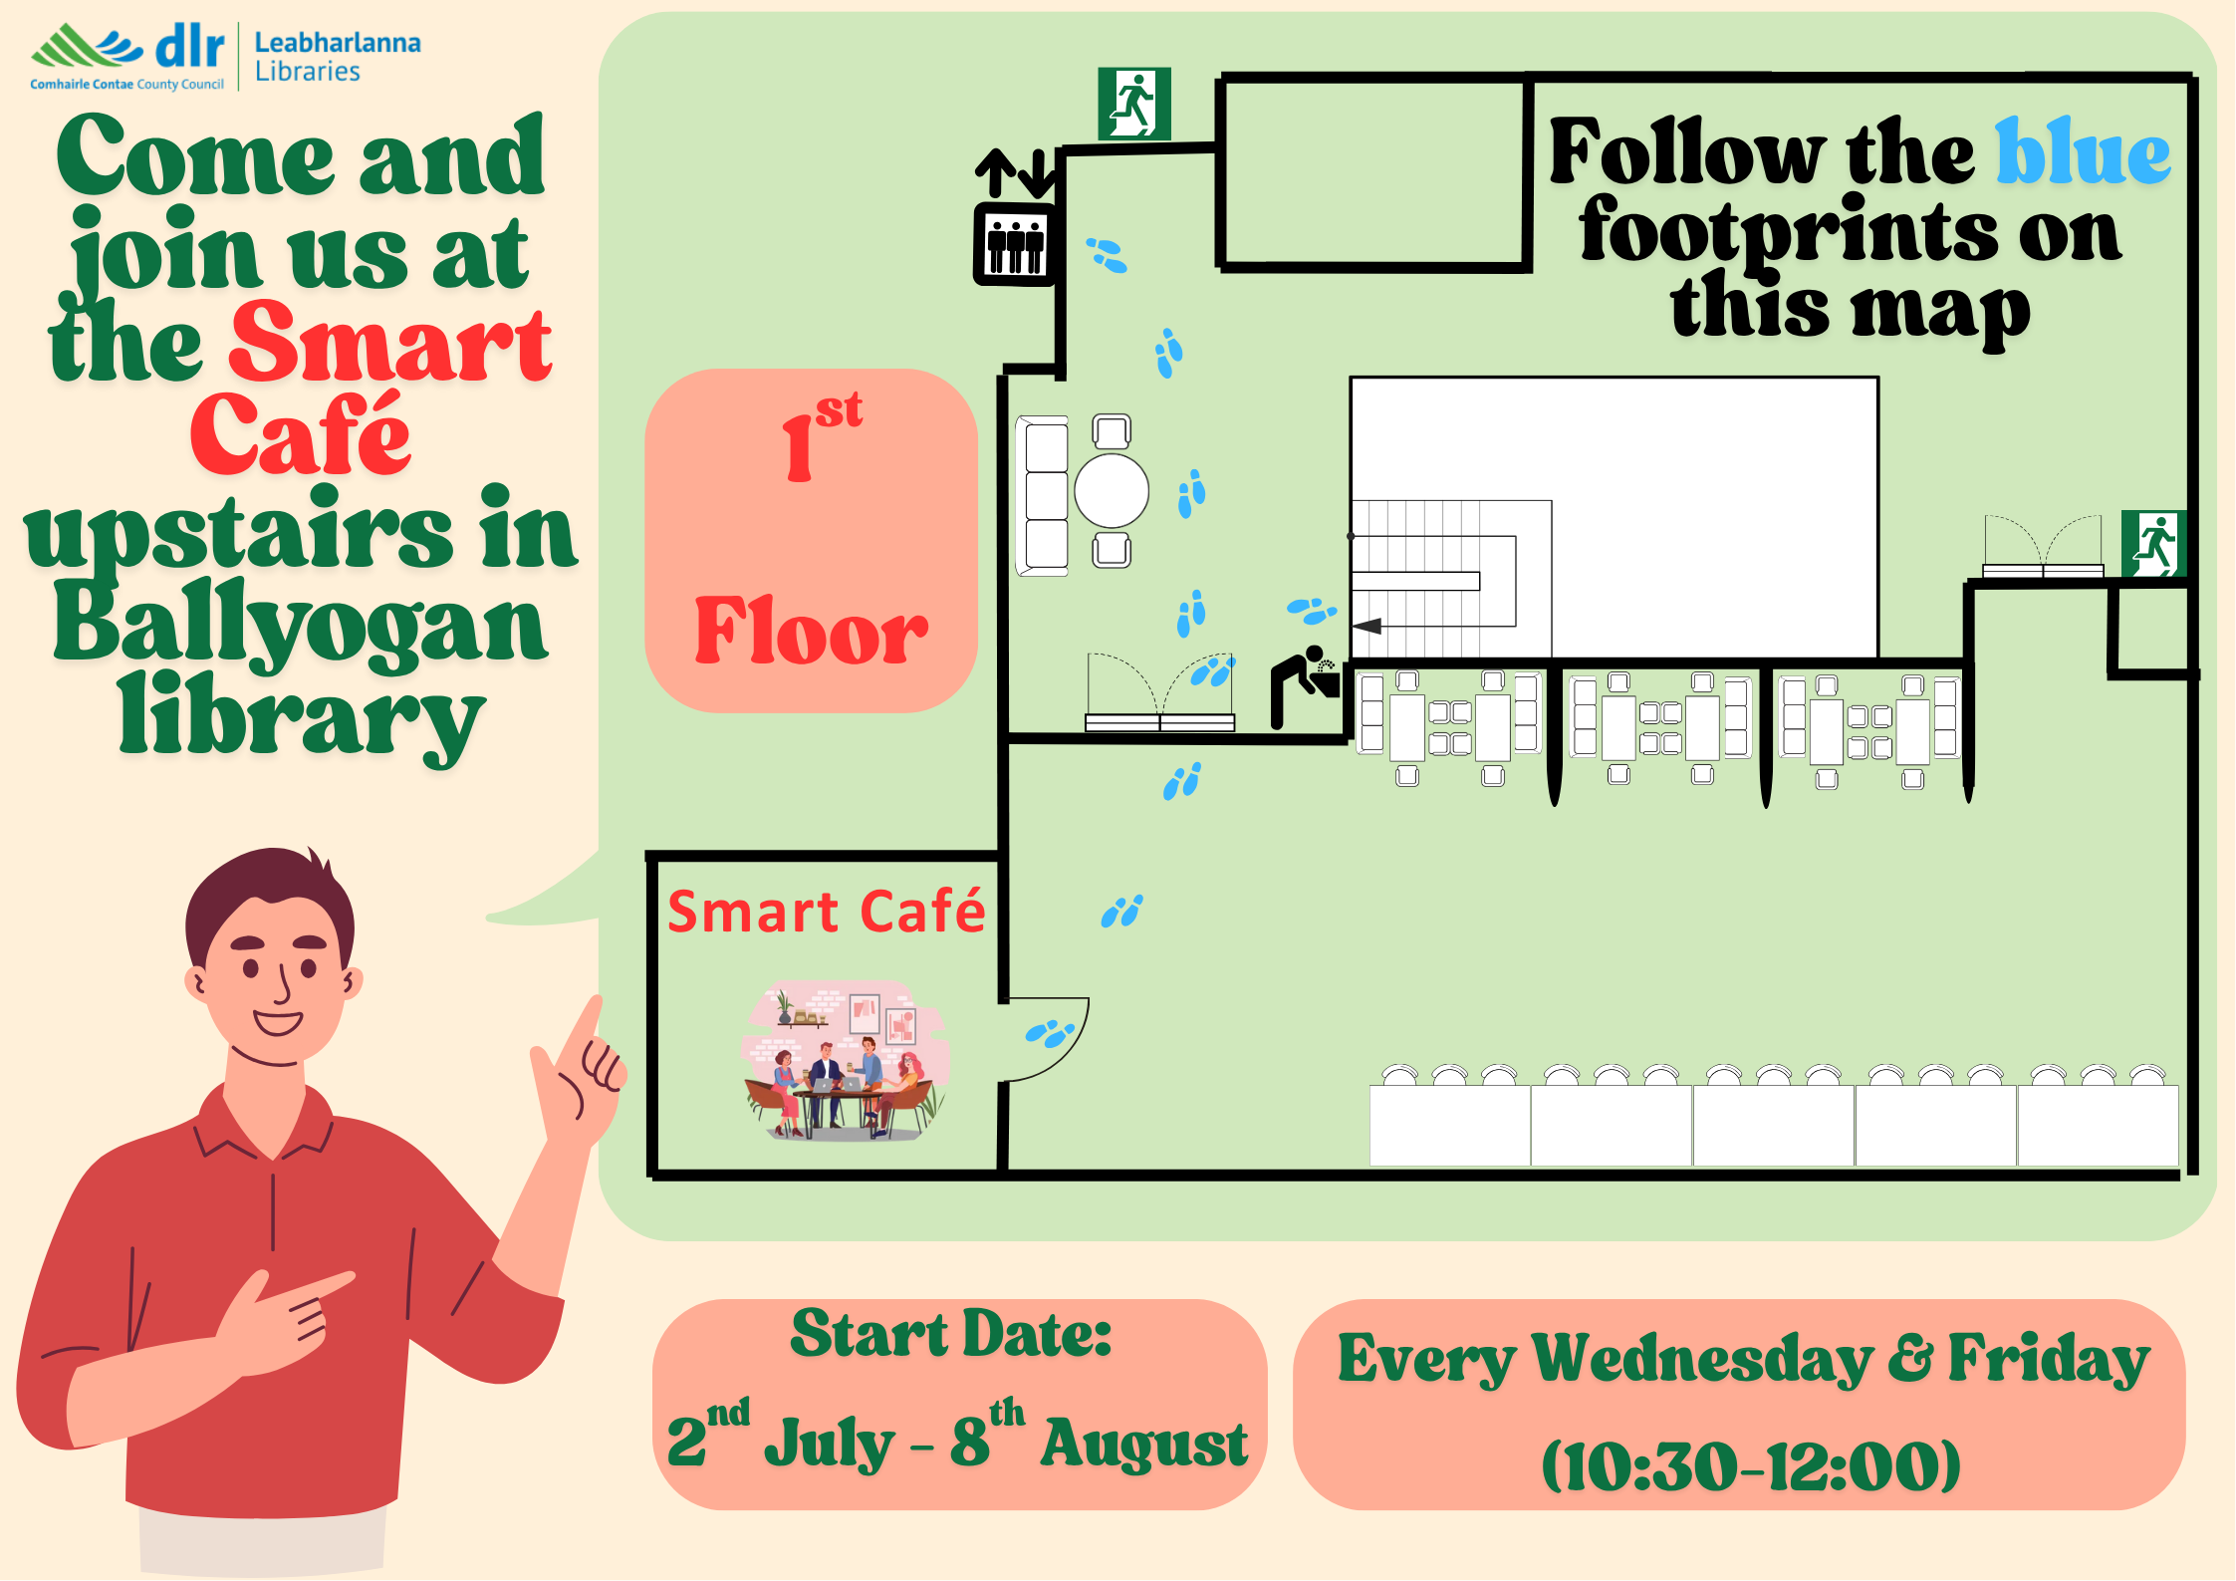
The library staff made this map to help learners find us. They were very open to suggestions on how to make the space more literacy friendly.

Slide 8
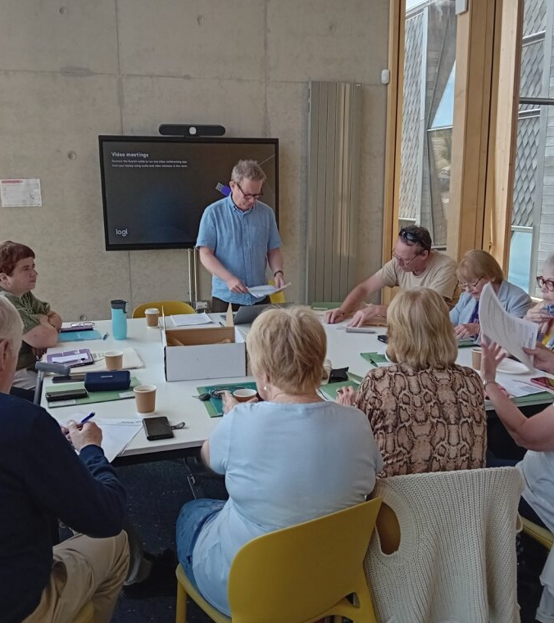
In the first session we had a general topic of using QR codes. One tutor took the group with this topic and another tutor took individual questions on a 1:1 basis.
As a group we discussed what topics would be useful to cover in the coming weeks

Slide 9
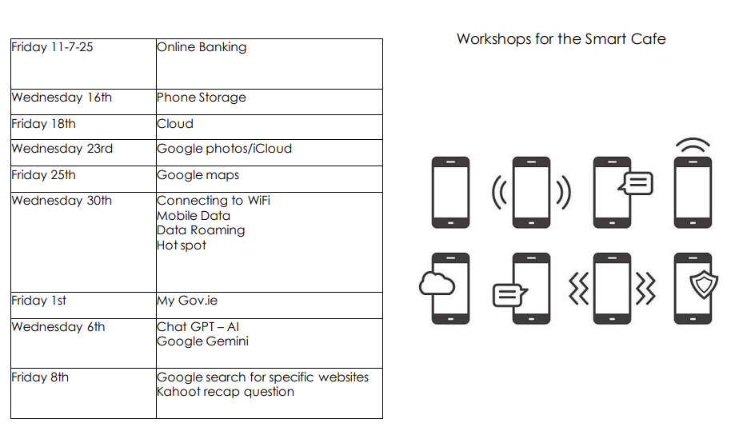
Workshop list for the Smart Café agreed with the participants

Slide 10

We covered many more topics:
WhatsApp
What biometric security is & why you need this, or a pin for your phone
Creating secure passwords, 2 Factor Authentication and managing them
How to cancel paid subscriptions on YouTube and other apps
How to use parking tag apps
Sending a voice note
Using mygov.ie
Revolut
Excel
How to delete emails, unsubscribe, send to spam and retrieve.

Slide 11

It was so popular we had to move to a bigger room!
In total we had approximately 25 total learners but a regular 15-18 attending.

Slide 12

What worked well?
The refreshments and pastries were a big motivator to attend.
The relaxed environment.
Co-creating the workshop topics with the learners.
The topics were popular and relevant.
Two tutors – helped with rolling registrations.
Two tutors – ability to provide both group and 1:1
1:1 was necessary due to GDPR concerns (password reset etc.)
The group dynamic was wonderful.
Flexibility/Experience and being able to answer questions as they arise.

Slide 13
What worked well?
Providing depth of knowledge through discussion, demonstrations, practice, visual as well as text-based printouts and worksheets.
Giving learners the NALA ‘Digital Matters’ book.
The library staff support and location.
Flexibility in stand-alone topics.
Attendance was continuous.
Rolling registration.
Kahoot quizzes were popular and a great way to use the phone and recap topics

Slide 14

What was tricky?
Anticipating new learner needs.
Some learners wanted more 1:1 time than was fair to the rest of the group.
All the learners wanted it to continue on site after the workshops finished.
Keeping up the pastry supply!

Slide 15
Result
One learner is now using the APCOA parking app which they could not do before.
One learner was able to renew their passport online with our support.
One learner was able to send voice notes and reply to text messages from their family.
Better general understanding of the topics covered.
Learners were able to use their phones to take part in Kahoot quizzes.
Learner evaluations forms were accessed and completed by each member of the group using their mobile device and a QR code – real-life use
Learners have joined our Smartphone
classes in the centre.

Slide 16
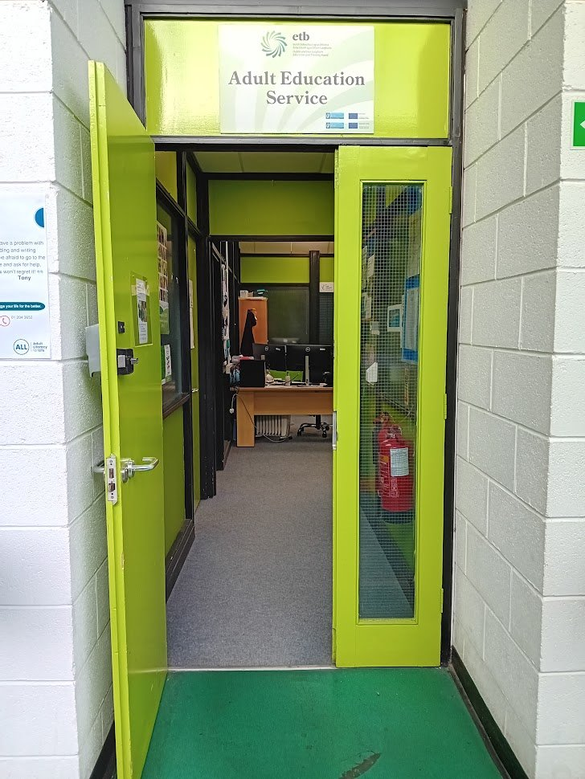

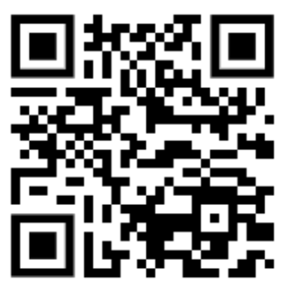
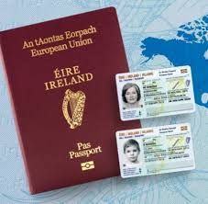
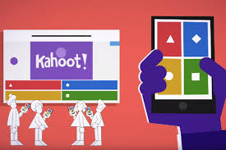


Results of the Smart Cafe

Slide 17

Thank you for your time today.
Caro Neville – Adult Literacy Organiser
24th November 2025

