Slide 1

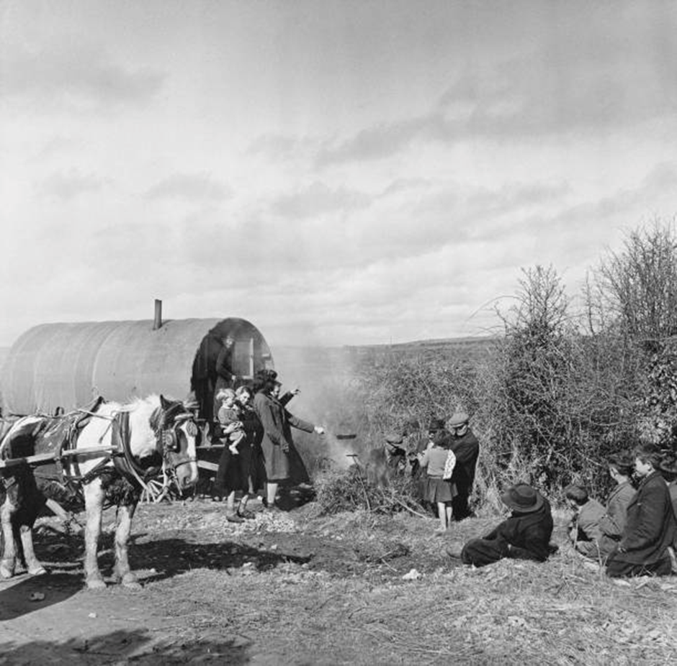

Traveller
Cultural and
Awareness Training
Developed by
Clare Traveller CDP
Funded by
Solas Learning Works

Slide 2
Introductions
Name, why you are here, what you would like to get out of the session
Opening discussion
Notes:
TIPS:
Set ground rules for respectful, confidential dialogue. Acknowledge discomfort is part of learning.
Balance discussions of challenge with celebration of Traveller-led solutions, creativity, and resilience.
Opening discussion depends on audience. Examples could be:
What are your main sources of information about Travellers and Traveller culture? How might those sources have shaped your perceptions?
Have you ever witnessed or heard a stereotype about Travellers? How did you respond?

Slide 3
What is this training and why?
WHAT:
A project by Clare Traveller CDP and funded by Solas Learning Works, to empower members of the Traveller community to deliver training to other Travellers, the settled community, public bodies and other stakeholders
WHY:
To provide an introduction and a chance to learn about the Traveller community and our culture in Ireland

Slide 4
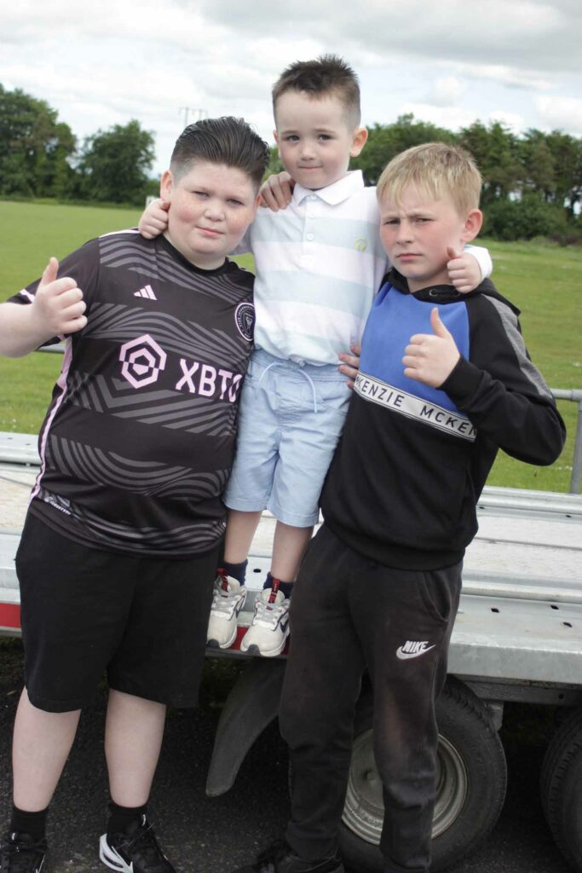
Who are the Irish Travellers?
Identity: A distinct indigenous ethnic minority within Ireland.
Being a Traveller is an ethnic and cultural identity, not a lifestyle choice or result of homelessness. (Ethnic status granted in 2017)
What Traveller are called:
  Travellers (capital 'T')
  Mincéirs / Pavee (own language terms)
  Avoid: Outdated/offensive terms like ‘itinerant/knacker’
Genetic & Historical Fact: Genetically distinct from the settled population for 12 generations (approx. 400+ years), before the Great Famine.
Notes:
Possible discussion questions:
The training mentions Travellers are "an ethnic and cultural identity, not a lifestyle choice." What's the difference between these two concepts? Why is this distinction important?
Travellers are an Indigenous Ethnic Minority: In 2017, after a long campaign led by Traveller organisations, the Irish government officially recognised Travellers as a distinct ethnic group within Irish society. This wasn't just a symbolic gesture; it acknowledges that our unique identity, history, and culture are a valuable part of Ireland's story.

Slide 5
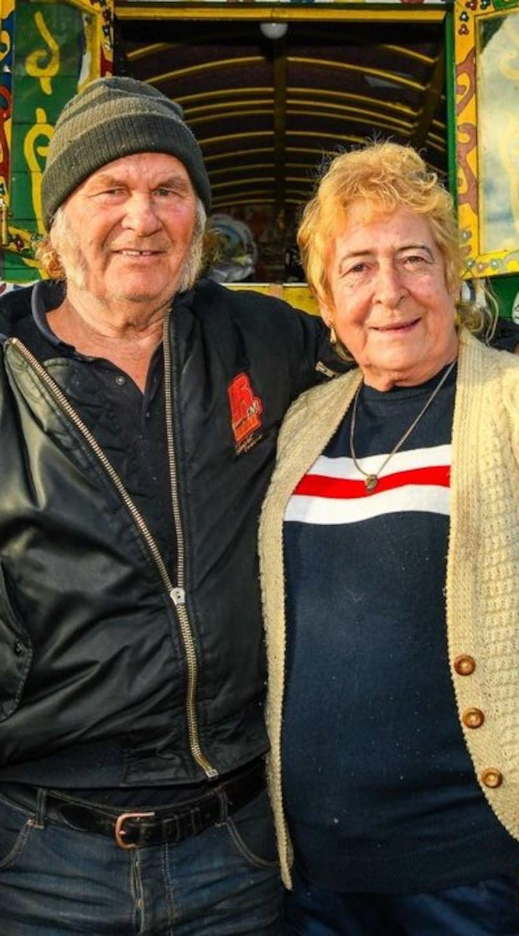
Demographics
Travellers make up less than 1% of the Irish Population
The Traveller population grew 6% between the last two censuses.
Travellers still have larger families and more children than the settled or country people.
Traveller households have an average of 4 people in each family whereas settled households have 2.7 people.
36% of all Travellers in Ireland are under the age of 15, whereas only 20% of the settled community are 15 or under.
Travellers, on average have shorter lives.
The average life expectancy for Traveller men is 61 years. That's 15.5 years less than men in the general population.
The average life expectancy for Traveller women is 70.5 years. That's 11.5 years less than women in the general population.

Slide 6
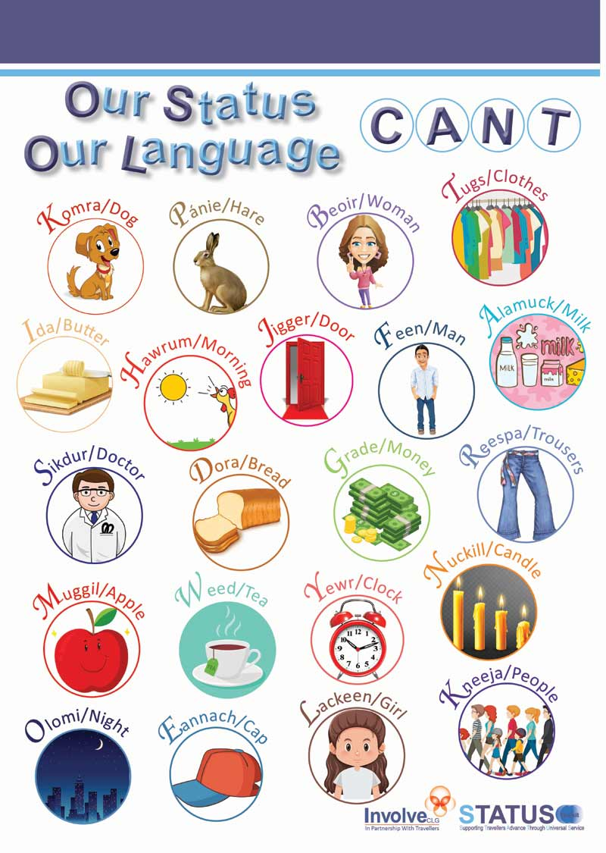
Our language
A Living Heritage: An ancient oral language with roots in Old Irish.
Evidence of Deep History: Its existence and survival underscore the community's long, separate cultural journey.
Importance: A cornerstone of unique cultural identity.
Notes:
Possible discussion question:
How does having your own language (Cant/Gammon) shape a community's identity and sense of belonging?

Slide 7
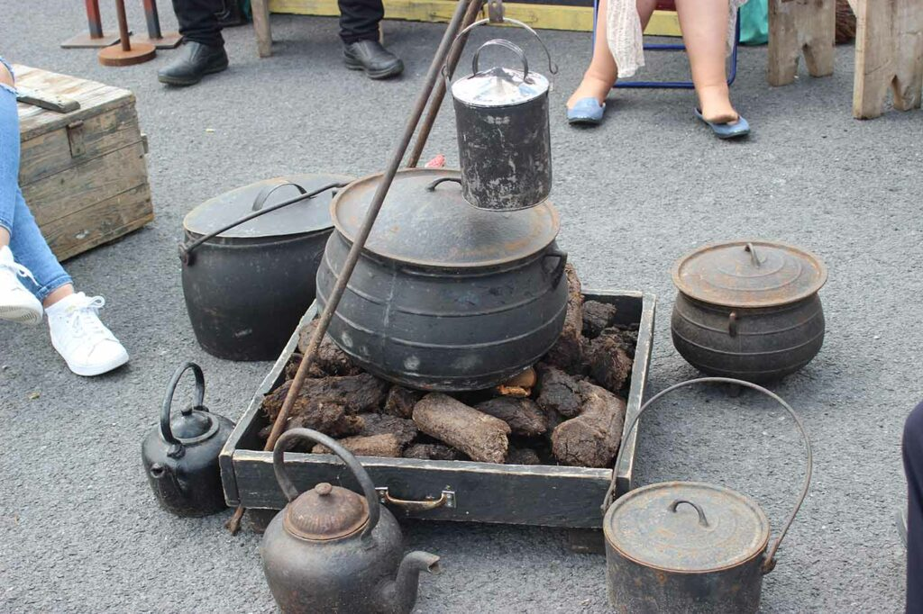
Traditional work & livelihood
For centuries, Travellers played a vital economic role in Ireland through skilled nomadic trades like tin-smithing, horse trading, and recycling. We moved seasonally, offering essential services and connecting communities.
We were also keepers of music, poetry and story-telling and were welcomed to fairs and celebrations all around Ireland.
Notes:
Possible discussion question:
How does having your own language (Cant/Gammon) shape a community's identity and sense of belonging?

Slide 8
Key Cultural Pillars
FAITH & BELIEFS
03
FAMILY & COMMUNITY
01
NOMADISM/
TRAVELLING
02
RESILIENCE & PRIDE
04
MUSIC & STORY TELLING
05
Notes:
Family & Community: Centered on the extended family. Strong bonds, loyalty, and respect for elders. Children are cherished.
Nomadism: A core cultural value (freedom of movement, roadside as social space). Now severely restricted by policy, law, and blocked stopping sites.
Faith & Beliefs: Majority Roman Catholic, with faith central to life events. Blending of Christian and older pre-Christian beliefs, traditional cures, and holy wells, visits to Knock Shrine.
Resilience & Pride: Culture has survived despite generations of assimilation policies and discrimination.

Slide 9
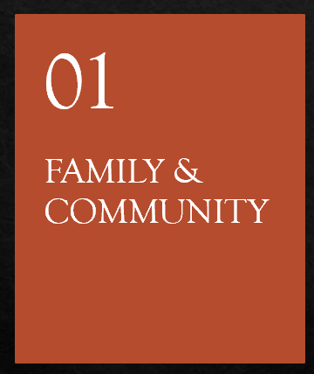
In Traveller culture, the individual is understood as part of an interconnected web of family and community. Identity is collective, not just personal. To be a Traveller is to belong to a family, and that family belongs to a wider network of kin and community.
The extended family (parents, grandparents, aunts, uncles, siblings, cousins, and often close family friends) are considered kin. Strong loyalty. Generations like to live near each other
Children are the heart of the community. Cherished by the entire extended family. Immersed in community life. First negative comment about being a Traveller is often outside the home (school).
Respect for elders. Keepers of family stories, cures, old stopping places, customs, oral history and language. Wisdom respected. Decision makers.
When the outside world rejects you, the family and the community's embrace is what allows identity and pride to survive.

Slide 10
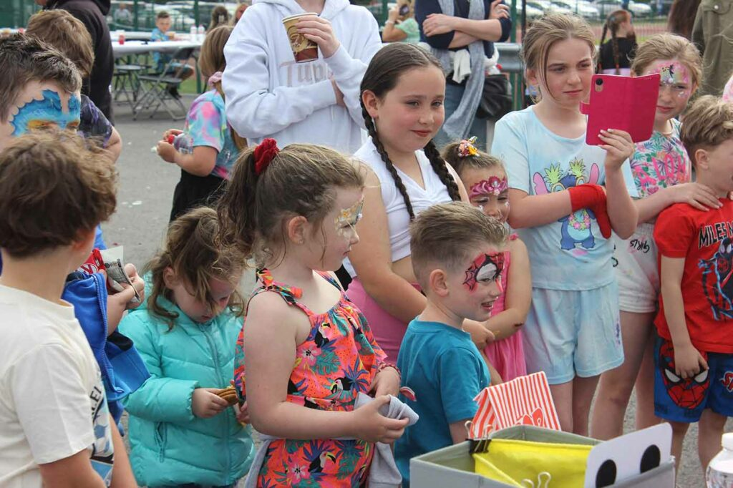

Slide 11
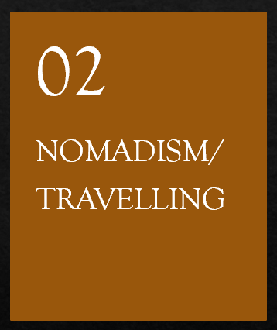
Nomadism is a core cultural value, a way of being and relating to the world that is deeply embedded in identity, social structure, and tradition. The forced end of widespread nomadism represents not just a change in accommodation, but a criminalizing of Traveller culture.
Freedom, independence and self-reliance. Tied to self employment. Avoiding state interference.
The roadside as cultural space. Families gathered around fires swapping news and stories, songs were sung, children played with extended kin. Ireland was mapped by stopping places, not towns. Boulders are a violent erasure of Traveller culture.
"The Walking People" (An Lucht Siúil). For young people, learning to travel, to set up camp, care for horses, navigate, was a key rite of passage into adulthood.
A society that makes a core cultural practice of a minority group illegal is not an inclusive one. True recognition of Traveller ethnicity is hollow without addressing the right to culturally appropriate accommodation, which must include provision for those who wish to travel.
Notes:
Traditional self employment included, tin smithing, horse trading, farm labouring, recycling, crafting, hawking, music.

Slide 12
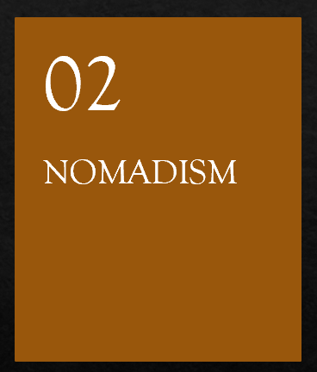
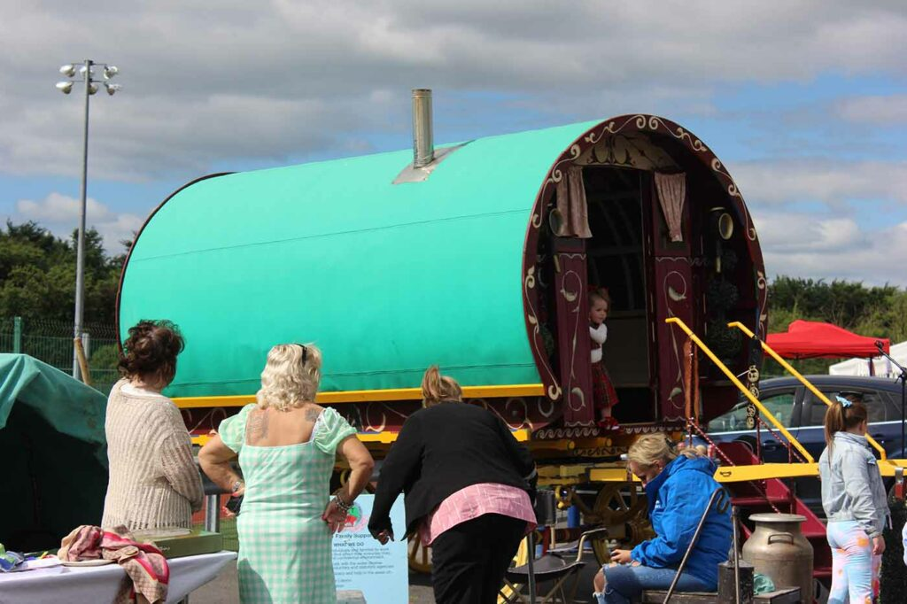
Notes:
Traditional self employment included, tin smithing, horse trading, farm labouring, recycling, crafting, hawking, music.

Slide 13
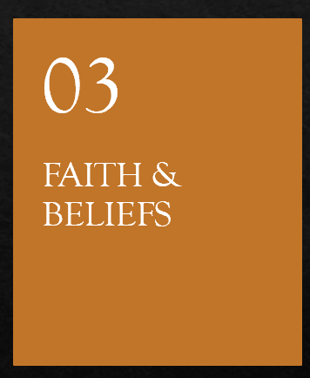
For Irish Travellers, faith and spiritual belief are woven into the very fabric of our daily existence, cultural identity, and community celebrations. This spirituality represents a mix of official Roman Catholic teaching with deep-rooted ancient traditions and a personal relationship with the sacred.
Roman Catholicism: The traditional framework. Baptism, Holy Communion, Weddings, Funerals are community occasions. Wearing of medals and scapulars. Religious pictures/statues in the home. Pilgrimage to Knock, Lourdes, Croagh Patrick etc. Born Again Christians on the rise.
The Old Ways: Holy Wells, cures, signs & superstitions, sacred sites and holy places.
Respect for the dead: Maintaining and visiting graves (fresh flowers, ornaments, lighting candles). An active connection with ancestors. A powerful expression of family loyalty that goes beyond death.
Mental and physical health are not separated from spiritual health. A doctor's medicine might be used alongside a prayer, a cure or water from a well.

Slide 14
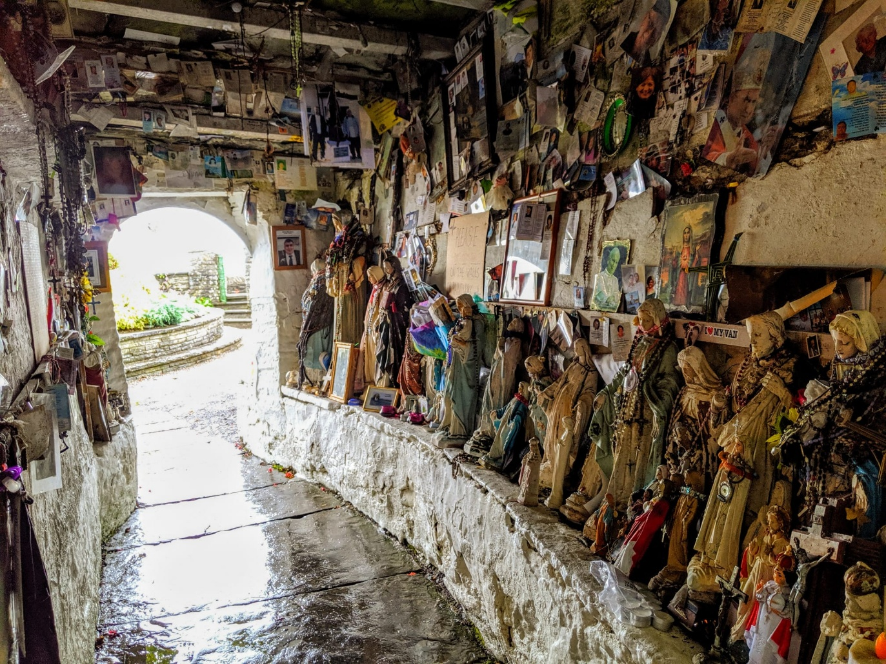
St. Bridget’s Well – Liscannor, Co. Clare

Slide 15
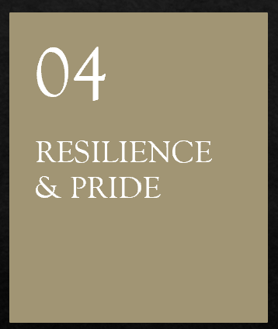
Travellers have had to be very resilient because of outside pressure. Resilience is the ability to survive tough times. The Irish State has been trying to remove the ‘Travellerness’ from Travellers for decades. Resilience & pride are essential so that Traveller culture survives.
Travellers need resilience:
Against making the Traveller way of life illegal/impossible
Against social & economic exclusion
Against negative stereotypes
Pride as the opposite to shame
Discrimination creates shame
Pride is defiance
Pride must built from within.
"We make the road by walking“
This community saying perfectly encapsulates adaptive resilience. The culture is a living path created through continuous movement and adaptation.
Notes:
Making the Traveller Way of Life illegal/impossible: From the 1963 Commission's policy of assimilation to the criminalisation of trespass and the physical blockading of traditional stopping places, state policy actively sought to eliminate the material basis of Traveller culture. Resilience was the community's collective refusal to disappear/’assimilate’ (become the same as the settled community)
Against Social & Economic Exclusion: Being barred from pubs, shops, housing, and employment required the development of self employment (recycling, horse trading within the community) and social structures that could operate independently of mainstream acceptance.
Against negative stereotypes: When society talks down your culture or portrays your people as a "problem," this calls on all of Travellers’ resilience to grow up with healthy self esteem and self worth
Pride as the Antidote to Shame
The "Shame" Narrative: State policies and social prejudice were explicitly designed to make Travellers feel ashamed of their identity, their nomadism, their language, their family structures. Children in schools were often treated as if they were lower than settled children, made to wash or change their clothes unnecessarily.
Pride as Defiance: Cultivating pride became a revolutionary act.
Internal vs. External Validation: Traveller pride had to be built from within. Travellers have been working across the county have been working very hard but change comes slowly.

Slide 16
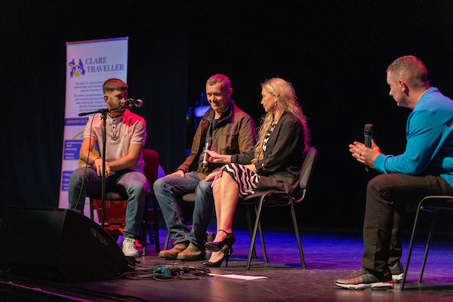
(l-r) Davie Keenan, Thomas McCarthy, Dr. Sindy Joyce, Willzy

Slide 17
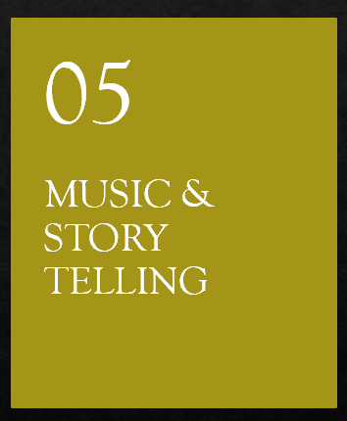
For Irish Travellers, music, poetry and storytelling are how we gather and pass on history, identity, values, and collective memory. In a nomadic culture where people had few belongings, sound and spoken word became the way to carry culture across generations and geography.
Some famous Traveller musicians, poets and storytellers
Poetry & storytelling: Travellers traditionally served as mobile news networks, carrying stories, local happenings, and family history from region to region. Poets and storytellers hold the community's collective historical record.
Music as a trade: Musical skill couldn't be confiscated. A talented musician carried "wealth" in their hands and voice. Traveller musicians played at fairs & weddings as well as around a campfire. They picked up and spread tunes from all around the country. Traditional Irish music owes huge credit to the Traveller community who kept the songs and tunes alive.
Margaret Barry
Paddy Keenan
Thomas McCarthy
Finbar Furey
Rosaleen McDonagh
Michael Collins
Michael McDonagh
Oein de Bhairduin
Pecker Dunne
Sharyn Ward
The Keenan Family
Jack Delaney
Martin Beanz Ward
Notes:
Fiddle, tin whistle, uilleann pipes were favored as portable, expressive instruments. The banjo was adopted and mastered, becoming a signature sound.

Slide 18
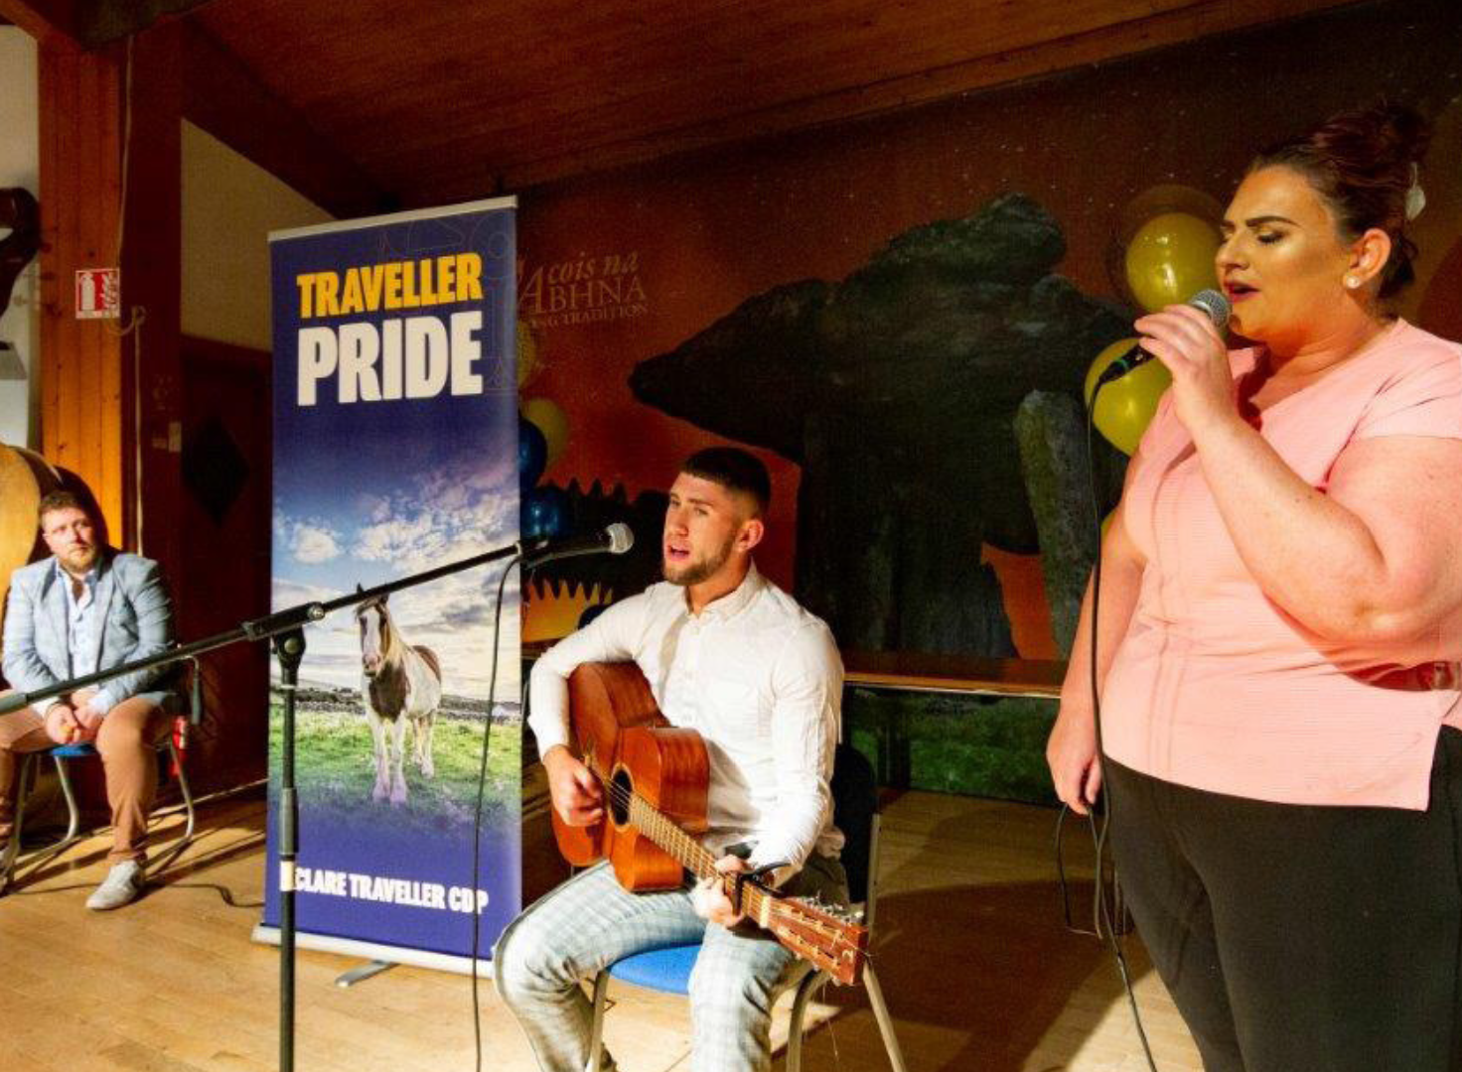
(l-r) Martin Beanz Ward, Davie Keenan, Kathleen Keenan
Notes:
Fiddle, tin whistle, uilleann pipes were favored as portable, expressive instruments. The banjo was adopted and mastered, becoming a signature sound.

Slide 19
A history of harmful policies
1963 Commission on Itinerancy, the State's first major policy, viewed Travellers as a "problem." No Traveller members.
Key goal was ‘assimilation’, to absorb and erase Traveller identity.
Legacy: Forced settlement, child removal, criminalisation of trespass (Criminal Justice At 1994), destruction of nomadic life. It caused profound intergenerational trauma.
"Nothing about us without us."
What does assimilation mean:
Cultural assimilation means when a smaller group like Travellers changes their culture to fully take on the values, behaviours, beliefs and customs of another usually bigger group, in this case, the settled community
Notes:
Possible discussion questions:
The 1963 Commission had no Traveller members. How does excluding a community from decisions that affect them lead to harmful policies? Can you think of other examples?
Assimilation vs. Inclusion: What's the difference between policies that try to make people conform vs. those that allow people to participate fully while maintaining their identity?
How might the historical trauma of assimilation policies and child removal affect community trust in state institutions today?

Slide 20
The reality of discrimination today
Research Shows: Highest levels of prejudice of any ethnic group in Ireland (ESRI).
Social Exclusion: 47% of people surveyed in 2023 would be uncomfortable living next to a Traveller.
In Daily Life: Frequent refusal of service in pubs, hotels, shops. Leads to shame, anger, and social isolation.
In Justice: Surveys show negative views of Travellers within An Garda Síochána, higher conviction rates.
The Law: Equal Status Acts (2000-2018) prohibit this discrimination. Enforcement remains challenging.
Notes:
Possible discussion questions:
The data shows high social discomfort with Travellers as neighbours or partners. What underlying beliefs might drive this? How can we address those beliefs?
Imagine being unsure if you'll be served at a pub or hotel because of your identity. How might that constant uncertainty affect a person's mental health and sense of belonging?
What are the barriers that might prevent someone from speaking up when they hear a prejudiced comment? What are practical ways to overcome those barriers?

Slide 21
Trauma
Generations of discrimination and harmful state policies have created deep intergenerational trauma within the Traveller community. This trauma shows itself as mental health crises, internal conflict, and tragically high suicide rates.
In response, the community has built its own healing services, including a dedicated Counselling Service, Mental Health Network, and Mediation Service.
However, these internal efforts cannot alone stop the cycle. Ending the external discrimination and State neglect, through proper investment in housing, health, and education, is essential. The state must work as an equal partner to repair the damage, recognising Traveller culture as valid and precious.

Slide 22
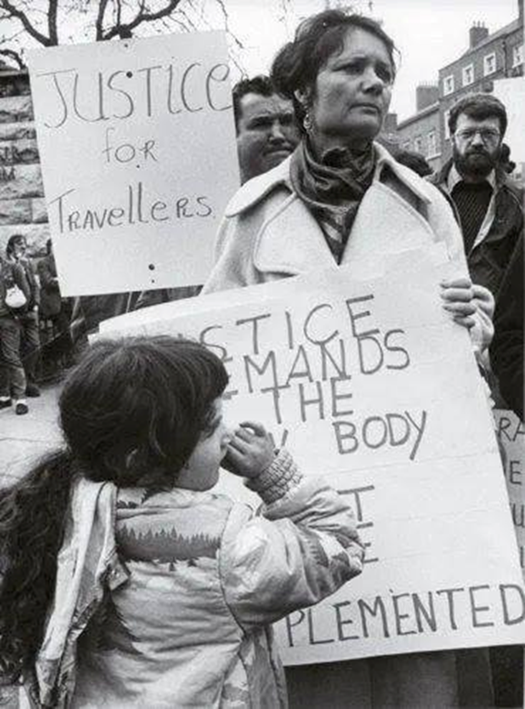
Travellers and political representation
Despite landmark political achievements, including the first Traveller Senator Eileen Flynn, Travellers remain a small minority with limited political power. The struggle, symbolised by Nan Joyce's 1982 campaign (pictured), continues unchanged after 43 years.
While Traveller organisations have consistently shown solidarity with other marginalised groups, we now urgently need the wider settled community to stand with us and be our allies. To secure a future where Travellers can thrive, strong external allies must join the fight, demanding the state finally fulfils its obligation to provide culturally appropriate housing and accommodation for all communities, ending decades of neglect.

Slide 23
Current Crisis
ACCOMMODATION
03
MENTAL HEALTH & SUICIDE
01
LIFE EXPECTANCY GAP
02
Notes:
Life Expectancy Gap:
Traveller men: 61 years (15.5 years less).
Traveller women: 70.5 years (11.5 years less).
Accommodation Crisis:
Travellers are 1% of the population but 13-25% of the homeless.
Chronic under-provision of culturally appropriate housing (halting sites, group schemes).
"They don't want us on the roads, they don't want us on halting sites and now they don't want us in houses. Where do they want us to go?" – Dr. Sindy Joyce.

Slide 24
Mental Health & Suicide
Decades of harmful state policies and widespread social discrimination have created a devastating mental health and suicide crisis within the Traveller community, with suicide rates vastly exceeding national averages.
This State oppression, some of the worst in Europe, means that Traveller parents to have to work tirelessly to instill cultural pride and confidence in their children.
We are harmed by laws that try to assimilate us, challenge our traditions and our identity while prejudice against Travellers remains widely unchallenged. Despite our rich nomadic heritage and close community this environments harms our wellbeing and threatens our cultural survival.
Notes:
Mental Health & Suicide Crisis:
Traveller men: 7x higher suicide rate.
Traveller women: 6x higher suicide rate.

Slide 25
The Life Expectancy Gap
The life expectancy gap for Irish Travellers represents one of the most severe health inequalities in Europe. Traveller men have an average life expectancy of just 61 years, which is 15.5 years less than men in the general Irish population. Traveller women live to an average of 70.5 years, 11.5 years shorter than non-Travellers. This is not due to biology but is a direct consequence of systemic discrimination and social exclusion. Contributing factors include:
Substandard Living Conditions
Barriers to Healthcare
Socioeconomic Exclusion
The Mental Health Crisis
Notes:
Substandard Living Conditions: Many Travellers live in overcrowded, unsafe, or culturally inappropriate accommodation, often without basic sanitation, which increases vulnerability to chronic illness and infectious disease.
Barriers to Healthcare: Experiences of discrimination within health services, combined with a lack of cultural understanding from providers, lead to lower uptake of preventative care, later diagnoses, and poorer health outcomes.
Socioeconomic Exclusion: High levels of unemployment, poverty, and educational disadvantage limit access to healthy food, safe environments, and understanding of good health
The Mental Health Crisis: The immense stress of enduring persistent prejudice and the trauma of intergenerational hardship fuel a suicide epidemic, directly impacting mortality rates.
The statistics are a devastating metric of inequality: while 15% of the general population is over 65, this is true for only 5% of the Traveller community. This gap is a preventable human rights failure, underscoring the urgent need for targeted, culturally knowledgable investment in Traveller housing, healthcare, and social inclusion.

Slide 26
Accommodation
Travellers face an acute and distinct accommodation crisis, far exceeding the general housing shortage. While less than 1% of the population, we make up 13-25% of Ireland's homeless.
The core issue is a catastrophic failure to provide safe, culturally appropriate housing. Despite available funding, Local Authorities consistently fail to spend millions earmarked for Traveller-Specific Accommodation, leaving families in overcrowded or bad conditions, sometimes even without toilets or running water.
Making this worse Travellers encounter severe discrimination from private landlords and opposition from settled communities when housing is proposed. This State neglect is a main cause of the community's hardship.

Slide 27
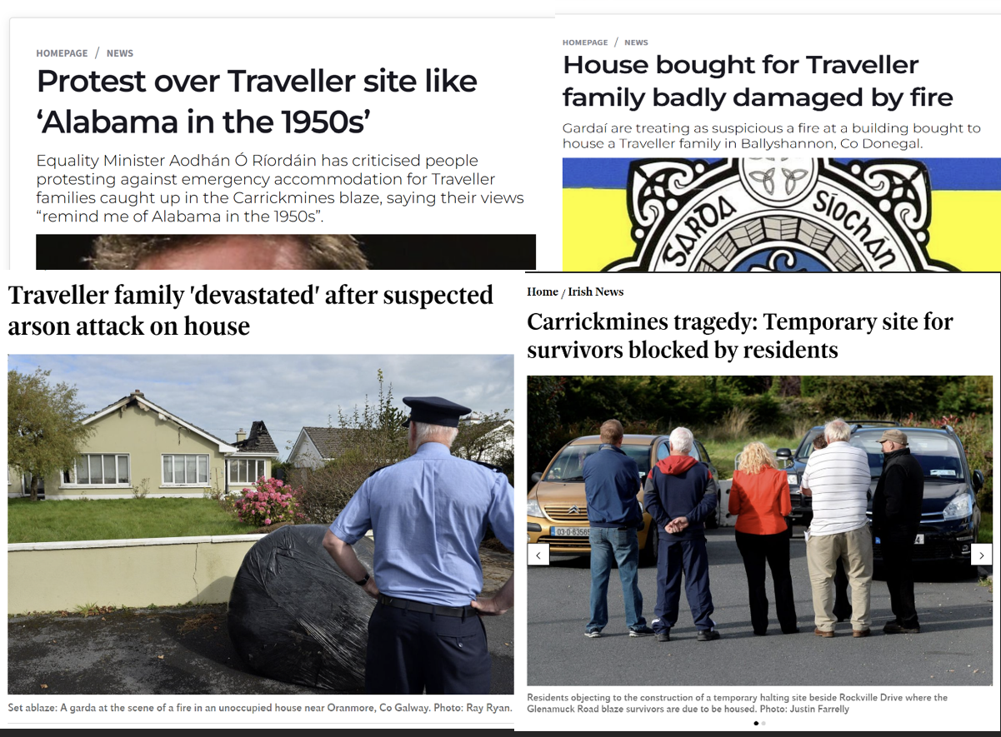
Accommodation

Slide 28
Additional Challenges
EMPLOYMENT
01
EDUCATION
02
NAVIGATING CONFLICT
03
Notes:
Employment:
Disparity: 61% unemployment (working age) vs. ~4.5% nationally.
Barriers include discrimination, qualification gaps, the "welfare trap" (low-wage insecurity vs. lost benefits).
Need: Investment in apprenticeships, supported pathways, and anti-discrimination measures in workplaces.
Education:
Barriers: Bullying, lack of cultural understanding, reduced school hours, few Traveller teachers.
Progress includes more parents prioritise education. Many high-achieving academics and professionals.
Only ~30% complete Leaving Cert. Traveller history/culture must be added to curriculum.
Navigating Conflict:
Causes: Intergenerational trauma (leading to depression & addiction), crowded living space, competition for scare resources.
The development of the Traveller Mediation Service is a powerful example of the community using its own values (respect for elders, desire for harmony) to develop culturally appropriate tools for conflict resolution from within.

Slide 29
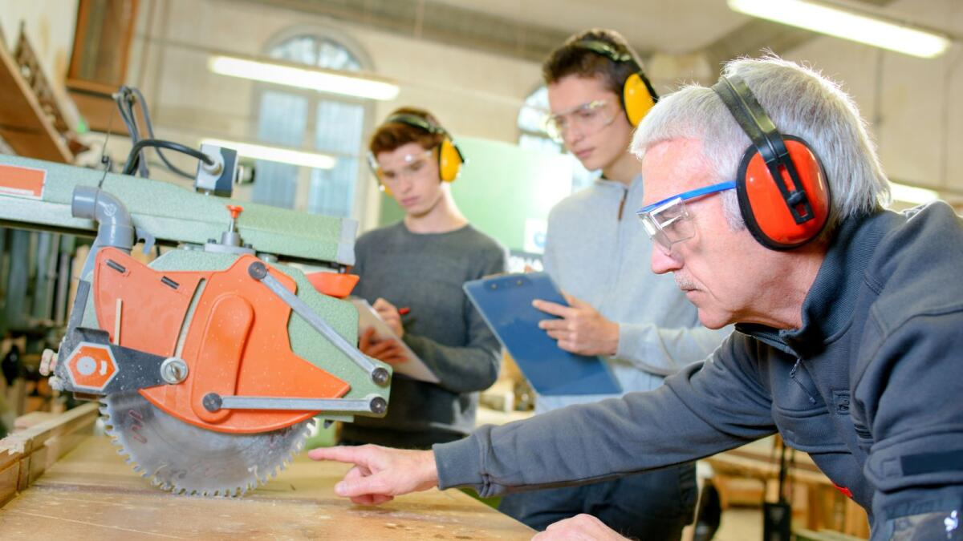
Employment
Fewer traditional trades, educational barriers, and severe discrimination creates an employment crisis for Travellers. Only 3% hold a primary degree (vs. 52% nationally), and 61% are unemployed (vs. 4.5%).
Travellers face huge hurdles: discrimination and the 'welfare trap' where low-wage, insecure work risks essential benefits like housing and medical cards.
Supportive programmes like apprenticeships are welcome, but real change requires policy that enables secure transitions into work, allowing Travellers to keep safety nets during the move, and major investment in anti-discrimination in education and supported employment.

Slide 30
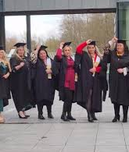
Education
While education is increasingly prioritised by Traveller parents, barriers still persist. Bullying, a lack of cultural understanding, and practices like reduced school hours, make schools difficult for many Traveller children.
As a result only about 30% complete our Leaving Cert. Despite these odds, individual Travellers have achieved remarkable academic success.
The promise to include Traveller history and culture in the national education is a positive step, but change will be slow. We urge all educators to use available resources and training now to create inclusive, supportive environments for every student.

Slide 31
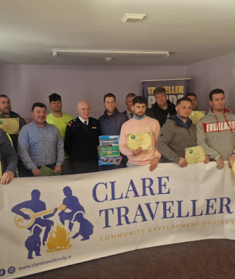
Navigating Conflict
One of the cruelest things about trauma is that it often turns inwards and causes conflict within communities as well as depression and addiction -you’ve probably heard the saying that ‘hurt people hurt people’ and while this is not always true of course, Travellers have had to learn to deal with conflict within our own communities.
One great response to this which has come from our community is the development of the Traveller Mediation Service which helps us manage and move on from conflict and also trains up mediators from within our community.

Slide 32
What is the Equal Status Act?
The Equal Status Acts 2000-2018 are laws that ban discrimination in the provision of goods, services, accommodation, and education. They mean that it is illegal to treat people worse because of their age, disability, race, religion, gender, sexual orientation, family status, marital status, or membership of the Traveller community.
A kind of court called the Workplace Relations Commission is able to investigate and fine companies that break these laws and to award the fines to the people who experienced the discrimination. This hasn’t prevented discrimination from happening, but it does help to make businesses aware that it is illegal to discriminate. At the moment there is a proposal to make the fines bigger and if this happens it might work better but the settled culture needs to change significantly too.

Slide 33
A powerful first step
This training is a powerful first step. By seeking understanding, you are choosing to see the richness of Traveller culture, the strength of our resilience, and the urgency for change.
Each of you now has the knowledge to challenge stereotypes, to amplify Traveller voices, and to become an active ally.
The future for the Traveller community is one of proud self-determination, where our distinct identity is not just recognised but celebrated as a vital part of Ireland’s history and culture.

Slide 34
How to be an ally
Use Respectful Language: "Traveller" (Capital T). Challenge slurs.
Challenge Stereotypes: Speak up against negative jokes or misinformation.
See the Individual: Don't see a Traveller as a representative of an entire group.
Listen & Learn: Seek out Traveller voices, art, music, and writing.
Be a Workplace/Community Ally: Support inclusive policies, call out discrimination.
Be a Friend: Foster genuine, inclusive social connections.
Support Demands: Advocate for proper housing, health, and education investment for the Traveller community.
What is an ally?
An ally is a someone who gives support and help to another, often to a person from a minority community. A good ally works to end oppression and discrimination even though it might not affect them themselves.

Slide 35
Traveller-led organisations and advocacy
Travellers live in both traditional and mainstream worlds as professionals while maintaining a strong identity. Pride events reclaim our narrative.
Our community has built a dual support system: inclusive groups with allies and Traveller-only spaces. While working with the settle community is valued, the settled community must also confront its role in the discrimination that Travellers live with daily.
Pavee Point
Irish Traveller Movement
Minceirs Whiden
National Traveller Women’s Forum
National Traveller Mental Health Network
National Traveller Counselling Service
Traveller MABS
Traveller Mediation Service
Traveller Voice (magazine)
Exchange House Ireland
CENA Approved Housing Body

Slide 36
Clare Traveller CDP
"True community development is about trusting communities to develop their own solutions and pathways.”
Clare Traveller CDP aims to improve living conditions, opportunities and achievement of human rights for Travellers in Clare, and this will be pursued through establishing and strengthening local alliances and, most importantly, through building effective Traveller leadership and a strong Traveller voice.
FOR MORE INFORMATION: https://claretravellercdp.ie

Slide 37
Final thoughts
Diversity: Travellers are not all the same. We are diverse in opinions, lifestyles, and identities (including LGBTQIA+, disabled, mixed heritage).
Living Culture: "We make the road by walking." Our culture is alive, dynamic, and evolving.
The Goal: A future where Travellers can thrive as our full selves, with pride as a valued part of Irish society.
Your Role: This presentation is an introduction. Continue the journey of understanding.
Notes:
Possible discussion questions:
What was most surprising or new to me in this training? Why did it stand out?
The phrase "We make the road by walking" suggests culture is living and dynamic. How do all cultures, including our own, change over time while maintaining core values?

Slide 38

Thank you
Thank you for your time and engagement.
Explore Further: See the handbook for a full list of recommended books, films, music, and podcasts by Traveller artists and creators.

