Slide 1
Healthy Living
for Everyday Life
A collaborative project, funded by the Adult Literacy for Life Collaboration and Innovation Fund 2025, for the collective development and delivery of an accessible health literacy programme.
Elaine Banville (HSE Health Promotion Officer)
Edel Finan (WWETB and Adult Literacy for Life)
Paula Lowney (HSE)
Notes:
Introduce Facilitator and organisation they work in and then Briefly the workshop and what it will be about - 1Min

Slide 2





Programme Rationale
39% Irish people ‘limited’ health literacy
(EU Health Literacy Survey, 2010).
21% unmet literacy needs
(PIAAC, 2023)
Lower levels of health literacy in lower socio-economic areas
(Sorensen 2015).
Lower socio economic areas 2.5 times as likely to present with a chronic disease
(HSE, 2019).
Are we reaching those most in need with information that can be understood?
The need for more than just signposting
(Cantrell, Booth and Chambers, 2024)
Notes:
Only a small number of service user needs are met by signposting services alone;
Users with complex health and social care needs require intensive, repeat support from specialist services equipped with specific knowledge and situational understanding.
A tension persists between efficient (transactional) service provision with brief referral and effective (relational) service provision, underpinned by competing narratives. Do signposting services represent 'diversion of unwanted demand from primary care/urgent care services' or 'improved quality of care through a joined-up response by health, social care and community/voluntary services'?
(Cantrell, Booth and Chambers, 2024)

Slide 3
Aims of Programme
To reduce the barriers to accessing health promotion related information and interventions within the community in Wexford
To promote health literacy amongst groups marginalised as a result of unmet health literacy needs.

Slide 4
Programme Proposal
Development and delivery of 6 literacy friendly health promotion workshops
Delivered in all 5 libraries in Co Wexford
Delivered by local health professionals who would receive in depth training in literacy friendly approaches
Smoking and Vaping
Physical Activity
Alcohol awareness
Healthy Eating
Mental Health and Wellbeing
Cancer Awareness

Slide 5
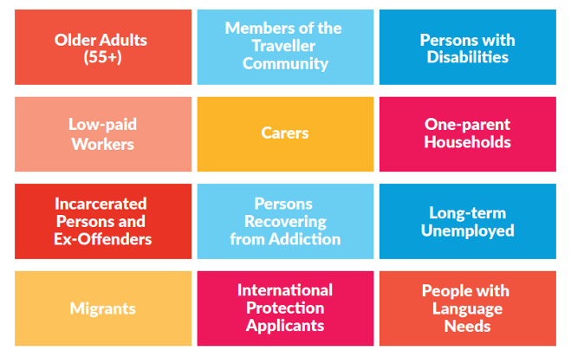
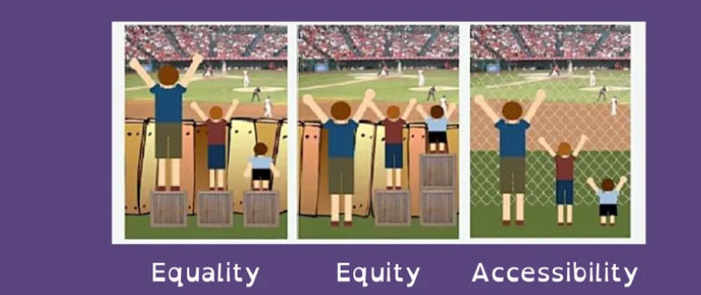
Target Population and Universal Design
Listed Target groups in ALL Strategy
Removing Barriers makes it accessible to all in the community

Slide 6
Programme
Implementation
Funding Proposal
Adult Literacy for Life Collaboration Fund
Project Management
Facilitator Engagement and Training
8 facilitators from 4 organisations
30 workshops on 6 health topics delivered across 5 libraries
€8790
Project Coordinator
Steering Group
Workshop Delivery
Promotion Campaign
Literacy friendly advertising
Reaching target audience
Training in Literacy Awareness
Notes:
Facilitator Engagement and Training:
4 online workshops in literacy, health literacy and plain English, facilitator meetings to plan content of workshops-continuity of approach, preparation of each workshop by facilitator, in person literacy workshop with Edel, adaptation of workshops.

Slide 7


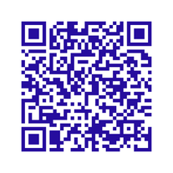
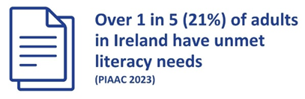


Adult Literacy for Life Strategy​
Vision: An Ireland where every adult has the necessary literacy, numeracy and digital literacy to fully engage in society and realise their full potential.
What is health literacy?​
Having the knowledge, motivation, and competencies to access, understand, appraise, and apply health information to make judgments and decisions in everyday life. These judgments and decisions are about health care, disease prevention and health promotion that maintain or improve quality of life. ​
The research
Collaboration and
Innovation Fund
Adult Literacy For Life's PIAAC Factsheet

Slide 8
Professional Development Continued: ALL workshop
Facilitation of a group review of health promotion workshops through a literacy and plain English lens to ensure easy to understand Community Health Workshops
Workshop objectives
  Understand how to assess your workshop for accessibility and clarity.
  Apply plain English and literacy-friendly principles
  Gain confidence in making small, meaningful changes

Slide 9

Easy to Understand Community Health Workshops
A group review of workshops through a literacy and plain English lens
Audience
Language and Jargon
Design and Layout
Facilitation and Verbal Delivery
Next Steps and Support
Text Clarity

Slide 10
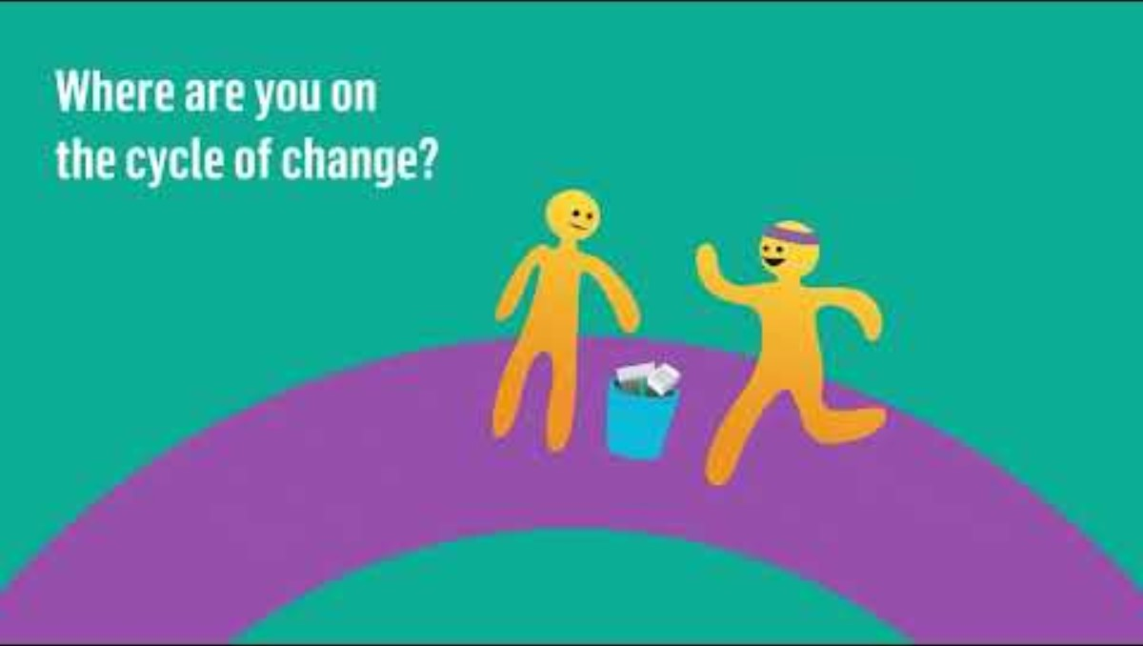
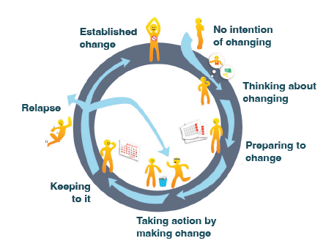
Stages of Change
https://www.youtube.com/watch?v=uNQpnrroCPo

Slide 11


Case study
Lets Meet Sandra

Slide 12
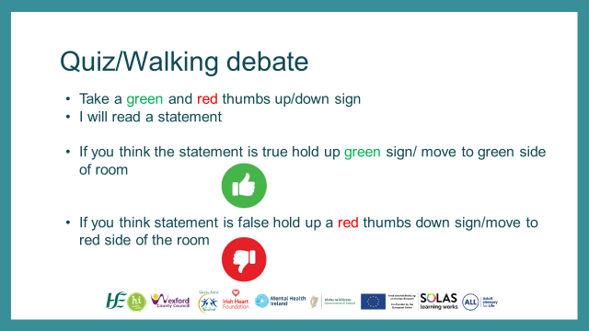
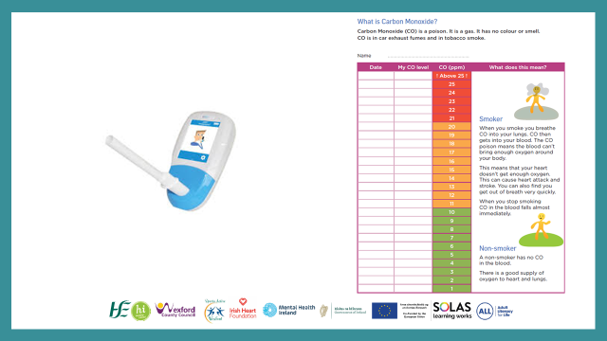
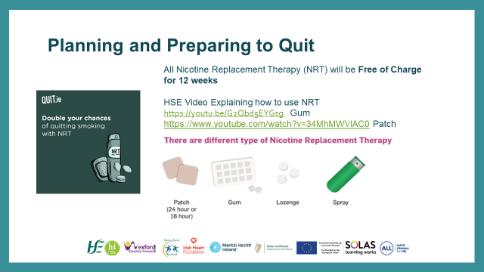
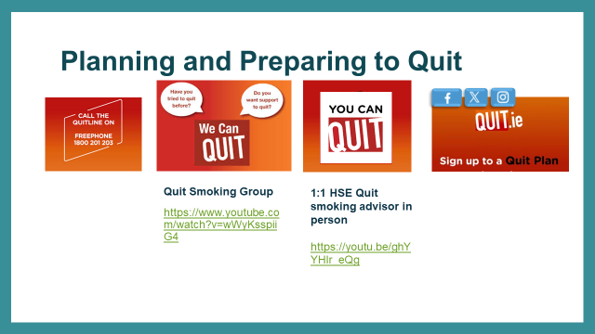

Slide 13

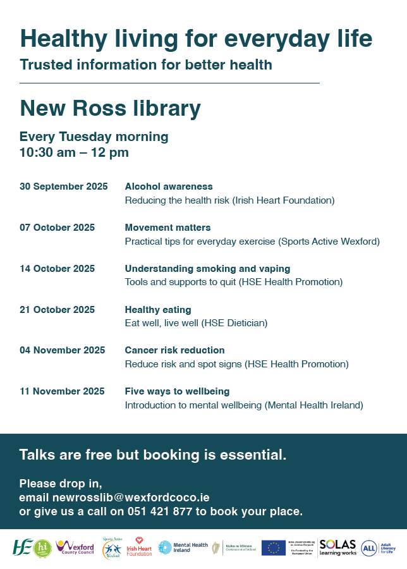
Notes:
6 Topic specific workshops
Delivered by professionals working in the health related field being discussed
In All 5 local libraries in Co Wexford
Booking available via the local library

Slide 14
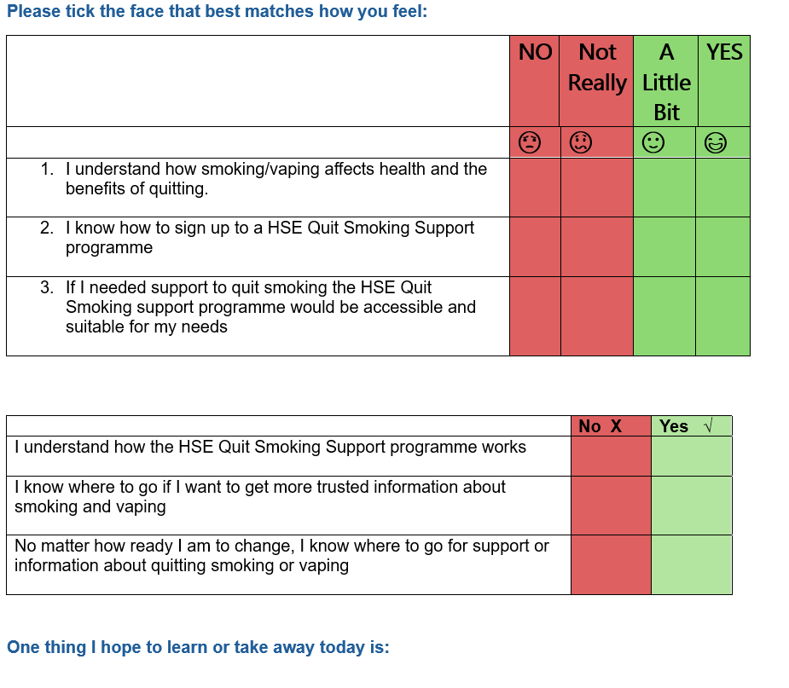
Evaluation Methods
Measured participants perceived knowledge of topic area pre and post
Facilitator feedback sheets post workshop
Facilitator feedback surveys post programme
Steering group feedback surveys post programme
Notes:
Pre and Post Participant Evaluations
Facilitator feedback sheets post workshop
Facilitator feedback surveys post programme
Steering group feedback surveys post programme

Slide 15
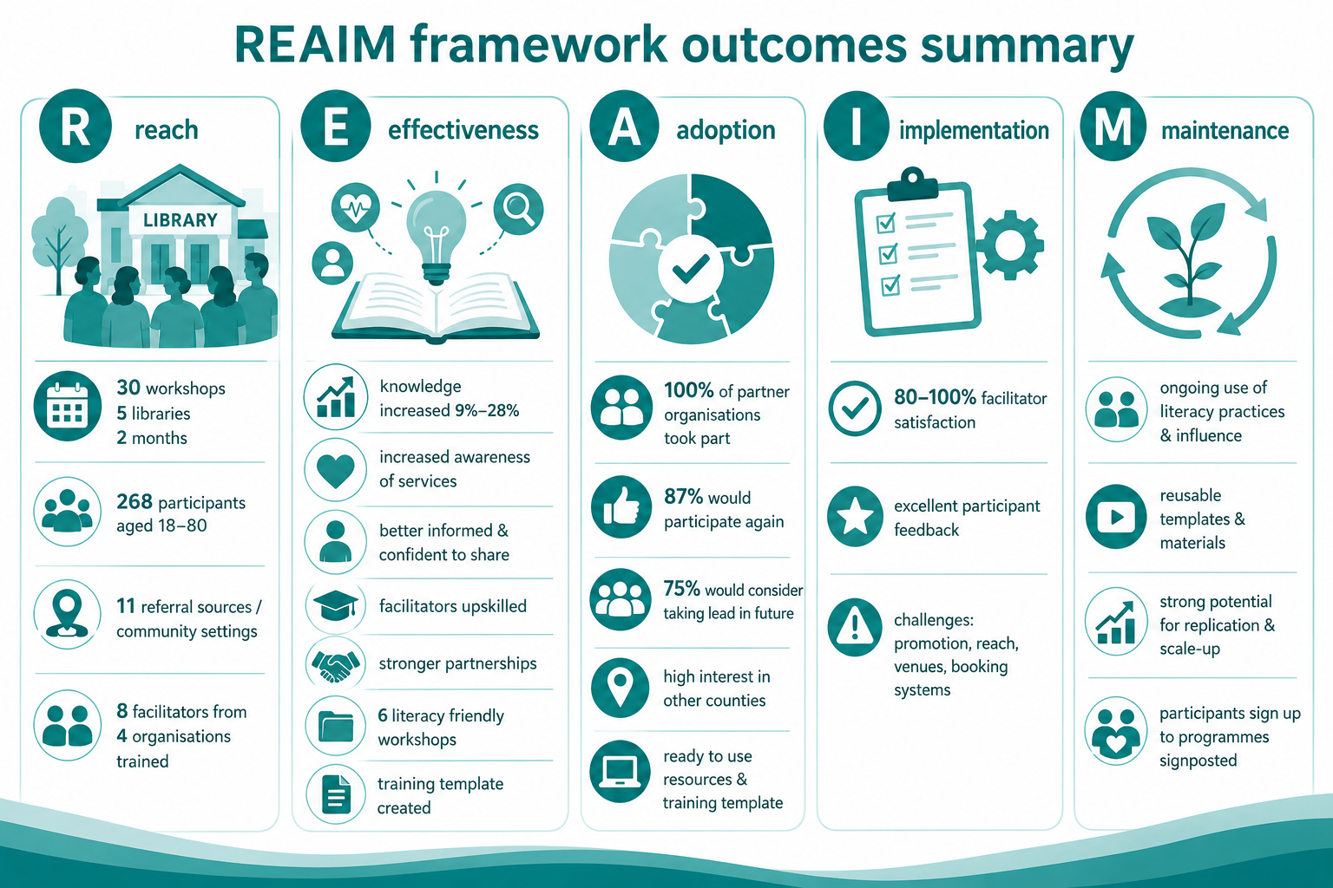

Slide 16
Challenge | Recommendation
Administration of finances in large organisation | Funding managed by community/voluntary organisations allowing for sustainable coordination and funding pathways.
Promotion- time and reaching the target audience | Two phased project : Development and Delivery Earlier and more targeted promotion Clearer messaging to ensure participants understand what to expect Videos/testimonials etc. Increased shared responsibility for engaging target participants Potentially deliver to closed groups/established settings
Workshop Booking : cancellations/no shows, participant information on system | Explore booking options-not capping registration numbers Focus on organisations bringing some groups along and liaise with key workers in organisations around attendance
Venue suitability | Consider fewer venues in higher population areas Explore other venue options
Sensitivity/suitability of topics: alcohol, smoking and mental health | Consider opportunities to combine some of the workshops and/or how they are promoted

Slide 17
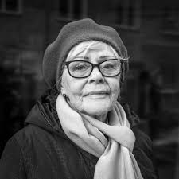




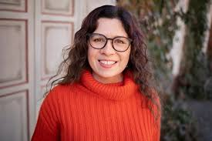
Programme Outcomes
Improved adult health literacy and confidence.
Enabled informed choices for everyday health.
Supporting family and friends to make healthier choices
More awareness of supports available
Built professional capacity in literacy-friendly delivery.
Strengthened cross- sector collaboration.

Slide 18
Next Steps
Develop programme booklet which can be published and shared with other organisations looking to implement the programme.
Scoping exercise with steering committee partners
Potential upskilling/train the trainer for additional facilitators to deliver workshops locally
Support other counties interested in delivering the programme

Slide 19
Contact Details
Elaine Banville
HSE Health Promotion and Improvement Officer
Elaine.Banville@hse.ie
0871880033
Edel Finan
Regional Literacy Coordinator, WWETB and Adult Literacy for Life
EdelFinan@wwetb.ie
086 084 5354

