Slide 1
Healthy Living
for Everyday Life
Movement Matters
Ben Hunt
Physical Activity for Health Officer - Sports Active Wexford

Slide 2
Introduction and Housekeeping
  Break/Toilets/Emergency Exit
  Group Contract

Slide 3
Icebreaker
2 truths and 1 lie

Slide 4
What is Physical Activity?

Slide 5
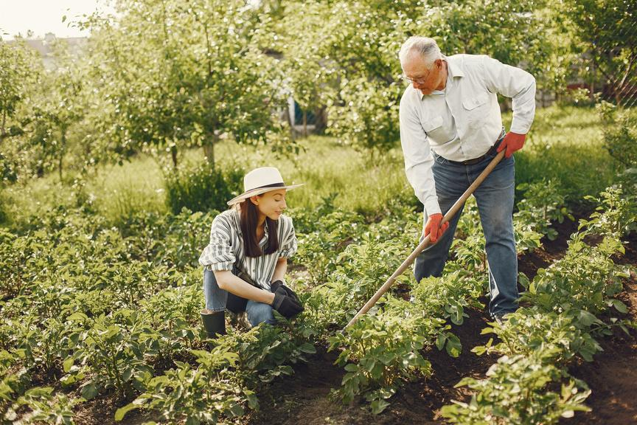

What is Physical Activity?
The World Health Organisation (WHO) defines physical activity as any bodily movement produced by skeletal muscles that requires energy expenditure.
Physical activity refers to all movement including during leisure time, for transport to get to and from places, or as part of a person’s work or domestic activities.

Slide 6
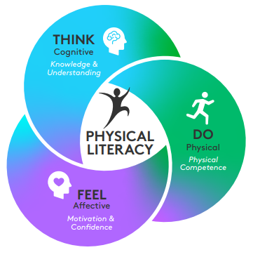
What is Physical Literacy?
Physical Literacy is the
  Motivation, confidence
  Physical competence
  Knowledge and understanding
that enables a person to value and participate in physical activity throughout life

Slide 7
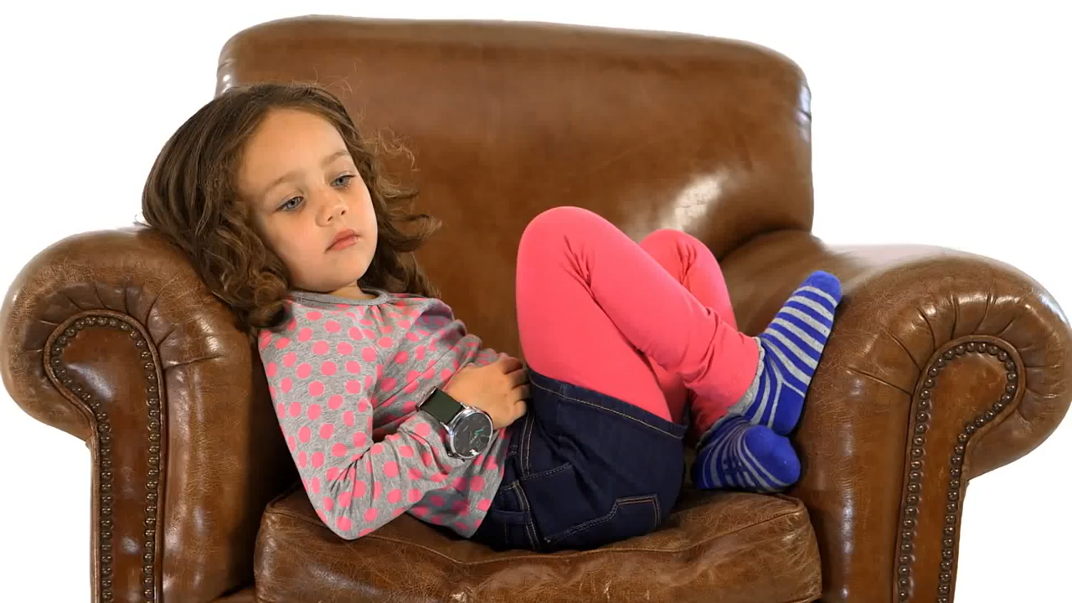
What is Physical Literacy?

Slide 8
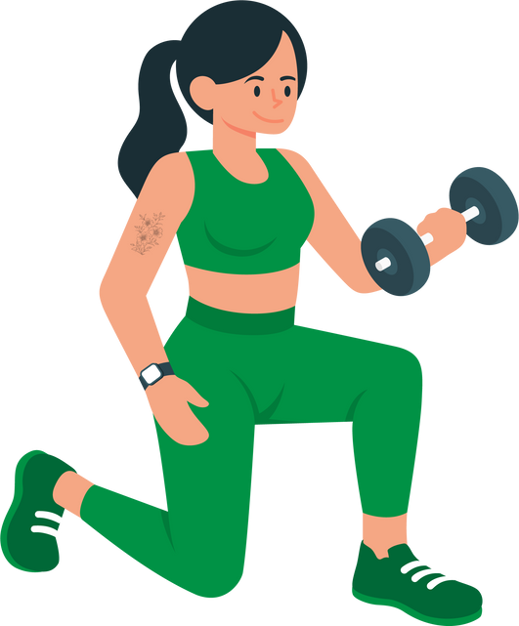
Examples of Types of Physical Activity

Slide 9
Examples of Types of Physical Activity
Aerobic
Strength
Balance

Slide 10
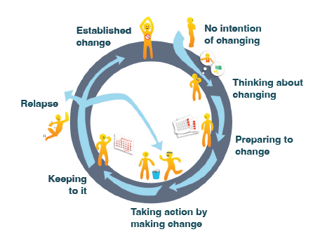
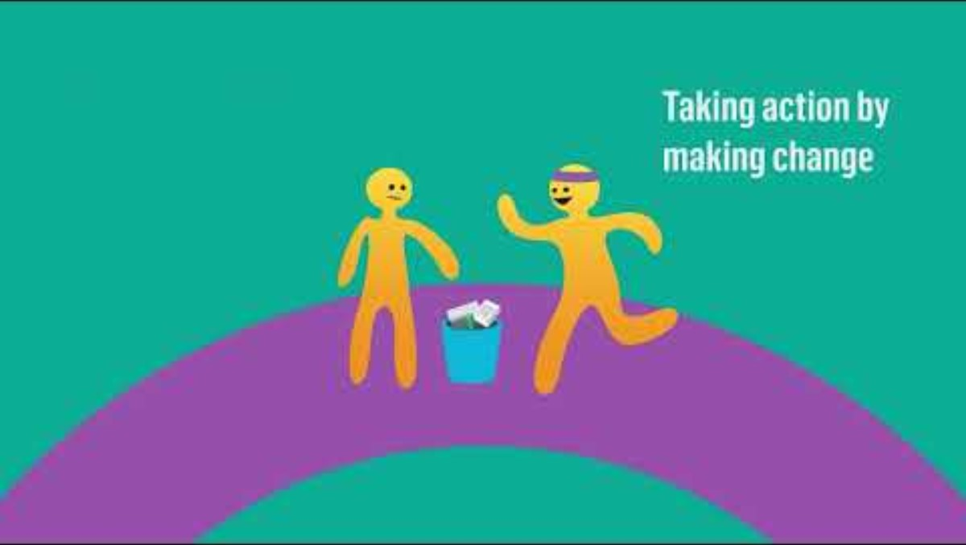
Stages of Change

Slide 11

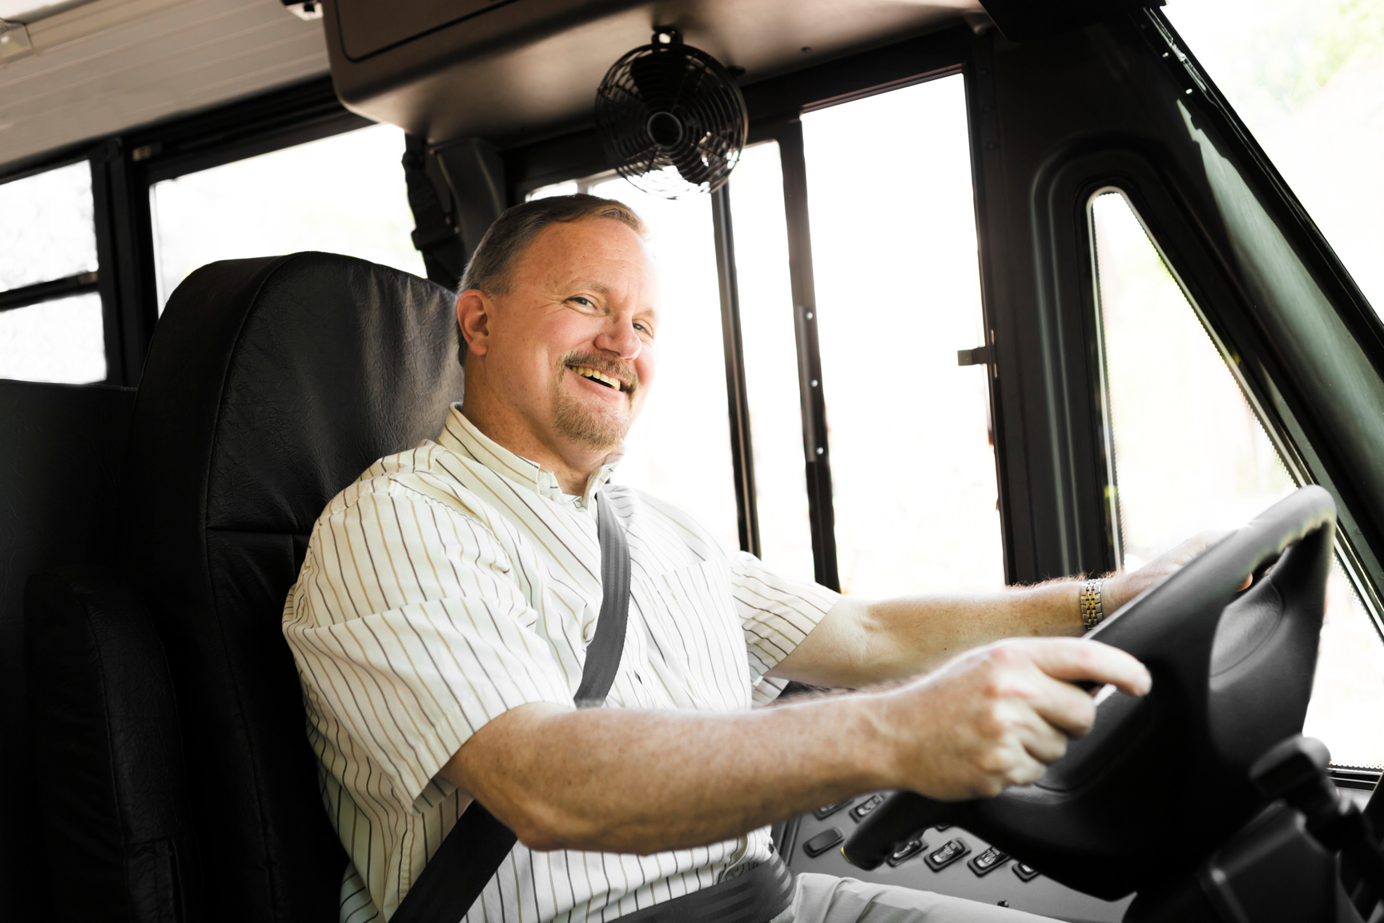
Case study
Meet Jim

Slide 12

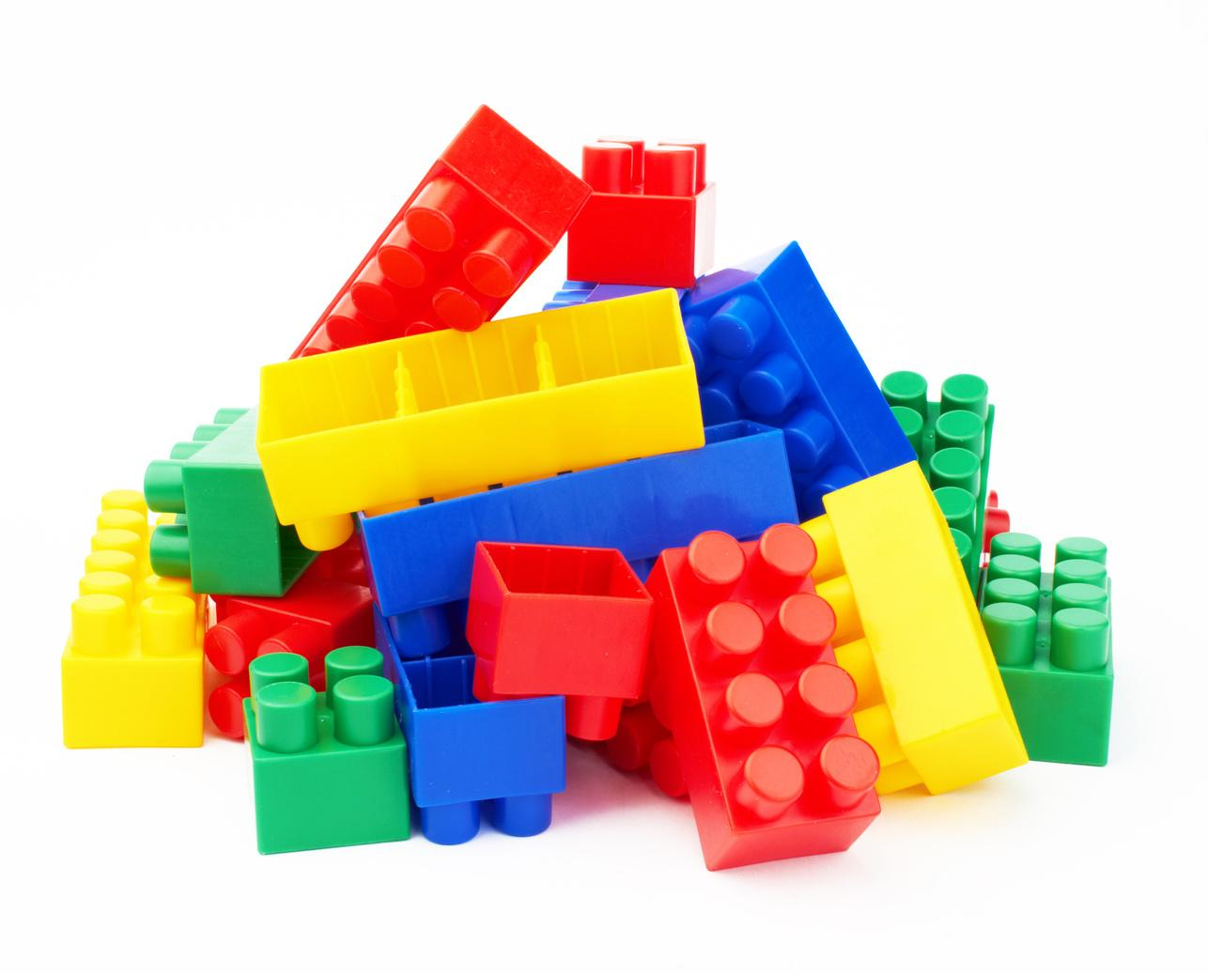
What Physical Activity do you currently do?
Lets build your physical activity in the last week
Green = Moderate intensity (30mins)
Yellow = Vigourous intensity (30mins)
Red = 1 Strength Session
Blue = 1 Balance Session

Slide 13
Stages of Change
Link to video

Slide 14
Lets build your physical activity in the last week
Green = Moderate intensity (30mins)
Yellow = Vigourous intensity (30mins)
Red = 1 Strength Session
Blue = 1 Balance Session
Moderate/Vigourous
Strength
    Brisk Walking
    Aqua Aerobics
    Cycling Slowly
    Housework/Gardening
    Tennis Doubles
    Farming
    Golf
    Dancing
    Hiking
    Running
    Swimming
    Sports (eg Tennis)
    Martial Arts
    Walking up Stairs
    Gymnastics
    Lifting Weights
    Working with Exercise Bands
    Body Weight Exercises
    Yoga/Pilates
    Climbing
    Repetitively Lifting Children or Heavy Objects
    Repetitive Stair Climbing

Slide 15
Example
How many minutes per week you take part in
1: Moderate/Vigourous intensity Physical Activity: 150mins Moderate 120 Vigourous mins
2. How many times you do Strength Exercises: 1 Yoga Session
3. Give yourself a score out of 10: ?/10

Slide 16
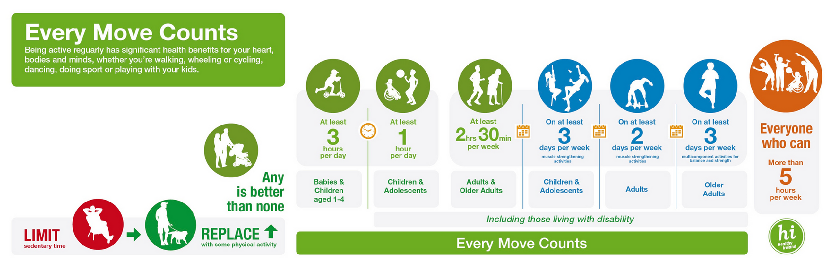
National Physical Activity and Sedentary Behaviour Guidelines

Slide 17



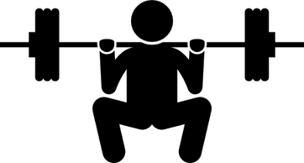

Moderate Intensity
Physical Activity
Vigorous Intensity
Physical Activity
OR
2hrs 30mins 5hrs
1hr 15mins 2hrs 30mins
Adults: 65+ years old
Or a combination of Moderate and Vigorous
Strength and Balance Activities
on 3+ Days
Provides Additional
Health Benefits

Slide 18
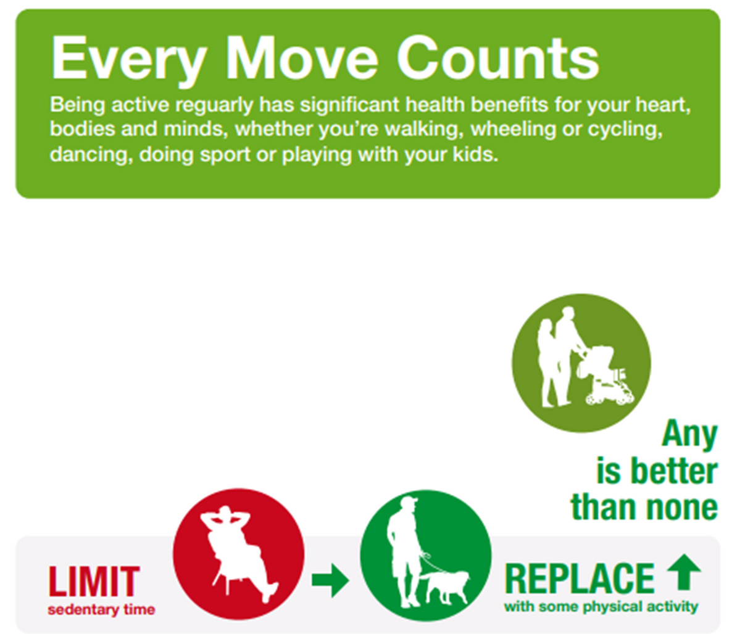

Slide 19
Stages of Change
Link to video

Slide 20




How Can We Be Physically Active?
Sports Active Wexford - Local Sports Partnership
053 919 6557
sports.active@wexfordcoco.ie

Slide 21
Stages of Change
Link to video

Slide 22
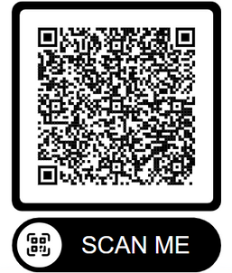
Lets sign up to a Sports Active Programme
Sports Active Wexford - Local Sports Partnership
Demo Programme - Healthy Living for Everyday Life Tickets, Mon 8 Dec 2025 at 10:00 | Eventbrite
sports.active@wexfordcoco.ie

Slide 23
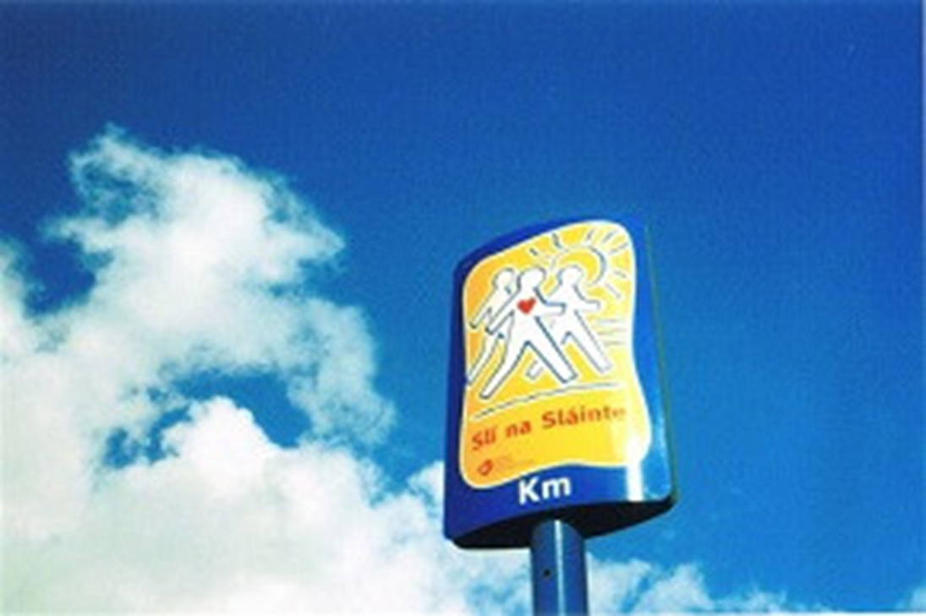
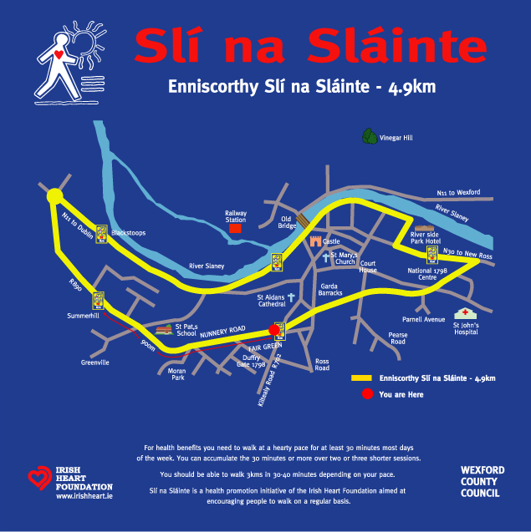
How Can We Be Physically Active?
Walking - Slí na Sláinte Routes (www.irishheart.ie)

Slide 24

How Can We Be Physically Active?
HSE Online Exercise Videos
Yoga
Pilates
Strength and Conditioning
Exercise videos - HSE.ie

Slide 25
Stages of Change
Link to video

Slide 26
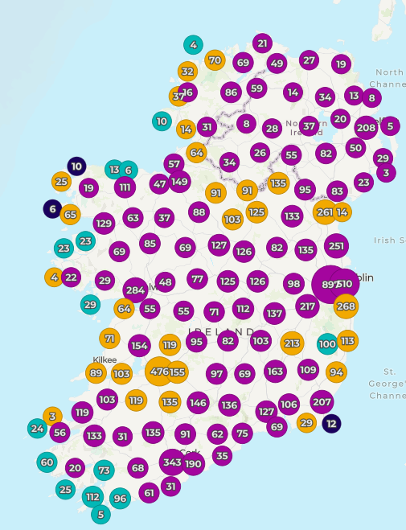

How Can We Be Physically Active?
https://getirelandactive.ie

Slide 27
What is Physical Literacy?
Physical Literacy is the
  Motivation, confidence
  Physical competence
  Knowledge and understanding
that enables a person to value and participate in physical activity throughout life

Slide 28
Stages of Change
Link to video

Slide 29
Last Activity!
Write down or think of 1 small change you can make toward your physical activity
What are the key takeaways from the session?
Is there anything that surprised you during the session today?

Slide 30

Physical Activity is for Everyone!

Slide 31
My Contact Details
Ben Hunt
Physical Activity for Health Officer
Sports Active Wexford
Wexford Co. Council
Ben.Hunt@wexfordcoco.ie
053-9196642

