Slide 1
Healthy Living
for Everyday Life
Cancer Prevention Awareness Session
Ann-Marie Lawlor
HSE Health Promotion Officer – Cancer Prevention, Dublin & South East

Slide 2
Introduction and Housekeeping
Ann-Marie Lawlor, Health Promotion Officer – Cancer Prevention Dublin and South East
I work with the Health Promotion Team locally & National Cancer Control Programme
I am not a cancer specialist/clinician so cannot answer questions about treatments or specific cases. My focus today is on prevention and early diagnosis of cancer
If anyone in the room needs to leave and take some time please feel free to do so. I will be around after todays session for 15 minutes if anyone needs to ask me a question

Slide 3

One word that you think of when you hear the word
Cancer

Slide 4
What we will talk about today ….
What is Cancer?
Cancer in Ireland
How to reduce your risk of getting cancer
Know the signs and find cancer early
Link to video

Slide 5
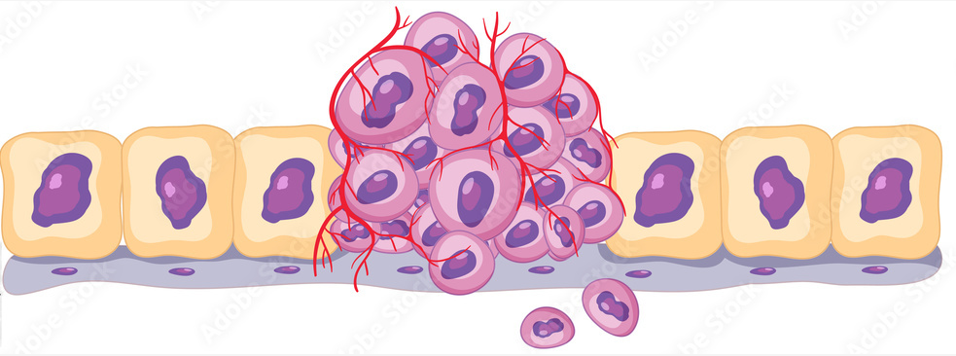
What is Cancer?
All the cells in our body are constantly growing, dividing, dying and being replaced in a controlled way
Cancer occurs when normal cells grow and change in an abnormal and uncontrolled way
When groups of these cancer cells continue to grow, they can form a lump called a tumour
Not all cancers cause a tumour. In blood cancers, such as leukaemia, abnormal blood cells grow out of control

Slide 6



Slide 7

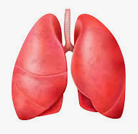

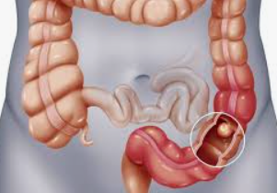
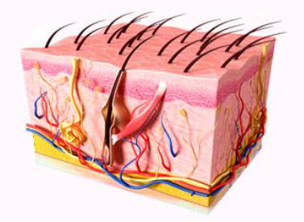
Most common cancers in women 2019-2021 NCRI 2023
Breast 30%
Lung 10%
Skin 5%
Bowel 11%

Slide 8
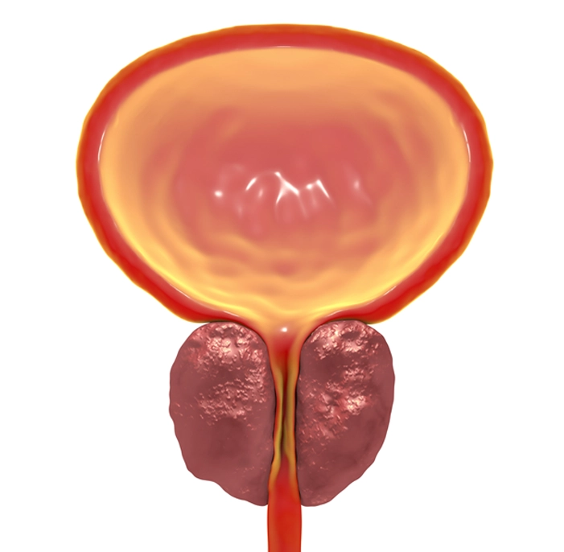


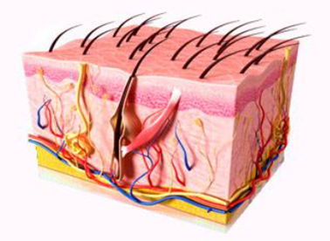
Most common cancers in men 2019-2021 (NCRI 2023)
Lung 11%
Prostate 30%
Skin 5%
Bowel 11%

Slide 9


Risk factors for cancer
Age
is your biggest risk factor for cancer
82% woman aged 50+ when diagnosed
90% men aged 50+ when diagnosed

Slide 10
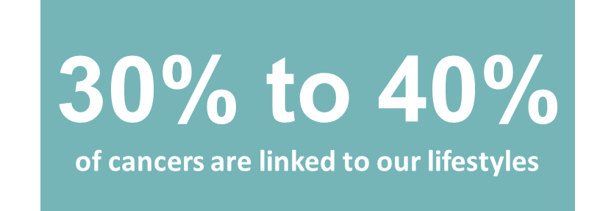
Cancer in Ireland
Ice breaker
What things in our lifestyles do you think are linked to cancer?

Slide 11


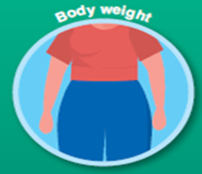







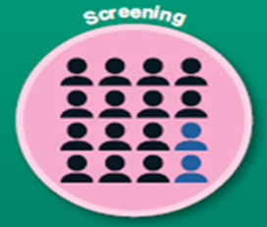
Things we can all do to reduce our risk of cancer
For more information visit:
www.hse.ie/cancerprevention
Notes:
How to reduce your risk of cancer

Slide 12
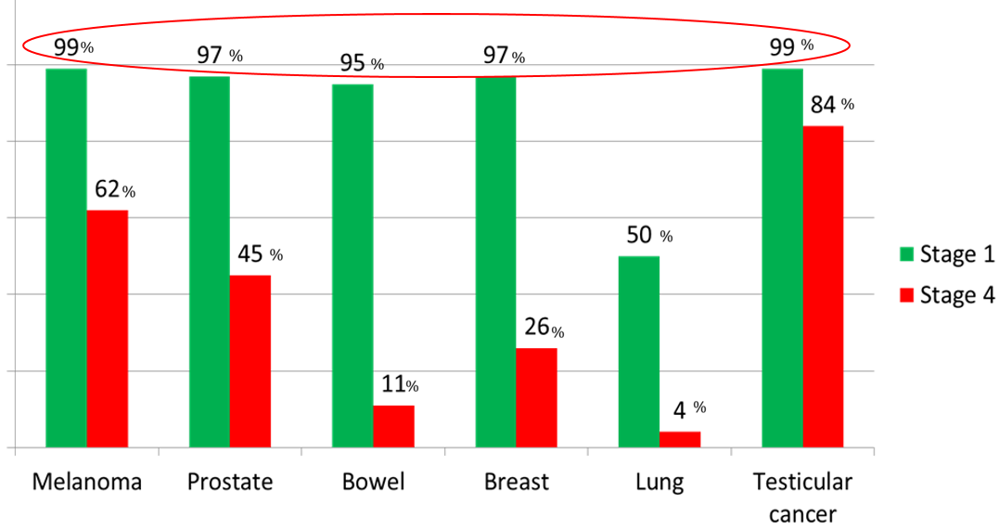
Why find cancer early?
5 year survival rates
100%
60%
0%

Slide 13




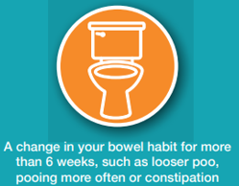



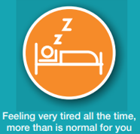

Know the signs and find cancer early

Slide 14

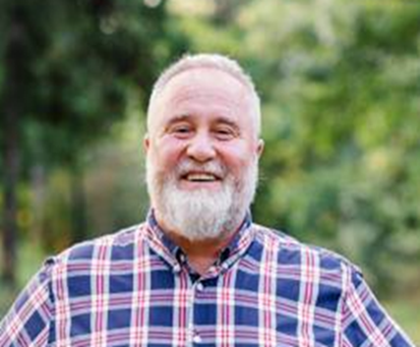

Case Study
Lets meet Michael

Slide 15



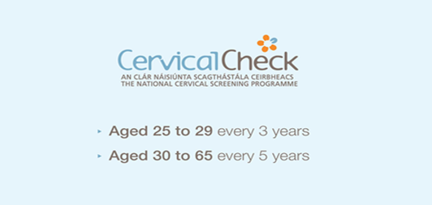
Cancer Screening Services
70
info@breastcheck.ie
Check that you are on the register, and keep your details updated on the register!

Slide 16



Slide 17

Check you are on the register & that you contact details are correct
Emailing: info@screeningservice.ie
NSS Freephone: 01 865 9300

Slide 18
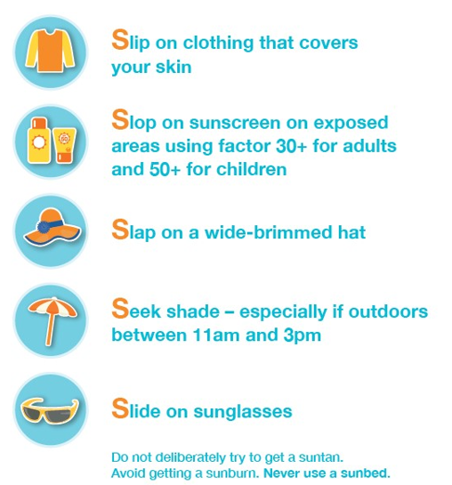


Minding your Skin

Slide 19
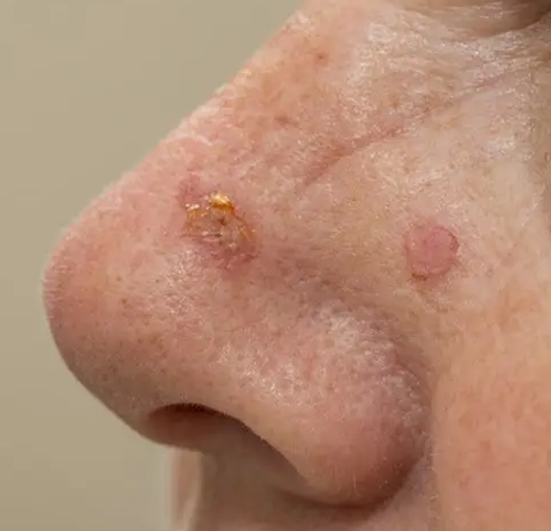
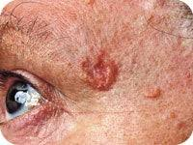
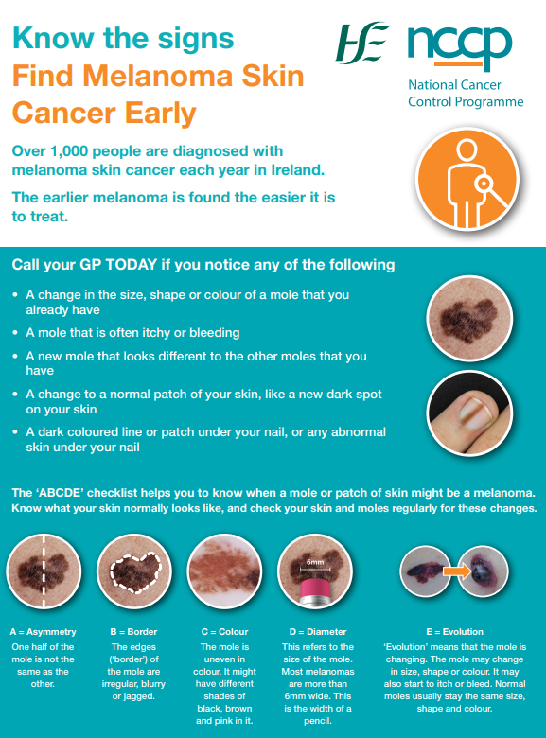
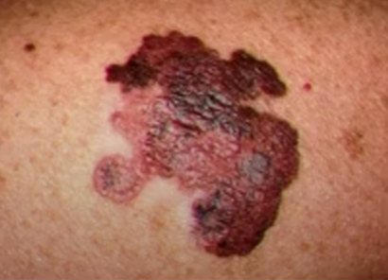
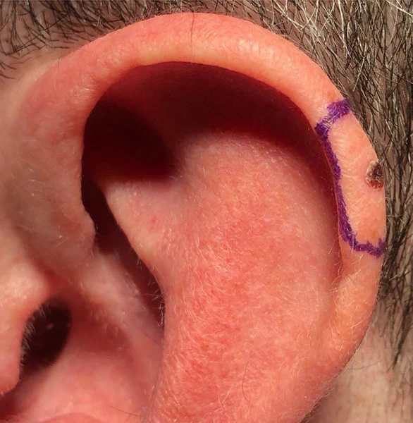
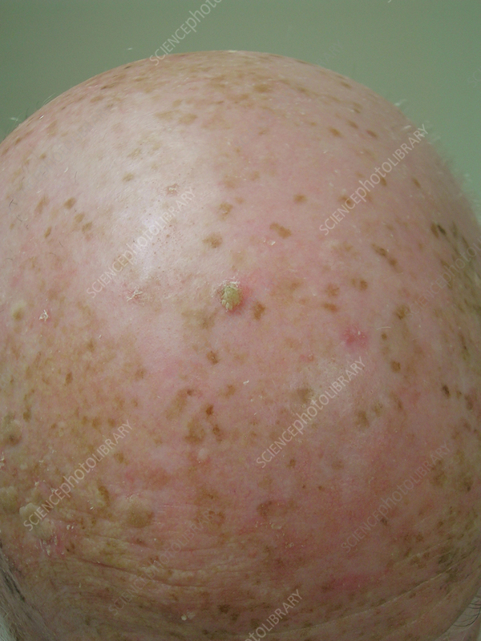
Know the signs – get checked out by your doctor
Notes:
Inspect your skin Melanomas can occur anywhere on the body, including areas that are protected from the sun. It is important to be familiar with your own skin so that you will notice any changes. The majority of melanomas are detected by the person affected themselves, or their partners. Ideally you should inspect your skin once a month. Check the whole of your body from head to toe. Undress completely.

Slide 20
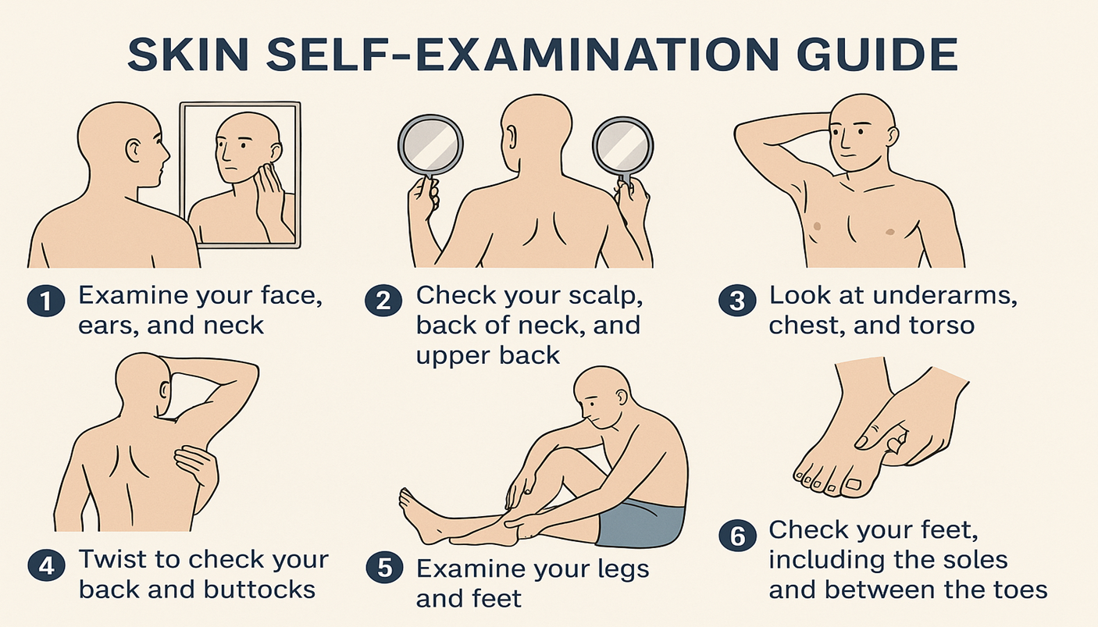

Slide 21
Where to get more support/information
www.hse.ie/preventcancer
www.hse.ie/findcancerearly
www.hse.ie/sunsmart

Slide 22
Thank you
Ann-Marie Lawlor
HSE Health Promotion Officer – Cancer Prevention & Early Diagnosis
Dublin & South East
Annmarie.Lawlor@hse.ie
087 66 27 377

Slide 23
70

Slide 24

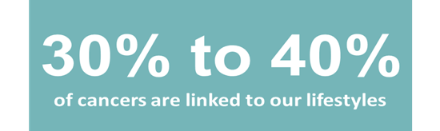
How to reduce your risk of getting cancer

Slide 25

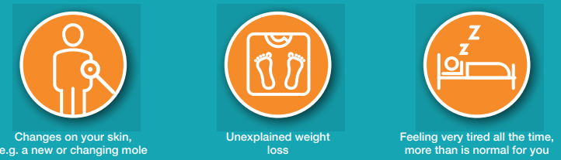
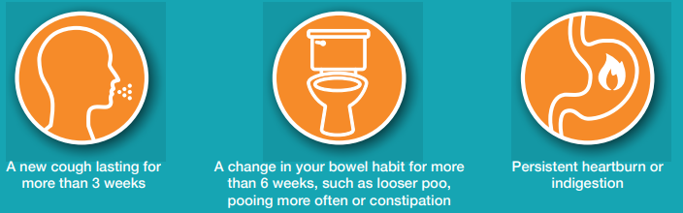
Know the signs and find cancer early

Slide 26
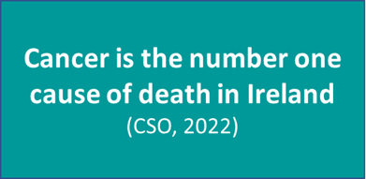

Biggest cause of cancer deaths in women & men
Lung Cancer
19%
Bowel Cancer
10%
Breast Cancer
16%
Lung Cancer
21%
Bowel Cancer
11%
Prostate cancer
12%
NCRI 2023

Slide 27
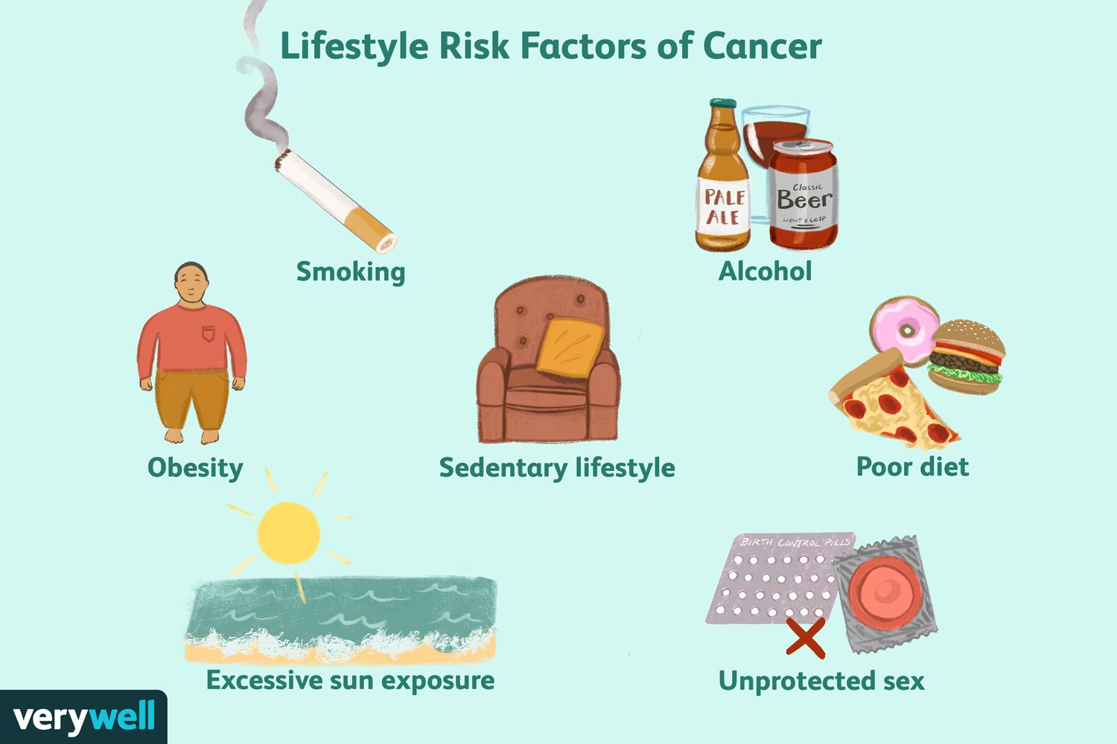


Cancer in Ireland
Ice breaker
Environmental exposure

